Slide 1
Americas Region Update
C.M. Ginsburg (Fermilab)
S0 Meeting - WebEx
December 7, 2010

Slide 2

JLab Update
Electron beam re-melting technique R&D
  TB9AES006
    Limit: 22 MV/m (quench) 2 defects (300 um, 500 um) 8mm from equator weld cell#5; to be improved with e-beam re-melting
    Process preparation under development
New Vendor development
  TB9NR001
    JLab standard process/test path
    In the queue to be tested
Collaboration with KEK
  Ichiro7 9-cell cavity fantastic performance – Fumio Furuta
  MHI08 9-cell cavity to be tested in December – Kirk Yamamoto
Plan for more process/test of new 9-cell cavities when infrastructure demand lightens ~Jan.
Geng, Eremeev
7 December 2010
CM Ginsburg S0 Mtg
2
Notes:
2

Slide 3
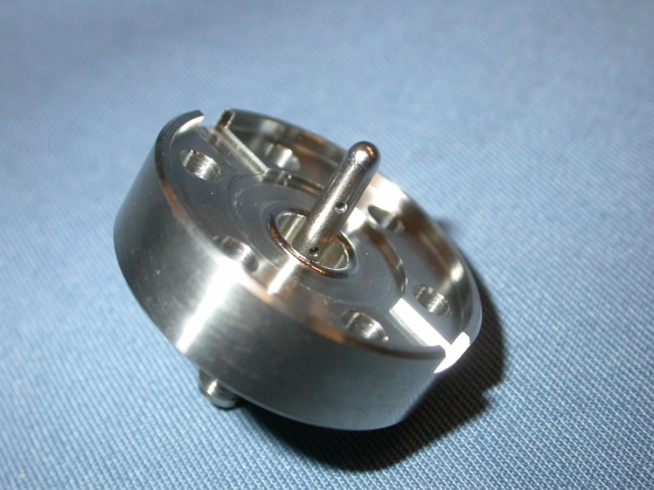
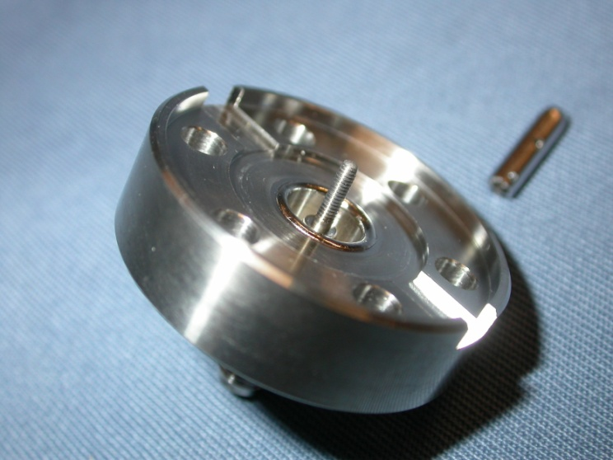
Cornell ILC Program
Status 1.Dec.2010
Cornell SRF
Crawford
  Vertical EP+repair techniques R&D
    TB9ACC010
      Vertical test 22.Nov.: 24 MV/m Q0=1.8E10 (quench); Rs=10 nOhm
      Next: re-test with second sound detectors. NB: RG174 cables were found to be magnetic!
    Fabricated Pt probe which can be left on during final HPR.
    ACCEL9: to be vertically tested in January before final EP
    TB9AES005: to get final EP next week
Cornell expected to get two of the new AES cavities for VEP commissioning; preliminary tuning was requested
1-72 Thread

Slide 4
Production Cavities for CM2
Cryomodule 2
Cavity ID | CM2 candidate | Vertical Test | He vessel? | Horizontal Test | cryomodule ready?
TB9AES009 | 1 | 36 MV/m | dressed | 35 MV/m | yes
TB9AES010 | 2 | 38 MV/m | dressed | >35 MV/m | yes
TB9AES008 | 3 | 41 MV/m | dressed | >35 MV/m | yes
TB9AES007 | 4 | 42 MV/m | dressed
TB9RI018 | 5 | 39 MV/m | dressed
TB9RI019 | 6 | 38 MV/m | dressed
TB9RI028 | 7 | 39 MV/m | dressed
TB9RI020 | 8 | 36 MV/m
ACCEL8 | backup | 31 MV/m | dressed | 31 MV/m | yes
TB9ACC013 | backup | 38 MV/m | dressed | FE limit
TB9ACC016 | backup | 39 MV/m | dressed | FE limit
TB9RI029 | backup | 35 MV/m | dressed | 29 MV/m
Vast majority of cavities vertically qualified at JLab
  TB9RI020 and TB9RI029 were processed/tested at FNAL/ANL
TB9ACC016 coupler problem – copper particles on antenna
TB9RI029 failed horizontal test: degradation from 35 MV/m (VT) to 29 MV/m
TB9AES007 is next for horizontal test

Slide 5
First pass:
  Bulk EP @ FNAL/ANL (EP params 18V, 32-40C), HT @ JLab, light EP @ FNAL/ANL (EP params 14.5V, 30C), HPR/Assy/120C Bake (120C)
  33 MV/m (quench, initial FE)
Second pass: light EP (EP params 18V, 30C). Baked @ 120C, then re-test.
  Max gradient 36 MV/m with Q₀ 1.1 x 10¹⁰ [quench]; no measured FE
  Second sound data indicate quench location is in cell #7 (unchanged)
  Observed mode mixing at fields greater than 32-33 MV/m
Promoted to dressing

Slide 6
Fermilab Update
Tumbling of 9-cell cavities
  JLab-2
    Complete: tumbling, field flatness measurement, rough HPR, 10 um light-EP, optical insp
    Next: 800C HT (FNAL furnace), tuning, light-EP+VTS prep, 120C bake and VT
  TB9ACC015
    Complete: tumbling, limiting (19 MV/m) feature in cell 3 HAZ molded, optical inspection, field flatness measurement, molded silicone sample analyzed; optical inspection shows very mirror-like surface
    Next: 800C HT (FNAL furnace), tuning, light-EP+VTS prep, 120C bake and VT
High-temperature furnace (currently all hydrogen degassing done at JLab)
  Installation in FNAL/IB4 and final acceptance tests completed
  1-cell cavity commissioning complete
  1st 9-cell yesterday (TB9ACC015) – 800C for 3 hours
Six cavity order from Niowave-Roark [new vendor qualification]
    TB9NR001: JLab standard process/test path – test soon
    TB9NR002: FNAL/ANL standard process/test path – good results seen last time; to receive second-pass standard process, re-test
Six cavity order from AES [experienced vendor; cavities partially for S0]
  All six have been received at Fermilab and are partially through quality control
7 December 2010
CM Ginsburg S0 Mtg
6
Notes:
6

