Slide 1
2010.12.07: Hayano
Cavity status; recent KEK activities
(1) MHI-012, MHI-013 ; 9 cell cavities field measurements
MHI-012: 1st VT 37.5MV/m @ Q0=5.5E09 Nov 11,2010
MHI-013: 1st VT 36.5MV/m @ Q0=7.5E09 Nov 25,2010

Slide 2
MHI-012 1st VT reaches 37.5MV/m
Quench at #9cell 0 degree

Slide 3
MHI-013 1st VT reaches 36.4MV/m
ILC specification
Quench at #5cell 270 degree

Slide 4
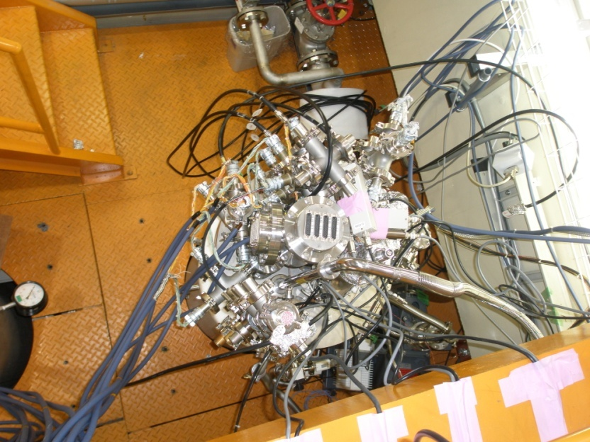
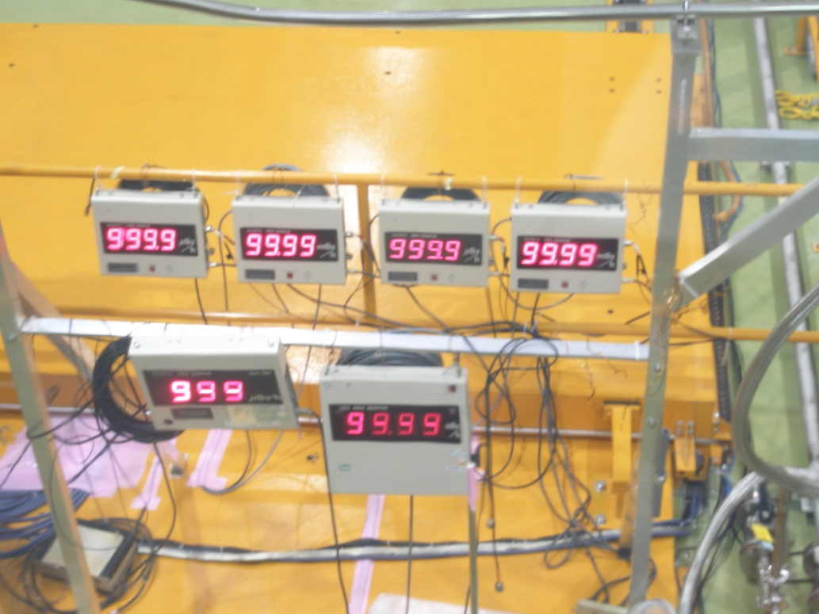
X-ray monitor
sensor
X-ray monitor
display
Sensitivity limit
of X-ray monitor
Low Sensitivity
X-ray monitor
High Sensitivity
X-ray monitor

