Slide 1
ACrawford
Cornell SRF
7dec10
A10 Treatment:
Slow tumbling -50 µm
VEP -120 µm
800C x 2 hours
HPR
110C x 48 hours
RF test

Slide 3
ACrawford
Cornell SRF
7dec10
AES_5 will get its final EP next week
A_9 will be tested in January before its final EP
A_10 will be retested with OSTs
RG174 cables used for OST readout in previous Cornell tests were magnetic and were eliminated from the A_10 test of 22nov10. They will be replaced with all copper RG174 cables for future tests
Mode analysis is inconclusive for this cavity. The quench could be in cells 1,2,7 or 8

Slide 4
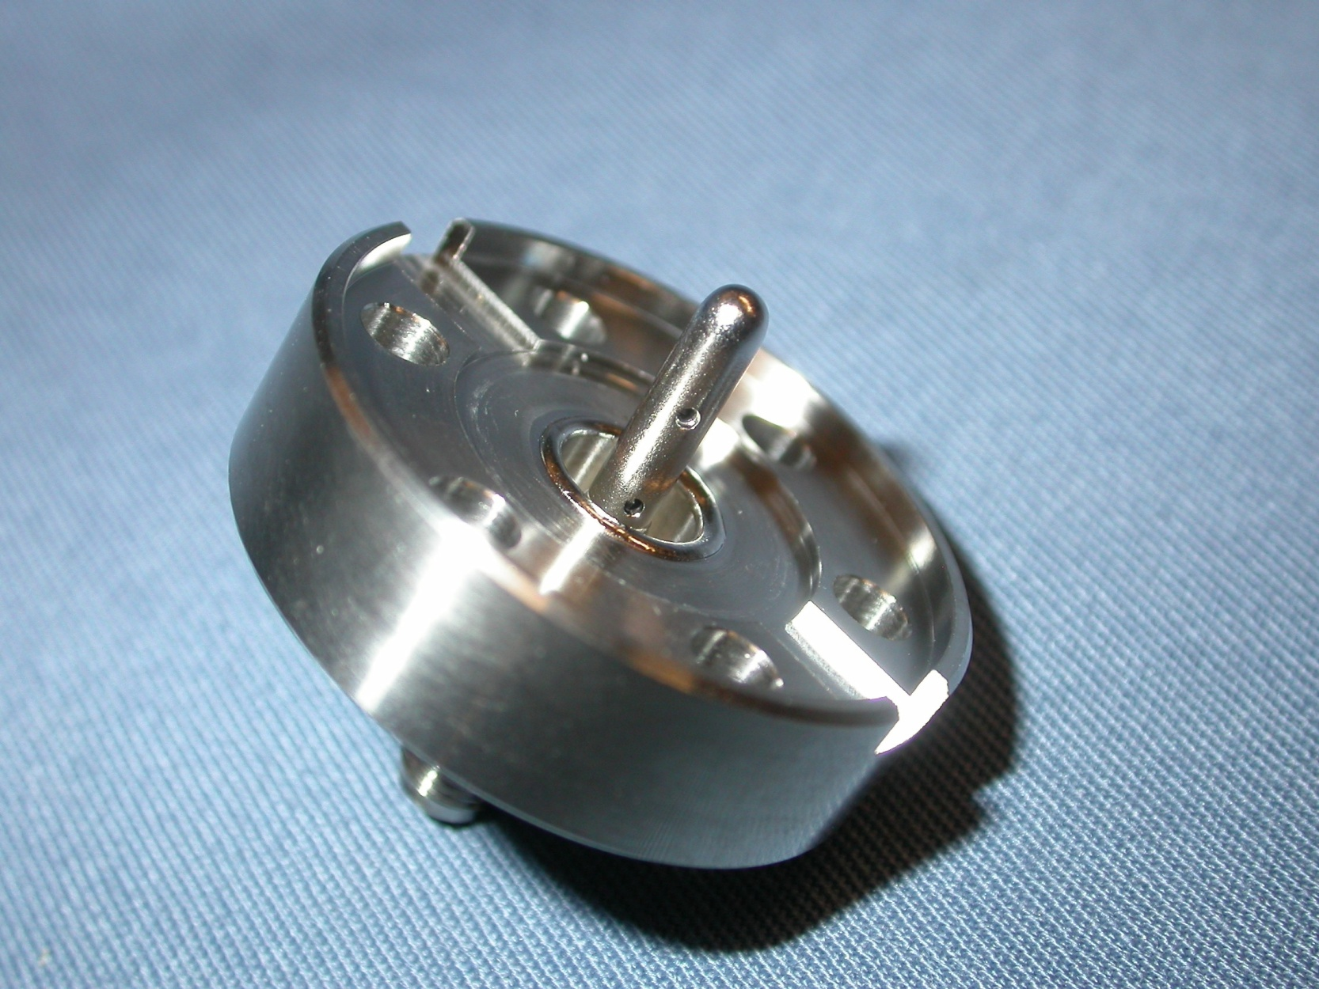
ACrawford 7dec10
Modified Titanium P_{trans} Feedthrough
Antenna is Niobium

Slide 5
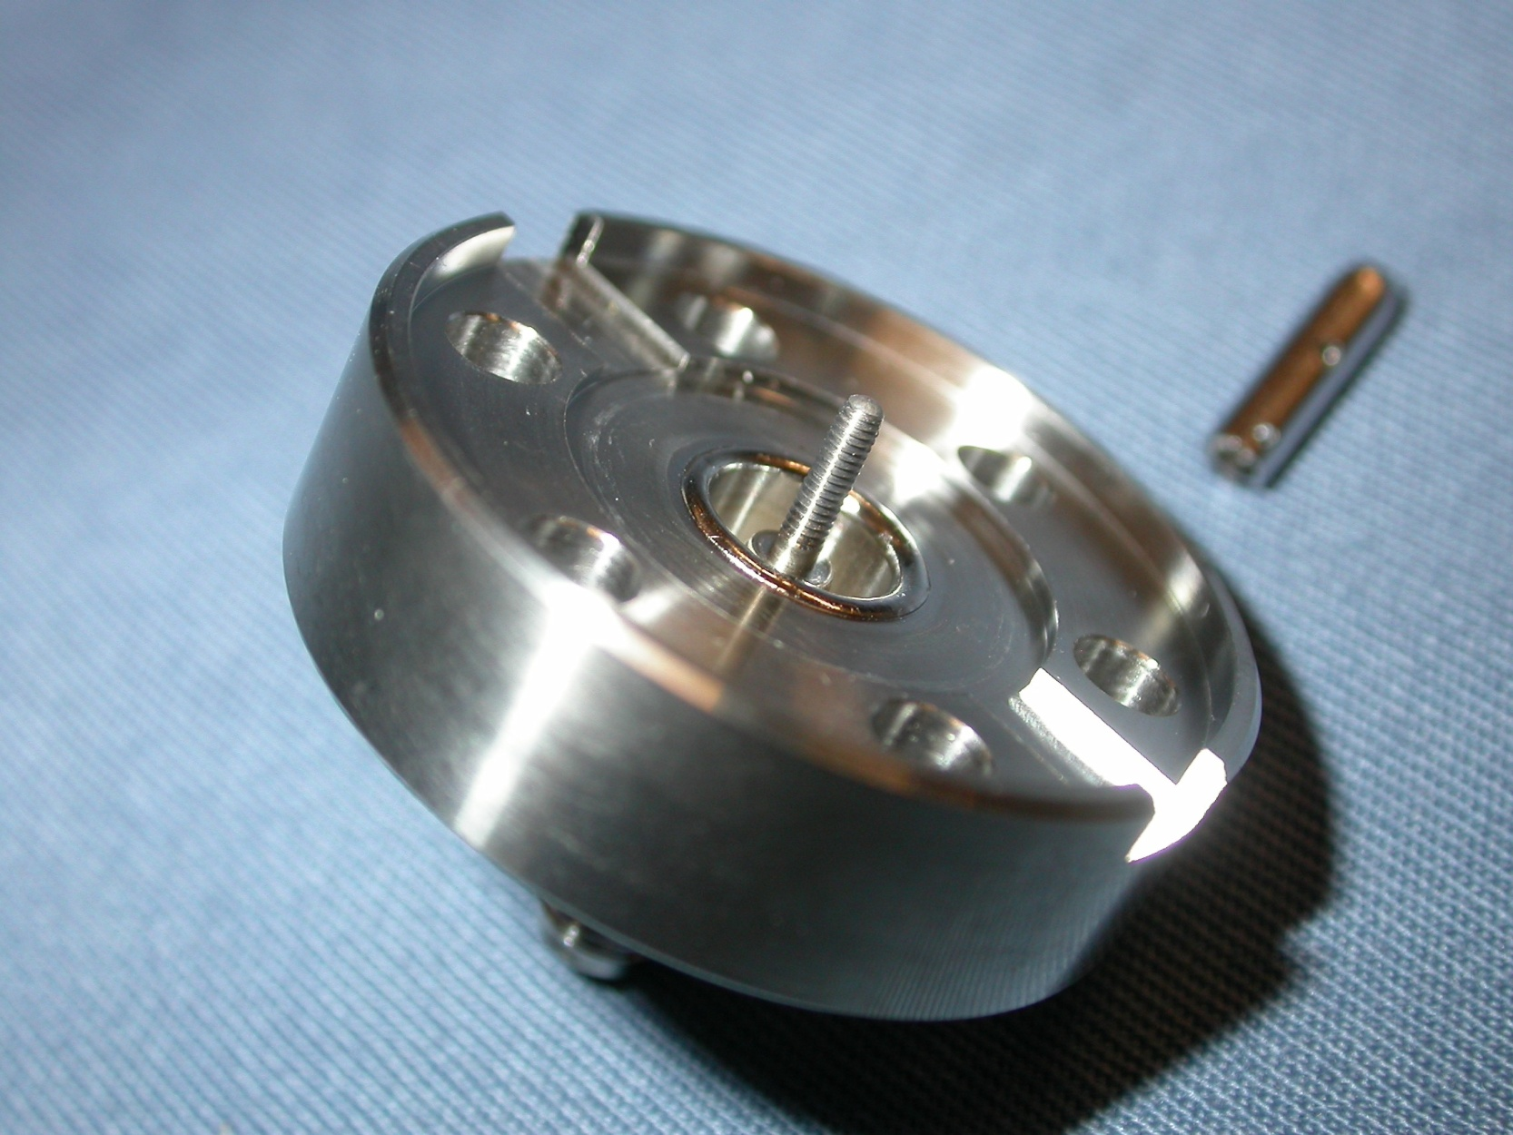
ACrawford 7dec10
Modified Titanium P_{trans} Feedthrough
Antenna is Niobium
1-72 Thread

