Slide 1
BAW-2 Themes
Two remaining themes:
  reduced bunch number per pulse (low-power)
  positron source relocation (including 10Hz operations scenario)
Strong desire to separate these issues into “independent proposals”
10Hz operation mode ‘couples’ BAW-2 themes (see later)
Combinations of possible options becomes cumbersome (too many)
Try to simplify configuration space for BAW-2 discussions
  Can make qualitative statements about ‘missing options’

Slide 2
Ecm = 300-500 GeV
Low-Power Options
(reduced n_{b})
Smaller
Damping Ring
6.4km→3.2km
Reduced Modulator & Klystron count
DRFS
50% reduction
4.5mA
2.2ms RF pulse
KCS/RDR
33% reduction
6mA
1.6ms RF pulse

Slide 3
Ecm = 300-500 GeV
Low-Power Options
(reduced n_{b})
Smaller
Damping Ring
6.4km→3.2km
Shorten positron transfer line
e+ Source re-location
Remove BDS FEXL
(now shared)
Move 1.2km insert from mid- to end-linac
Reduced Modulator & Klystron count
DRFS
50% reduction
4.5mA
2.2ms RF pulse
KCS/RDR
33% reduction
6mA
1.6ms RF pulse

Slide 4
Ecm = 200-300 GeV - 10Hz
Low-Power Options
(reduced n_{b})
Smaller
Damping Ring
6.4km→3.2km
Shorten positron transfer line
e+ Source re-location
Remove BDS FEXL
(now shared)
Move 1.2km insert from mid- to end-linac
Reduced Modulator & Klystron count
Reduced Damping Time
200ms→100ms
Increased average AC power
DRFS
50% reduction
4.5mA
2.2ms RF pulse
RF unit cost for 10Hz operation
KCS/RDR
33% reduction
6mA
1.6ms RF pulse
New beamlines and dumps
Coupled Themes via 10Hz scenario

Slide 5

Ecm = 200-300 GeV - 10Hz
Low-Power Options
(reduced n_{b})
Smaller
Damping Ring
6.4km→3.2km
Shorten positron transfer line
e+ Source re-location
Remove BDS FEXL
(now shared)
Move 1.2km insert from mid- to end-linac
Reduced Modulator & Klystron count
Reduced Damping Time
200ms→100ms
Increased average AC power
DRFS
50% reduction
4.5mA
2.2ms RF pulse
RF unit cost for 10Hz operation
KCS/RDR
33% reduction
6mA
1.6ms RF pulse
New beamlines and dumps

Slide 6
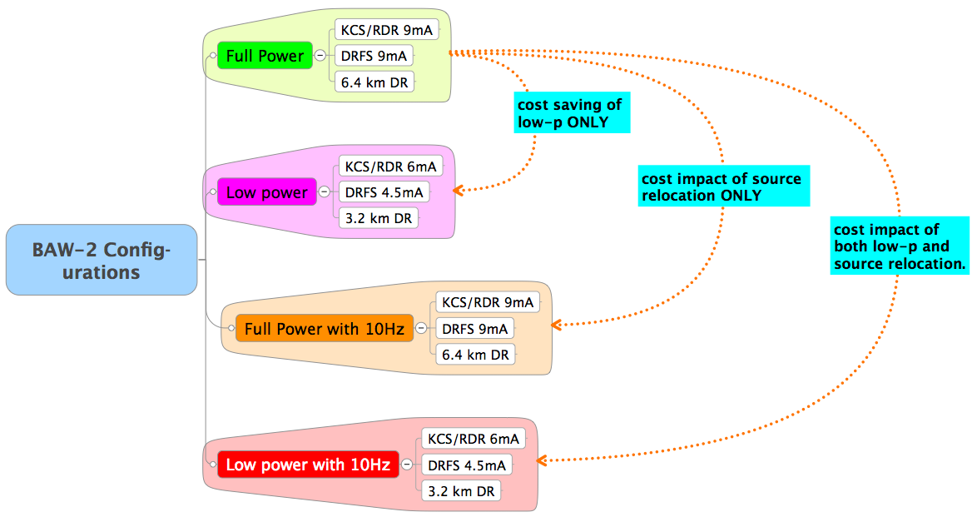
Cost Scenarios
Manageable permutations?
Notes:
DR – probably manageable. Only 2x2=4 scenarios. Susanna has already provided more than needed for cost estimation.
HLRF more complex. 2x2x2=8 possible scenarios (4 each with KCS/RDR and DRFS).

Slide 7
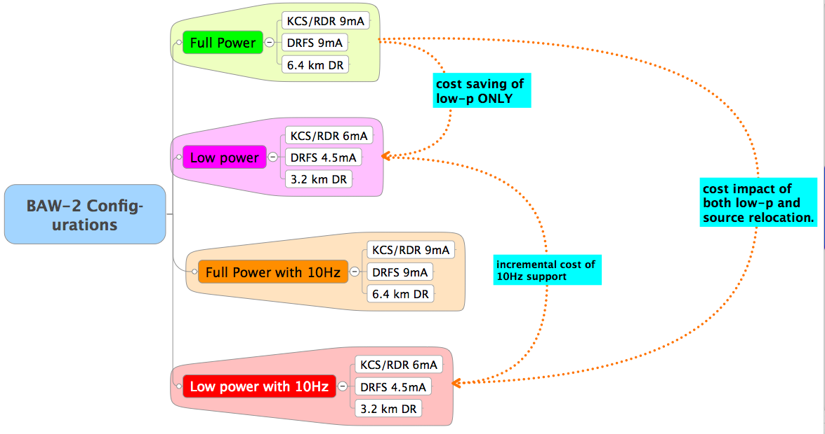
Cost Scenarios
✘
Manageable permutations?

Slide 8
10Hz Scenario:
Reducing Study Scope for BAW-2
Proposal: Consider 10Hz scenario only for reduced bunch number option
  Scope of additional hardware (cost) with respect to low-power configuration
Specifically: 10Hz impact on
  3.2 km damping ring (1312 bunches)
  DRFS with 4.5 mA
  KCS/RDR with 6.0 mA
Not considered: Full power option at 10Hz
  6.4 km ring 2630 bunches
  DRFS/RDR with 9 mA
BAW-2 proposals will be based on these studies
  No longer completely separated

Slide 9
Discussion on bunch number “restoration”
Important to discuss scenarios for increasing the bunch number 1300→2600
Damping Ring:
  Additional 3.2km ring for positrons
  2600 bunches in single (existing) electron ring
  Tunnel/alcoves spec’d for 3 stacked rings.
HLRF
  Add klystrons/modulators/power supplies
  Scenarios for CFS support
    what must we invest in up-front to support this
Complete studies left for TDP-2
  but qualitatively, scenarios need to be discussed at BAW-2

Slide 10
BAW-2 Presentation:
Low-Power Considerations
HLRF
  Klystron/Mod. configuration/count for reduced current
    KCS/RDR 6.0mA 1.6ms RF pulse
    DRFS 4.5mA 2.2ms RF pulse
  Including re-evaluation of overhead for gradient spread
  Focus on 500 GeV cm
    full gradient operation at 5 Hz
Damping Ring
  3.2 km ring with 1310 bunches

Slide 11
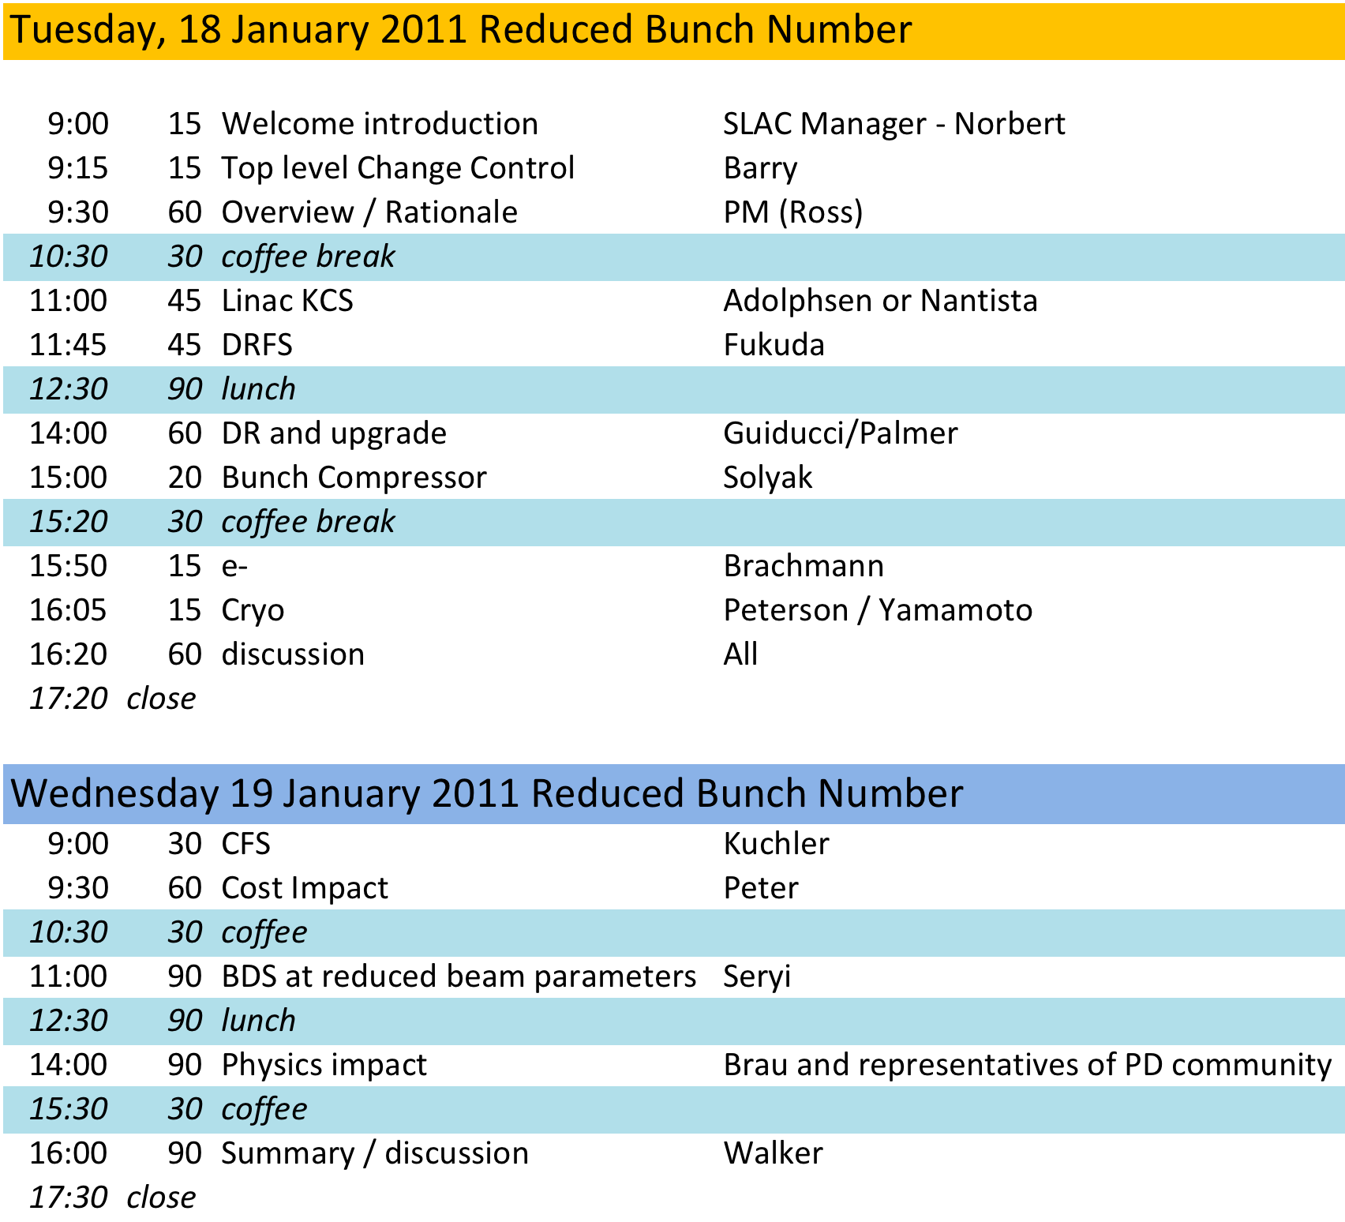
BAW-2 programme

Slide 12
BAW-2 Presentations: e+ source relocation considerations
Source integration with BDS
  ~1.2km to end of linac
  Integration with fast extraction system etc.
  Reduced length transfer line
  …
10Hz mode
  DR: reduced damping time modifications
  HLRF (6mA/4.5mA)
    Efficiency at reduced gradient → AC power requirement
    Unit cost of modified HLRF hardware (klystron/modulators)
Performance & parameters

Slide 13
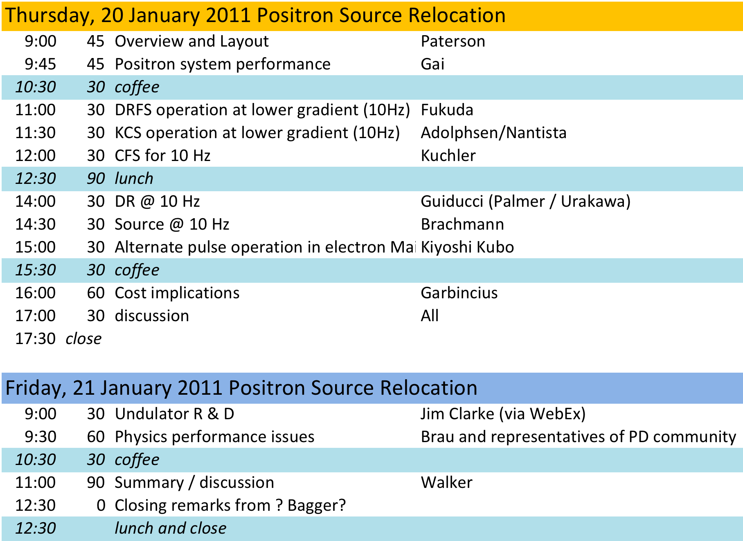
BAW-2 Programme

Slide 14
Physics Impact
Most physics impact associated with low-power option
  higher luminosity per bunch crossing (but less bunches)
  enhanced beam-beam
Low-energy running scenarios have been a focus point
  includes IP divergence constraint and new FD option.
e+ source relocation no longer a luminosity issue
  solutions to provide full bunch charge at 5Hz collisions
  only impact remains energy spread and polarisation
Two P&D slots currently foreseen for low-p and
e+ source location themes
  Can the physics and detector issues be cleanly separated?

Slide 15
Source Location Differences
electron energy spread
positron polarisation
J. Clarke
Now all 5Hz across range (but no change in the numbers)

