Slide 1
ILC CFS AND GLOBAL
SYSTEMS MEETING
CONVENTIONAL FACILITIES
AND SITING GROUP
Preparation for BAW-2
V. Kuchler

Slide 2
Full Power and Low Power Criteria
  The CFS Group has Worked with the Area Systems for Over a Year and a Half to Establish Full Power Heat Load and Electrical Power for KCS and DRFS
  Preliminary Criteria for Low Power Heat Load and Electrical Power has been Collected Over the Last Few Months
  CFS Continues to Work to Develop Low Power Criteria
  An Initial Set of DRFS Main Linac Criteria has been Developed but is Still Subject to Refinement
  CFS will Pursue Preparation for BAW-2 Based on the Following Assumptions:
    The Main Linacs and the Damping Ring will be Affected by the Low Power Option and Current Criteria will be Used
    The e- and e+ Sources, RTML and BDS will Use the Same Criteria as the RDR
    Low Power Criteria for the Damping Ring has been Established
    Damping Ring Tunnel Will be Sized for Three Rings

Slide 3
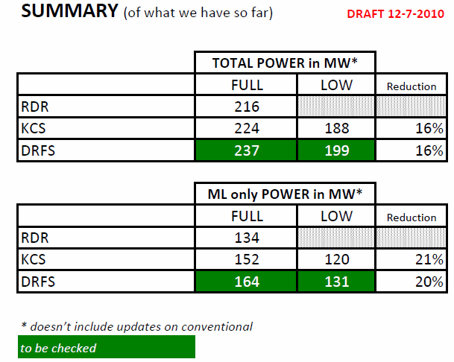

Slide 4
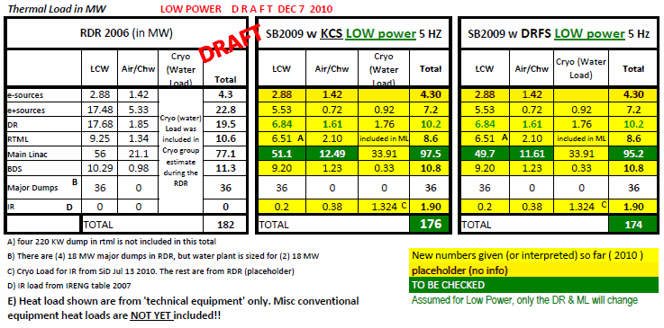

Slide 5
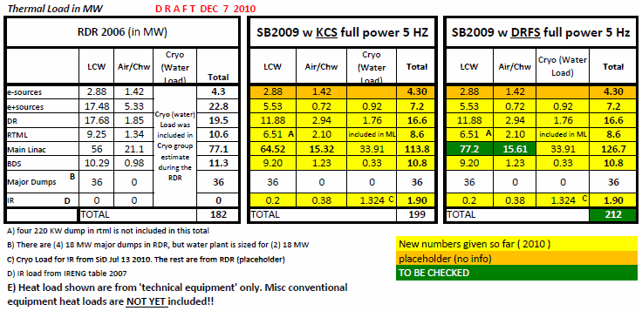

Slide 6
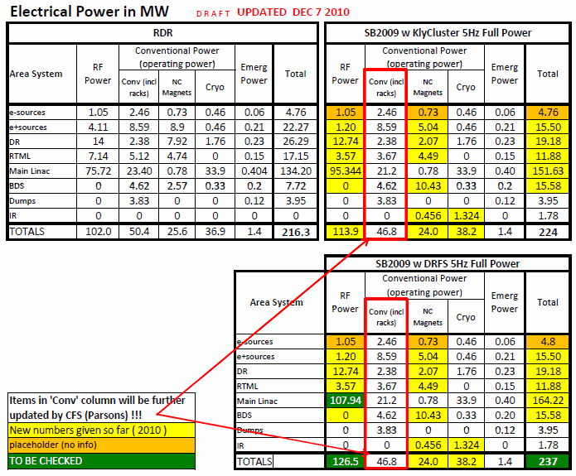

Slide 7
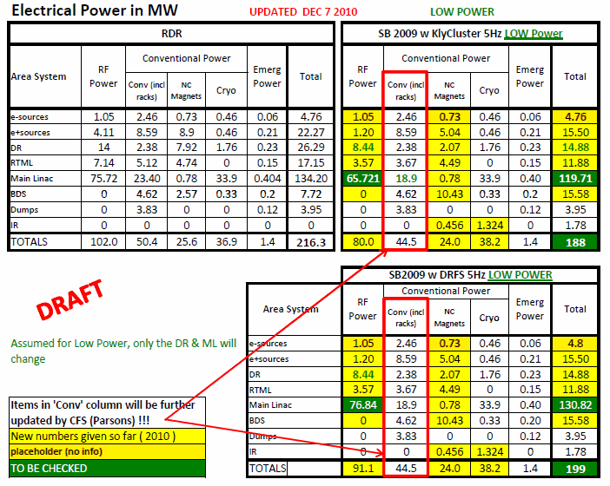

Slide 8
Upgrade Back to Full Power
  We Will Evaluate the Major CFS Cost Drivers, Civil Construction (Surface and Underground Facilities), Process Water Cooling and Electrical Distribution
  At This Time, Results are Preliminary
  Some Refinement will be Developed Prior to BAW-2 Including Cost Information
  All Considerations Assume a Reasonable Path Back to the Full Power Option
  Civil Construction
    Fundamental Reduction to Low Power is the Size of the Klystron Cluster Buildings
    At Each Main Linac Shaft, KCS Surface Building Size Would be Reduced by ~40%
    Cryogenic Building Requirements will Remain the Same or Could Slightly Increase (T Peterson)

Slide 9
Upgrade Back to Full Power cont.
  Process Water Cooling
    Reductions Can be Made in the Number of Cooling Towers, Heat Exchangers, Pump Sizes and Distribution Piping Size
    Main Piping Headers and the Remainder of the System Would Remain Unchanged from the RDR
  Electrical Distribution
    Electrical Distribution is Reduced to the Surface Klystron Cluster Buildings in Direct Proportion to the Reduction in Building Size
    Main High and Medium Voltage Equipment and Cabling Will Remain as Initially Installed Capital Equipment
    Damping Ring Distribution Made See Reduction, But Information is Still Being Developed
  At This Time KCS is More Understood Than DRSF w/r to CFS Facility Support
  CFS will Work to Develop DRFS Facility Requirements

Slide 10
Summary
  CFS will Continue to Work on the Low Power Option Criteria and Design in Preparation for BAW-2
  We will Develop Facilities Criteria for the DRFS RF Alternative
  CFS Cost Information, as Complete as Possible, will be Provided for BAW-2

