Slide 1
Topics from CLIC study
Many slides are taken from Lucie, Konrad, Chiristian, Andre, etc…
at
http://indico.cern.ch/categoryDisplay.py?categId=1954
宮本彰也
高エネルギー加速器研究機構(KEK)
金曜ミーティング
2010年12月3日

Slide 2
CLIC physics/detector CDR
Chapter editors meeting
October 25th 2010

Slide 3
Aim of the CDR
Main aim of the physics/detector CDR:
Physics and Detectors:
Describe the CLIC physics potential
  CLIC as a discovery machine
  CLIC as a precision machine
Demonstrate that CLIC physics can be measured with adequate precision
  Describe detector concepts and sub-detectors that can do the job
  Demonstrate their performance under CLIC conditions

Slide 4
the CLIC CDR deadlines (1)
The CDR will have 3 volumes:
1 Executive summary (~50 pages)
2 The CLIC accelerator and site facilities (~800 pages)
3 Physics and detectors at CLIC (~170 pages)
Volume 3 editors: Lucie Linssen (CERN, CLIC), Akiya Miyamoto (KEK, ILD), Marcel Stanitzki (STFC-RAL, CLIC), Harry Weerts (ANL, SiD)
Deadlines:
Oral presentation to CERN Scientific Policy Committee (SPC) => June 20^{/21} 2011
  Ask SPC to appoint a sub-committee for receiving the document
  Allow some time for SPC comments before Dec-2011 CERN council meetings
Our deadline for the completed Vol 3 document: end-August 2011
Final presentation of printed version to CERN council in December 2011

Slide 5
the CLIC CDR deadlines (2)
Comment to the deadline
The oral presentation in June 2011 puts additional constraints on the work plan:
  End-May 2011 => all essential input material for the CDR has to be available
  End-June 2011 => final deadline of individual chapters
  End-August 2011 => deadline for the finished Vol 3 document
  End-August 2011 => deadline for the finished Vol 1 document

Slide 6
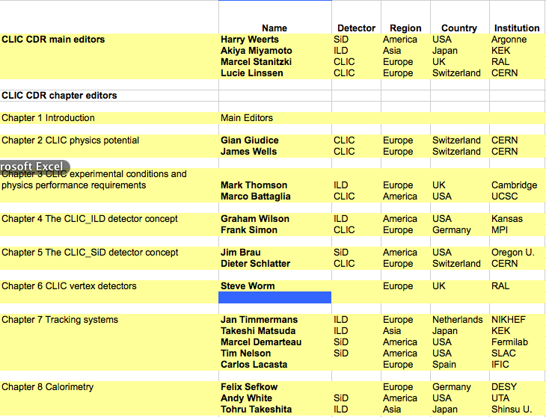
Vol. 3 CDR editors (1)

Slide 7
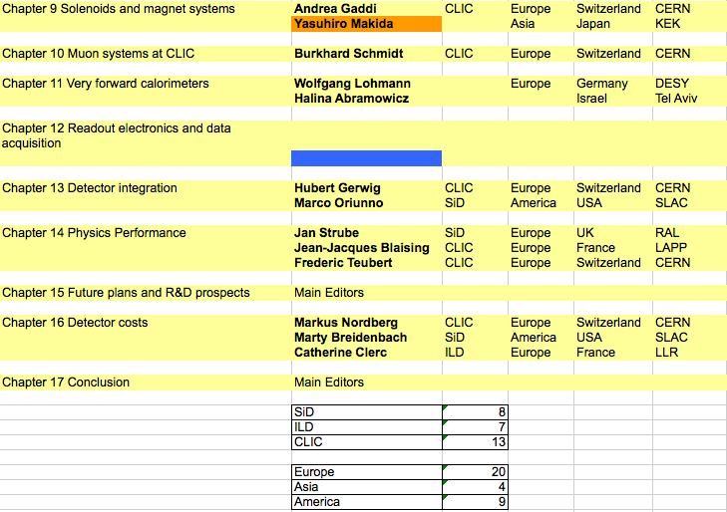
Vol. 3 CDR editors (2)

Slide 8
Authorship of the CDR
CDR Authorship
The CLIC CDR will be based on vast amounts of work, previously carried out by the ILC physics/detector communities.
We plan to provide broad opportunity to sign the CLIC CDR.
Signing the CDR is a recognition for work in the past (on ILC or CLIC) and/or a firm intention to contribute in the future.
Due to the fact that “the CLIC CDR” comprises both the accelerator and the detectors, the author list will be a common author list
We will set up a web-based inscription for this (e.g. like for ILD and SiD LoI’s). Timing: ~May 2011

Slide 9
Internal notes
LCD internal notes:
http://lcd.web.cern.ch/LCD/Documents/Documents.html
As the #pages for the CDR shall be kept within limits, this will not allow for too many details.
Like for the LoI’s we hope to refer as much as possible to more detailed internal notes or publications
Authors are requested to submit their draft note to
Andrei Nomerotski and Dieter Schlatter, who will organize the review and attribute an LCD-Note-Number if approved.

Slide 10
Planning of benchmark studies
Requirements/Performance simulations are the most critical part
Current time-line of benchmarking WG6:
25/10/2010: Finalize geometry for CLIC_ILD and CLIC_SID
01/11/2010: Finalize Mokka and SLiC implementations of CLIC_ILD and CLIC_SID
01/11/2010: Complete implementations of Overlay processor
01/12/2010: Complete validation reconstruction path for CLIC_ILD and CLIC_SID
15/12/2010: Finalize reconstruction software and tag releases
“We are in pretty good shape with the reconstruction software for the CDR
and the aim of finalising this before the end of the year is probably
not unrealistic. “ by M. Thomson 2-Dec.
“Mokka-07-06, ILD_01pre00 & CLIC_ILD_CDR frozen”, released 30 Nov.,
from release note by Gabriel

Slide 11

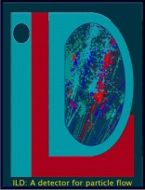



ILD and SiD
Detector Concepts for CLIC
Presented at IWLC 2010, Geneva + Update
October 25, 2010
Christian Grefe
CERN, Bonn University
Notes:
11

Slide 12
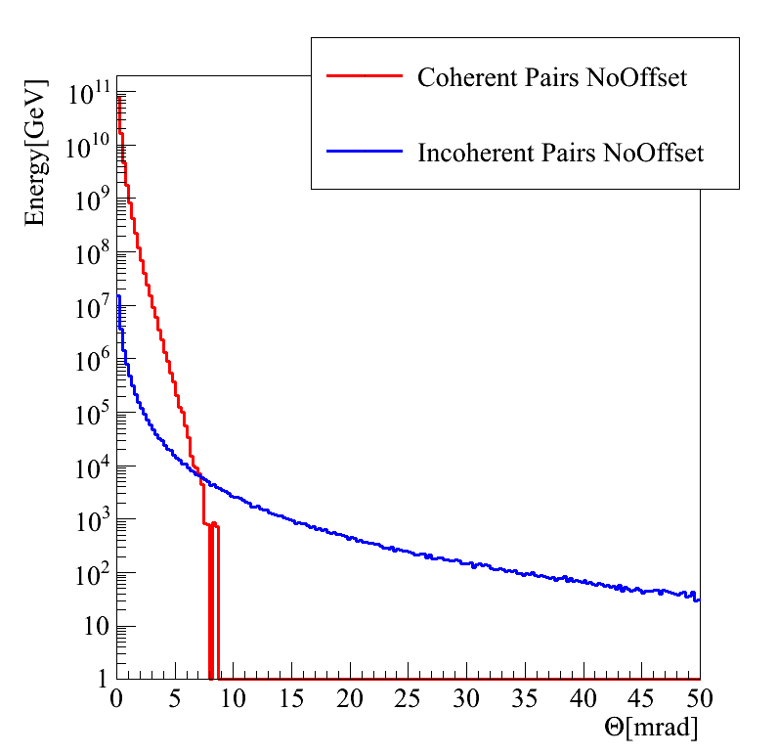
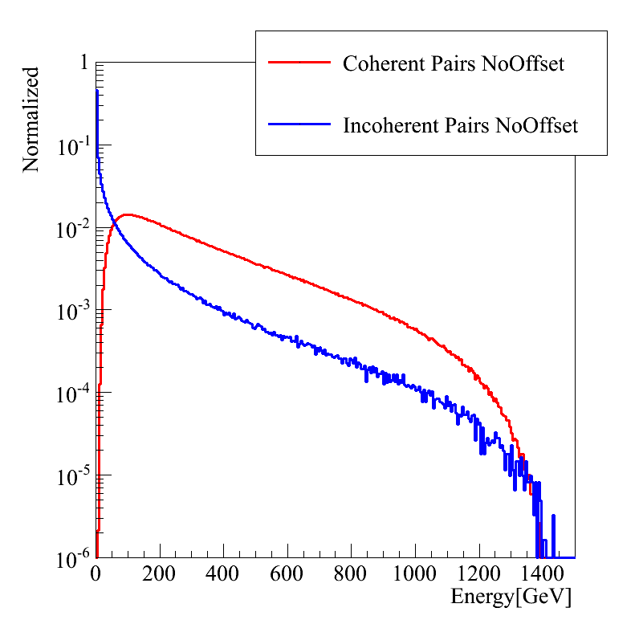
Vertex Detector & Forward Region
Crossing angle: 20mrad (14 mrad @ ILC)
Beam-beam interactions produce photons and e⁺e⁻ pairs
  coherent pairs with high energies and low angles, leave the detector through the beam pipe
  incoherent pairs (~300k per BX) with high angles and low energies per particle, can be confined by solenoid field
Move beam pipe and first vertex layer to ~30 mm to reduce direct hits from pair background
Increase outgoing beam pipe radius to 10 mrad (r_{min} BeamCal)
Allow space for intra-train-feedback-system and kickers between BeamCal and QD0
André Sailer

Slide 13
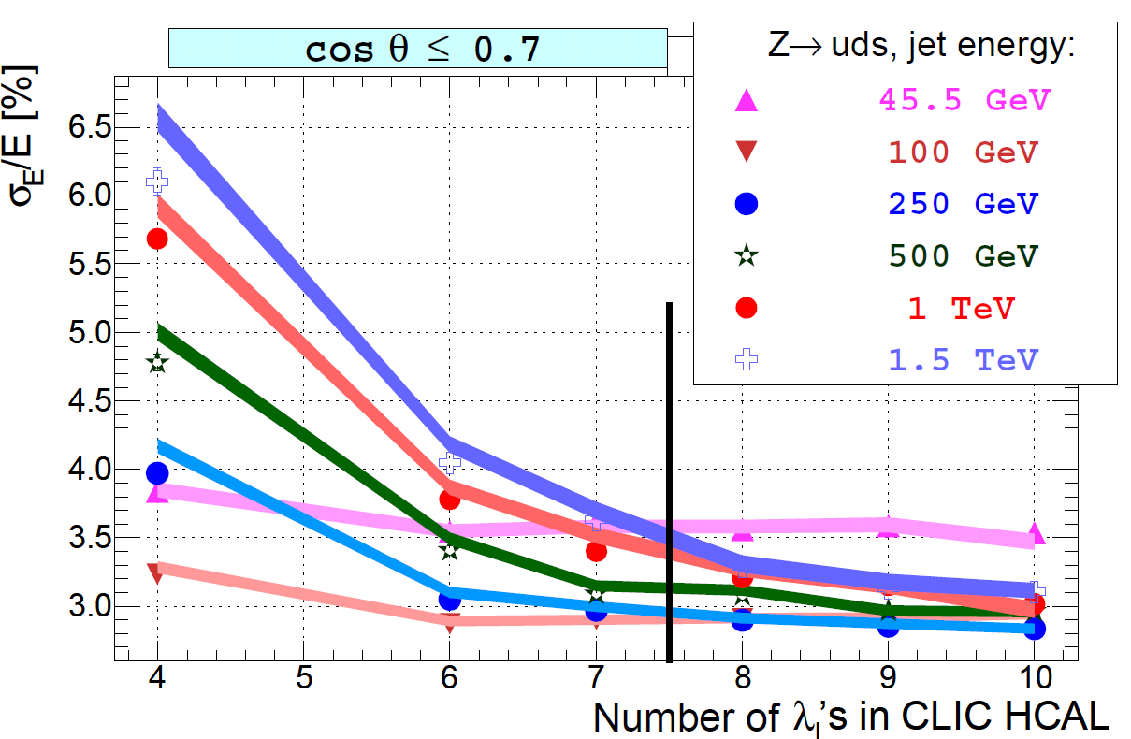
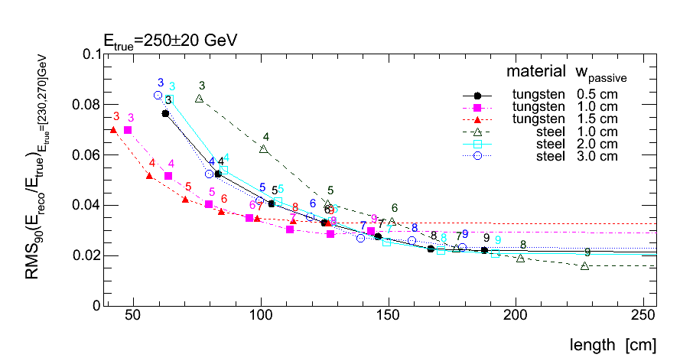
Calorimeters
Need good jet energy resolution up to TeV jets
  increase HCal depth to contain energetic showers
  keep coil size reasonable (cost & feasibility)
tungsten HCal
Optimization of sampling fractions in steel or tungsten HCal
(see talk by Peter Speckmayer)
HCal depth studies with Pandora PFA
(see talk by Angela Lucaci-Timoce)
~7.5 λ_{i} in HCal, barrel: 75*1cm W, endcap: 60*2cm steel

Slide 14
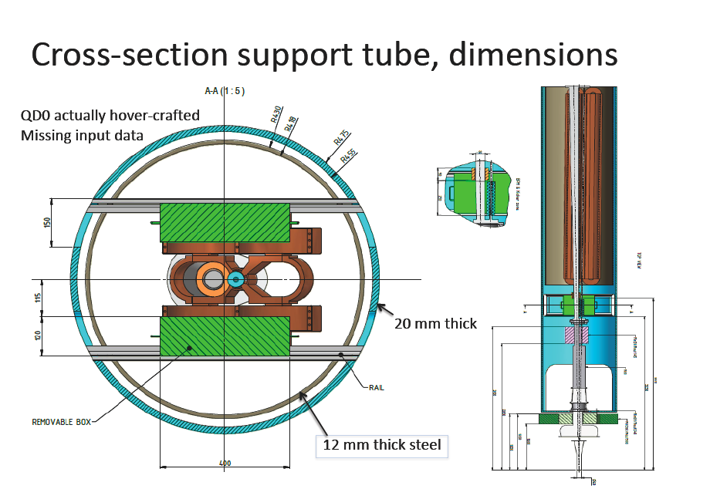
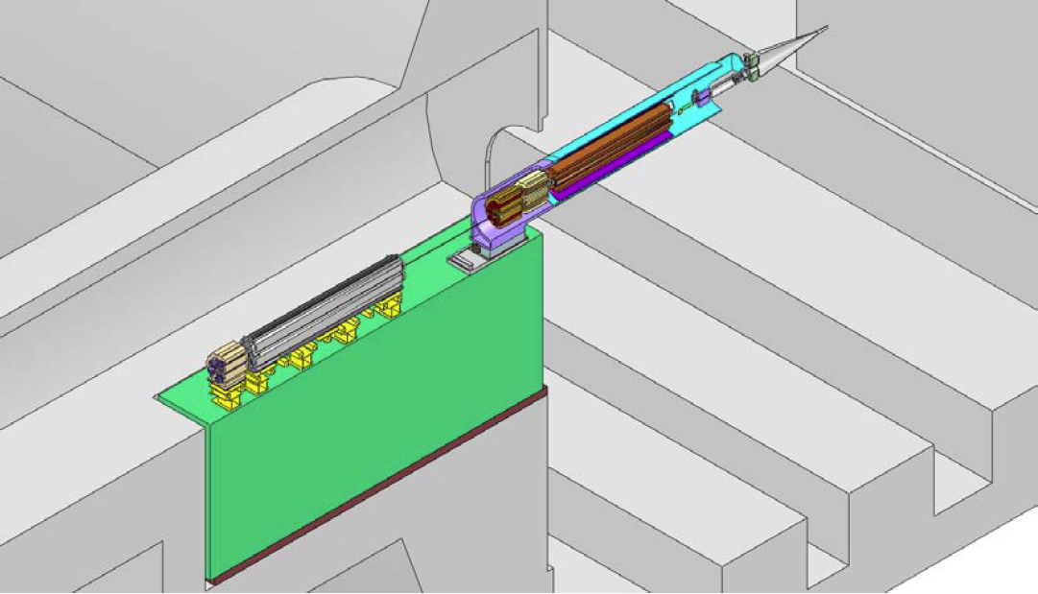
MDI
QD0 has to be stabilized with nm precision at CLIC
Has to be as close as possible to IP to gain maximum luminosity
Support QD0 from tunnel with a stable support tube
Hubert Gerwig
  Significant cut into acceptance of HCal and Muon system:
    r_{min} HCal: ~50cm (support tube)
    r_{min} Muon System: ~70cm (support tube + anti solenoid)

Slide 15
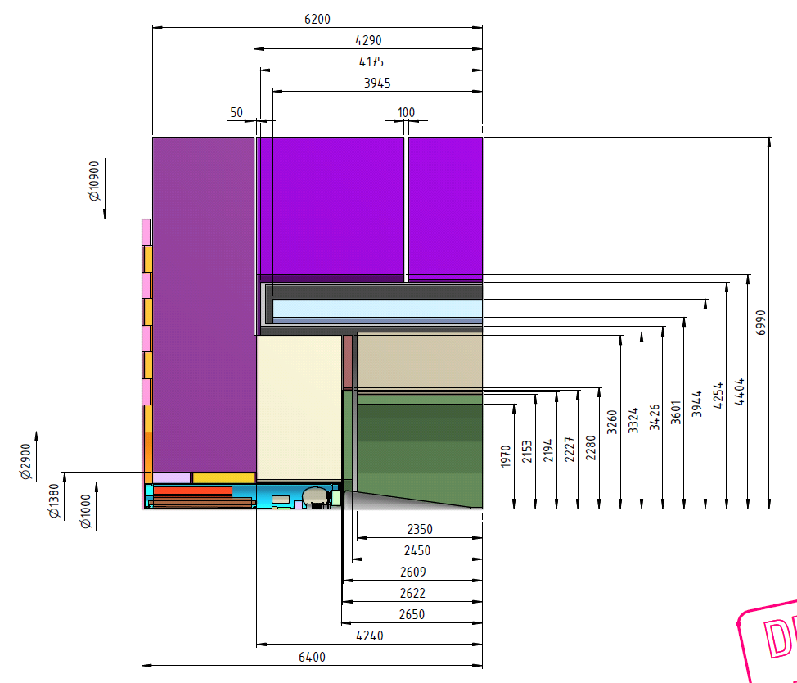
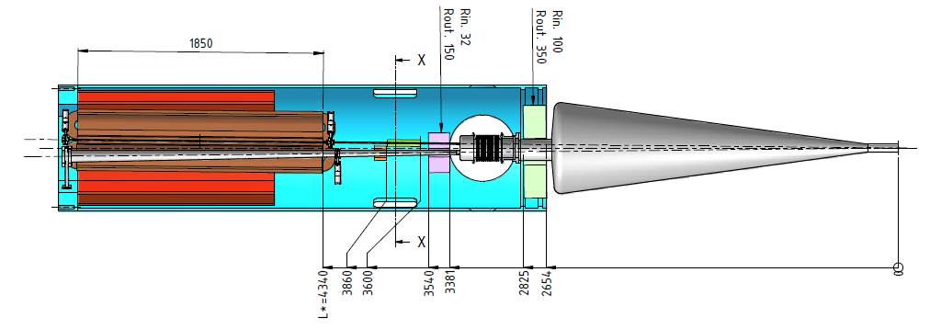
CLIC_ILD Numbers
Nicolas Siegrist

Slide 16
CLIC_ILD in Mokka
Based on ILD00 (LOI detector model)
Available with next Mokka release as CLIC_ILD_CDR
André Sailer

Slide 17
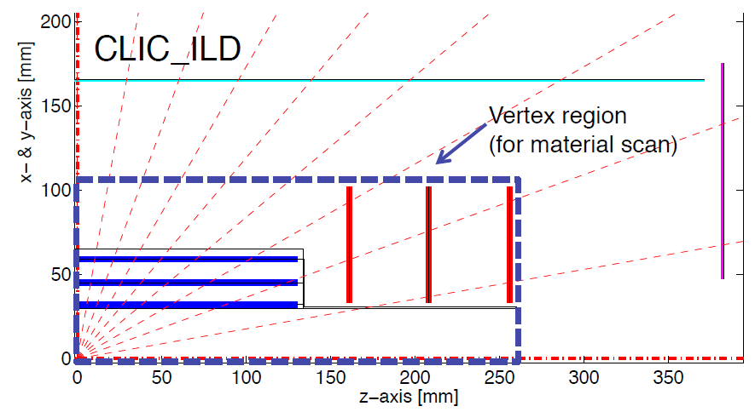
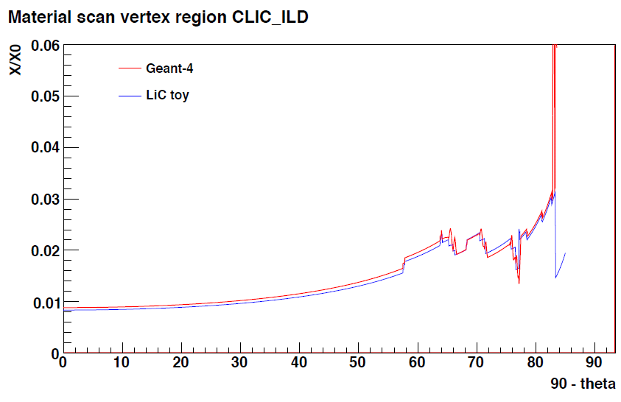
CLIC_ILD Vertex Detector
0.6 mm Be beam pipe with r_{max} = 30 mm
3 double pixel layers in barrel z_{max} = 100 mm
3 double pixel disks in endcap
20*20 µm² pixels with analog readout (σ = 2.8µm )
2*50 µm Si + 134µm Carbon support per double layer (0.18% X₀)
Talk on optimization study for CLIC vertex and forward tracking region by Dominik Dannheim

Slide 18
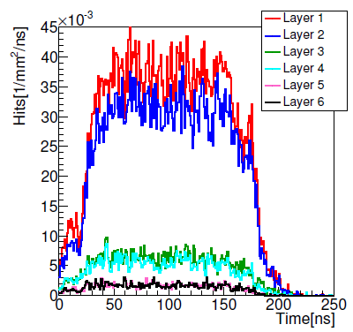
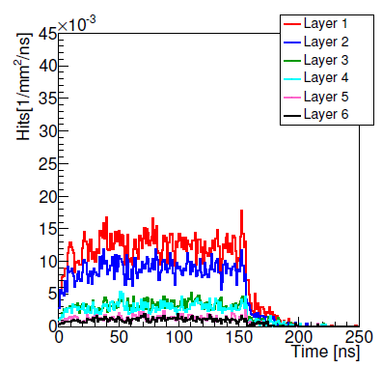
CLIC_ILD Forward Region
Moved LumiCal behind ECal and increased radius to avoid gap, increased to 40 layers
Removed LHCal
Moved BeamCal as close as possible to the IP to allow for kickers and intra-train-feedback-system, increased to 40 layers
Pair background levels in Vertex Barrel
Anti Solenoid
ECal
HCal
BeamCal
QD0
LumiCal
introduce more material into conical beam pipe
Preliminary!
see talk on beam-beam-background @ CLIC by André Sailer

Slide 19
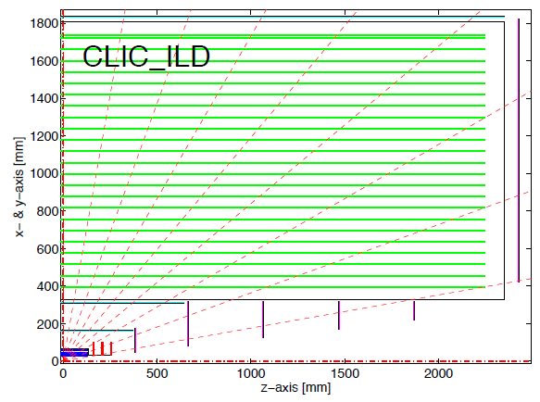
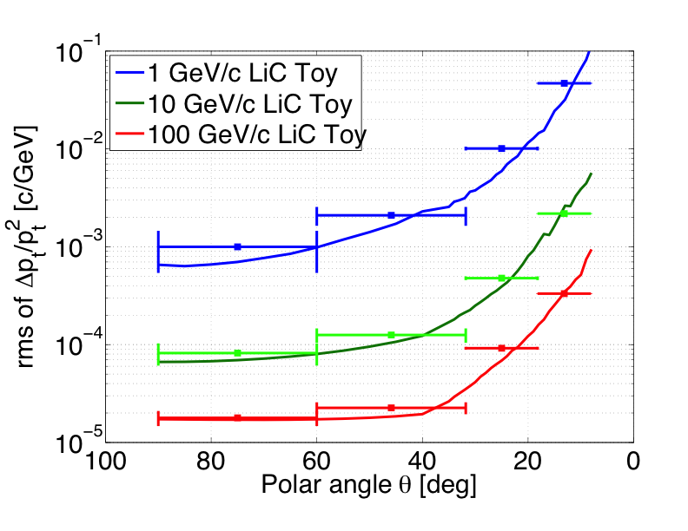
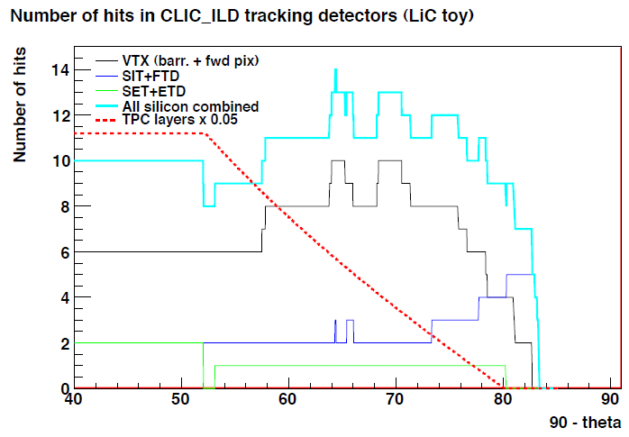
CLIC_ILD Tracker
4T solenoid field
TPC as main tracking device
  changed cathode: removed air gap and use 100 µm Mylar + 10 µm copper on each side
Si strip layers inside and outside of the TPC (2 layers SIT & SET, σ_{r-φ} = 7µm, σ_{z} = 50µm )
Si strip layers behind TPC endcap (ETD, σ_{x,y,z} = 7µm )
5 forward tracking disks (FTD, Si stereo strips, σ_{r-φ} = 7µm, σ_{r} = 50µm )
Points with error bars: Mokka
Dominik Dannheim

Slide 20
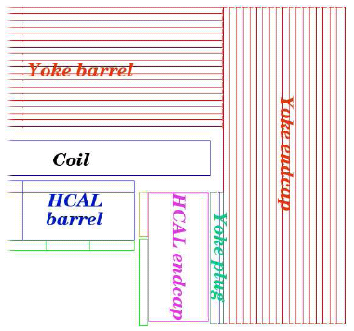
CLIC_ILD Calorimeters
ECal (8 sides)
  Absorbers:
    20*2.1 mm tungsten absorber layers
    10*4.2 mm tungsten absorber layers
  Active:
    3.15 mm gap size (0.3 mm Si + Air, Copper Capton), 5*5 mm² readout
HCal (8 sides inside, 16 sides outside)
  Barrel: 75*10mm tungsten
  Endcap: 60*20mm steel
  Active: 6.5 mm gap size (5 mm polystyrene + 1.5 mm air), 3*3 cm² cell size
Analog readout for the HCal was chosen as a baseline for mass production
Alternative technologies will be investigated in dedicated studies and presented in the CDR

Slide 21
B A C K U P

Slide 22
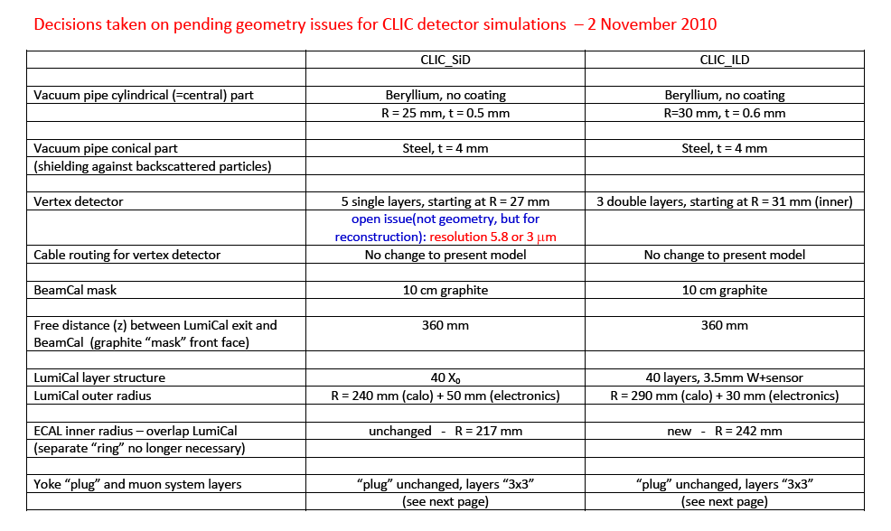

Slide 23
Links
LCD project web page:
http://lcd.web.cern.ch/LCD/
LCD indico pages:
http://indico.cern.ch/categoryDisplay.py?categId=1954
Includes also the indico pages of the 6 working groups
Wiki page with various documentation:
https://twiki.cern.ch/twiki//bin/view/CLIC/Detector
For example, in the wiki page you can find:
  The SiD’ and ILD’ modified detector geometries for CLIC,
  Current data samples (temporary web location)
  Software documentation, grid production documentation

Slide 24
How to join our mailing lists
For a list/description of our working groups, see our indico page:
http://indico.cern.ch/categoryDisplay.py?categId=1954
If you want to join one or several of our mailing lists you can subscribe to the respective mailing lists, by following the e-groups link:
https://groups.cern.ch/Pages/GroupSearch.aspx?k=lcd-wg
or
https://groups.cern.ch/Pages/GroupSearch.aspx?k=lc-
In case you encounter any problems, please contact:
Kate.ross@cern.ch

