Slide 1
The Sample Test of the FNAL/IB4 Vacuum Furnace for Hydrogen Degassing
G. Wu

Slide 2
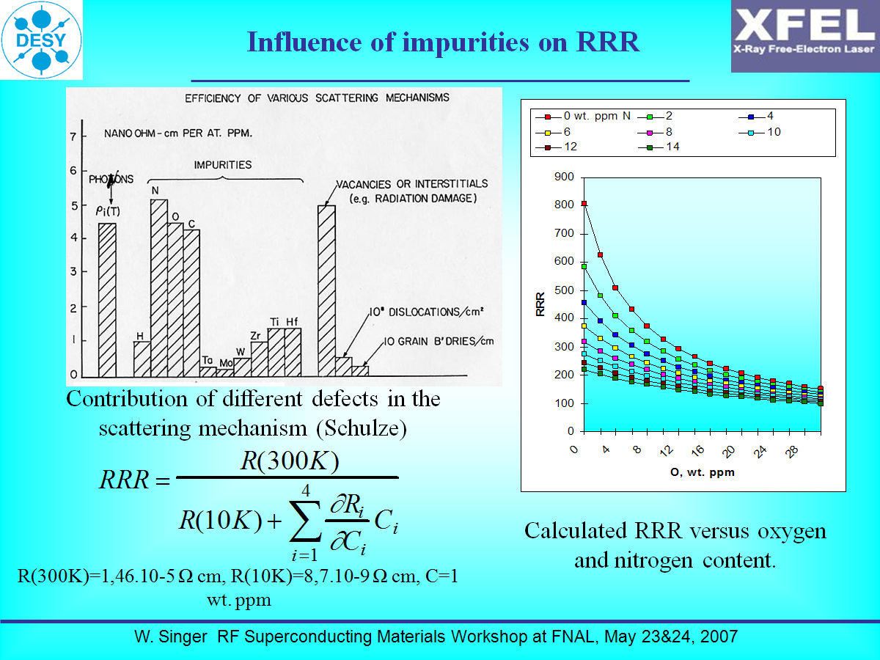
Niobium RRR and impurities

Slide 3
RRR Niobium Samples
Niobium samples are cut from cavity production sheet
  Low impurities of H.O.N.C.
  Annealed with low crystal defects
Niobium sample preparation
  Measure RRR
  BCP etching or ultrasonic clean
  Bake out in furnace
  Measure RRR

Slide 4
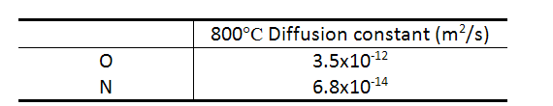
Furnace vacuum quality indicators
Furnace vacuum quality is essential. Indicators are total pressure, oxygen pressure and hydrogen pumping capacity
O, N, C, H are the main residuals in a furnace; Niobium is a perfect getter, O is the prime source among them that can change the niobium RRR.

Slide 5
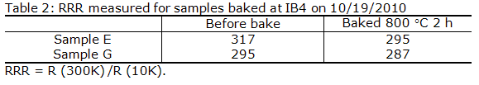
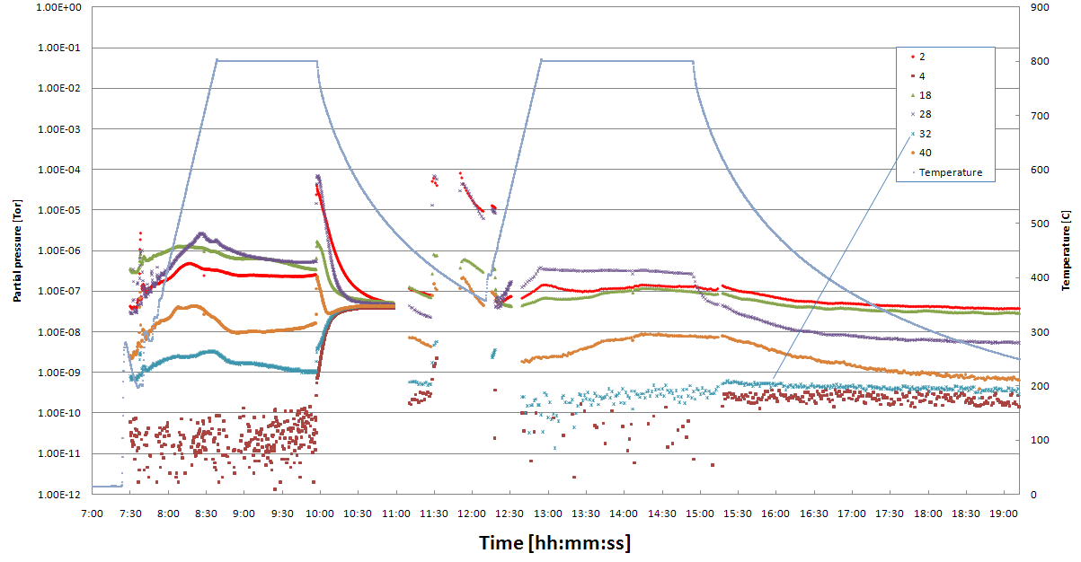
RGA reading during baking on 10/19/2010
Air supply stopped
Oxygen partial pressure was inaccurate. Vacuum lost when samples were still hot (400-700°C).

Slide 6
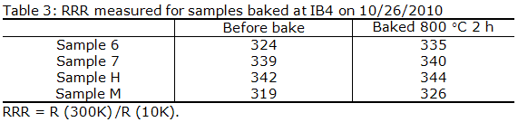
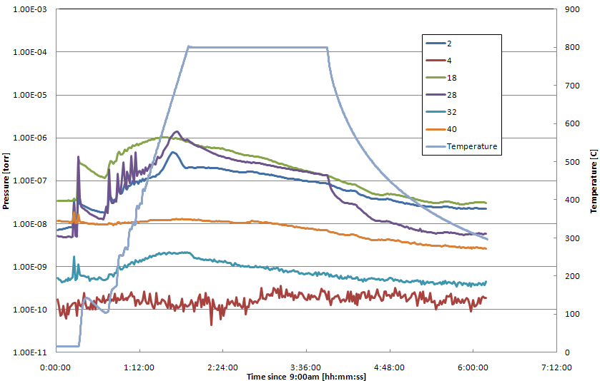
RGA reading during baking on 10/26/2010
Oxygen partial pressure was nicely low, averaged in 1x10⁻⁹ Torr

Slide 7
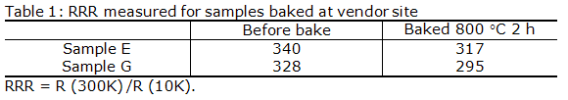
Three tests of RRR niobium samples
With Stainless Steel Tube, no RGA logging
With Stainless Steel Tube, see RGA logging
No Stainless Steel Tube, see RGA logging
RRR improved in third test indicating furnace is compatible to niobium

Slide 8
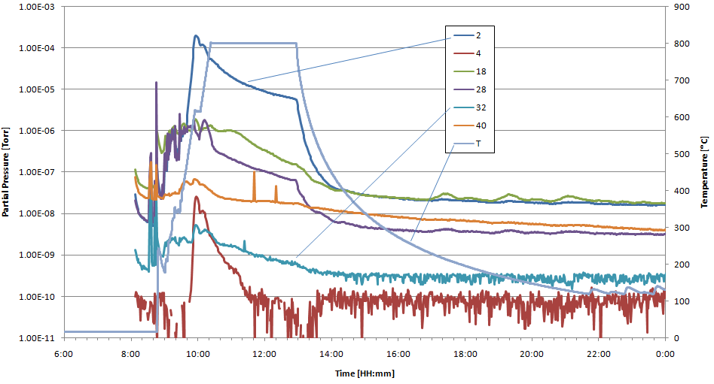
TE1ACC004/TE1CAT002 baking

Slide 9
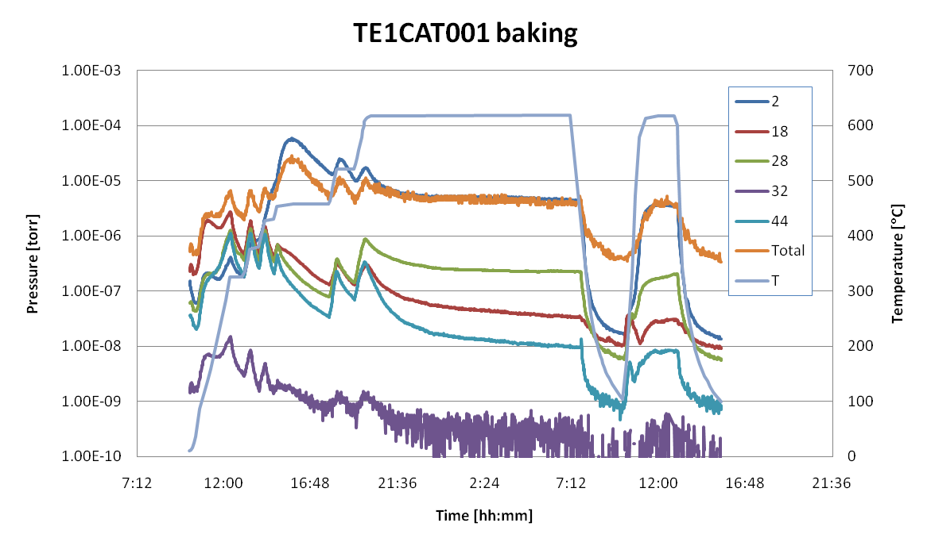
RGA reading during baking (600 °C) at ANL/APS
Compared to ANL/APS furnace

Slide 10
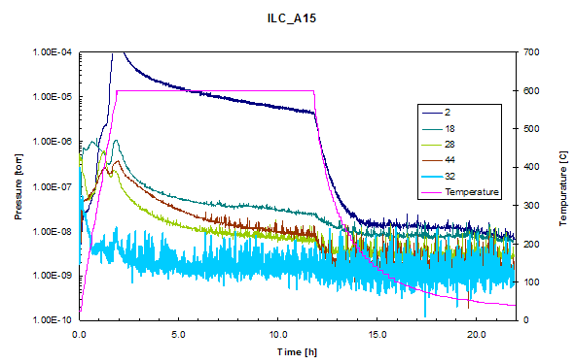
RGA reading during baking (600°C) at JLAB
Compared to JLAB furnace

Slide 11
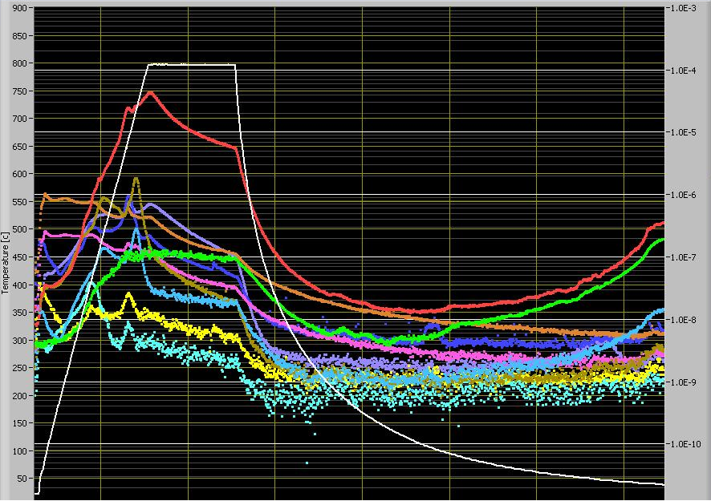
RGA reading during baking (800°C) at JLAB
Compared to JLAB furnace
Temperature
H
O
9-cell PKU-2

Slide 12
Partial pressure comparison
H O partial pressure at the end of baking cycle
Furnaces | H pressure [torr] | O pressure [torr] | Note
JLAB (800°C) | 0.4-1.2 x10⁻⁵ | <6 x10⁻⁹ | No Q-disease
ANL/APS (600°C) | 0.4 x10⁻⁵ | <0.5 x10⁻⁹ | No Q-disease
“Little TIM” (800°C) | 0.6 x10⁻⁵ | <0.7 x10⁻⁹ | ?

Slide 13
Conclusions
The FNAL/IB4 furnace is acceptable for cavity baking
The hydrogen degassing for cavity is effective, to be confirmed by Q-disease measurement of 1-cell cavities.

