Slide 1
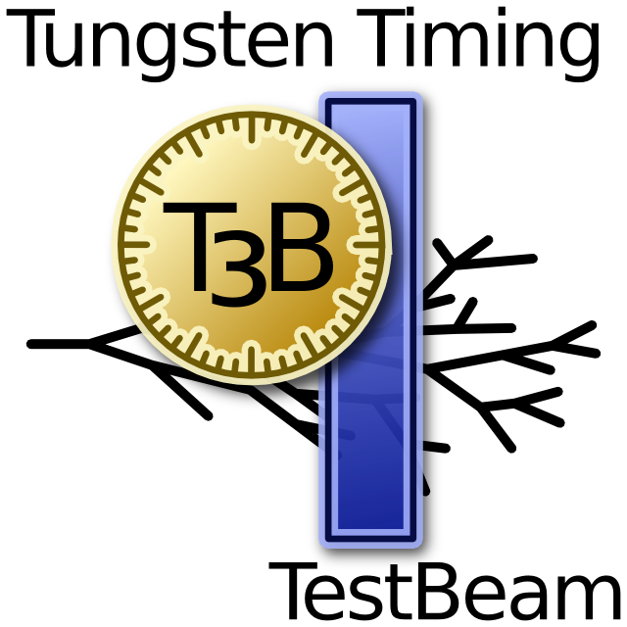



First Results from T3B
Calice AHCAL Meeting – Desy, January 2011
Christian Soldner
Max-Planck-Institute for Physics

Slide 2
Outline
Overview of T3B (Tungsten Timing Test Beam)
Creation of an Analysis Framework
Software Triggering
Waveform Rejection: Filters
First Steps Towards Calibration
Where we want to go: Timing Analysis
Summary

Slide 3
Overview of T3B

Slide 4
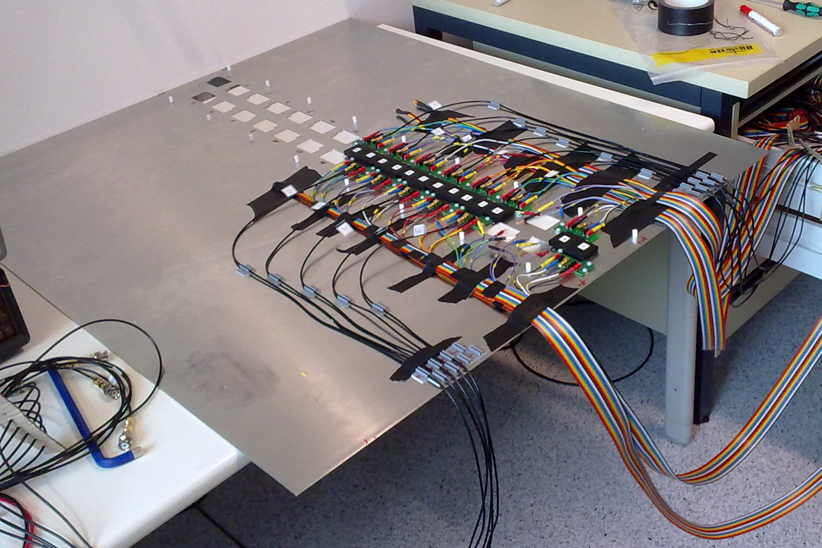
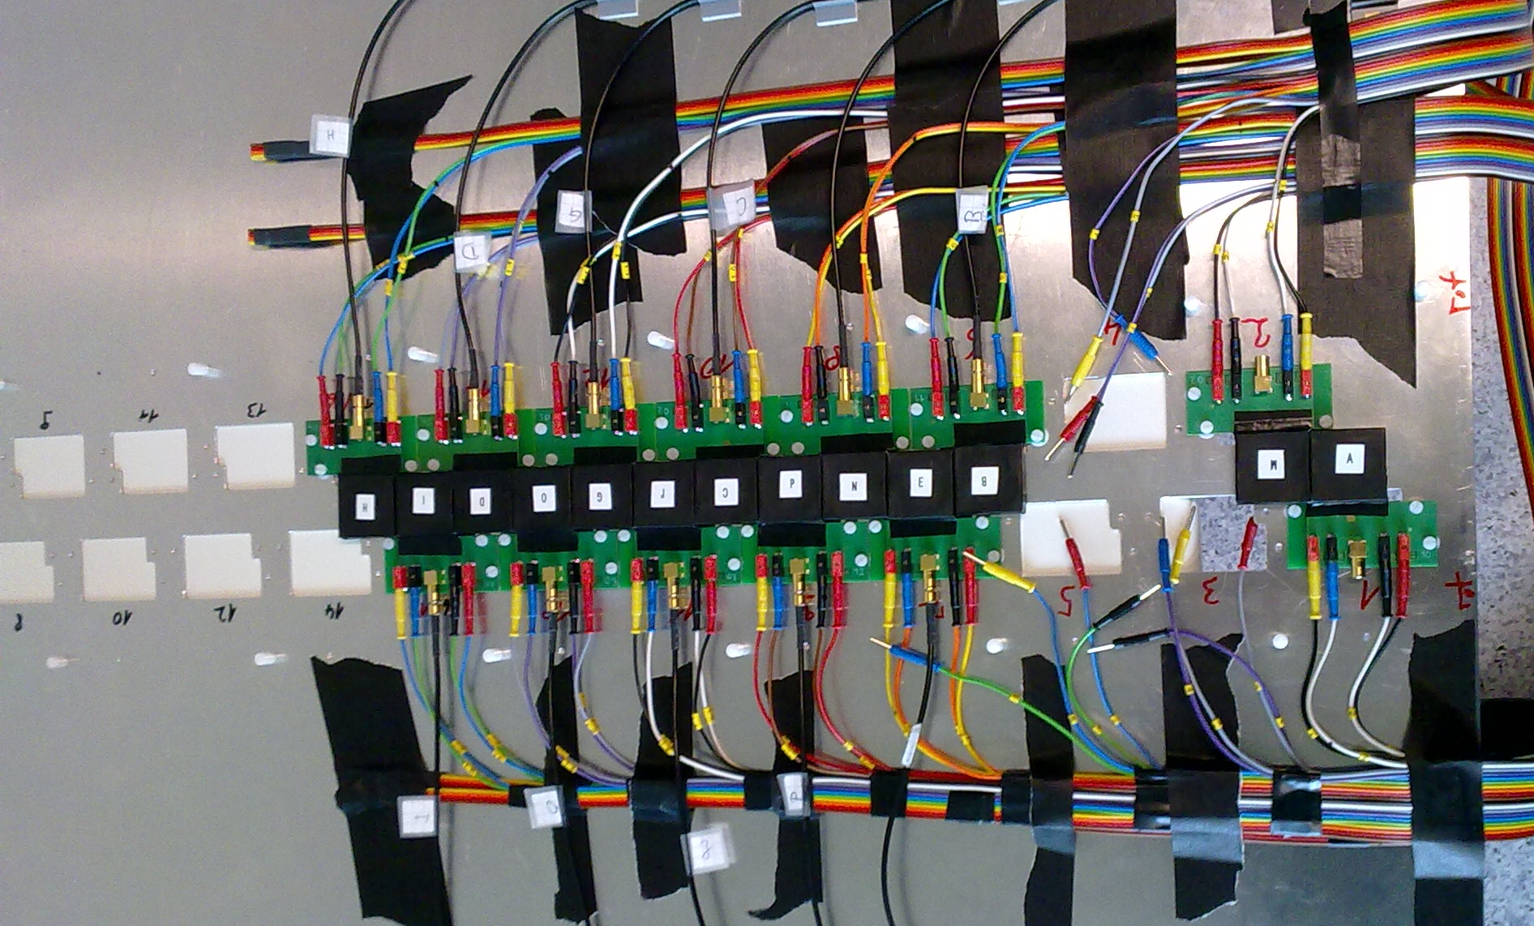
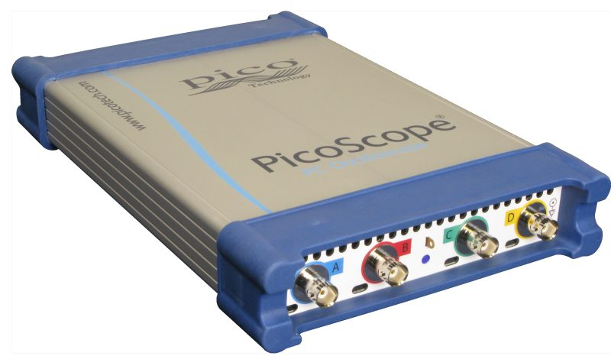

The Test Beam Setup of T3B
One layer = row of 15 scintillator tiles
Tile size: 3 x 3 x 0.5 cm³
SiPM: Hamamatsu MPPC-50C
Readout: 4 x PicoScope 6403
  Fast Digitizer (1.25GSa/s on 4CH)
  Deep memory (1GSa)
  Fast data capturing (up to 1MHz)

Slide 5
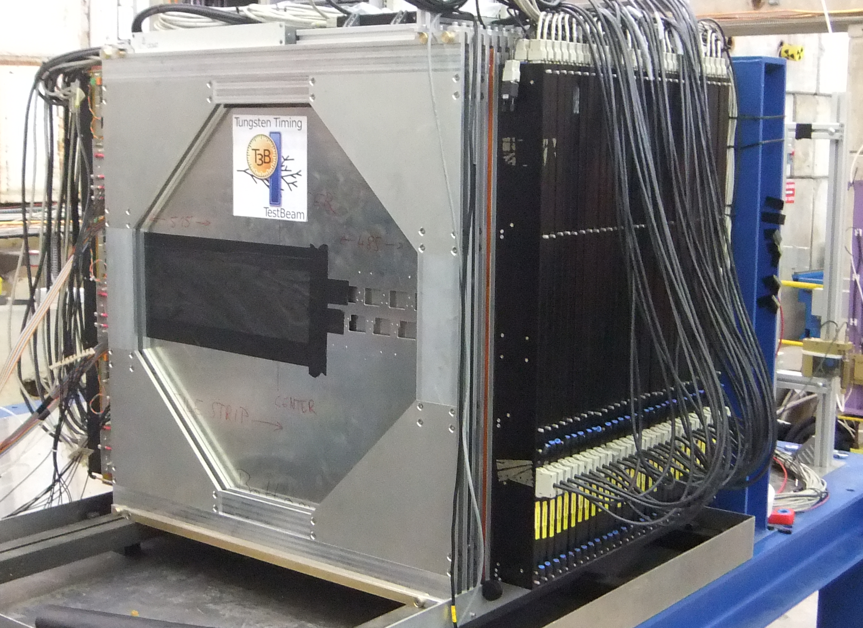
T3B as parasitic experiment in CALICE
T3B Layer positioned behind the CALICE W-HCAL
Testbeam in Nov 2010 @ CERN PS
Particle composition: Hadron mix (e,mu,pi,K,p)
Energy range: 2-10GeV

Slide 6
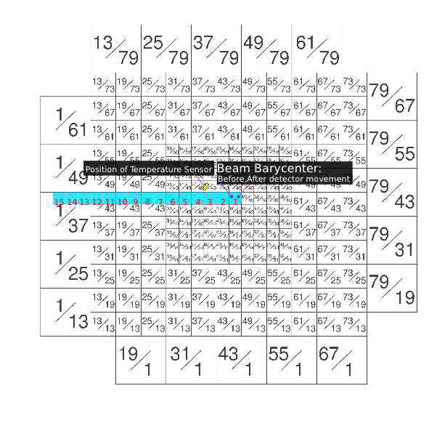

Slide 7
T3B Strip Position

Slide 8
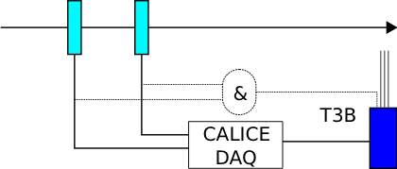

CALICE <-> T3B: Synchronisation
Goal: Use CALICE HCAL to determine shower start information
  T3B events need to be in sync with CALICE
Trigger Setup:
  CALICE Trigger on
  Scintilltor Concidence
  T3B Trigger on CALICE
  T3B monitors Scintillator Coincidence on one channel

Slide 9
Creation of an analysis framework

Slide 10
The T3B Analysis Framework
The T3B Analysis Framework is written in object-oriented C++ using the STL, ROOT and QT Core libraries
Main Tasks (so far stand-alone T3B):
Easy and efficient access of the data taken during the TB period
Calibrate the raw Waveforms (from ADC bits)
Cycle through the Waveforms and extract the Info of interest
Analyze the Waveforms and Create Plots
Designed to be modular and easily extendable (work in progress…)
Provide a set of Analysis Modes, Software Triggers, Filters and Access Classes (e.g. for the Temperature Information, Pedestal Substraction…)

Slide 11
The Analysis Framework: Overview
Analysis Mode
Process the waveforms to look like on an oscilloscope
Trigger
Trigger Waveforms from the full acquisition window
Filter
Reject Waveforms that do not match certain criteria
Calibration
Create calibration files for Analysis Modes
Analysis
Analyze the Data and create plots
Rising Edge
Rising and Falling Edge
Default
.
.
.
Scintillator Coincidence
Total Waveform Integral
Typical Trigger Time
.
.
.
Pedestal Substraction
SiPM Gain
(MIP)
(Saturation)
.
.
Hadron Analysis
Muon Analysis
Random Trigger
Analysis
.
.
.

Slide 12
Software Triggering

Slide 13
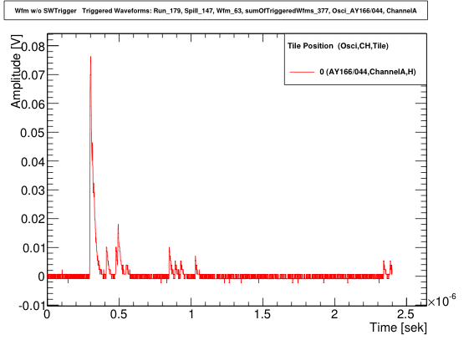
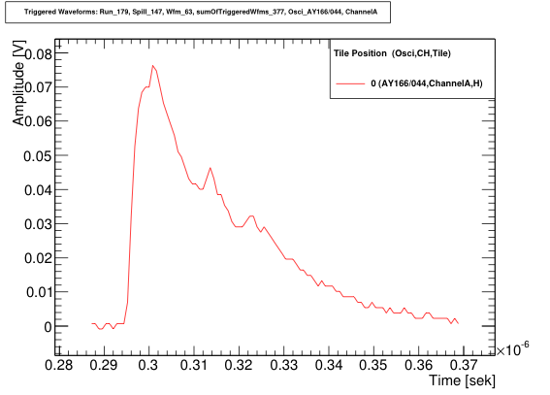
T3B Framework: Trigger
Waveform of Total
Acquisition window
Software Trigger: Rising and falling edge
Extract acquisition window if sample above and later below threshold
Time resolved triggering of individual energy depositions

Slide 14
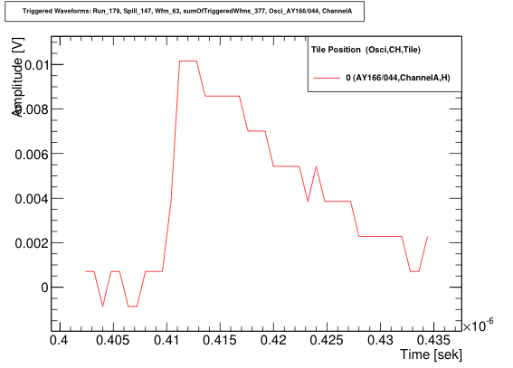
T3B Framework: Trigger
Waveform of Total
Acquisition window
Software Trigger: Rising and falling edge
Extract acquisition window if sample above and later below threshold
Time resolved triggering of individual energy depositions

Slide 15
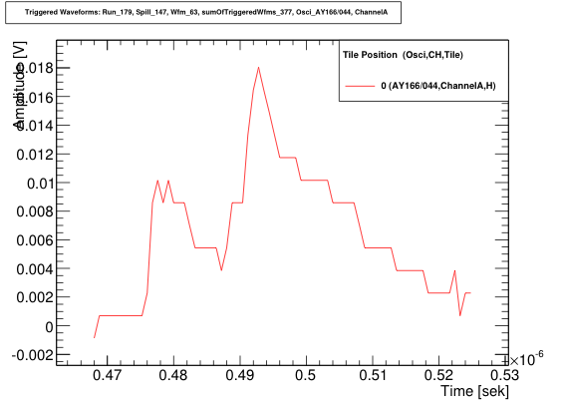
T3B Framework: Trigger
Waveform of Total
Acquisition window
Software Trigger: Rising and falling edge
Extract acquisition window if sample above and later below threshold
Time resolved triggering of individual energy depositions

Slide 16
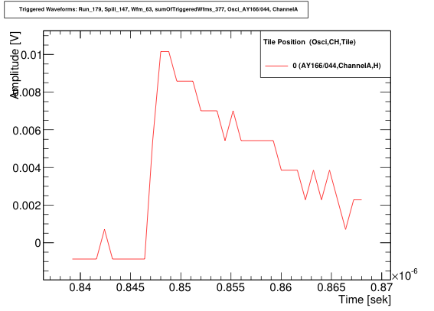
T3B Framework: Trigger
Waveform of Total
Acquisition window
Software Trigger: Rising and falling edge
Extract acquisition window if sample above and later below threshold
Time resolved triggering of individual energy depositions

Slide 17
T3B Framework: Trigger
Waveform of Total
Acquisition window
Ignore e.g. all 1p.e. peaks
Software Trigger: Rising and falling edge
Extract acquisition window if sample above and later below threshold
Time resolved triggering of individual energy depositions

Slide 18
Waveform Rejection:
Filters

Slide 19
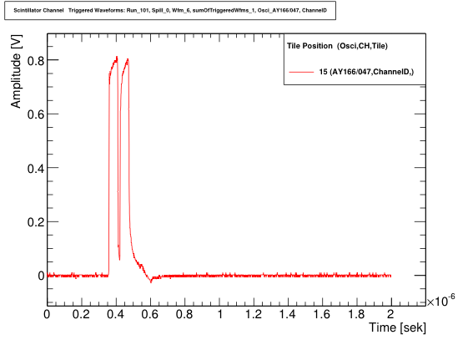
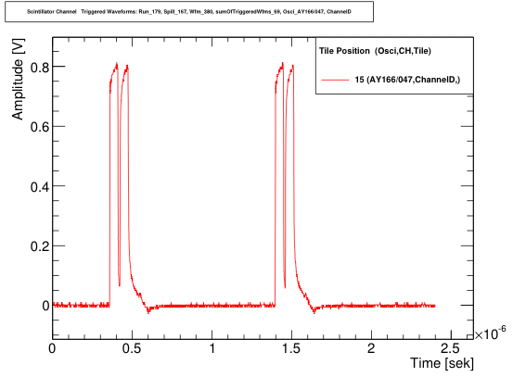
T3B Framework: Filter
The 16th T3B Channel was connected to the scintillator coincidence signal in front of CALICE
Unfortunately, we had a cable reflection in the NIM Signal → Double Signal = 1 particle
Single Particle Event
Double Particle Event
Scintillator Coincidence Filter:
All Events which contain a number of coincidences != 1 are rejected
Protection from multiple hits in one event
Additional noise rejection

Slide 20
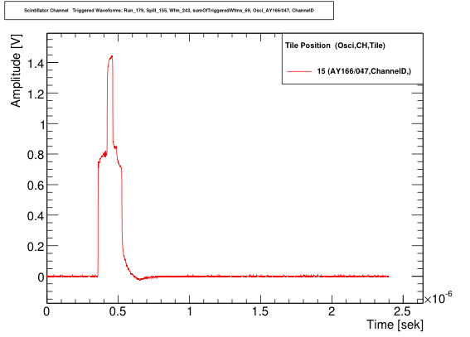
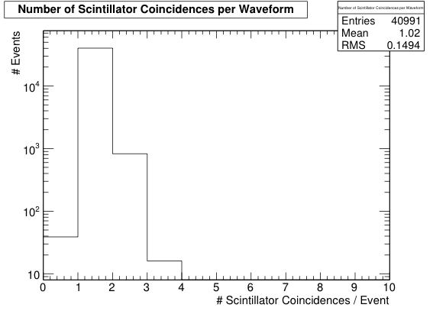
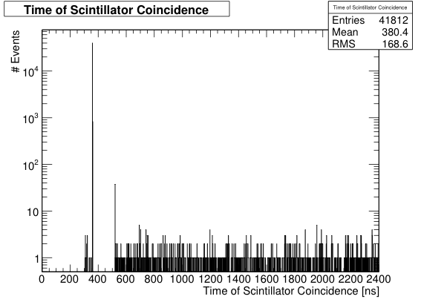
T3B Framework: Filter
1 Particle Ev: 97.85%
2 Particle Ev: 2.02%
3 Particle Ev: 0.04%
0 Particle Ev: 0.09%
Multi-particle hits equally distributed over time
Gap due to hold-off time
Can be avoided in next step
… to be continued

Slide 21
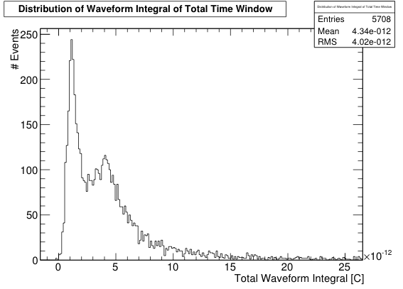
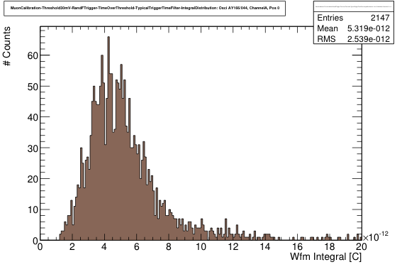
T3B Framework: Filter
1 MIP
SW Trigger @ 4p.e.
Integral distribution of a
muon run
Total Waveform Integral Filter:
All Waveforms with a total Waveform Integral (in full acquisition window) below the minimum of the distribution (at 0.6MIP) are rejected
Efficient way to reject noise events
Only possible with a dedicated pedestal substraction (see later)
so far just coarse estimation → requires fits (Langau) work in progress…

Slide 22
First Steps Towards Calibration

Slide 23
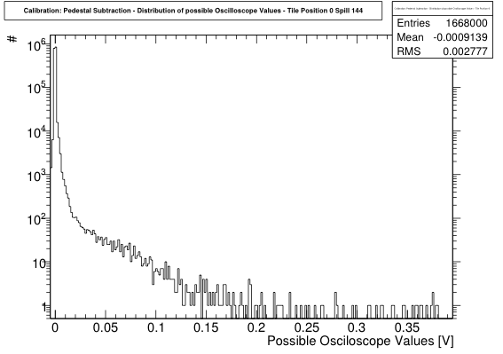
T3B Framework: Calibration
Calibration Mode: Pedestal Substraction
The disadvantage of recording so many “zeros” is an advantage for this calibration mode
Procedure:
Determine the distribution of all possible oscilloscope values
Extract the bins which contain more than 5% of all histogram entries
(mostly 2-3 bins)
The mean equals the pedestal
Pedestal value is determined on a spill by spill basis for each channel
Procedure proved to be very stable

Slide 24
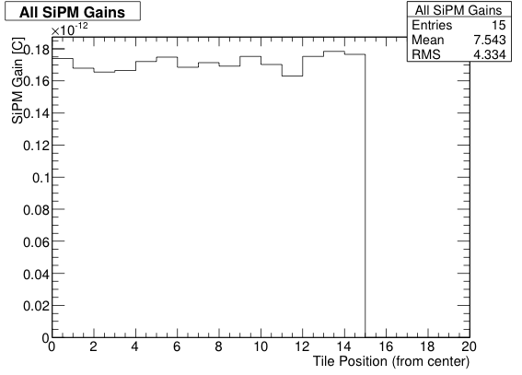
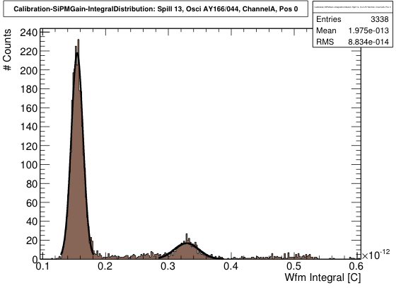
T3B Framework: Calibration
Calibration Mode: SiPM Gain
We have ~125 Darkrate Events per Channel after each spill processing
Gain Extraction with only 3000 Events possible
~3000-4000 Events suffice for SiPM Gain extraction
choose 31 Spills
→ one independent gain calib value every ≈ 12minutes (assuming on average 2 Spills per supercycle)
Very high gain extraction efficiency (≈100%)

Slide 25
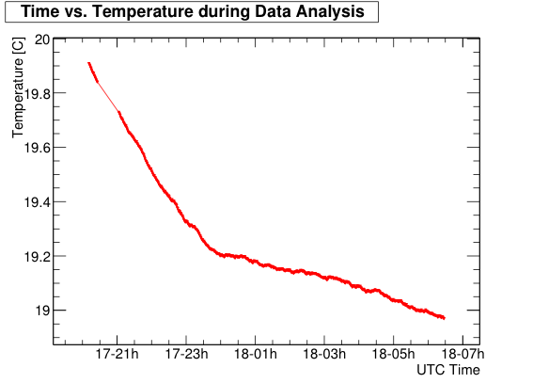
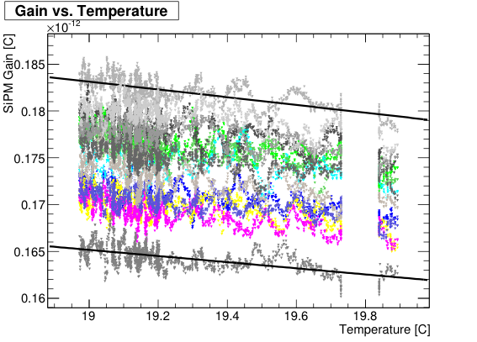
T3B Framework: Calibration
Long Term Stability of Gain Extraction:
Choosing Run_179 with 2100 Spills
Correct tendency of the gain-temperature can be seen at only 0.8C Temperature difference

Slide 26
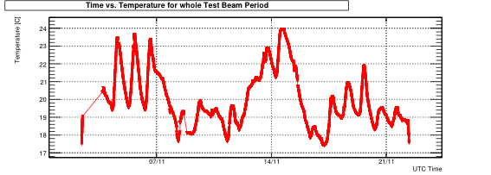
T3B Framework: Calibration
Run_134
Run_179
Run_168
Wide Temperature Range of 17.5C-24C during TB Phase
→ Choosing 3 good Runs with extreme temperatures

Slide 27
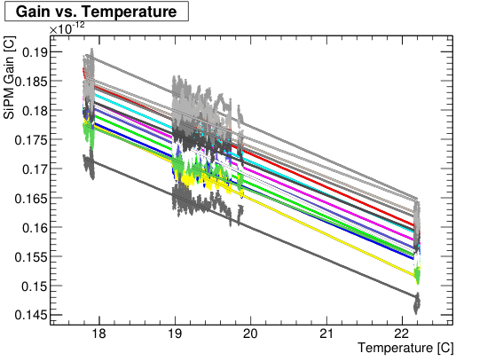
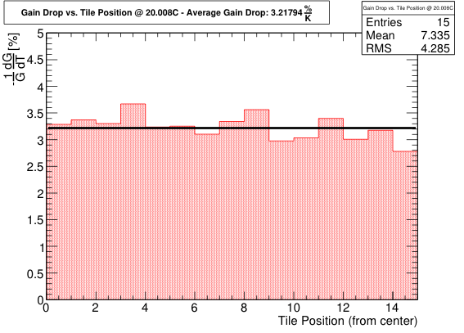
T3B Framework: Calibration
Gain Temperature Dependence for
all channels
Extracting the gain drop
1/G dG/dT from Fits
Average Gain drop of:

Slide 28
T3B Framework: Calibration
Next Steps:
Gain extraction fit has still room for improvement → reduce fluctuations
get SiPM Gain values for all runs
But:
Gain Calibration is not the end of the story → Need MIP Calibration
Test Bench: Gain-Amplitude Correlation
Measure #p.e./MIP with Sr90
(note: e- ≠ MIP but correlation identical)
Steer through different Bias Voltages and Temperatures and create dictionary
Obtain:
Check consistency for different cells
Perform a MIP Calibration using
SiPM Gain Data

Slide 29
T3B Framework: Calibration
Further Challenges:
SiPM Saturation correction:
→ Requires another Test Bench Setup, a calibrated low-intensity blue emitting LED, an efficient method to couple the light into the tile, and quite some time…
Correction for Afterpulsing:
  Need a dictionary: which pulse height causes on average which afterpulse contribution at a certain time after the initial pulse?
  Procedure:
  Record cosmics and rare very high darkpulses
  Average all waveforms in a certain pulse height range
  Substract the extracted AC from the average energy deposition at a certain time
  Challenge:
  Aquiring enough statistics requires a long term measurement
  This was already done over the Christmas Holidays
  Analysis is still to be done …

Slide 30
Where we want to go:
Timing Analysis

Slide 31
T3B Framework: Analysis
Long-term Goal: Measure the time resolved development of
hadronic showers in a WHCAL
Important key parameters at CLIC:
Mean Time of First Hit, Mean Time of Hit, Energy Deposition vs. Time
The developed framework is capable of producing those plots, but a lot more work is to be done till they are perfectly reliable
Regard them as a first glimpse towards what’s to come
Configuration: T3B Standalone Analysis
Particles: Hadron-Lepton Mix Energy: -10GeV
Statistics: 450.000 Events
Framework: Trigger: RisingAndFalling Thresholds: r: 2.5p.e. , f:0.5p.e.
Filter: Scintillator Coincidence, Total Waveform Integral (0.6MIP)
applied Calibration: Pedestal Substraction

Slide 32
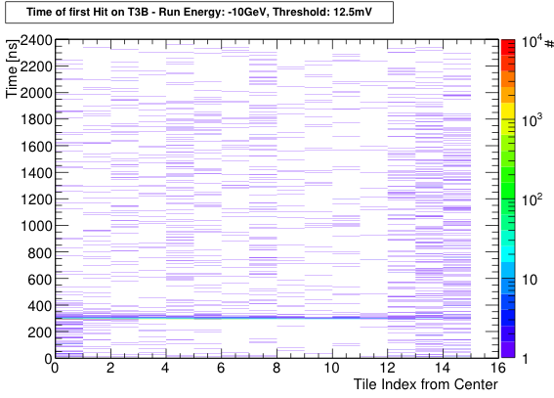
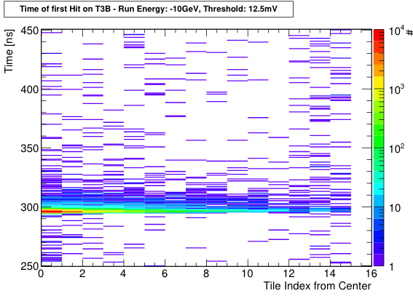
T3B Framework: Analysis
Time of First Hit:
Least biased by the incomplete calibration
Entries accumulate in a narrow region around the typical trigger time
Mean time of first hit increasing with distance from shower core

Slide 33
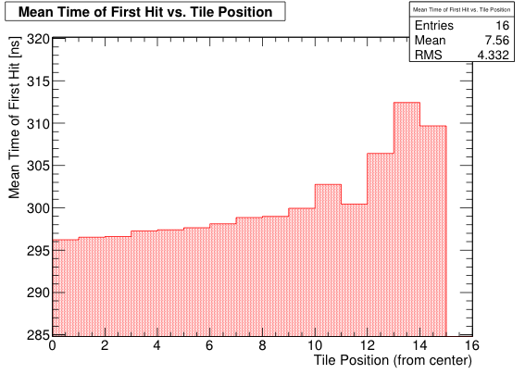
T3B Framework: Analysis
Time of First Hit:
Least biased by the incomplete calibration
Entries accumulate in a narrow region around the typical trigger time
Mean time of first hit increasing with distance from shower core

Slide 34
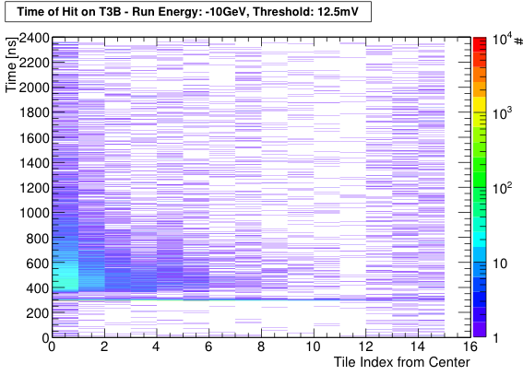
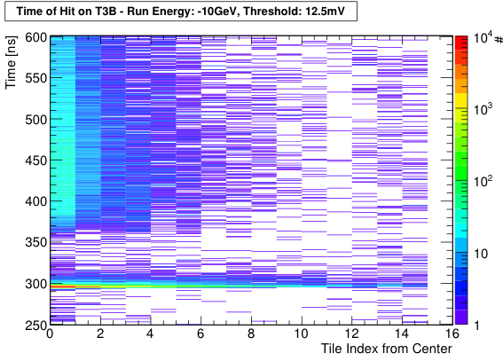
T3B Framework: Analysis
Time of Hit:
Additional late energy depositions above trigger threshold
Afterpulsing contribution not yet accounted for
Time Gap:
Typical Signal Width
Software trigger waits for falling threshold

Slide 35
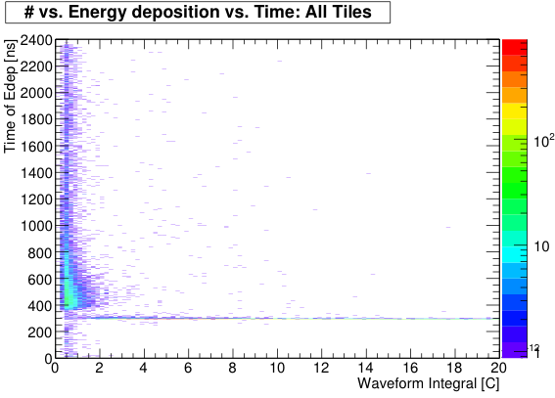
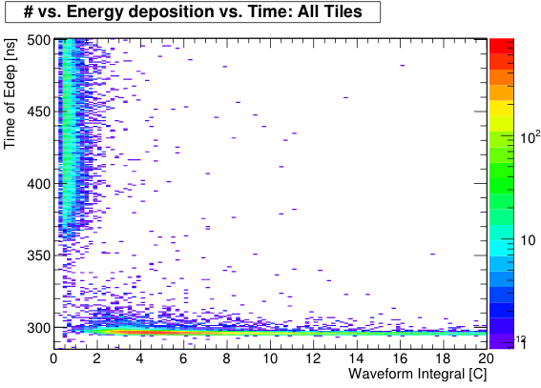
T3B Framework: Analysis
EDep vs. Time
High energy depositions are mostly within first 10-20ns
Few late Edeps above 1MIP, mostly below 0.5MIP
Afterpulsing and Saturation correction will have influence
1 MIP

Slide 36
Summary

Slide 37
Summary
Achieved so far:
Started development of an Analysis Framework for T3B (so far standalone)
SiPM properties require dedicated analysis methods (Dakrate, Afterpulsing, T-dependence…)
First set of Software Triggers, Waveform Filters and Data Access classes available
Pedestal Substraction and SiPM Gain Calibration (through DR) works and seems stable
  → Both values available for each spill and each channel
There is still a lot of work to do:
Complete the missing calibration steps (MIP, Saturation, Afterpulsing)
Continue working on synchronization with CALICE
  → Needed for shower start and particle ID
Simulate T3B events and develop a digitization procedure
Compare simulation and data

Slide 38
Special Thanks to:
Frank Simon and Lars Weuste, whose commitment at CERN Commissioning and at Data Analysis
The CALICE AHCAL Group, whose permanent support
Make this experiment possible!

Slide 39
Backup

Slide 40
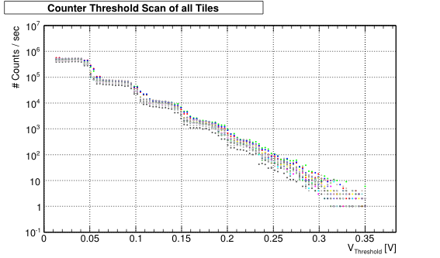
Backup: CTS

Slide 41
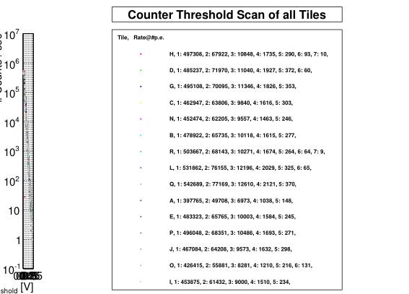
Backup: CTS

Slide 42
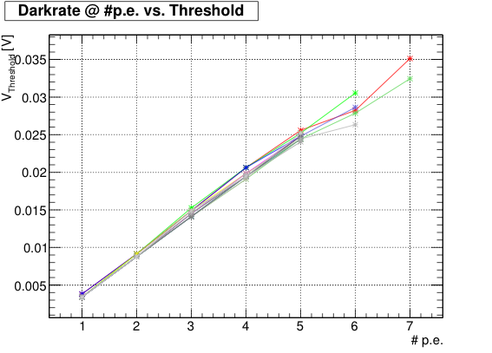
Backup: CTS

Slide 43
OLD Backup

Slide 44
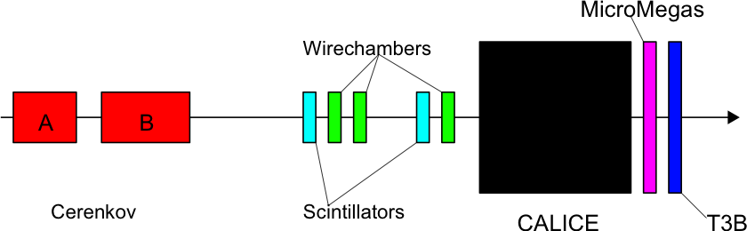
Testbeam Setup November 2010
Cerenkov used for particle ID
MicroMegas in front of T3B

Slide 45
Recap: Aims of the T3B Experiment
Information about the time structure of hadronic showers in Tungsten is crucial for the development of a CLIC HCAL
  The observed Time Structure depends on the active medium (sensitivity to neutrons) → Need scintillators to evaluate an analog HCAL
  Directly coupled scintillator tiles, read out with fast digitizers can be used for detailed measurements of the time structure of the shower
  Construct one timing layer = one strip of tiles
  Run together with the CALICE AHCAL at CERN PS in November
  Match T3B Events to CALICE Events to obtain the shower start
  Obtain first information on the timing of the lateral and longitudinal shower profile

Slide 46
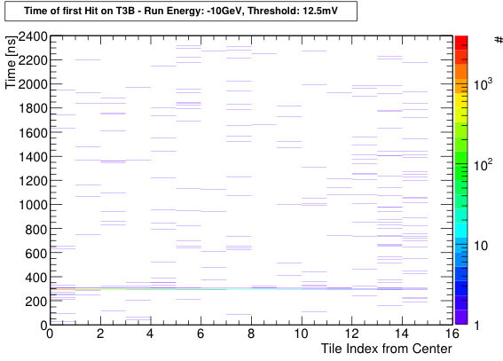
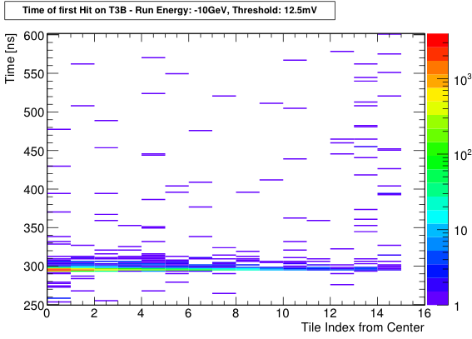
T3B Framework: Analysis
Time of First Hit:
Least biased by the incomplete calibration
Entries accumulate in a narrow region around the typical trigger time
Mean time of first hit increasing with distance from shower core

Slide 47
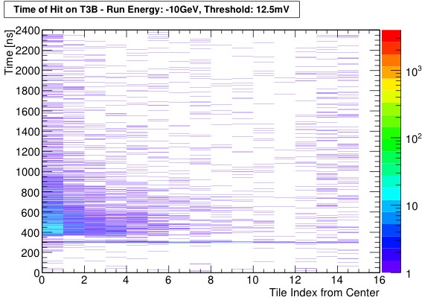
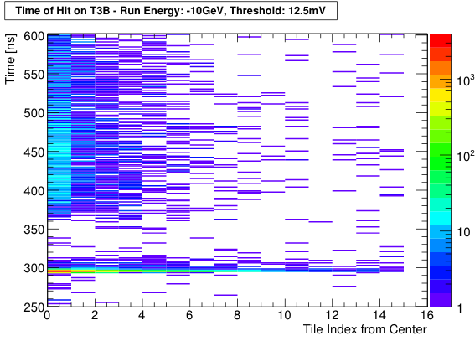
T3B Framework: Analysis
Time of Hit:
Additional late energy depositions above trigger threshold
Afterpulsing contribution not yet accounted for
Time Gap:
Typical Signal Width
Software trigger waits for falling threshold

Slide 48
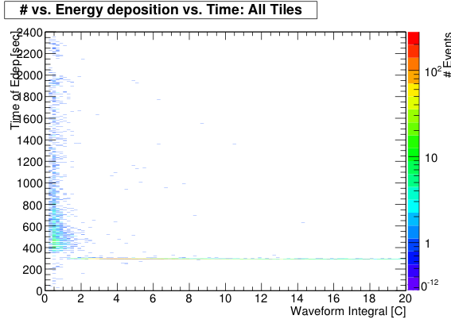
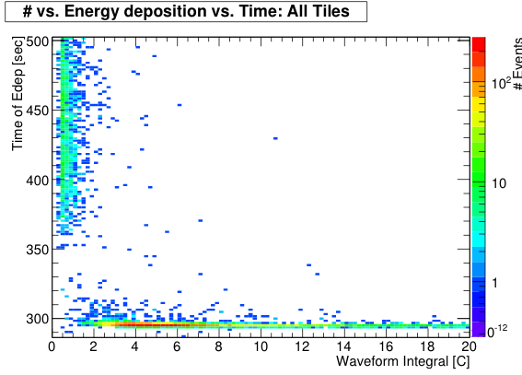
T3B Framework: Analysis
EDep vs. Time
High energy depositions are mostly within first 10-20ns
Few late Edeps above 1MIP, mostly below 0.5MIP
Afterpulsing and Saturation correction will have influence
1 MIP

