Slide 1
ILC MDI IR Cavern Layout Studies
John Amann
SLAC ILC MDI Group
1/13/11

Slide 2
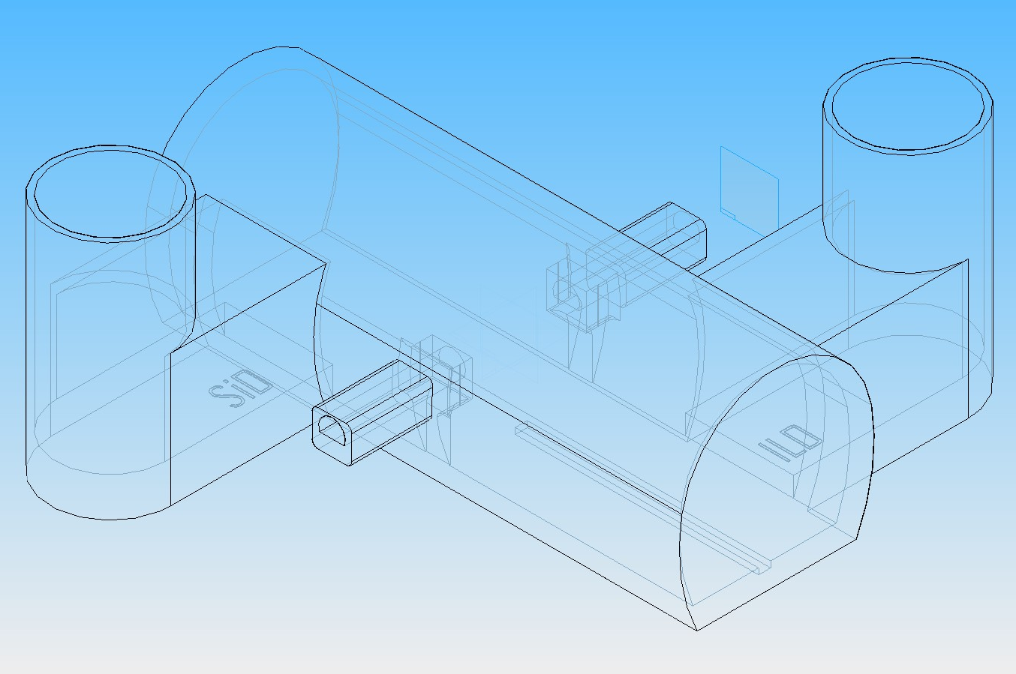
CERN Site IR Cavern

Slide 3
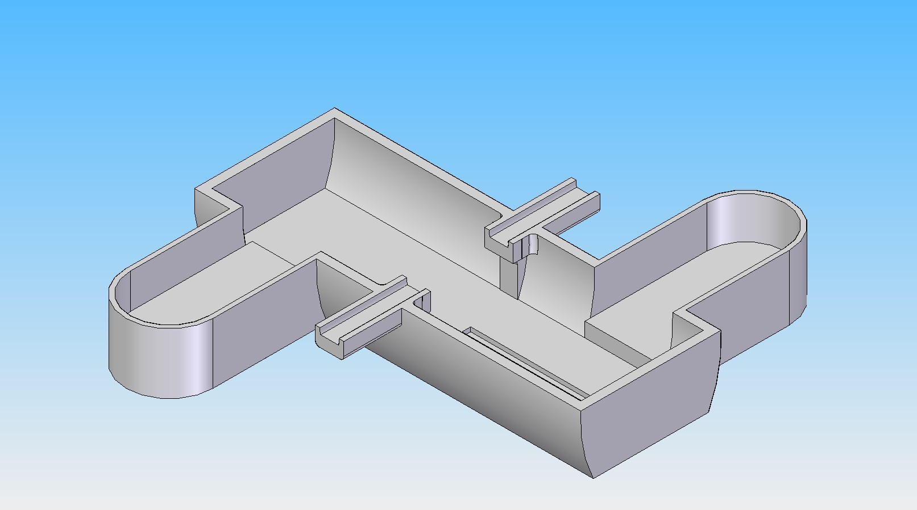
IR Cutaway Partial Ledges

Slide 4
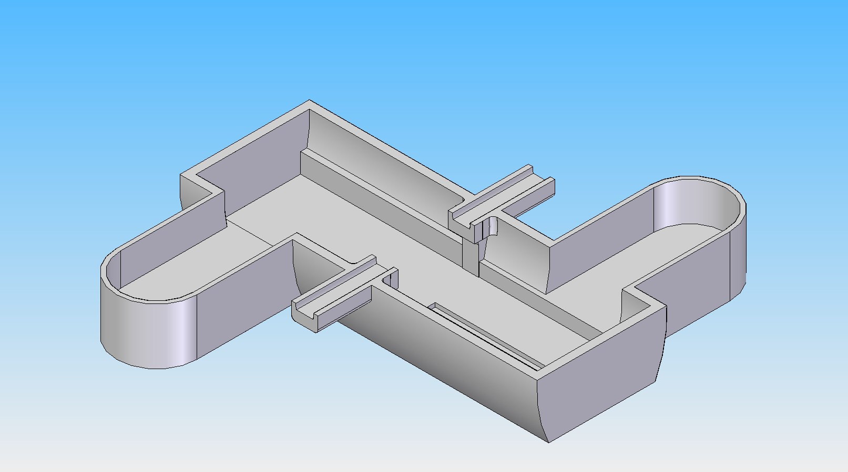
IR Cutaway Full Ledges

Slide 5
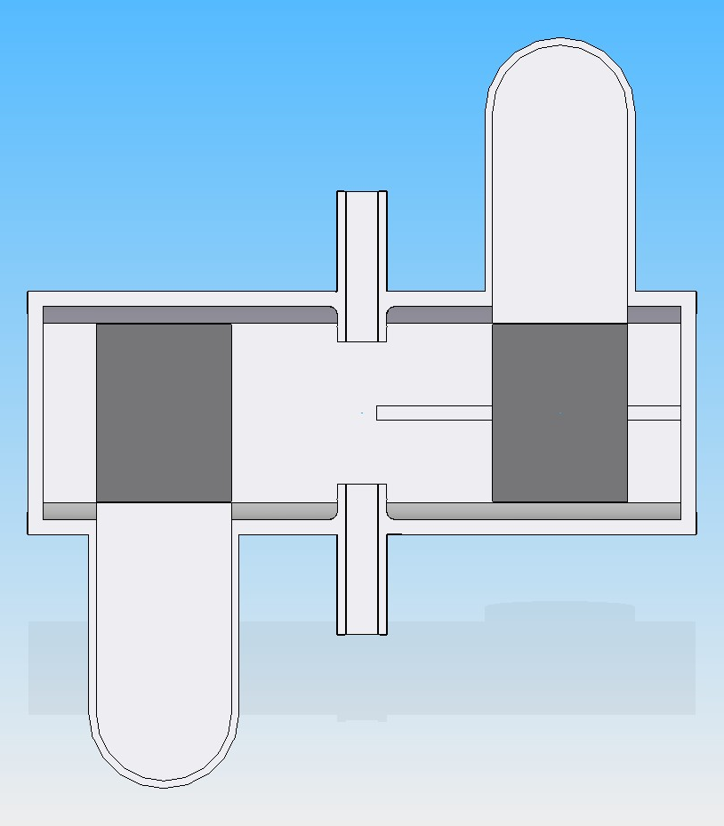
IR Cutaway Partial Ledges Platforms Only

Slide 6
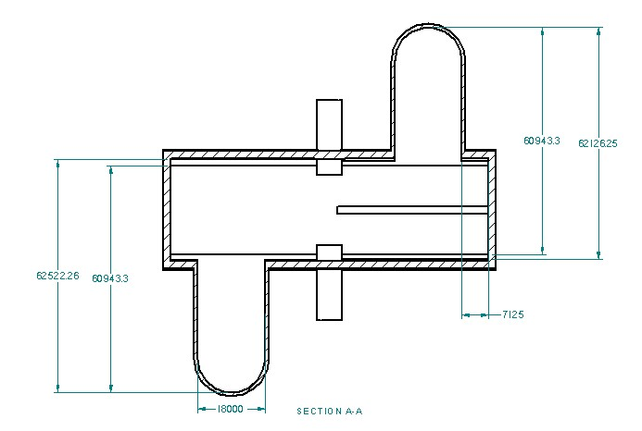
Assembly Area Dimensions

Slide 7
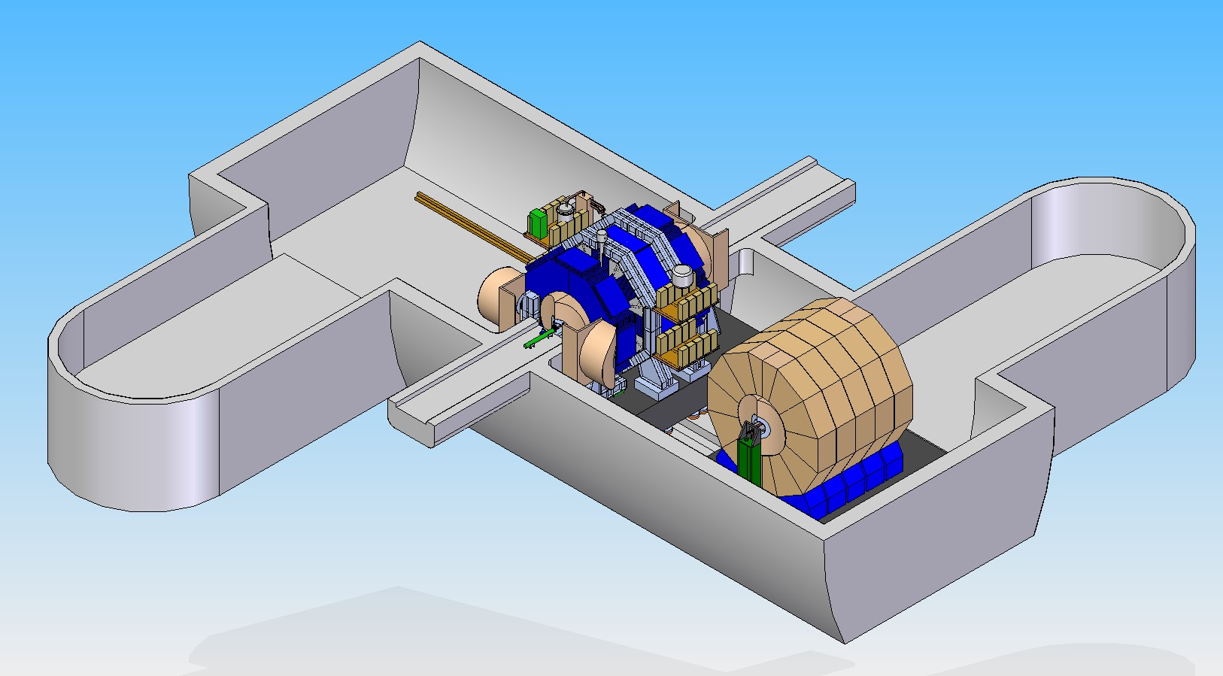
SiD Beamline - ILD Parked

Slide 8
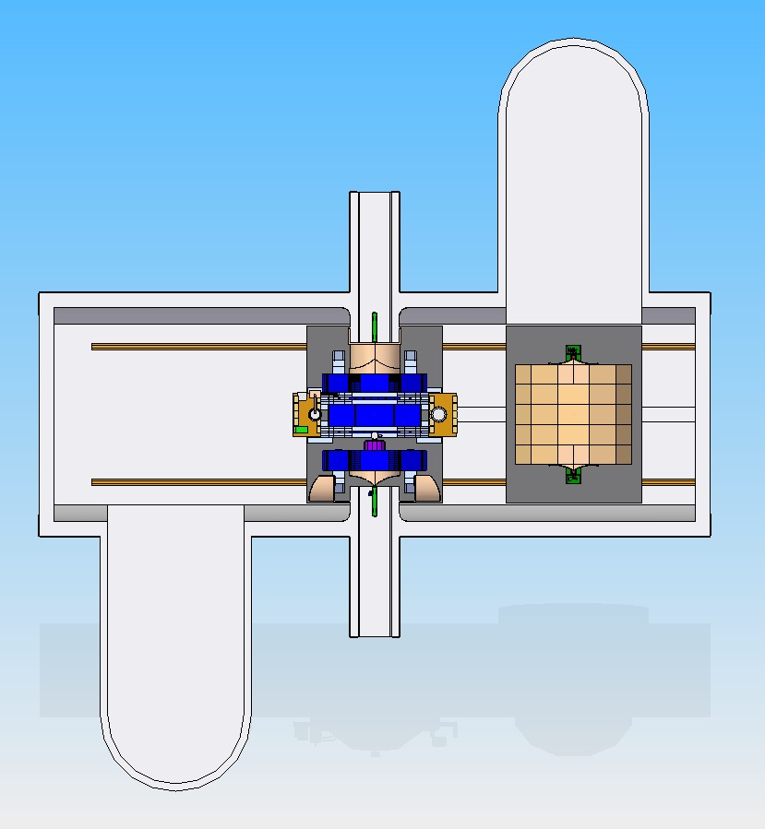
SiD Beamline - ILD Parked

Slide 9
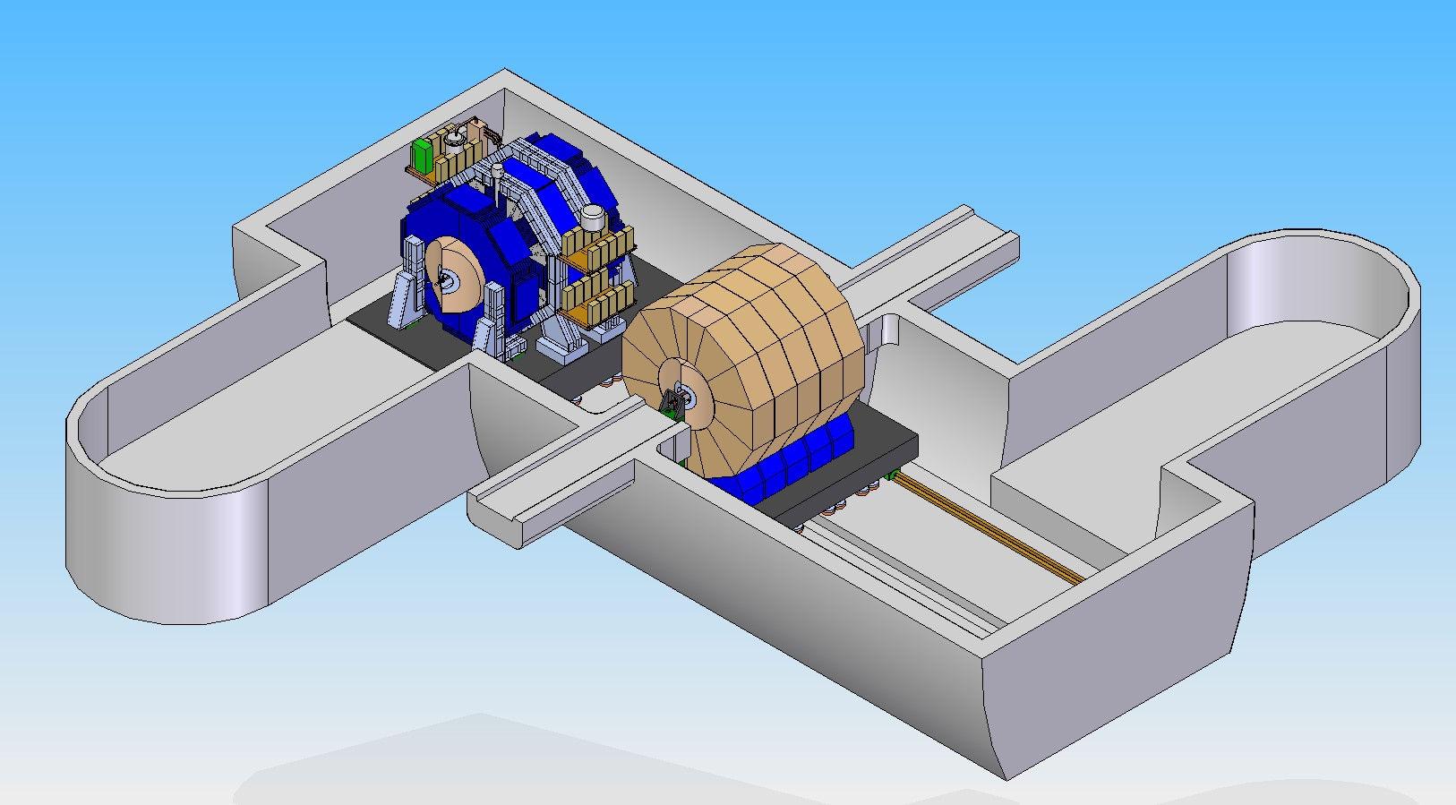
SiD Parked - ILD Beamline

Slide 10
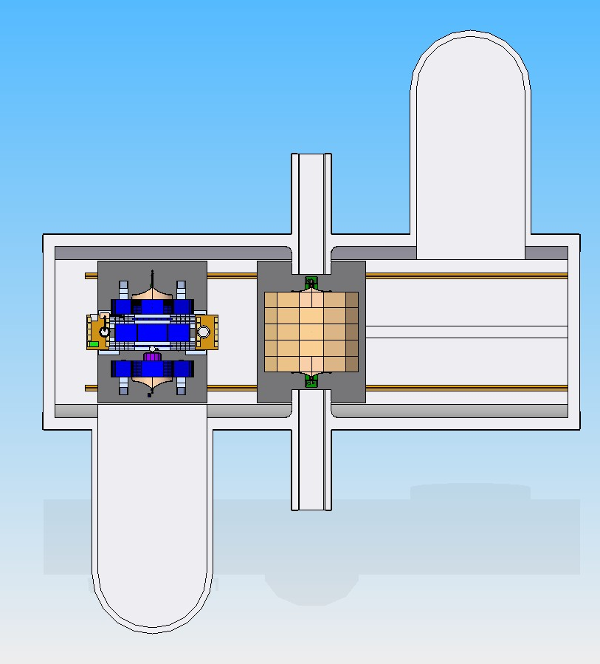
SiD Parked - ILD Beamline

Slide 11
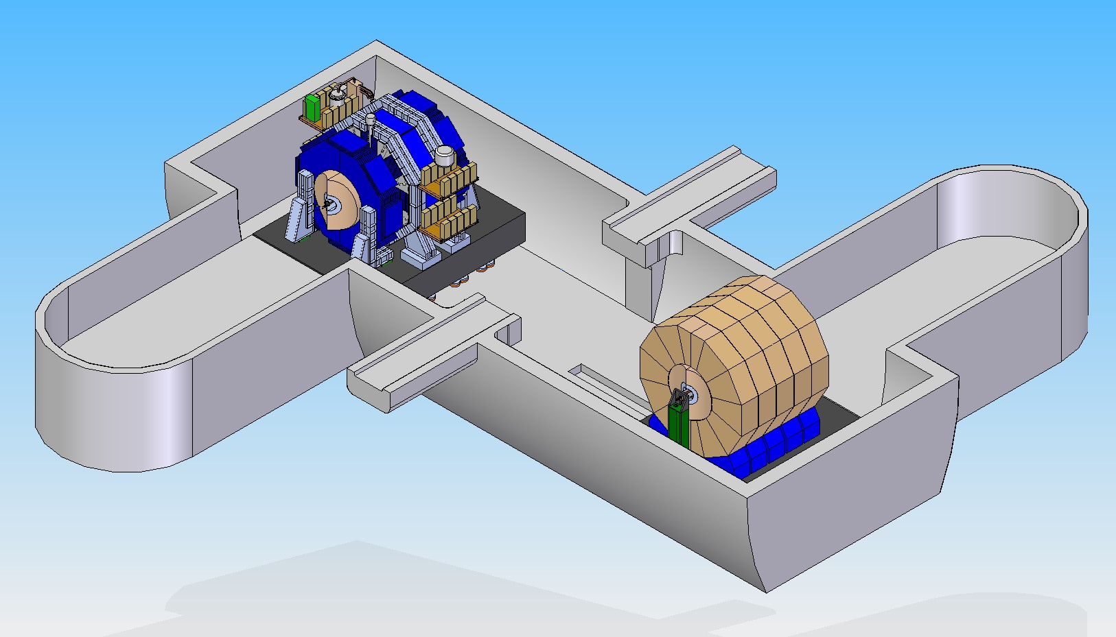
SiD Parked - ILD Parked

Slide 12
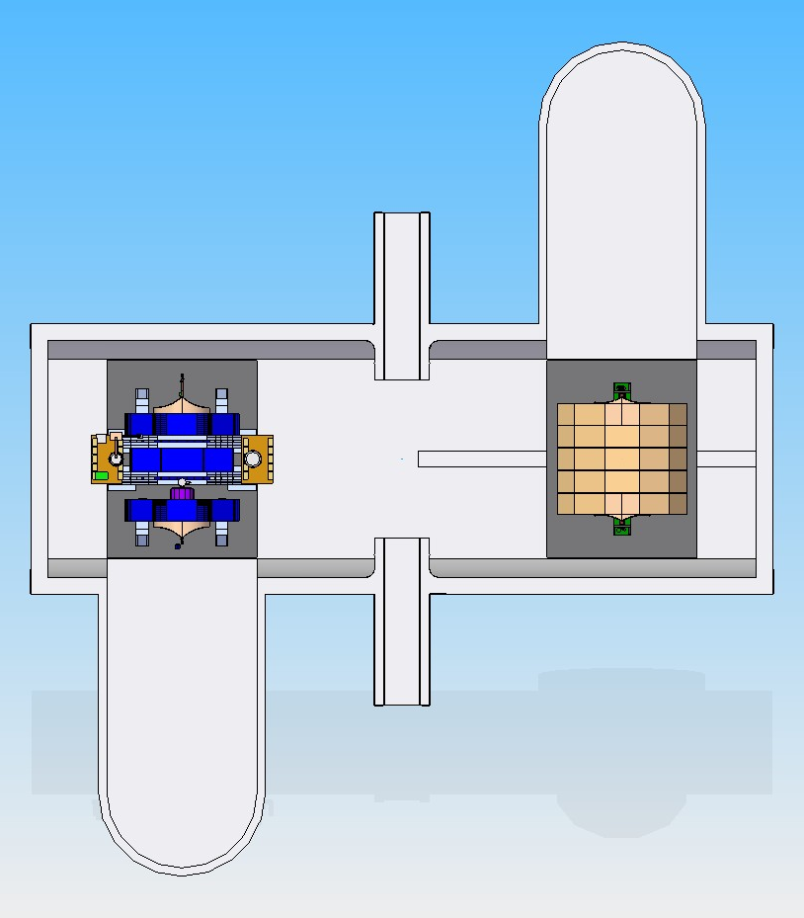
SiD Parked - ILD Parked

Slide 13
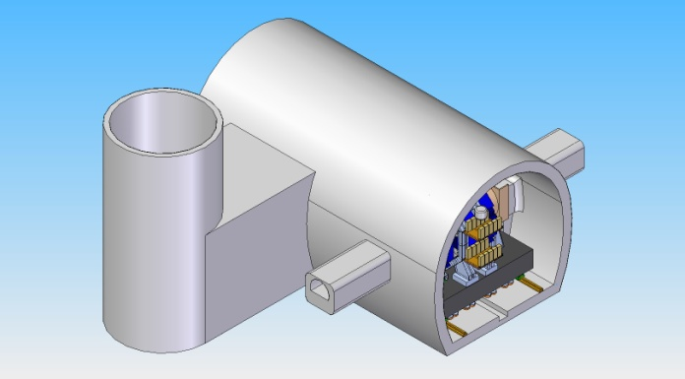
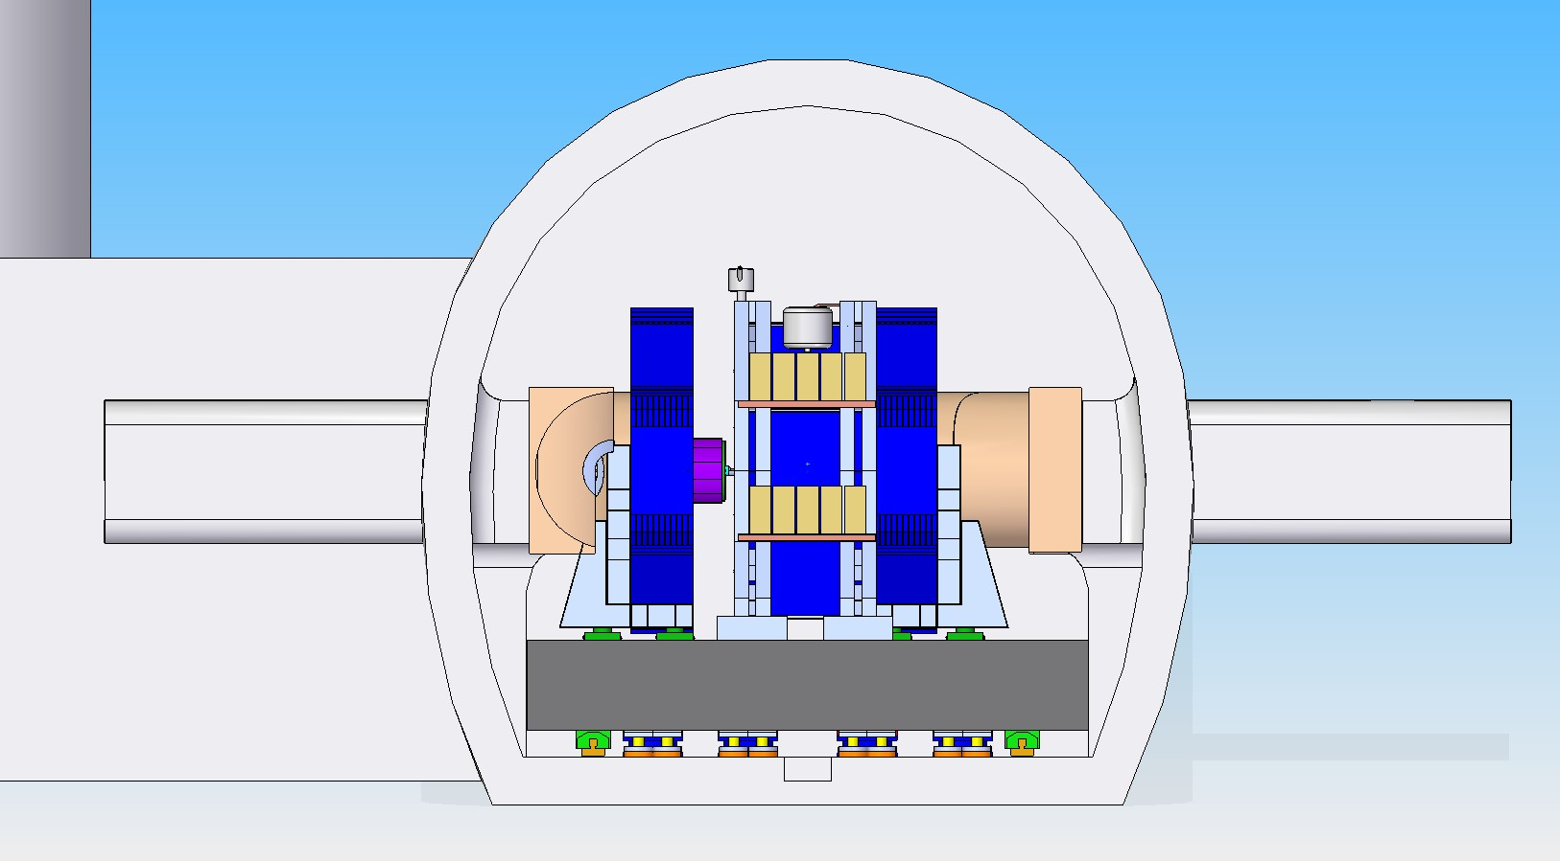
SiD Section View

Slide 14
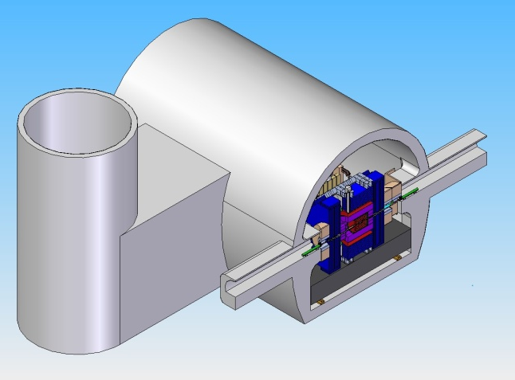
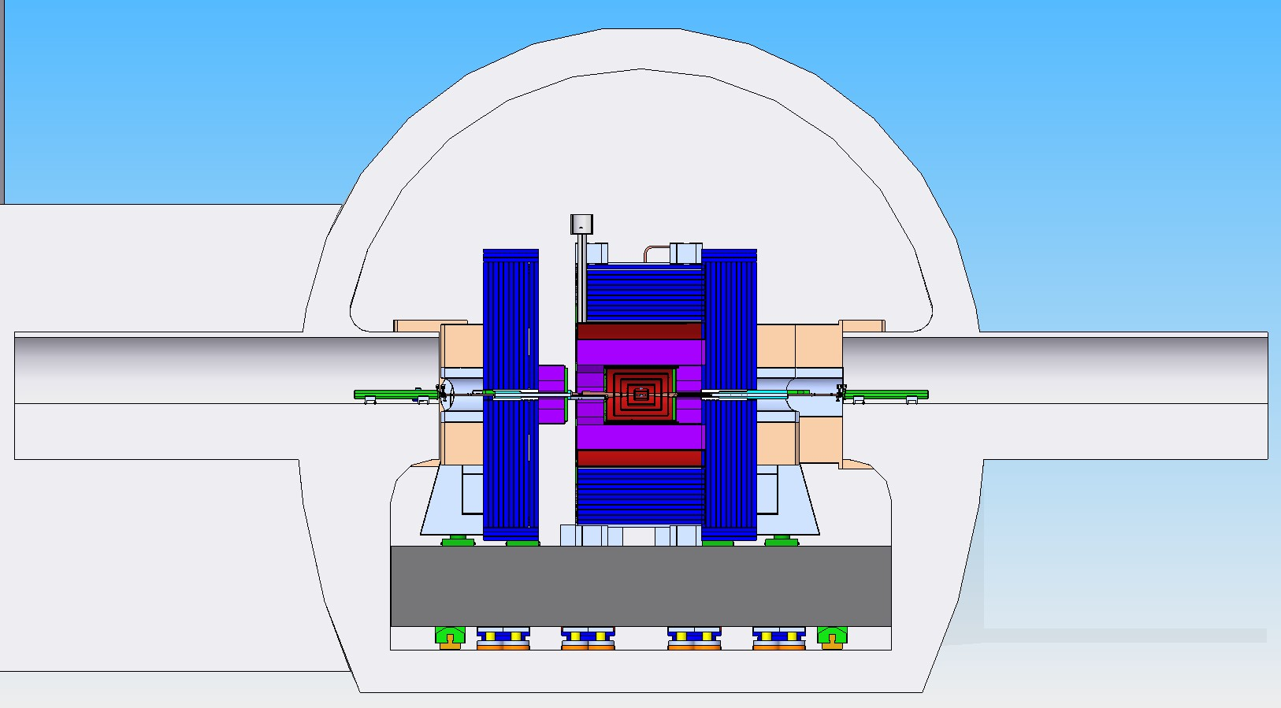
SiD Section View

