Slide 1
Simulations of Random Vibrations of large reinforced concrete structure.
Development of models: FEM and Analytical
Benchmark with existing, measurable structures
Extrapolation to the ILC case : THE PLATFORM

Slide 2
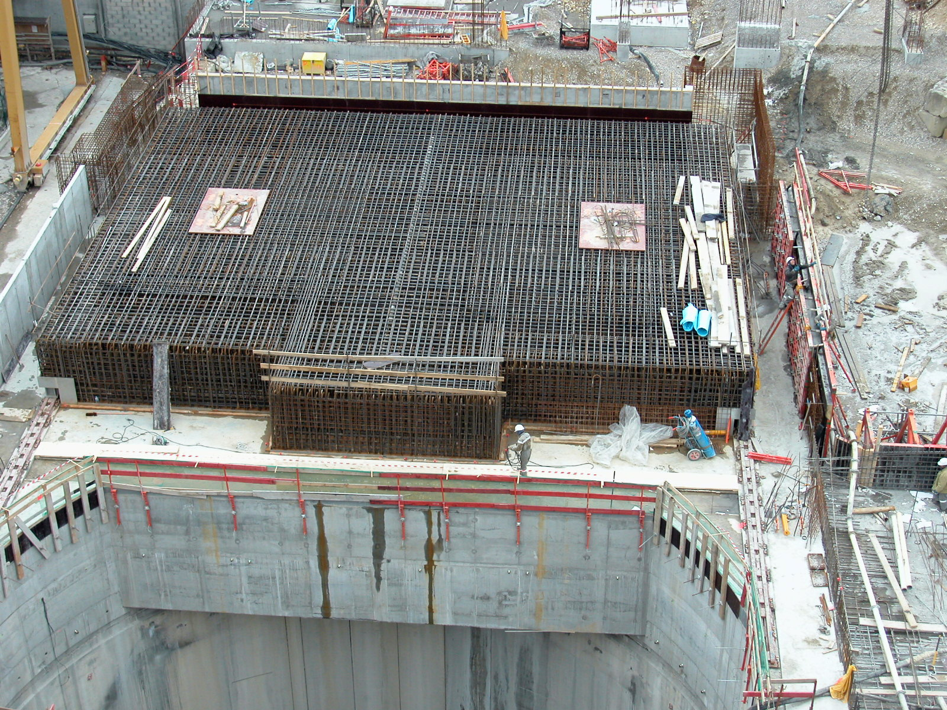
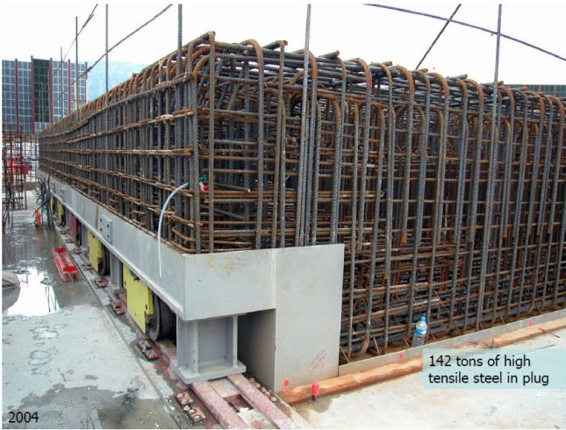
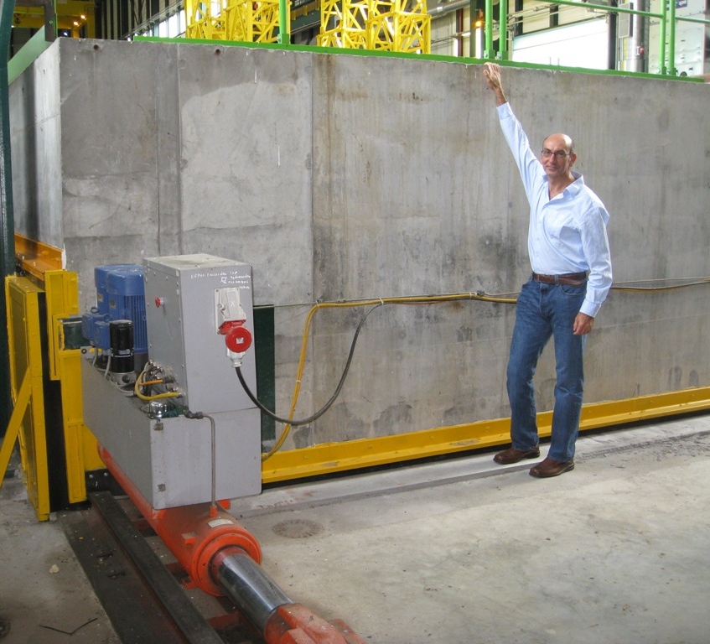
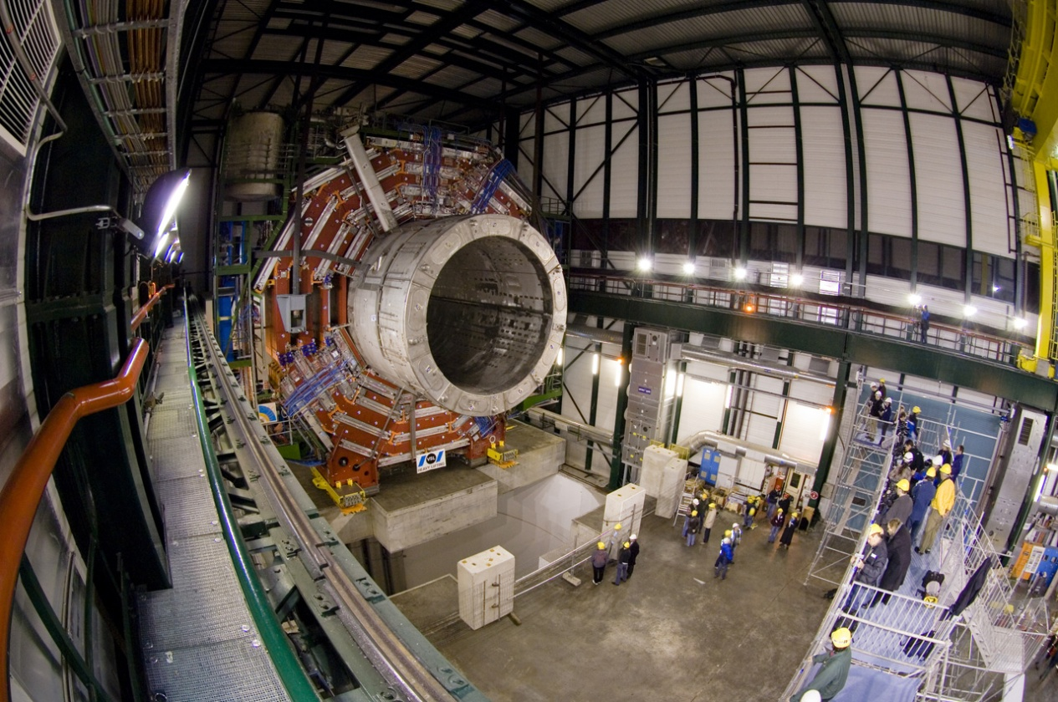
The CMS Plug
2
Notes:
2

Slide 3
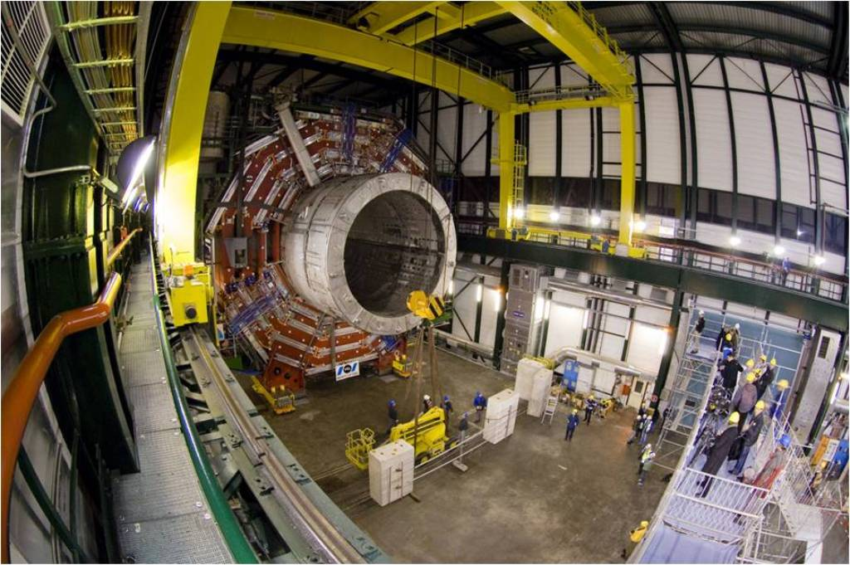
Benchmark the FEA code: The CMS platform
The radiation cover shield of the PX56 shaft at the LHC Point 5 is has very close dimensions to the push-pull platform.
It is an ideal benchmark
Platform Closed
Platform half open
M.Oriunno, IWLC10 – Geneva, Oct.2010
3
Notes:
3
3

Slide 4
(CERN EDMS Document N.1099646)

Slide 5
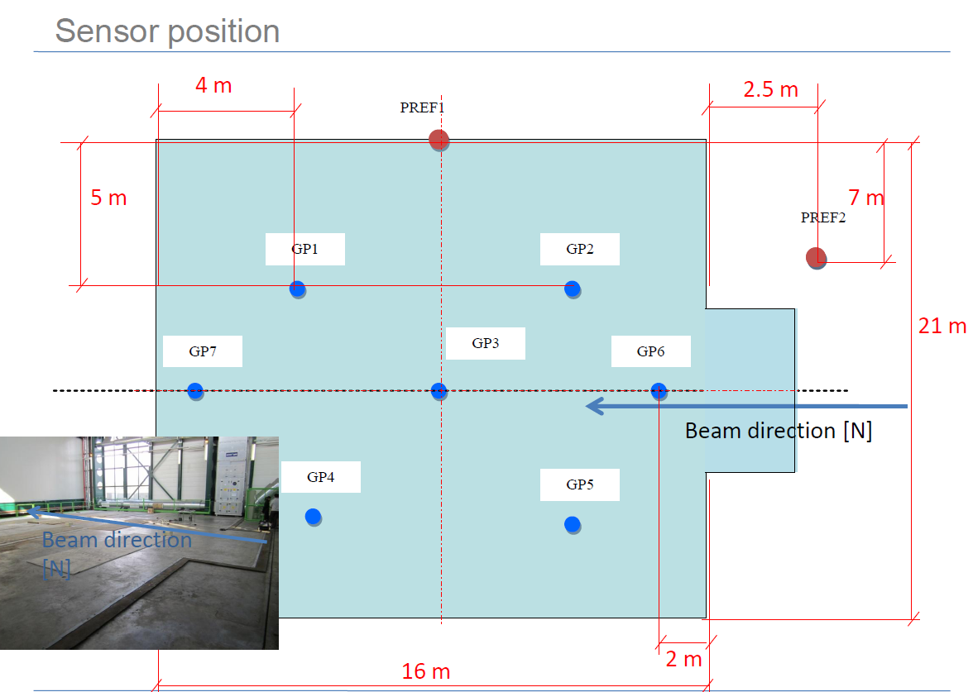

Slide 6
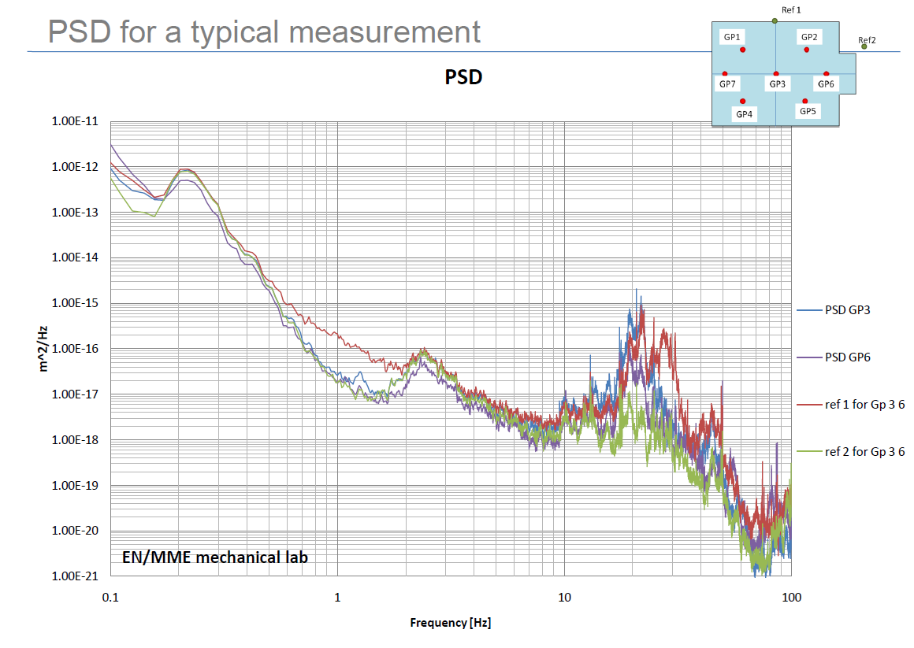

Slide 9
Random vibrations with FEM
Full 3D mesh in conjuction with the Random Vibration Solver Module:
Huge model with ~300k elements,
Very Long Computing time ~ 12 hours
Not suitable for parametric study, i.e. changes of geometry or material properties
Solver as Black Box, hard to have full control of the algorithm
Harmonic Analysis -> Determination of the Transfer Functions
Modal analysis of the full 3D mesh, still very long, computing time waste on several uniteresting local modes
Simplified 3D or 2D model representing the master degree of interest: fast, reliable, flexible. One need to know exactly which global mode are of interest.

Slide 10
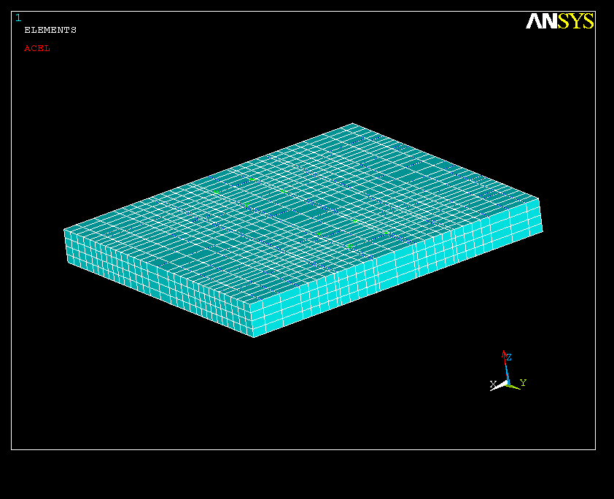
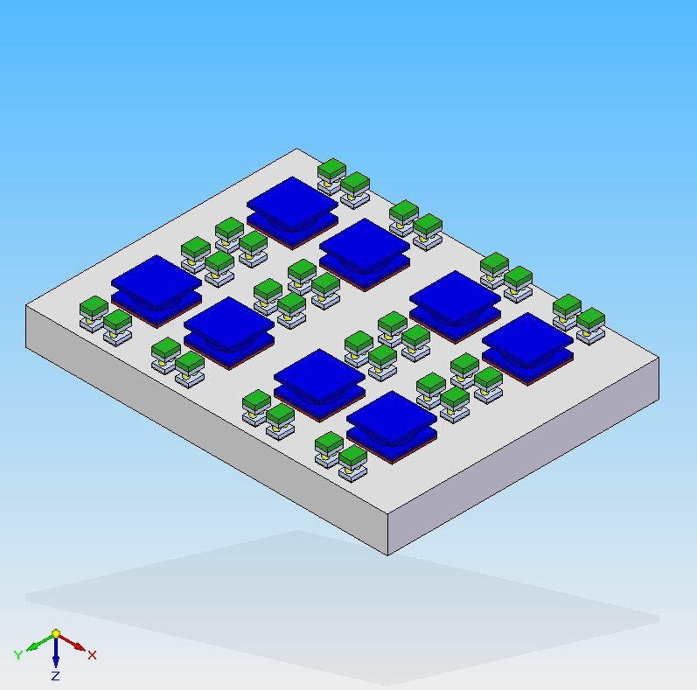
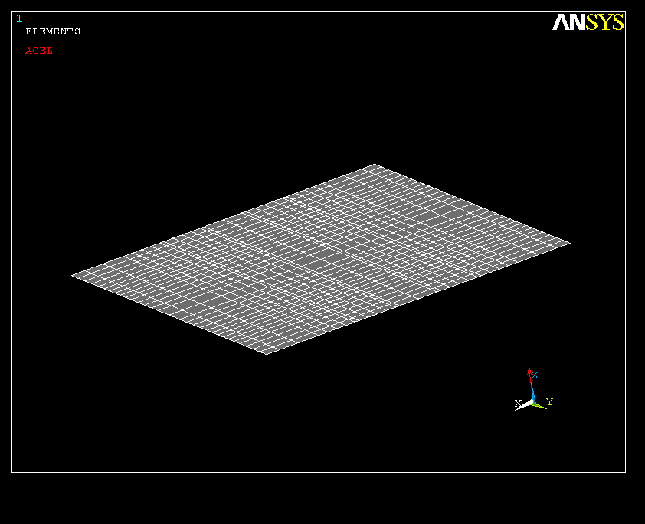
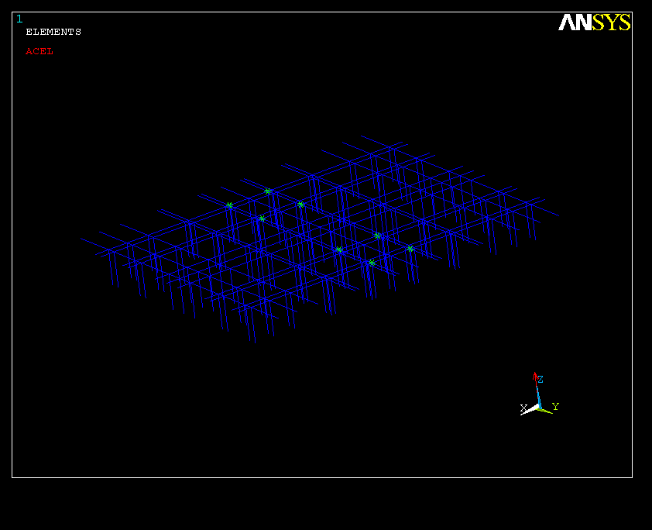
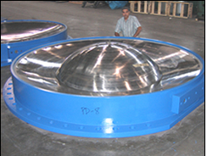
Total mass 1800 t
2 m
18 m
20 m
Reinforced concrete Slab
Four support lines for 4’000 tons each
Steel plate 30 mm at the bottom
Steel re-bars 16mm²
10kt Anti-seismic supports

Slide 11
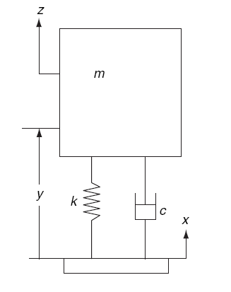
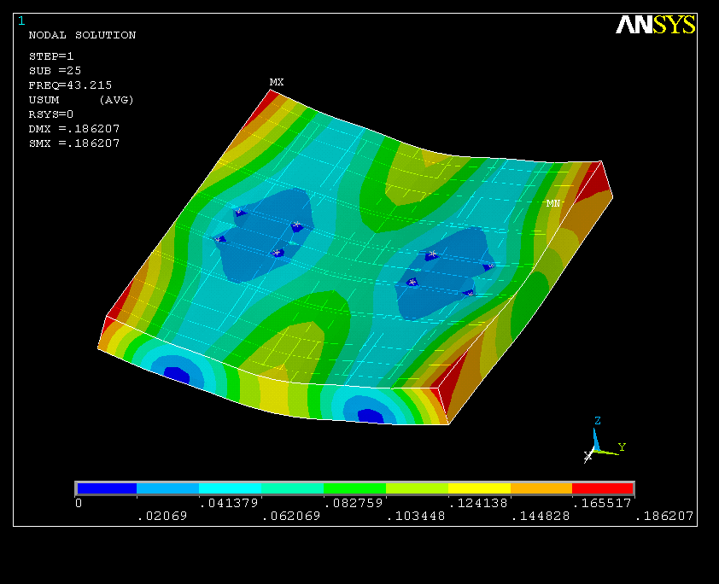
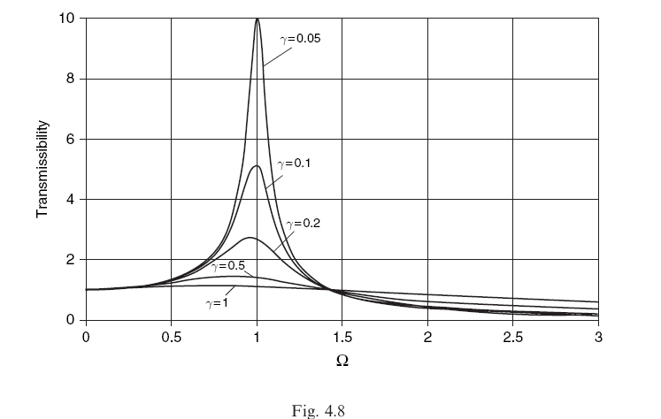
Random vibrations study
The Model requires the Ground Motion Spectrum P(f) and the Frequency Response Function H(f) of the structure
2
=
X
Ground Motion PSD
Frequency Response Function
FEA
Analytically
M.Oriunno, IWLC10 – Geneva, Oct.2010
11

Slide 12
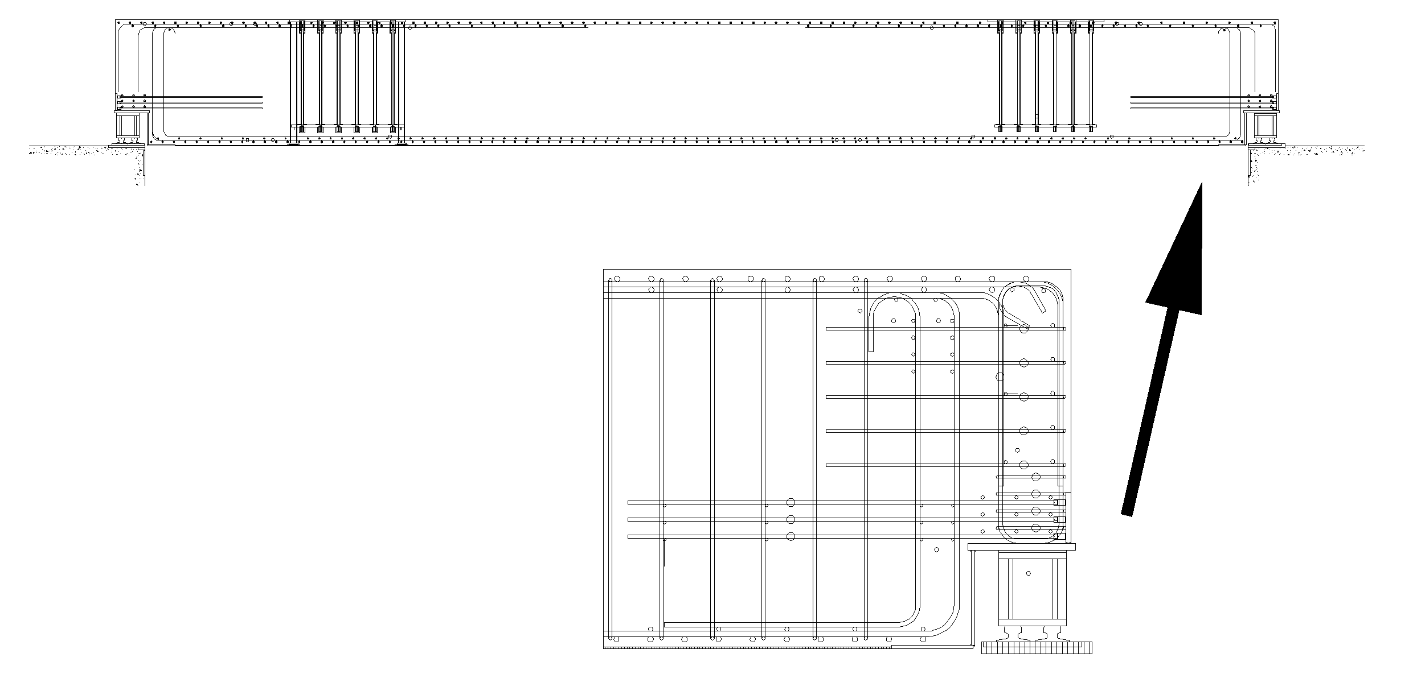
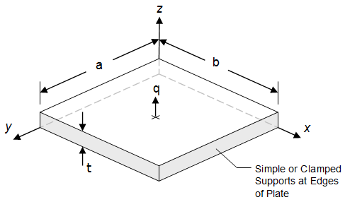
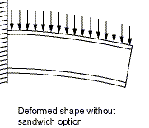
20.5 m
2200
CMS Platform (as built)
Detail of the support
Iron re-bars (equivalent th. 25 mm)
Concrete, 2150 mm
Iron re-bars (equivalent th. 25 mm)
Total th. 2.2 m

Slide 13
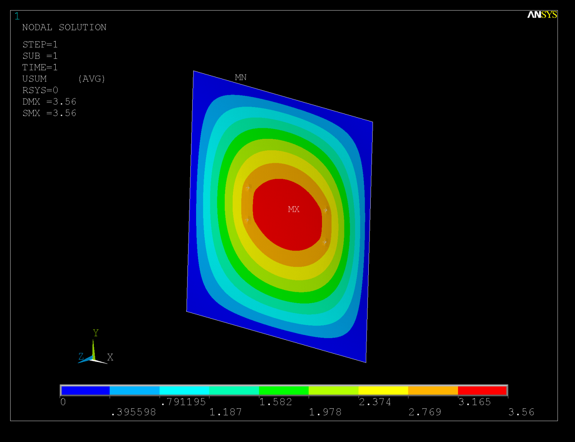
Comparison with Static test performed on the platform
Dummy load = 2500 tons,
Weight of the platform = 1780 tons
Max sag at the center = 3.5 mm
N.B. = Platform Simply supported on the edges

Slide 14
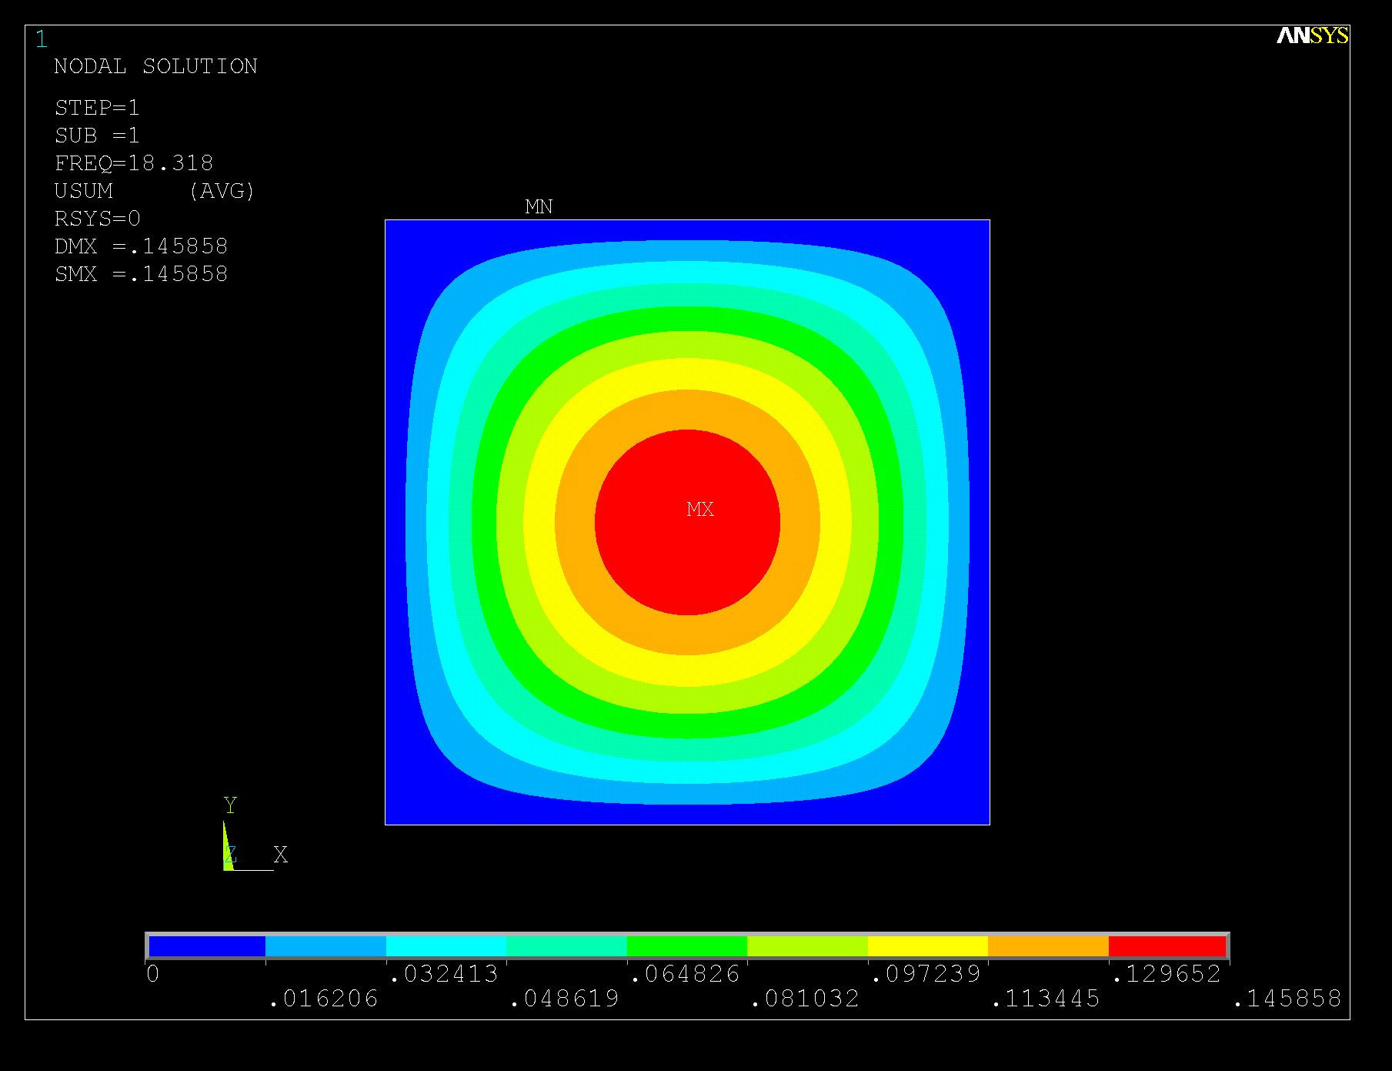
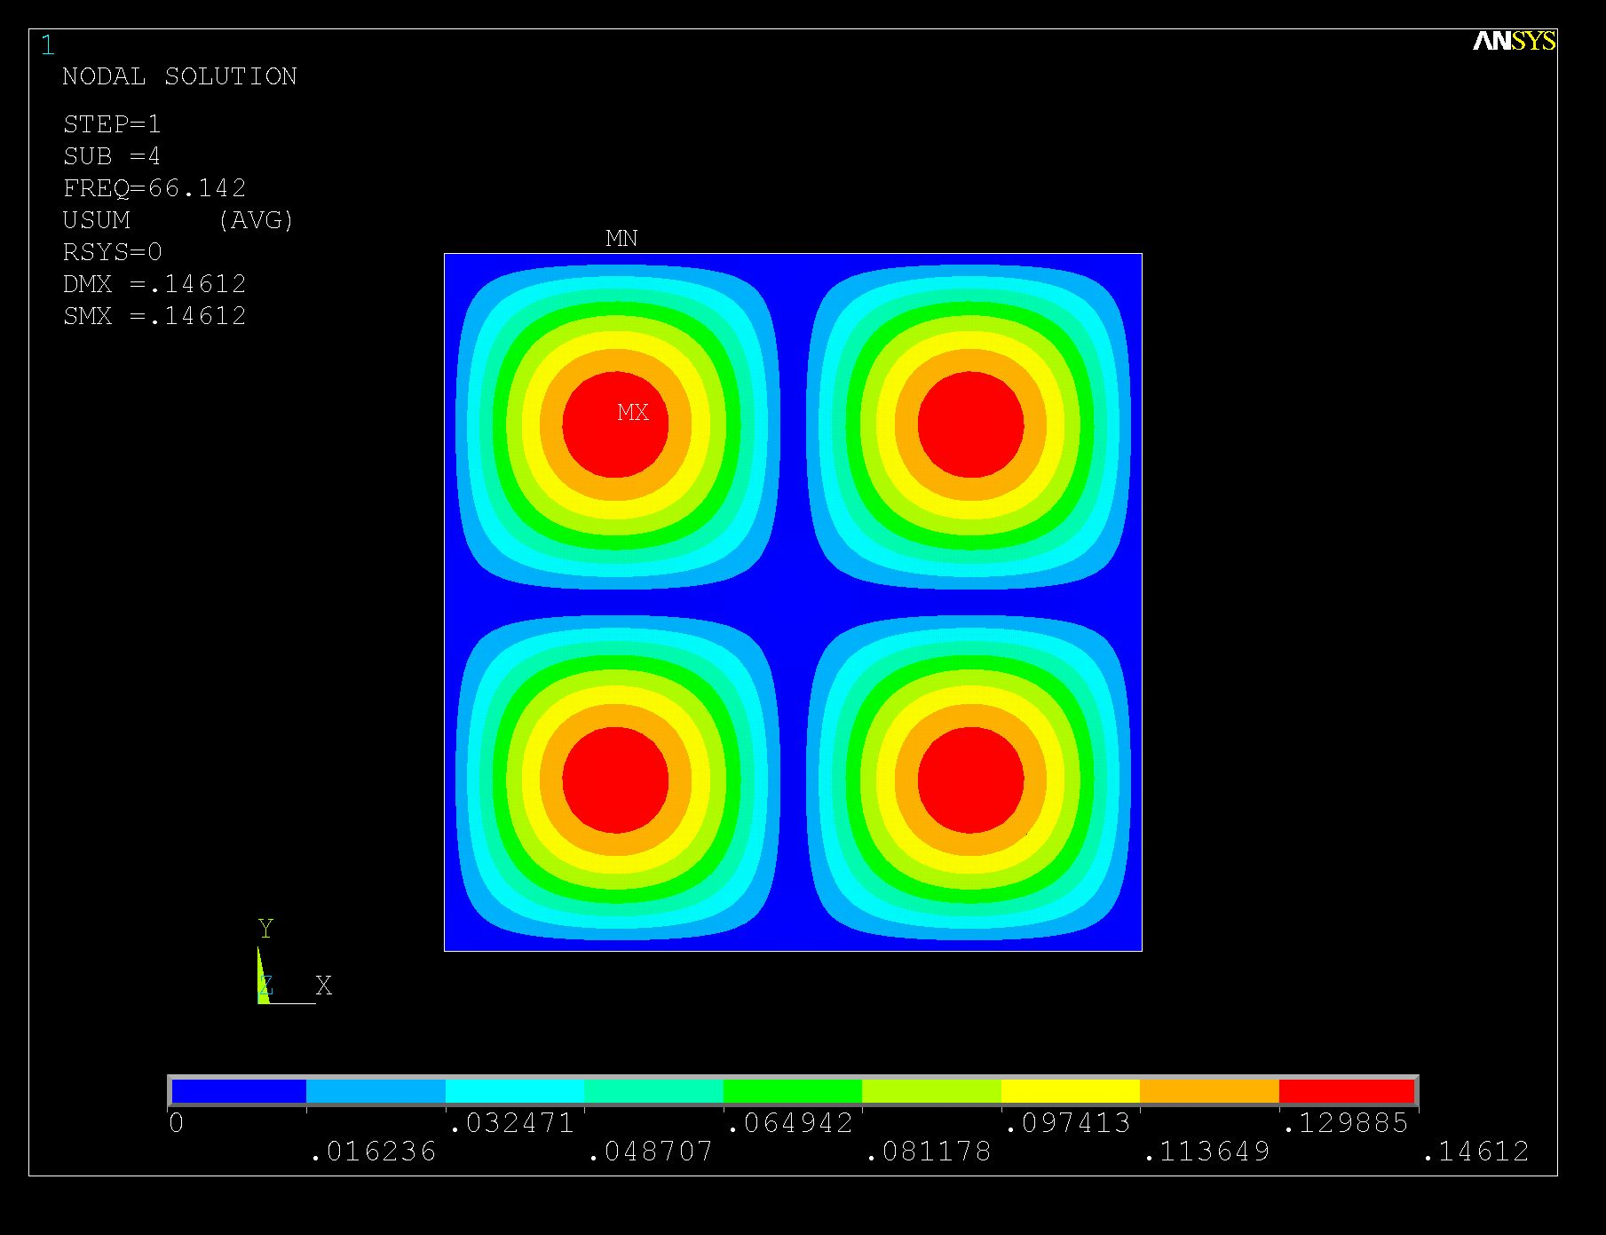
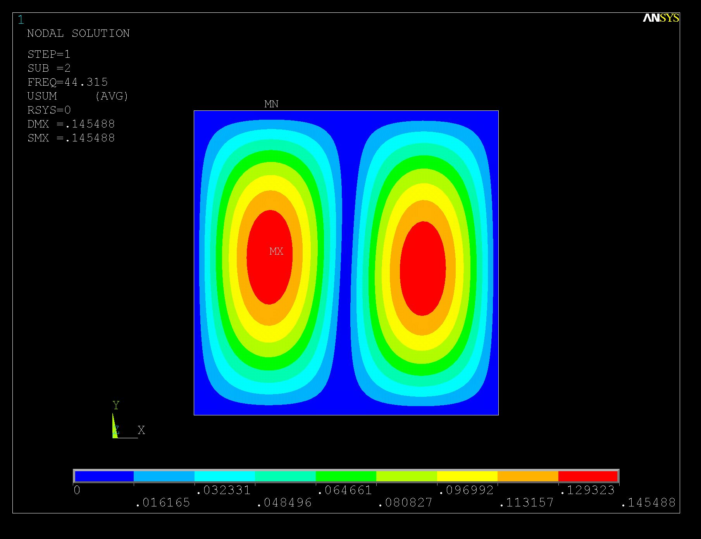
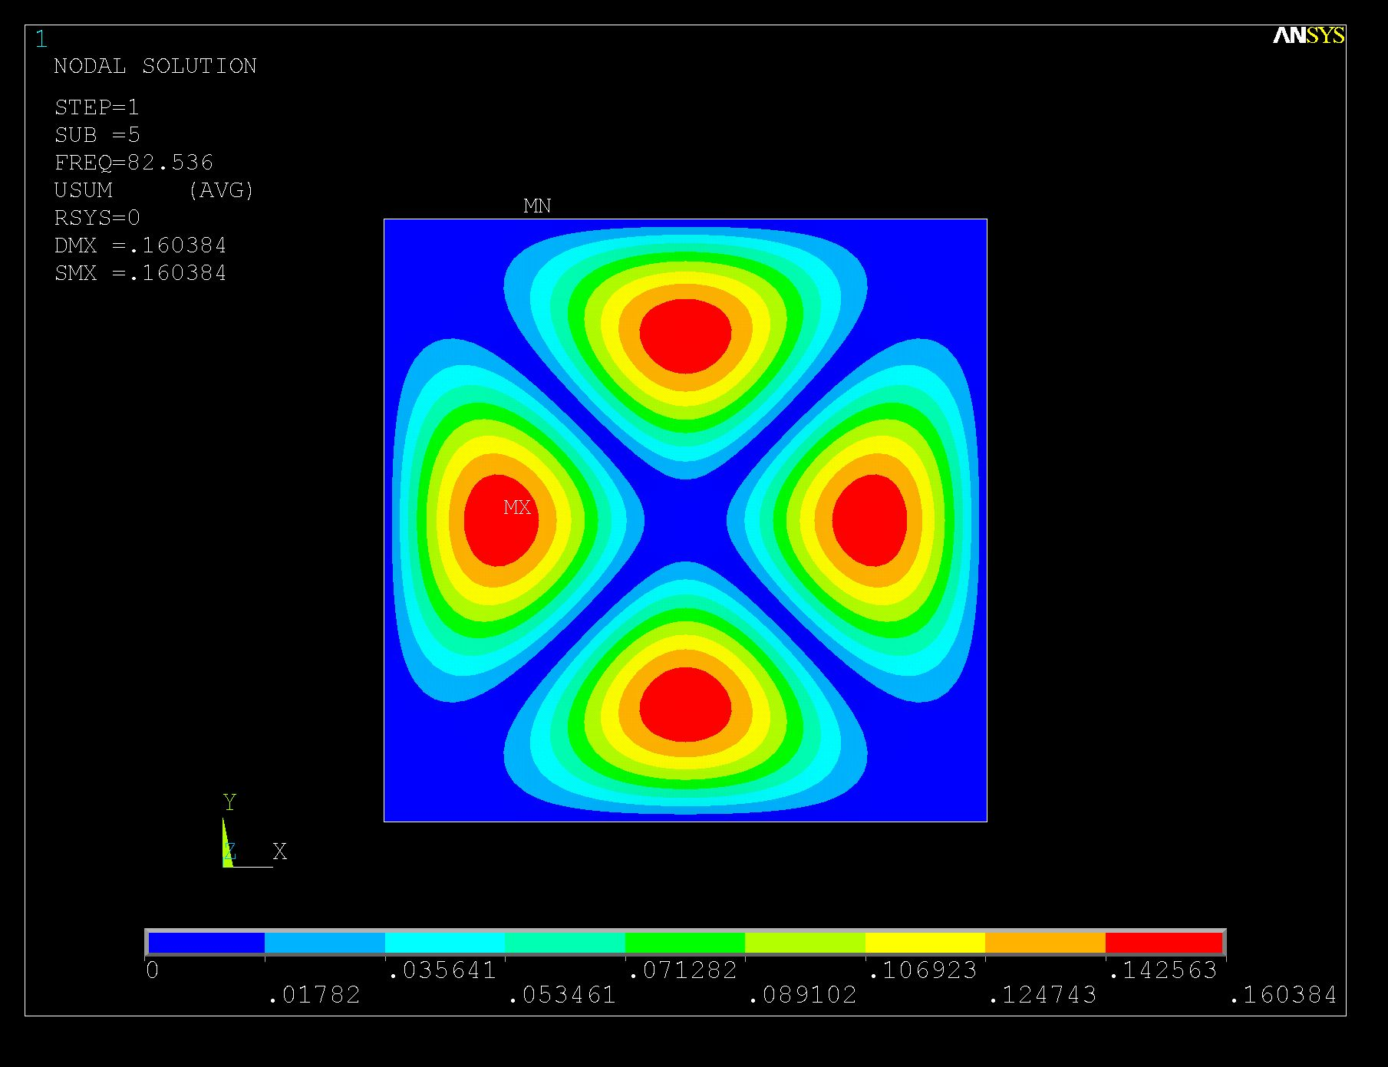
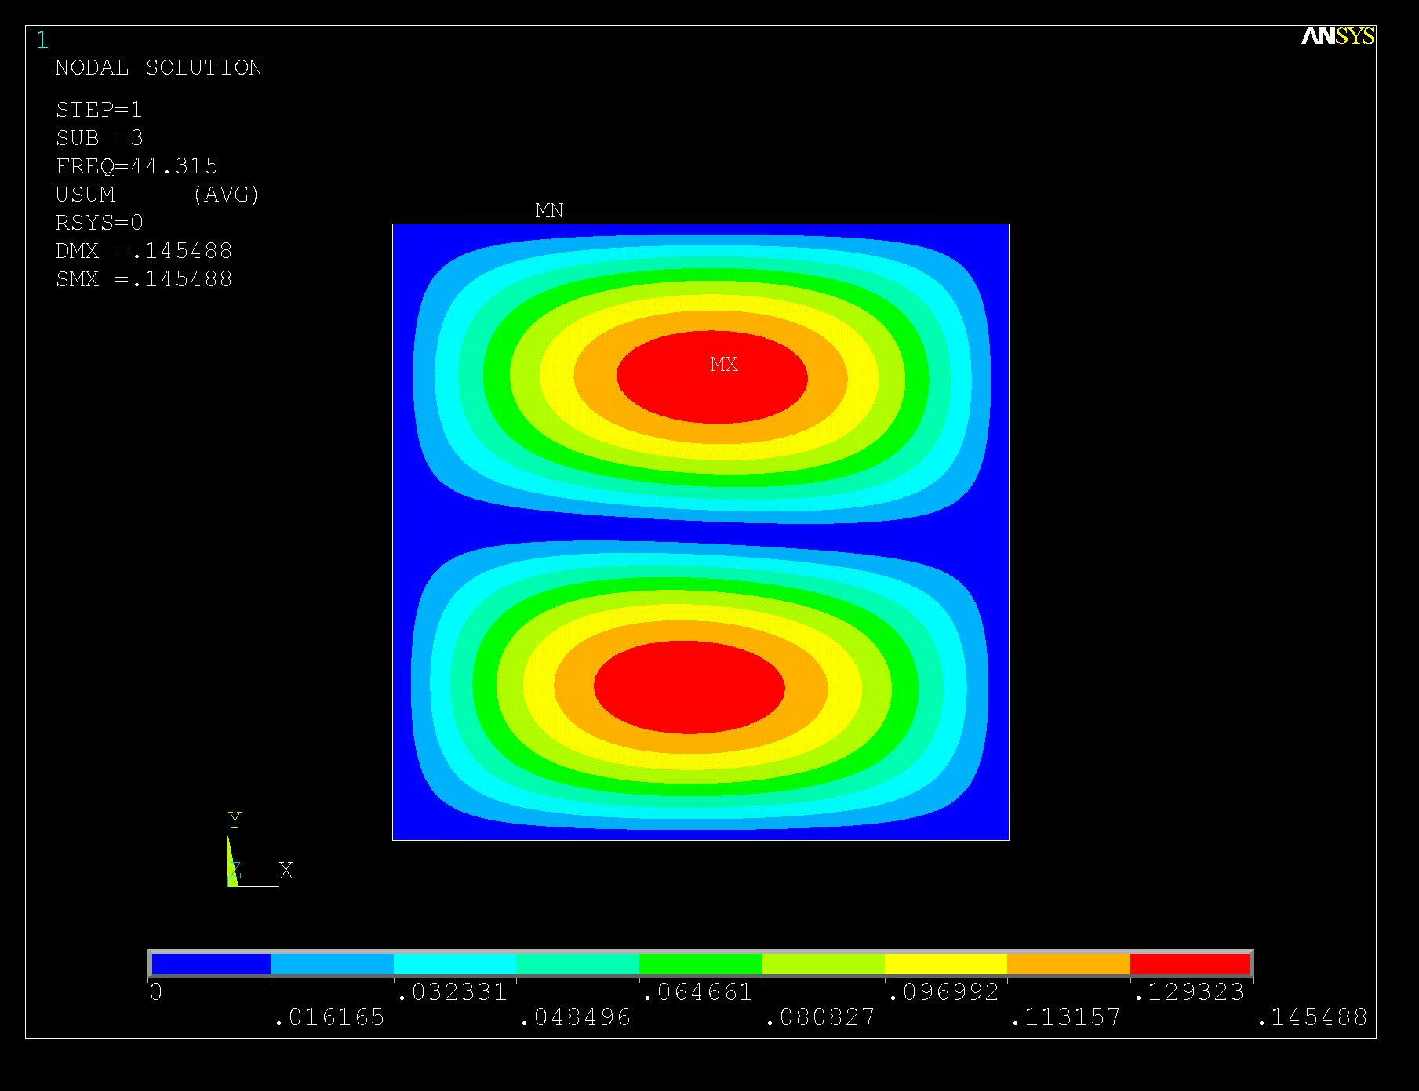
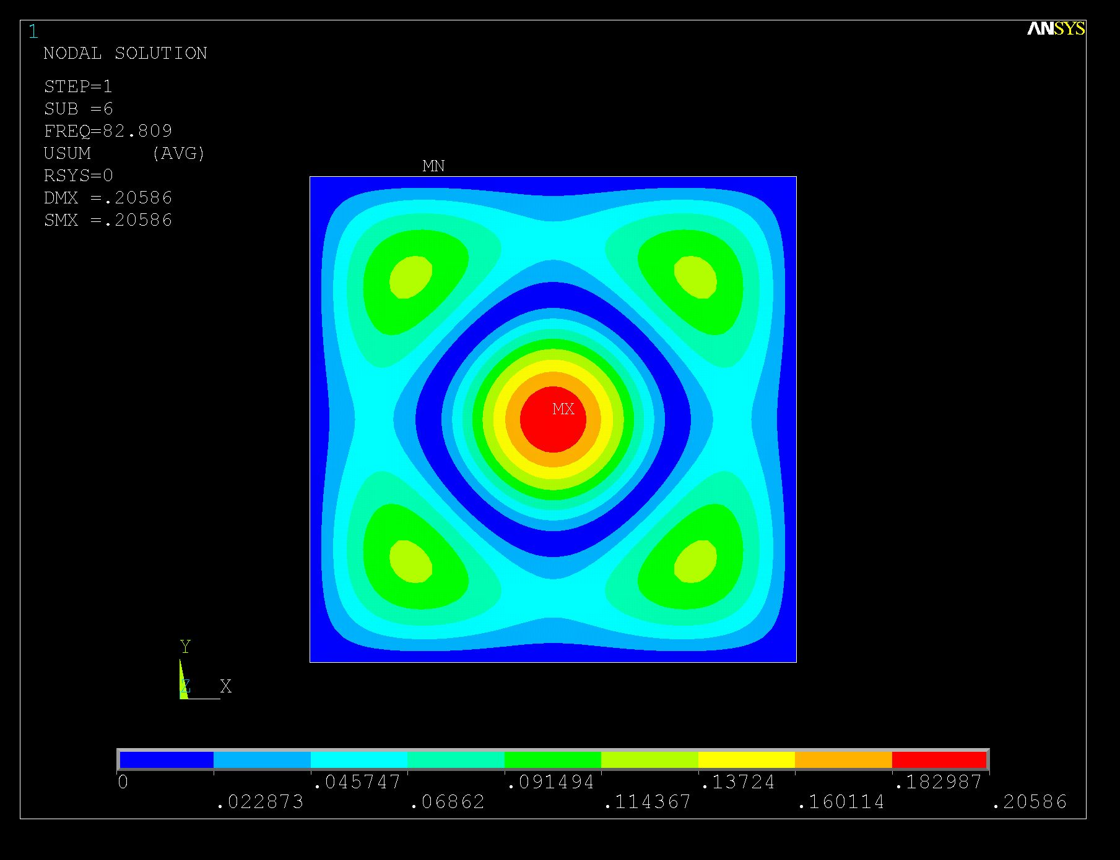
Mode 1
Mode 4
Mode FREQ
1 18.318
2 44.315
3 44.315
4 66.142
5 82.536
6 82.809
7 89.630
8 89.630
9 100.68
10 100.68
Mode 2
Mode 5
Mode 3
Mode 6

Slide 15
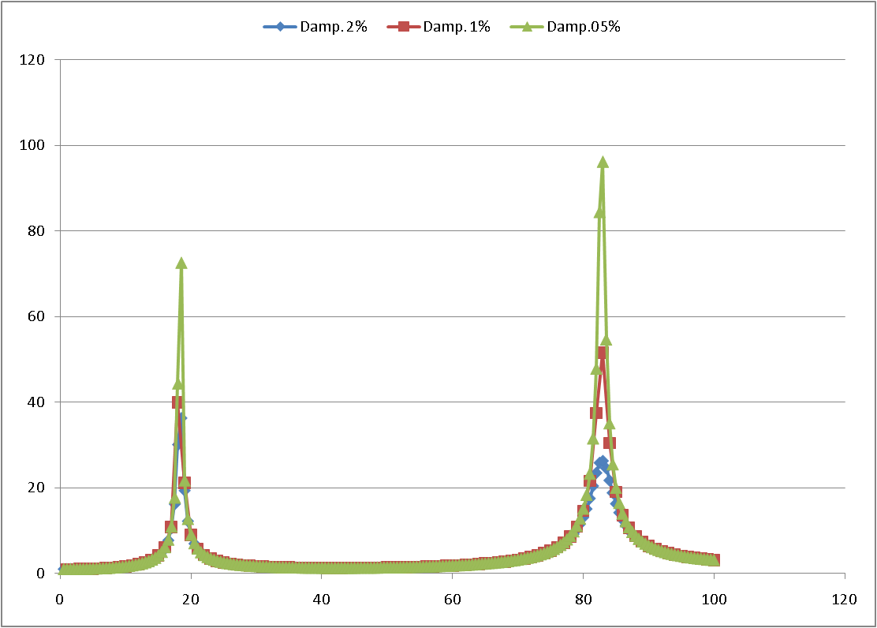
Middle Point (Gephone N.3) Transfer Function

Slide 16
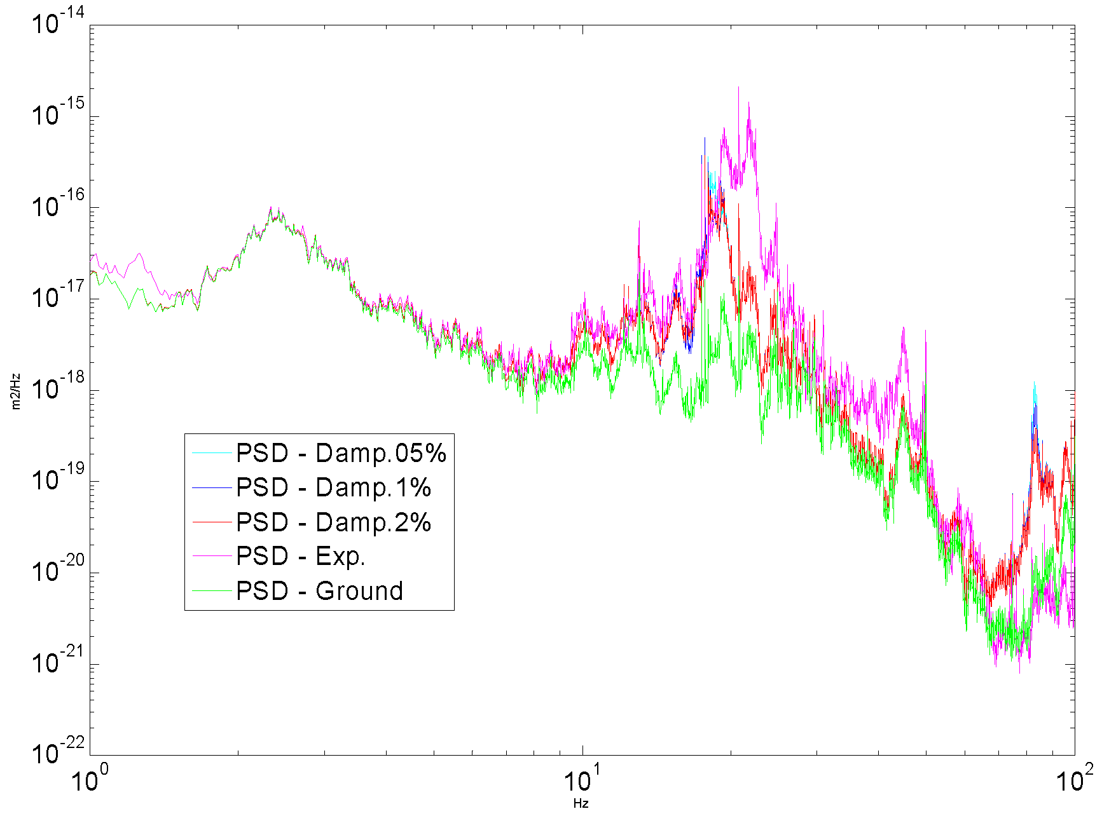
Simulations vs. Measured PSD (Platform middle Point)
Peak 44 Hz
(Geoph. Offset from Platfom center ? )
Peak 89 Hz
Resonance at ~18 Hz

Slide 17
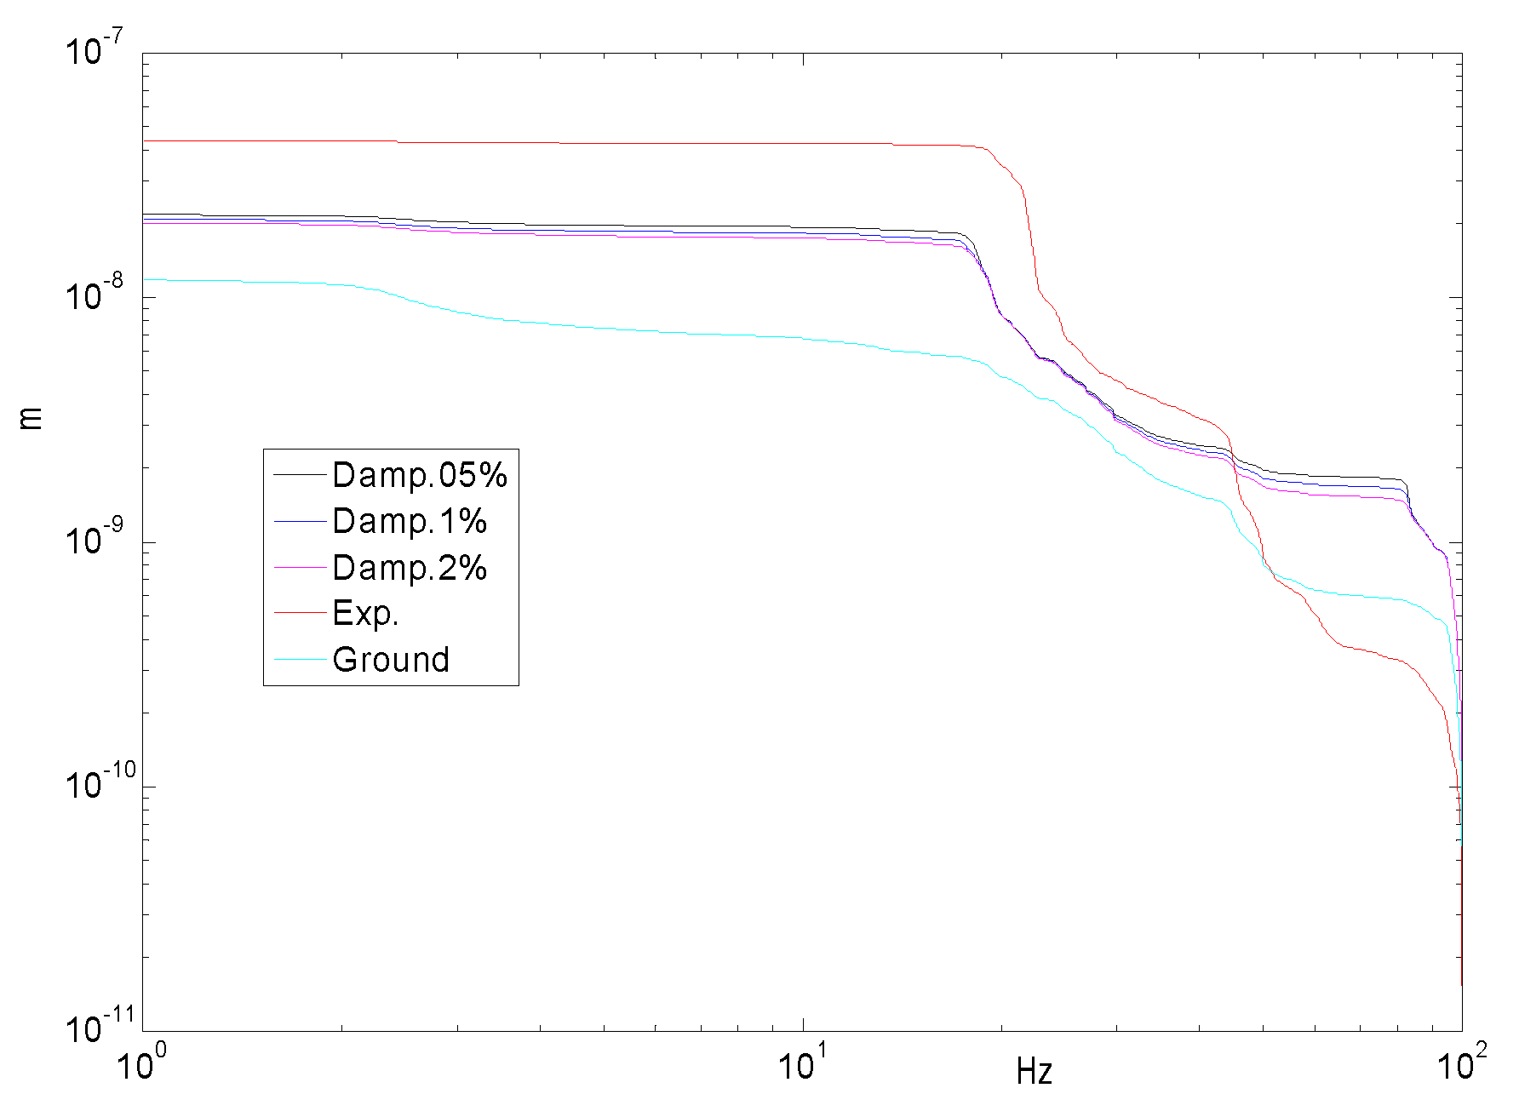
Integrated Displacement (r.m.s.)

