Slide 1
Dynamic Loss Measurement
 | C-4 | C-1 | A-3 | A-2 | A-2 | 4 C Cavities | 4 A Cavities | 4 C Cavities | 4 A Cavities | 7 Cavities | 7 Cavities
Date | Nov. 17 | Nov. 19 | Nov. 23 | Nov. 24 | Nov. 25 | Nov. 26 | Nov. 30 | Dec. 2 | Dec. 3 | Dec. 9 | Dec. 10
Gradient | 28 MV/m | 25.2 MV/m | 32.3 MV/m | 38 MV/m | 32 MV/m | 32 MV/m Detune | 32 MV/m Detune | 20 .0 MV/m | 26.9 MV/m | 25.4 MV/m | 20.4 MV/m
Dynamic Loss | 0.84 W | 1.44 W | 2.8 W | 4.8 W | 2.6 W |  |  | 2.7 W | 6.9 W | 9.6 W | 4.8 W
Detuned Loss | 0.09 W | 0.18 W | 0.7 W | 1.8 W | 1.2 W | 0.5 W | 4.6 W | 0.2 W | 2.5 W | 2.6 W | 1.6 W
Dynamic Loss at Cavity | 0.75W | 1.26 W | 2.0 W | 2.9 W | 1.3 W |  |  | 2.5 W | 4.4 W | 7.0 W | 3.2 W
Q₀ | 8.8E9 | 4.3E9 | 4.3E9 | 4.2E9 | 6.5E9
 |  |  |  |  |  |  |  | C1=22.2 C2=18.9 C3=14.9 C4=24.3 | A1=15.8 A2=37.6 A3=32.9 A4=21.4 | C1=25.2 C2=NA C3=17.6 C4=28.8 A1=15.3 A2=37.4 A3=32.4 A4=20.9 | C1=20.1 C2=NA C3=14.1 C4=23.0 A1=12.3 A2=30.4 A3=26.0 A4=16.7

Slide 2
Measured Q₀ value
  C-4 (Z109): Q₀ =8.8E9 @ 28 MV/m
  C-1 (AES004): Q₀ =4.3E9 @ 25.2 MV/m
  A-3 (MHI07): Q₀ =4.3E9 @ 32.3 MV/m
  A-2 (MHI06): Q₀ =4.2E9 @ 38 MV/m
  A-2 (MHI06): Q₀ =6.5E9 @ 32 MV/m
Detuned heat loss (four cavities)
  C1, C2, C3, C4: 0.5 W @ 32 MV/m
  A1, A2, A3, A4: 4.6 W @ 32 MV/m
[ Input coupler requirement in RDR (for one RF unit) ]
  Static loss = 1.6W, Dynamic loss = 0.5 W

Slide 3
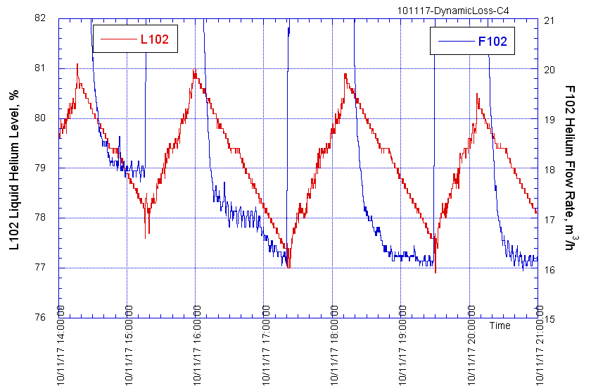
C4 Dynamic Loss Measurement
28MV/m
No RF
Static Loss Meas.
Detuned
28MV/m
Static Loss Meas.
Static Loss Meas.

Slide 4
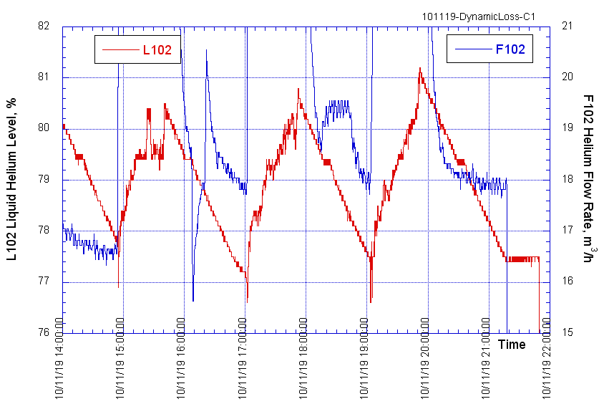
C1 Dynamic Loss Measurement
25.2MV/m
Static Loss Meas.
Static Loss Meas.
Detuned
25.2 MV/m

Slide 5
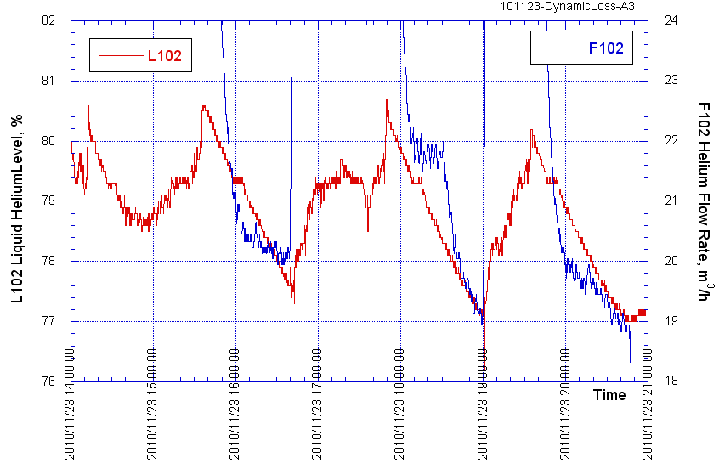
A3 Dynamic Loss Measurement
32.3 MV/m
Static Loss Meas.
Detuned
32.3 MV/m
No RF
Static Loss Meas.

Slide 6
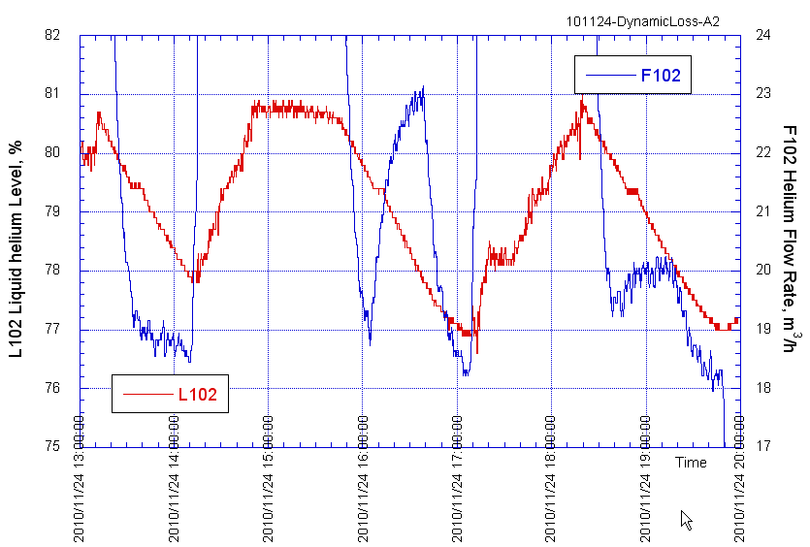
A2 Dynamic Loss Measurement
Detuned
38 MV/m
38 MV/m
Static Loss Meas.
Static Loss Meas.

Slide 7
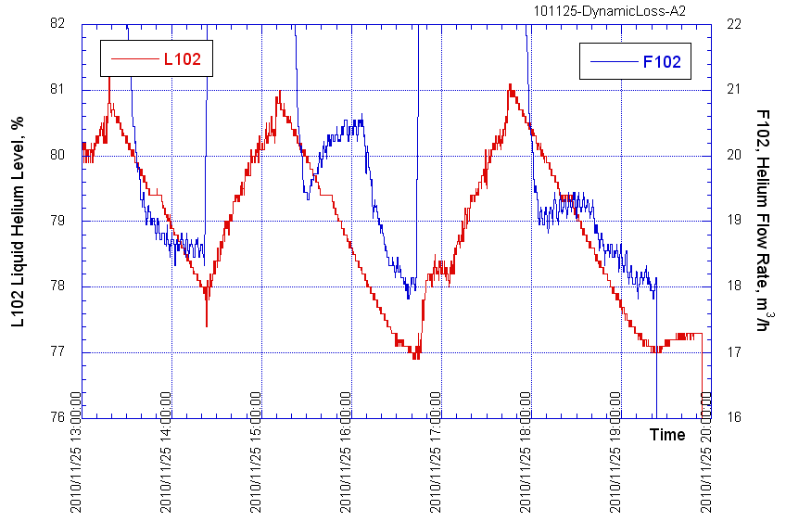
A2 Dynamic Loss Measurement
32 MV/m
Detuned
32 MV/m
Static Loss Meas.
Static Loss Meas.

Slide 8
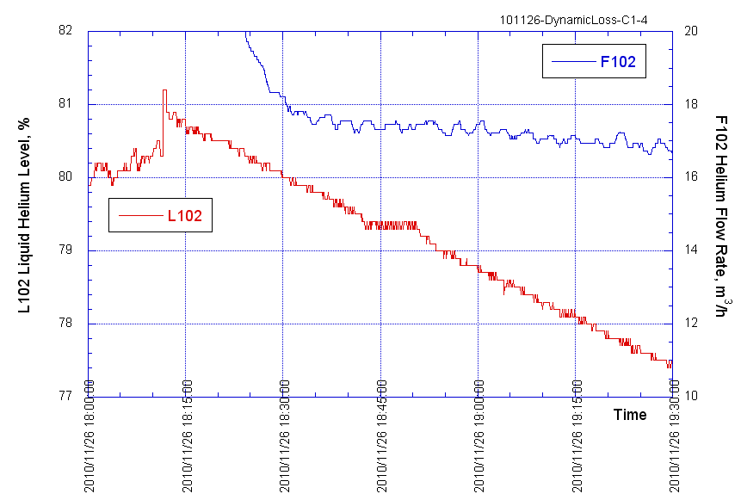
Four C cavities (detune)
32MV/m
(detune)
No RF
Static loss meas.

Slide 9
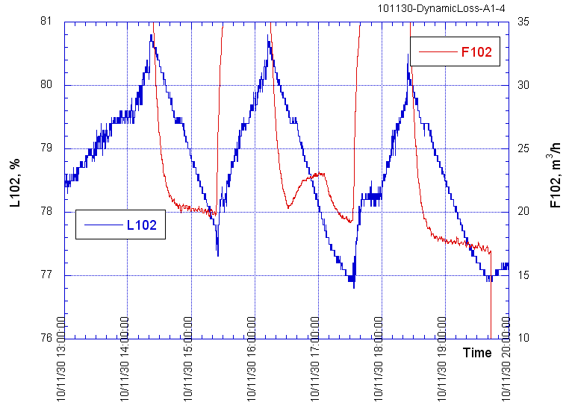
Four A cavities (detune)
32MV/m
(detune)
No RF
Static loss meas.
No RF
Static loss meas.
No RF
Static loss meas.

Slide 10
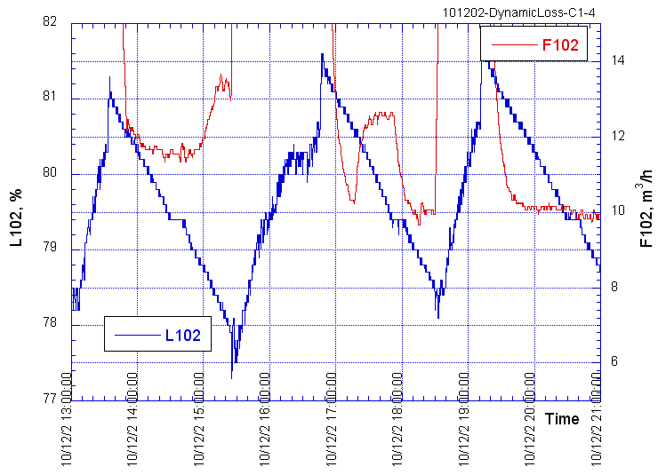
Four C cavities (20MV/m)
20.0 MV/m
20.0 MV/m
(detune)
No RF
Static loss meas.
No RF
Static loss meas.

Slide 11
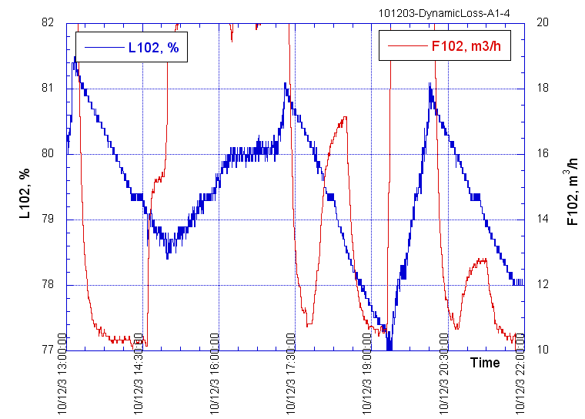
Four A cavities (26.9 MV/m)
26.9 MV/m
26.9 MV/m
(detune)
No RF
Static loss meas.
No RF
Static loss meas.

Slide 12
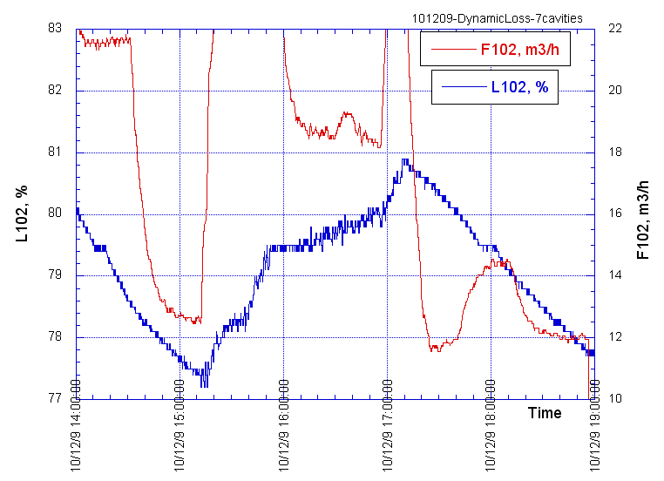
Seven cavities (25.4 MV/m)
25.4 MV/m
25.4 MV/m
(detune)
No RF
Static loss meas.
No RF
Static loss meas.

Slide 13
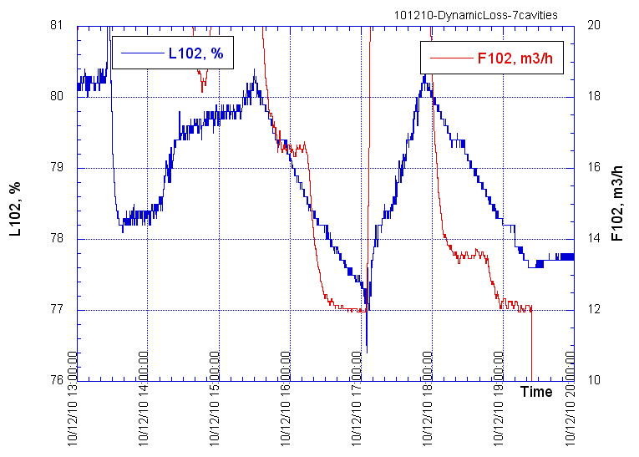
Seven cavities (20.4 MV/m)
20.4 MV/m
20.4 MV/m
(detune)
No RF
Static loss meas.
No RF
Static loss meas.

