Slide 1
CM1 Status at NML
Jim Kerby
Fermilab
Speaking on behalf of Jerry Leibfritz, Alex Martinez, Mike McGee, Nathan Eddy and with thanks to everyone involved at NML

Slide 2
CM1 Test Plan
Nov 17, 2010
ML-SCRF Meeting
2
Virtually identical to DESY run plan for XFEL modules (courtesy of Dennis Kostin) and Fermilab experience at HTS and CC2
TEST PROCEDURE:
1. RF Cable Calibration done
2. Technical Interlock / Sensor checkout done
3. RF source / Waveguides / LLRF done
4. Warm Input RF Coupler Conditioning done
5. Cooldown to 2K (Nov.)→done
6. Cavity Spectra measurements
7. Cavity Tuners Test and Tuning
8. Coupler Q_{load} measurement
9. Set Cavities On Resonance
10. Cold Input RF Coupler and Cavity Conditioning
11. Single Cavity RF Measurements
12. RF Measurement of 8 Cavity Cryomodule
13. Cryo performance testing (non-ILC conditions)

Slide 3
CM-1 Cooldown Strategy
CM-1 Consists of Three Cryogenic Circuits
80K Nitrogen Shield Circuit
5K Helium Shield Circuit
2K Helium Cavity Circuit
Constraints on Cooldown of Each Circuit
The difference between the inlet and outlet temperatures of each circuit must be maintained at or below 50K in the temperature range from roughly 300K to 100K
Cooldown Rate to be kept at <= 10K/hour
300 mm Gas Return Pipe Vertical Temperature Difference to be maintained <= 15K
Alex Martinez

Slide 4
CM-1 Cooldown Timeline
Cooldown to 4.5K
Division approval for CM-1 cooldown granted on 11/17/10
Cooldown process was controlled in round the clock shifts
Cooldown from 300K to 4.5K was achieved in roughly 56 hours
Cooldown to 2K
Cooldown performed on Monday, November 22nd
Currently at 2K
System operating parameters tuning
Simulating RF load using resistive heating

Slide 5
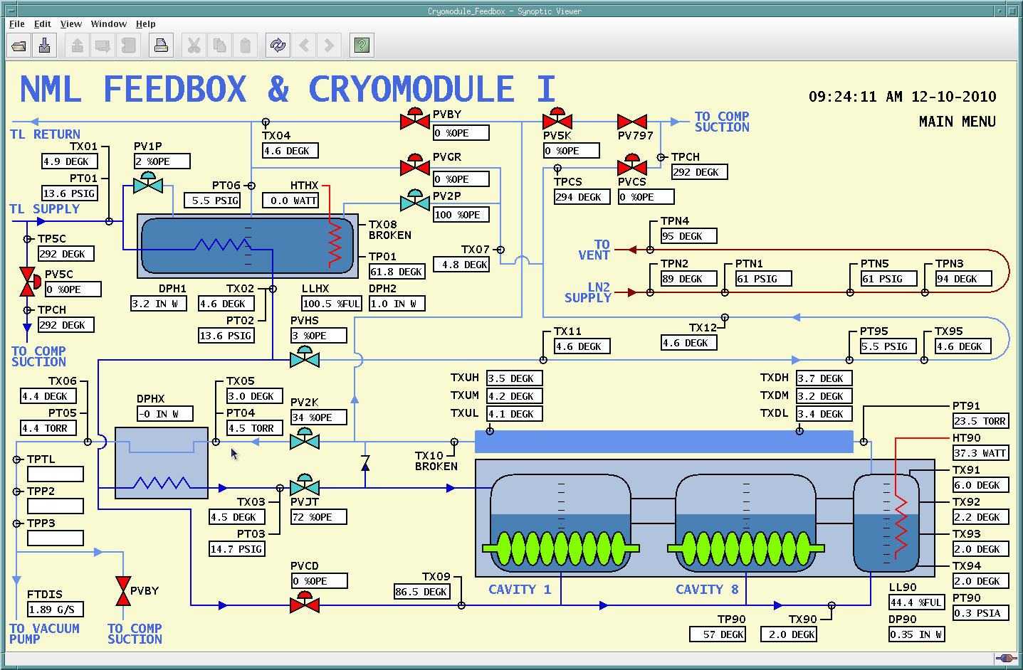
NML Feed Box and CM-1 Synoptic Interface
CM1 Status / S1 Global Webex

Slide 6
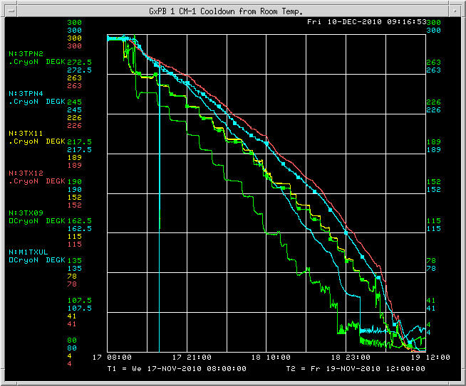
CM-1 Cooldown from Room Temperature

Slide 7
Summary - Cryogenics
System at 2K
Tuning of cryogenic plant parameters for better stability
Optimization of cooldown sequence
Initial Heat Load measurements in expected range; more detailed review of data underway
Heaters used to simulate dynamic loads
RF powering about to start

Slide 8
NML Cooldown
Mike McGee

Slide 9
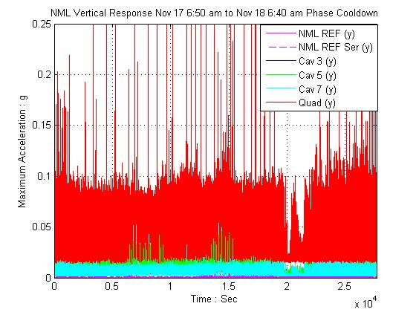
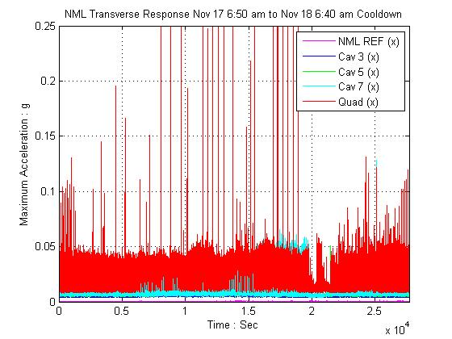
NML Cooldown (day 1)
Flowing gas thru piping circuits…
Quad transverse accelerations
of 0.05g
Cooldown begins
Quad vertical accelerations of 0.1g
*Instantaneous accelerations based on peak(g)/sec

Slide 10
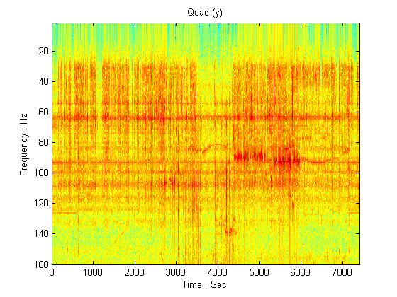
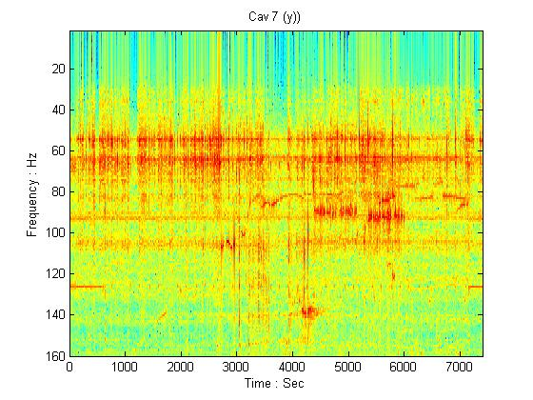
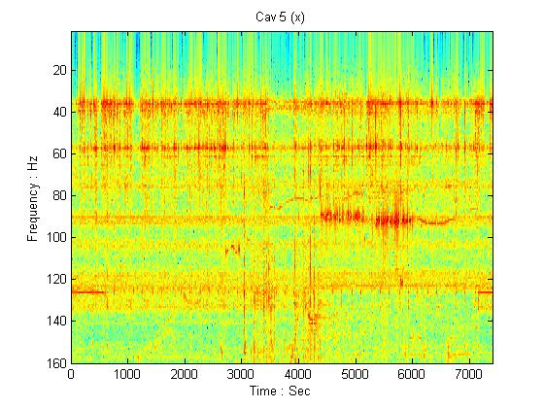
NML Cooldown (day 1)
Quad (y) | Cav 7 (y) | Cav 5 (y) | Cav 3 (y)
[Hz]
56 | 56 | 56 | 56
62 | 62 -64 | 62 -64 | 62
94 | 94 | 94 | 94
Quad (x) | Cav 7 (x) | Cav 5 (x) | Cav 3 (x)
[Hz]
38 - 40 | 38 - 40 | 38 - 40 | 38 - 40
56 - 58 | 56 - 58 | 58 | 56 - 58
94 | 94 -96 | 94 | 94

Slide 11
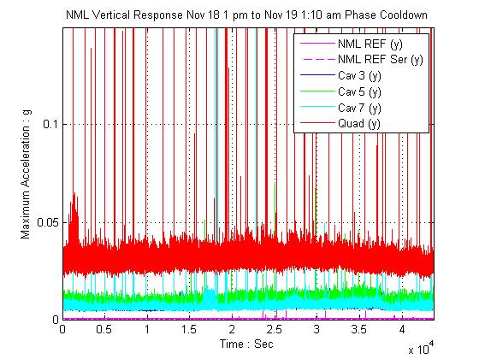
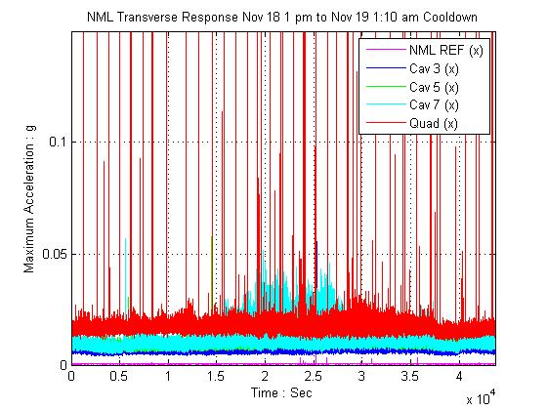
NML Cooldown (day 2)
Quad transverse accelerations
of 0.025 g
Quad vertical accelerations
of 0.05 g (rms)

Slide 12
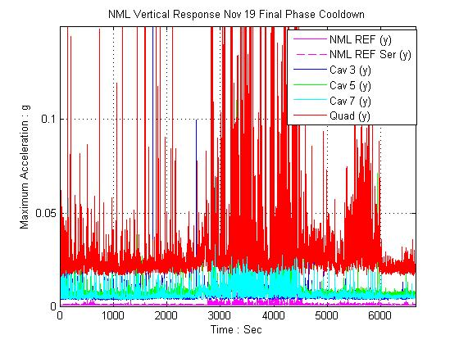
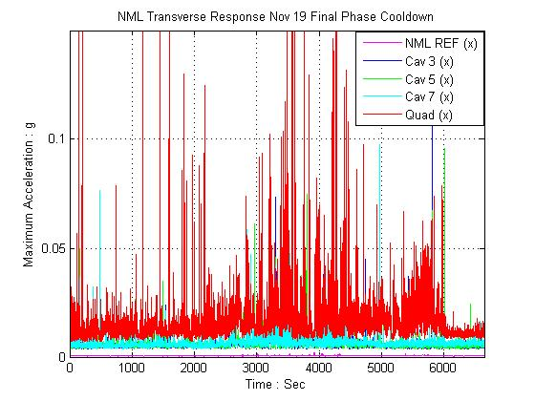
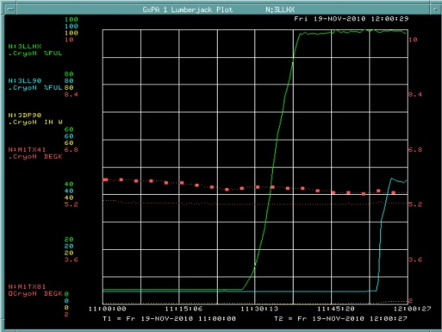
NML Cooldown (day 3)
6:50 am to 12:49 pm
Vertical peaks above 0.1 g
Transverse peak above 0.1g
Liquid fill (w/in CM1)
Cavities full at 4.2K

Slide 13
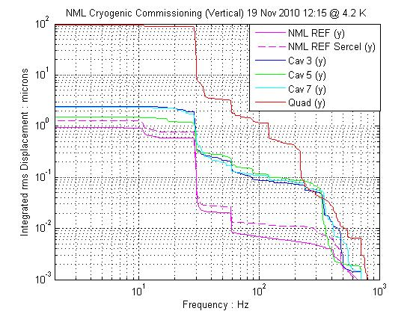
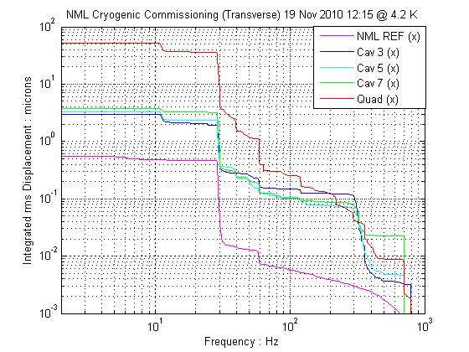
NML CM1 at 4.2 K (liquid)
Baseline (17 Nov 10 at 2 am) Quad vertical 8μ, transverse 6 μ (rms)
Quad transverse integrated displacement of 50 μ (rms)
Quad vertical integrated displacement of 100 μ (rms)

Slide 14
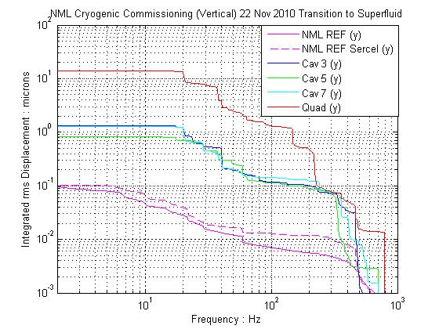
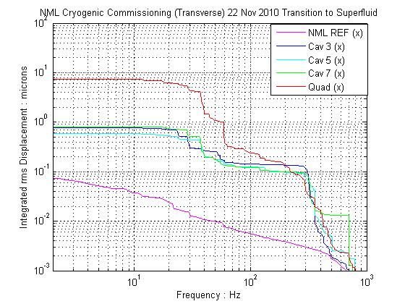
NML CM1 Superfluid Transition
Superfliud operation quite stable!
Quad transverse integrated
displacement of 8 μ (rms)
Quad vertical integrated displacement
of 10 μ (rms)
*Cavities move vertically & horizontally at ~1 μ (rms)

Slide 15
Summary - Vibration
Initial data set complete
Further review of data, comparison w/ other measurements
Data logging is continuous
Quadrupole more sensitive than remainder of system
2K operation quieter than 4.5K

Slide 16
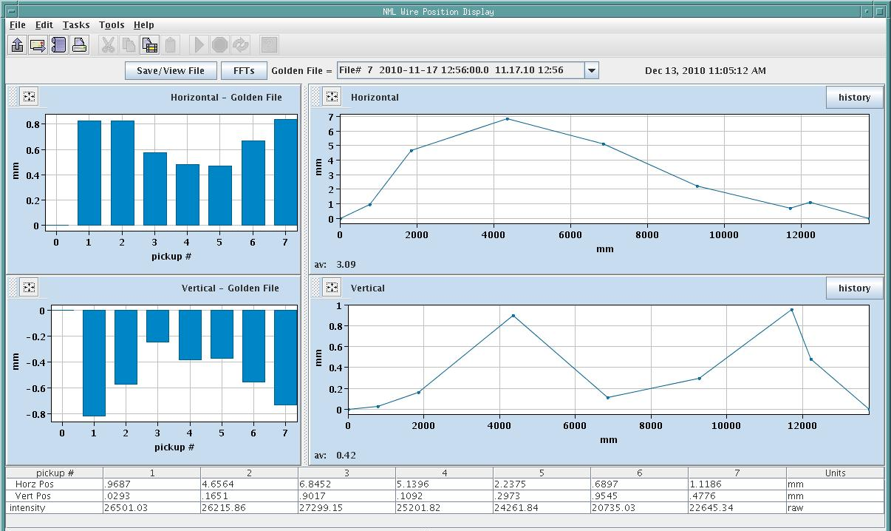
Wire Position Monitors
N27 Java Application
Nathan Eddy
Positions are measured at 7 locations by a stretched wire through BPMs attached to the 300mm return pipe

Slide 17
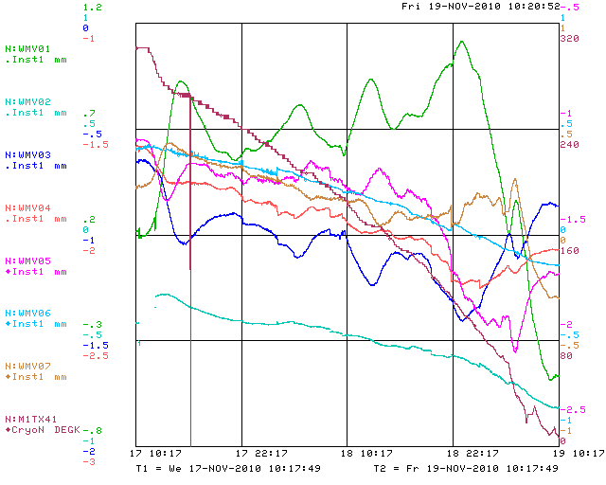
Initial Cooldown - Vertical

Slide 18
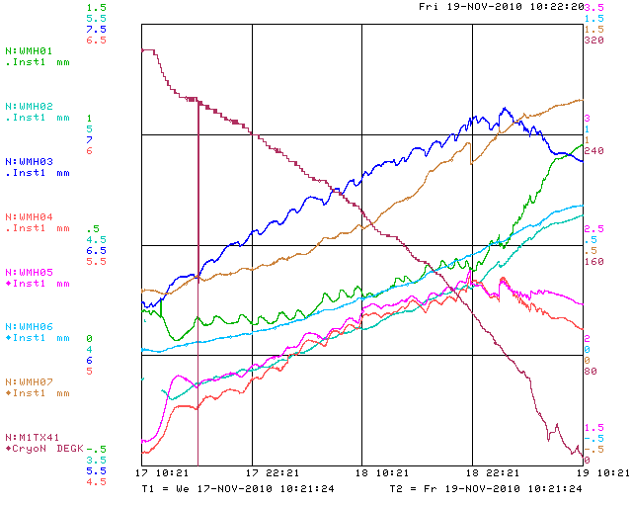
Initial Cooldown - Horizontal

Slide 19
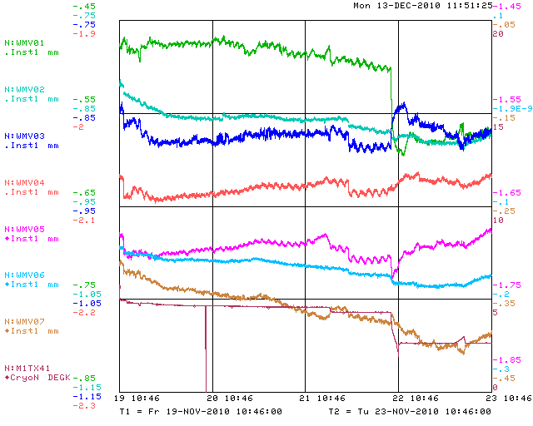
Final Cooldown- Vertical

Slide 20
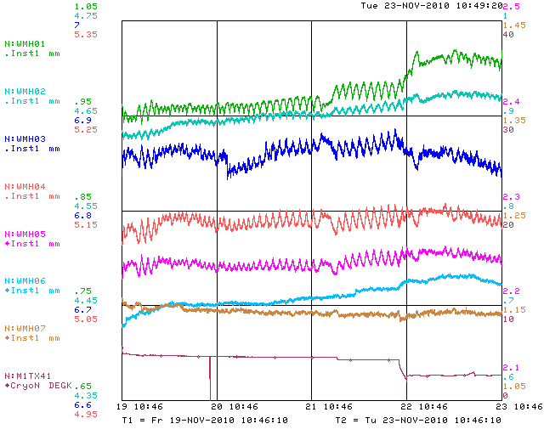
Final Cooldown - Horizontal

Slide 21
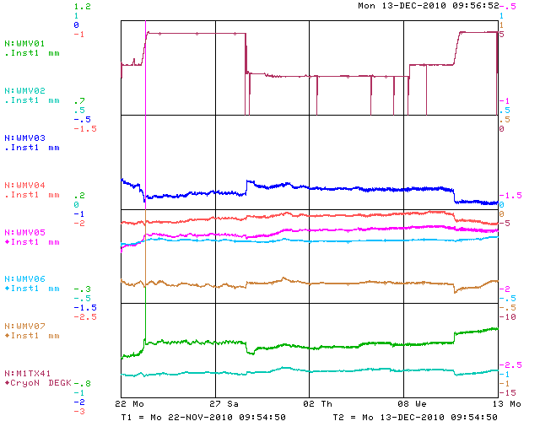
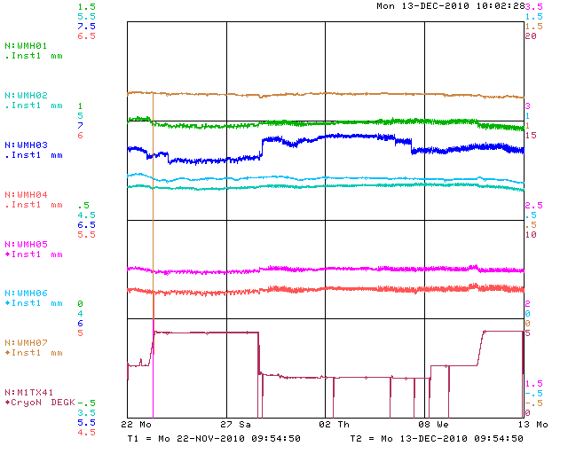
Last 3 Weeks
Vertical
Horizontal
In general, the motion of the pickups is correlated with temperature changes

Slide 22
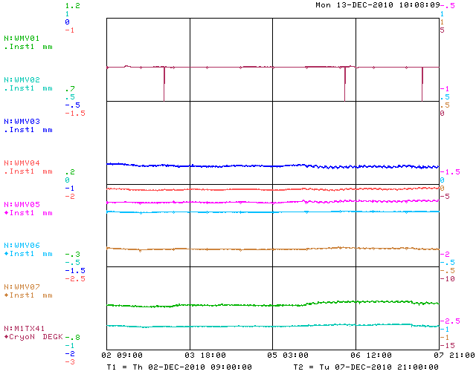
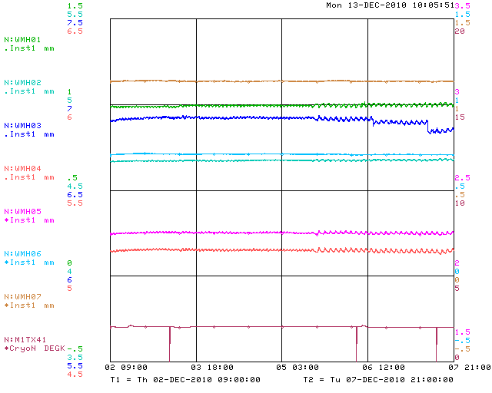
5 Days at 2K
Vertical
Horizontal
All monitors, except WMH03, are well behaved. See RMS from 2-10um over several days.

Slide 23
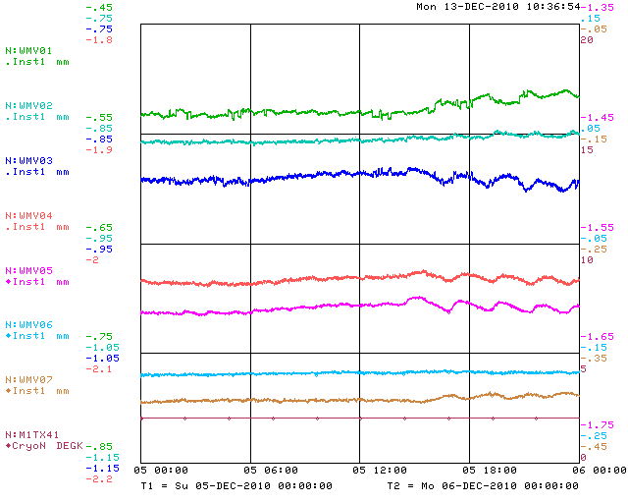
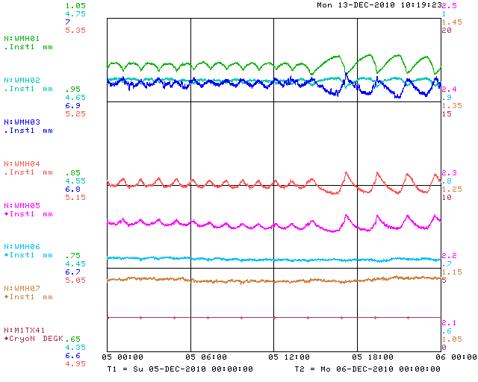
5 Days at 2K
Vertical
Horizontal
See slow structure at about 75 minutes and 2 hours which is more prevalent in horizontal.

Slide 24
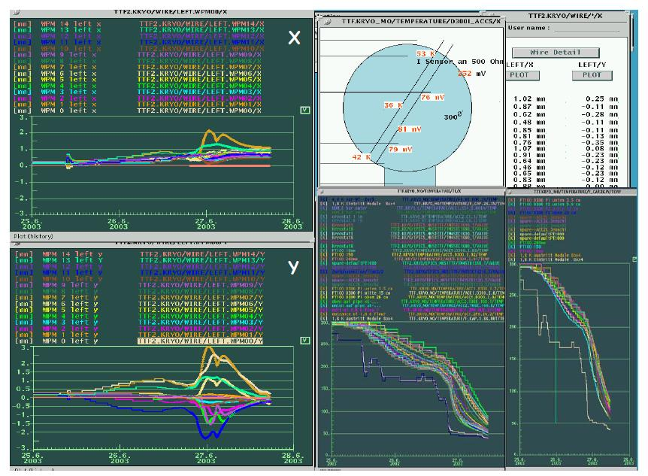
Results from DESY

Slide 25
Summary - WPM
Overall the WPM system worked as expected.
There are issues with the signal processing and long term stability which will be looked into further
See interesting motion as the module is cooled down
Similar to what was observed at DESY but smaller in magnitude
See slow motion (especially horizontally) while the module is sitting at 2K
This is not seen in our system cross checks
Is it real?
Vibration analysis forthcoming

Slide 26
Summary – CM1
Single Cavity Powering tests now through mid-January
Shutdown in January to attach waveguide, prep for multi cavity powering
Plenty of fresh data
Need time to digest, recalibrate systems as required, and compare with other measurements
Single cavity RF tests starting now!

