Slide 1




R&D activity @ pole MicRhAu
dedicated to High Granularity Si-W Ecal
The CALORIC chip
Laurent Royer, J. Bonnard, S. Manen, P. Gay
LPC Clermont-Ferrand

Slide 2
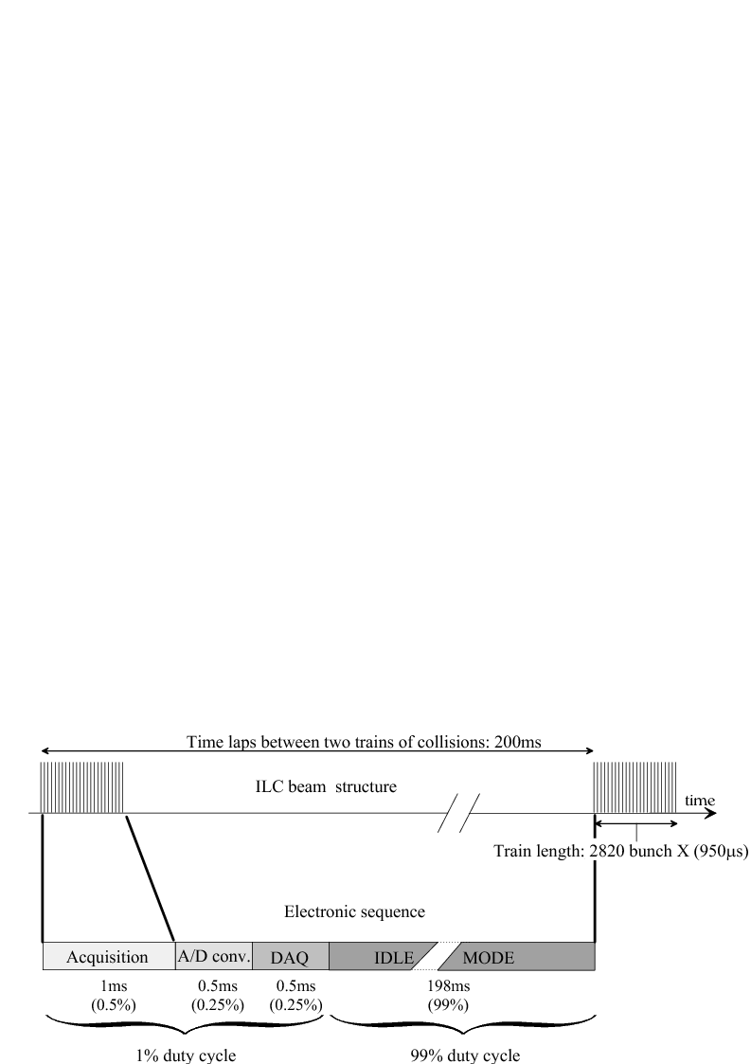
Readout Electronics for High Granularity Ecal
Electrical specifications of the readout electronics:
  Dynamic range of the signal delivered by a Si-diode : from MIP (4 fC) to 2500 MIPs (10 pC)
  Level of noise limited to 1/10 MIP ➔ SNR ≥ 10
  Error of Linearity:
    < 0.1 % up to 10 % of the dynamic range (1 pC)
    < 1% from 10 % and 100 % of the dynamic range
  Power budget limited to 25µW per channel
Axes of developments @ MicRhAu:
  Synchronous (with beam) analog signal processing: shaping with Gated Integrators, latched comparators
  Fully differential architecture, except for the Charge Sensitive Amplifier (CSA)
  One low-power ADC attached to each channel
  Use of a pure CMOS technology, no bipolar transistors
2

Slide 3
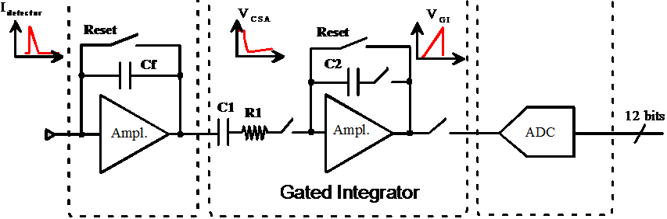
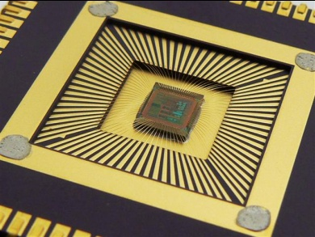
First prototype channel
Status report presented at Desy in July 2010
A VFE channel performing the amplification, the filtering, the memorization and the digitalization of the charge from Si detector has been designed and tested.
  Global Linearity better than 0.1 % (10 bits) up to 9.5 pC (2375 MIP).
  ENC = 1.8 fC (0.5 MIP) with a single gain stage
  Power consumption with power pulsing estimated to 25µW (no digital part).
3

Slide 4
The CALOrimetry Readout Integrated Circuit
x16
4
ADC
Low noise CSA
Low-gain shaper
12-bits cyclic ADC
New chip designed and now ready to be sent to foundry (CMP run of 14th February)
Technology AMS CMOS 0.35 µm
Architecture of CALORIC based on the previous channel tested, with some improvements:
Reduction of the power consumption of the CSA
Reduction of the noise of the amplifier of the Gated Integrator
Increase of the analog memory depth to 16
Fully power pulsed
4

Slide 5
The CALOrimetry Readout Integragted Circuit
x16
4
ADC
Low noise CSA
Low-gain shaper
12-bits cyclic ADC
x16
Gain discri.
High-gain shaper
Threshold
A High-Gain (about x 20) channel added to reach the MIP-to-noise ratio of 10.
A discriminator indicates the dynamic range of the signal → select the signal to be converted
5

Slide 6
The CALOrimetry Readout Integragted Circuit
x16
4
ADC
Low noise CSA
Low-gain shaper
12-bits cyclic ADC
x16
Gain discri.
High-gain shaper
Trigger discri.
x5
Amplifier
High-gain shaper
Analog part
A Trigger channel added to select events over the MIP
→ The trigger signal determinates if the active memory cell is reset or the signal kept into memory
6

Slide 7
The CALOrimeter Readout Integrated Circuit
x16
4
ADC
Low noise CSA
Low-gain shaper
12-bits cyclic ADC
x16
Digital Block
(State Machine)
Gain discri.
12
High-gain shaper
Output
data
Trigger discri.
x5
Amplifier
High-gain shaper
Analog part
A digital block controls the chip
Thresholds
Control of the channel
7

Slide 8
Global State Machine
IDLE
WAIT for 198 ms
No power
Wake Up
Analog signal
processing
1 ms max.
Up to 16 events stored
Bunch Crossing
End of the beam train
A/D conversion
< 1 ms
x events stored
All events converted
DAQ
(not implemented)
Master clock of 20 MHz
8

Slide 9
Timing of the analog processing
Signal delivered by the Si-diode
Output signal of the CSA
Output signal of the trigger channel
Output signal of high-gain channel
Output signal of the low-gain channel
+ 350 ns: ready to process next event
t = 0 ns: event synchronous w/ beam
+ 200 ns: decision of the trigger comparator
+ 250 ns: decision of gain comparator
+ 300 ns: end of integration: reset or memorization
9
Notes:
Carge delivered

Slide 10
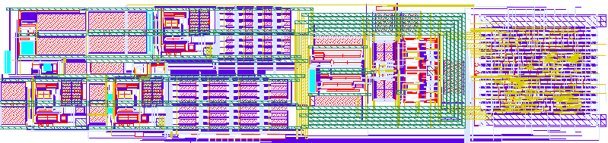
Layout of CALORIC
CSA, trigger channel and comparators
Gated Integrator and the 32 memory cells
The cyclic ADC
The digital block
10

Slide 11
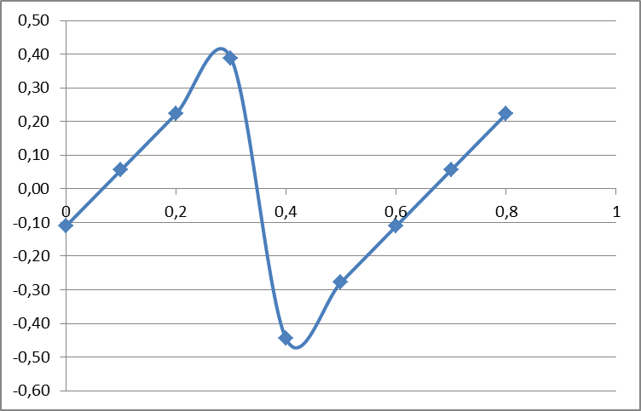
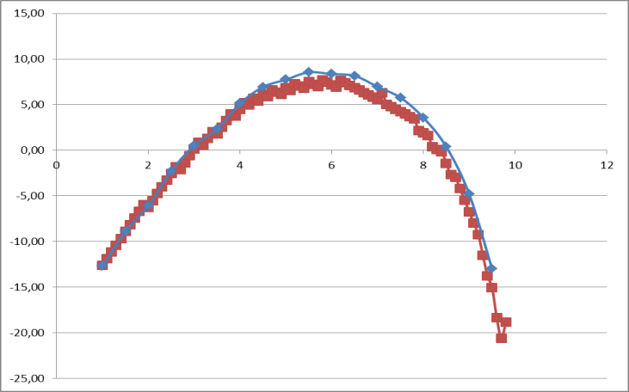
Simulated performance
Gain-20 channel
Gain-2 channel
LSB
LSB
pC
pC
INL < 0.1%
INL < 1%
  ENC (rms value) = 0.4 fC = 2400 e⁻ = MIP/10
  with the High-Gain channel and C_{detector} = 30 pF
11

Slide 12
Power consumption
Evaluation using power pulsing with the ILC duty cycle:
➔ 45 µW per channel
CSA
Trigger channel
Gain-20 channel
Gain-2 channel
12

Slide 13
Conclusion and perspectives
The CALORIC chip is ready for fabrication.
Simulated performance is in agreement with the requirements of Calice, except power consumption.
The first measured performance is expected before summer.
A multi-channel chip should be submitted for fabrication before the end of 2011
→ compatible with Calice DAQ
→ compatible with pinout of FEV board for test

