Slide 1
SINGLE-STAGE BUNCH COMPRESSOR FOR ILC-SB2009
Nikolay Solyak
Fermilab
GDE Baseline Assessment Workshop (BAW-2)
SLAC, Jan. 18 -21, 2011

Slide 2
Outline
Motivation
Lattice description and design
  Parameter choice
  Wiggler optimization
  Tuning flexibility for shorter bunches
Performance overview
  Misalignments and coupler kick
  Beam Based alignment, incl. girder tuning
Comparison single-stage BC vs. two-stage BC
  Components, cost, performance.
Status of other changes in RTML (SB2009)
  New Extraction Line and Beam Dump
  RTML lattice in Central Area
  RTML LET start-to-end Simulation (emittance budget)
Summary / Conclusion

Slide 3
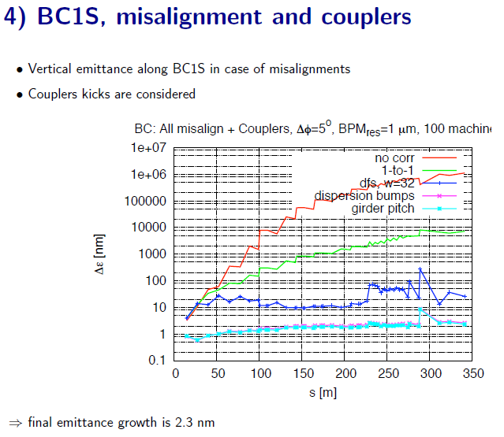

Slide 4
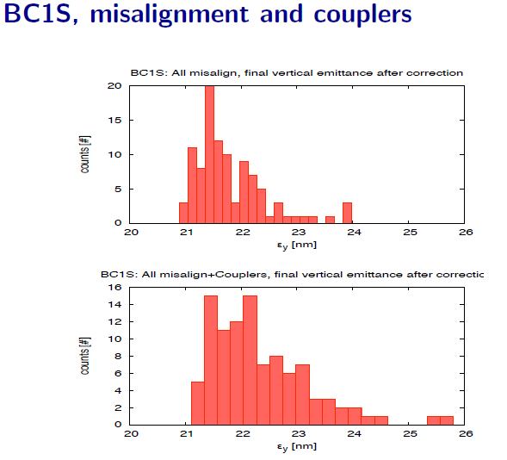

Slide 5
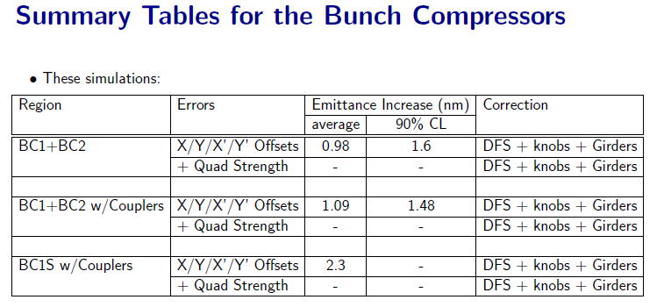
Comparison

Slide 6
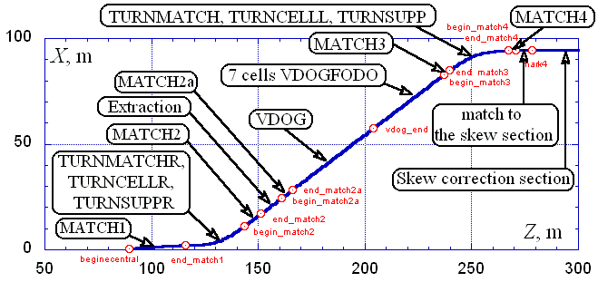
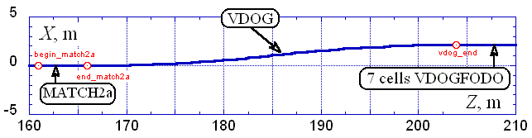
RTML lattice in Central Area

Slide 7
Conclusion
Single stage bunch compressor looks OK for 6mm→0.3mm compression
Emittance budget comparable with RDR two-stage BC
Limited flexibility, possible to achieve 230 micron bunch length.

