Slide 1
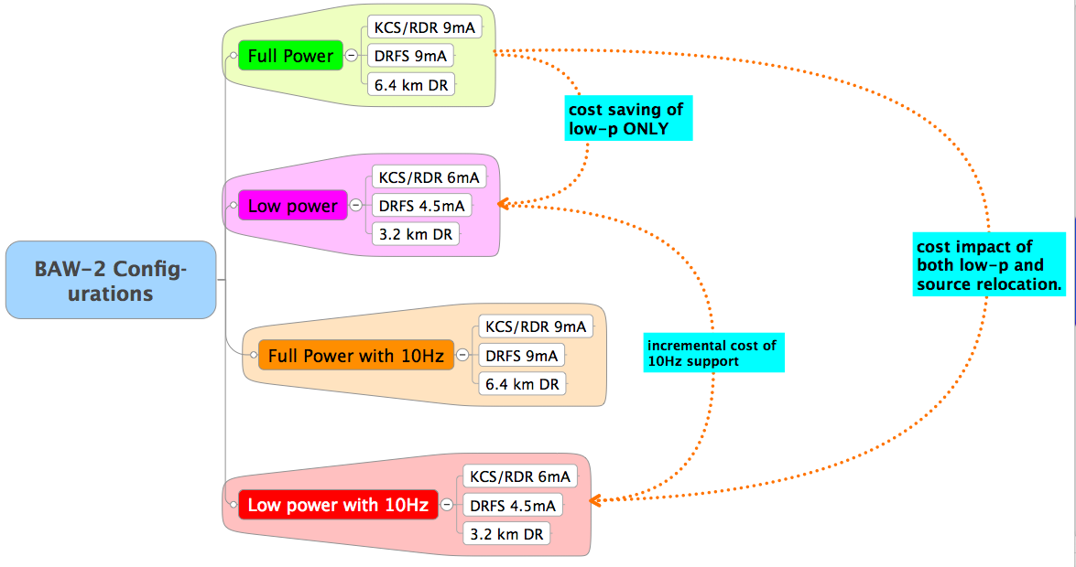
Cost & Study Scenarios
✘
Manageable permutations?

Slide 2
Low Power Parameters
Parameter | unit | RDR (nom.) | TLCC
E_{cm} | GeV | 500 | 500
Rep. rate | Hz | 5 | 5
Q_{bunch} | nC | 3.2 | 3.2
Bunches/pulse |  | 2625 | 1312
LINAC RF parameters:
RF pulse length | ms | 1.6 | KCS: 1.6 DRFS: 2.2
Beam current | mA | 9 | KCS: 6 DRFS: 4.5
Damping Ring:
Circumference | m | 6476* | 3238
Avg. Current | mA | 388 | 390
Damping time | ms | 21 | 24
RF power | MW | 3.97 | 1.76
Focus on 500 GeV centre-of-mass
Different parameters for DRFS and KCS(RDR T.O.).
2x3.2km DR with reduced bunch number (@5Hz)

Slide 3
Discussion on bunch number “restoration”
Important to discuss scenarios for increasing the bunch number 1300→2600
  At some later date, after initial construction.
Damping Ring:
  Additional 3.2km ring for positrons → no parameter changes
  2625 bunches in single (existing) electron ring
    780 mA avg. current
    4.84 MW power
  Tunnel/alcoves spec’d for 3 stacked rings.
HLRF
  Add klystrons/modulators/power supplies
  Scenarios for CFS support
    what must we invest in up-front to support this
Complete studies left for TDP-2
  but qualitatively, scenarios need to be discussed at BAW-2

Slide 4
Low Ecm Running
Four additional Ecm points of interest agreed-upon:
  Ecm e- linac mode
  350 GeV 5Hz (normal)
  250 GeV 10Hz (alternate pulse 150/125)
  230 GeV 10Hz (alternate pulse 150/115)
  200 GeV 10Hz (alternate pulse 150/100)
For 10Hz operation, consider incremental requirements/cost wrt 500 GeV low-p parameters (slide 3)
Main Linac:
  Uniformly reduced ML gradient (scaled)
  RF pulse length and RF power (AC power) different for KCS(RDR T.O.) and DRFS → CFS requirements!
  Do we run all cavities at equal gradients?
Damping Ring:
  Reduced damping time 24 → 13 ms (18 ms for e- ring)
  Increased RF power and wiggler length → CFS requirements!
Notes:
Should check with Susanna on different damping times for rings.

Slide 5
Other Considerations
BDS (parameters given by A. Seryi)
  Stronger IP focusing (incl. travelling focus)
  beam-beam issues
  tolerances/stability
  Note: beam dumps remain rated for 1TeV full RDR power.
Consequences from BAW-1
  ±20% gradient spread and required RF power overhead
  Move to zero spread at low Ecm scenarios?
Other systems
  Bunch compressor: assume nominal 300μm IP bunch
  Electron source: 10Hz issues? 1300/2600 issues?
  Positron source:
    10Hz issues for target/FC ?
    Additional beamlines and kicker systems
    …
  LET beam dynamics: alternate pulse operation

