Slide 1
Positron Source Overview and Layouts
Outline of presentation for discussion at ADI Meeting, Jan 7
BAW-2
Jan 20, 2011
Ewan Paterson

Slide 2
DRAFT OUTLINE
# of slides
SOURCE REQUIREMENTS 2
BASIC RDR DESIGN & PERFORMANCE 3
OMD OPTIONS 4
HISTORICAL DEVELOPMENT 2
LOW ENERGY RUNNING and 10Hz OPERATION 2
KEEP ALIVE OR AUXILIARY SOURCES 2
WALKTHROUGH OF A 3D LAYOUT OF E+ SOURCE AND CENTRAL REGION 13
SOME CONCLUSIONS 1

Slide 3
Comments on above Outline
Design means Undulator Based Source. There will be no discussion of alternate sources except AUX/KAS
The 4 slides on OMD is to explain reasons for continuing R&D on FC, although QWT is the assumed system for the proposed baseline. This is the only talk which will mention Flux Concentrator R&D program?
Walkthrough in 3D will emphasize that tunnel layouts and complexity which will be very similar whether the source systems are at mid or end of linac.
Conclusions :- Delay detail discussions until after the full day of presentations on system performance and 10Hz operation.

Slide 4
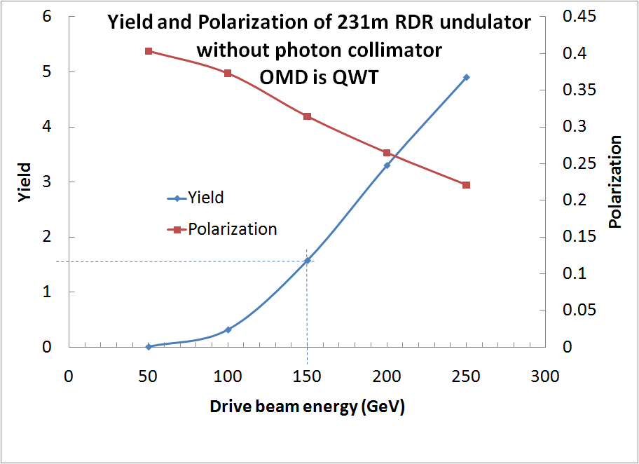
Yield and polarization with different drive beam energies.
Needs correction ??
or omit tables ?
Drive beam energy | Energy lost per 100m | Energy lost for 1.5 yield
50GeV | ~225MeV | N/A
100GeV | ~900MeV | ~9.9GeV
150GeV | ~2GeV | ~4.6GeV
200GeV | ~3.6GeV | ~3.7GeV
250GeV | ~5.6GeV | ~3.96GeV
Drive beam energy | Yield | Polarization
50GeV | 0.0041 | 0.403
100GeV | 0.3138 | 0.373
150GeV | 1.572 | 0.314
200GeV | 3.298 | 0.265
250GeV | 4.898 | 0.221
4

Slide 5
Some conclusions
A final evaluation of having the e+ source systems at the end of the electron linac and 10Hz operation at low energies, should wait until after the upcoming presentations of impacts on CF&S, Technical Systems and Cost.
HOWEVER
It looks attractive as a new Baseline for the continuing engineering studies on the technical design and TDR, and for studies of site specific designs including optimization of tunnel cross sections, alcoves and vaults.

