Slide 1
(CERN EDMS Document N.1099646)

Slide 2
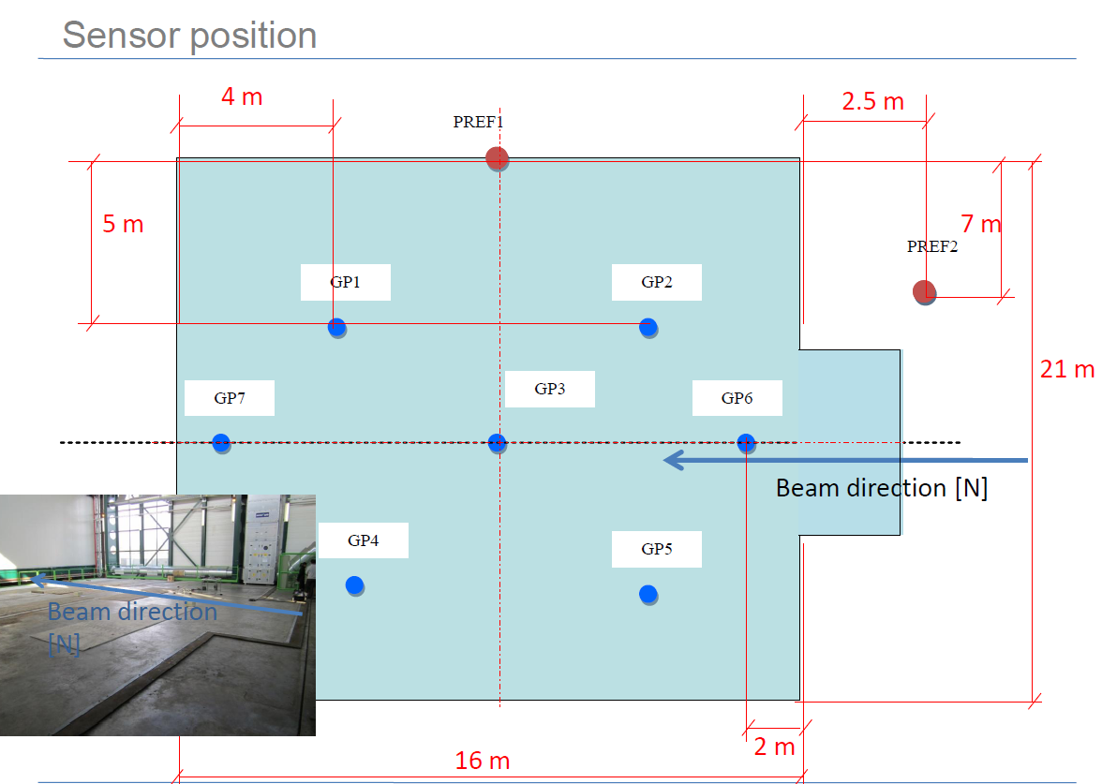

Slide 3
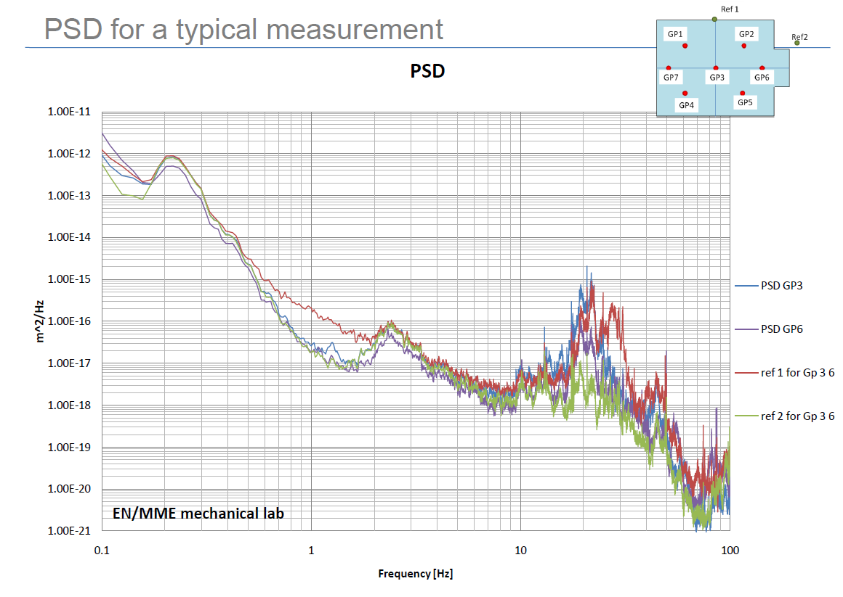

Slide 6
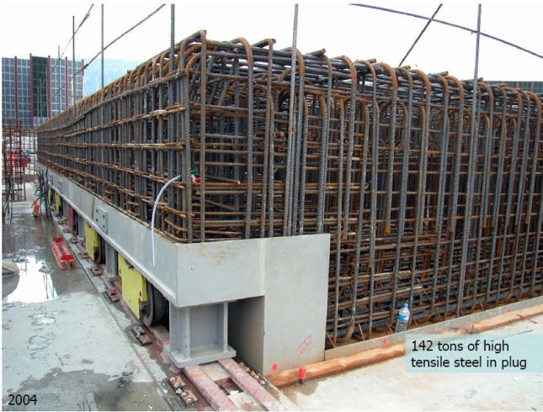

Slide 7
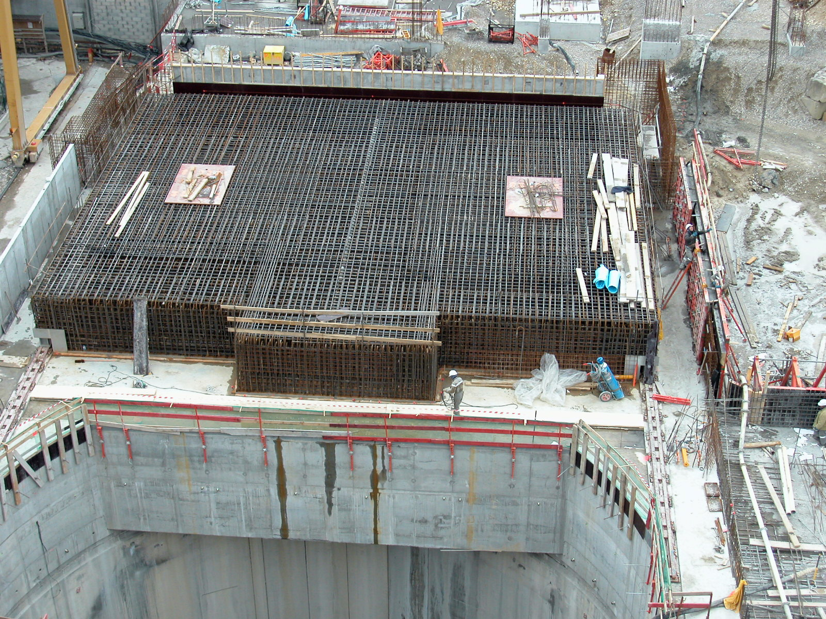

Slide 8
Random vibrations and FEM
Full 3D mesh in conjuction with the Random Vibration Solver Module:
Huge model with ~300k elements,
Very Long Computing time ~ 12 hours
Not suitable for parametric study, i.e. changes of geometry or material properties
Solver as Black Box, hard to have full control of the algorithm
Harmonic Analysis -> Determination of the Transfer Functions
Modal analysis of the full 3D mesh, still very long, computing time waste on several uniteresting local modes
Simplified 3D or 2D model representing the master degree of interest: fast, reliable, flexible. One need to know exactly which global mode are of interest.

Slide 9
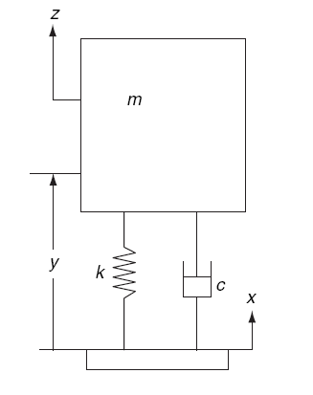
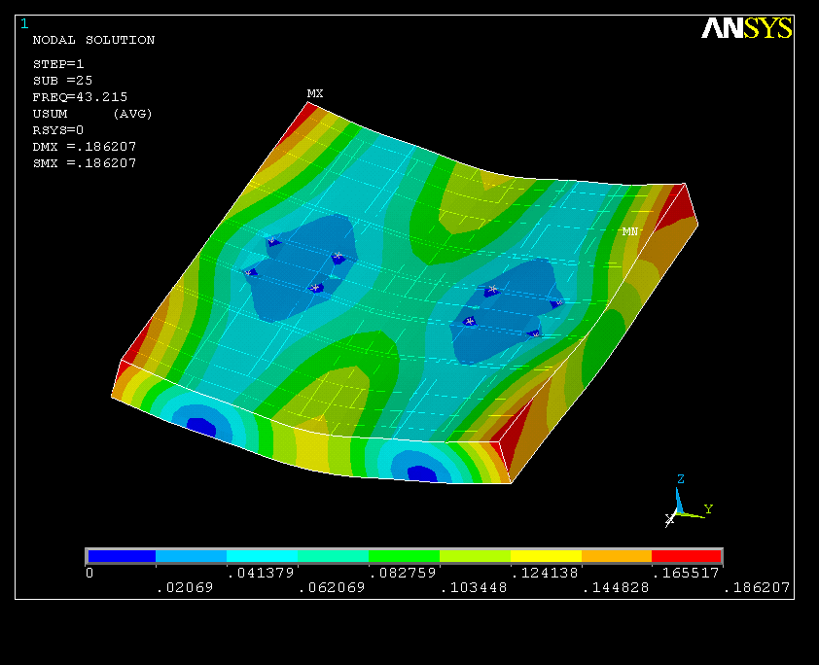
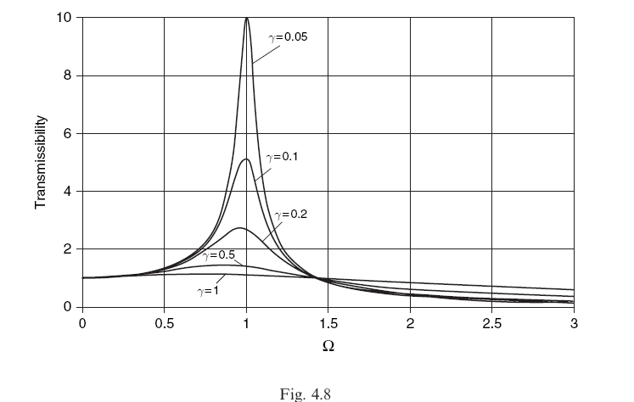
Random vibrations study
The Model requires the Ground Motion Spectrum P(f) and the Frequency Response Function H(f) of the structure
2
=
X
Ground Motion PSD
Frequency Response Function
FEA
Analytically
9

Slide 10
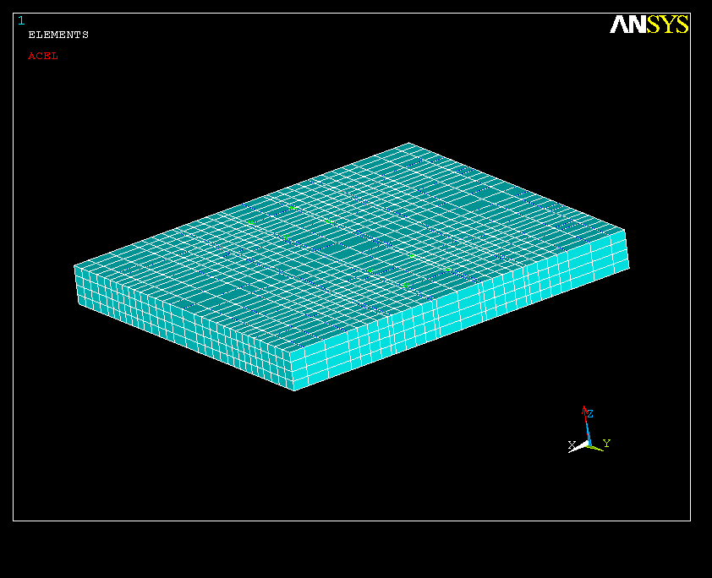
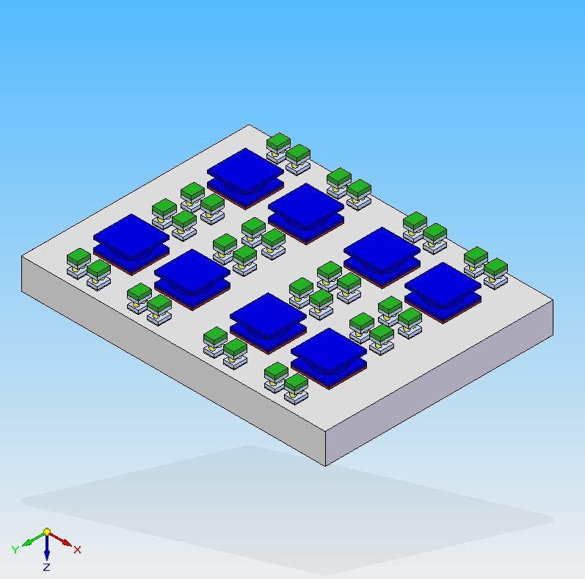
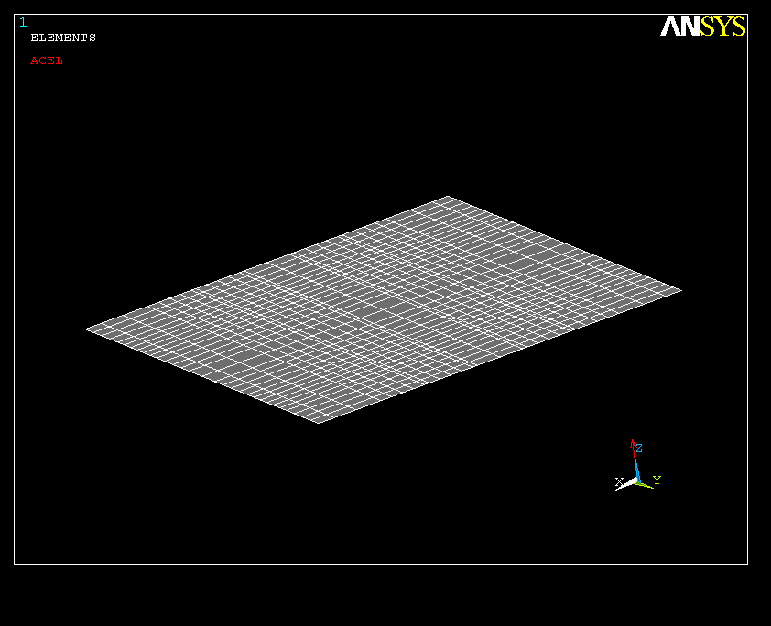
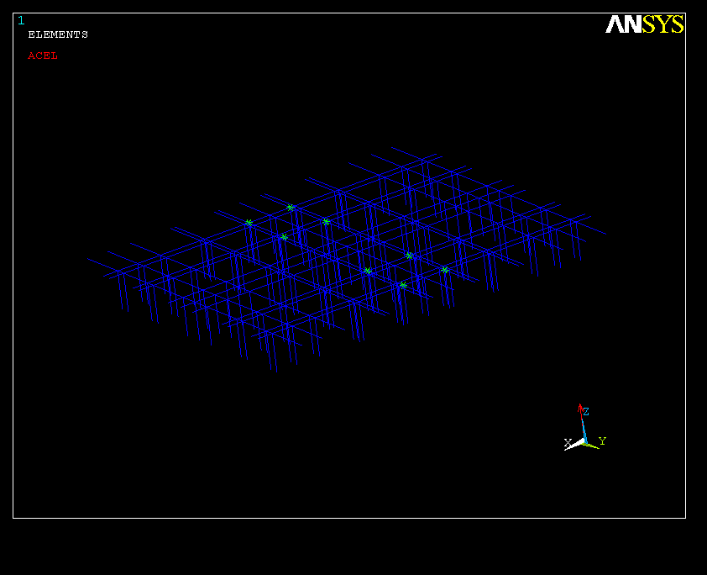
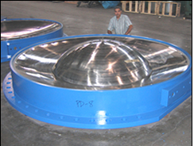
Total mass 1800 t
2 m
18 m
20 m
Reinforced concrete Slab
Four support lines for 4’000 tons each
Steel plate 30 mm at the bottom
Steel re-bars 16mm²
10kt Anti-seismic supports

Slide 11
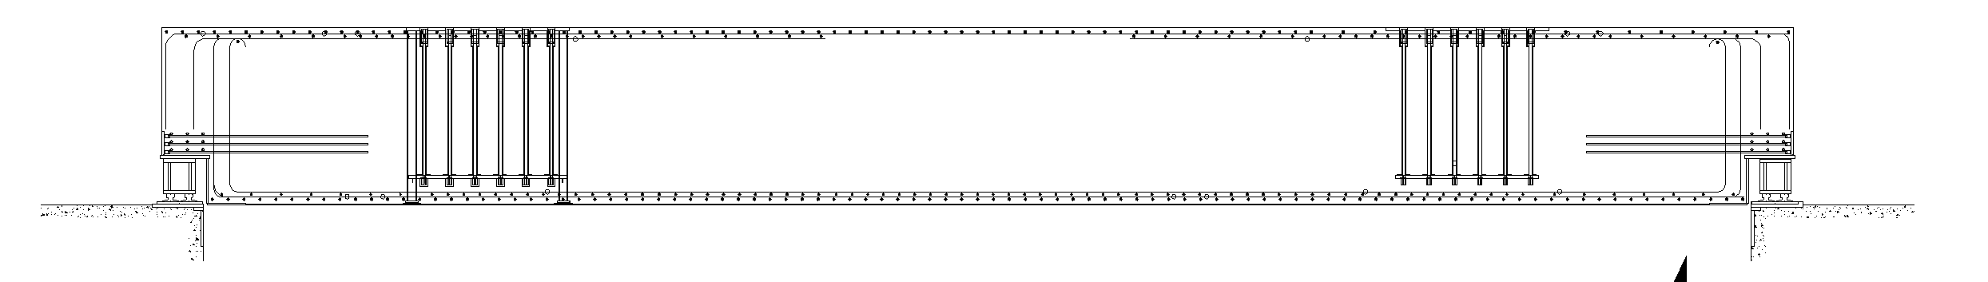
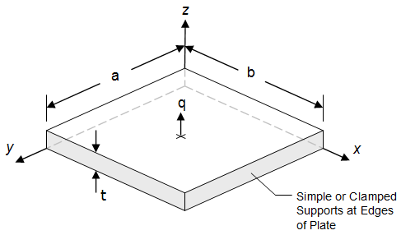
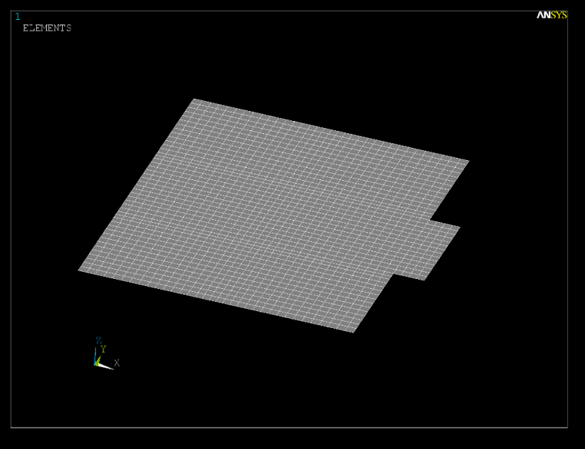
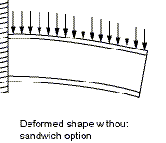
20.5 m
2200
CMS Platform (as built)
Plate Model: zero thickness with bending stiffness around the middle plane
Iron re-bars (equivalent th. 25 mm)
Concrete, 2150 mm
Iron re-bars (equivalent th. 25 mm)
Total thick. 2.2 m

Slide 12
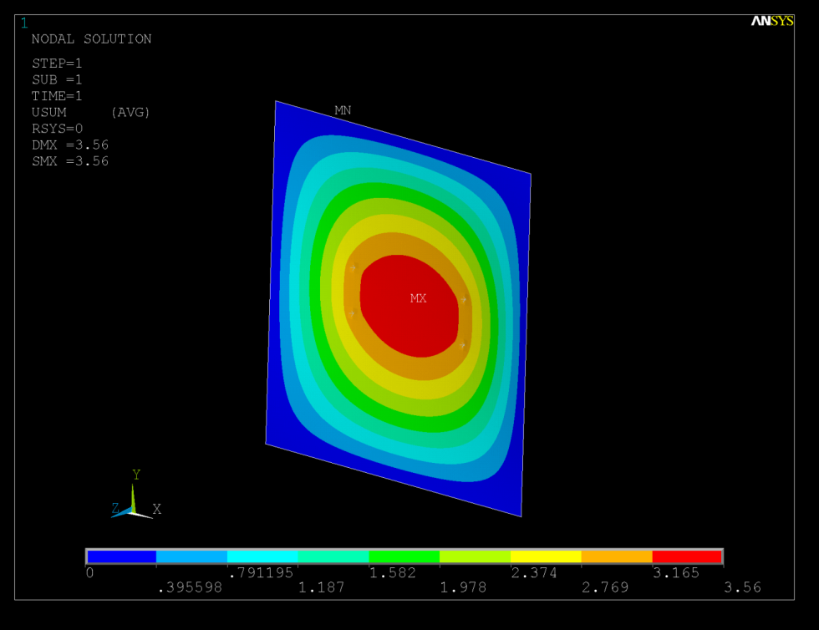
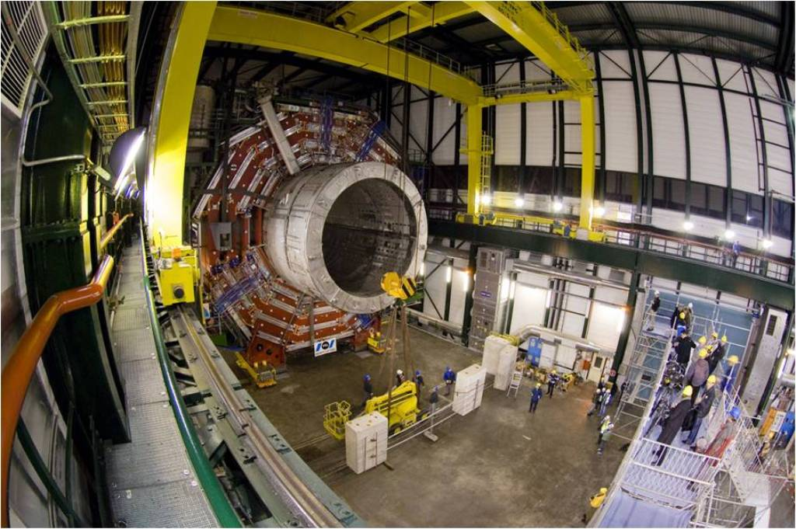
Bencmark with static test done on the platform
Dummy load = 2500 tons,
Weight of the platform = 1780 tons
Max sag at the center = 3.5 mm
N.B. = Platform Simply supported on the edges

Slide 13
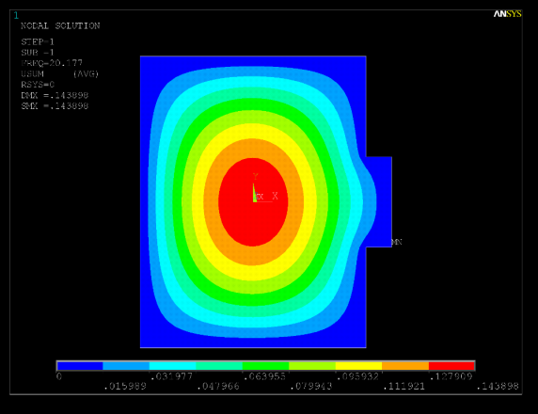
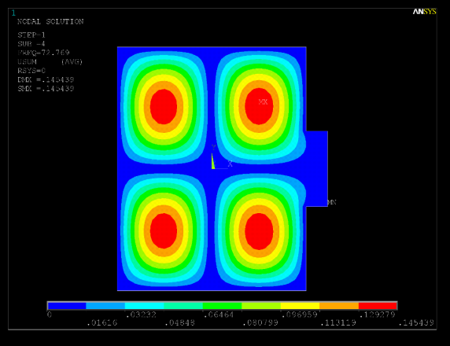
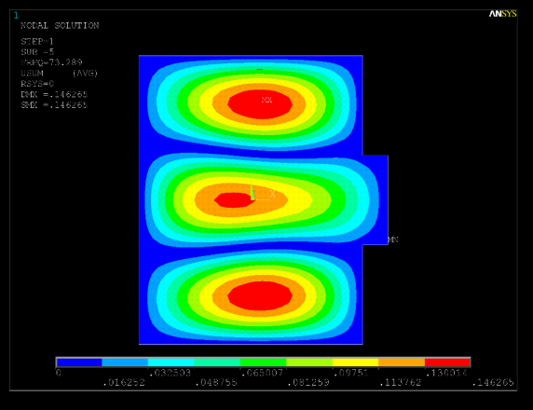
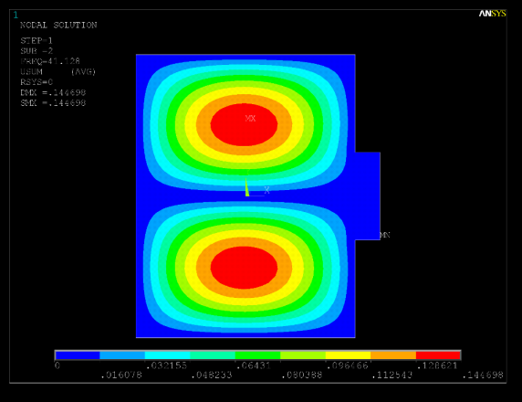
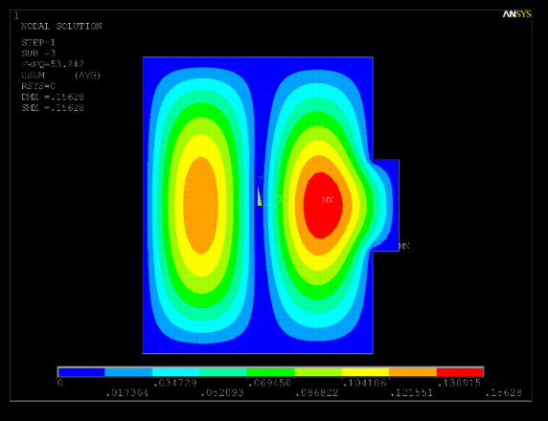
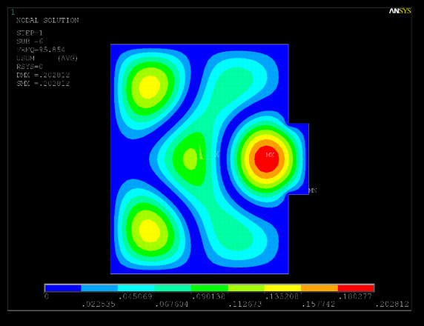
Mode 1
Mode 4
Mode FREQ
1 20.17
2 41.12
3 53.24
4 72.76
5 73.28
6 95.85
Mode 2
Mode 5
Mode 3

Slide 14
Transfer Function - Middle Point (Geophone N.3)
Critical damping ∼ γ = (f₂ – f₁)/2* f_{n}
γ = 6.8%
0.707*Max. Ampl
(1+γ)*f_{n}
(1−γ)*f_{n}

Slide 15
Simulations vs. Measured PSD (Platform Center)
Peaks 80 and 90 Hz
Resonance at ~20 Hz

Slide 16
Integrated Displacement (r.m.s.)

