Slide 1
Americas Region Update
C.M. Ginsburg (Fermilab)
S0 Meeting - WebEx
January 11, 2011

Slide 2

JLab: TB9NR001 summary
Eremeev
The first 9-cell cavity assembled by the cavity production group’s technicians
In pi mode the cavity was limited at 17 MV/m by a quench in the center cell
Field emission was observed from 15 MV/m in pi mode
The quench location was determined by the thermometry system
Preheating was observed at the quench location
Quench limitation was reached in every passband mode
Quench limits were reached in four distinct cells during passband measurements, as suggested by four distinct signals from 2nd sound detectors

Slide 3
Cornell ILC Program Update 8.Jan.2011
Cornell SRF
Crawford
Vertical EP+repair techniques R&D
TB9AES005:
being prepared for rf test
high pressure rinse 8.Jan
bake this week

Slide 4
Fermilab Items
9-cell cavity tests:
TB9ACC015: tumbling
TB9RI024: production process
TB9RI027: processed/tested at JLab; remaining FE improved at FNAL
1-cell cavity tests:
TE1CAT002: New vendor, tumbling
TE1ACC006: ECS defect cavity, treatment variations
CM Ginsburg S0 Mtg
4
Notes:
4

Slide 5
4th test
Quench limited to 36MV/m. Initially FE appeared at 12-22 MV/m, then processed away – no FE thereafter. Both low and high field Q₀’s were reasonably good. Mode mixing observed at E ≥ 25MV/m.
Cavity meets specification and is promoted to dressing.

Slide 6
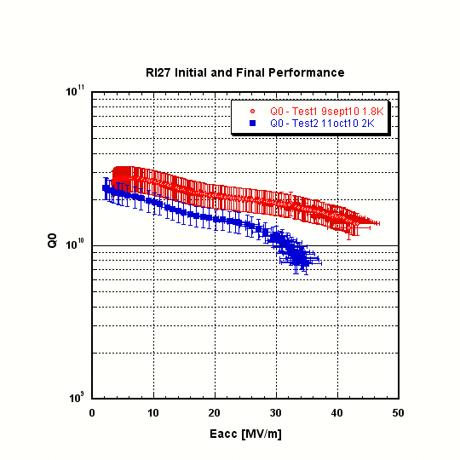
TB9RI027
Red/Blue=JLab result
Green squares = FNAL result. FE greatly reduced, lower E_{acc, max} compared to 1.8K.
Cavity meets ILC-spec and is promoted to dressing.

Slide 7
Fermilab Items
Tumbling of 9-cell cavities [details from Charlie…]
JLab-2
Complete: tumbling, field flatness measurement, rough HPR, 10 um light-EP, optical insp, 800C HT (FNAL furnace), tuning, light-EP+VTS prep, 120C bake and VT
TB9ACC015
Complete: tumbling, limiting (19 MV/m) feature in cell 3 HAZ molded, optical inspection, field flatness measurement, molded silicone sample analyzed; optical inspection shows very mirror-like surface, 800C HT (FNAL furnace), tuning, light-EP+VTS prep, 120C bake and VT
Achieved 35 MV/m, good Q0
High-temperature furnace (before Dec. all hydrogen degassing was at JLab)
Installed and commissioned in FNAL/IB4
In regular operation
Six cavity order from Niowave-Roark [new vendor qualification]
TB9NR001: JLab standard process/test path – 17 MV/m in first pass
TB9NR002: FNAL/ANL standard process/test path – 29 MV/m in first pass
NR was given the go-ahead to fabricate the remaining 4 cavities
Six cavity order from AES [experienced vendor; cavities partially for S0]
All six have been received at Fermilab and are partially through quality control
(At least) one cavity will be tumbled
CM Ginsburg S0 Mtg
7
Notes:
7

Slide 8
Production Cavities for CM2
Cryomodule 2
Cavity ID | CM2 candidate | Vertical Test | He vessel? | Horizontal Test | cryomodule ready?
TB9AES009 | 1 | 36 MV/m | dressed | 35 MV/m | yes
TB9AES010 | 2 | 38 MV/m | dressed | >35 MV/m | yes
TB9AES008 | 3 | 41 MV/m | dressed | >35 MV/m | yes
TB9RI018 | 4 | 39 MV/m | dressed | next
TB9RI019 | 5 | 38 MV/m | dressed
TB9RI028 | 6 | 39 MV/m | dressed
TB9RI020 | 7 | 36 MV/m
TB9RI027 | 8 | 40 MV/m
ACCEL8 | backup | 31 MV/m | dressed | 31 MV/m | yes
TB9ACC013 | backup | 38 MV/m | dressed | FE limit
TB9ACC016 | backup | 39 MV/m | dressed | FE limit
TB9RI029 | backup | 35 MV/m | dressed | 29 MV/m
TB9AES007 | backup | 42 MV/m | dressed | FE limit
TB9RI024 | backup | 36 MV/m
Majority of cavities vertically qualified at JLab
TB9RI020, TB9RI024, and TB9RI029 were processed/tested at FNAL/ANL
TB9RI027 received final HPR and test at FNAL/ANL
Now on 10th HT of 1.3 GHz cavities for CM2: FE an outstanding issue
TB9AES007 HT: field emission limits to 33 MV/m; re-rinse and re-test evtl.
Coupler conditioning/QC studies underway
Correlations VT/HT ongoing – including field emission
We will not pass on any cavities with substantial field emission for dressing

