Slide 1
Novel Cavity Processing at Fermilab

Slide 2
How Cavities Are Processed
Baseline Path
120-150 Micron Electropolishing
High Temperature Bake
Light Material Removal
(Alcohol Rinse)
High Pressure Rinse
Assembly
(Low Temperature Bake)
RF Test
Rinse
Alternate Path
120-150 Micron Tumbled
5 micron EP
(HF Rinse)
Rinse
800 C for 2 hours
600 C for 10 hours
20 Micron EP
For Sulfur Precipitate Removal
1200 psi, Ultrapure Water
Class 10 Clean-room
48 Hour, 100 C

Slide 3
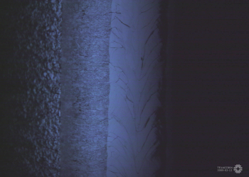
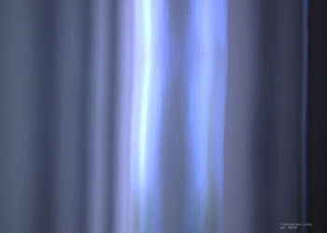
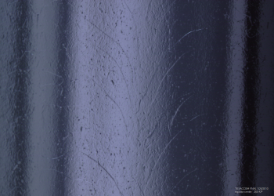
Why do tumbling?
Unprocessed
Remove weld bead at equator cavity created from E-beam welding.
Can yield surface finishes(Ra) on the order of 10s of nanometers. Best by EP alone is around 100 nanometers.
Environmentally friendly.
Most likely will still require a small amount of chemistry(on the order of 5-10 microns compared to 120 microns for EP)
Cheaper.
Repeatable.
Tumbled
Electropolished
Electropolished
10 mm Scale Bars

Slide 4
What is tumbling?
Tumbling is a mechanical polishing process in which the inside of the cavity is filled with abrasive material and then rotated at high speeds.
Tumbling materials include man made materials like plastics and ceramics and natural materials like corn cob or walnut shells.
Main Shaft up to 115 RPM
Individual Barrels 115 RPM in opposite direction to main shaft

Slide 5
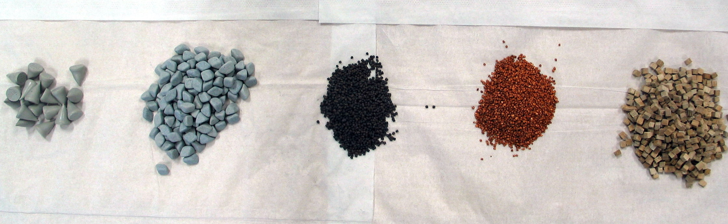
Tumbling Process
3 Stages – Multiple Steps in Some Stages
Cutting Stage to Remove Weld Bead (Ra 3 microns)
Intermediate Polishing (Ra 0.05 microns)
Final Polishing (Ra 0.015 microns)

Slide 6
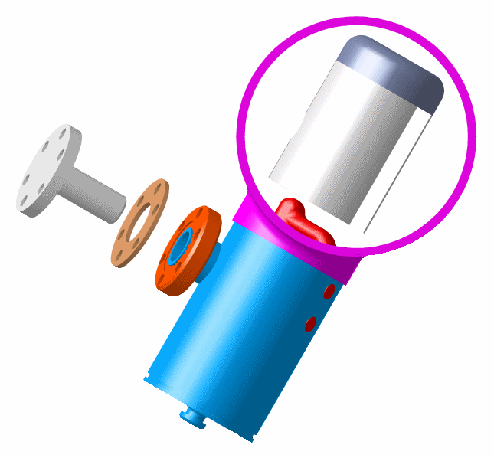
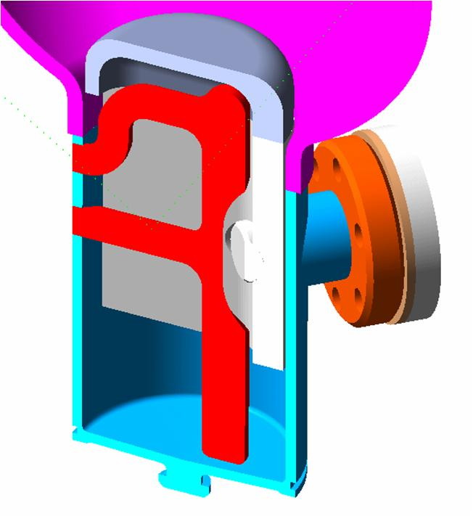
9 Cell Cavity Tumbling
HOM Can Must Be Protected or the Antenna Would be Destroyed.
Caps are Made From Niobium to Avoid Contamination.

Slide 7
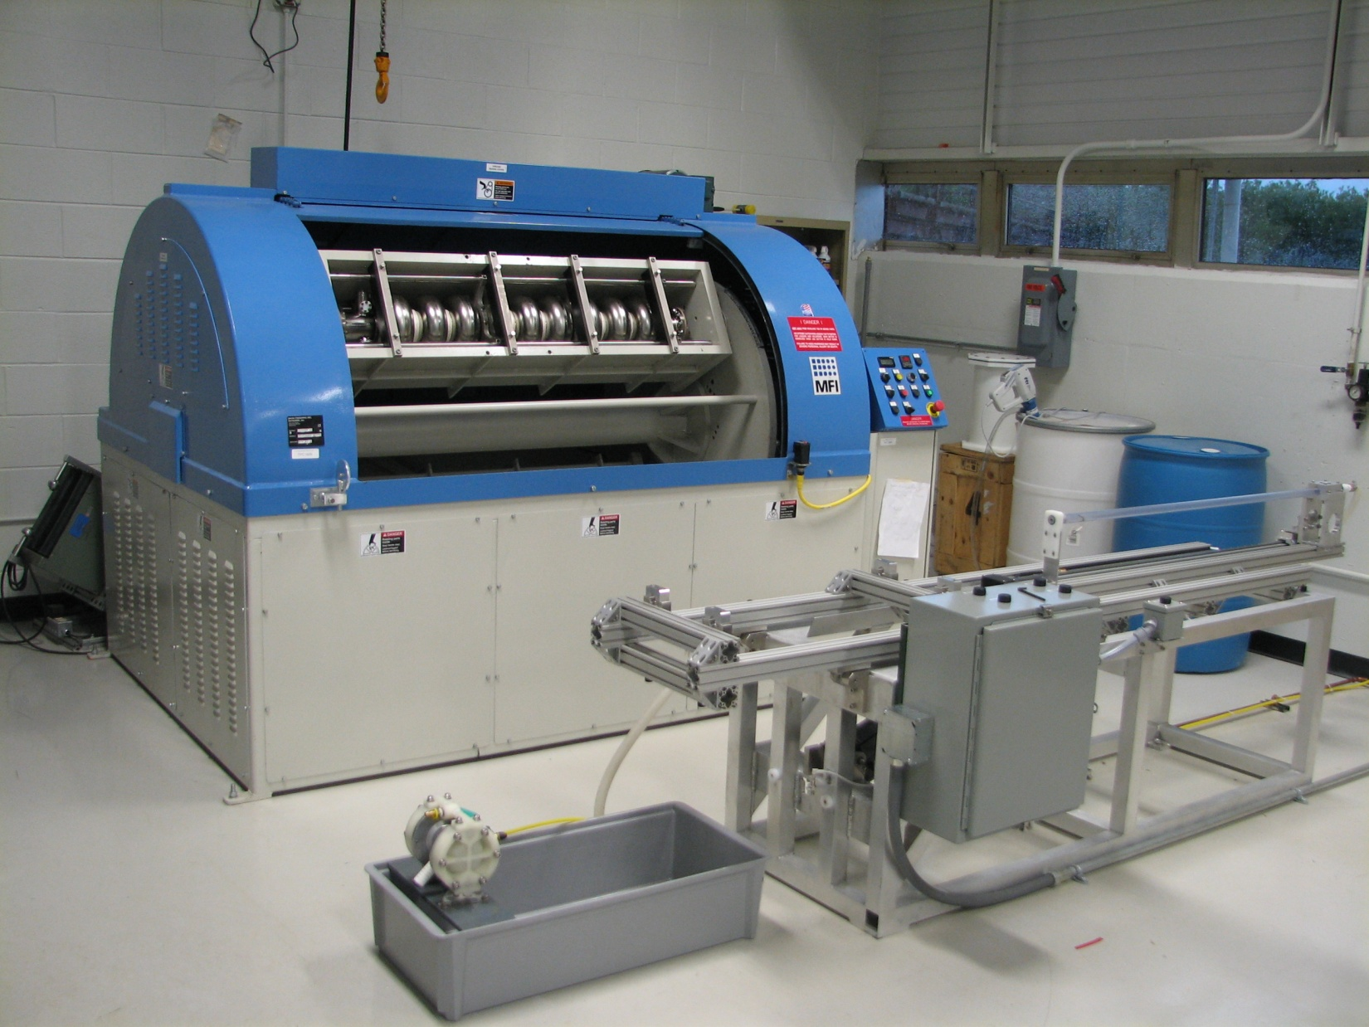
Tumbler & Rinse Station

Slide 8
Cavities Processed
Two 9- Cell Tesla Type Cavities
Eight 1-Cell Tesla Type Cavities
Two 1-Cell 3.9 GHz Cavities
Present all the Cold Test Data Taken
Many of the cavities not tested yet because we were without easy access to a furnace for some time.

Slide 9
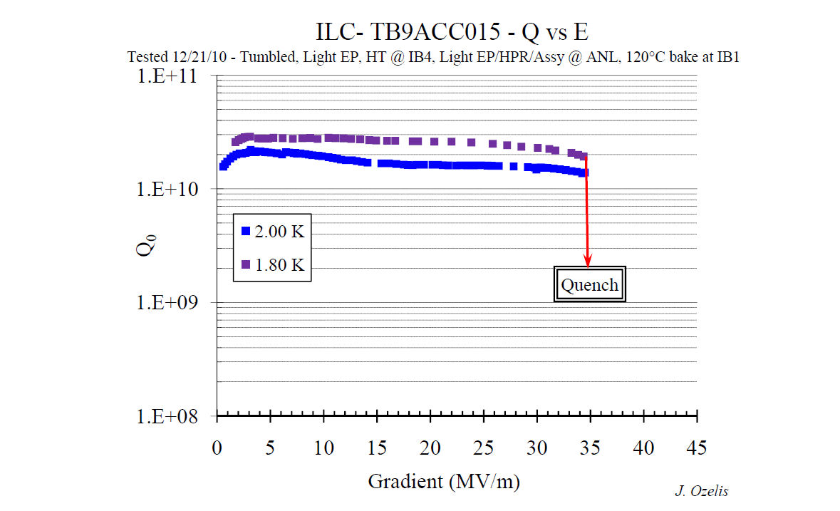
TB9ACC015
Residual Resistance of 6.8 nohms
Had a large (~200micron) pit in cell 3 – previously processed and tested at JLab to 19 MV/m

Slide 10
Virgin Tesla Single Cell Cavity ACC004
Exceeds ILC Goal

Slide 11
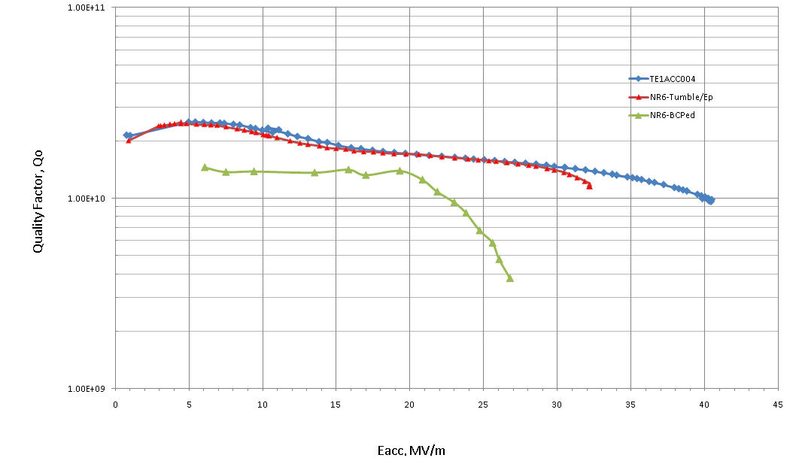
Single Cell Cavity Performance of ACC004 vs NR6
NR6 was tested after tumbling and reached as high as any of the other 6 single cell cavities from Niowave/Roark from that lot.

Slide 12
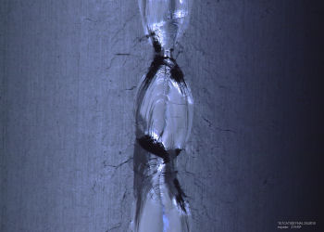
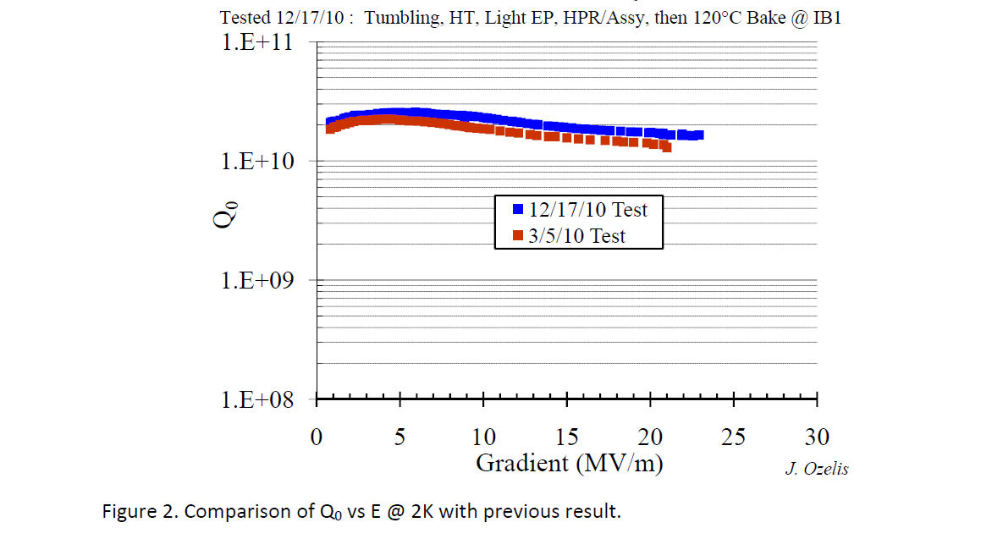
RRCAT2 Single Cell Performance
Irregular weld
Voids in weld by x-ray
Blue – Tumbling
Red - EP

Slide 13
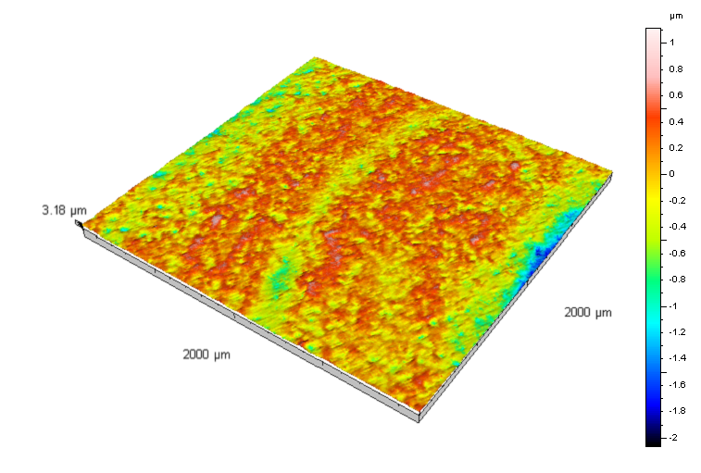
All Previous Results Shown for Cavities With Only Intermediate Polishing
Typical finish achieved by intermediate polishing.
Ra = 0.0692 µm +/- 0.00457 µm
Rz = 1.1 µm +/- 0.188 µm

Slide 14
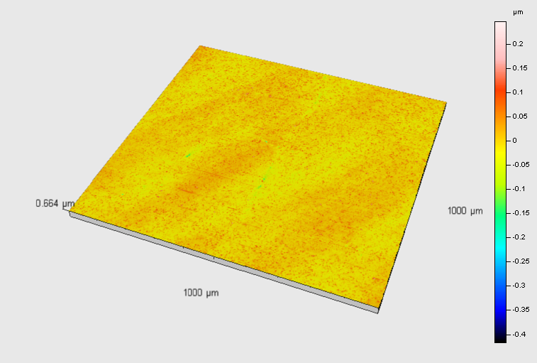
Fine Polishing Yields Mirror Like Surface
Typical finish achieved by fine polishing.
Ra = 0.0139 µm +/- 0.00216 µm
Rz = 0.139 µm +/- 0.0242 µm

Slide 15
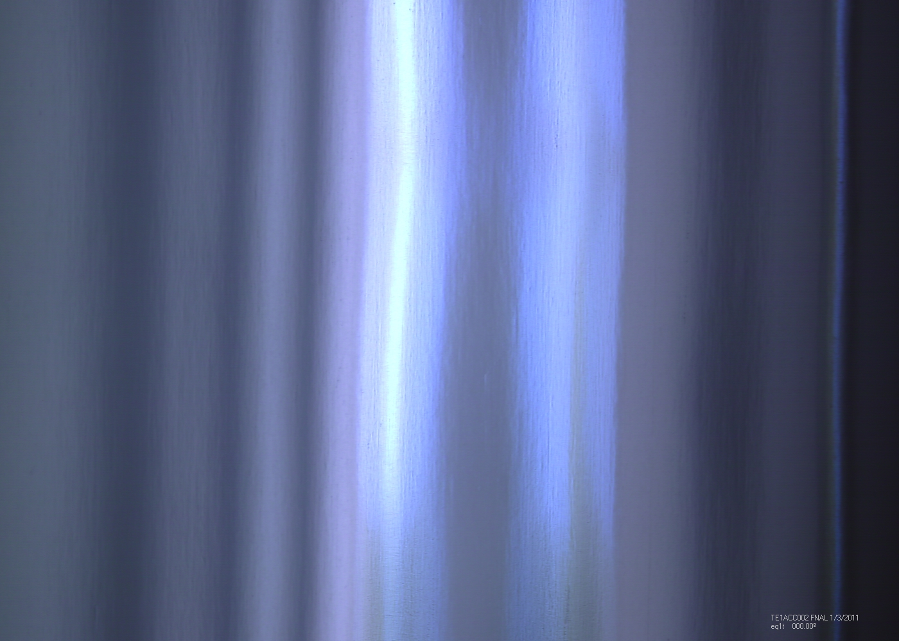
Currently

Slide 16
Current Work
Repair another 9 cell cavity – Mirror Finish
Process a virgin 9 cell cavity – Mirror Finish
Evaluate if a simple HR rinse can replace the micron EP after tumbling
See how mirror finish on single cell cavities effects BCS surface resistance
Tumbled and Being Processed for Cold Testing
Nine Cell
JLab 2 (intermediate finish – large pits)
Single Cell
ACC001(very nice finish) 10 microns EP total
AES005 (mirror finish) 10 microns EP total
ACC002 (mirror finish) HF rinse only

Slide 17
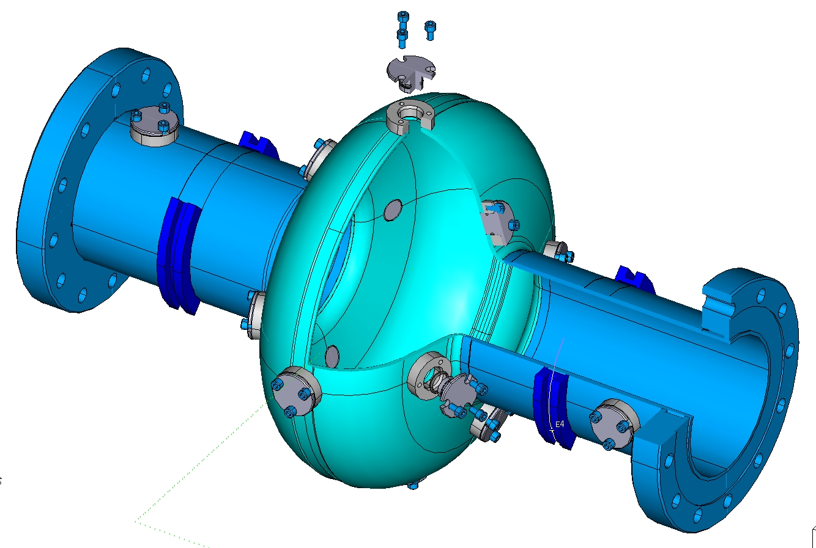
Future Plans - Coupon Cavity
With the use of coupon cavities perfect process.
Use Surface Profilometry and SEM/EDS to determine the average surface roughness and chemical contamination present after each step.

Slide 18
Future Plans
Process re-entrant cavity to mirror finish.
Correlate Ra to cavity performance.
Examine effects of surface chemistry on cavity performance.
Evaluate need for chemistry after heat treatment.
Evaluate “Hydrogen Free” processing that would eliminate the heat treatment step.
Prepare single cell cavities for thin film studies.

