Slide 1
Bananas in X
3804 ns
3815 ns
3826 ns
3838 ns
3849 ns

Slide 2
Jitters in X
3804 ns
3815 ns
3826 ns
3838 ns
3849 ns

Slide 3
Bunch Correlations in X
3804 ns
3815 ns
3826 ns
3838 ns
3849 ns

Slide 4
BPM Correlations in X
3804 ns
3815 ns
3826 ns
3838 ns
3849 ns

Slide 5
Bananas in Y
3804 ns
3815 ns
3826 ns
3838 ns
3849 ns

Slide 6
Jitters in Y
3804 ns
3815 ns
3826 ns
3838 ns
3849 ns

Slide 7
Bunch Correlations in Y
3804 ns
3815 ns
3826 ns
3838 ns
3849 ns

Slide 8
BPM Correlations in Y
3804 ns
3815 ns
3826 ns
3838 ns
3849 ns

Slide 9
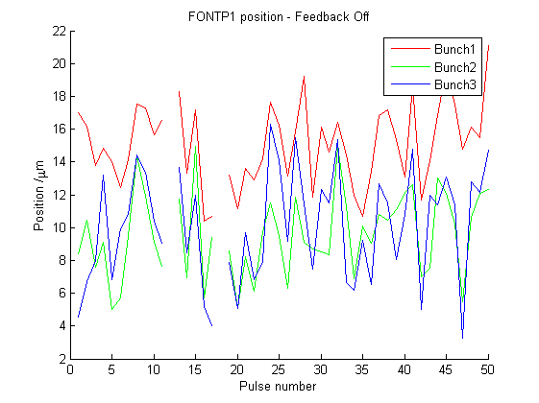
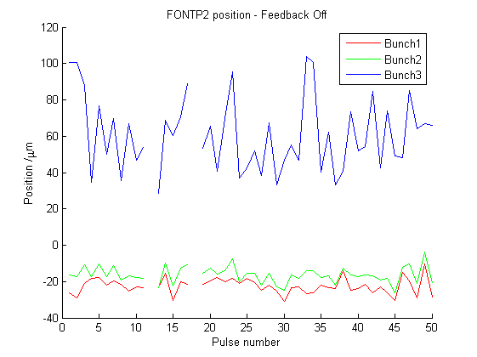
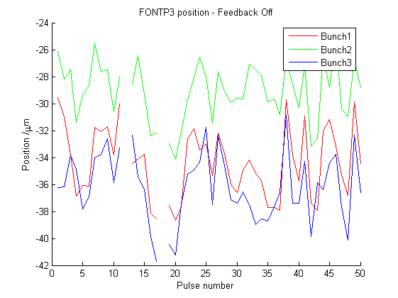
Kicker Delay 3804ns, Measurements in Y

Slide 10
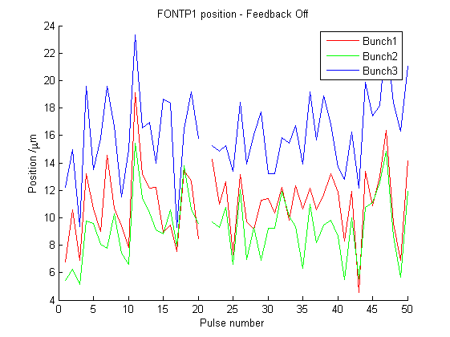
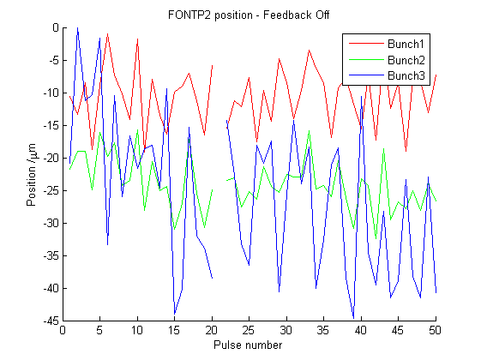
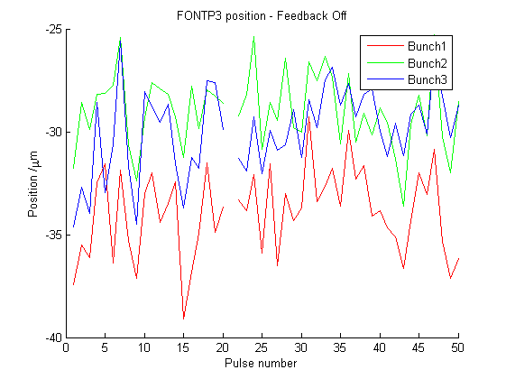
Kicker Delay 3815ns, Measurements in Y

Slide 11
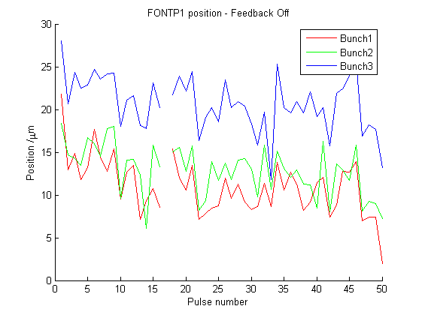
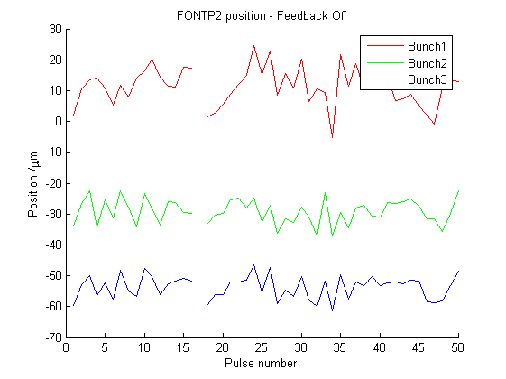
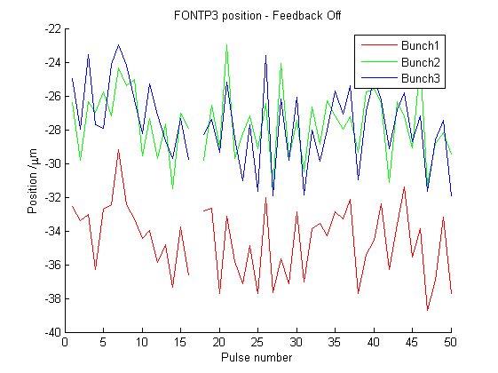
Kicker Delay 3826ns, Measurements in Y

Slide 12
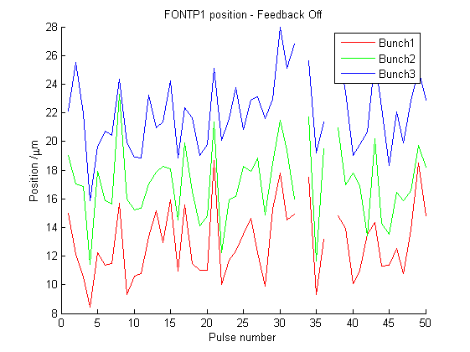
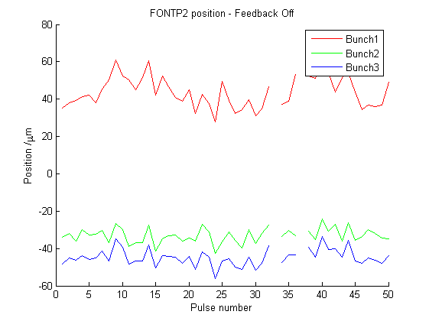
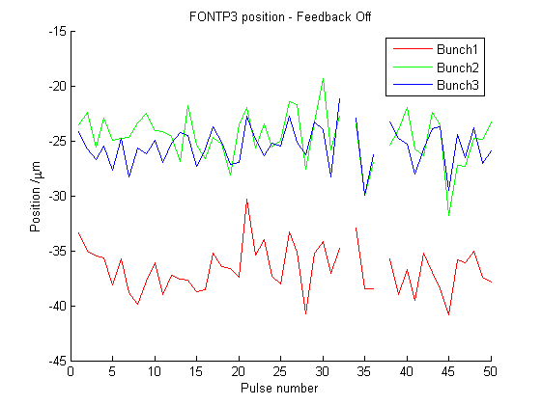
Kicker Delay 3838ns, Measurements in Y

Slide 13
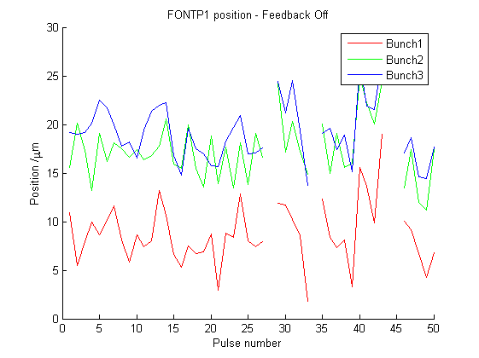
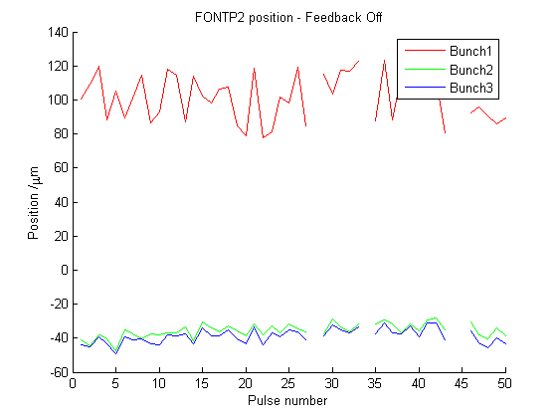
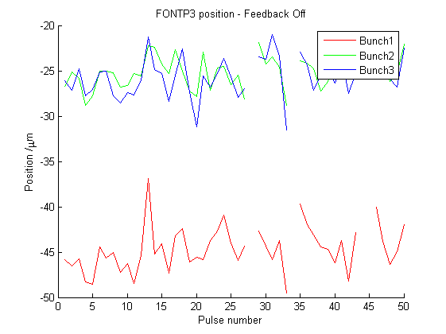
Kicker Delay 3849ns, Measurements in Y

Slide 14
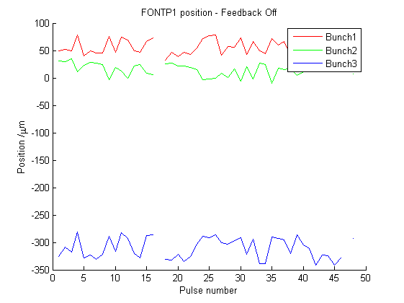
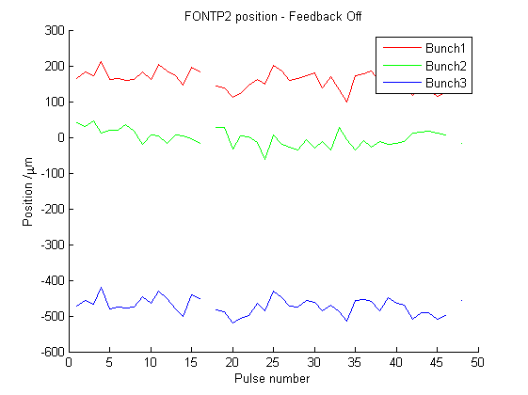
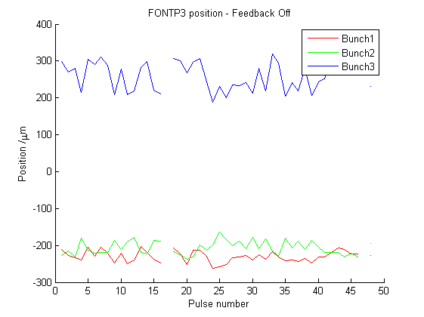
Kicker Delay 3826ns, Measurements in X

Slide 15
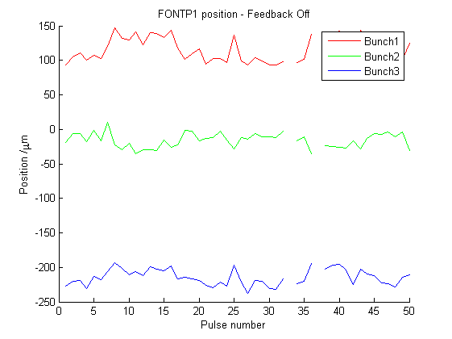
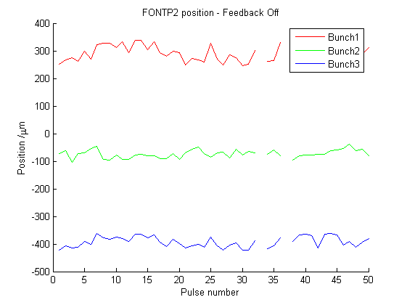
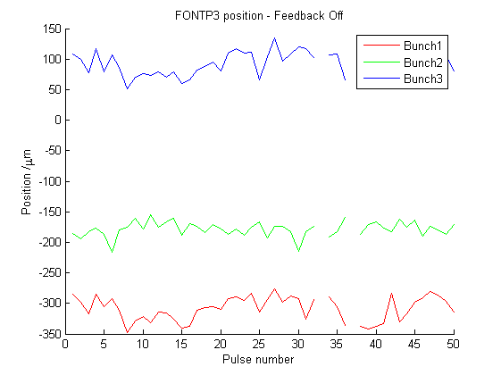
Kicker Delay 3838ns, Measurements in X

Slide 16
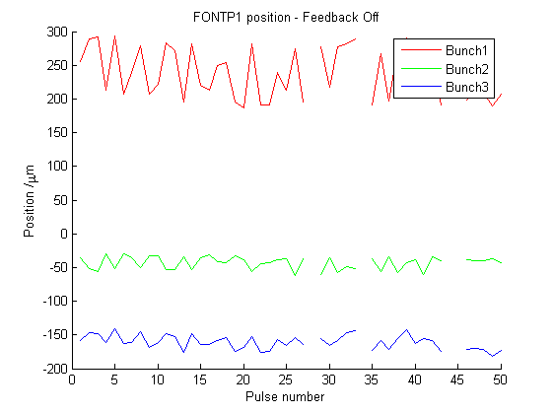
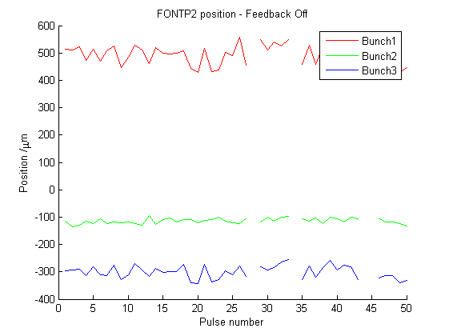
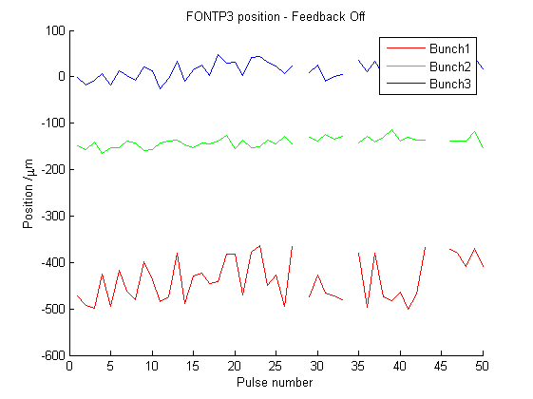
Kicker Delay 3849ns, Measurements in X

