Slide 1
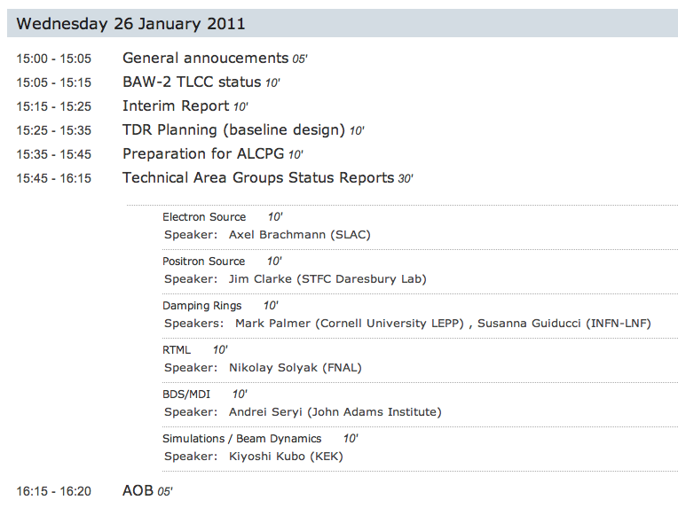
PM

Slide 2
BAW-2 TLCC Status 1/2
Low-P parameters (focus on 500 GeV)
  Damping ring OK
  HLRF solutions OK
  Luminosity
    goal remains 2×10³⁴
    top 30% of L is considered ‘high risk’ due to travelling focus
    (more studies)
Source re-location
  Primary focus on 10Hz alternate pulse implementation
    DR reduced damping time OK
    Positron DR 50% duty cycle OK
    HLRF & cryo requirements OK (no change)
    pulsed magnets and layout work in source needed.
Physics & Detectors
  Generally positive (supportive) response across the board
  Low Ecm running a focus
  Restoration of e+ P from 20% (SB2009) back to 30% (RDR)
400-500 MILCU
saved
cost neutral

Slide 3
BAW-2 TLCC Status 2/2
PMs now complete proposal documents to send to Director for final decision
  submission end of this week
Similar format to KEK BAW documents:
  Scope of change request
  More detailed description
    incremental to SB2009 proposal
  Issues
  Cost impact
Will be made public (via ILC-EDMS)
Director to convene ‘Change Review Panel’ to advise him before final decision
TLCC should be complete by ALCPG ☺

Slide 4
Interim Report
All text now received. Most edited (at least once)
  section 3.1 CestTA to do (NJW)
  Many thanks to all authors
Final editing iteration with communicators (English!) and layout now started
Figures are still an issue
  Several need better resolution copies
  Will send out a list ASAP

Slide 5
ALCPG
Will follow our now established GDE workshops format
  joint plenary with Physics & Detector
  Parallel WG
“Standard” 6 Working Groups:
  Sources
  Damping Rings
  SCRF (Main Linac)
  BDS/MDI
  Beam Dynamics
  CFS
Conveners: TAG leaders + additional (to be announced)
Strong focus on TDR planning
  TDR writing starts here!
  See next slide
R&D status and progress also included
Special session on TeV upgrade
  ultra-high SCRF gradient R&D
http://physics.uoregon.edu/~lc/alcpg/
  Registration Open – please register!

Slide 6
TDR Planning
ALCPG will begin to see the next step in establishing and documenting TDR baseline
Next-Level Change Control process
  PM driven (internal)
Concept: small focused workshops to review baseline design
  Layout, parameters, R&D status (risk)
  Address outstanding design decisions
  Identify what’s missing
Generate relevant design documents (and supporting documents)
  Structured into ILC-EDMS
Expect ~5 face-to-face meetings over 10-12 months
  starting with ALCPG
Goal: comprehensive baseline design for TDR established in ILC-EDMS engineering database by Spring 2012.

