Slide 1
ILC 9mA P_{K}/Q_{L} studies at FLASH shift summary and time logs
Feb 4-8 2011

Slide 2
5 LLRF shifts : overall view
Friday 2/4 night shift:
  no beam
  ACC6/7 vector sum calibration 100 bunches, 1 MHz, 1.6 nC
  QL tuners characterization for ACC6/7
  simulator calibration to reflect ACC6/7 power distribution
Saturday 2/5 night shift:
  1mA beam, low gradient (100 MeV – 200 MeV)
  Successfully implemented QL adjustments to flatten cavity gradients
  beam loading tilts correction (all tilts below 1%) using simulator predicted values
  Simulated values are reliable
Sunday 2/6 night shift:
  1.6mA beam, low gradient (200 MeV)
  low gradient, beam loading tilts Q_{L} correction (below 1%)
  beam current scan
  QL scan
Monday 2/7 night shift:
  3.0mA beam, 200 MeV
  QL adjusted for gradient flat at 3mA
  beam scan from 0.9 to 4.5 mA
  4.5mA beam, 300 MeV
  QL adjusted for gradient flat at 4.5 mA
  beam current scan
Tuesday 2/8 afternoon shift:
  4.2mA beam, 360 MeV
  Lorentz force detuning compensation
  Use calculator to predict QL → gives very accurate prediction
  Flatten ACC6/7 gradients tilts to ~ 1.5%
  beam current scan

Slide 3
Friday Feb. 4 night shift

Slide 4
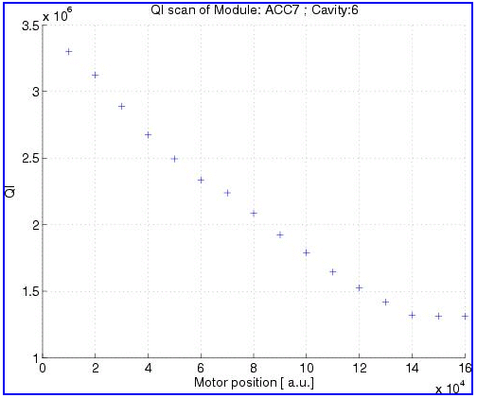
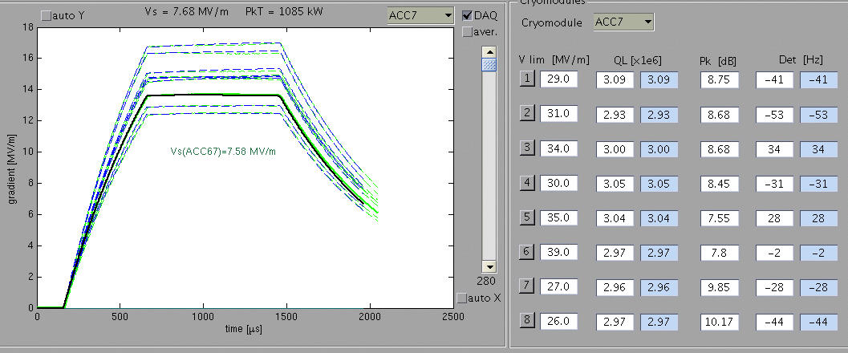
Friday 2/4 night shift – highlights:
no beam
ACC6/7 vector sum calibration 100 bunches, 1 MHz, 1.6 nC
Q_{L} tuners characterization for ACC6/7
simulator calibration to reflect ACC6/7 power distribution

Slide 5
Friday Feb. 4 night shift
ACC6 QL range scans
  Cav1:
  Cav2:
  Cav3:
  Cav4:
  Cav5:
  Cav6:
  Cav7:
  Cav8:
ACC7 QL range scans
  Cav1: 1.2 → 3.3
  Cav2: 2.0 → 3.7
  Cav3: 1.7 → 3.7
  Cav4: 1.2 → 3.7
  Cav5: 1.2 → 3.3
  Cav6: 1.6 → 3.2
  Cav7: 1.2 → 3.2
  Cav8: 2.2 → 4.5

Slide 6
Saturday Feb. 5 night shift

Slide 7
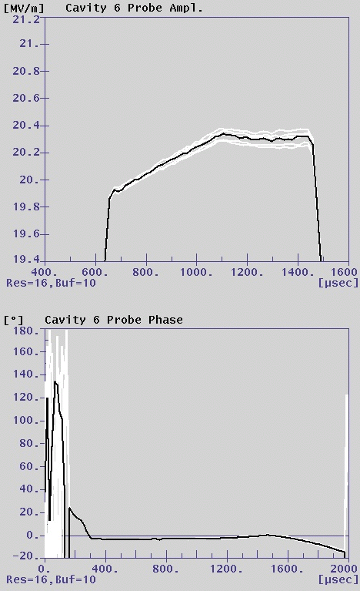
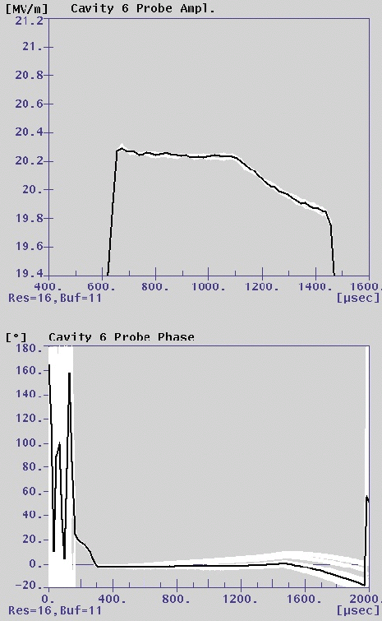
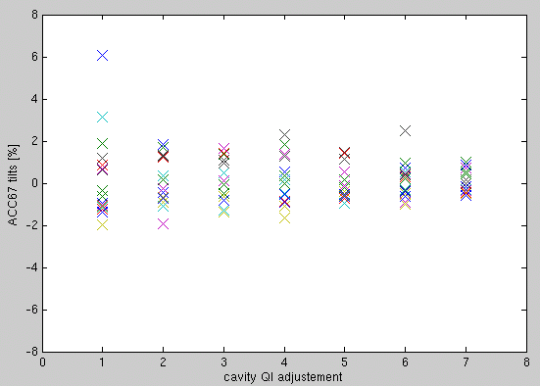
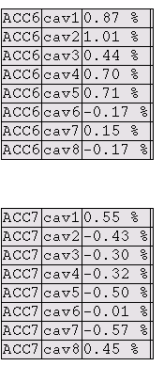
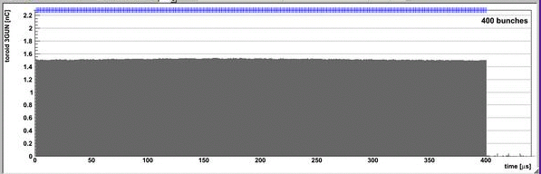
Saturday 2/5 night shift – highlights:
1mA beam, low gradient (100–200 MeV)
Successfully implemented QL adjustments to flatten cavity gradients
beam loading tilts correction (all tilts below 1%) using simulator predicted values
Simulated values are reliable
Q_{L} = 3e6
Q_{L} = 2.65e6

Slide 8
Saturday Feb. 5 night shift
ACC6-cav4: QL → 2.8e6 2:13 am
ACC6-cav5: QL → 3.4e6 3:07 am
ACC6-cav1: QL → 2.5e6 3:25 am
ACC6-cav2: QL → 2.9e6
ACC6-cav6: QL → 3.3e6 4:08 am
ACC6-cav3: QL → 2.85e6 4:34 am
ACC6-cav7: retune + beam on 4:36 am
Turn FB off 4:41 am
ACC7-cav6: QL → 2.65e6 4:55 am
Beam ON/OFF 5:29 – 5:30am

Slide 9
Sunday Feb. 6 night shift

Slide 10
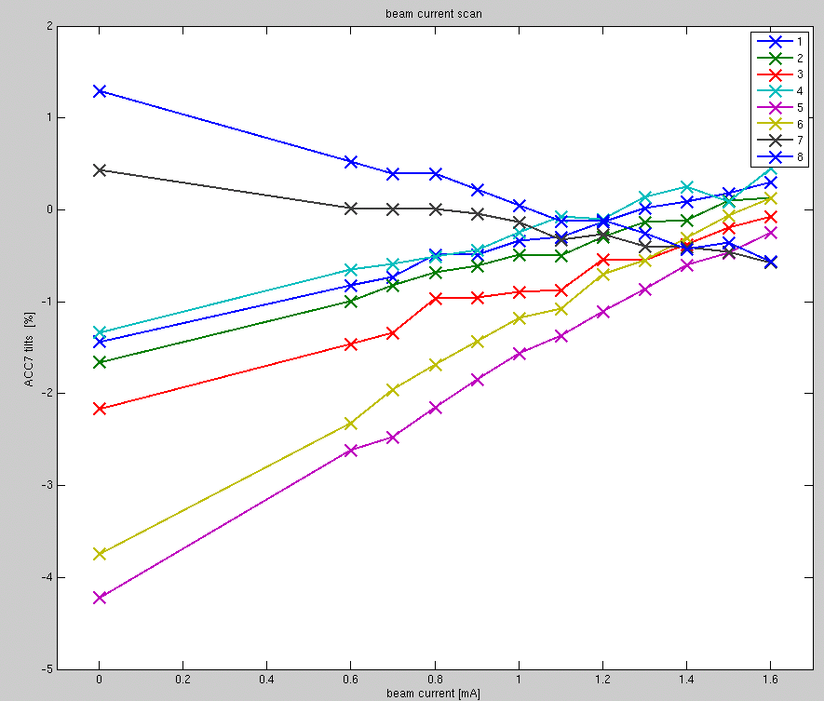
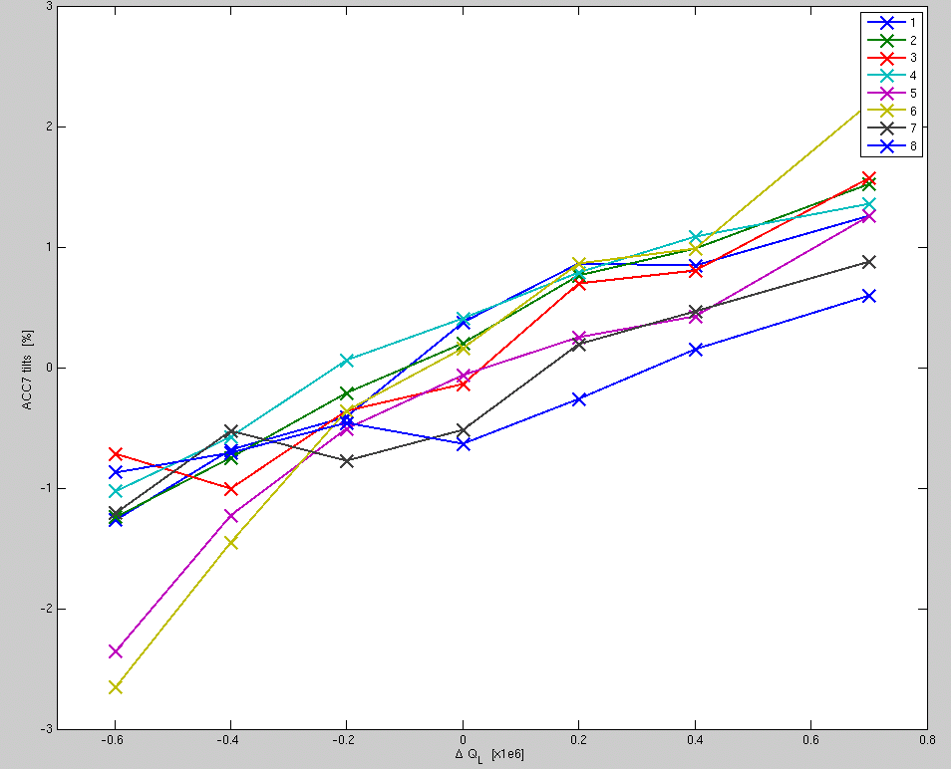
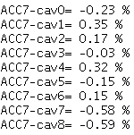
Sunday 2/6 night shift – highlights:
1.6mA beam, low gradient (200 MeV)
beam loading tilts Q_{L} correction (below 1%)
(several cavities at once, with beam on)
beam current scan
Q_{L} scan
Ql config is for ACC7:
cav1 : 2.8 e6
cav2 : 2.8 e6
cav3 : 2.8 e6
cav4 : 2.8 e6
cav5 : 2.5 e6
cav6 : 2.5 e6
cav7 : 3.1 e6
cav8 : 3.2 e6

Slide 11
Sunday Feb. 6 night shift
Initial conditions 23:44 – 23:54
ACC6 QL adjustments
  ACC6-cav5: QL → 5.5e6
  ACC6-cav6: QL → 5.5e6
  ACC6-cav1: QL → 3e6
  ACC6-cav2: QL → 3e6
  ACC6-cav3: QL → 2.9e6
  ACC6-cav8: QL → 3.4e6
Beam OFF 1:04 am
Beam ON/OFF 1:26 – 1:27 am
ACC7 QL adjustments
  ACC7-cav1: QL → 2.8e6
  ACC7-cav2: QL → 2.8e6
  ACC7-cav4: QL → 2.8e6
  ACC7-cav5: QL → 2.5e6
  ACC7-cav6: QL → 2.5e6
Beam ON/OFF 2:00 -2:02 am
ACC7-cav3: QL → 2.8e6 2:25 am
ACC7-cav8: QL → 3.2e6 2:51 am

Slide 12
Sunday Feb. 6 night shift (cont’d)
Beam scan times
  3:03 am 1.6nC
  3:04 am 1.5nC
  3:06 am 1.4nC
  3:07:11 am 1.3nC
  3:07:49 am 1.2nC
  3:09:11 am 1.1nC
  3:10:43 am 1.0nC
  3:11:49 am 0.9nC
  3:13:13 am 0.8nC
  3:14:32 am 0.7nC
  3:15:32 am 0.6nC
  3:19:57 am 0nC
  3:20:56 am 1.6nC

Slide 13
Sunday Feb. 6 night shift (cont’d)
QL scan
ACC7 | 0 | -0.2 | -0.4 | -0.6 | +0.2 | +0.4 | +0.7
Cav1 | 2.8 | 2.6 | 2.4 | 2.2 | 3.0 | 3.2 | 3.5
Cav2 | 2.8 | 2.6 | 2.4 | 2.2 | 3.0 | 3.2 | 3.5
Cav3 | 2.8 | 2.6 | 2.4 | 2.2 | 3.0 | 3.2 | 3.5
Cav4 | 2.8 | 2.6 | 2.4 | 2.2 | 3.0 | 3.2 | 3.5
Cav5 | 2.5 | 2.3 | 2.1 | 1.9 | 2.7 | 2.9 | 3.2
Cav6 | 2.5 | 2.3 | 2.1 | 1.9 | 2.7 | 2.9 | 3.2
Cav7 | 3.1 | 2.9 | 2.7 | 2.5 | 3.3 | 3.5 | 3.8
Cav8 | 3.2 | 3.0 | 2.8 | 2.6 | 3.4 | 3.6 | 3.9
TIME | 3:20:56 | 3:54:40 | 4:05:21 | 4:13:25 | 4:35:45 | 4:43:22 | 5:01:59

Slide 14
Monday Feb. 7 night shift

Slide 15
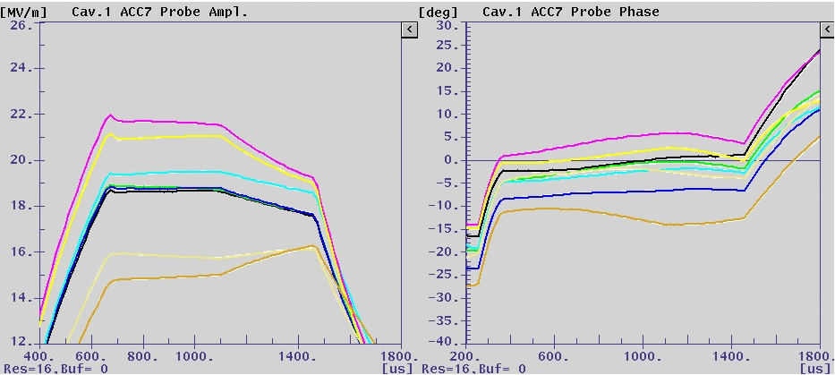
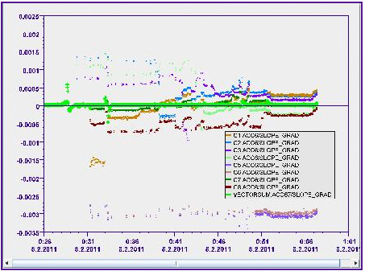
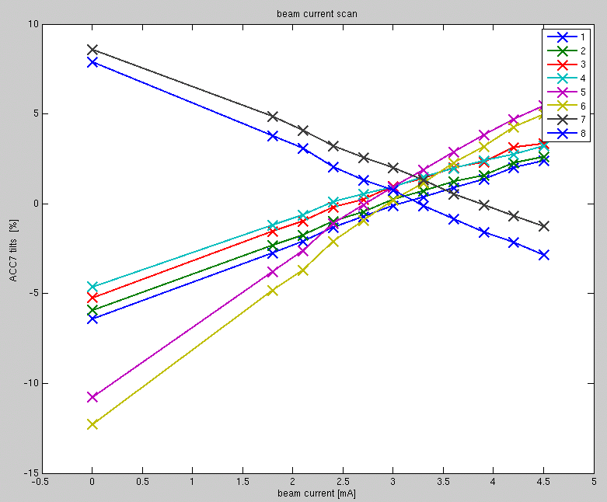
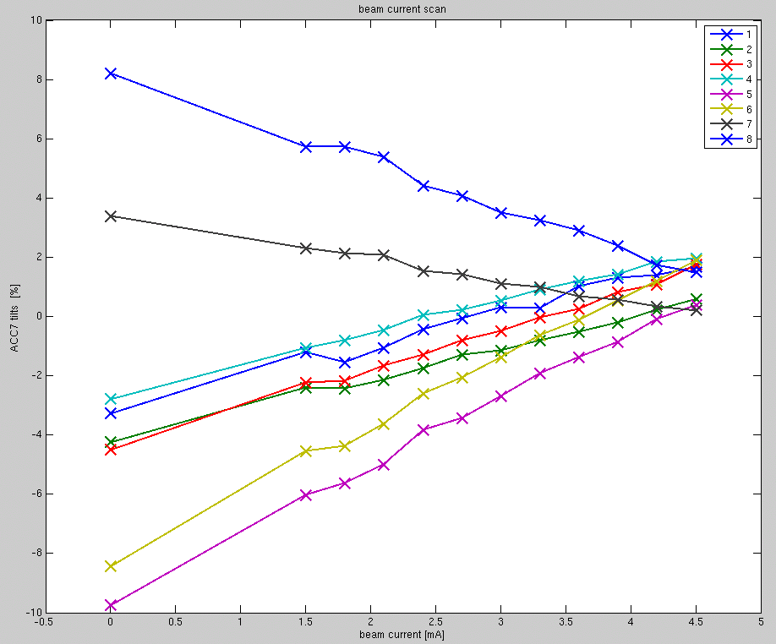
Monday 2/7 night shift – highlights:
3.0mA beam, 200 MeV
Q_{L} adjusted for gradient flat at 3mA
beam scan from 0.9 to 4.5 mA
4.5mA beam, 300 MeV
QL adjusted for gradient flat at 4.5 mA
beam current scan

Slide 16
Monday Feb. 7 night shift
Initial conditions, 1nC, 3MHz 23:10
Initial tilts 23:19:36
ACC6 QL adjustments
  Cav1: QL → 2.2e6
  Cav2: QL → 2.2e6
  Cav3: QL → 2.4e6
  Cav4: QL → 2.4e6
  Cav5: QL → 4.1
  Cav6: QL → 4.0
  Cav7: QL → 3.5e6
  Cav8: QL → 4.0e6
End of ACC6 QL adjustments 0:52 am
ACC7 QL adjustments
  Cav1: QL → 2.2e6
  Cav2: QL → 2.2e6
  Cav3: QL → 2.2e6
  Cav4: QL → 2.0e6
  Cav5: QL → 1.9e6
  Cav6: QL → 1.9e6
  Cav7: QL → 2.7e6
  Cav8: QL → 2.7e6
End of ACC7 QL adjustments 1:08 am
Tuning ACC7 1:33 am

Slide 17
Monday Feb. 7 night shift (cont’d)
Beam current scan
  Reference 1:34:23 am
  0.6nC 1:37:28 am
  0.7nC 1:38:09 am
  0.8nC 1:38:30 am
  0.9nC 1:38:56 am
  1.0nC 1:39:20 am
  1.1nC 1:39:46 am
  1.2nC 1:40:39 am
  1.3nC 1:41:31 am
  1.4nC 1:42:12 am
  1.5nC 1:42:59 am
  0nC 1:43:44 am
Beam ON (drift / stability analysis) start 2:07 am

Slide 18
Monday Feb. 7 night shift (cont’d)
Increased energy to 300 MeV (Vsum ~ 18.75 MV/m), 4.5 mA
ACC6 QL adjustments
  Cav1: QL predicted (2.5e6) implemented (2.4e6)
  Cav2: QL predicted (2.5e6) implemented (2.4e6)
  Cav3: QL predicted (2.5e6) implemented (2.4e6)
  Cav4: QL predicted (2.6e6) implemented (2.4e6)
  Cav5: QL predicted (4.0e6) implemented (4.3e6)
  Cav6: QL predicted (4.0e6) implemented (4.4e6)
  Cav7: QL predicted (3.7e6) implemented (2.85e6)
  Cav8: QL predicted (3.7e6) implemented (2.86e6)
ACC7 QL adjustments
  Cav1:QL predicted (2.6e6) implemented (2.4e6)
  Cav2:QL predicted (2.6e6) implemented (2.4e6)
  Cav3:QL predicted (2.5e6) implemented (2.4e6)
  Cav4:QL predicted (2.4e6) implemented (2.4e6)
  Cav5:QL predicted (2.1e6) implemented (2.1e6)
  Cav6:QL predicted (2.2e6) implemented (2.2e6)
  Cav7:QL predicted (3.5e6) implemented (2.8e6)
  Cav8:QL predicted (3.8e6) implemented (2.9e6)
ACC6/7 adjusted 4:17 am
ACC4/5 corrected 4:22 am
Beam 3mA 4:51 am
Beam 4.5 mA 4:57 am

Slide 19
Monday Feb. 7 night shift (cont’d)
Beam current scan 4.5mA, 300 MeV
  1.5nC 5:46:14 am
  1.4nC 5:47:00 am
  1.3nC 5:47:20 am
  1.2nC 5:47:46 am
  1.1nC 5:48:06 am
  1.0nC 5:48:27 am
  0.9nC 5:48:52 am
  0.8nC 5:49:26 am
  0.7nC 5:49:58 am
  0.6nC 5:50:13 am
  0.5nC 5:50:51 am
  0nC 5:51:36 am

Slide 20
Tuesday Feb. 8 afternoon shift

Slide 21
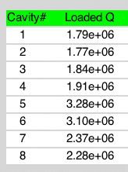
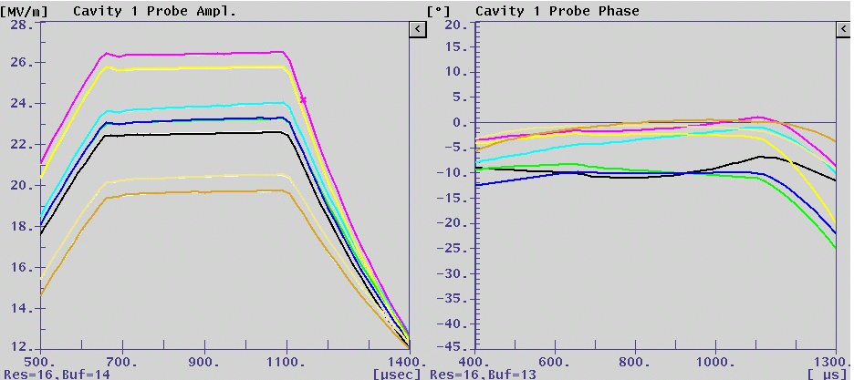
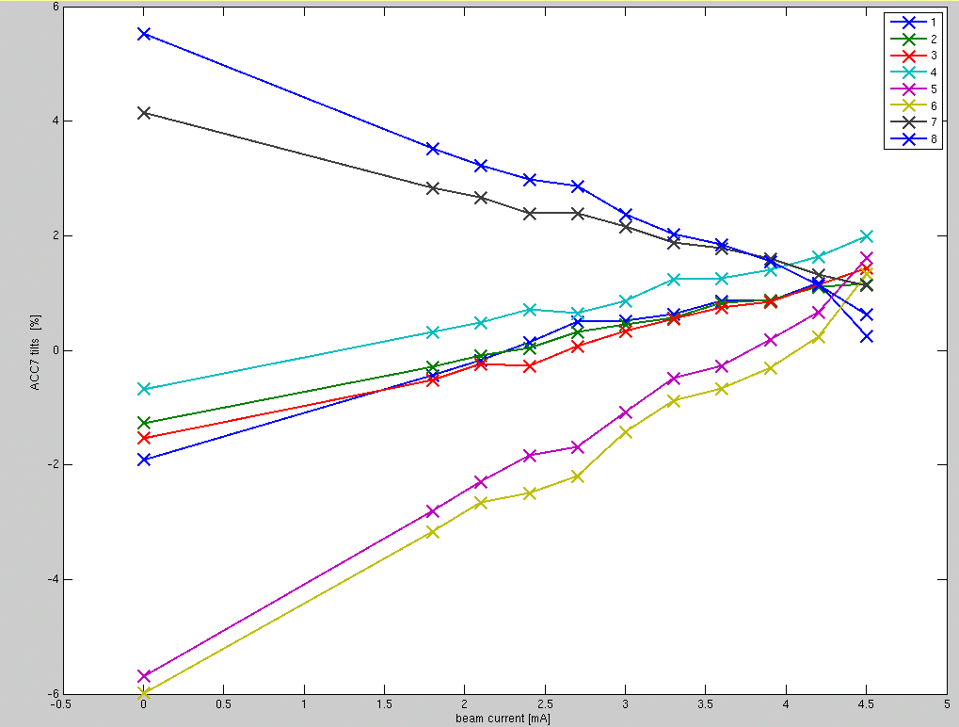
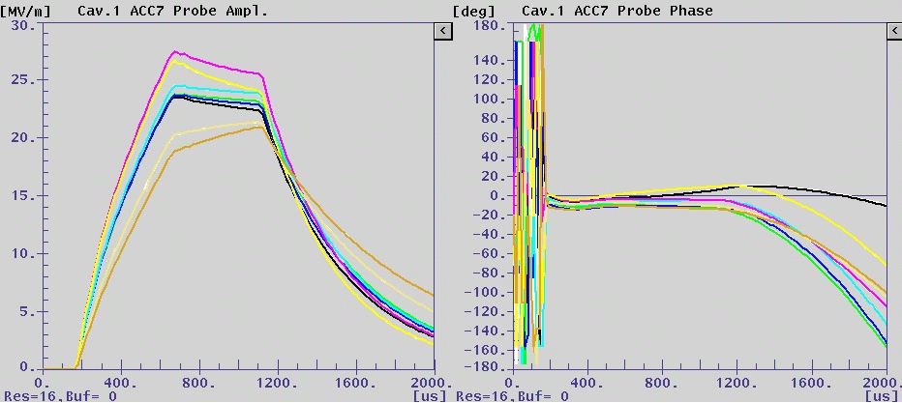
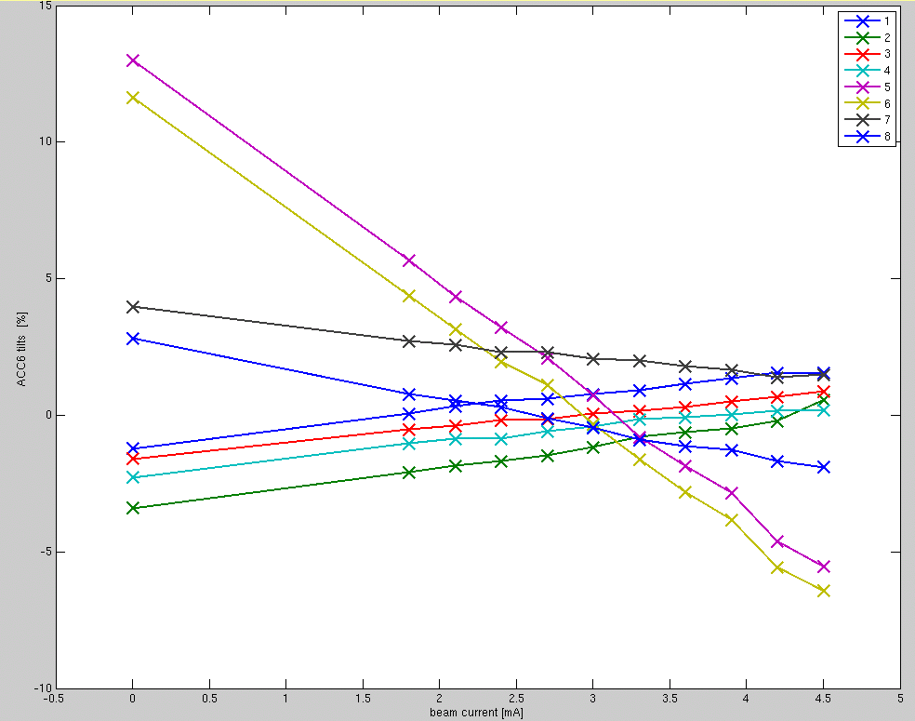
ACC7 Q_{L} values
Predicted Implemented
cav1. 1.78 e6
cav2. 1.74 e6
cav3. 1.85 e6
cav4. 1.88 e6
cav5. 3.25 e6
cav6. 3.12 e6
cav7. 2.37 e6
cav8. 2.40 e6
Tuesday 2/8 afternoon shift – highlights:
4.2mA beam, 360 MeV
Lorentz force detuning compensation
Use calculator to predict QL → very accurate prediction
Flatten ACC6/7 gradients tilts to ~ 1.5% (tuned for 4.2mA)
beam current scan to 4.5 mA
Beam ON
ACC7
ACC6
Beam OFF

Slide 22
Tuesday Feb. 8 afternoon shift
500 usec flat top (shorten to prevent quench)
1.4nC, 3MHz beam stable 19:08
Adjusted piezo
Adjusted ACC7 according to Gustavo’s values 19:58
Adjusted ACC6 according Gustavo’s values 20:34
Tilt measurement 20:52
Beam scan
  1.5nC 21:02:04
  1.4nC 20:50:37
  1.3nC 20:53:01
  1.2nC 20:53:27
  1.1nC 20:53:41
  1.0nC 20:54:03
  0.9nC 20:55:34
  0.8nC 20:56:53
  0.7nC 20:58:59
  0.6nC 21:00:07
  0nC 21:07:04
Tilt measurement 21:26
Readjustment of piezo

Slide 23
A few comments
Overall, machine very reliable and up all the time
  Some hysteresis with frequency tuner
  No end cap for Q_{L} tuners
Tuning the cavity plays a crucial role in getting the gradient flat
  Static detuning
  LFD compensation
Easier to flatten cavities:
  at lower gradients (less LFD)
  at lower currents (less beam loading, smaller Q_{L} corrections)
Simulation is reliable to predict Q_{L} values
No solution to flatten cavity traces for maximum gradient

