Slide 1
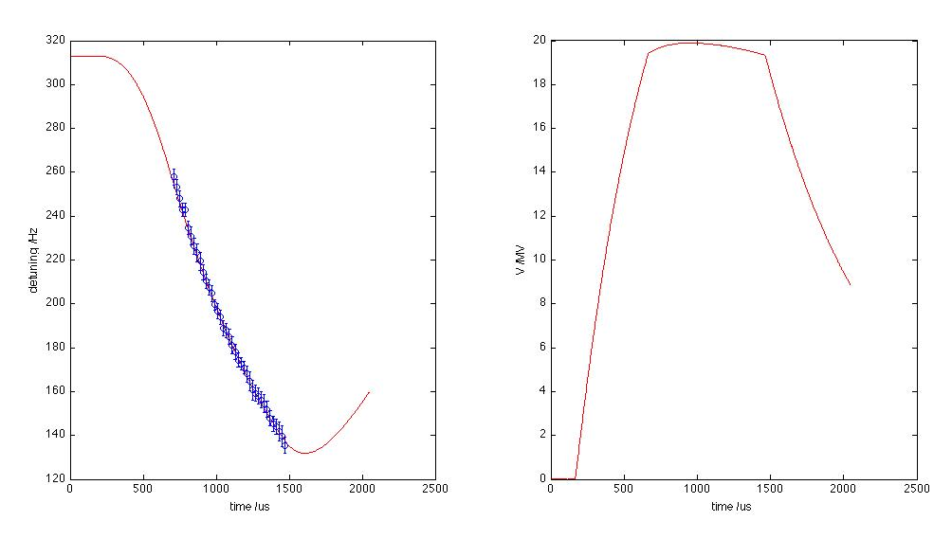
ACC6 cavity #1
Measured detuning
Fit to LFD model assuming measured cavity voltage
Assumed DAQ scale for V[MV]=7.15×10⁻⁴ V_{DAQ}
Adjusted initial detuning Δω₀ and K_{LFD}
Δω₀ = 310 Hz
K_{LFD} = 4. 5×10⁻¹² Hz/V²
Assumed τ_{LFD} = 1ms

Slide 2
Comments
Detuning calculated from data taken 4.02.11 by JC.
Adjusted RF pulse length and measured detuning using phase change at end of pulse (zero forward power) where dφ/dt = Δω⋅t
Fit also sensitive to τ_{LFD} – need data at additional gradients to get better fit.

