Slide 1
Review Layout of E- Linac Side of Central Region for Feb 10,2011 Meeting
For E+ use Norbert’s data from CF&S meeting 12th July, 2010, which has coordinates of E+ systems in X,Y and Z with Z=0 at the IP
For BDS use Seryi presentation at BAW-2 Jan, 2011. Coordinates have IP at 3400 m.
Combine into single ‘physicist’ picture and check for consistency--- see next slide
Result is only an approximate fit! For example Norbert has TGT at 2172 m from IP and Andrei has it at 2300m.
Did recent changes to polarimeter etc chicanes lengthen BDS?

Slide 2
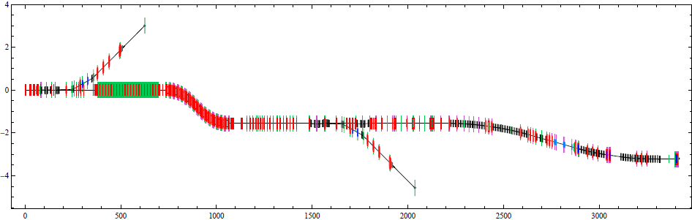
GEOMETRY OF CENTRAL REGION
Geometry of Central Region Electron Linac E+ Source Side
Fast abort line
TGT & TW Accel
LTR & RTML
5 GeV Booster
Positron Capture
Undulator
Dogleg
Betatron collimation
Energy collimation
Sacrificial collimators + chicane to detect off energy beams
Final Focus
Chicane to detect LW photons
Polarimeter chicane
Skew correction & emittance measurement
DC Tuning line
Main Dump
IP
3500 3000 2500 2000 1500 1000 500 0

Slide 3
Some Questions coming from this exercise to think about before Feb 10
Need to resolve layouts of E+ source and BDS
Location of Iron Wall needs to be fixed to allow access to IR with beams to and from DR.
Need to discuss layout options, (doglegs and dumps) for 10 Hz operation.
Asymmetry between E+ and E- side of Central needs attention…. Either add dogleg to E+ linac side which makes everything symmetric or offset linacs and tunnels by 1.5 meters which complicates LTR/RTML layouts and CFS design.

Slide 4
Backup source material
The referenced presentations are available via INDICO
Have not checked what is in EDMS

Slide 5
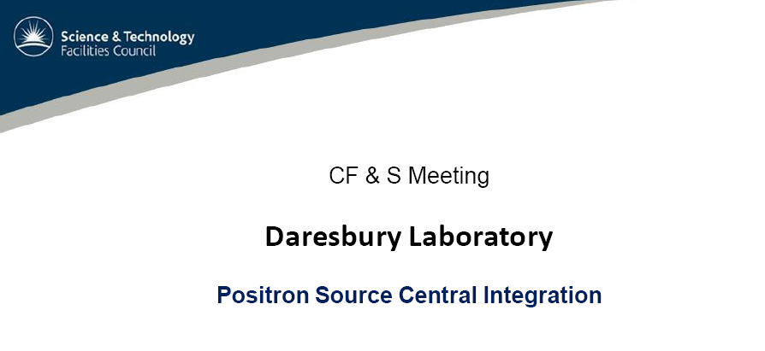
Meeting July, 2010

Slide 6
Earlier BDS

Slide 7
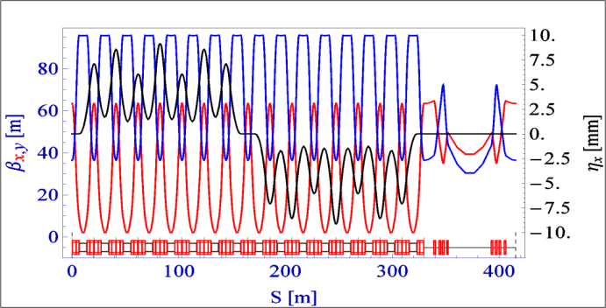
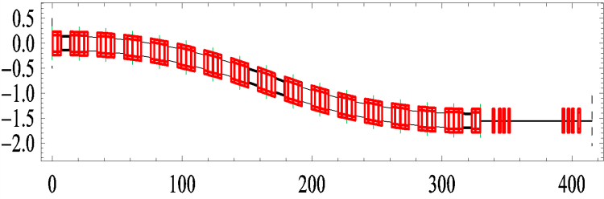
At BAW-2 (A. Seryi Talk)
e-BDS
Fast abort line
Chicane to detect LW photons
Polarimetry chicane
Undulator
Dogleg
Betatron collimation
Energy collimation
Sacrificial collimators + chicane to detect off energy beams
Final Focus
Skew correction & emittance measurement
DC Tuning
line
IP

