Slide 1
Positron Source meeting
J. Clarke, D. Angal-Kalinin, N. Collomb

Slide 2
Positron Source close out
Positron Source is broken down into the following parts
  Undulator Area
    Undulator Protection
    Undulator Matching
    Fast Abort Dump
    Auxiliary Source
    Target Area
    Capture Area
    ‘Positron Source’ Dogleg
    Transfer Line (PTRAN 1 and 2)
    5GeV Booster
    Positron Line Transfer (PLTR)
      Spin Rotation
      Energy Compression

Slide 3
Positron Source close out
Each section has a list of:
  Work done,
  Improvement suggestion and
  Work to be done
  There are 2 documents pertinent to this work:
  Document list – contains the majority of documents used to perform the work
  ILC Central Integration Close Out report – provides an overview of the work done for the Central Integration task

Slide 4

Positron Source – General View
Positron Source side of ILC including BDS, RTML, Positron Source and Damping Ring extract
Damping Ring extract ‘smudge’
PLTR ‘smudge’
PTRAN 2
Fast Abort ‘smudge’
I.P.
Tune-up ‘smudge’
5GeV Booster
PTRAN 1
End of Main LINAC
Positron ‘Production Area’, incl. AUX Source, Target, Capture, 400MeV Pre-Accelerator and ‘Positron Source’ Dogleg
Undulator Area

Slide 5
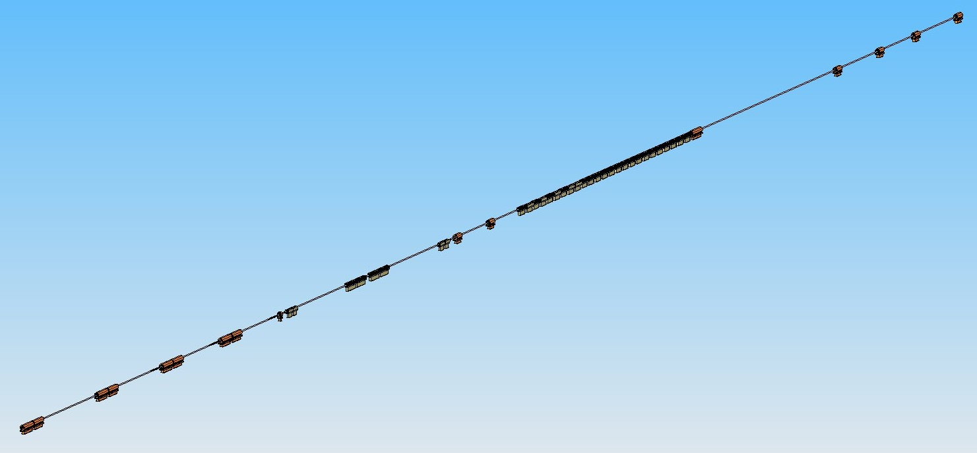
Positron Source – Undulator Protection
Model created using the lattice design from 09/09/2009 (Positron Source – SB2009 simplified.xlsx)
Costing is based on specified magnets (SB2009 CostsV2a.xls) and Magnets_uberSummary_allStyles and vacuum_Positron_source_vacuum_cost_estimate_04_Nov_2009.xlsx
End of Main LINAC
Heat – Power load estimate (Positron Source Global Heat Load Summary.xlsx) based on 07-02-28 ILC Magnet Power Supply List.xls and other magnet data available
This area can be optimised according to http://projects.astec.ac.uk/ilcdecks/ in conjunction with the Fast Abort Dump. These sections have been ‘copied’ from the RDR Tune-Up line and undergone an initial optimisation process.

Slide 6
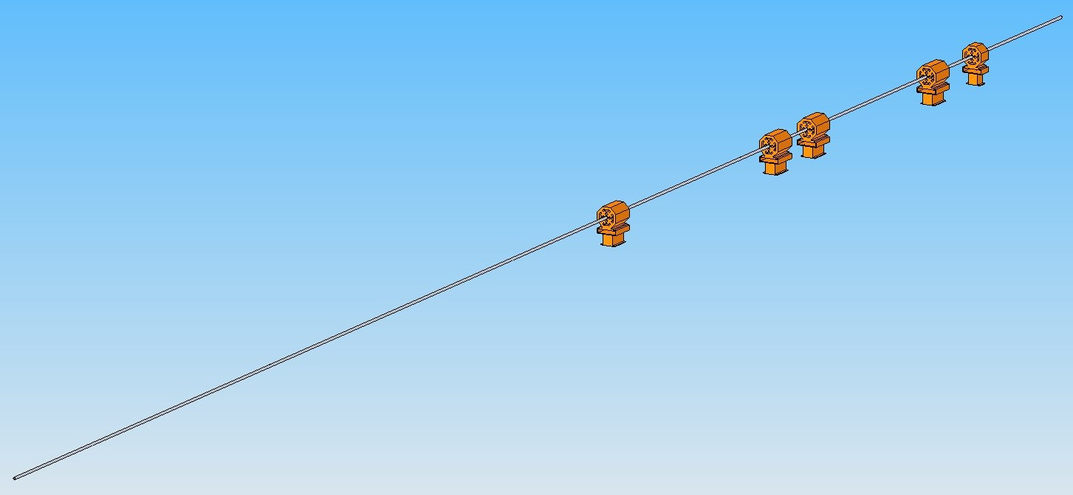
Positron Source – Undulator Matching
Model created using the lattice design from 09/09/2009 (Positron Source – SB2009 simplified.xlsx)
Heat – Power load estimate (Positron Source Global Heat Load Summary.xlsx) based on 07-02-28 ILC Magnet Power Supply List.xls and other magnet data available
Costing is based on specified magnets (SB2009 CostsV2a.xls) and Magnets_uberSummary_allStyles and vacuum_Positron_source_vacuum_cost_estimate_04_Nov_2009.xlsx
This area can be considered complete. There may be a change in position (relative to I.P.) due to BDS optimisation.

Slide 7
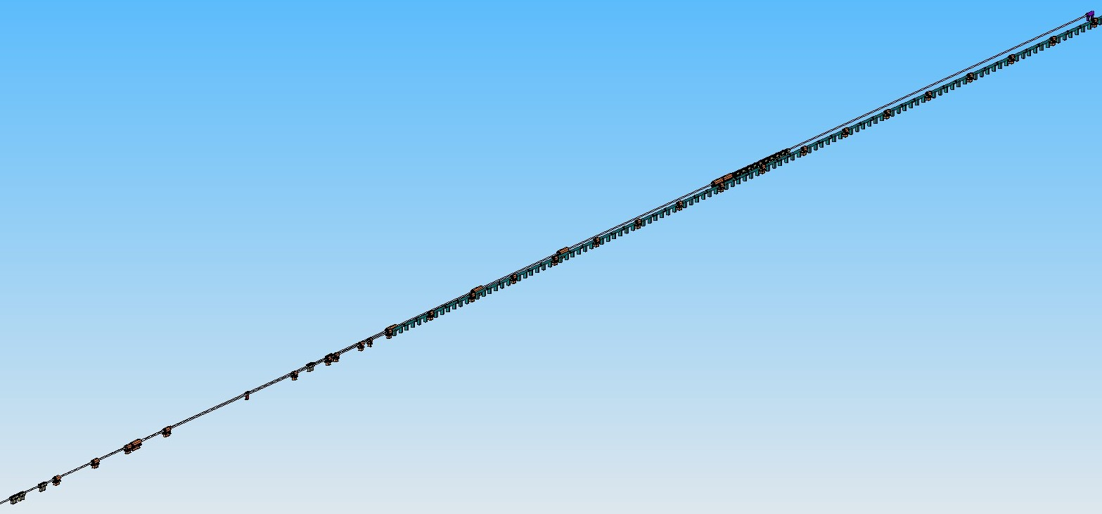
Positron Source – Fast Abort
Model created using the lattice design from 09/09/2009 (Positron Source – SB2009 simplified.xlsx)
Heat – Power load estimate (Positron Source Global Heat Load Summary.xlsx) based on 07-02-28 ILC Magnet Power Supply List.xls and other magnet data available
Costing is based on specified magnets (SB2009 CostsV2a.xls) and Magnets_uberSummary_allStyles and vacuum_Positron_source_vacuum_cost_estimate_04_Nov_2009.xlsx
This area must be revised. Some criteria to bear in mind are the shielding requirement and separation from Undulator section.

Slide 8
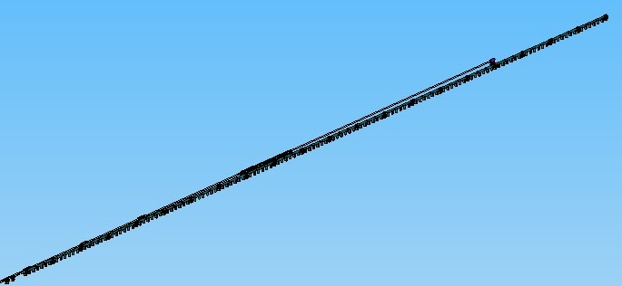
Positron Source – Undulator
Model created using the lattice design from 09/09/2009 (Positron Source – SB2009 simplified.xlsx)
Heat – Power load estimate (Positron Source Global Heat Load Summary.xlsx) established from information supplied by RAL colleagues
Costing is based on information supplied by RAL colleague and includes Cryo and Power supply
The Undulator area has been extended to an effective 235m (306m physical) and the magnet length (at end of 3 Undulator string) increased. The Undulator prototype is now not far of completion). See: 2010.07.15_-_7th_Positron_Source_Meeting_-_DESY_-_4m_module_-_Owen_Taylor.ppt

Slide 9
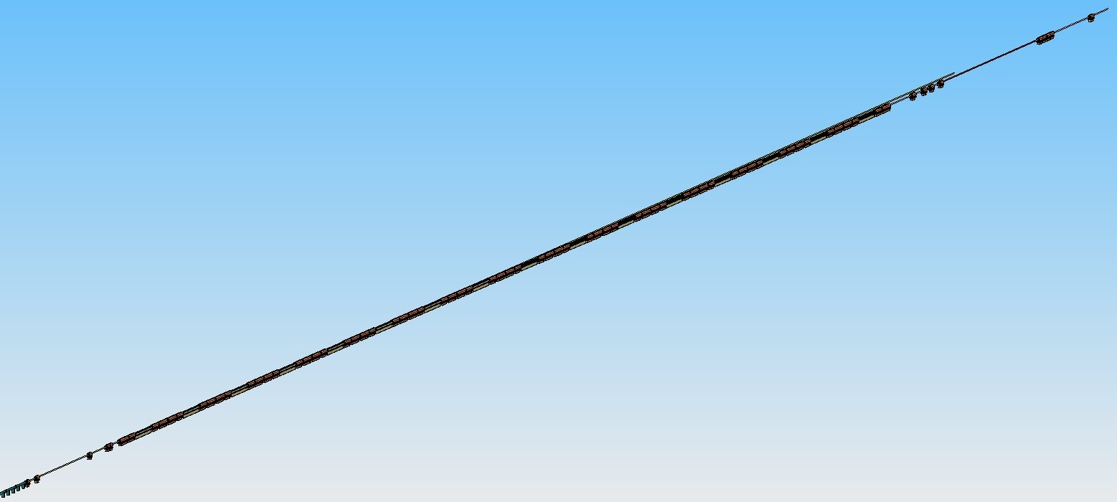
Positron Source – Dogleg
Model created using the lattice design from 09/09/2009 (Positron Source – SB2009 simplified.xlsx)
Photon Beam pipe
40m Drift
Heat – Power load estimate (Positron Source Global Heat Load Summary.xlsx) based on 07-02-28 ILC Magnet Power Supply List.xls and other magnet data available
Costing is based on specified magnets (SB2009 CostsV2a.xls) and Magnets_uberSummary_allStyles and vacuum_Positron_source_vacuum_cost_estimate_04_Nov_2009.xlsx
The dogleg provides a 1.5m beam offset. For the 10Hz low energy operation this must be revised. An Additional beam line is required and a 5Hz switching magnet. See 10HZ Low Energy Operation.pptx

Slide 10
Switched Mode
Jim’s 10Hz proposal:
BDS
To IP
Undulator
High Power Dump
Switching Magnet
(5 Hz)
150 GeV Electron Transport to Dump (Switched Mode)

Slide 11
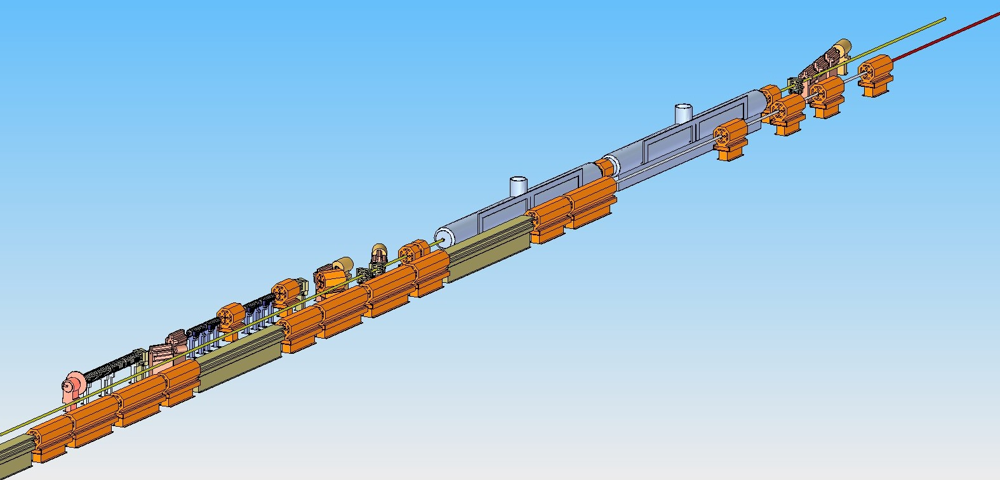
Positron Source – AUX Source
Model created using KAS Layout.pdf (Axel’s e- source basis)
Heat – Power load estimate (Positron Source Global Heat Load Summary.xlsx) based on 07-02-28 ILC Magnet Power Supply List.xls and other magnet data available.
Cryomodule data from ML 989 Criteria All LCW NOV 27B 2006 Updated Oct 31 2007.pdf
40m Drift
Costing is based on specified magnets (SB2009 CostsV2a.xls) and Magnets_uberSummary_allStyles and vacuum_Positron_source_vacuum_cost_estimate_04_Nov_2009.xlsx and ML info.
The AUX source is at this moment in time not much more than an artists impression. The lattice needs to be designed. It is feasible to utilise the photon vacuum vessel and the distance to the target needs to be defined.

Slide 12
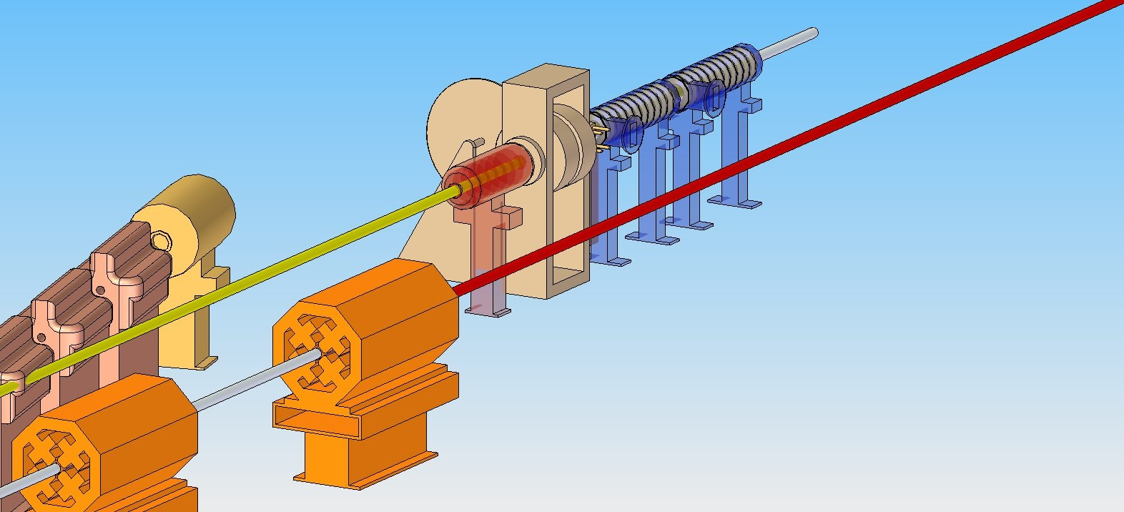
Positron Source – Target Area
40m Drift
Standing Wave Accelerator (SLAC model 390-011-29)
QWT
Target
Photon Collimator
The Target Area has seen a lot of work during Positron Source workshops. The remote handling enclosure is not shown. The target requires a redesign to cater for the AUX source. Latest workshop info: http://indico.desy.de/conferenceOtherViews.py?view=standard&confId=3061

Slide 13
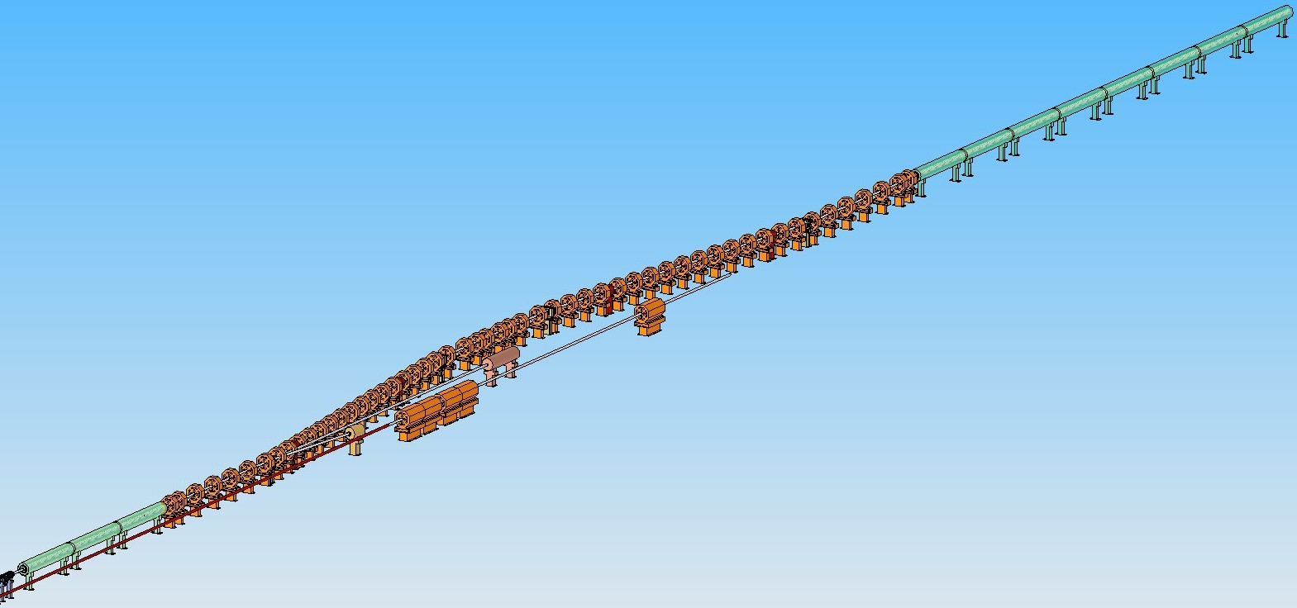
Positron Source – Capture Area
400MeV Travelling Wave Accelerator
Capture Chicane
Photon Dump
End of Positron Source Dogleg
Electron Dump
40m Drift
An additional Electron Dump is required due to the AUX source. The lattice needs to be designed as the illustration is a re-arrangement of the RDR layout (400 MeV in middle of chicane).

Slide 14
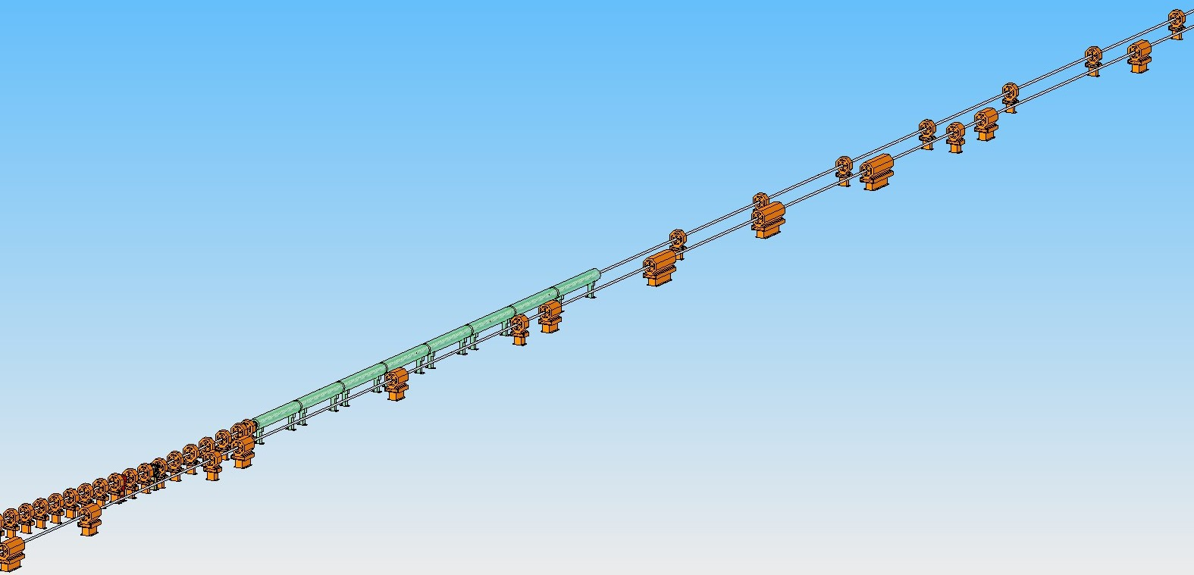
Positron Source – PTRAN 1
Tune Up dump or diagnostics required after 400MeV? No info
400MeV Travelling Wave Accelerator
PTRAN 1
Electron BDS
End of Positron Source Dogleg
Again, this area is a best guess as far as CAD is concerned. The Positron Transfer (PTRAN1) is the same as the RDR where a Quad is followed by a drift. Lattice needs to be designed.

Slide 15
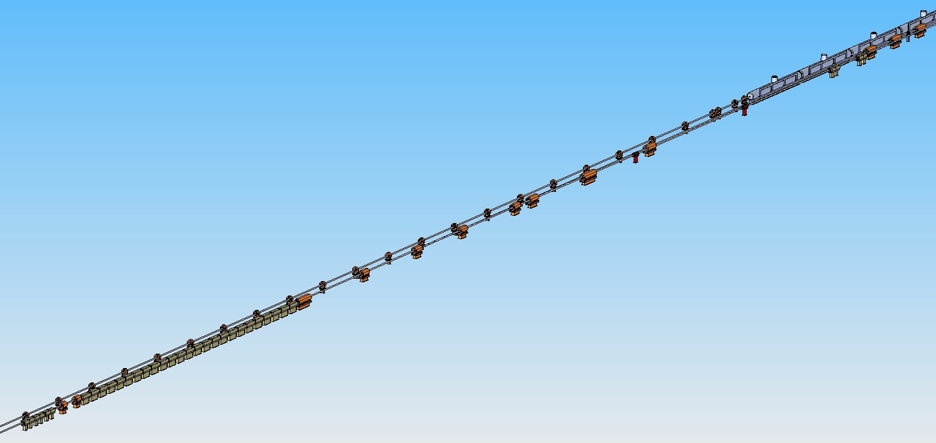
Positron Source – End PTRAN1 – 5GeV Booster
Cryomodule info from Main LINAC WG for cost and Power/Heat Load estimates
Currently 60 Magnet – Drift strings
Tune Up Dump Mattison magnets (e- BDS)
5GeV Booster start
Tune Up Dump branch off (e-BDS)
The lattice needs to be designed. The 5GeV Booster section can still move up or down the beam line (PTRAN).

Slide 16
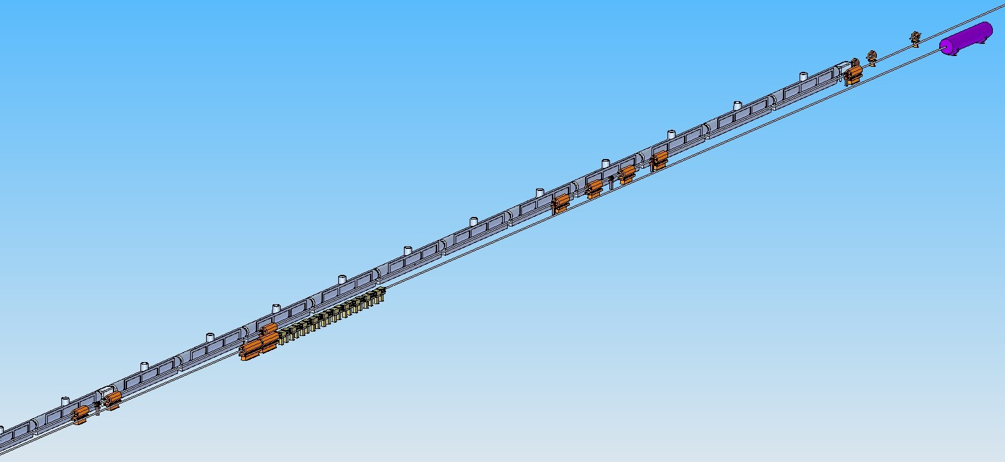
Positron Source – 5GeV Booster End
Cold Box at each end of a 11 Module string
5GeV Booster end
Tune Up Dump (e-BDS)
e-BDS
Tune Up Dump sweepers(e-BDS)
The lattice needs to be designed. The 5GeV Booster section can still move up or down the beam line (PTRAN). Currently shown just upstream of e-BDS Tune up dump for radiation and CF&S reasons.

Slide 17
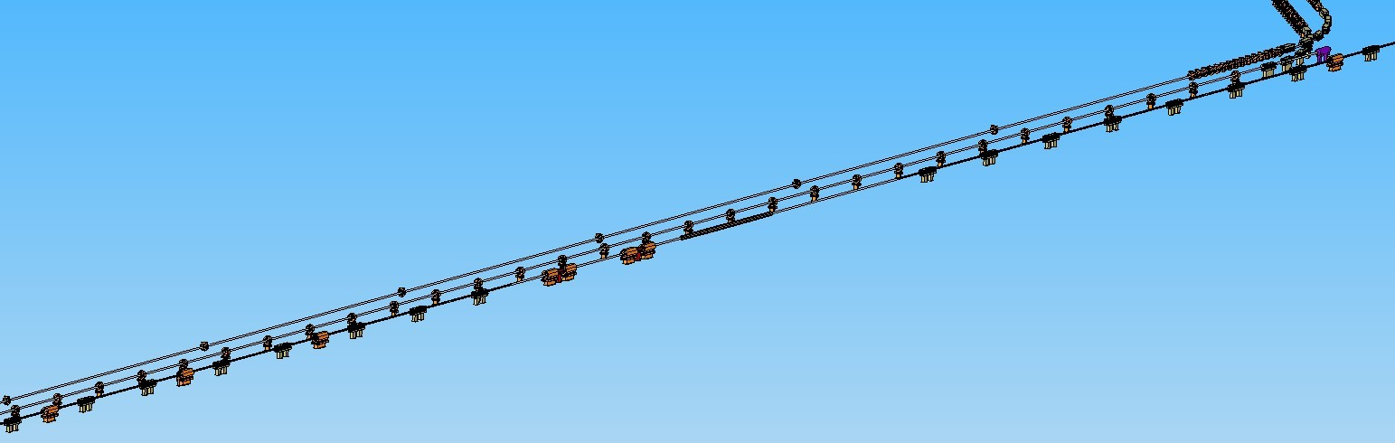
Positron Source – End PTRAN2
RTML for illustration
Currently 118 Magnet – Drift strings
RTML for illustration
PTRAN Dump
Positron Transfer Branch point, worked out from DR Injection point and offset and angle multiple (Spin Rotation).
e-BDS
The lattice needs to be designed. Depending on the 5GeV Booster location, it is envisaged to have 118 magnet – drift strings.

Slide 18
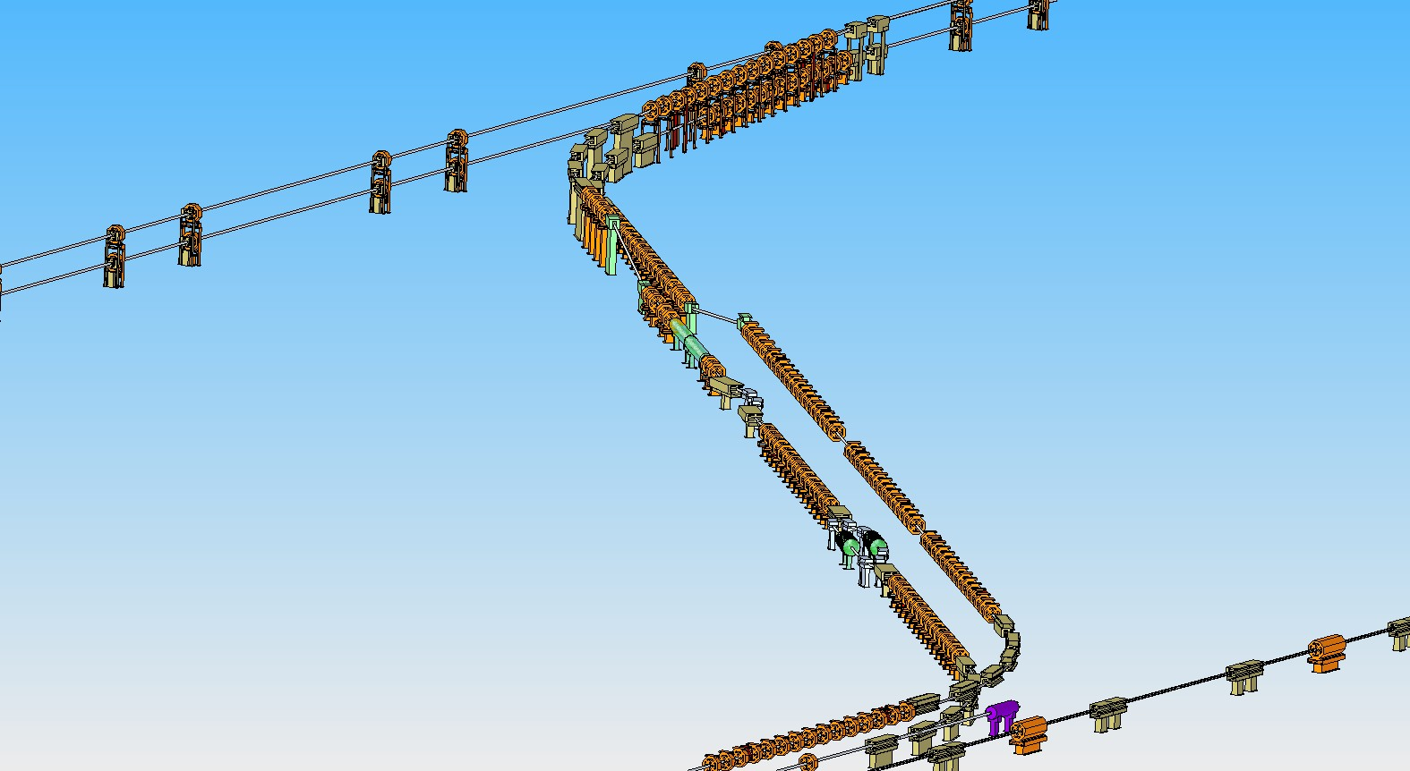
Positron Source – PLTR
Damping Ring Septums, Injection Point at Z= -80.9m and X= 90m
Elevator from 1.1m to 2.4m
Energy Compression
RTML illustration
Spin Rotation
The lattice needs to be designed. This area is a pure guesstimate and place holders have been used for the cost and Power/Heat load estimates.

Slide 19
Positron Source notes
Notes to accompany slide numbers:
Slide X, comment

