Slide 1
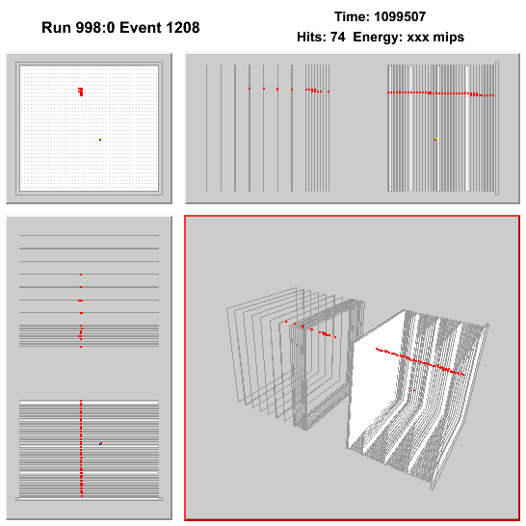


Analysis of Muon Events in the DHCAL
José Repond
Argonne National Laboratory
ALCPG 2011 Meeting, University of Oregon, Eugene, OR

Slide 2
DHCAL Analysis Strategy
Noise measurement
- Determine noise rate
- Identify (and possibly mask) noisy channels
- Provide random trigger events for overlay with MC events
Measurements with muons
- Align layers in x and y
- Determine efficiency and multiplicity in ‘clean’ areas
- Simulate response with GEANT4 + RPC_sim (requires tuning)
- Determine efficiency and multiplicity over the whole 1 x 1 m²
- Compare to simulation and tune MC
- Perform additional measurements, such as scan over pads, etc…
Measurement with positrons
- Determine response
- Compare to MC and tune 4th (d_{cut}) parameter of RPC_sim
- Perform additional studies, e.g. software compensation…
Measurement with pions
- Determine response
- Compare to MC (no more tuning) with different hadronic shower models
- Perform additional studies, e.g. software compensation, leakage correction…

Slide 3

The DHCAL Project
Argonne National Laboratory
Boston University
Fermi National Accelerator Laboratory
IHEP Beijing
University of Iowa
McGill University
Northwestern University
University of Texas at Arlington
DCHAL Collaboration | Heads
Engineers/Technicians | 22
Students/Postdocs | 8
Physicists | 9
Total | 39
…and integral part of

Slide 4
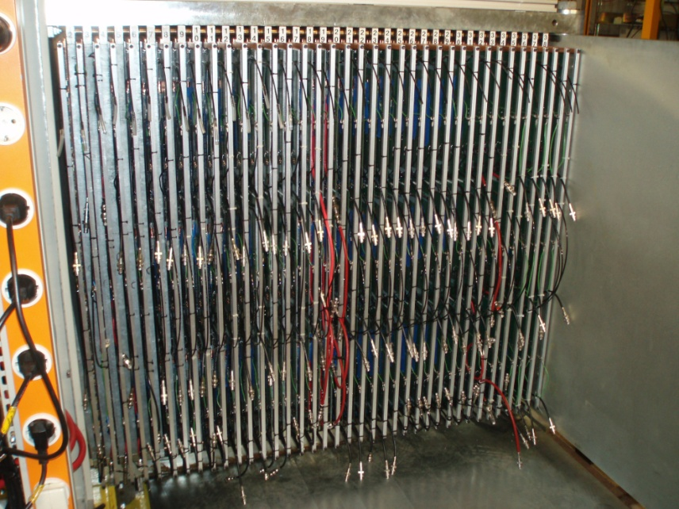
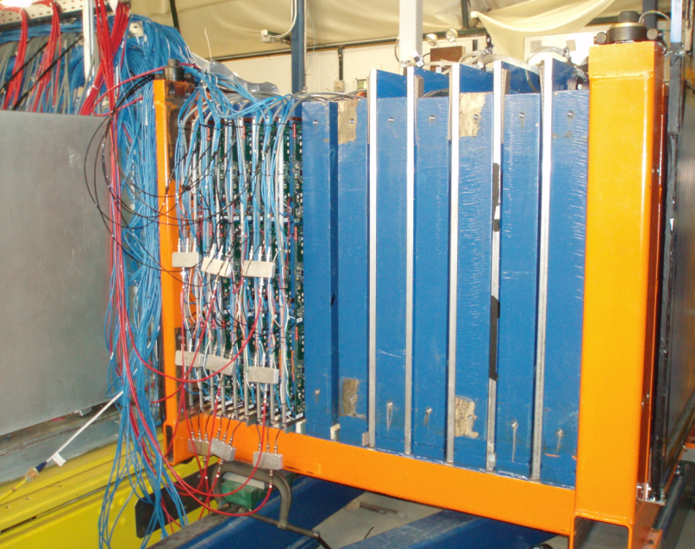
The DHCAL in the Test Beam
Date | DHCAL layers | RPC_TCMT layers | SC_TCMT layers | Total RPC layers | Total layers | Readout channels
10/14/2010 – 11/3/2010 | 38 | 0 | 16 | 38 | 54 | 350,208+320
1/7/2011 – 1/10/2011 | 38 | 0 | 8 | 38 | 46 | 350,208+160
1/11/2011 – 1/20/2011 | 38 | 4 | 8 | 42 | 50 | 387,072+160
1/21/2011 – 2/4/2011 | 38 | 9 | 6 | 47 | 53 | 433,152+120
2/5/2011 – 2/7/2011 | 38 | 13 | 0 | 51 | 51 | 470,016+0
Run I
Run II

Slide 5
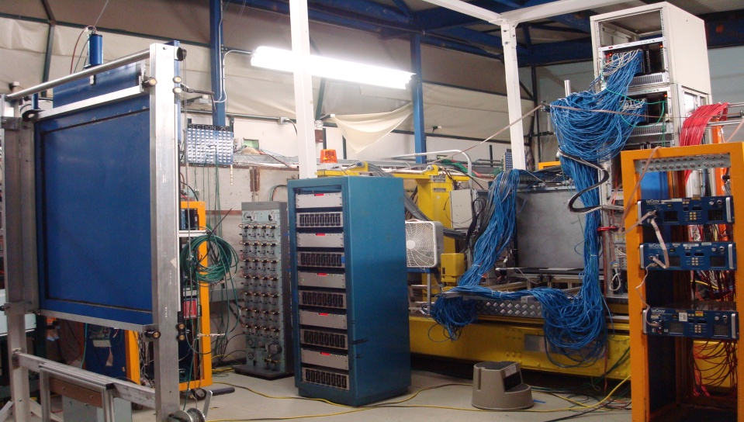
Beam and Trigger for Muon events
Trigger
DHCAL
TCMT
+32 GeV/c secondary beam + 3m Fe
DAQ rate typically 500/spill
1 x 1 m² Scintillator Paddle A
1 x 1 m² Scintillator Paddle B
Run | # of muon events
October 2010 | 1.4 Million
January 2011 | 1.6 Million

Slide 6
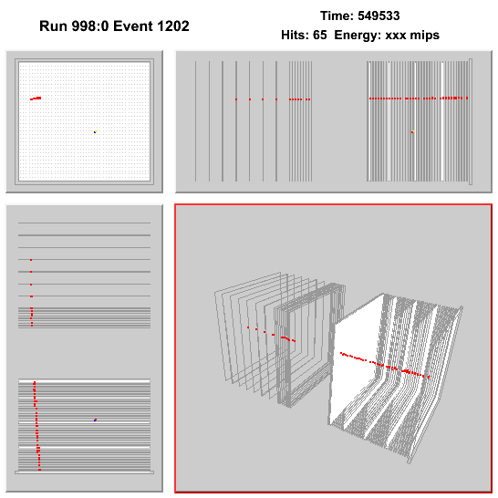
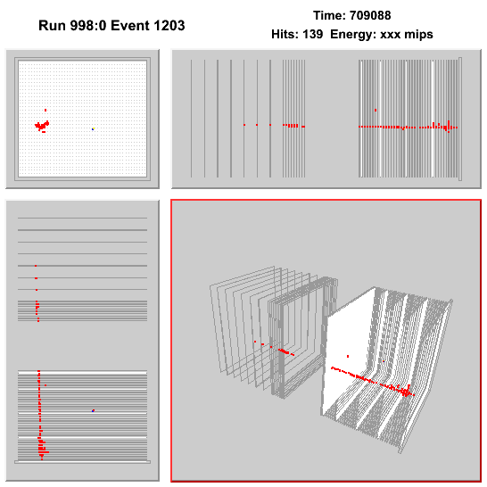
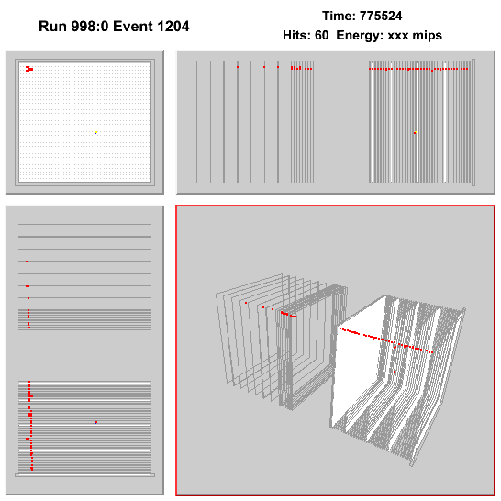
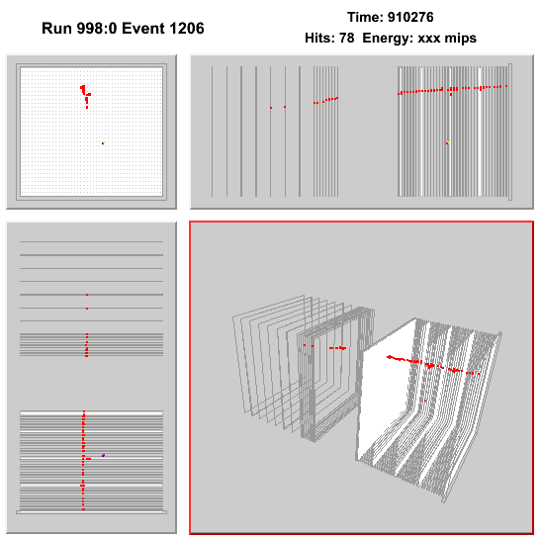
Some cute muon events
Note: Consecutive events (not selected)
Look for random noise hits

Slide 7
Analysis strategy

Slide 8
Establish track parameters and average response away from troubled areas
a) Select clean muons
apply cleaning cuts (1 cluster in layer 0, not more than 3 hits in layer 0)
fit track to straight line (omitting layer to be measured)
select clean tracks (cut on slope, Chi2, points on track)
extrapolate to layer to be measured
b) Align the boards in x and y
c) Measure track parameters
measure impact point on layer 0
measure slope in both x and y
d) Cut out troubled areas in layer to be measured
dead areas
regions between RPCs
regions around fishing lines
edges in x
high multiplicity layer
e) Measure spectrum of number of pads hit
for all layers
for each layer separately
f) Scan across pads
measure average number of hits/multiplicity

Slide 9
B) Simulate muons
a) Use 20 GeV/c muons
b) Compare track parameters
adjust impact point on layer 0 so it matches the data
adjust slope in both x and y so it matches the data
c) Cut out troubled areas in layer to be measured (apart from ‘dead areas’ same as data
regions between RPCs
regions around fishing lines
edges in x
d) Measure spectrum of number of pads
for all layers
e) Adjust RPC_sim parameters
adjust RPC_sim parameters to reproduce the measured spectrum of number of pads

Slide 10
C) Compare muon response everywhere
a) Select clean muons
apply cleaning cuts
fit track to straight line (omitting layer to be measured)
select clean tracks
extrapolate to layer to be measured
b) Measure spectrum of number of pads in regions of x and y (squares)
for all layers only cutting out dead areas
c) Compare to simulation
adjust simulated geometry to reproduce measurement
- thickness of fishing line
- thickness of borders
- corners?
d) Compare each layer to average response
determine c_{ij} = <hit>_{layer} _{ij} /<hit>_{total} i = layer number, j = 1,2,3 for top, middle and bottom RPC
→ These are the calibration constants!

Slide 11
D) Detailed muon studies I
a) Select clean muons
apply cleaning cuts
fit track to straight line (omitting layer to be measured)
select clean tracks
extrapolate to layer to be measured
b) Measure efficiency/multiplicity as function of position on pads
Compare to simulation
c) Determine position resolution of extrapolated track positions
Look at response as function of y
- Identify gas barriers
- Identify gaps between RPCs

Slide 12
E) Detailed muon studies II
a) Select clean muons
apply cleaning cuts
fit track to straight line (omitting layer to be measured)
select clean tracks
extrapolate to layer to be measured
b) Measure efficiency/multiplicity
Perform systematic studies of track selection

Slide 13
Tracking
Clustering of hits
Performed in each layer individually
Use close neighbor clustering (one common side)
Determine unweighted average of all hits in a given cluster (x_{cluster} ,y_{cluster})
Loop over layers
for layer i request that all other layers have N^{j}_{cluster} ≤ 1
request that number of hits in tracking clusters N^{j}_{hit} ≤ 4, otherwise don’t use this cluster for tracking
request at least 10/37 layers with tracking clusters
fit straight line to (x_{cluster},z) and (y_{cluster},z) of all clusters j not in layer i
calculate χ² of track
request that χ²/N_{track} < 1.0
inter/extrapolate track to layer i
search for matching clusters in layer i within
record number of hits in matching cluster

Slide 14
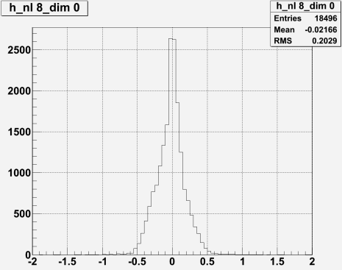
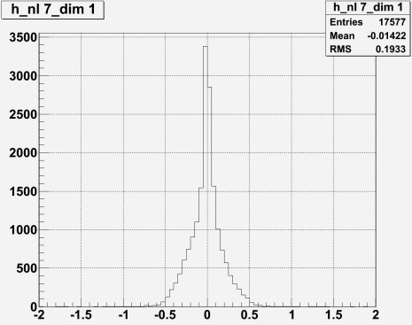

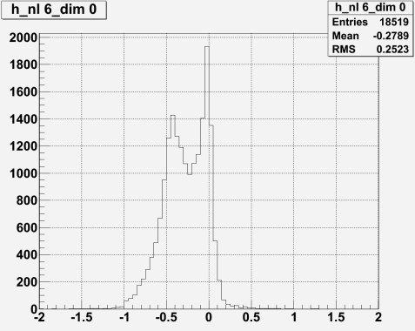
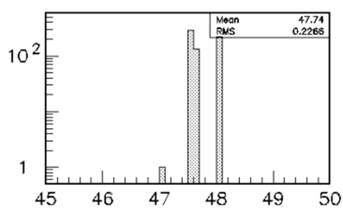
Alignment
For each layer i plot residual in x/y
R^{i}_{x} = x^{i} _{cluster}- x^{i}_{track}
R^{i}_{y} = y^{i}_{cluster} - y^{i}_{track}
Most distributions look OK (Dimensions in [cm])
Few have double peaks
Dimensions in [cm]
As does simple toy MC

Slide 15
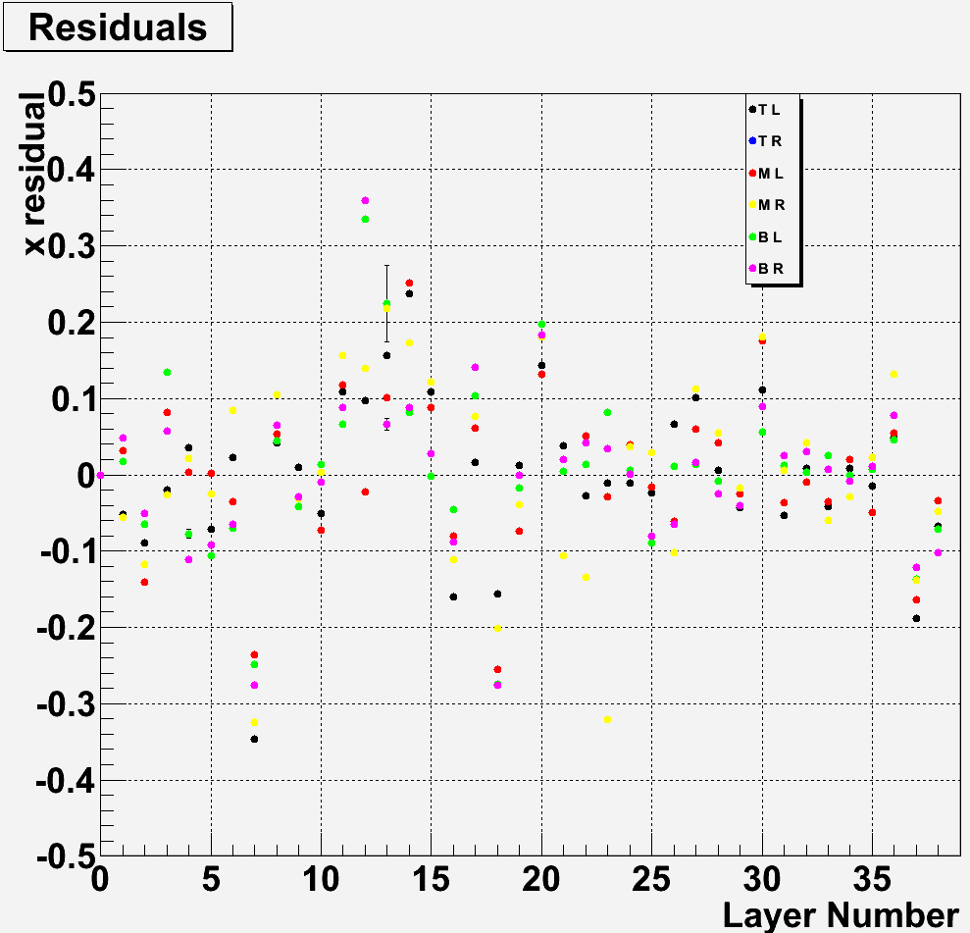
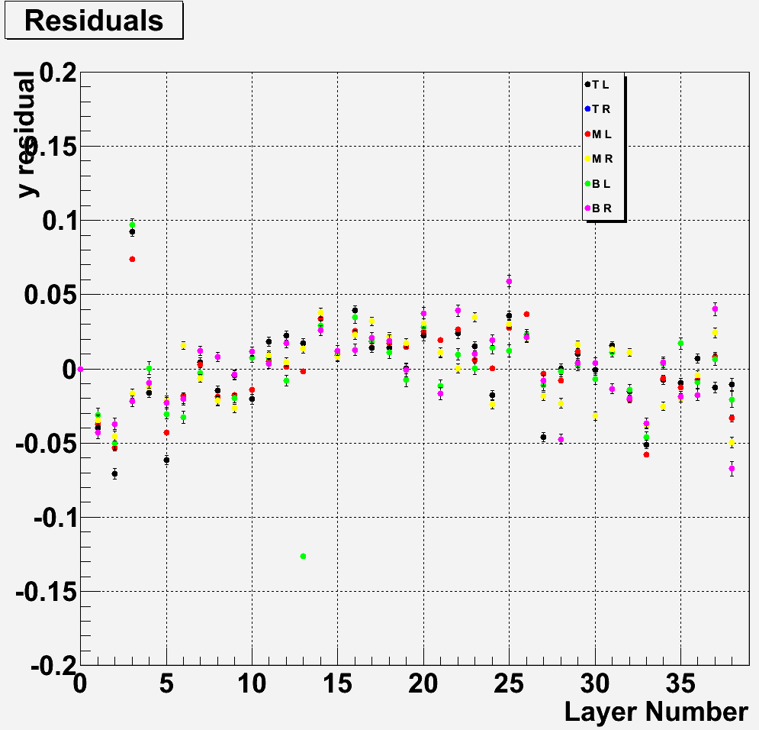
Residuals for each Front-end board versus layer#
Mean of residual distributions
x-residual
Variations of < 3 mm
Alignment of layers by hand
Correlation between boards within a layer
y-residual
Variations of <0.5 mm
Cassette resting on CALICE structure
Systematic trend compatible with cassettes being lower
in center of stack

Slide 16
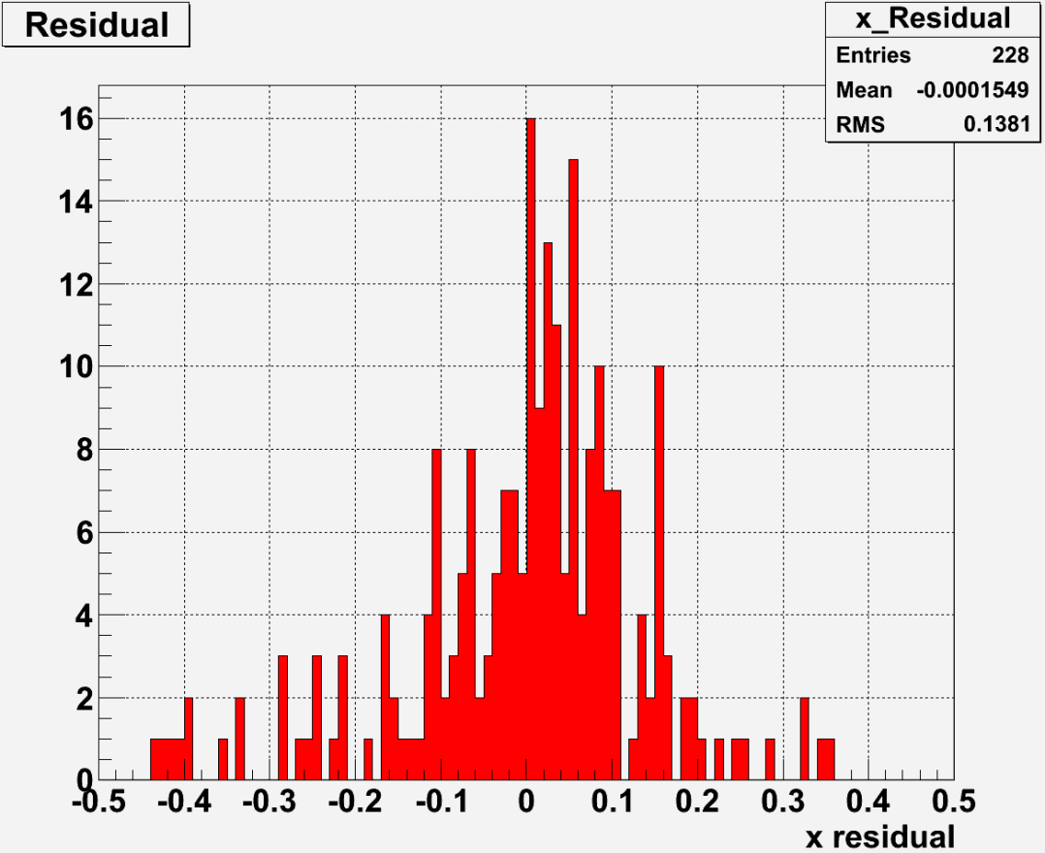
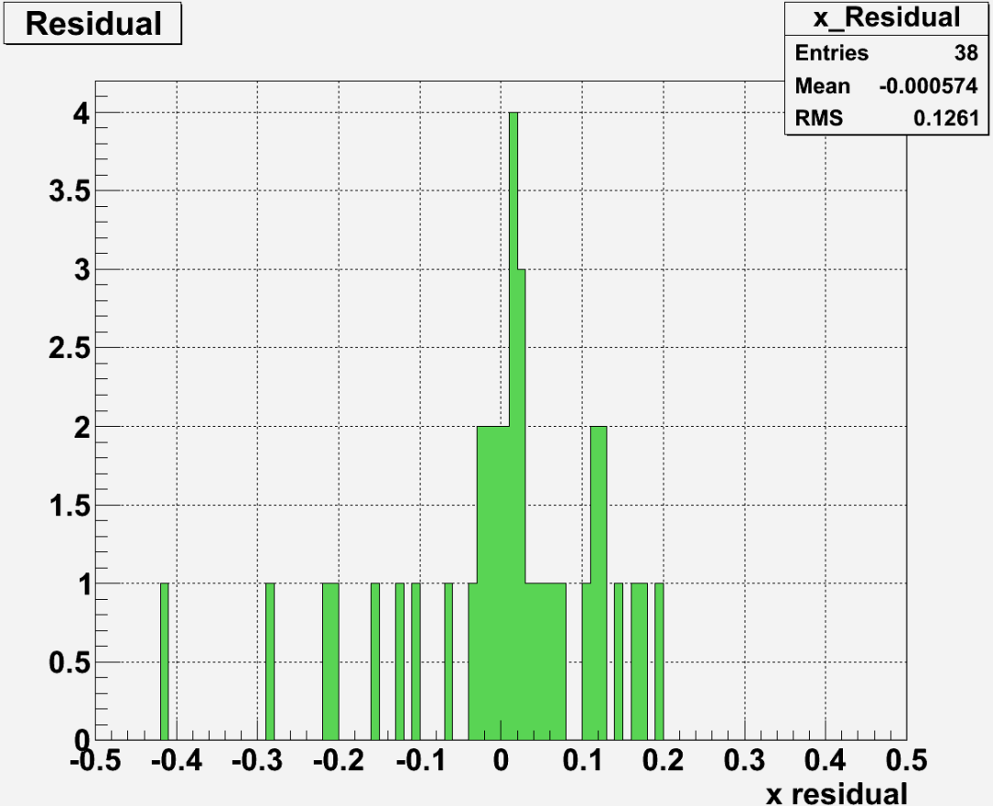
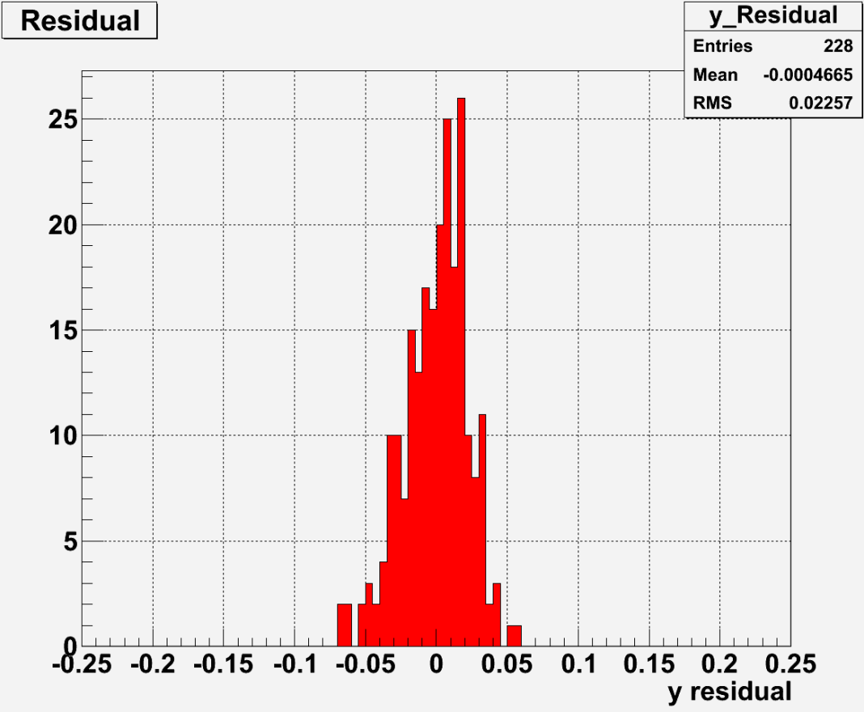
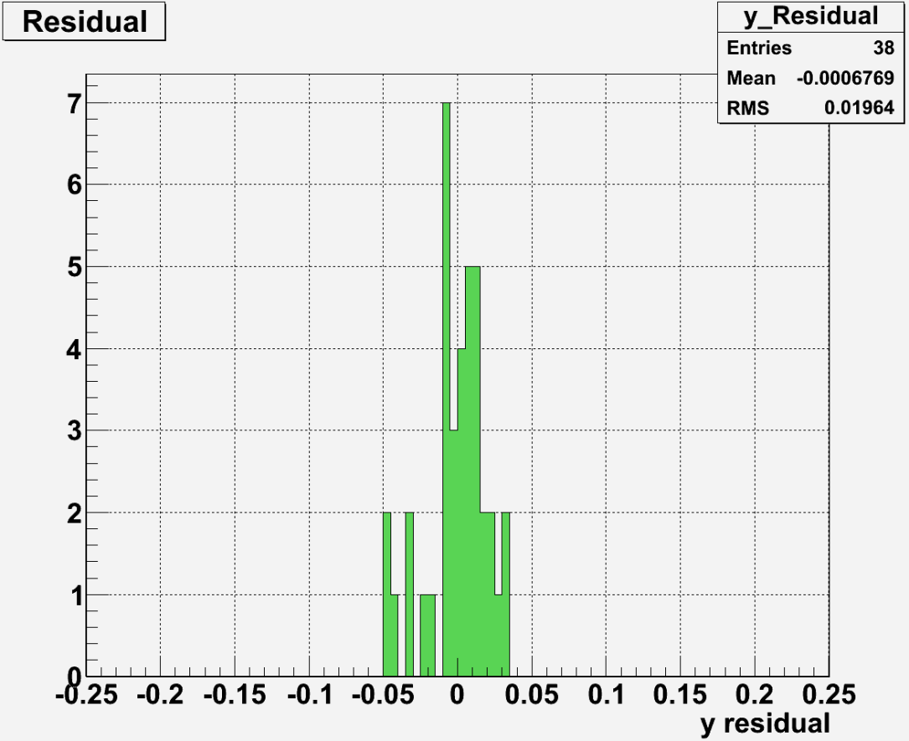
Residuals for each Front-end board or layer
Note: mean by construction close to 0

Slide 17
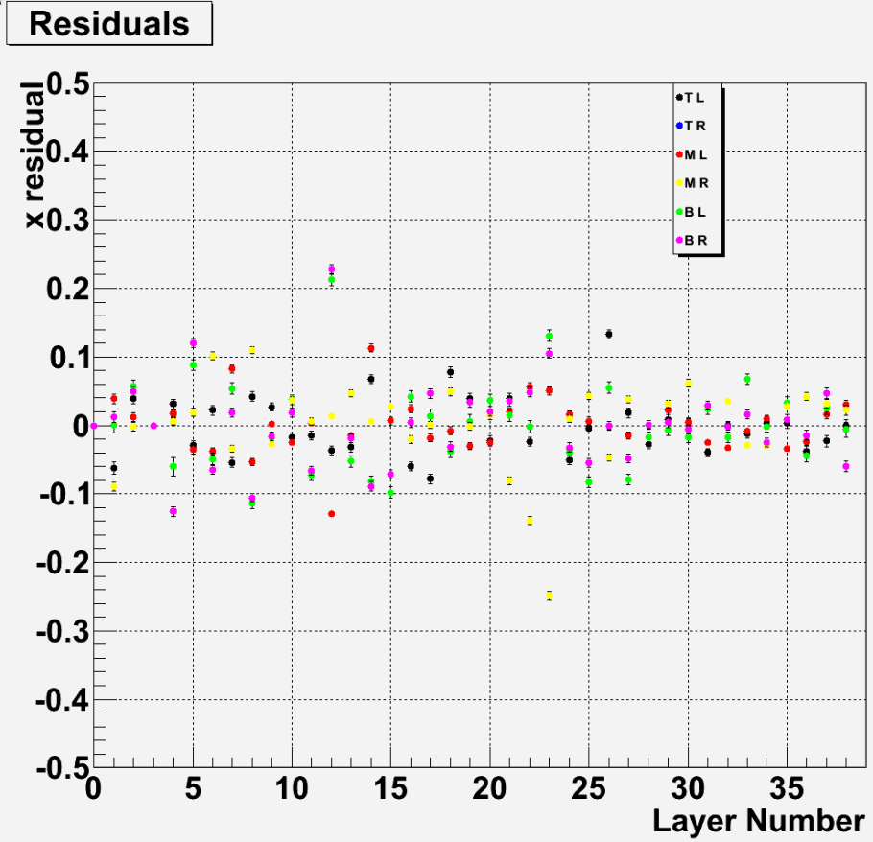
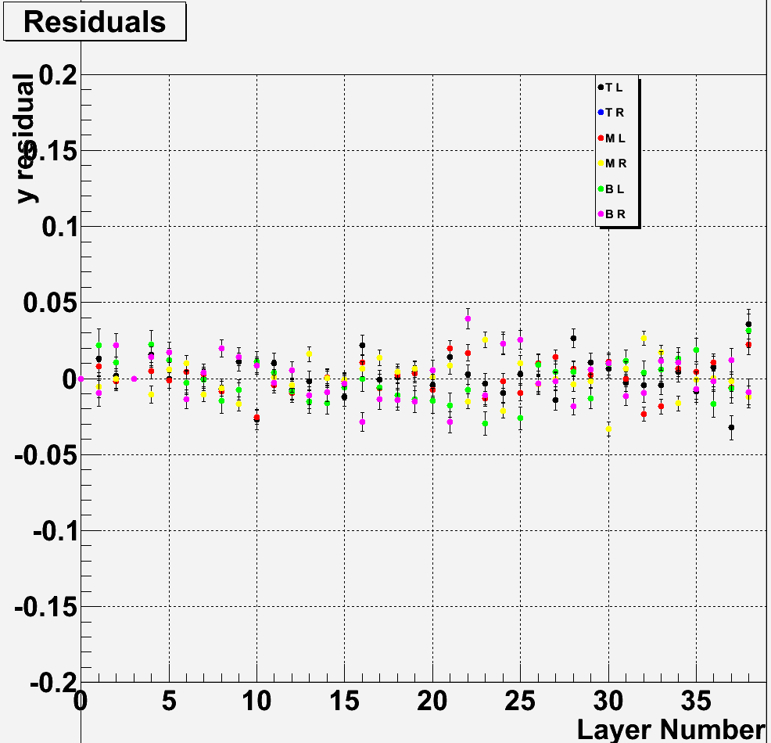
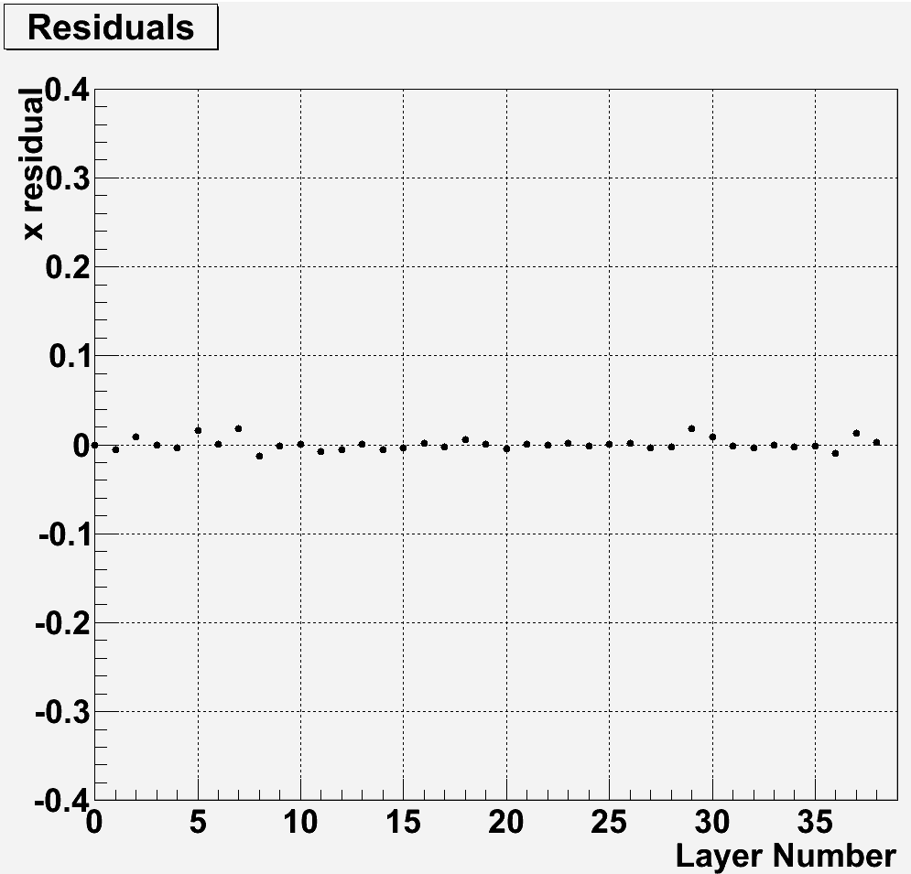

Use average residual to align layers
Works
nicely!

Slide 18
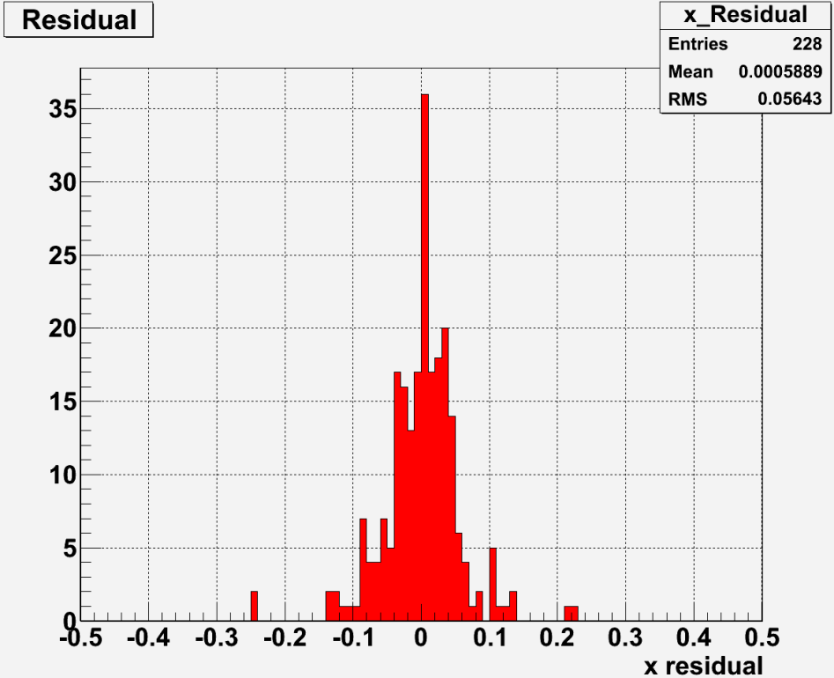
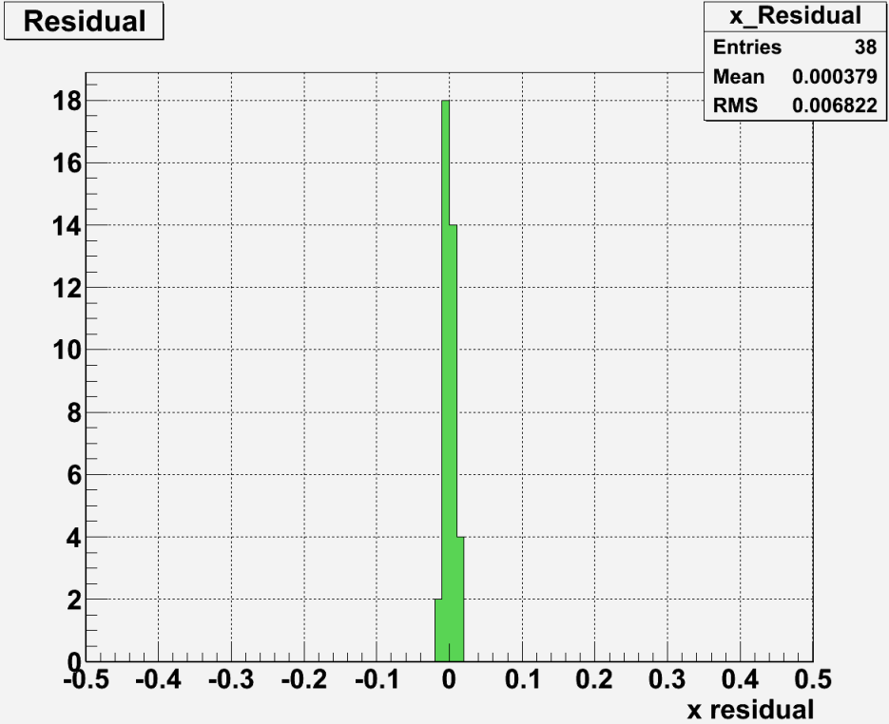
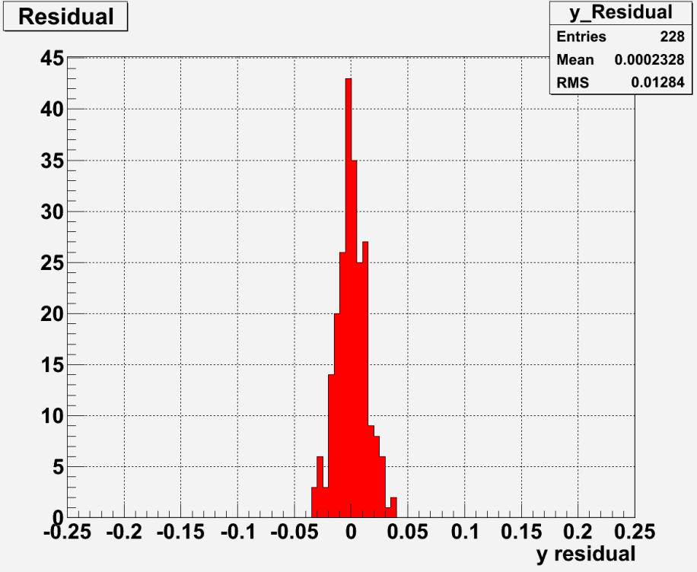
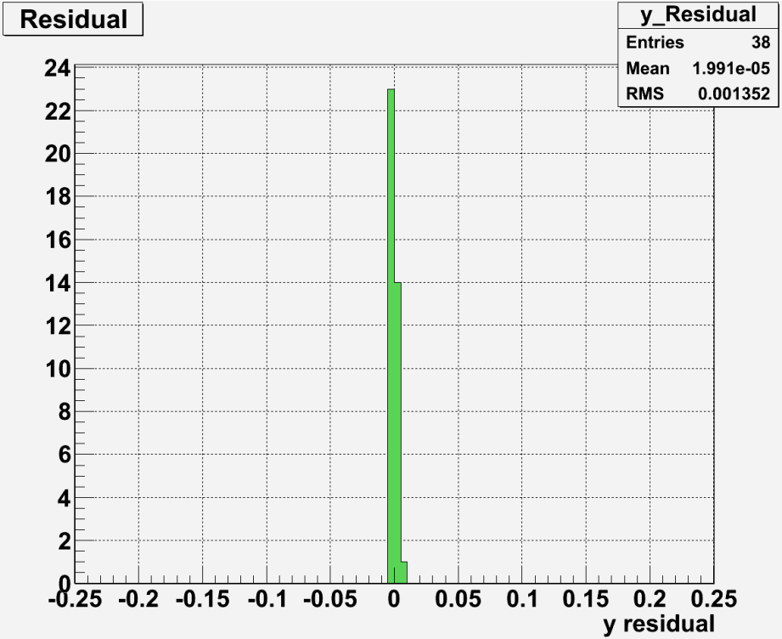
Remaining residuals after alignment
570/130 μm for FEBs
70/14 μm for layers

Slide 19
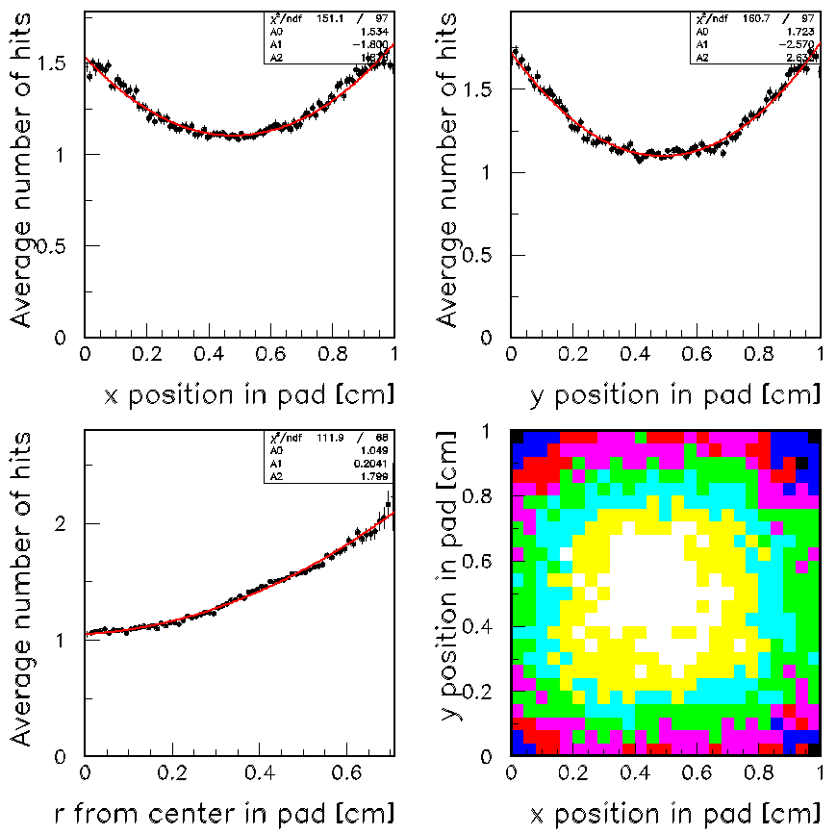
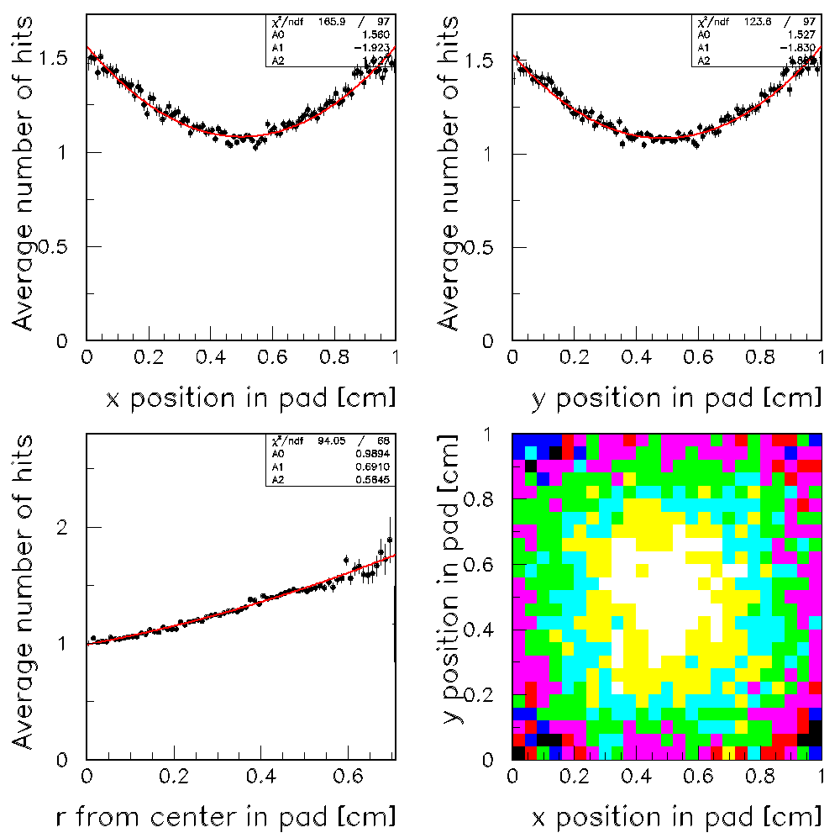
Scan across pad
x = Mod(x_{track} + 0.5,1.)
y = Mod(y_{track} – 0.03,1.)
Data
GEANT4 + (not-yet-tuned) RPC_sim
Note: These features not implemented explicitly into simulation
Simulation distributes charge onto plane of pads…
Tracking resolution to be determined (using fishing lines e.g.)

Slide 20
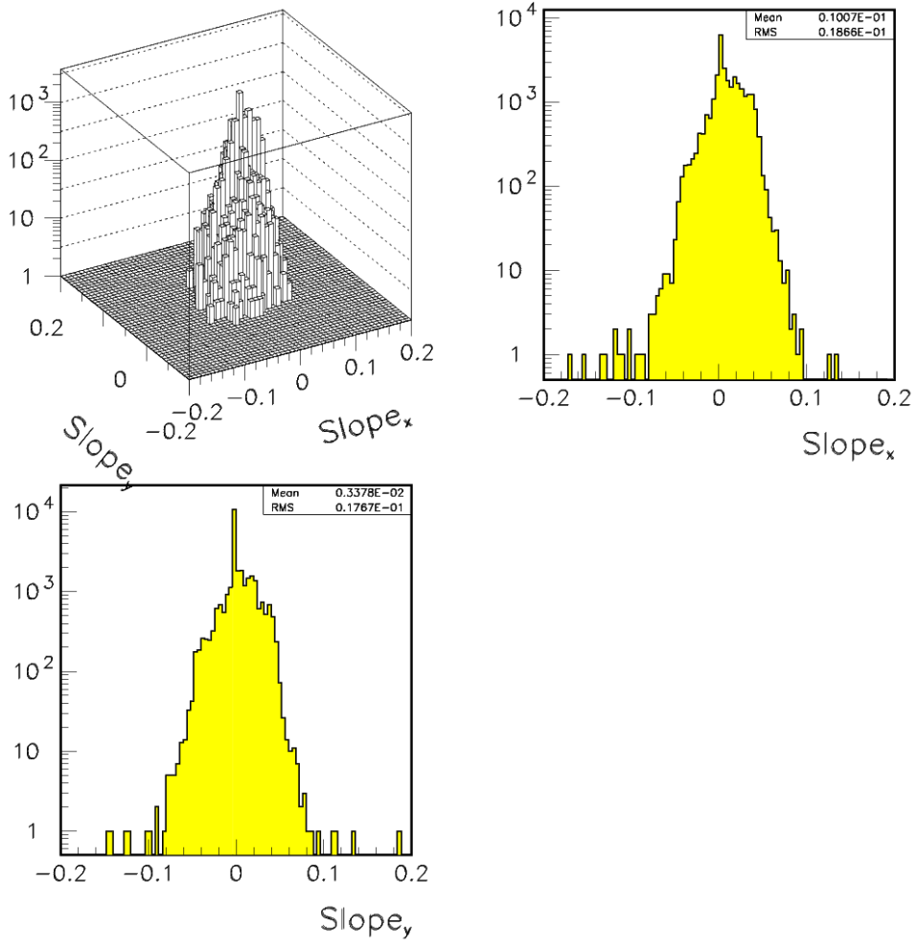
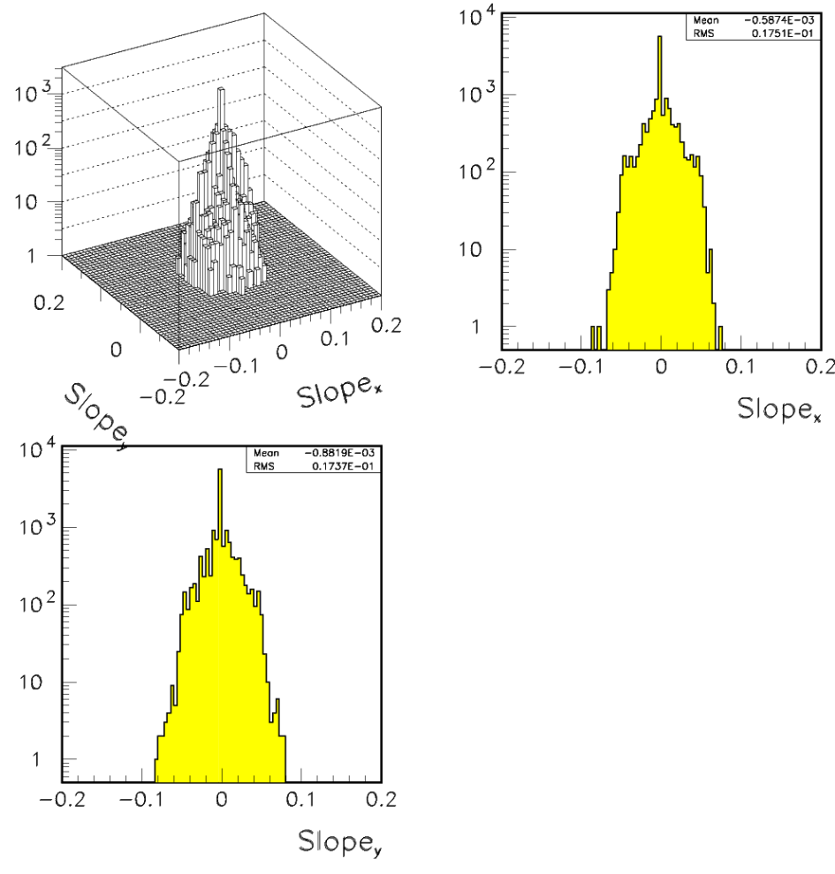
Angles of muon tracks
Data
GEANT4 + (not-yet-tuned) RPC_sim
Good enough!

Slide 21
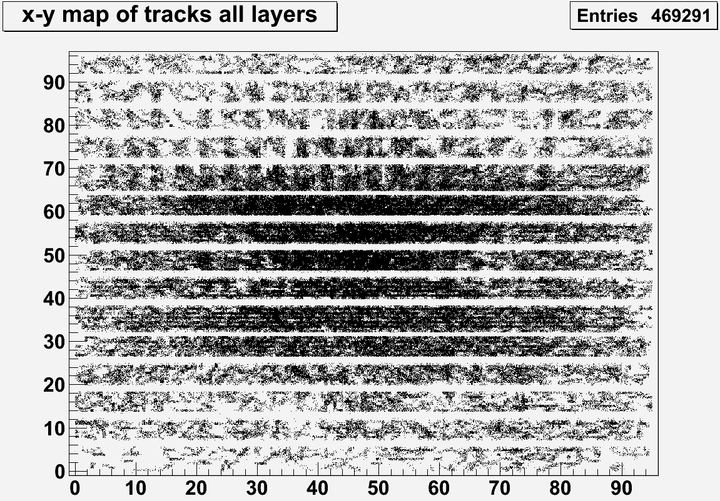
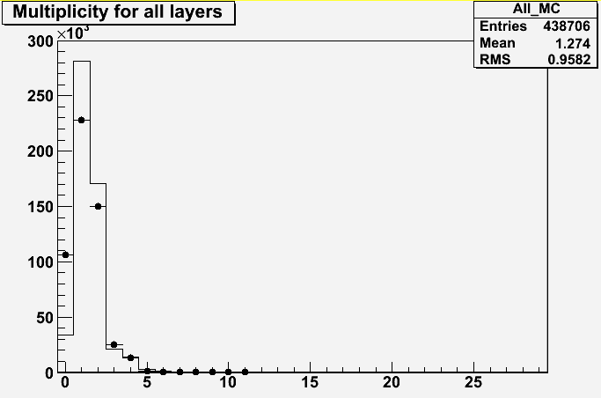
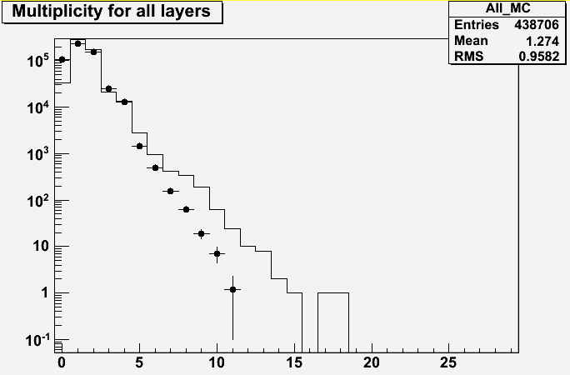
Efficiencies, multiplicities
Select ‘non – problematic’ regions away from
- Dead ASICs (cut out 8 x 8 cm² + a rim of 1 cm)
- Edges in x (2 rims of 0.5 cm)
- Edges in y (6 rims of 0.5 cm)
- Fishing lines (12 rectangles of ±1 cm)
- Layer 27 (with exceptionally high mulitplicity)
Measure average response
Efficiency, multiplicity
Data – Histogram
MC - Points
Note: Simulation of RPC tuned to Vertical Slice Test
DHCAL shows higher efficiency and lower multiplicity (thinner glass)

Slide 22
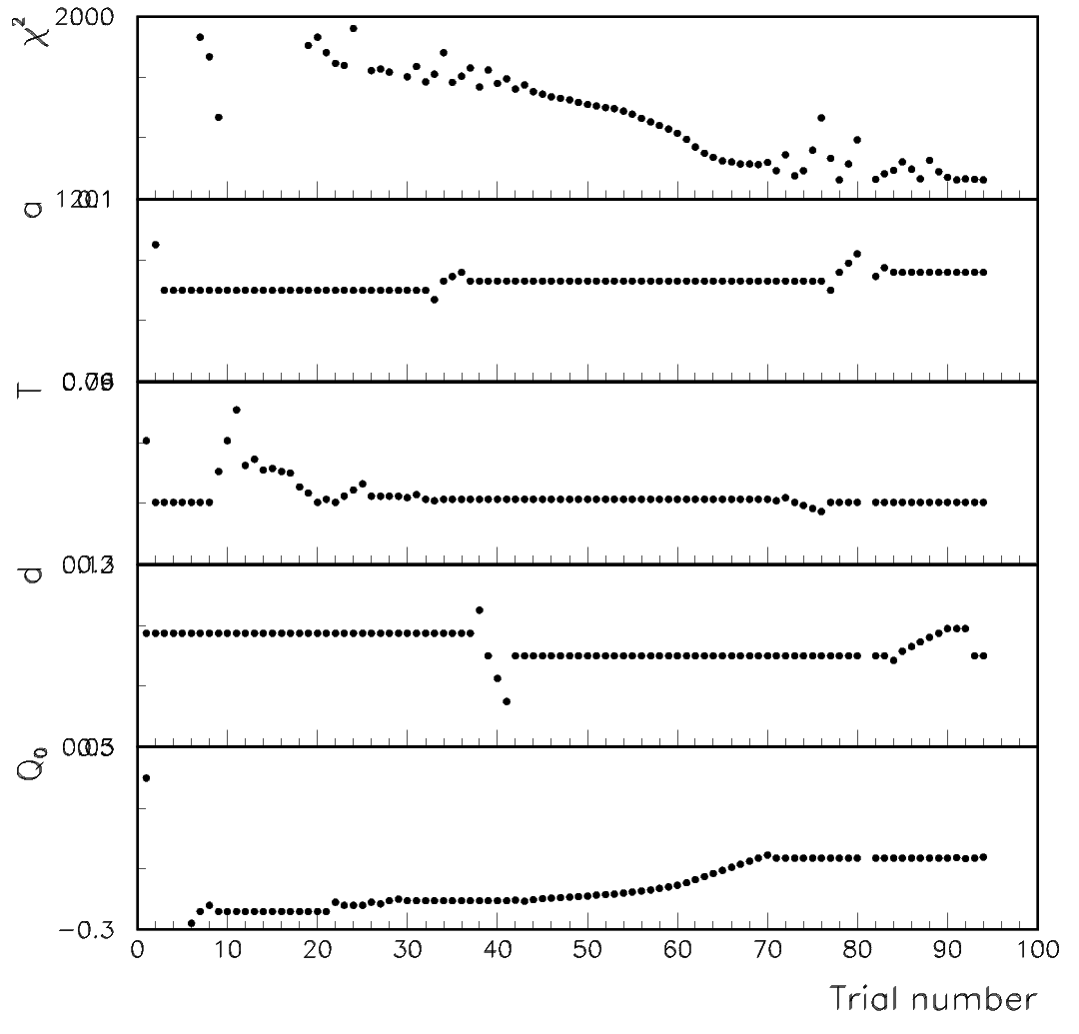
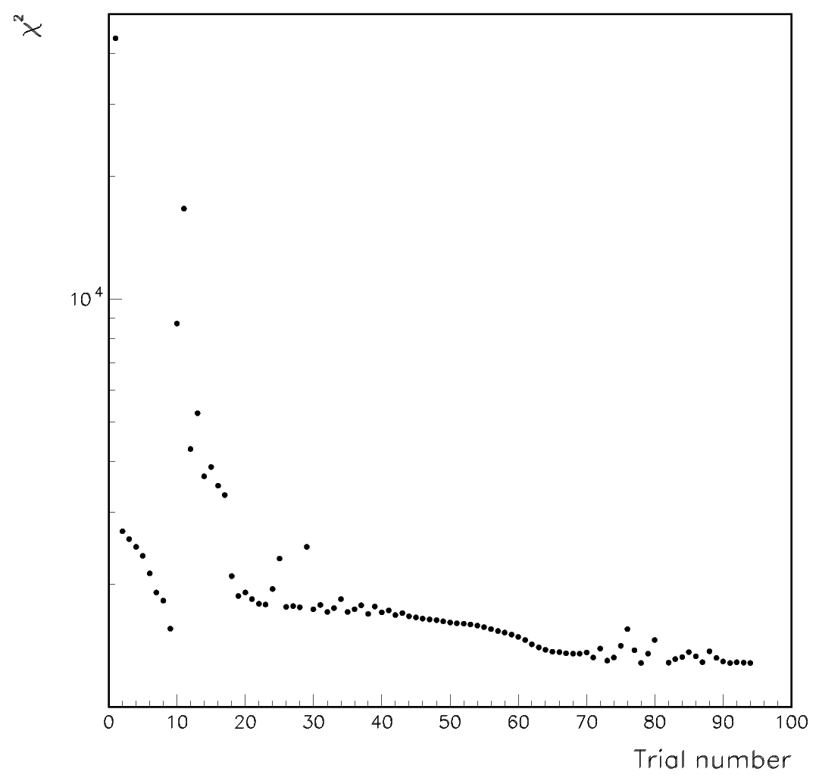
Tuning, tuning, tuning…
χ² comparison of normalized
histograms of multiplicity
VST Tuning
Incomplete statistics

Slide 23
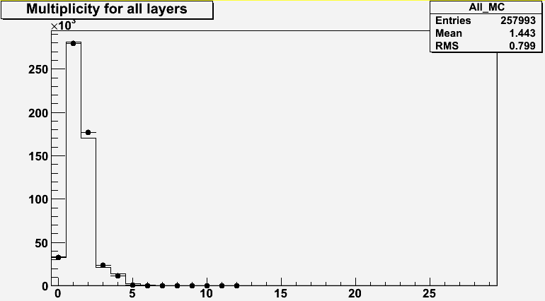
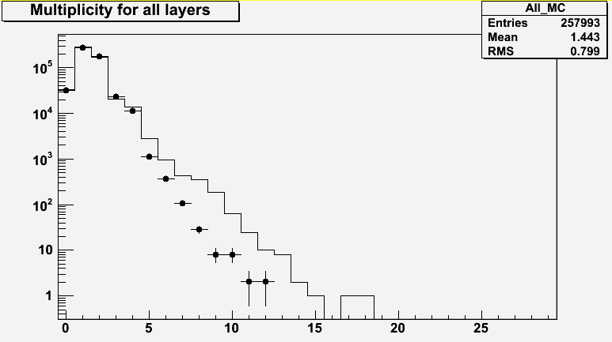
Current best fit
χ² = 1285
Data – Histogram
MC - Points
Note: High statistics (error bars « dots)
Efficiency well reproduced
Low multiplicity well reproduced
Tail problematic (excess of 0.6% in the data)
Efficiency = 93.6% in data
93.8% in MC
Multiplicity = 1.563 in data
1.538 in MC
Mean = 1.4614in data
1.443 in MC
To further improve need
different function to
distribute charge in plane of readout pads

Slide 24
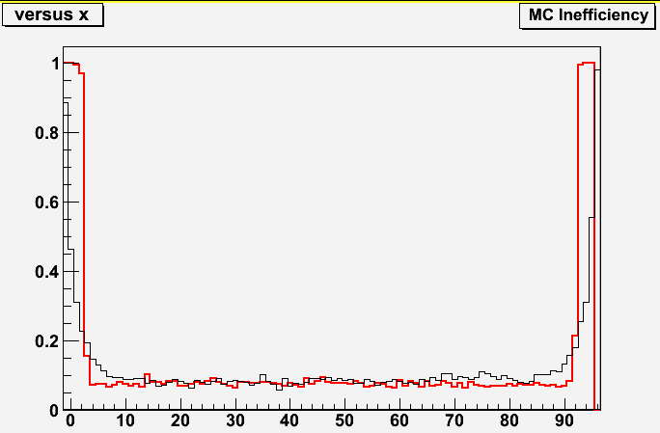
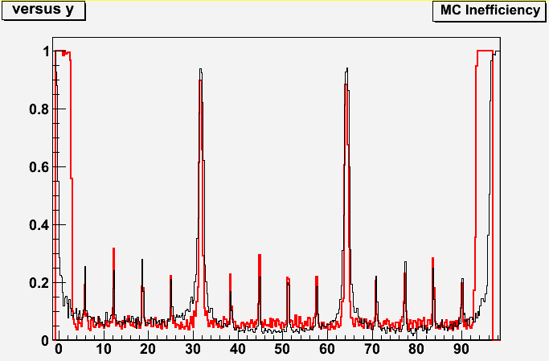
Response over the entire plane I
Implemented dead areas of data in MC (delete corresponding hits)
Note: x-axis in [cm] (not pad number)
Data
MC
x-distribution
Well reproduced, apart from edges
y-distribution
Inter-RPC gaps well reproduced
Fishing lines well reproduced
Edges again problematic

Slide 25
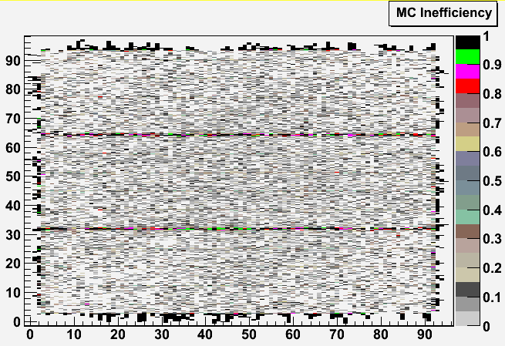
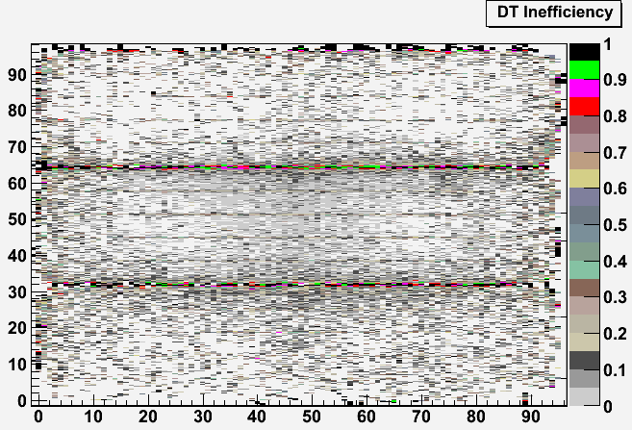
Response over the entire plane II
Note: distribution of tracks not the
same in data and MC

Slide 26
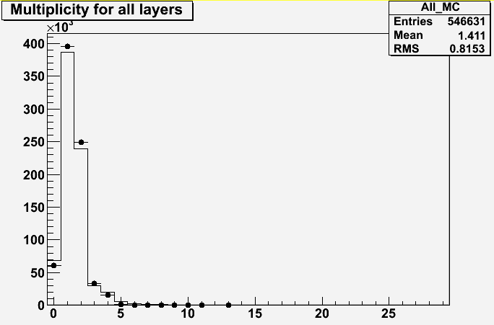
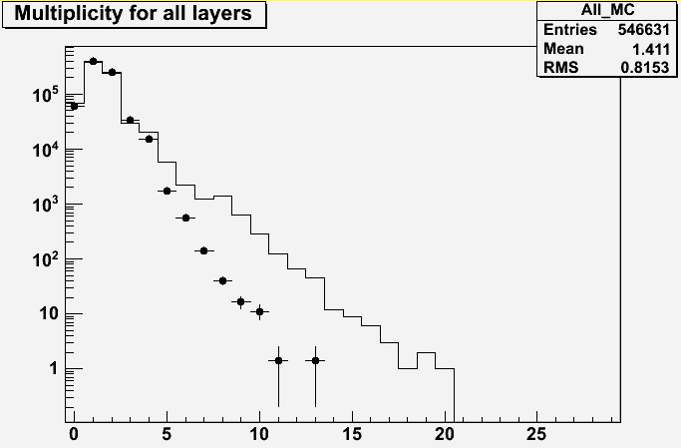
Average response over the entire plane
Note: There are systematic uncertainties
→ due to track selection
→ still need to be studied
These number include the dead areas
Some tuning of the MC still needed
Efficiency = 90.9% in data
92.1% in MC
Multiplicity = 1.611 in data
1.535 in MC
Mean = 1.464 in data
1.411 in MC

Slide 27
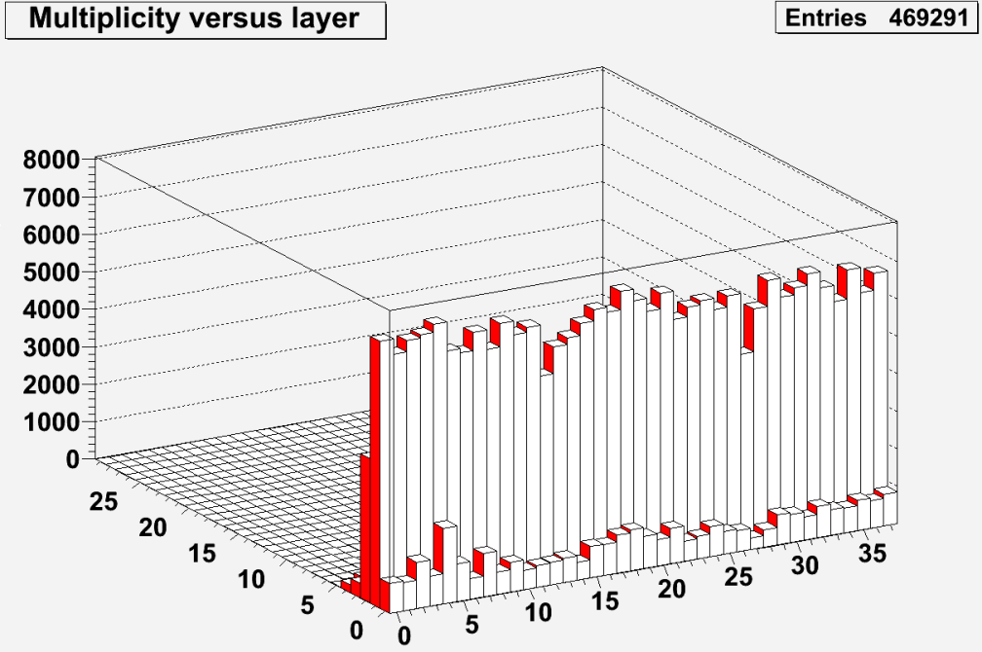
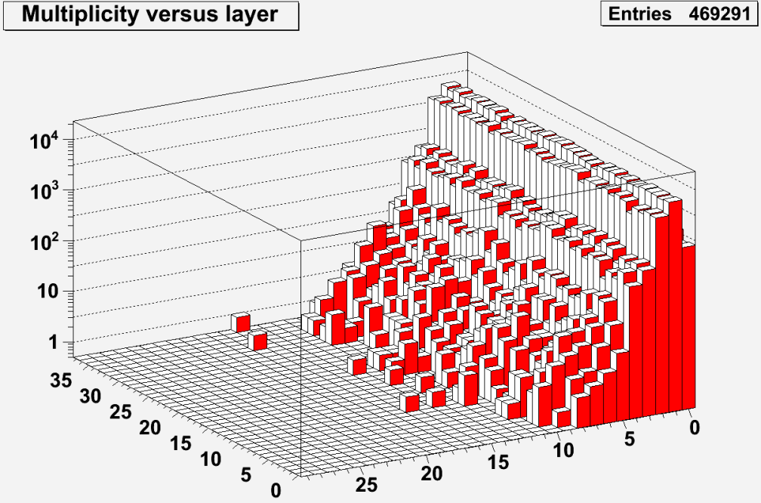
Response versus layer number
Dead areas, fishing lines, and edges are excluded

Slide 28
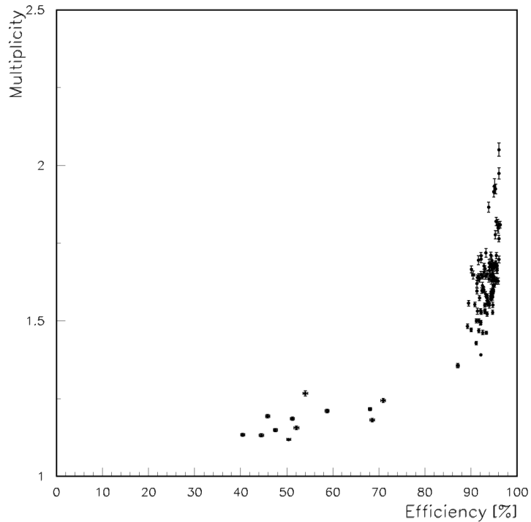
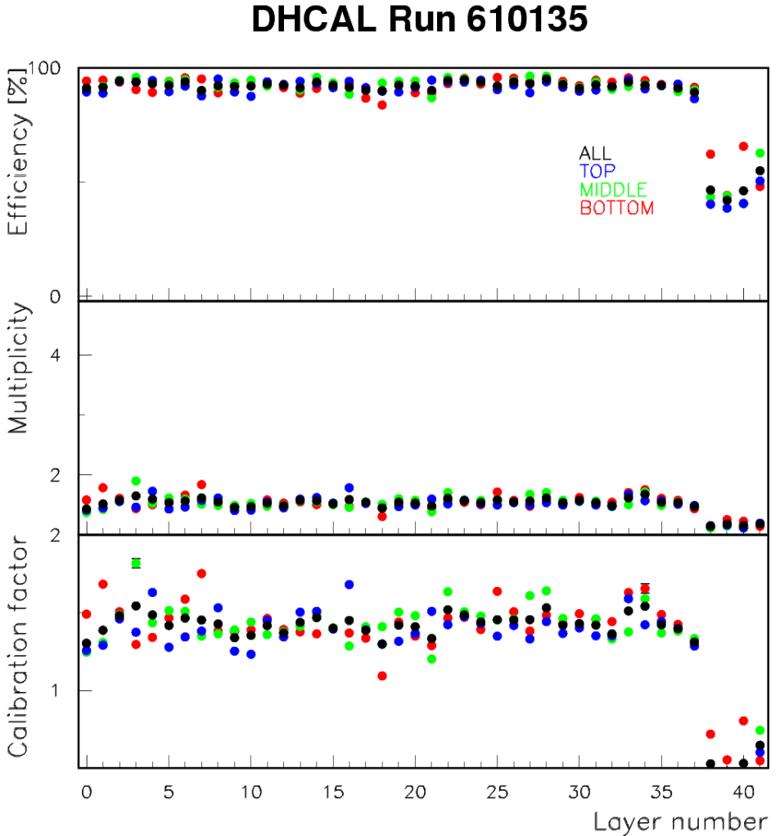
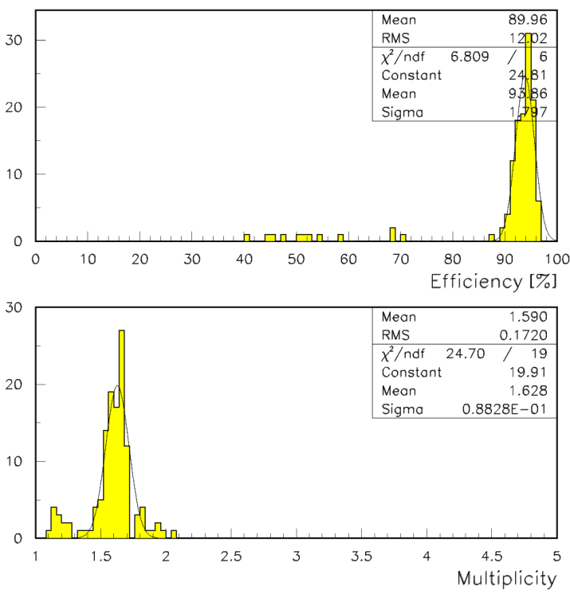
Calibration constants
HV on TCMT not at
full value due to problems
with mainframe

Slide 29
Calibration constants as function of time

Slide 30
Track segment analysis
Analysis by Burak Bilki (University of Iowa)

Slide 31
Track Segments Algorithm
Use clusters in two layers (source clusters) to measure a third layer (target cluster):
  Use Layer_2 and Layer_3 to measure Layer_1
  Use Layer_36 and Layer_37 to measure Layer_38
  Use Layer_(i-1) and Layer_(i+1) to measure Layer_i
Require size of the source clusters be less then 4 hits and the distance between their centers of mass be less than 3 cm.
Require the isolation of the source clusters in a 7 cm-radius circular area.
Search for target clusters within 2 cm of the point predicted by the source clusters.
Use Layer_(i+1) and Layer_(i-2) to measure Layer_i if the interpolated pad is in an inefficient region of Layer_(i-1).
Similarly, use Layer_(i-1) and Layer_(i+2) to measure Layer_i if the interpolated pad is in an inefficient region of Layer_(i+1).

Slide 32
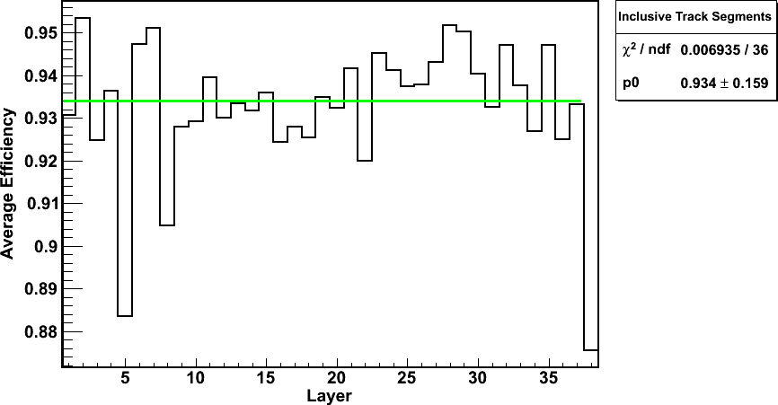
Track Segments Algorithm Results
Efficiency

Slide 33
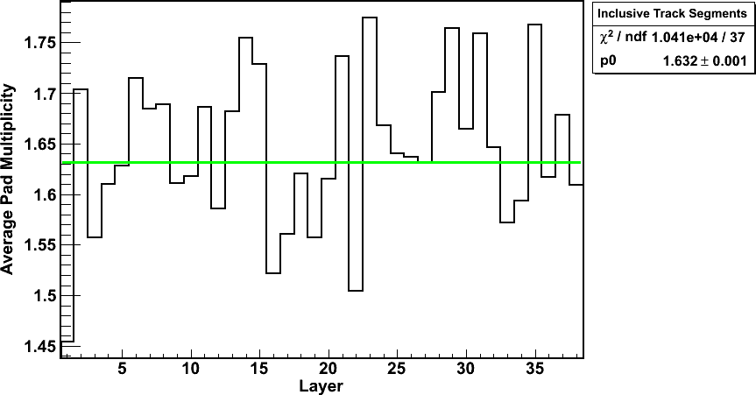
Track Segments Algorithm Results
Pad Multiplicity

