Slide 1
AD & I Meeting – 11 March, 2011
ALCPG11 parallel sessions we would like to:
Review and discuss ongoing R&D to understand how it is to be included in the TDR. Special focus should be given to those changes which could substantially impact system interfaces and/or project cost.
Evaluate the potential of R&D on alternates and upgrades to be carried out after the TD phase. This fits well with the emphasis on the 1 TeV upgrade and cost containment.
Develop a schedule for the next 12 months that leads to the start of the actual writing and editing of the TDR and allows the collection of key supporting documents.

Slide 2
ALCPG Parallel sessions
1) review plans for the ALCPG11 parallel sessions. WG Conveners: Please prepare a 5 minute summary for the meeting:
  WG1 – Sources: Wei Gai, Tsunehiko Omori
  WG2 – Damping Ring: Susanna Guiducci, Mark Palmer, Junji Urakawa
  WG3 – Main Linac/SCRF: Hitoshi Hayano, Chris Nantista, Carlo Pagani
  WG4 – BDS: Andrei Seryi, Hitoshi Yamamoto
  WG5 – CFS: Vic Kuchler, John Osborne, Atsushi Enomoto
  WG6 – Beam Dynamics / AP: Kiyoshi Kubo, Nikolay Solyak, Daniel Schulte

Slide 3
TDR will have:
Description of the design, including siting
Updates / choices made on the basis of R&D
Cost estimate, including industrialization
1 TeV upgrade
Explanation of EDMS repository
Implementation Plan / Governance scheme
Outline to be discussed ALCPG11

Slide 4
Description of the design, including siting
RDR civil cost estimate based on average of input from each region
  Separated ‘site dependent’ and ‘component’ costs
“1.83 Billion (ILC Units) for site-dependent costs, such as the costs for tunneling in a specific region.” (6.2.1)
  This separation was clear for uniform siting → will be different for TDR
  Utility cost estimation effort split → also different
“A more complete study of a shallow site –either a shallow tunnel or a cut-and-cover site – will be made in the future as part of the Engineering and Design phase.” (4.1)
  Now to also include mountainous region configuration

Slide 5
Updates / choices made on the basis of R&D
Use R & D Plan to guide ‘down-selection’ process or ‘plug-compatible’ interface definition process
http://ilc-edmsdirect.desy.de/ilc-edmsdirect/document.jsp?edmsid=*813385
“Results from critical R&D programmes and test facilities, which either demonstrate or support the choice of key parameters in the machine design.”
Evaluation of progress made v/v RD Plan milestones

Slide 6
Cost estimate, including industrialization
(RDR 3.7.4): Cavities ~ 40% CM, in turn 30% of total → 12% of the total
  To be cross-checked; too high….
SB2009:
TLCC (% of RDR) | KCS | DRFS
1 Single tunnel | 2 | 1.5
2 Gradient spread | 1.5 | 1.5
3 reduced beam | 6 | 8.4
4 positron | 0 | 0
TOTAL TLCC | 6.5 | 8.4
Central Complex | 1.6 | 1.6
Oxford TOTAL | 12.3 | 12.6

Slide 7
Klystrons Needed per 27 Unit KCS (1/2 bunches)
Scaling from the full current case, we need (0.69×284.2=) 196.1 MW worth of klystron power. At 10 MW each, 20 klystrons would give us 200 MW (2.0% to spare).
However, we want to be robust against a single klystron failure per system. With N sources combined in a passive network, failure of one source leaves combined the equivalent of (N-1)²/N sources.
With 22 klystrons and 21 on, we have 200.5 MW available (2.2% to spare).
However, we also need 7% (5% usable) overhead for LLRF to be harnessed via phase control of the rf drives, oppositely dephased in pairs, such that the combined power is reduced as P = P_{max} cos² φ, with φ nominally 15˚.
V_{tot}
φ
-φ
V_{2n}
V_{2n-1}
The maximum power requirement rises to 196.1 MW ÷ 0.933 = 210.2 MW,
With 23 klystrons and one off, we have 210.4 MW (0.12% to spare).
(21 klystrons for the 24 unit KCS and
18 klystrons for the 20 unit KCS)
TOTAL: 20×23 + 21 + 18 = 499 klystrons installed (477 on)
30.2% reduced from full current

Slide 8
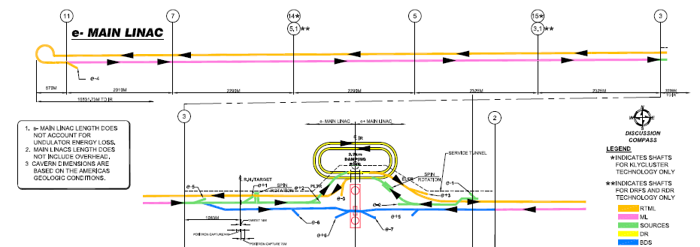
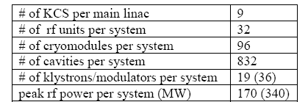
Layout
KCS at AAP Oxford, Jan 2010
Requires Addition of Two 3 m Diameter Shafts per Linac

Slide 9
1 TeV upgrade
“While the focus of the CFS design work has been on the 31 km long 500 GeV machine, the sites are required to support the footprint of the 1 TeV upgrade, both in terms of space and available infrastructure (e.g. power).” (RDR 4.1)
One TeV upgrade will be a focus topic.
  two plenary sessions (Sunday + Monday)
Group to be formed (Nick) to document issues
  timeline?
  resources?

Slide 10
TDR Preparation Baseline Technical Reviews
Dates and venues:
Physics and Detector to be represented

Slide 11
TDR Prep Review Meeting Goals:
Review the TDP R & D and summarize progress and plans.
Review the system design
  including a change control procedure so that key design changes can be discussed openly
  The updated baseline will be used for the TDR plan and cost estimate.
Review the system cost
  For SCRF and CFS, additional meetings, parallel sessions etc are also required.
Review system interface criteria;
  for example, requirements to CFS
Review supporting documents for inclusion in the EDMS
Discuss TDR preparation plans.
  Upon the completion of the review, we should be able to publish a plan for producing that part of the TDR; resources, milestones, etc
The review to be accessible to the community

Slide 12
TDR Preparation Review Meeting Scheme
each meeting to include document discussion and sign-off
  drawings, specifications and spreadsheets with parameters and costs
  relatively small, compared to BAW
  each key participant can understand their immediate tasks and responsibilities.
the meeting to also include more general summary wrap-up talks, as needed.

Slide 13
Preparation Review Meetings
TDR Preparation Review Meeting Scheme (2)
meet with TAG’s, group by group.
5 to 6 meetings in the next 12 to 15 months.
start with the Accelerator Systems –
  Source
  DR
  BDS
Work on the AS systems:
  scope is understood,
  but there will be questions and changes
remaining resources are directed toward completion of specific tests –
  CesrTA, ATF2 and source technology development.

Slide 14
Schedule constraints and concerns:
Each review should last two days
Comprehensive costing for only SCRF and CFS TAG’s
SCRF industrialization study to be launched this month; expected ~ 1 year
CFS contracts and HLRF (DRFS) costing work is expected to be ready in late 2011.
Limit the total number of reviews to six, to take place between mid 2011 and early 2012.
Try to achieve regional balance and etc

Slide 15
Preparation Review Meetings
TDR Preparation Review Meeting Scheme - participation
CFS representatives to participate in every one of the AS meetings.
costing engineers also.
(SCRF group leaders are not required to participate)
Physics and Detector representatives required for MDI-related meetings; welcome at others
SCRF and CFS meetings toward the end of 2011 or in early 2012
  consistent with our schedule
reasonable and necessary set of meetings. required to close-out the TDP.

Slide 16
Topics for System Design Review
Review the TDP R & D and summarize progress and plans.
Review the system design
  including a change control procedure so that key design changes can be discussed openly
Example topics:
Cavity pairing – Power Distribution System.
Marx modulator
RDR HLRF fallback
RTML RF design and civil design.
Tunnel diameters
Power dissipation in the tunnel
DRFS components
Optimization of Positron production parameters:
  undulator length and field;
  polarization collimator space

