Slide 1
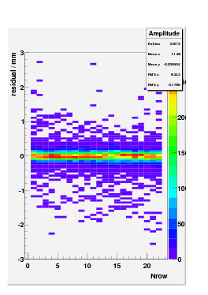
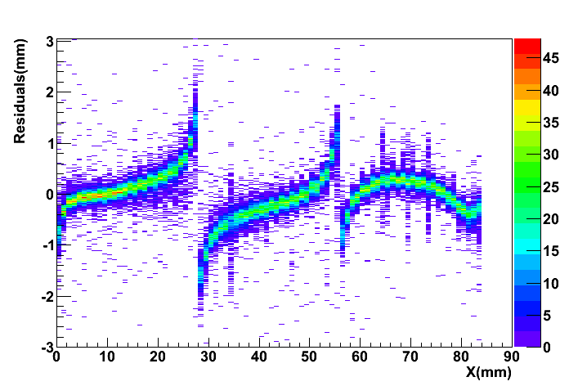
Residuals( with B= 1T) before corrections
Very preliminary
GEM detector
Micromegas detector

Slide 2
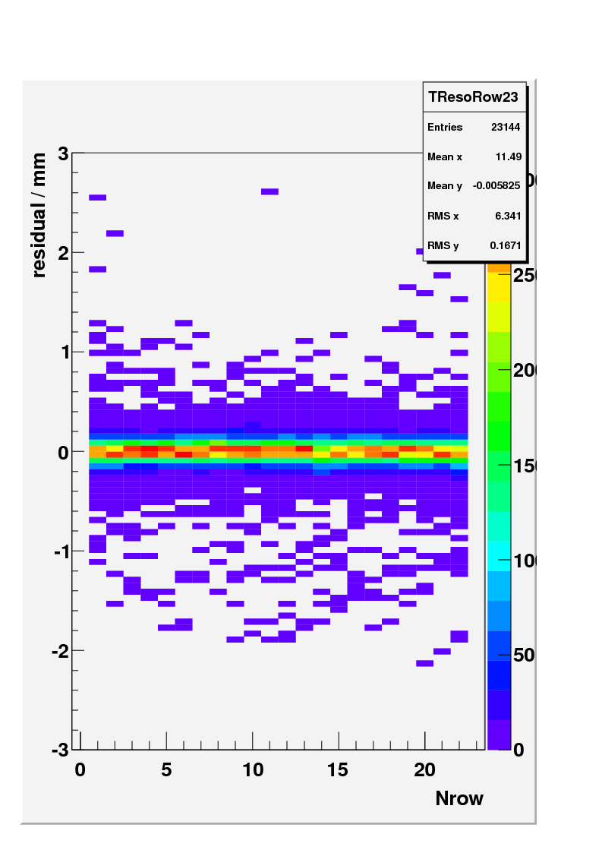
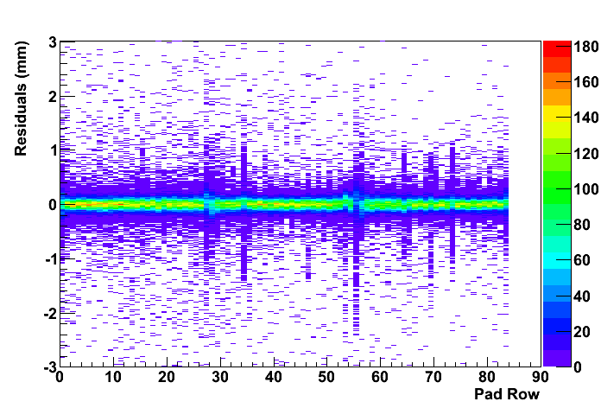
Residuals( with B= 1T) (after corrections)
Very preliminary
GEM detector Z=10cm
Micromegas detector Z=15cm

