Slide 1


Cable Matching
Mikey Davis
FONT Meeting 17/3/11
4/4

Slide 2
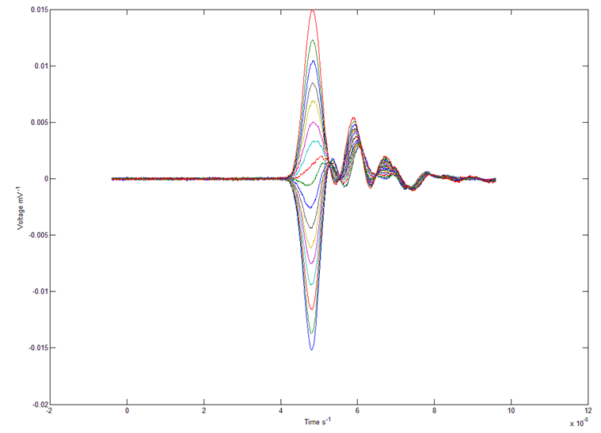
Cable Matching
Mikey Davis
FONT Meeting 17/3/11
1/4

Slide 3
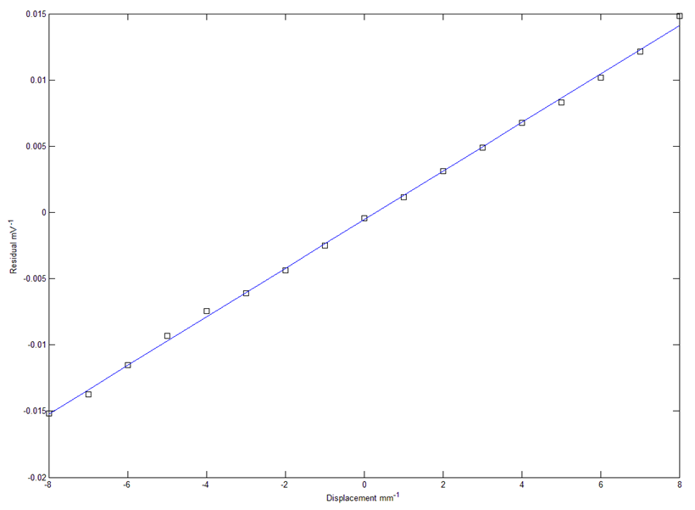
Cable Matching
Mikey Davis
FONT Meeting 17/3/11
2/4

Slide 4
Cable Matching
Mikey Davis
FONT Meeting 17/3/11
3/4

