Slide 1
TeV Upgrade Study
Nick Walker
AD&I WebEx Meeting
01.04.11
Brief summary of ALCPG’11 discussions.

Slide 2
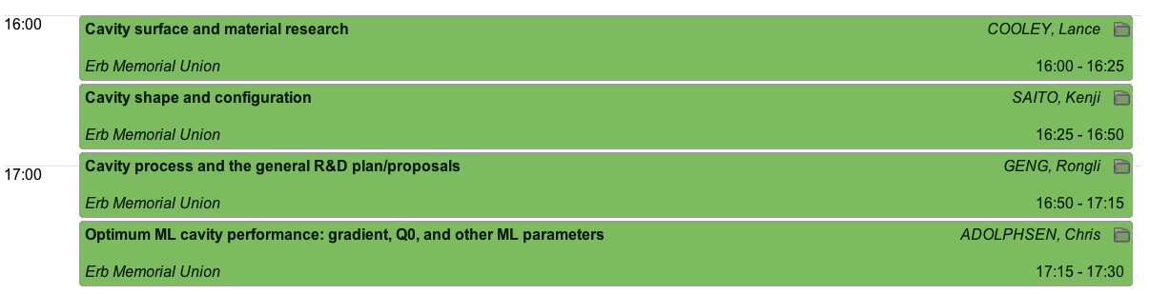
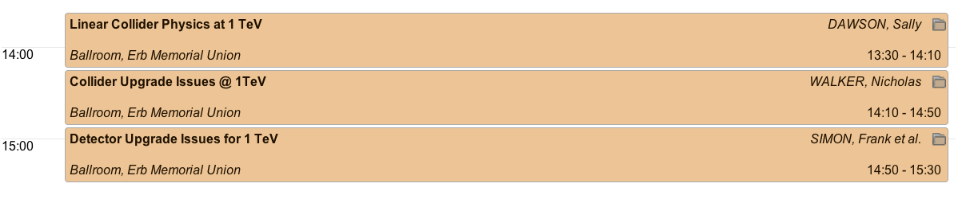
ALCPG’11 References
Sunday 20.03
GDE plenary session on ultra-high gradient R&D
http://ilcagenda.linearcollider.org/sessionDisplay.py?sessionId=2&confId=4572#20110320
Monday 21.03
Joint plenary session on TeV upgrade
http://ilcagenda.linearcollider.org/sessionDisplay.py?sessionId=0&confId=4572#20110321

Slide 3
Why (now)?
ILCSC Parameters subcommittee report:
  “An initial center-of-mass (cms) energy up to 500 GeV with the ability to upgrade to 1 TeV”
  Upgrade has always been part of ILC “requirements”
RDR: superficial treatment
  site length and available power as part of siting requirements.
  BDS and main dump layout
  No parameter set or detail information!
Cavity R&D progress
  Knowledge base and industrial capacity for baseline tech. now well established
  Promising forward looking R&D results indicate promise of even-higher gradients (→ 60 MV/m)
    Post-TDP R&D
LHC results
  Physics landscape changing almost weekly!
  ILC design (scope) must be flexible in 2013
Note: 200-500 GeV still primary TDR focus
  TeV study will be only conceptual
Must do more for TDR

Slide 4
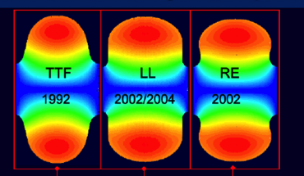
From 500 to 1000 GeV
<26 km ?
(site length <52 km ?)
1.1 km
<10.8 km ?
10.8 km
1.3 km
2.2 km
Main Linac
BDS
e+ src
IP
bunch comp.
Main Linac
<G_{cavity}> = 31.5 MV/m
G_{eff} ≈ 22.7 MV/m
(fill fact. = 0.72)
central region
Snowmass 2005 baseline recommendation for TeV upgrade:
G_{cavity} = 36 MV/m ⇒ 9.6 km
(VT ≥ 40 MV/m)
Based on use of low-loss or re-entrant cavity shapes

Slide 5
From 500 to 1000 GeV
<26 km ?
(site length <52 km ?)
1.1 km
<10.8 km ?
10.8 km
1.3 km
2.2 km
Main Linac
BDS
e+ src
IP
bunch comp.
Main Linac
<G_{cavity}> = 31.5 MV/m
G_{eff} ≈ 22.7 MV/m
(fill fact. = 0.72)
central region
Snowmass 2005 baseline recommendation for TeV upgrade:
G_{cavity} = 36 MV/m ⇒ 9.6 km
(VT ≥ 40 MV/m)
Based on use of low-loss or re-entrant cavity shapes
2011 Update:
40-60 MV/m ??

Slide 6
Cost Scaling
cost optimum now off the scale!
(Assumption of non-degrading Q₀)
Relative Linac Cost
Qo = 2e9
Qo = 1e10
Cryo-Plant Cost
~ (Load)^1.0
Qo = 5e10
~ (Load)^0.6
Linac Gradient (MV/m)
C. Adolphsen
http://ilcagenda.linearcollider.org/sessionDisplay.py?sessionId=2&confId=4572#20110320

Slide 7
Efficiency and Power
nb 4 Hz rep. rate
(updated)
efficiency %
Total AC Power MW
half-power (SB2009)
half-power (SB2009)
Gradient MV/m
Gradient MV/m
Simples scaling – needs more detailed analysis

Slide 8
1 TeV Tentative Parameters
Current “official” parameter set in EDMS*.
Should still be considered tentative, pending review and further study.
Understanding (and updating) these parameters is our job for the next ~6 months.
negotiation!
* EDMS Doc ID: D*925325
http://ilc-edmsdirect.desy.de/ilc-edmsdirect/file.jsp?edmsid=*925325&fileClass=ExcelShtX

Slide 9
The TDR Upgrade Study
Begins this workshop (next slide)
Limited resources means only a very conceptual study
  design parameters
  scaling of 500GeV designs
  Working assumptions on ML technology
SCRF Tech. will define forward looking R&D
  beyond 2012
  upgrade scenarios can be ‘aggressively optimistic’ at this stage.
An AD&I activity – including physics & detector
Proposal to produce a White Paper by early 2012
  Will eventually be part of TDR
Primary editors (tentative – needs discussion):
  3 PMs
  1 Integration
  1 Parameters
  3 reps from physics and detectors (2 detectors + theory)
  1 cost & schedule
Note that 500GeV remains our primary focus for the TDR
Expected to drive the study and write the White Paper
Notes:
The editors

Slide 10
Next Steps
Each TAG needs to produce a comprehensive list of issues/questions
  Report back AD&I meeting 25.05.2011 (two months)
Formation of the White Paper task force
  hopefully in next few weeks
Early initial review of top-level parameter(s)
  working assumptions for remainder of studies
  Also by 25.02.2011
Identification of key studies and deadlines for reports
  integrated into monthly AD&I meetings
Outline of white paper and writing assignments

