Slide 1
Damping Rings Technical Review Proposed Program
Susanna Guiducci, Mark Palmer
GDE

Slide 2
Proposed Topics
DR Parameter Specifications
Baseline Lattice Choice
  Key Design Choices
  Component Counts
  Physics Issues
    R&D
    Required Design Studies
  Alternate Modes of Operation
    Compatibility with high power and 10Hz operation
    Projections for limitations due to physics performance
Interfaces to Adjacent Area Systems
Layout & CFS Interface
Documentation
Costing
Schedule

Slide 3
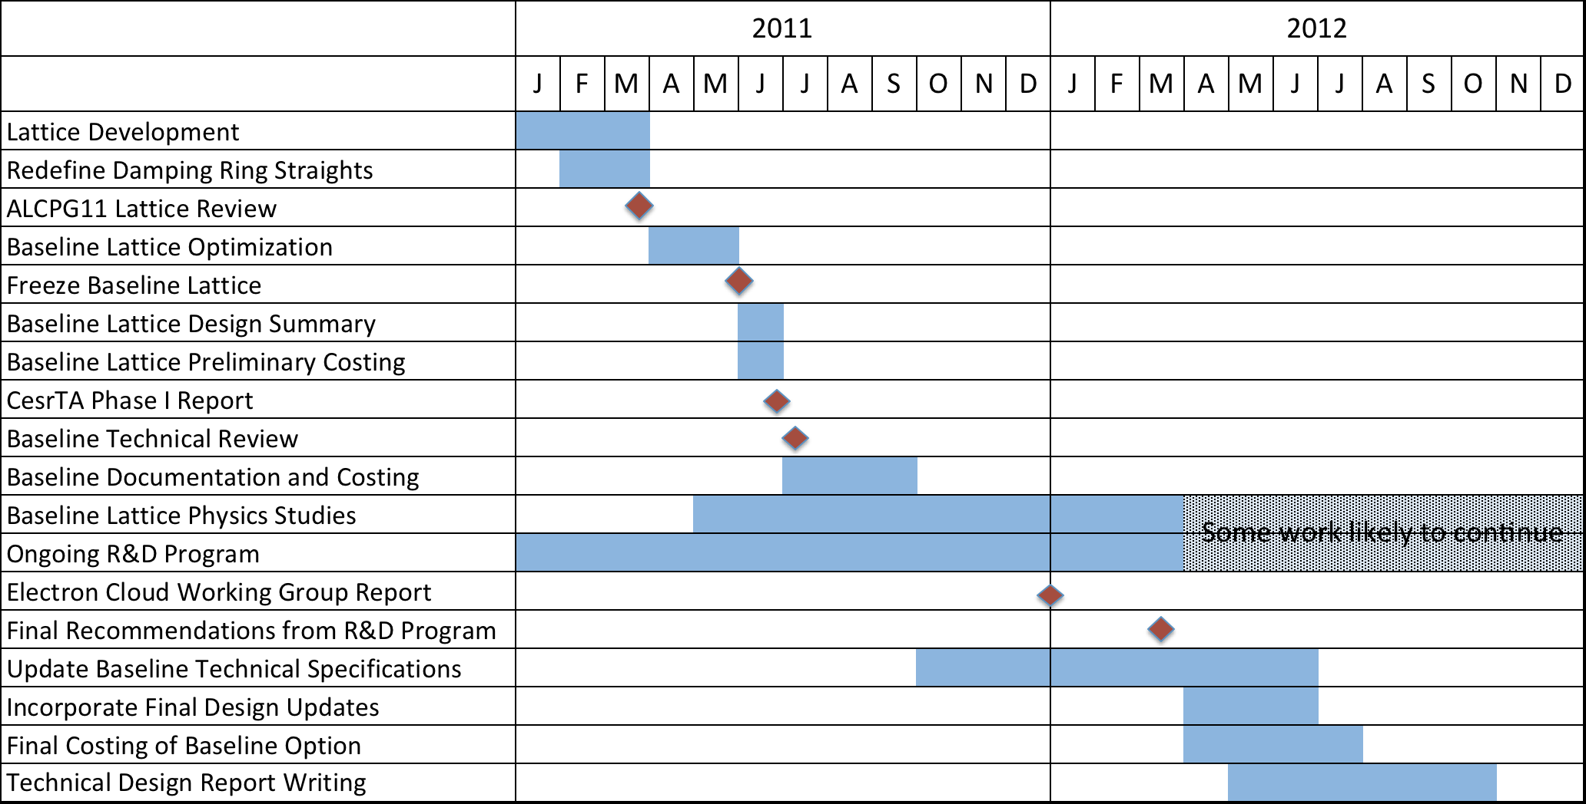
TDP-II Schedule

Slide 4
Agenda
Thursday, July 7
Morning Session
Introduction
DR Parameter Specifications
Baseline Lattice Choice
TDP R&D Progress/Plans
Afternoon Session
Interfaces to Adjacent Area Systems
Layout & CFS Interface
Friday, July 8
Morning Session
Documentation
Costing
Afternoon Session
TDP-II Schedule
Review Closeout
EDMS Session

Slide 5
Preparations Timeline
Tuesday, April 19th: DR Lattice WebEx
  Lattice status reports
  Update “standard” straights design
Tuesday, May 24th: DR Lattice WebEx
  Lattice down-select
  Identify critical issues for further refinement
Tuesday, June 28th: DR Lattice WebEx
  Group review of baseline lattice
  Discussion of preliminary documentation for review

