Slide 1
Beam structure, occupancies, time-stamping for TPC pad readout at CLIC
Lucie Linssen, CERN
with principal input from:
Martin Killenberg, CERN
http://lcd.web.cern.ch/LCD/

Slide 2
CLIC machine parameters
Parameter | Value
Center-of-mass energy √s | 3 TeV
Instantaneous peak luminosity | 5.9x10³⁴ cm⁻² s⁻¹
Integrated luminosity per year | 500 fb⁻¹
Beam crossing angle | 20 mrad
Train length | 156 ns
N_{bunches} / train | 312 (every 0.5 ns)
Train repetition rate | 50 Hz
IP size x/y/z | 45 nm / 1 nm / 40 μm
# γγ→hadrons / bx | 3.2
# incoherent electron pairs / bx | 3 x 10⁵
# halo muons | 5 (including safety factor of 5)

Slide 3
CLIC time structure
Train repetition rate 50 Hz
156 ns
20 ms
CLIC
CLIC: 1 train = 312 bunches 0.5 ns apart 50 Hz
ILC: 1 train = 2820 bunches 308 ns apart 5 Hz

Slide 4
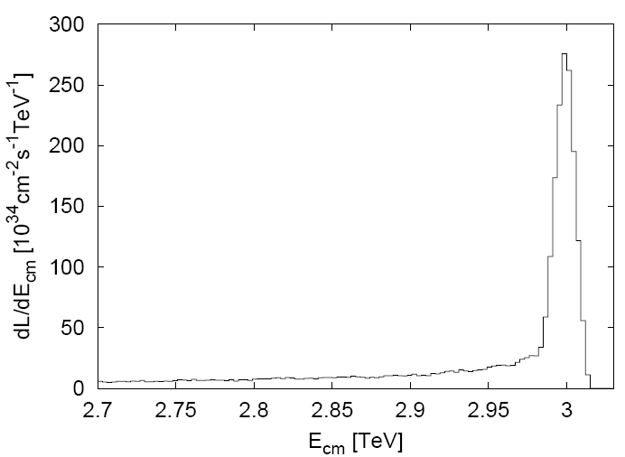
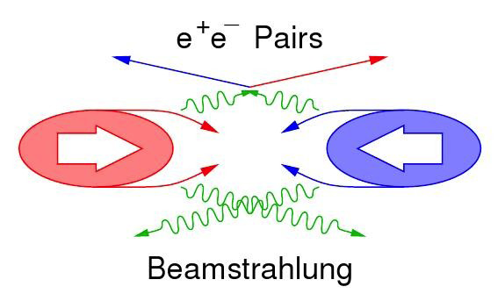
Beam-induced background (1)
Main backgrounds:
CLIC 3TeV beamstrahlung ΔE/E = 29% (10×ILC_{value})
  Coherent pairs (3.8×10⁸ per bunch crossing) <= disappear in beam pipe
  Incoherent pairs (3.0×10⁵ per bunch crossing) <= suppressed by strong solenoid-field
  γγ interactions => hadrons (3.3 hadron events per bunch crossing)
In addition: Muon background from beam delivery system(~5 muons per bunch crossing) <= spread over detector surface
CLIC luminosity spectrum
30% in “1% highest energy”

Slide 5
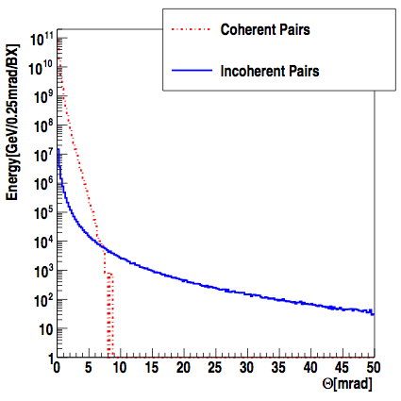
Beam-induced background (2)
Coherent pairs:
Very numerous at very low angles
Very high total energy
Incoherent pairs:
Extend to larger angles
More difficult for the detector
Determines beam crossing angle (20 mrad)
Determines opening angle of beam pipe for outgoing beam (±10 mrad)

Slide 6
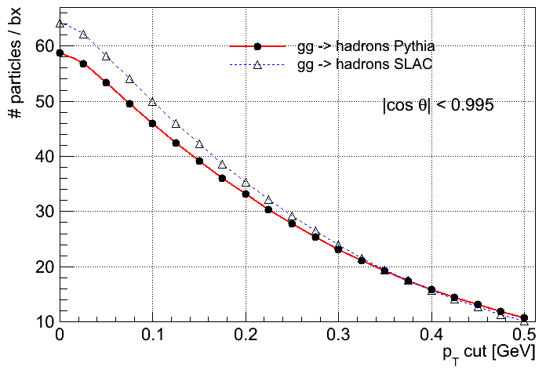
Beam-induced background (3)
CLIC beamstrahlung: γγ ➔ hadrons
Per bunch crossing:
3.2 such events
~28 particles into the detector
50 GeV
Forward-peaked
15 TeV dumped in the detector per 156 ns bunch train !
we need
TIME STAMPING !
…and play with clever event selections
D. Dannheim, CERN

Slide 7
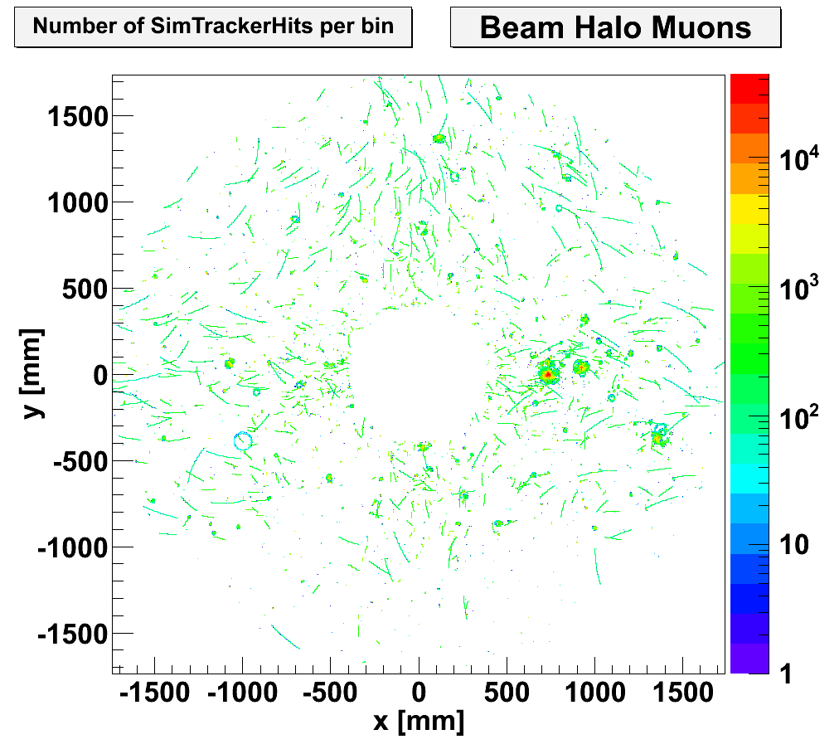
TPC occupancies from halo muons
M. Killenberg, CERN
TPC voxel hit spectrum for 5 muons/bx, for 6*1 mm² pads and 40 MHz readout.

Slide 8
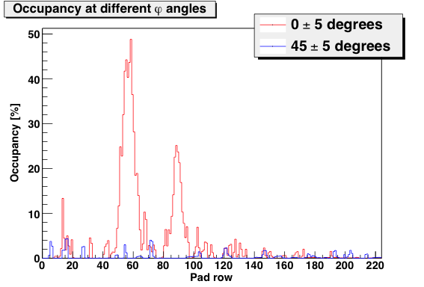
TPC occupancies from halo muons
Voxel occupancy due to halo muons in specific regions (for full bunch train and 6*1 mm² pads).
Showing effects of hot spots.
M. Killenberg, CERN

Slide 9
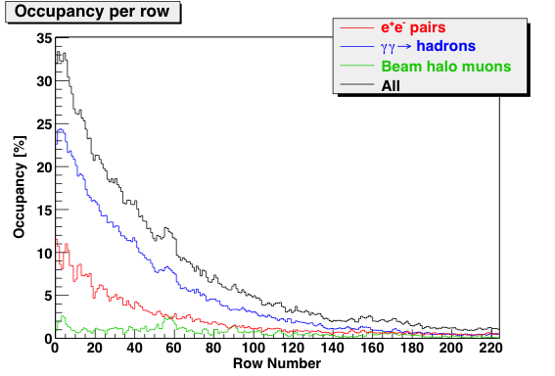
TPC occupancies
M. Killenberg, CERN
Pad occupancy (percent of time voxels occupied) for full bunch train and 6*1 mm² pads at 40 MHz readout

Slide 10
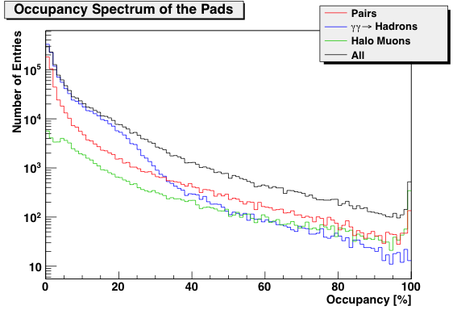
TPC occupancies
Occupancy spectrum for individual pads, for full bunch train and 6*1 mm² pads.
Total average is 5.1% (31% in inner pad row)
M. Killenberg, CERN

Slide 11
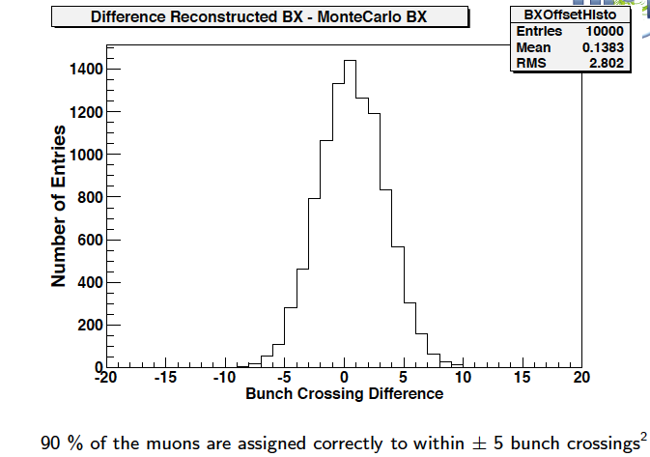
Time-stamping with TPC at CLIC
Approximately 40 micron drift per BX, ~7mm drift for full train
Study mismatch between outer Si tracker (SET) and TPC tracks.
Different muon energies, different angles.

Slide 12
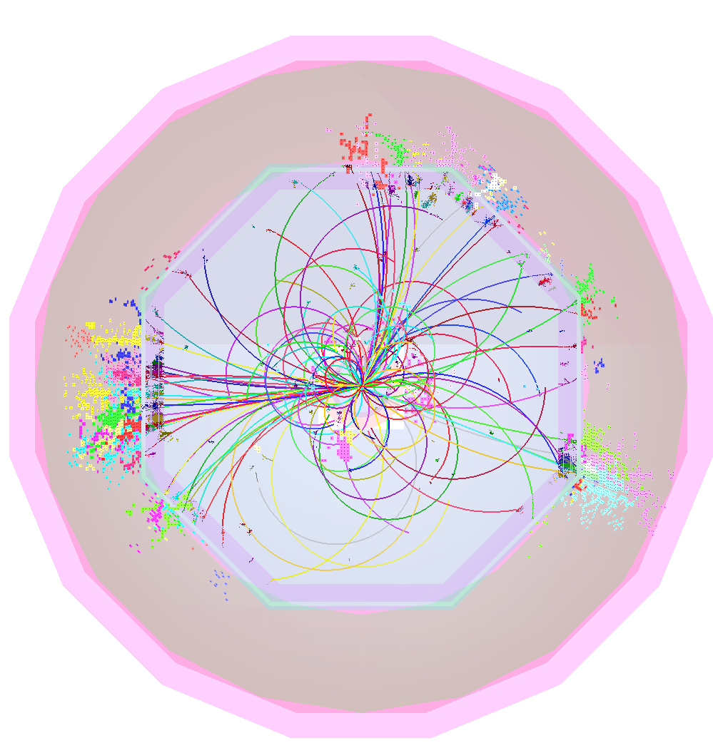
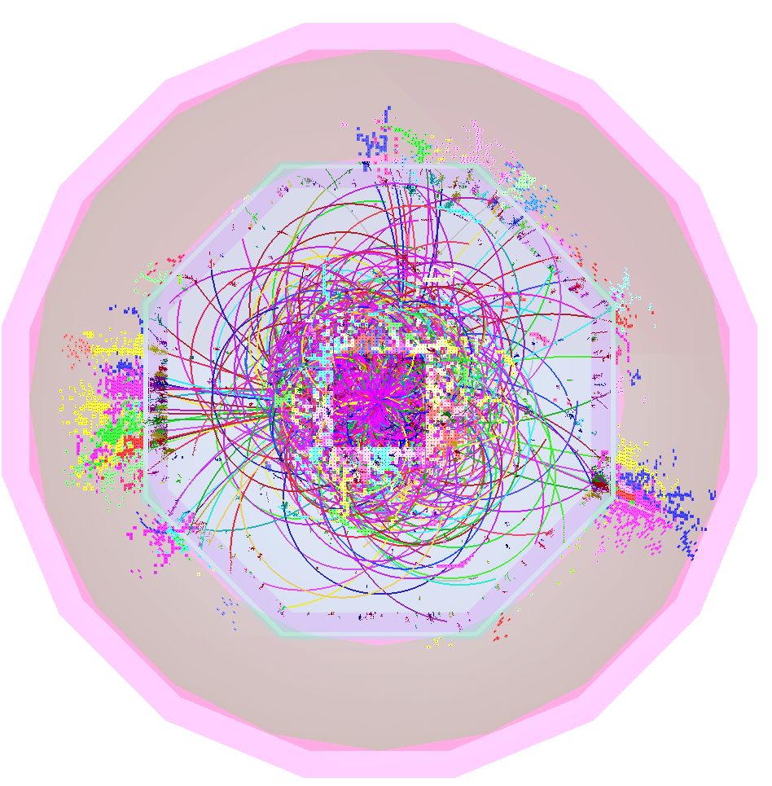
Thank you!

Slide 13
SPARE SLIDES

Slide 14
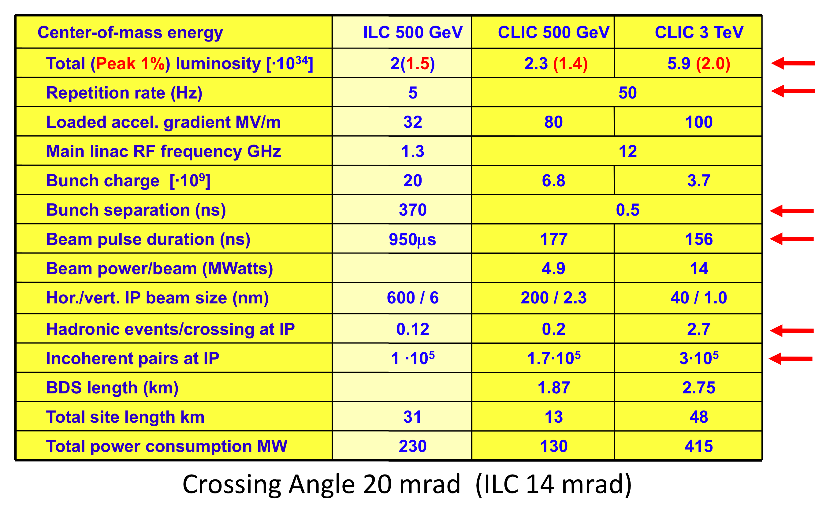
CLIC parameters

Slide 15
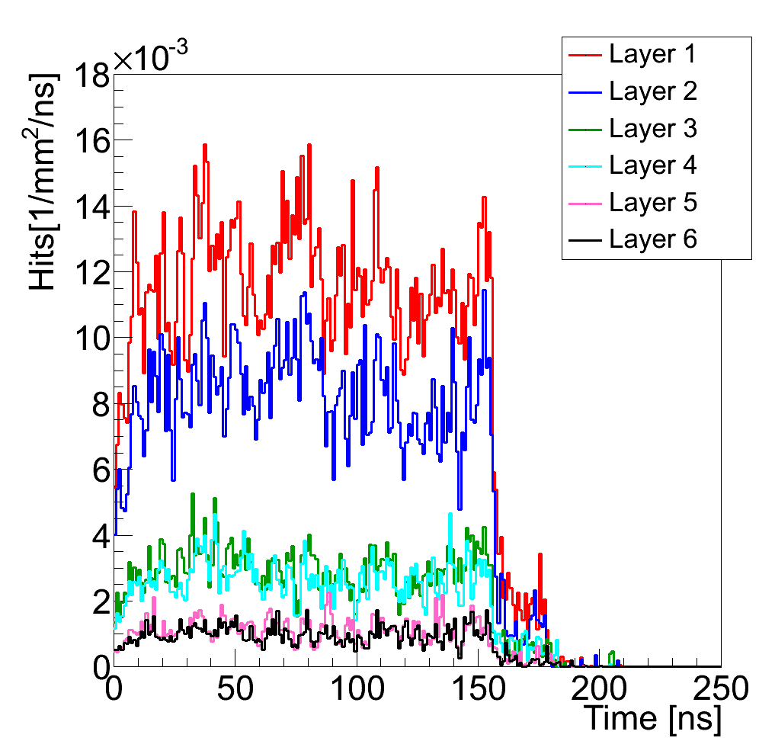
Beam-Beam backgrounds
Background occupancies in vertex region dominated by
incoherent electron pairs produced from the interaction of real or virtual photons with an electron from the incoming beam
20 mrad crossing angle leads to large amount of back-scattered particles, suppressed in latest design by optimization of absorbers and forward geometry
In CLIC_ILD innermost barrel layer
(R=30 mm):
  ~1.5 hits / mm² / 156 ns train
assuming 20 x 20 um² pixels,
cluster size of 5,
safety factor of x5:
  ~1.5% occupancy / pixel / 156 ns train
γγ→hadrons: ~5-10x smaller rates
CLIC-SiD: similar background rates
Multiple hits per bunch train can occur
Sufficient to readout only once per train
Time stamp with 5-10 ns required
CLIC-ILD
A. Sailer
A. Sailer

Slide 16
Timepix2 ASIC development
Follow-up on Timepix and Medipix3 chips
Broad client community (HEP and non-HEP):
  X-ray radiography, X-ray polarimetry, low energy electron microscopy
  Radiation and beam monitors, dosimetry
  3D gas detectors, neutrons, fission products
  Gas detector, Compton camera, gamma polarization camera, fast neutron camera, ion/MIP telescope, nuclear fission, astrophysics
  Imaging in neutron activation analysis, gamma polarization imaging based on Compton effect
  Neutrino physics
Main Linear Collider application: pixelized TPC readout
Technology IBM 130nm DM 3-2-3 or 4-1
Design groups: NIKHEF, BONN, CERN
PLL and on-pixel oscillator architecture test (MPW, spring 2011)
Expected submission of full Timepix2 chip (early 2012)
X. Llopart-Cudie, CERN

Slide 17
Timepix2 Main requirements
Matrix layout: 256x256 pixels (Pixel size 55x55 µm)
Low noise and low minimum detectable charge:
  < 75 e- ENC
  < 500 e- minimum threshold
Time stamp and TOT recorded simultaneously
  4 bits Fast time-stamp
    resolution ~1.5ns (if using on-pixel oscillator running at 640MHz)
    Dynamic range 25ns
  10-12 bits Slow time-stamp
    Resolution 25ns (@40MHz)
    Dynamic range 25.6 µs (10 bit) to 102.4 µs (12 bit)
  8-10 bit Energy Measurement (TOT)
    Standard Resolution 25ns (@40MHz)
    Energy Dynamic range from 6.4 µs to 25.6 µs (@40MHz)
Bipolar input with leakage current compensation
  e- and h+ collection, input capacitance <<50 fF
Sparse Readout
X. Llopart-Cudie, CERN

Slide 18
Timepix2 Top Level Schematic
128 double-columns @ 256● 55μm = 1.4cm
Analog Front-end
Digital Pixel Region
Readout
Control (TOKEN based)
Slow Counter 4b
DAC
ToT Counter 4b
Pixel array (256 x 256)
RefCLK Counter 6b
Fast Counter 4b
double column bus
Data 18b
&
pixel ID 9b
32 pixel regions @ 256● 55μm = 1.4cm
one double column with a 40MHz common data bus
Fast oscillator (600MHz)
MUX
Fast Counter 4b
Slow Counter 4b
ToT Counter 4b
FAST OR
RefCLK Counter 6b
DAC
8-Pixel Region
End of Column Logic
FiFO 4-depth
periphery bus
GLB time stamp
Readout control
(Token based)
periphery
periphery data bus 40MHz
Data output block
DAC
Bandgap
Bias gen.
EFUSE
chip ID
Serializer/
64-to-8
Slow control
Tx
RX
RX
RX
Tx
640MHz
Oscillator PLL
Tx
V. Gromov, Nikhef
Data_out Data_in
Fast OR
Reset_GLB
Clock 40 MHz
8 x 320MHz LVDS

Slide 19
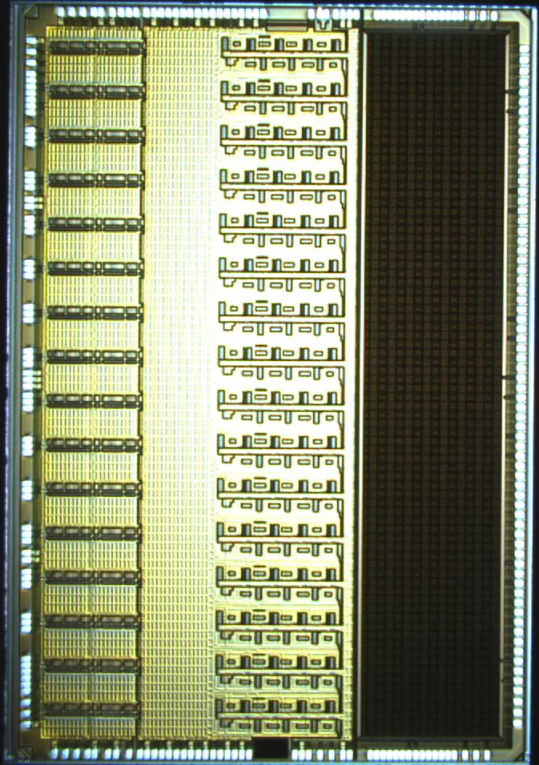
The Saltro 16
P. Aspell, M. de Gaspari, H. Franca,
E. Garcia, L. Musa, CERN
A 16 channel front-end chip including DSP functions for the readout of gaseous detectors such as MWPC, GEM, Micromegas.
Submitted in IBM 130nm CMOS technology, Q3 2010.
Received back from the foundry Q1, 2011, currently under test.
Size: 5750um x 8560um, 49.22mm²

Slide 20
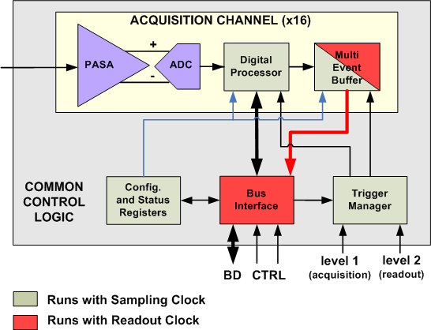
The Saltro 16
architecture.
16 channels,
Each channel comprising :
Low-noise programmable pre-amplifier and shaper,
ADC,
Digital Signal Processor.
Max sampling frequency: 40MHz
Max readout frequency: 80MHz
Interface compatible with the ALICE TPC
PASA | ADC | Digital Signal Processor
Single-ended to differential | 10bit | Baseline correction 1: removes systematic offsets
Pos/neg polarity | 40MHz max freq | Digital shaper: removes the long ion tail
Shaping time 30-120ns | Power adjustable to the freq | Baseline correction 2: removes low-freq baseline shifts
Gain 12-27mV/fC |  | Zero Suppression
Power pulsing feature included. | Possibility of power pulsing via external bias control. | External clock control for power pulsing

