Slide 1
Electronics for LC TPC
Expected signals, rates, real estate

Slide 2
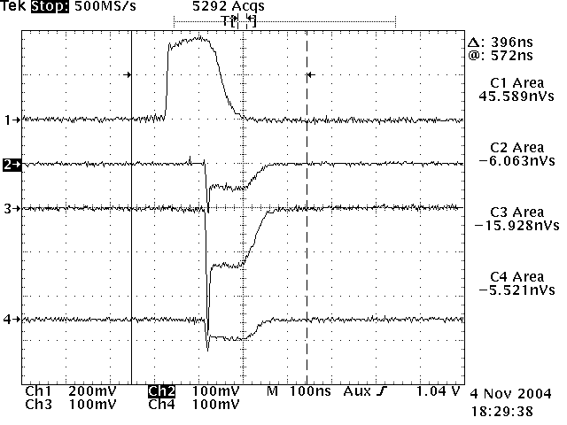
Expected signals
Mesh signal
Micromegas (as seen by
a fast amplifier):
GEMs: only electron signal, but enlarged by longitudinal diffusion over the transfer gaps O(ns)
In both cases, superposition of 50-70 electrons smeared by longitudinal diffusion (O(100 ns)) and track angle.
No significant difference overall as drift effects dominate
Pad signal

Slide 3
Expected signal amplitude
Given the pad length and the gas choice (probably Ar-based), we expect 50-70 ionization electrons per padrow.
There will be an attempt to limit the gain to about 1000, to avoid feeding back too many ions
There are long tails in the ionization distribution (say 5 times the mean value)
Overall, we have to be sensitive from 0.2 fC to 60 at least, thus have noise < 500 e- rms and at least 11 bit dynamics.

Slide 4
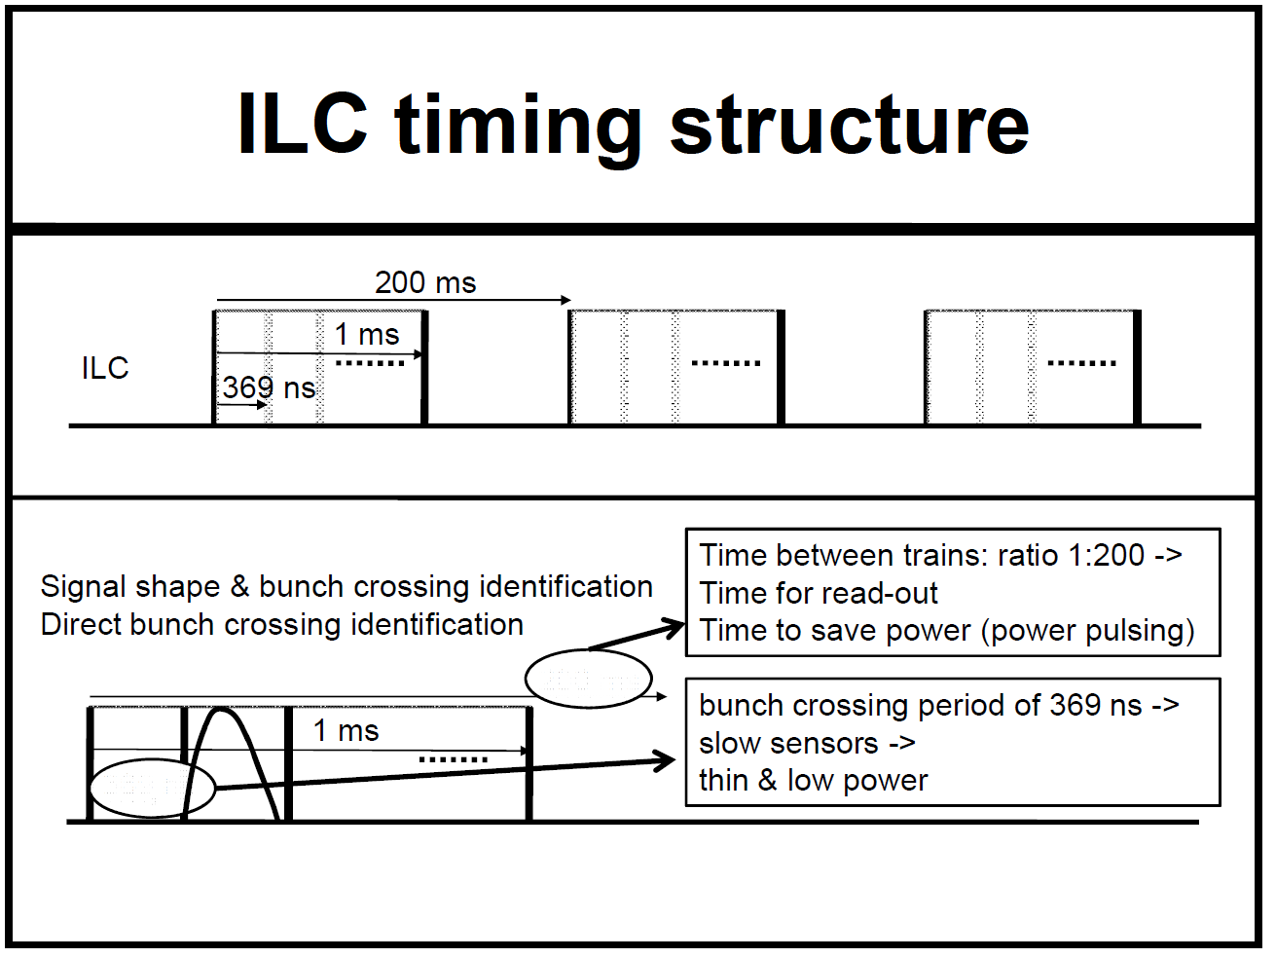
From A. Kluge,
TWEPP09
Triggerless readout of 1 ms basic units

Slide 5
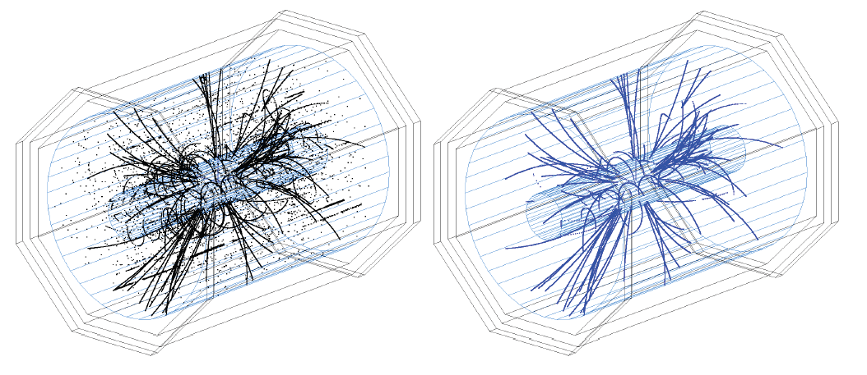
Data rate and occupancy
Dominated by background (integrate up to 80 bunch crossings in one TPC volume) : 1000 photon, 140 neutrons, (300 e- produced) per bunch crossing.
r-dependent (diminishes from low r to high r)

Slide 6
Power consumption
Real estate
Present main streams are 2-3 mm x 7 mm pads for Micromegas and 1 mm x 4-5 mm for GEMs. Small pads might be required also for Micromegas at small r because of occupancy by background.
Present numbers from ALTRO and AFTER based test electronics:
  ALTRO 40-80 mW/ch, AFTER 20 mW/ch
  For ‘main stream’ pad size this is 10-20 kW/m² for GEMs and 1 kW for Micromegas.

Slide 7
Summary
Time (2013) to re-think from scratch the electronics for ILD TPC readout
Should also be usable for other projects
130 nm seems to be the technology, but might be questionned
Power distribution and consumption are important issues (taking in and out power both need matter)
To start with: improve SALTRO 16 design:
  Compact, make less gourmand ADC, maybe get read of digital filter
Work out storage and real-time data reduction

