Slide 1

Status of AFTER
7 module integration for the Micromegas Large Prototype
D. Attié, P. Baron, D. Calvet, P. Colas, C. Coquelet, E. Delagnes,
R. Joannes, A. Le Coguie, S. Lhenoret, I. Mandjavidze, M. Riallot, E. Zonca
TPC Electronics: SALTRO Status & Evolution
May 10th, 2011
Notes:
I’m here to present a TPC review

Slide 2
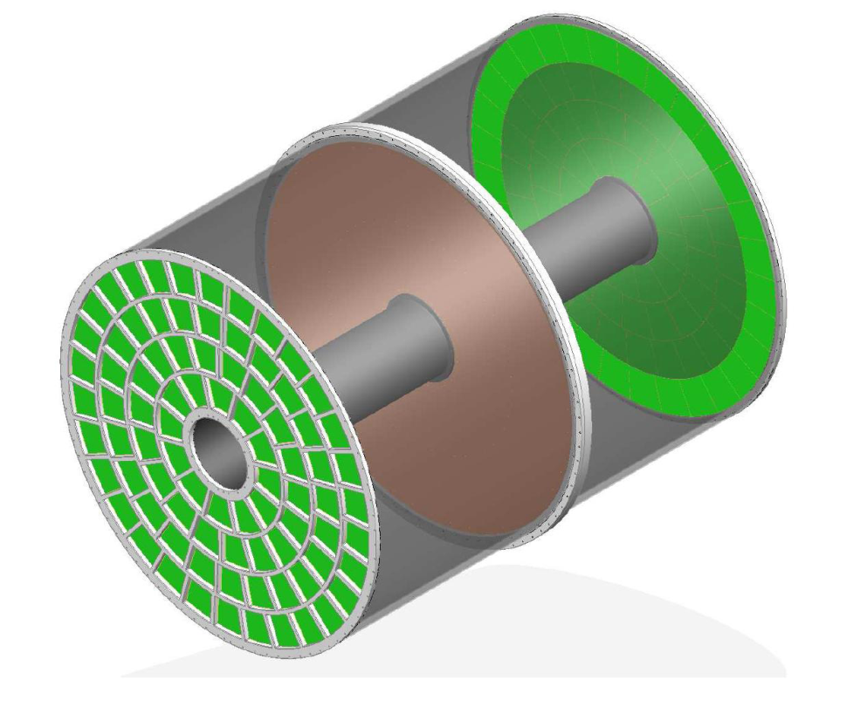
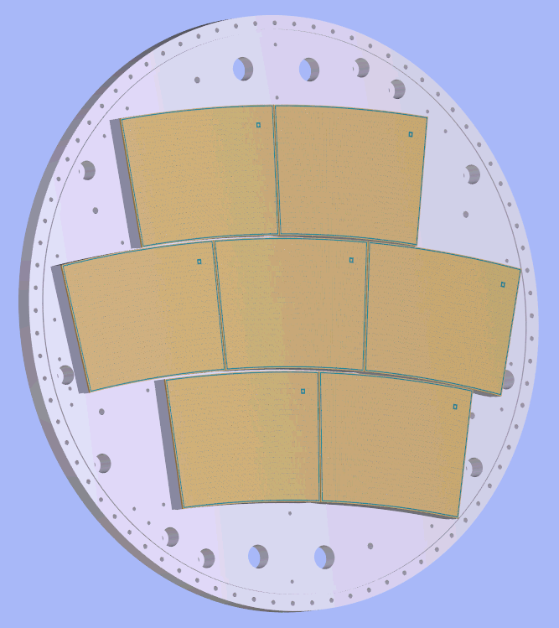
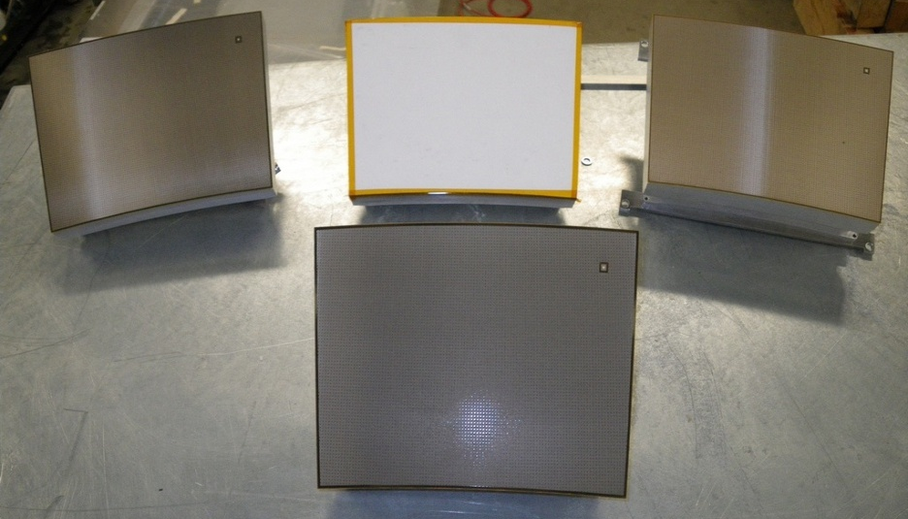

Overview of our roadmap
Large Prototype TPC
ILD-TPC
Resitive Micromegas
Detector
Baseline
Document

Slide 3
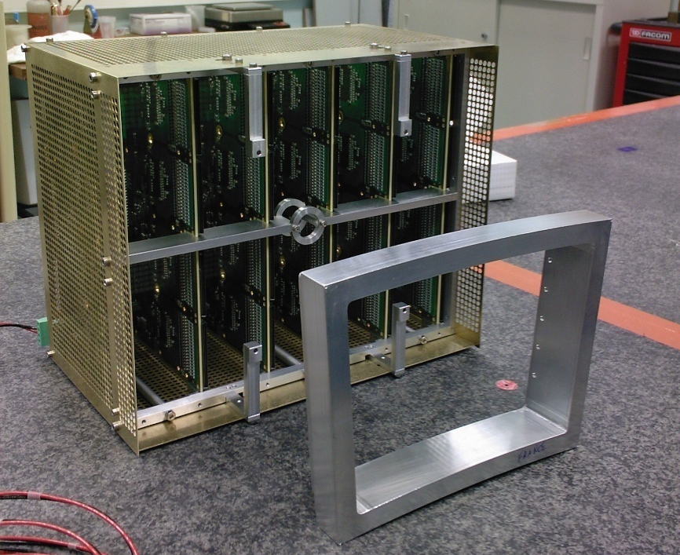
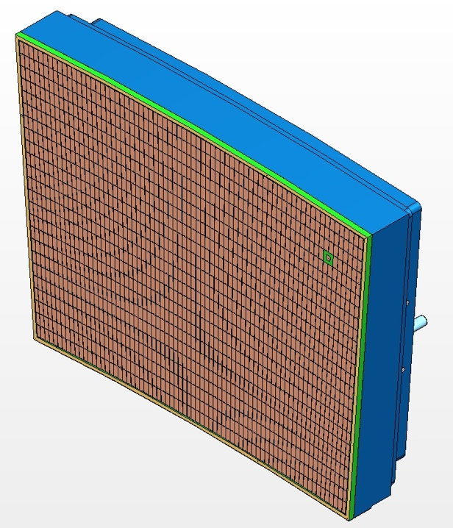
T2K electronics
AFTER-based electronics (72 channels/chip) from T2K experiment:
low-noise (700 e-) pre-amplifier-shaper
100 ns to 2 μs tunable peaking time
full wave sampling by SCA
Zero Suppression capability
Bulk Micromegas detector: 1726 (24x72) pads of ~3x7 mm²
frequency tunable from 1 to 100 MHz (most data at 25 MHz)
12 bit ADC (rms pedestals 4 to 6 channels)
pulser for calibration

Slide 4
Power Supply
Reference Voltage
Reference Current
x72(76)
AFTER
1 channel
Asic
For
Tpc
Electronic
Read-out
120fC<Cf<600fC
BUFFER
FILTER
SCA
76 to 1
CSA
ADC
511 cells
100ns<tpeak<2us
TEST
SLOW CONTROL
Power
On
Reset
SCA MANAGER
Asic Spy Mode
W / R
CK
In Test
Serial Interface
Mode
CK
CSA;CR;SCAin (N°1)
Design features:
72 channels x 511 analog memory cells; F_{write}: 1-50 MHz; F_{read}: 20 MHz
4 Charge Ranges (120 fC; 240 fC; 360 fC & 600 fC)
Supports positive or negative input signals
16 Peaking Time Values (100 ns to 2 µs)

Slide 5
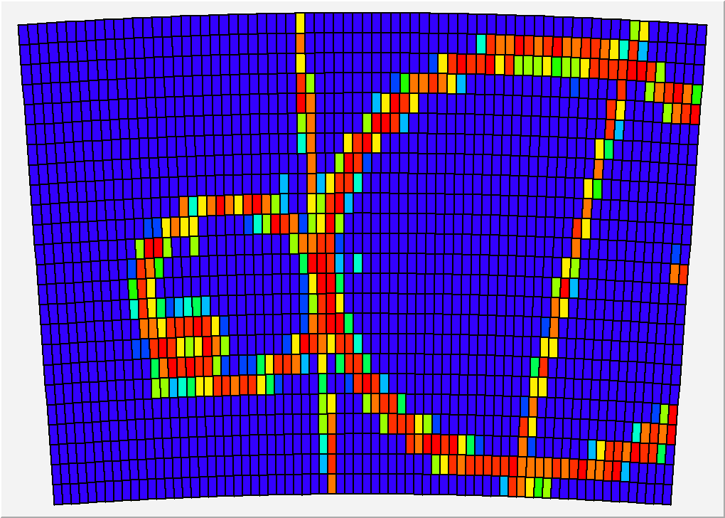
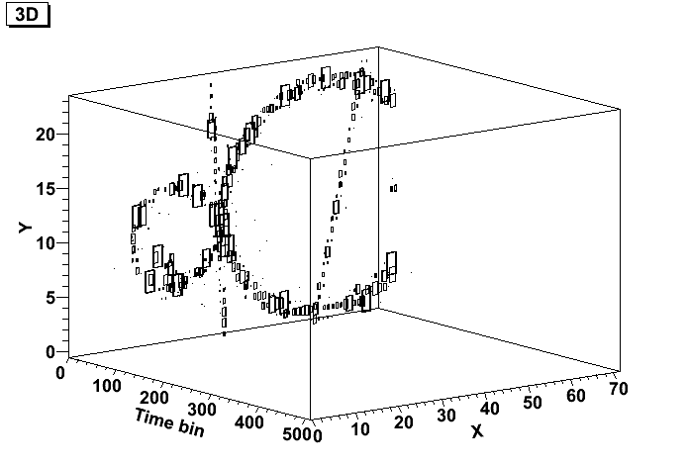
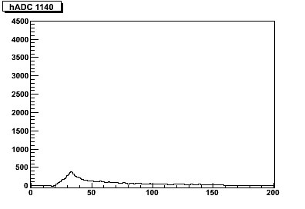
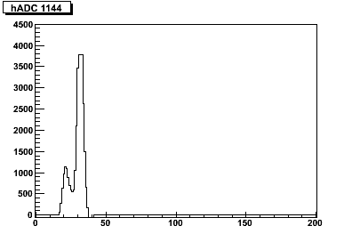
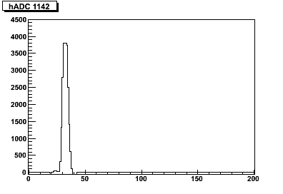
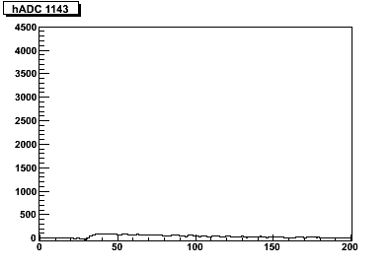
Beam data sample
B = 1T
T2K gas
Peaking time: 100 ns
Frequency: 25 MHz
z = 5 cm

Slide 6
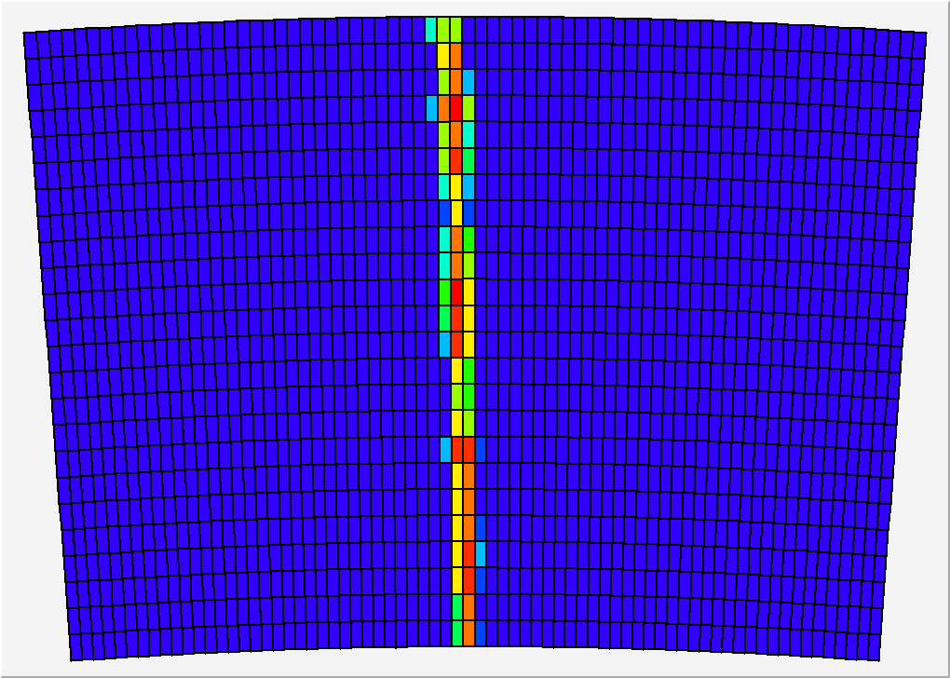
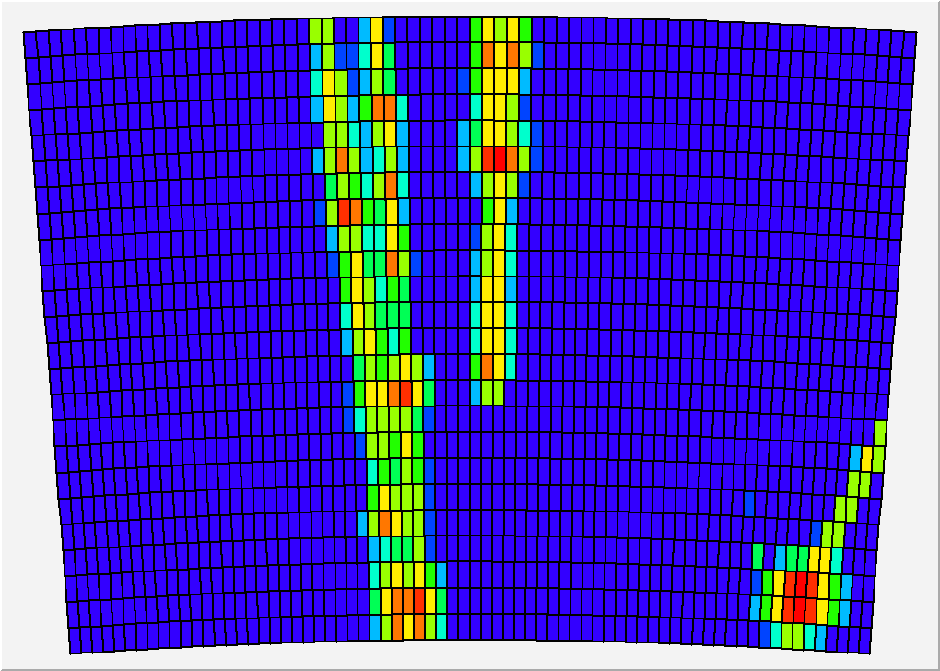
Two detectors at B=1T, z ~ 5 cm
Resistive Kapton
Resistive Ink
RUN 310
v_{drift} = 230 cm/μs
V_{mesh} = 380 V
Peaking time: 500 ns
Frequency Sampling: 25 MHz
RUN 549
V_{drift} = 230 cm/μs
V_{mesh} = 360 V
Peaking time: 500 ns
Frequency Sampling: 25 MHz

Slide 7
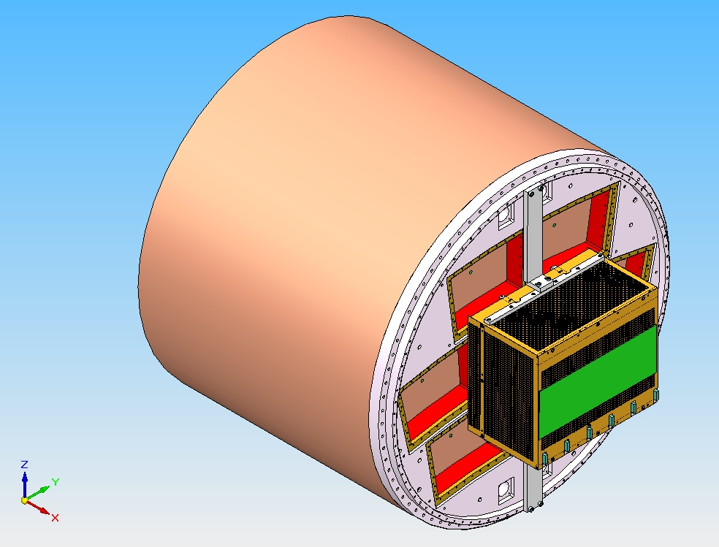
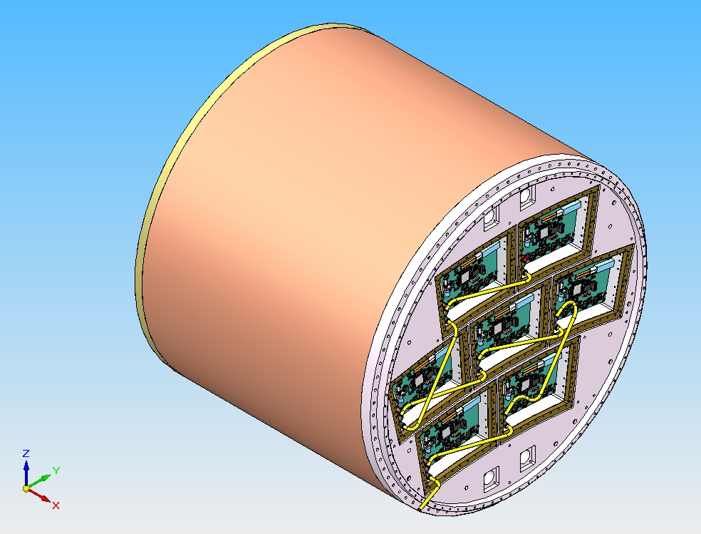
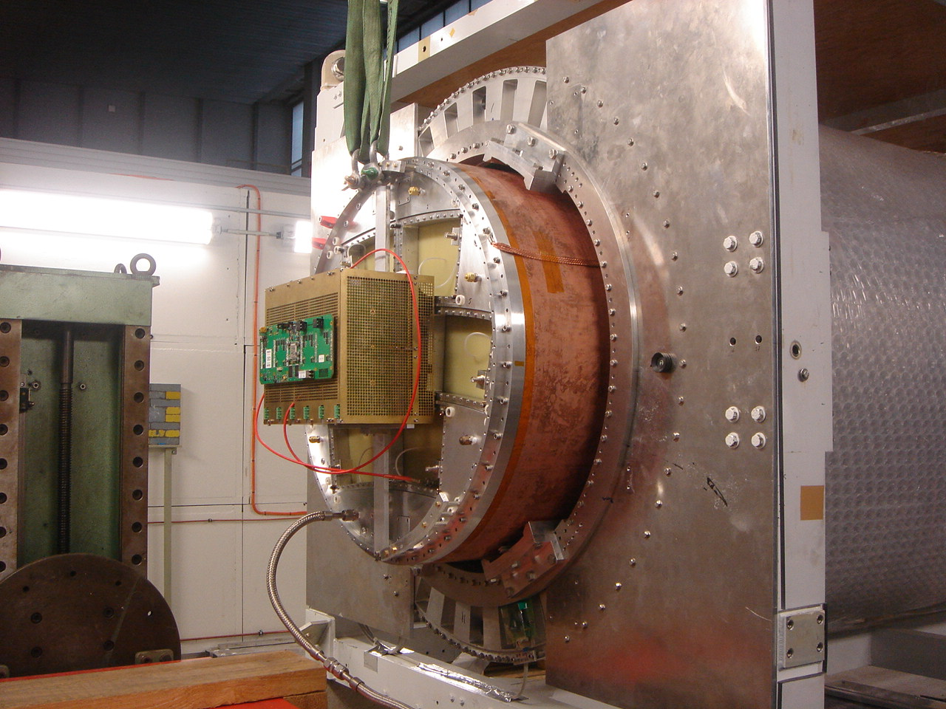
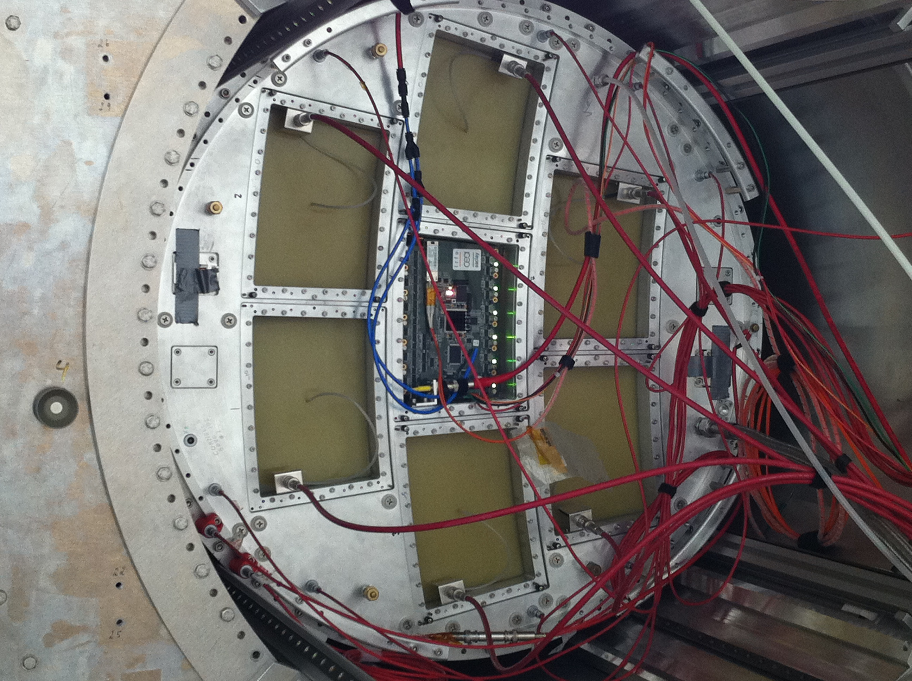
Integrated electronics for 7 module project

Slide 8
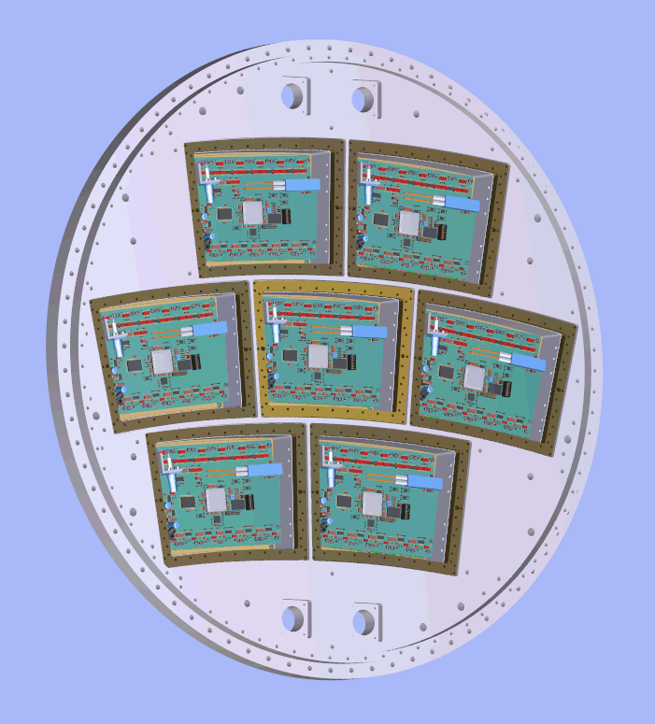
7-module Micromegas project for the Large Prototype TPC

Slide 9
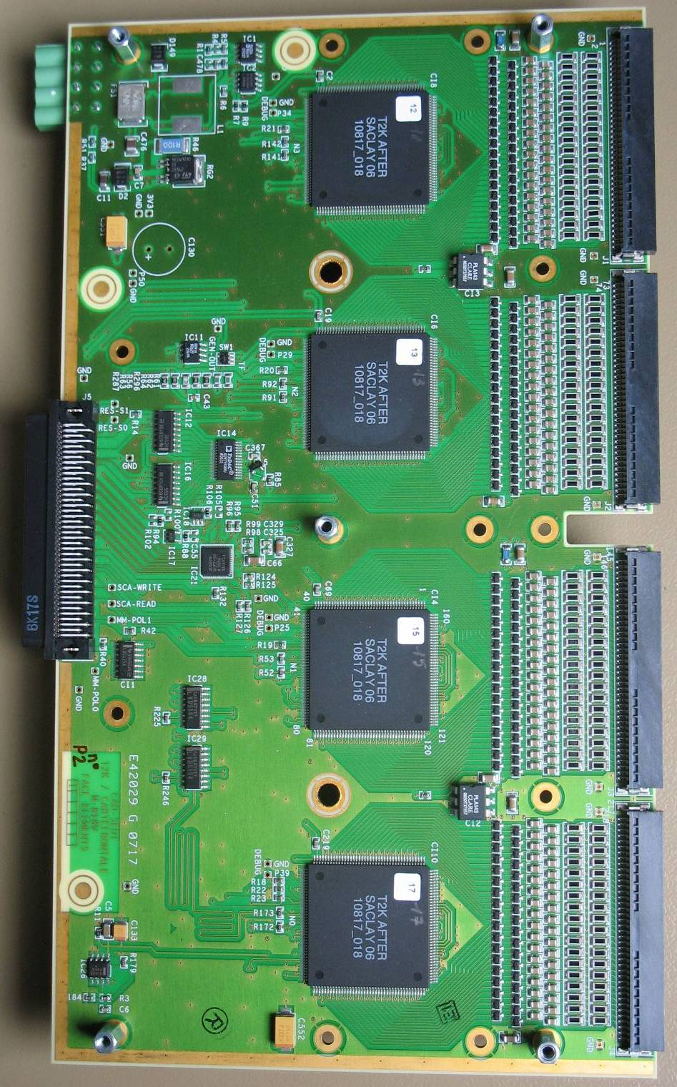
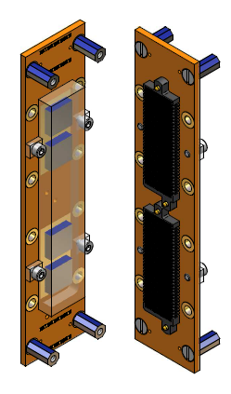
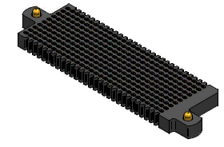
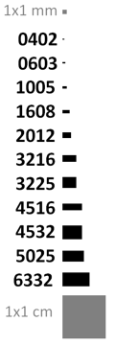
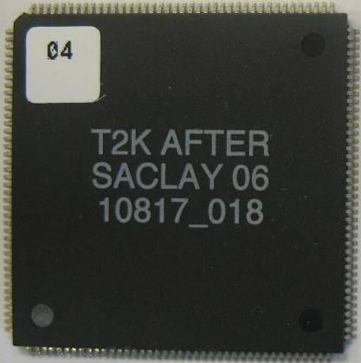
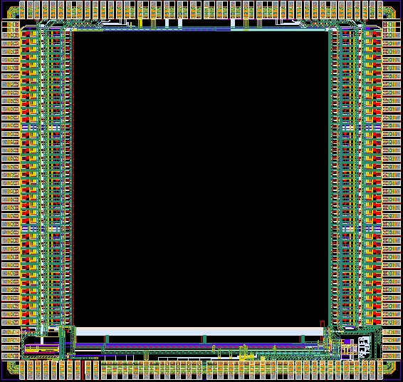
Integrated electronics for 7 module project
Remove packaging and protection diodes
Wire –bonding on board for AFTER chips
Use 2 × 300 pins connector
Replace resistors SMC 0603 by 0402 (1 mm × 0.5 mm)
FEC
25 cm
12,5 cm
4,5 cm
14 cm
3,5 cm
2,8 cm
3,5 cm
0,78 cm
Chip
0,74 cm

Slide 10
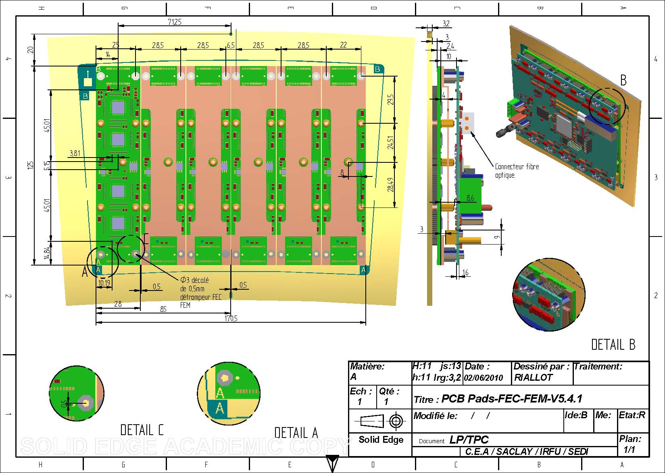
Design of the integrated electronics

Slide 11
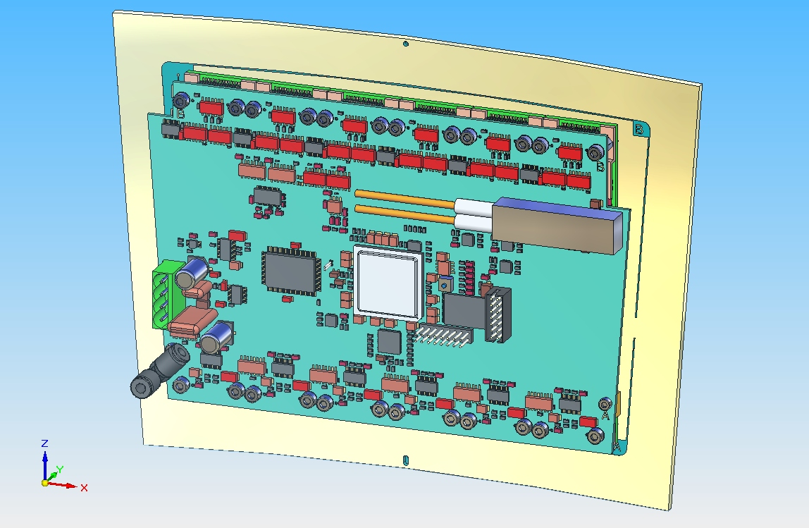
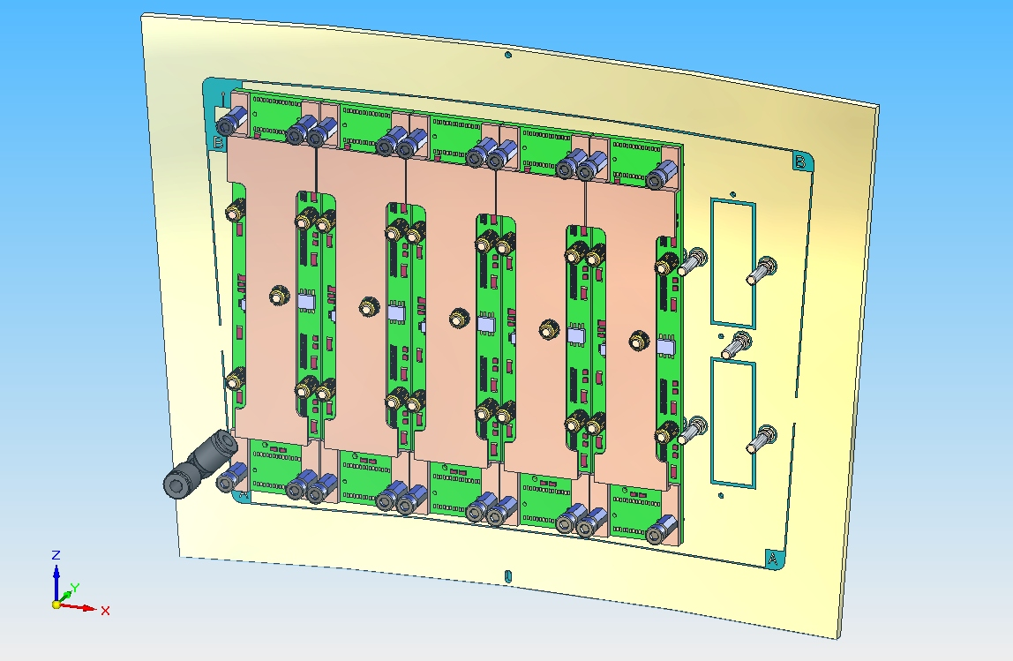
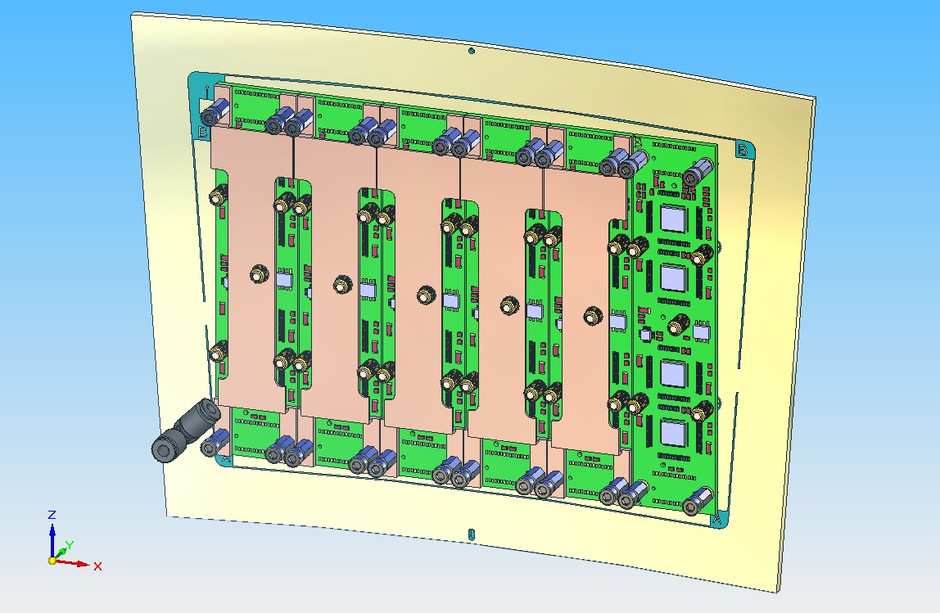
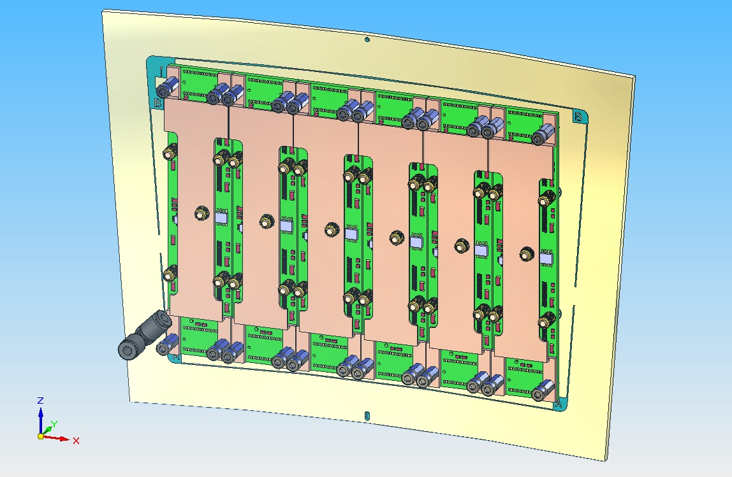
Design of the integrated electronics

Slide 12
Front-End Mezzanine (FEM)
30 pins
connector
30 pins
connector
30 pins
connector
30 pins
connector
30 pins
connector
30 pins
connector
SRAM
ADC
FPGA
Xilinx V5
Xilinx
Prom
Optical
connector
Test Pulser
30 pins
connector
30 pins
connector
30 pins
connector
30 pins
connector
30 pins
connector
30 pins
connector

Slide 13
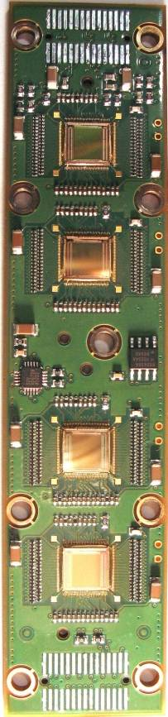
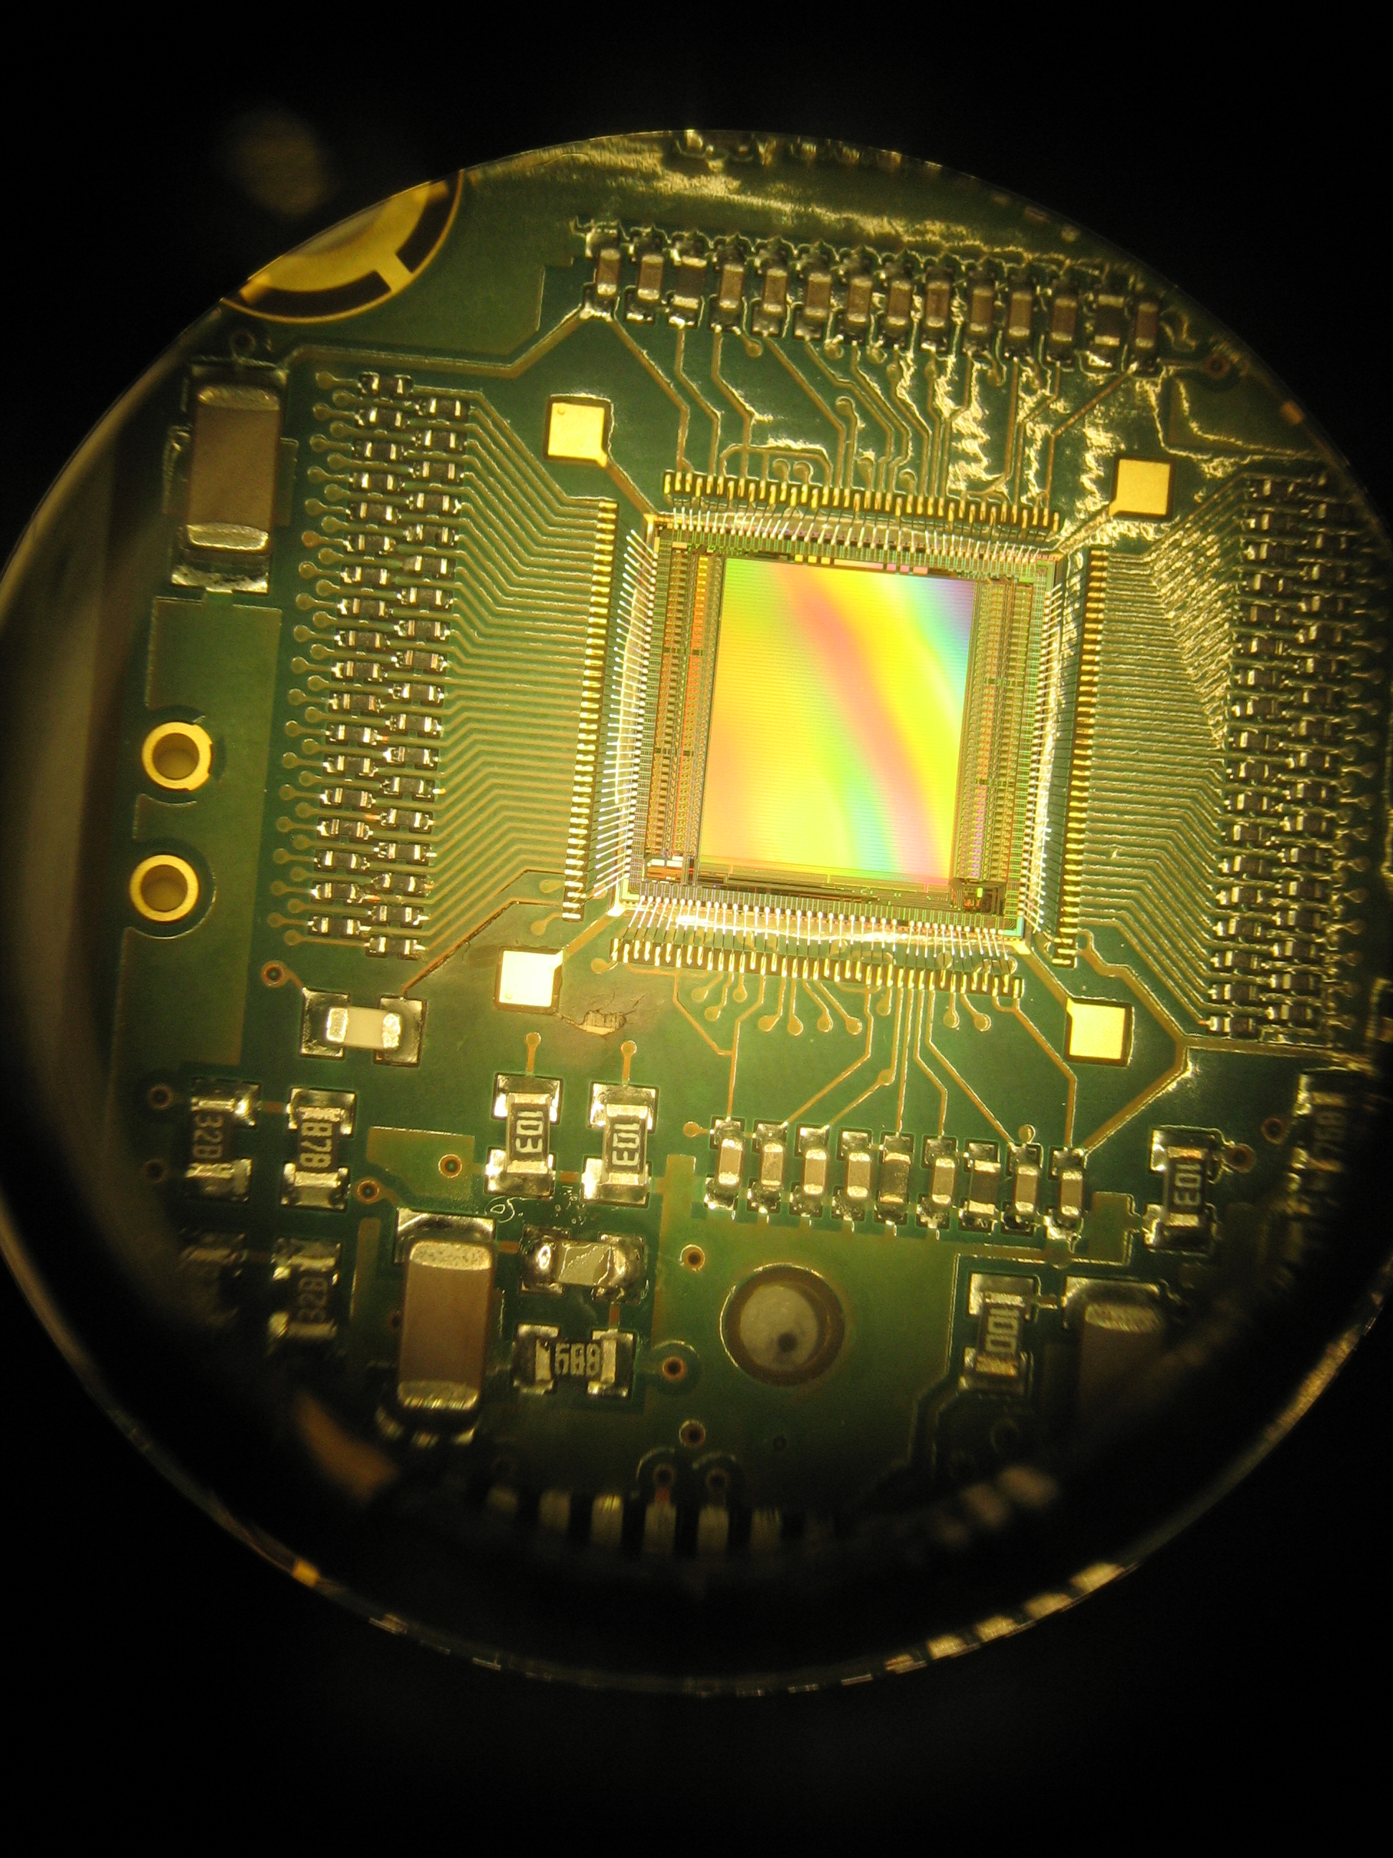
Front-End Card (FEC)
4 chips per FEC wire bonding on the 8-layer PCB
Protections: a resistor (0201 SMC) at each channel input
A0: 0Ω
A1: 3Ω
A2: 5,1Ω
A3: 10Ω
Temperature measurement device for each FEC

Slide 14
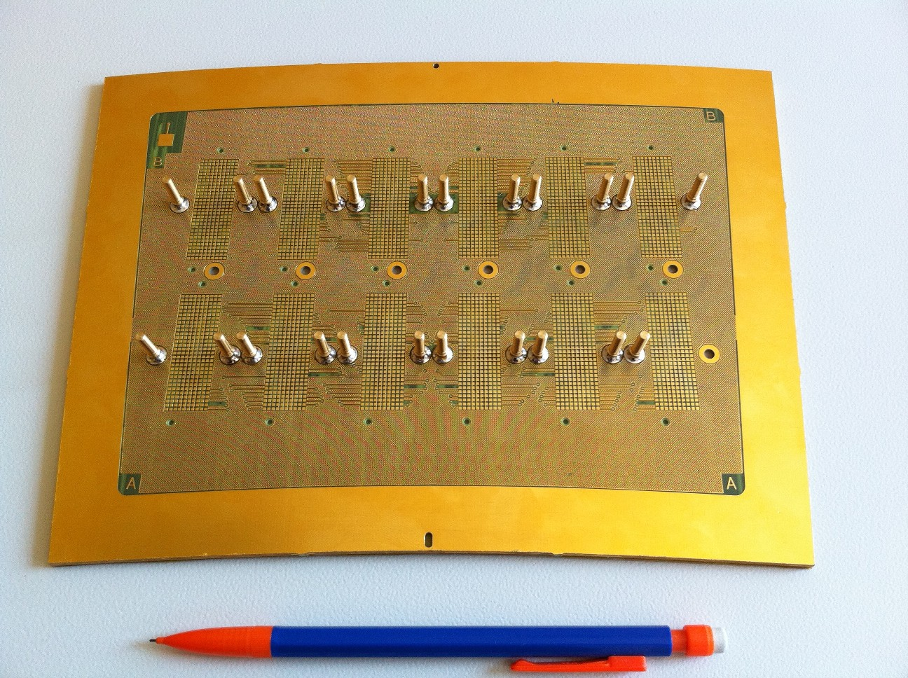
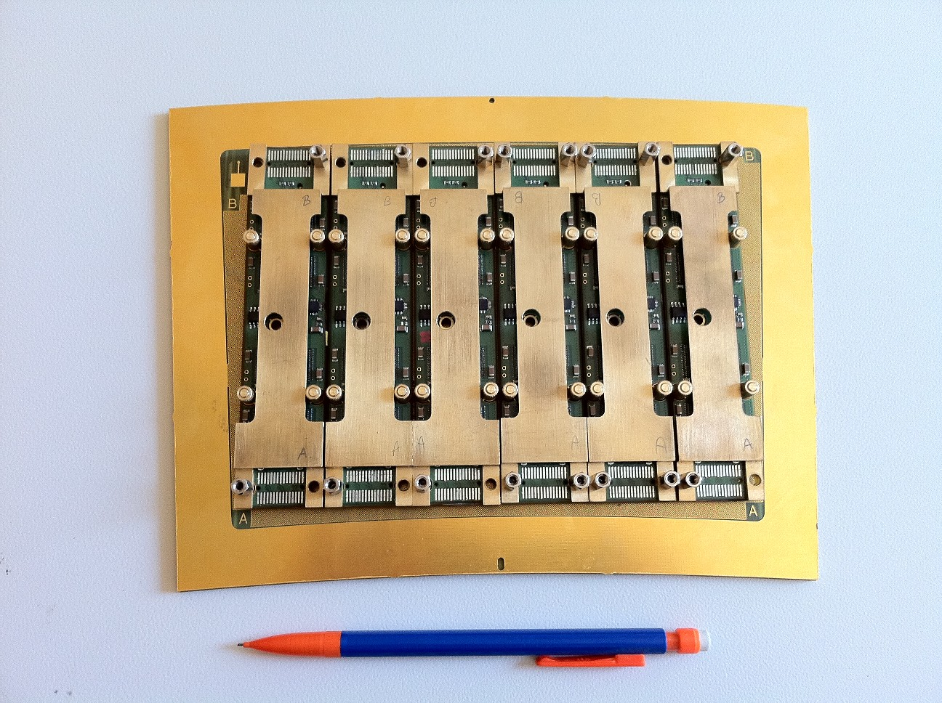
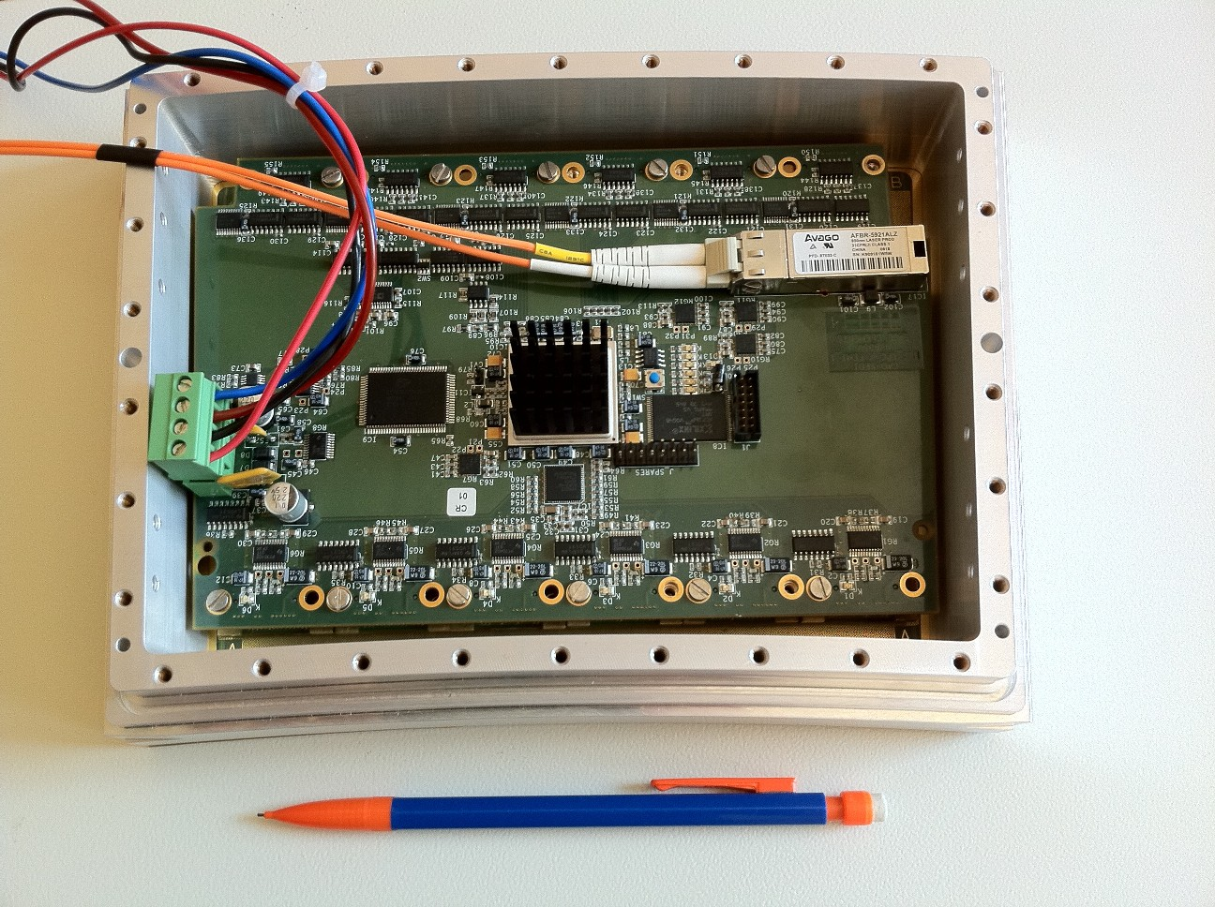
First prototype of the electronics

Slide 15
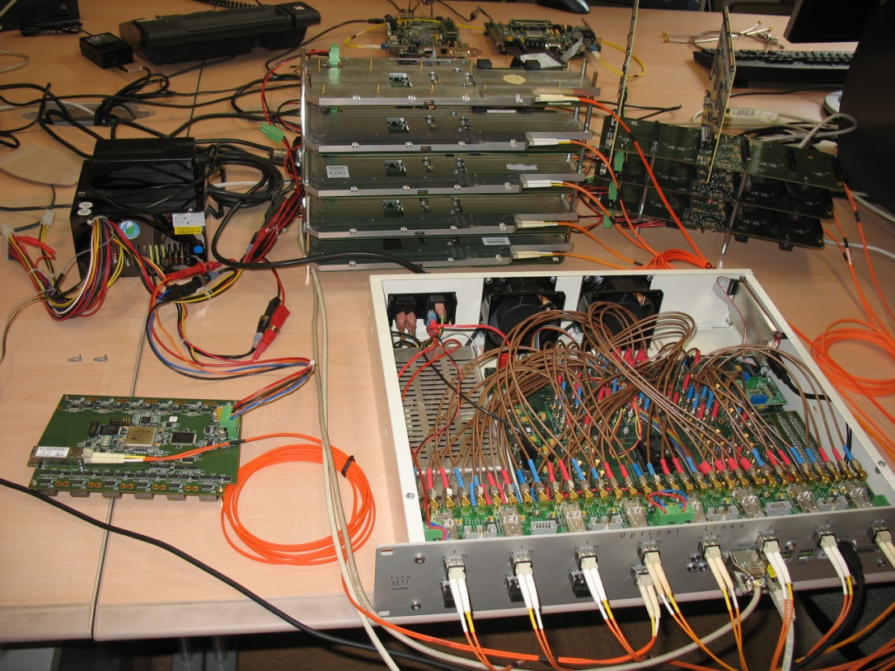
Back-end Hardware
ML523 development kit from Xilinx
vc5vfx100t FPGA from Virtex-5 device family
Embedded PowerPC
16 Multi Gigabit Transceivers
Embedded Ethernet MAC
128 Mbyte DDR2 memory
RS232 interface
Up to 3 4-channel SMA-SFP interface cards
2 Gbit/s optical transceivers for FE links (×12)
RJ45 Ethernet transceiver for the DAQ link
Trigger – Clock – Fast Control link mezzanine card
To be developed according to the link specifications

Slide 16
Temperature during switching on
Temperature in the hall

Slide 17
Temperature after cooling
Increasing of the Nitrogen flow
Temperature in the hall

Slide 18
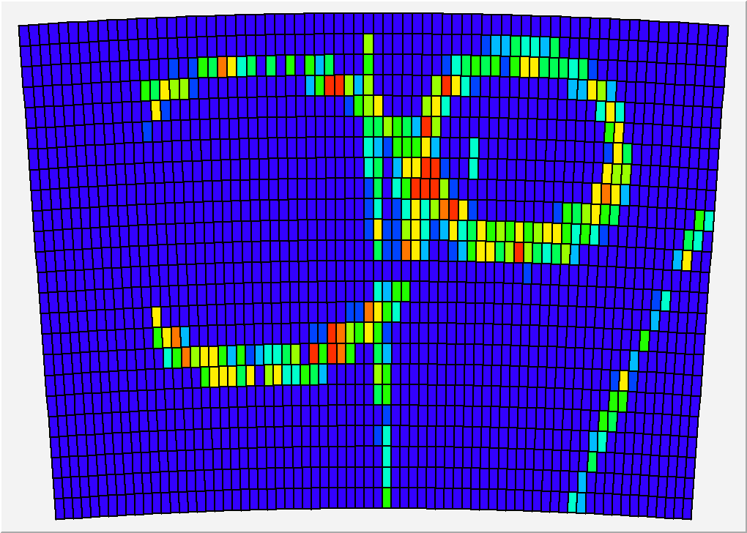
Event samples in B=1T
Commissioning last week in 5 GeV electron beam at DESY:

Slide 19
Conclusion
The first module is currently testing in DESY we should definetly validate the integrated AFTER-based electronics
New concepts have been used and validated: flat high-density, zero-extraction-strength connectors, naked chips on board, and many improvements to the T2K readout: latest ADCs, FPGAs
Now entering the production phase for 7 modules (+ 2 spares) to equip the Large Prototype TPC endplate. This production will also be a semi-industrial production and a proof of feasability, meeting the LOI specs

