Slide 1
The future readout system based on SALTRO16
Anders Oskarsson,
Lund University
Proposal & discussion
prototype step based the 16 channel integrated version of PCA16+ALTRO
and the road to a final system with 64ch chip on
TPC in ILD

Slide 2
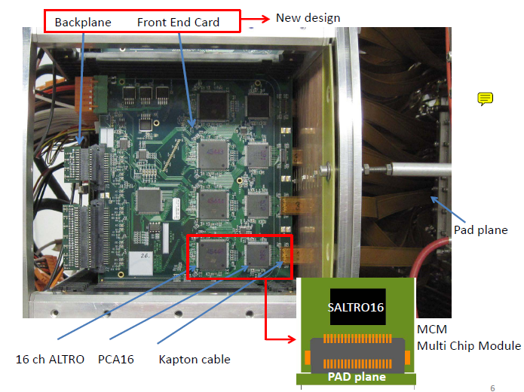
Present front end electronics

Slide 3
Summary of experiences with the PCA16-ALTRO (EUDET) electronics
(12-27mV/fC) (30-130ns shaping) (20MHz sampling)
  Good
  Excellent noise, ca 350 electrons. One FEC connected to chamber
  Routine operation of ~8000ch with global threshold at 4 adc channels
  ( ca 2000 electrons).
Problems
  Breaking amplifier channels with GEMs. Severe, has to be solved
  Diffcult assembly
  cooling FECs, needs forced air cooling . Not OK for the future
  Global threshold limited by
    Touching cables.
    Edges of pad panel
    Long cables. The cables are the unpredictable part of the system

Slide 4
It has been (is) the working assumption that the final LD-TPC will have the readout
electronics mounted directly on the outer face of the pad panel.
With SALTRO16 the channel density is too low , limiting the pad size to 1*9mm (in theory). In practise probably twice that even if we bond naked die to the panel.
As long as we are bonding untested chips we have to work with fabrication modules with few chips otherwise we are killed by the yield.
We plan to place the SALTRO16 on a multi-chip-module (FEC-MCM) which
connects to the pad panel with the JAE connectors used for the ALTRO electr.
After some detours we have now settled on a FEC-MCM module with 8 SALTRO16 (bonded individually on a carrier card) chips (128channels) resembling the present FEC.
The digital readout and control on a separate pc-board

Slide 5
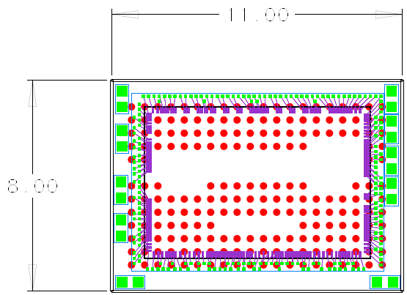
SALTRO16 bonded on small BGA carrier card
BGA pad on below side
Top side traces
Front row 16inp +4 DC
Middle 10 rows, DC, no pulses
Back 2 rows, 2*20 outputs
8 layers, 6 signal 2 pwr
75/75 micron lead/space
filter caps on BGA card

Slide 6
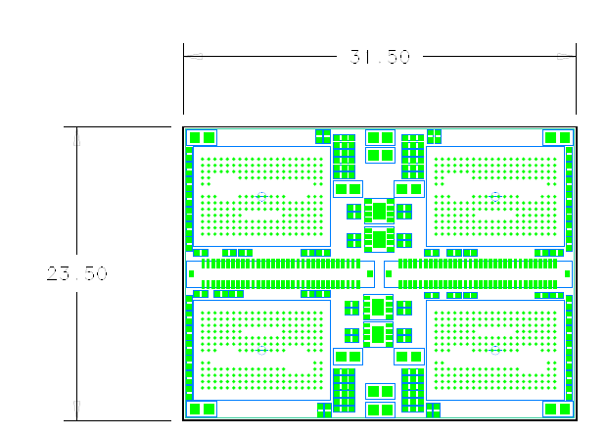
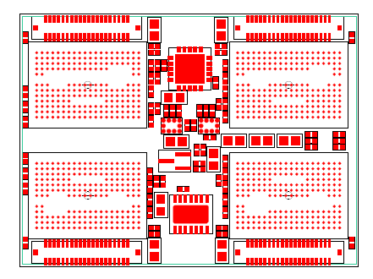
The FEC-MCM for SALTRO16
Connector to readout and LV
Should be reduced to minimum
Top side
Below side
No room for boardcontroller and circuitry for
Readout. Place on separate card.
Connectors to pads

Slide 7
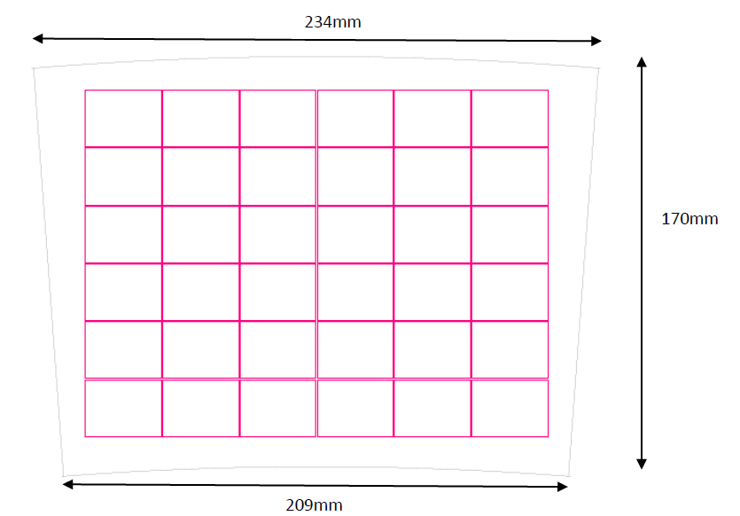
On a pad panel.
6*6 matrix of FEC-MCM.
Total 4608 channels,
pad size, 1.0*5.9mm
Connectors have
to match with very
high accuracy
36 is a bad number
Does not fit an RCU
32 more adequate
Means 11% larger pads
FEC-MCM
SALTRO64
FEC-MCM
SALTRO16

Slide 8
Advantages with dismountable FEC-MCM
in protoyping with SALTRO16
(compared to all on the pad panel)
trace routing from pads to SALTRO16 becomes simpler
MCM module offers 2 extra layers for components and traces.
analog and digital readout functions are well separated
No direct thermal contact to the TPC pad panel
Easy installation and service by replacement of plug-in
FEC-MCM module.
electronics prototyping cheaper and easier with small module.
parallel development of analog and readout part possible
possibility to distribute design and fabrication

Slide 9
Dismountable FEC-MCM on final TPC
with SALTRO64
(compared to all on the pad panel)
4 times more area with SALTRO64
Not thicker (you need the extra layers in the panel )
8 chips on a FEC-MCM, manufacturable after wafer testing
Active components on one side only
accessibility for cooling easier.
Easy service by replacement of plugin FEC-MCM module.
Service goal: replace a FEC-MCM in maintenance day
Possibly simplified endplate mechanics.

Slide 10
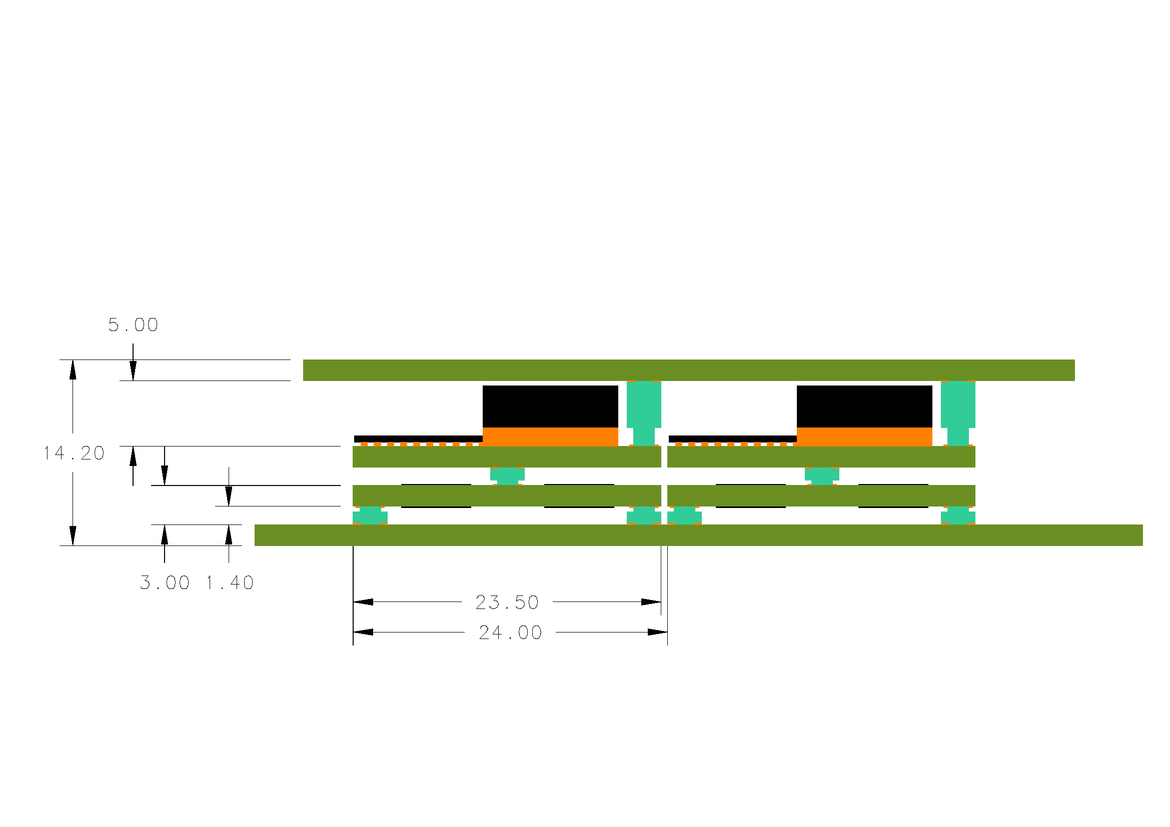
FEC-MCM,mounted horizontally,
with ALTRO bus 40 bit, 40MHz parallel readout like today
LV Voltage
regulators
Back plane
FPGA Board CTRL
LV&ctrl
FEC-MCM
Pad panel
Bad :
difficult to mount the bricolage of cards.
Many connectors
Difficult access for cooling,
geometry fixed by backplane
Need many bus drivers (GTLs)
Slowed down by noisy FEC-MCM
Good:
Close to present solution.
Shorter development,
Lower risk,
can keep RCU mostly as it is

Slide 11
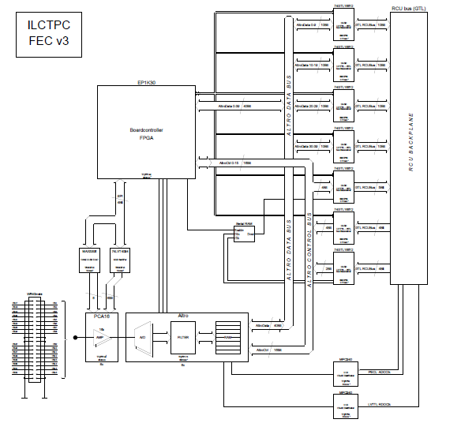
40 bit parallel readout of present FEC
X8

Slide 12
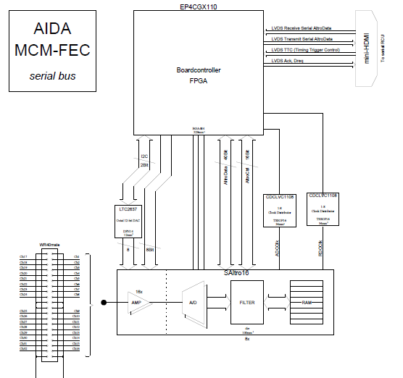
Tentative Serial readout of a FEC
Small outline
FPGA in BGA
Package. Expensive
Probably sampling clock
and trigger must come
as signals directly from
the cable.
X8

Slide 13
Old architecture
New
32 FEC-MCM
or more/less
mHDMI, 1.6Gbit serial link
Flexible cable.
32 FEC-MCM
Fibre to DAQ
meters away
Serial
RCU
rcu
Fibre to DAQ
ILD
40 bit parallel, 40MHz
1.6Gbit/s
Possibly tree structure to
reduce cabling

Slide 14
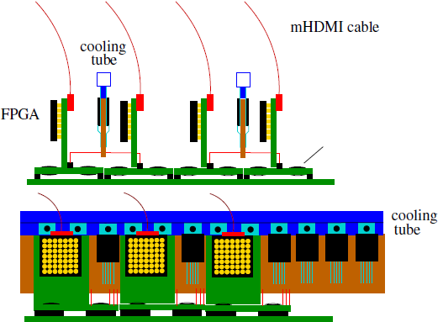
One solution of several possible.
LV
At least regulators cooled
FPGA cards may be
horisontal
36 HDMI cables
from panel
LV bars
Full panel

Slide 15
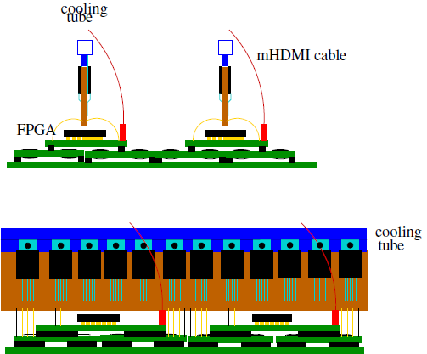
And another one. 4 FEC-MCM 512ch, 32 SALTRO16 , 1 board CTRLr 1 serial link
Could be the architecture of SATRO64
9 mHDMI cables
One FPGA services 4 FEC MCM

Slide 16
Crucial question, mainly for LCTPC
Shall we rush SALTRO16 electronics for use within a year or so
for further proof of principle tests?
Then we need to stay with the ALTRO bus readout and RCU
Or
Shall we take the opportunity to let the next prototype step be
much closer to final in 3 years from now, i.e. full feasibility test?
New readout closer to ILD

Slide 17
Or more specifically:
Is PCA16-ALTRO electronics sufficient for further testing of avalanche readout concepts and pad geometries, i.e. everything that goes with features inside the gas envelope?
Lund thinks, yes, since the ALTRO system has:
  Adequate noise and resolution
  Flexibility
  Ready to use
  Repairable (since testing new HV stuff can always give accidents)
What could be better done with SALTRO16 for basic tests?
  SALTRO16 allows higher sampling rate 40 vs 20MHz
  No input cables. Should have much better threshold performance.

Slide 18
Summary:
The 128 channel FEC-MCM seems feasible with carrier card
The ALTRO bus parallel readout with present RCU is feasible but does not
bring much forward. Tests of final system difficult.
Propose serial readout:
Development on the front end modules (FEC-MCM):
  realistic cooling
  realistic power pulsing
  serial readout of FEC-MCM
On the sRCU level :
  serial communication to/from FEC-MCM
  New communication to ILD DAQ interface .
Integration with ILD not ALICE! Or shall we use ALICE solutions awaiting ILD specs.
Big development project towards final system, 3-4 years
Make the final system the overall goal, not immidiate tests
More groups involved!

Slide 19
Backup slides

Slide 20
Problems using unpackaged chips.
More expensive protoyping.
Prototyping takes longer time
Special for us with an 128 channel FEC-MCM:
Risky as long as the broken channel problem is not under control
Expensive to replace 128 channels if one is broken.
Expensive to manufacture since the chip yield is unknown. If 90% (which would be
quite good for a large chip like this) less than half of the 8 chip modules will be OK
We cannot waste expensive protoype chips like that
Testing on the wafer too expensive for prototype quantiites.
We have to make some compromises for these reasons meaning small module for bonding.
The best is one chip per module.

