Slide 1
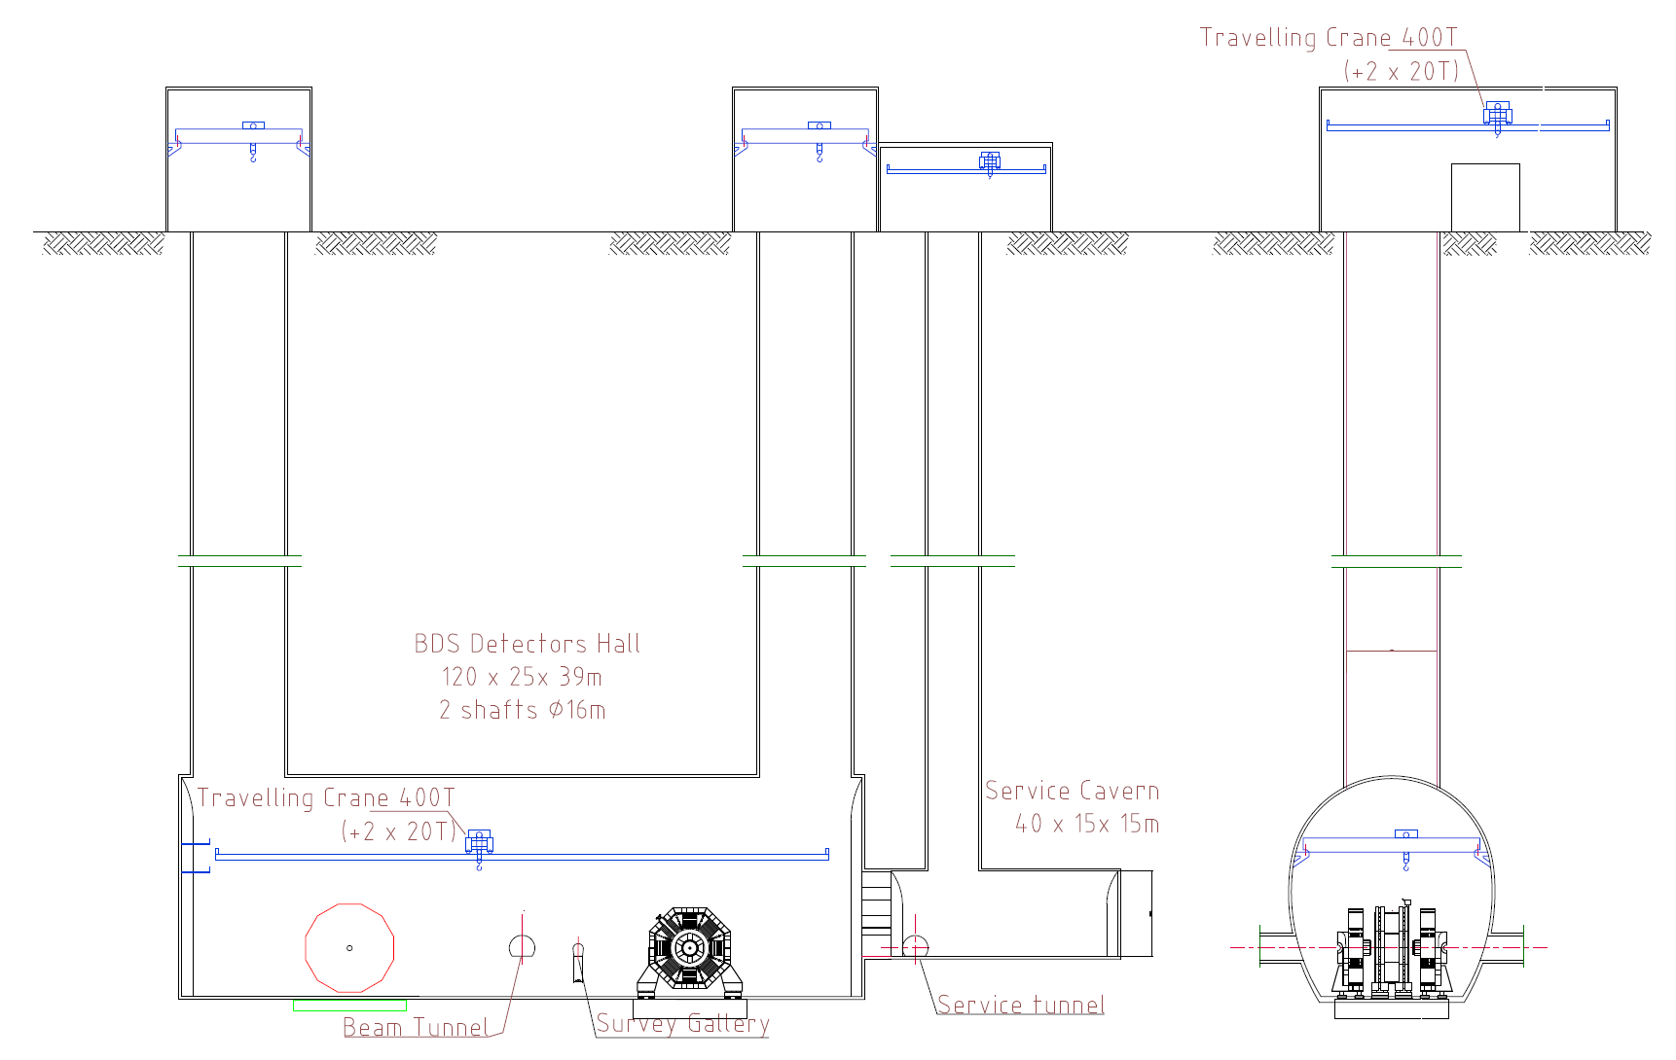
RDR Experimental Area

Slide 2
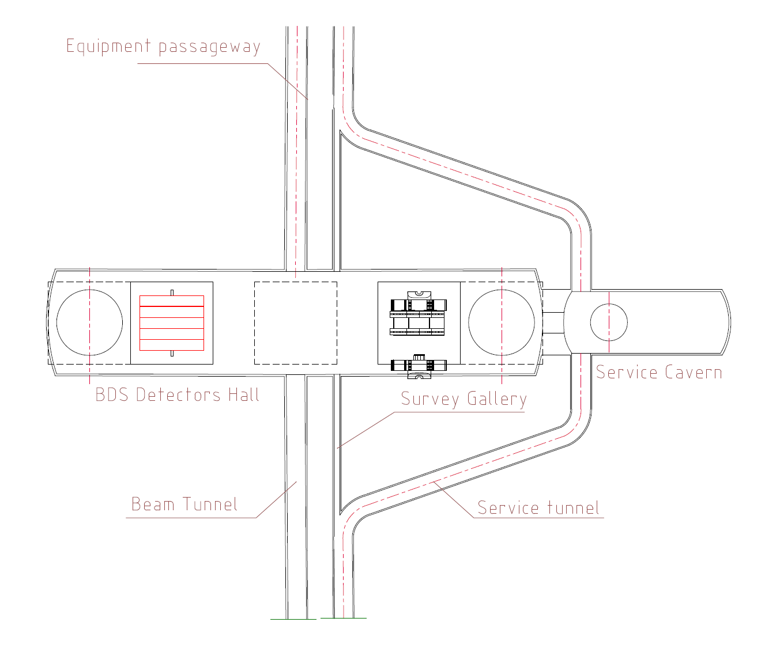
RDR Experimental Area

Slide 3
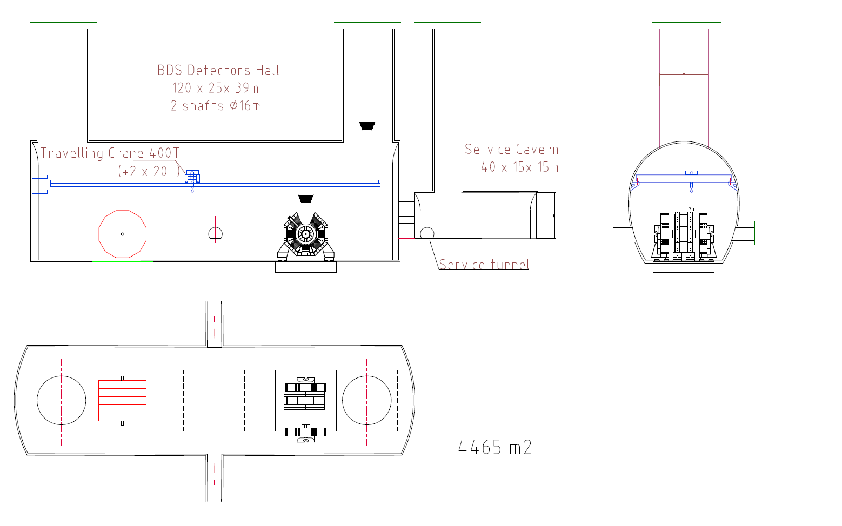
RDR Experimental Area - Modified

Slide 4
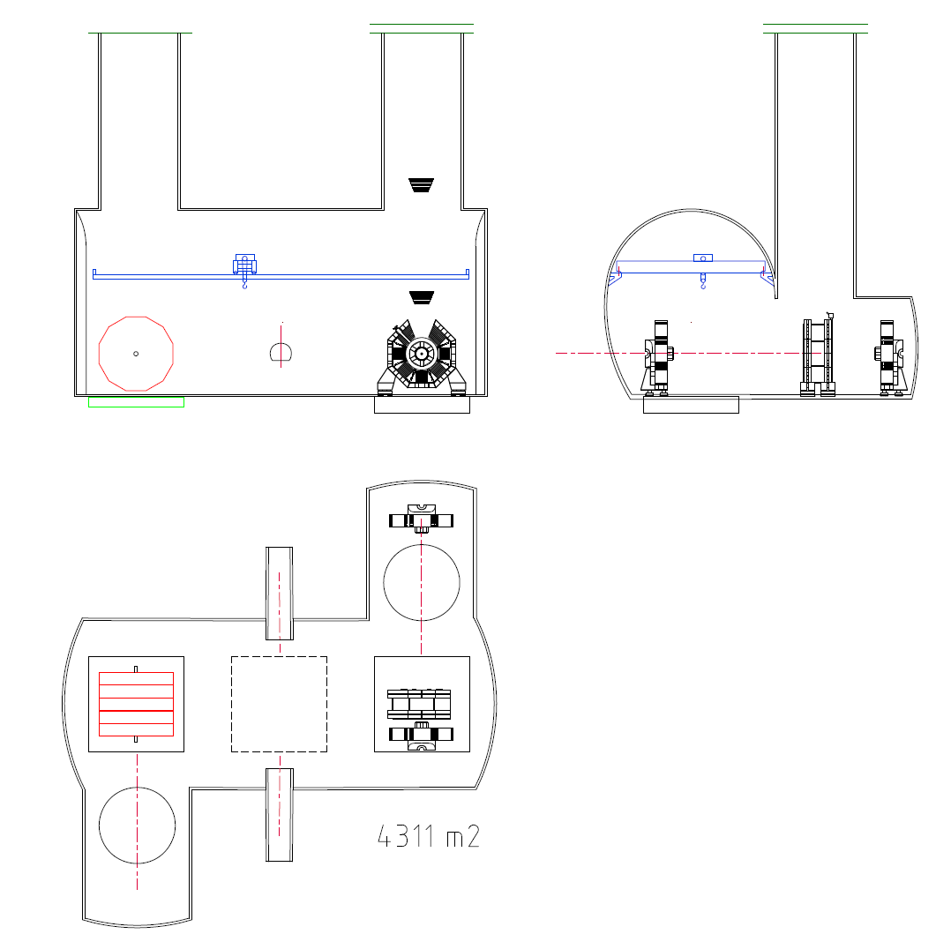
Experimental Area – Lateral Shafts

