Slide 1


FONT Meeting
Converting Mark Woodley’s MAD8 decks to MADX
Advantages
PTC thick lens tracking module
Macros vs Subroutines
Better multipole approximation
Differences
Based on C not Fortran
Some word / definition / method changes
Mikey Davis
08 April 2011
1/9

Slide 2
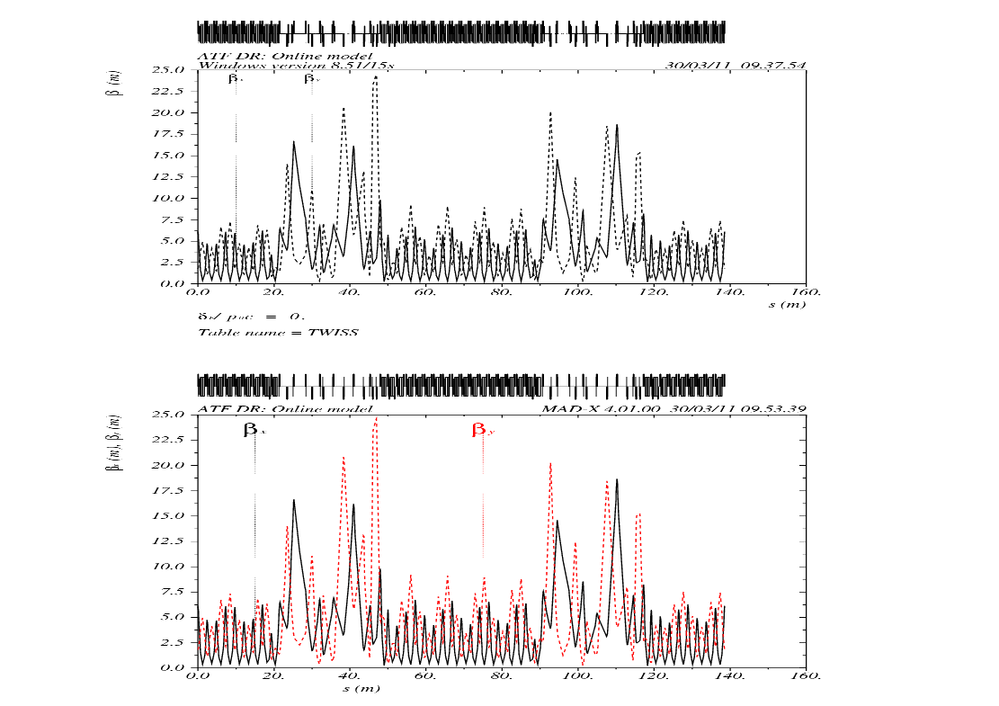
FONT Meeting
Mikey Davis
08 April 2011
2/9

Slide 3
FONT Meeting
Javier Work
Mikey Davis
08 April 2011
3/9

Slide 4
FONT Meeting
Tried to reproduce results from first principles
Want to know if it is the kicker which causes jitter
Take lattice alter kicker angle
Assumed a normal random distribution of particles from damping ring
Made up a statistical distribution to fit kicker
Mikey Davis
08 April 2011
4/9

Slide 5
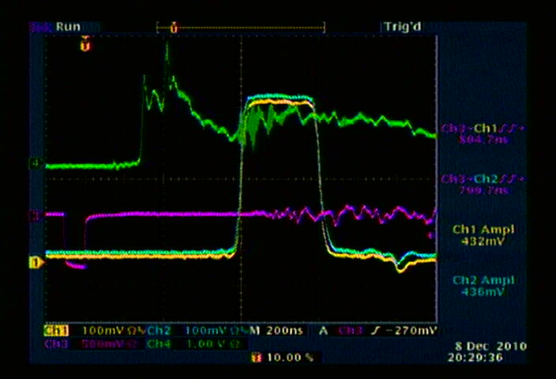
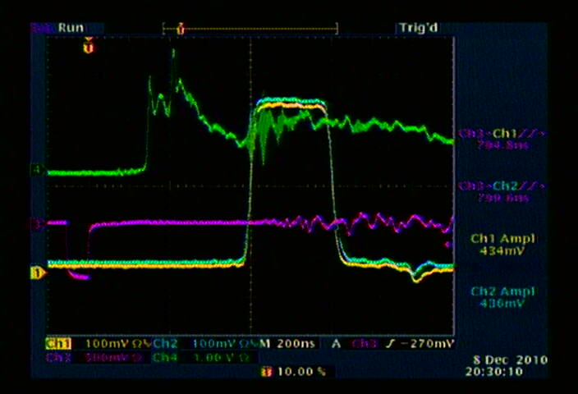
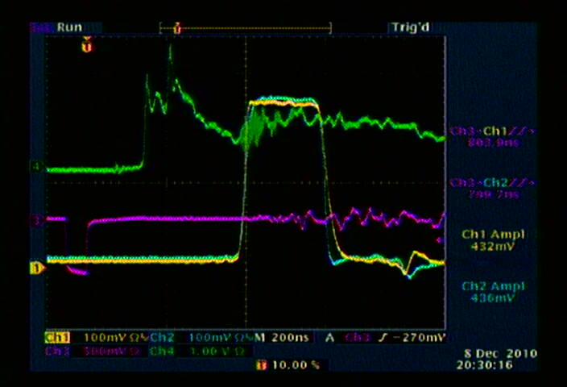
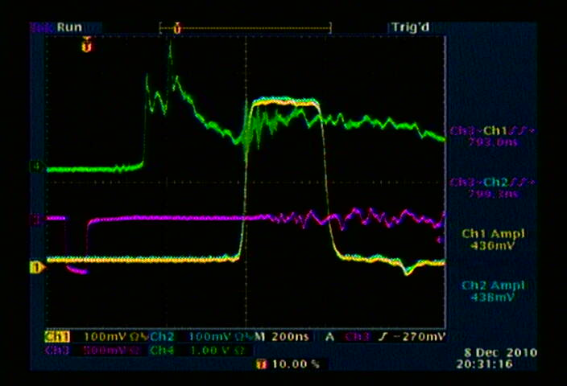
FONT Meeting
Mikey Davis
08 April 2011
5/9

Slide 6
FONT Meeting
Invented Prob Distribution
Mikey Davis
08 April 2011
6/9

Slide 7
FONT Meeting
Position Along Extraction Line
Mikey Davis
08 April 2011
7/9

Slide 8
FONT Meeting
Histergram of Positions
Mikey Davis
08 April 2011
8/9

Slide 9
FONT Meeting
Problems
Need to do actual jitter calculation
Need better understanding of damping ring
Need better understanding of kicker power
Would like to perhaps look at kicker more at ATF to see if I could improve simulation
Mikey Davis
08 April 2011
9/9

