Slide 1
PM Report CFS /Gbl 13.04.2011
ILC PAC (19-20 May) Agenda:
  Akira, Rongli, Hitoshi H, Marc, Nick, Toshiaki, Mark P., Peter G.
  Nick will report on Design
  Marc on FLASH 9mA
  Peter G. on costing (likely his last PAC report for GDE)
Fixed TDR Baseline Review dates
PM to meet with XFEL (28-29 April)
Prep DR TDR Review INFN and
Prep 9mA Workshop DESY (John)

Slide 2
Request for information to SRF industries
12 each
GDE Plan:
  1) Receive initial responses before PAC review;
  2) Provide a common forum for discussion (24 July Chicago, prior to SRF2011);
  3) Develop the scope of cost estimate effort (to end 2011)
  Goal: Replace the RDR estimate – which was based on DESY / TESLA studies

Slide 3
TDR Technical Baseline Reviews
Dates and venues:
Physics and Detector to be represented

Slide 4
Planning for the TDP 2
 | 2010 | 2011 | 2012
Risk Mitigating R&D
Re-Baseline (CC)
AD&I (TLCC)
AD&I (TBR*)
TeV upgrade study
Update VALUE estimate
Tech. Risk Assessment
PIP
Write TDR report(s)
You are here!
* Technical Baseline Reviews
Notes:
Use this to show there is not so much time as people think to achieve the TDR goals.

Slide 5
TDP Key Focus (beyond R&D)
SCRF Cost
mass production models
global distribution
CFS design & cost
Design update
Baseline Design
Final design decisions
Documentation
Value engineering
Cost estimate
High Priority
(updated estimate)
RDR update
Documentation
(scaled estimate)
Highest Priority
(new estimate)
CFS requirements
critical input
Notes:
Rest of talk will concentrate on last box

Slide 6
TDR Prep Review Meeting Goals:
Review the TDP R & D and summarize progress and plans.
Review the system design
  including a change control procedure so that key design changes can be discussed openly
  The updated baseline will be used for the TDR plan and cost estimate.
Review the system cost
  For SCRF and CFS, additional meetings, parallel sessions etc are also required.
Review system interface criteria;
  for example, requirements to CFS
Review supporting documents for inclusion in the EDMS
Discuss TDR preparation plans.
  Upon the completion of the review, we should be able to publish a plan for producing that part of the TDR; resources, milestones, etc
The review to be accessible to the community

Slide 7
Topics for System Design Review
Review the TDP R & D and summarize progress and plans.
Review the system design
  including a change control procedure so that key design changes can be discussed openly
Example topics:
Cavity pairing – Power Distribution System.
Marx modulator
RDR HLRF fallback
RTML RF design and civil design.
Tunnel diameters
Power dissipation in the tunnel
DRFS components
Optimization of Positron production parameters:
  undulator length and field;
  polarization collimator space

Slide 8
CFS – DR Review Preparation
CFS should meet with AS groups via webex, starting May 2011, and process the list of questions
  (should have no new questions at Baseline Review)
  Started ALCPG11
  See questions from Emil for e+ (posted)
  shown June in DR TDP-II schedule
Tuesday weekly meeting topic?

Slide 9
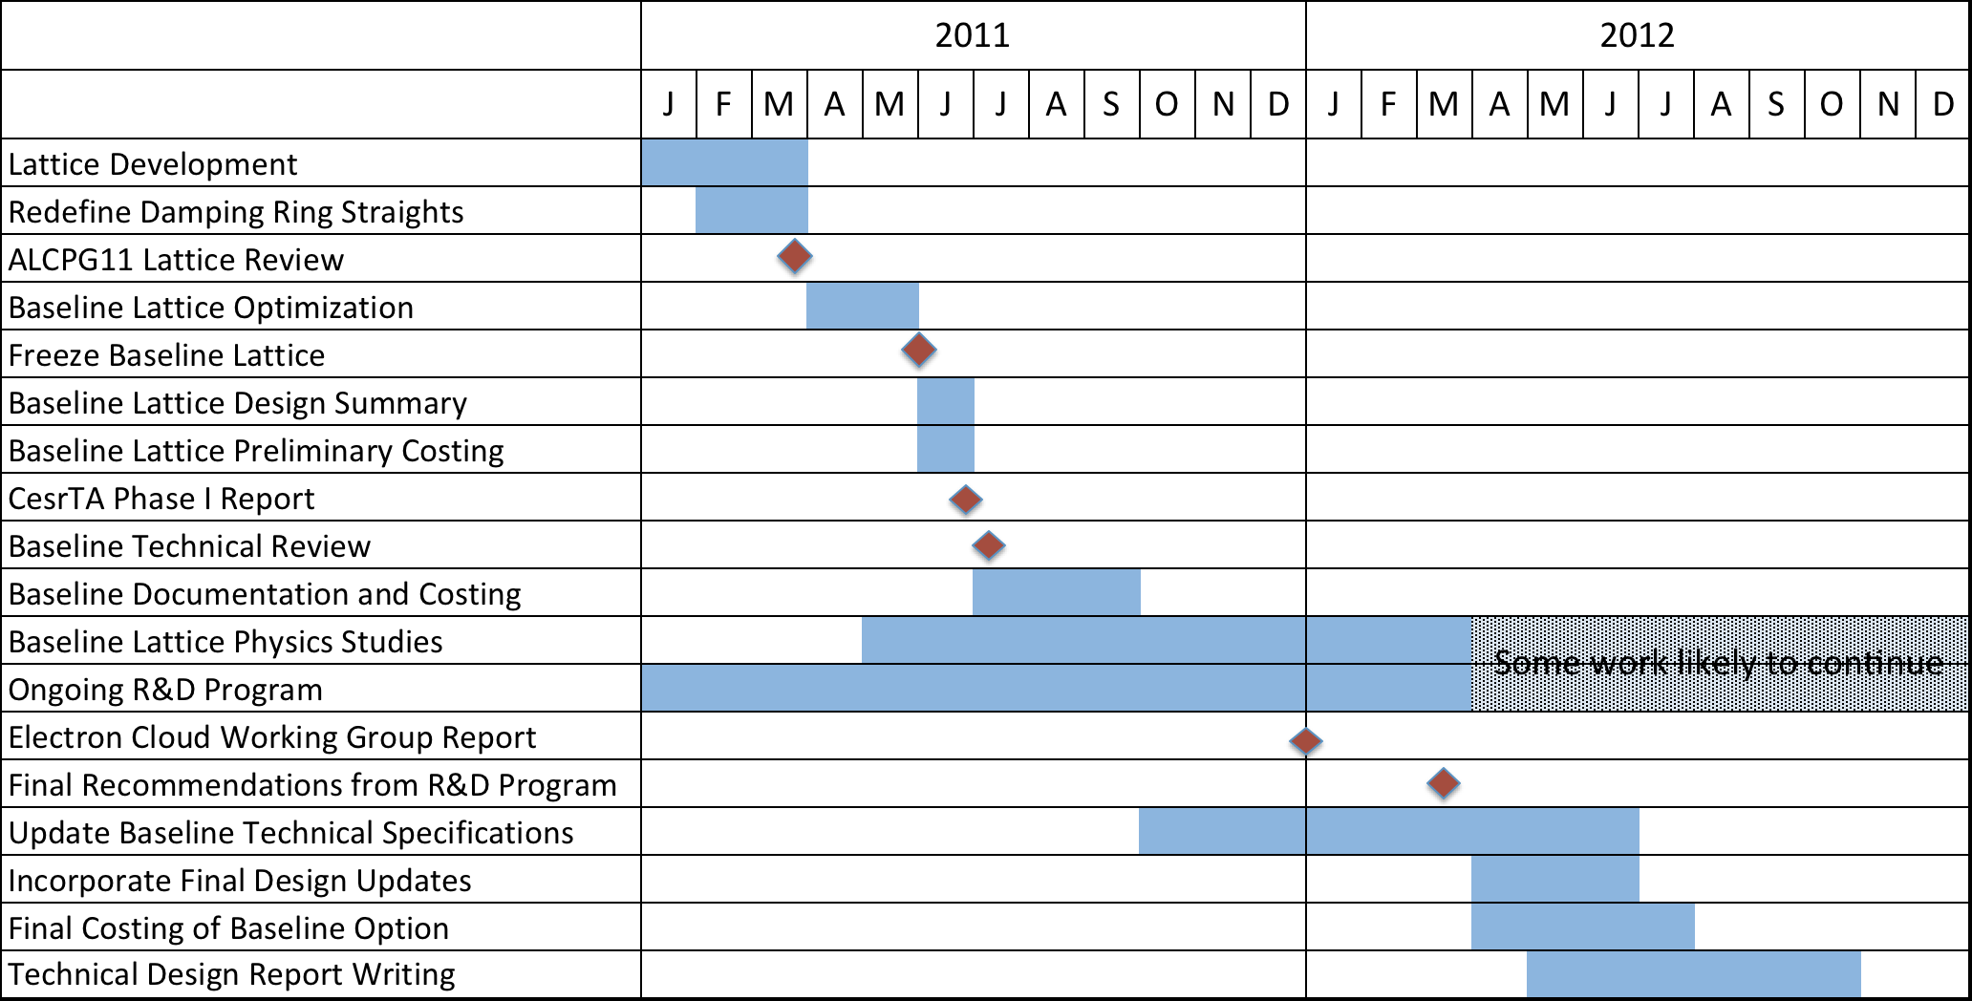
DR TDP-II Schedule

Slide 10
DR Agenda
Thursday, July 7
Morning Session
Introduction
DR Parameter Specifications
Baseline Lattice Choice
TDP R&D Progress/Plans
Afternoon Session
Interfaces to Adjacent Area Systems
Layout & CFS Interface
Friday, July 8
Morning Session
Documentation
Costing
Afternoon Session
TDP-II Schedule
Review Closeout
EDMS Session

Slide 11
AD I notes – 01.04.2011
1) We should produce a written, prioritized, list of specific topics for discussion
  DR TAG and the PM (AND CFS)
  to be merged
  timing constraint concerns
2) 'final' all-system review where interfaces and dependencies are discussed.
3) term: 'WBS' in AD&I and ALCPG to refers the outline structure to be used for organizing documents in EDMS.
4) We will devote the 25 May ADI meeting to the 1 Tev upgrade.

Slide 12
Global Sys. SRF Review Prep
How will we meet the ‘S2’ goals set forth in the S2 RDB report, generally, and in the RD Plan?
we will not be able to do it all – but what are the problems and limits?:
  Cavity detuning measurement
  Cavity gradient – what do we miss with only limited high grad cavities? (note SNS gradient limits ~<20 MV/m)
  Beam current – what do we miss by having ½ nominal 9 mA?
  LDF compensation performance
  Q_l adjustment control
  Tuner reliability

Slide 13
Global Sys. SRF Review Prep (2)
What should we plan to do at FLASH in 2011/12?
  Other test facilities?
Dark current interaction with linac operation
Workshop – June 2011…
Review – January 2012
  how do 9mA tests define the new baseline?
  Given our experience with FLASH - what are the implications for upcoming baseline technical choices?
  mainly in support of the cryomodule gradient operation spec:
  → reaffirm the CM Specification determined at BAW-1

