Slide 1


FONT Meeting
Converted Mark Woodley’s MAD8 decks to MADX
Advantages
PTC thick lens tracking module
Macros vs Subroutines
Better multipole approximation
Differences
Based on C not Fortran
Some word / definition / method changes
Mikey Davis
15 April 2011
1/14

Slide 2
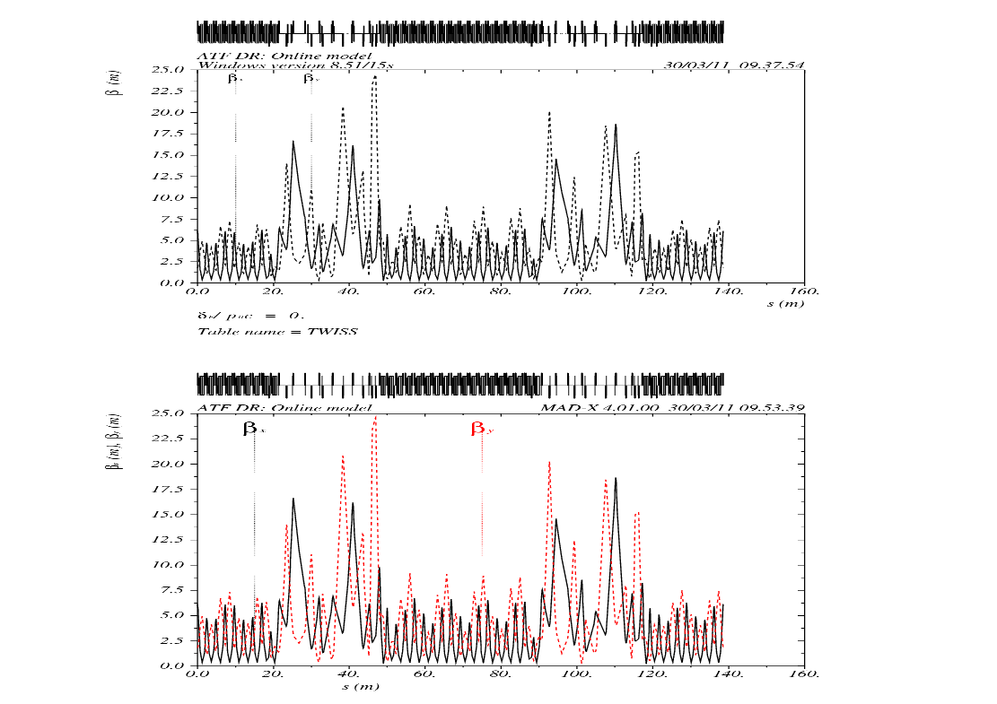
FONT Meeting
Mikey Davis
15 April 2011
2/14

Slide 3
FONT Meeting
Javier Work
Mikey Davis
15 April 2011
3/14

Slide 4
FONT Meeting
Tried to reproduce results from first principles
Want to know if it is the kicker which causes jitter
Take lattice alter kicker angle
Assumed a normal random distribution of particles from damping ring
Made up a statistical distribution to fit kicker
Mikey Davis
15 April 2011
4/14

Slide 5
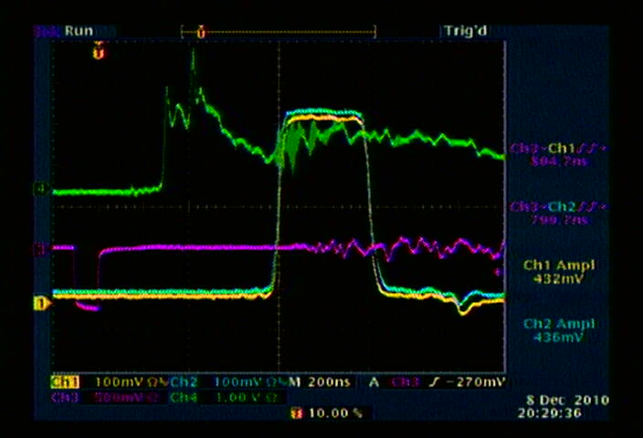
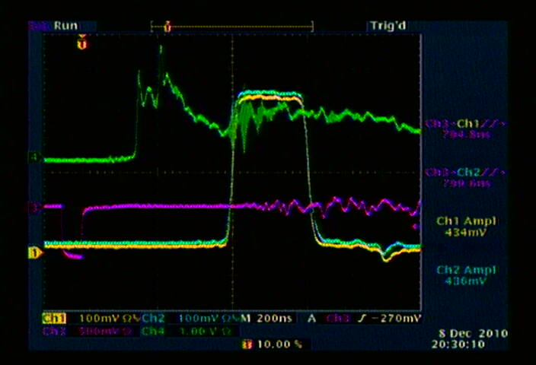
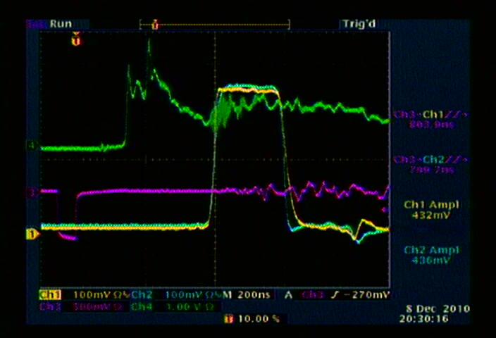
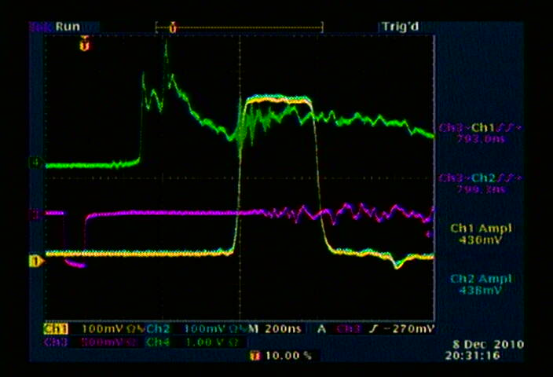
FONT Meeting
Mikey Davis
15 April 2011
5/14

Slide 6
FONT Meeting
Invented Prob Distribution
Mikey Davis
15 April 2011
6/14

Slide 7
FONT Meeting
Position Along Extraction Line
Mikey Davis
15 April 2011
7/14

Slide 8
FONT Meeting
Histergram of Positions
Mikey Davis
15 April 2011
8/14

Slide 9
FONT Meeting
Tried to improve model using real data from DR
Used data from long runs using Doug’s FW
Ideally want position and angle just before EXT line
Therefore need 2 bpms, we only used 1
Treat the damping ring as a long line and use turns
Approximating whole ring to one matrix invalid
Use PTC tracking instead -> still some problems
Mikey Davis
15 April 2011
9/14

Slide 10
FONT Meeting
Mikey Davis
15 April 2011
10/14

Slide 11
FONT Meeting
No Error
First Kicker Error
Second Kicker Error
Both Kicker Errors
Mikey Davis
15 April 2011
11/14

Slide 12
FONT Meeting
No Error
First Kicker Error
Second Kicker Error
Both Kicker Errors
Mikey Davis
15 April 2011
12/14

Slide 13
FONT Meeting
Jitter Results ( in μm)
Run | Run | P1 | P2 | P3
X | 1 | 0.007 | 0.0266 | 0.0093
 | 2 | 95 | 280 | 128
 | 3 | 102 | 328 | 147
 | 4 | 138 | 431 | 196
 | Javier | 31.75 | 54.6 | 38.14
Y | 1 | 0.0189 | 0.0503 | 0.0618
 | 2 | 0.0146 | 1.14 | 3.2315
 | 3 | 0.0189 | 1.49 | 3.44
 | 4 | 0.1614 | 1.88 | 4.70
 | Javier | 0.081 | 9.36 | 1.53
Mikey Davis
15 April 2011
13/14

Slide 14
FONT Meeting
Numbers in the right order of magnitude
Really need some better data
Ideally you would use 2 bpms to test tracking
Record the information from the kicker for better model
This could be done parasitically
Would like to do this next time in Japan to see if it the kicker really is the source of the problems
Mikey Davis
15 April 2011
14/14

