Slide 1
Recovery Plan of ATF after the earthquake on March 11, 2011
N.Terunuma, KEK
ATF2 meeting, April 27, 2011

Slide 2
Recovery Plan/Policy
Try to pass a test beam to the ATF2 dump before the summer shutdown
  Tune up the instruments and tools in the summer is strongly expected.
Try to restart a beam in autumn with a much better conditions of devices and tools
  It should be better than that of the best operation in FY2010.
It is not clear that the ATF is automatically extended after 2012 even if the earthquake delays programs.

Slide 3
Constraints at present
Radiation Safety for beam
  Safety devices has to be well inspected again.
  Radiation shields have to be repaired as approved.
Electricity
  No limitation for the checkout of each devices, but minimization of usage is required.
  Full accelerator operation needs to be approved by KEK.
Cooling water
  RF system and Magnets need the cooling water.
  The system has to be inspected and resumed by the KEK facility division. It is scheduled from May 9th due to the priority of the KEK accelerators.

Slide 4
Present Status
So many things to do!
No Access limitation to the ATF building at present
Total power of KEK is limited 1/10 of requested.
    It will be improved 2MW→18 MW in May.
Damaged power line was recovered.
All of the vacuum system (beamline and RF system) are in operation.
All DR bellows were inspected.
Alignment of the devices has been started.
Careful checkout of the RF system has been started.
Adjustment of the moved Radiation Shields has been started.

Slide 6
Survey of the beamline level
Target of re-alignment
EXT
LINAC
BT
DR
FF
(Mover off)
Jumped table
(Not yet aligned)

Slide 7
Survey of LINAC Roll
Roll (mrad)
Target of re-alignment

Slide 8
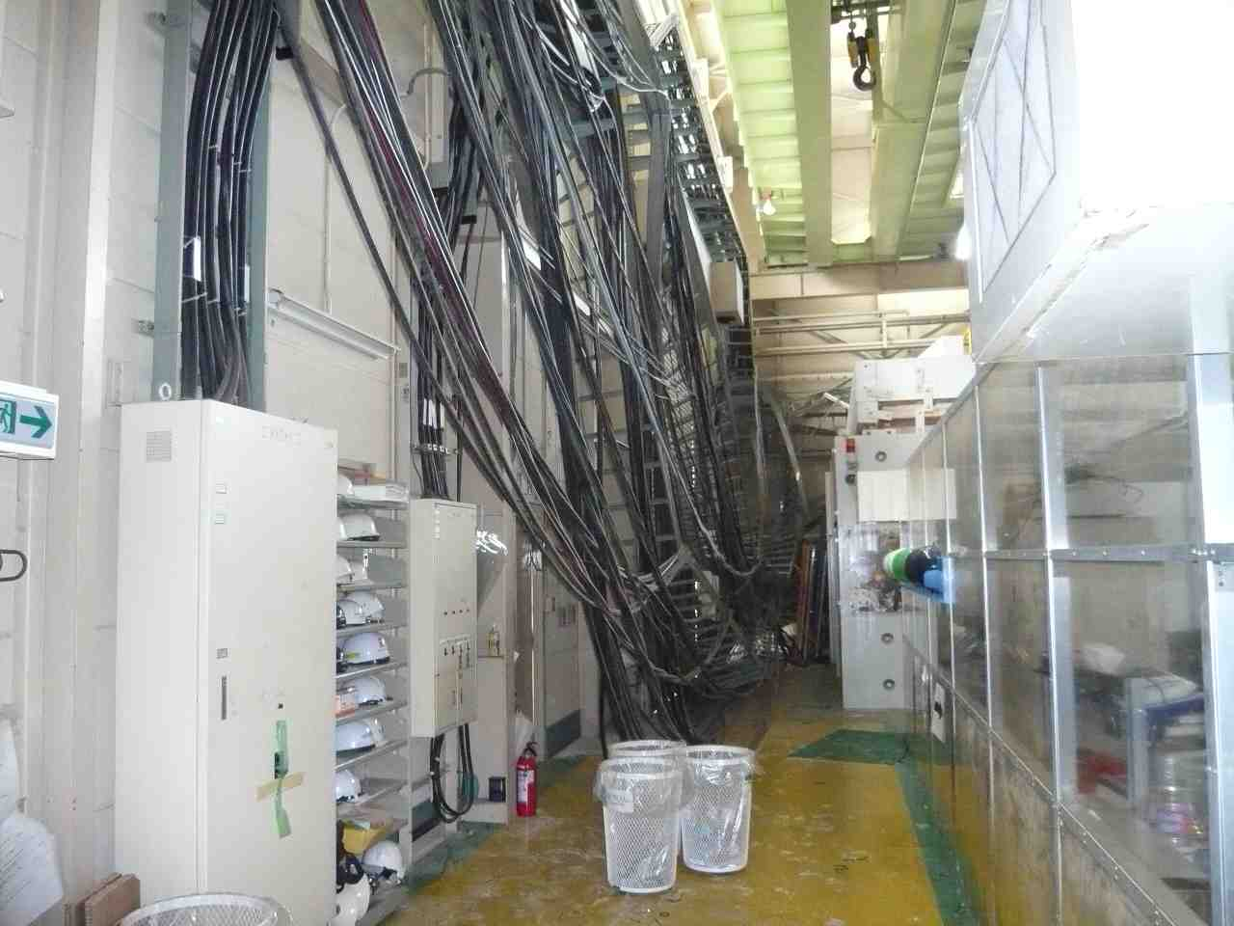
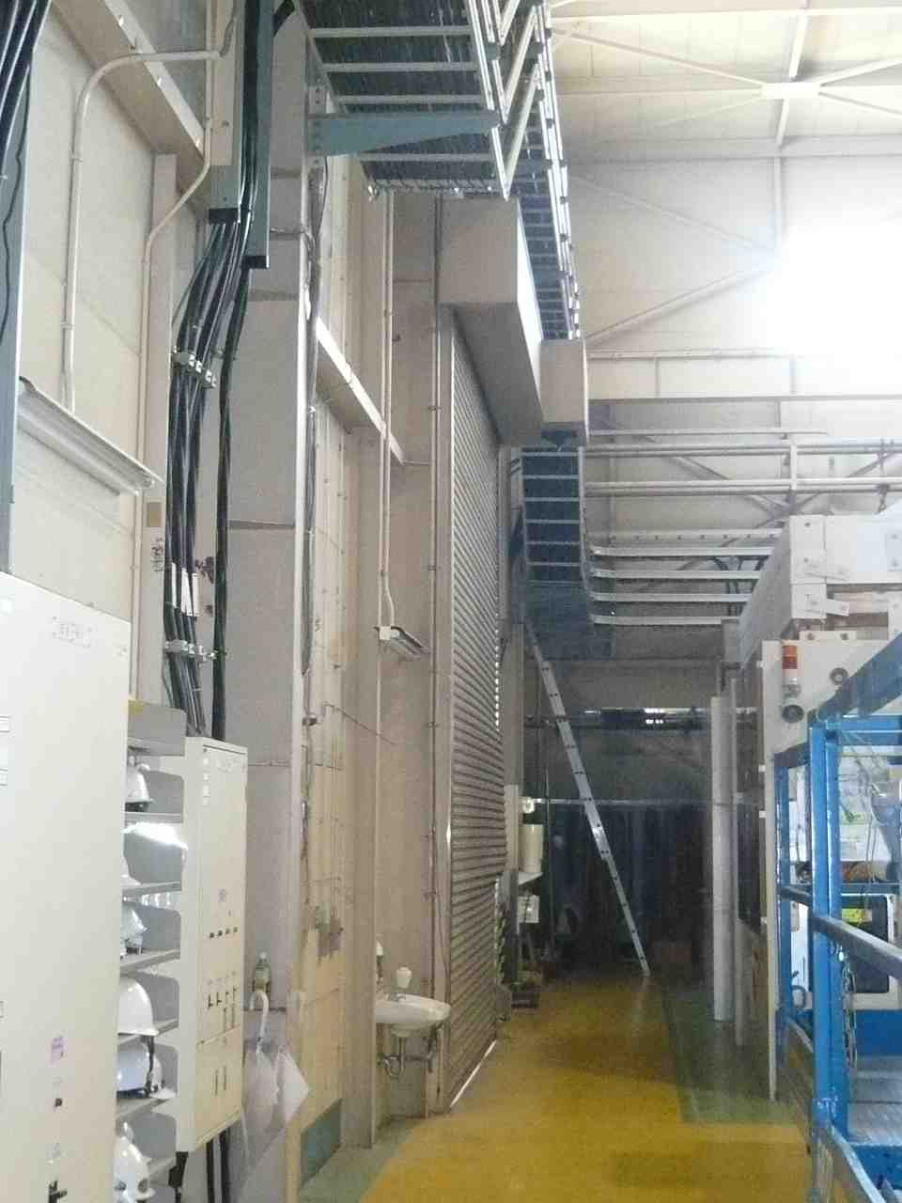
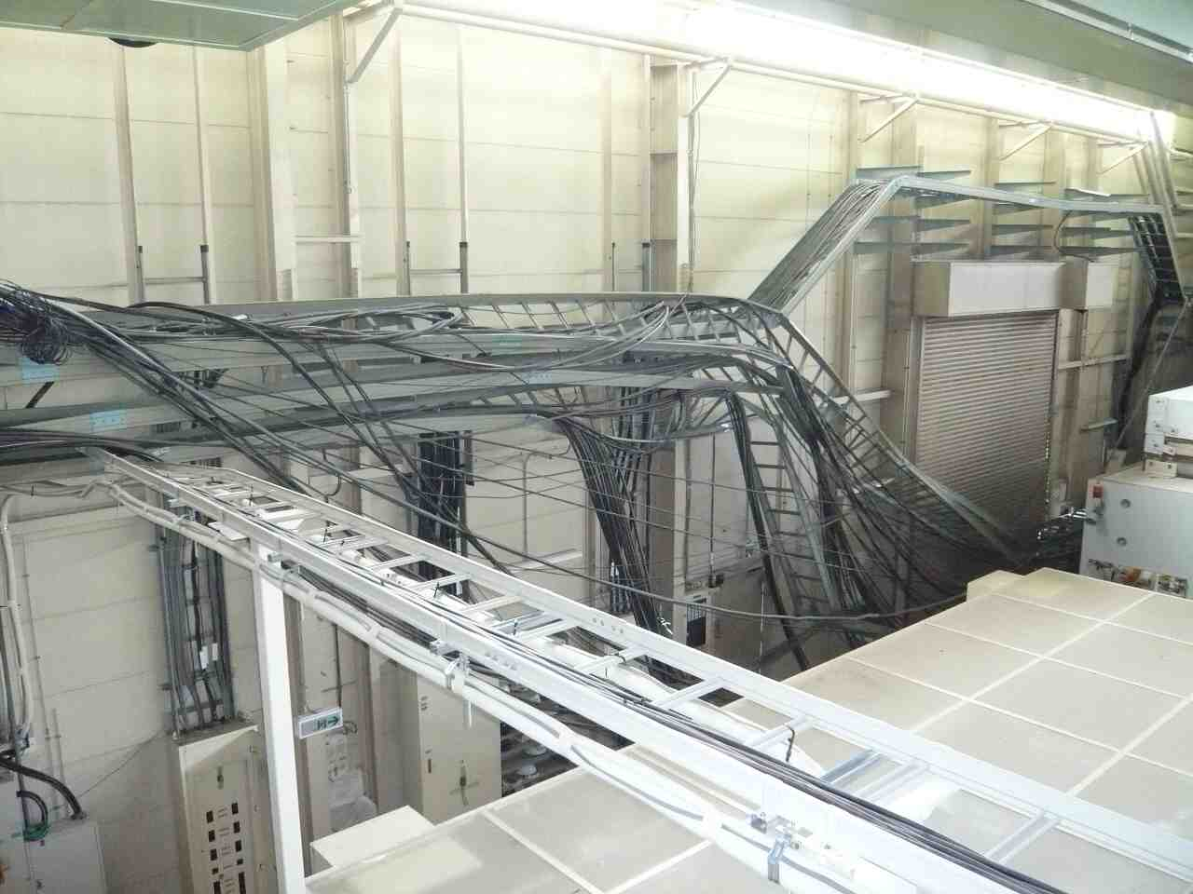
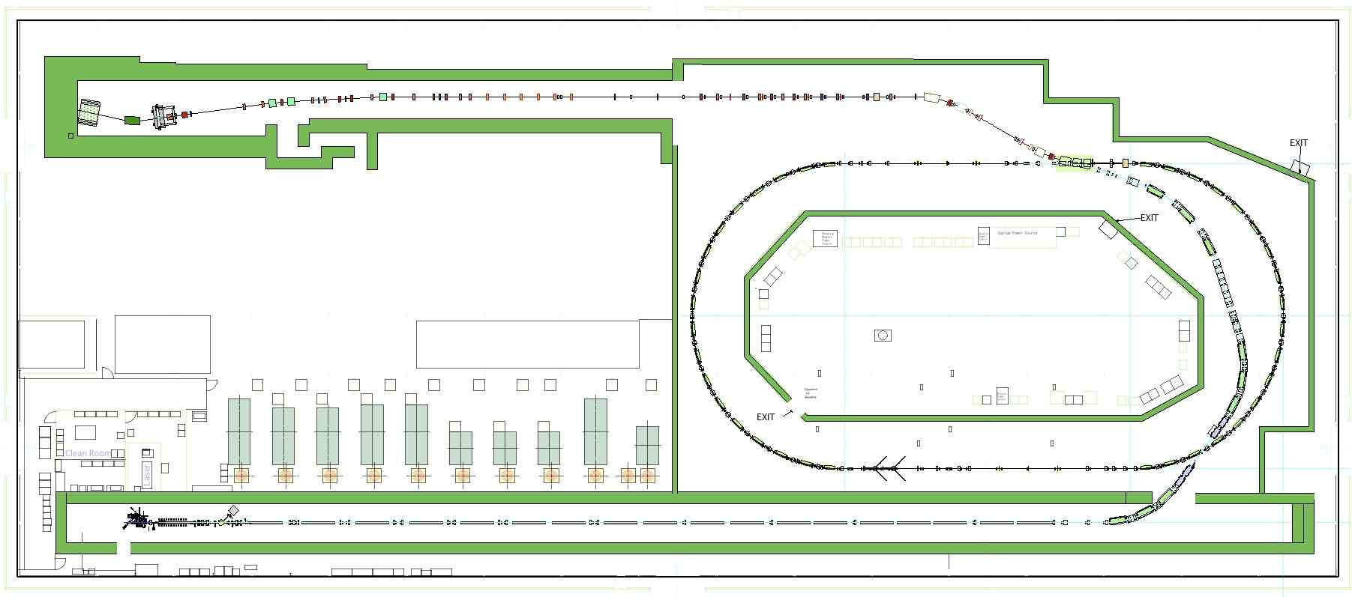
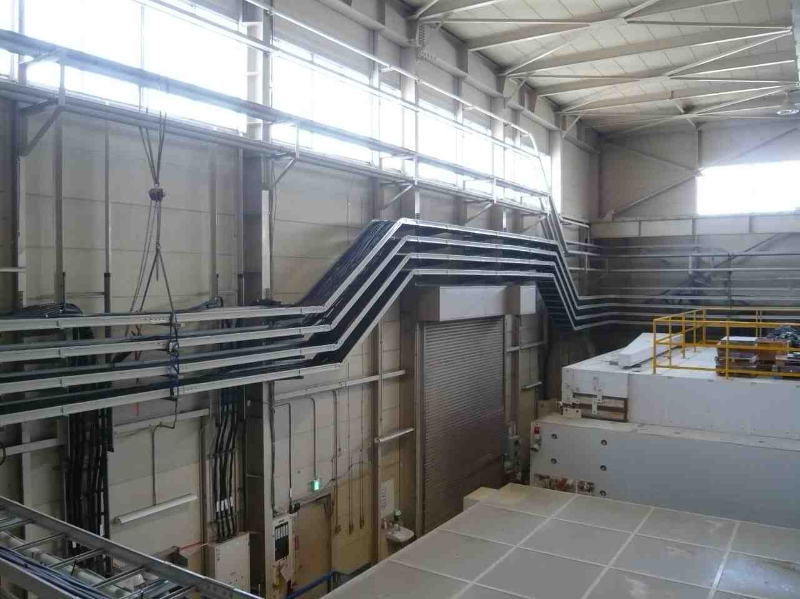
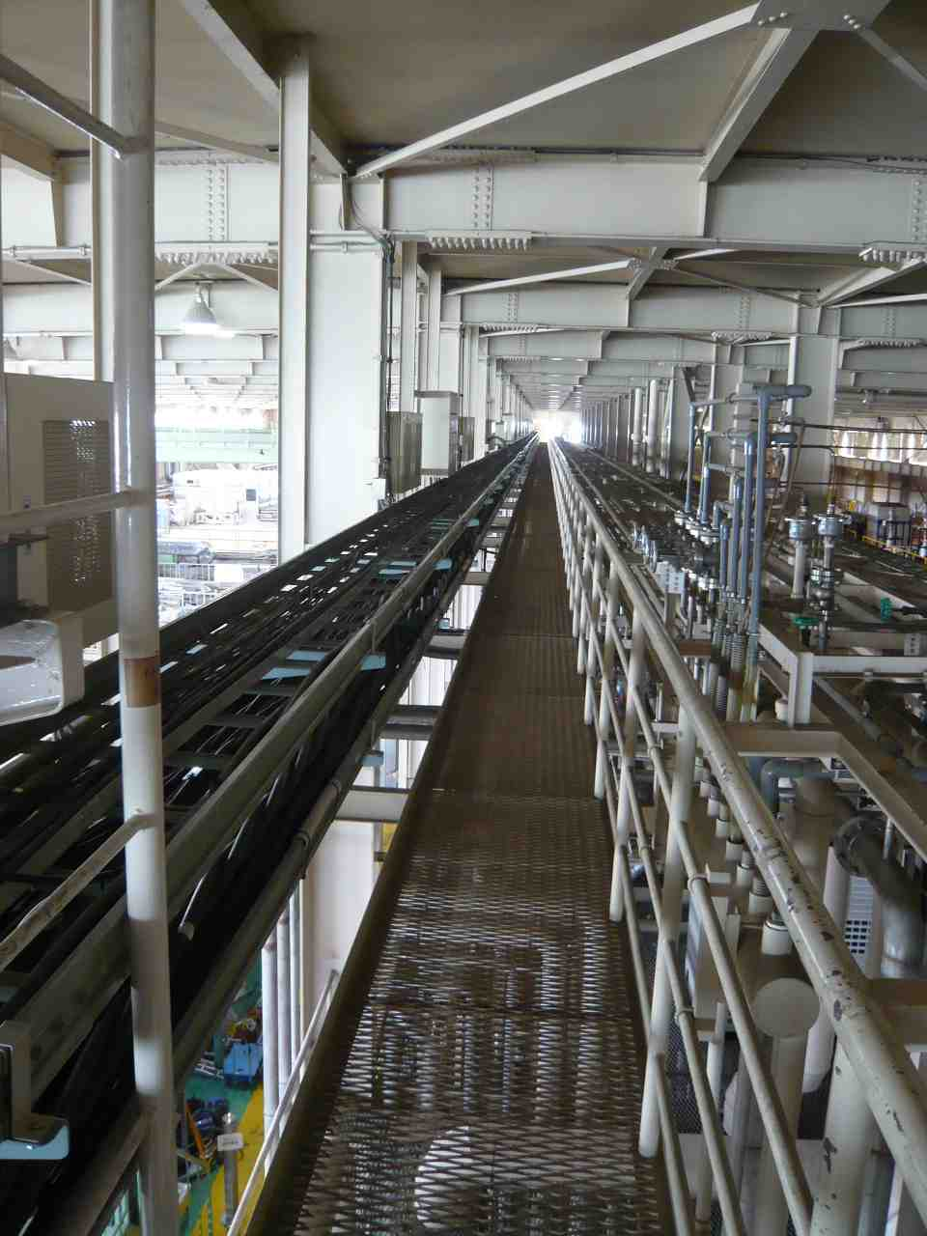
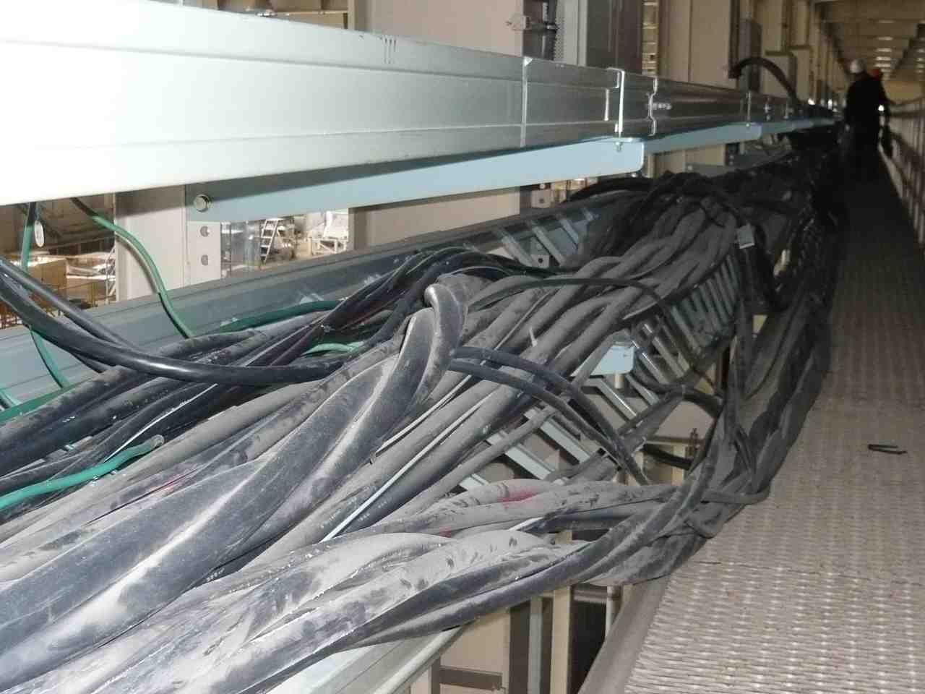
Main Power Line was recovered.

Slide 9
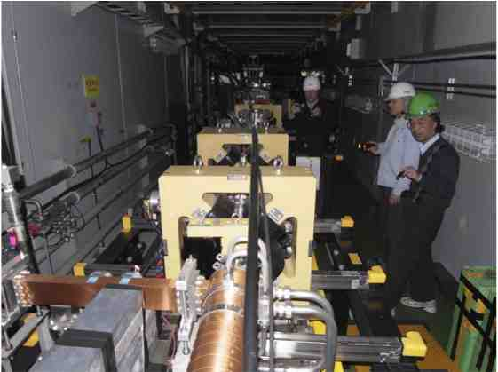
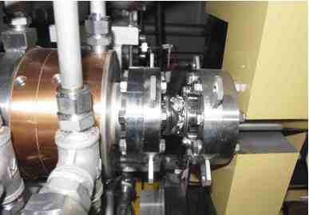
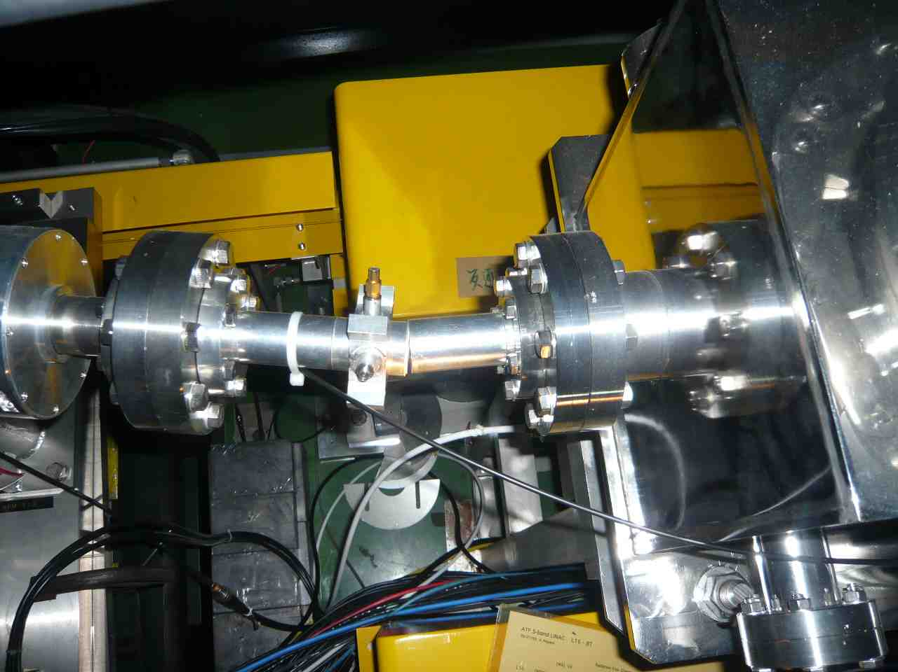
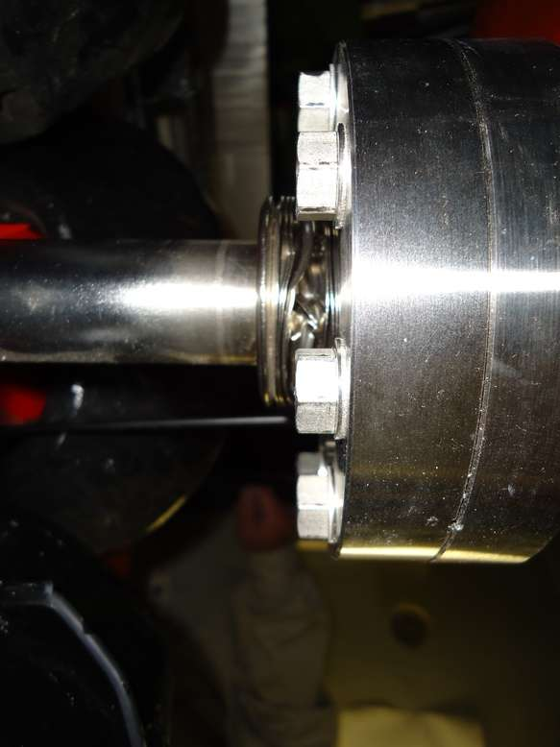
ATF LINAC
QM2L table was backed to the original.
Chambers were exchanged.
QD10L bellows was exchanged.

Slide 10
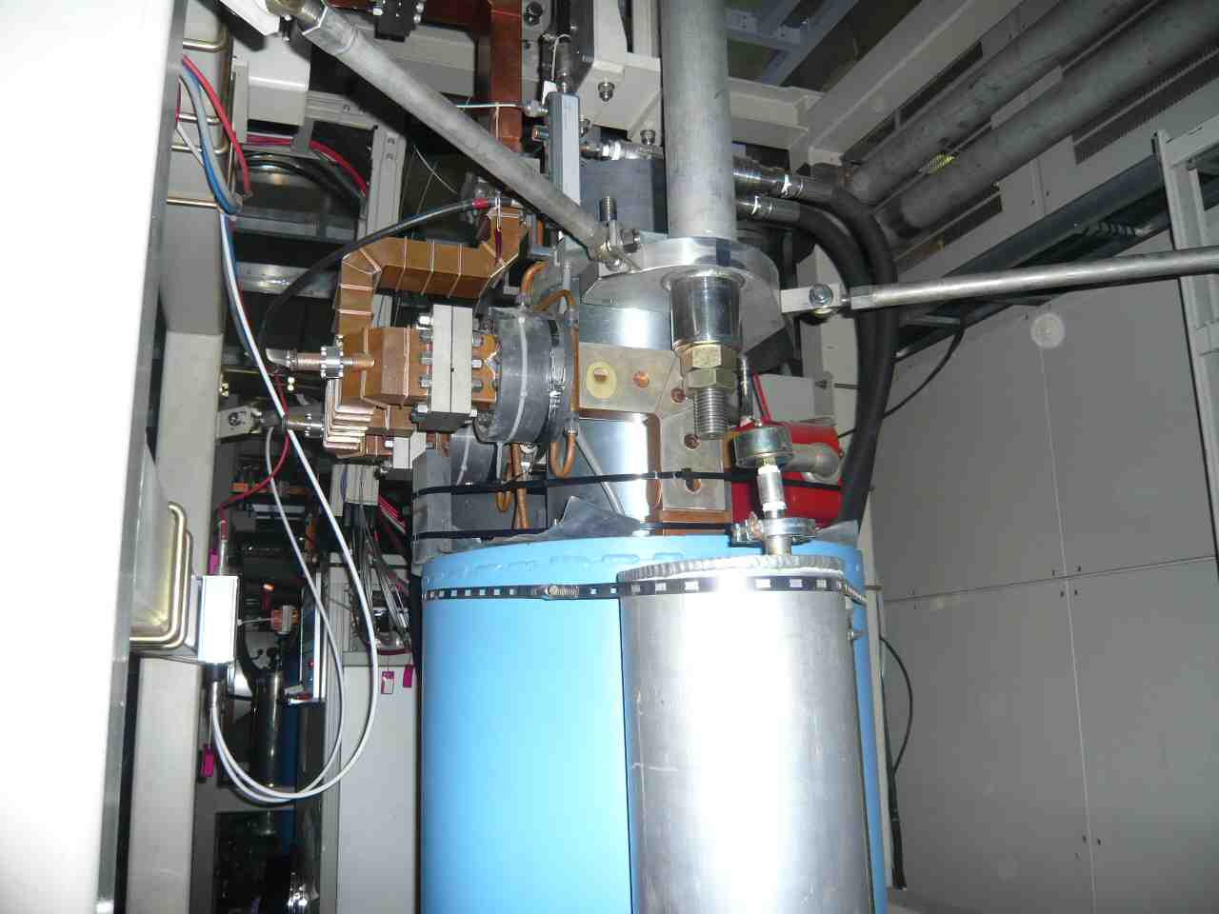
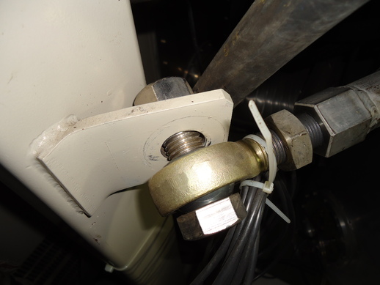
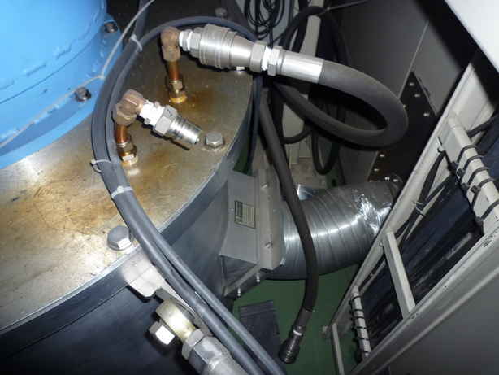
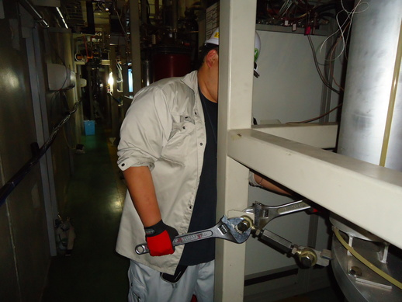

Slide 11
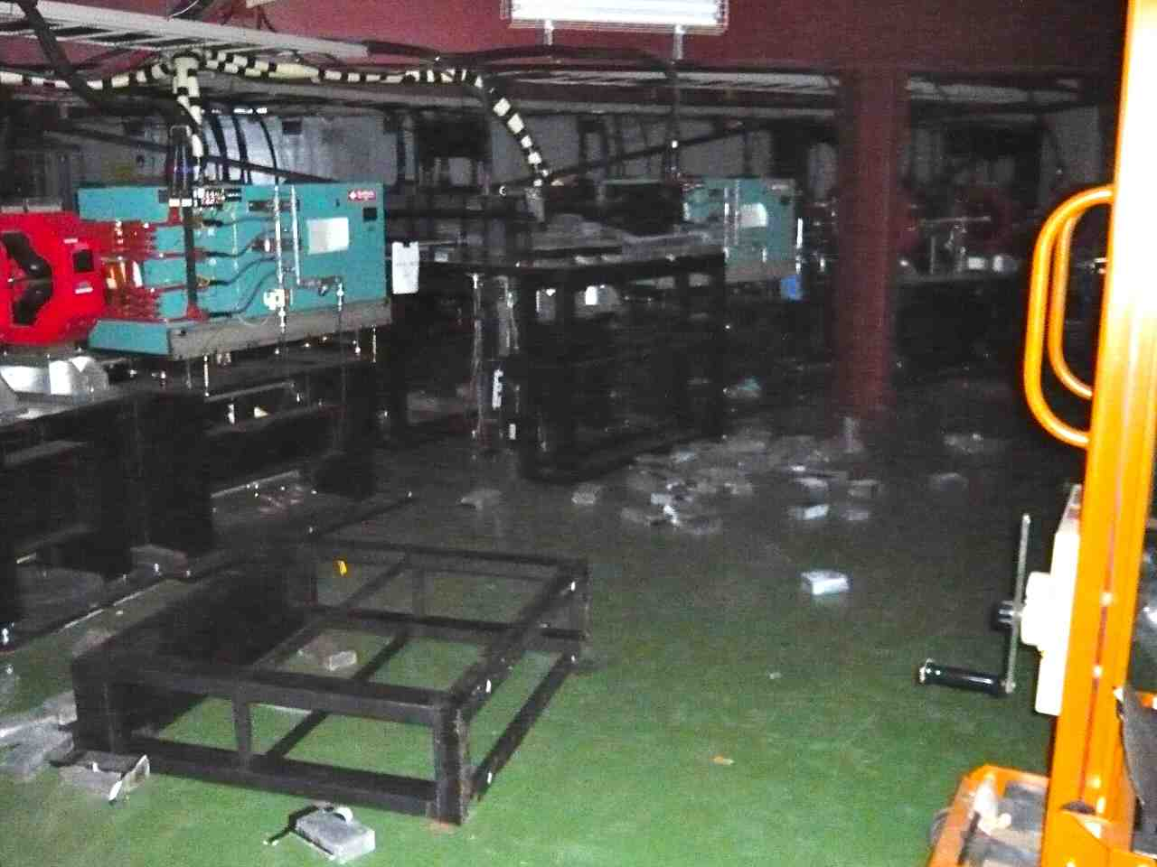
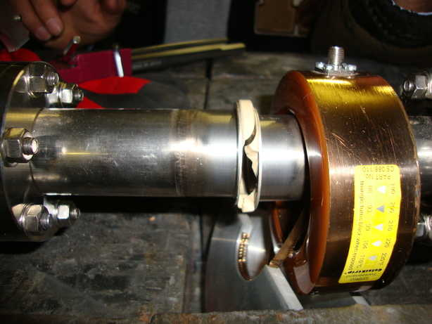
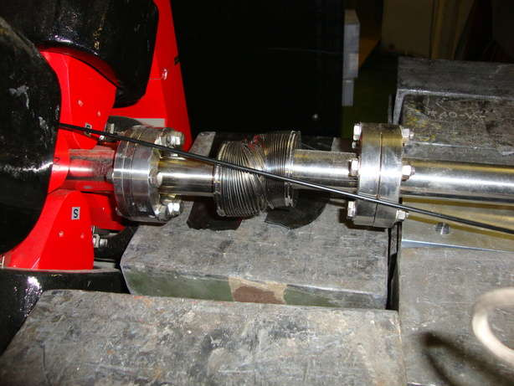
Beam Transport
Fallen Pb blocks were cleared.
Ceramic of the CT monitor and a bellows were exchanged.

Slide 12
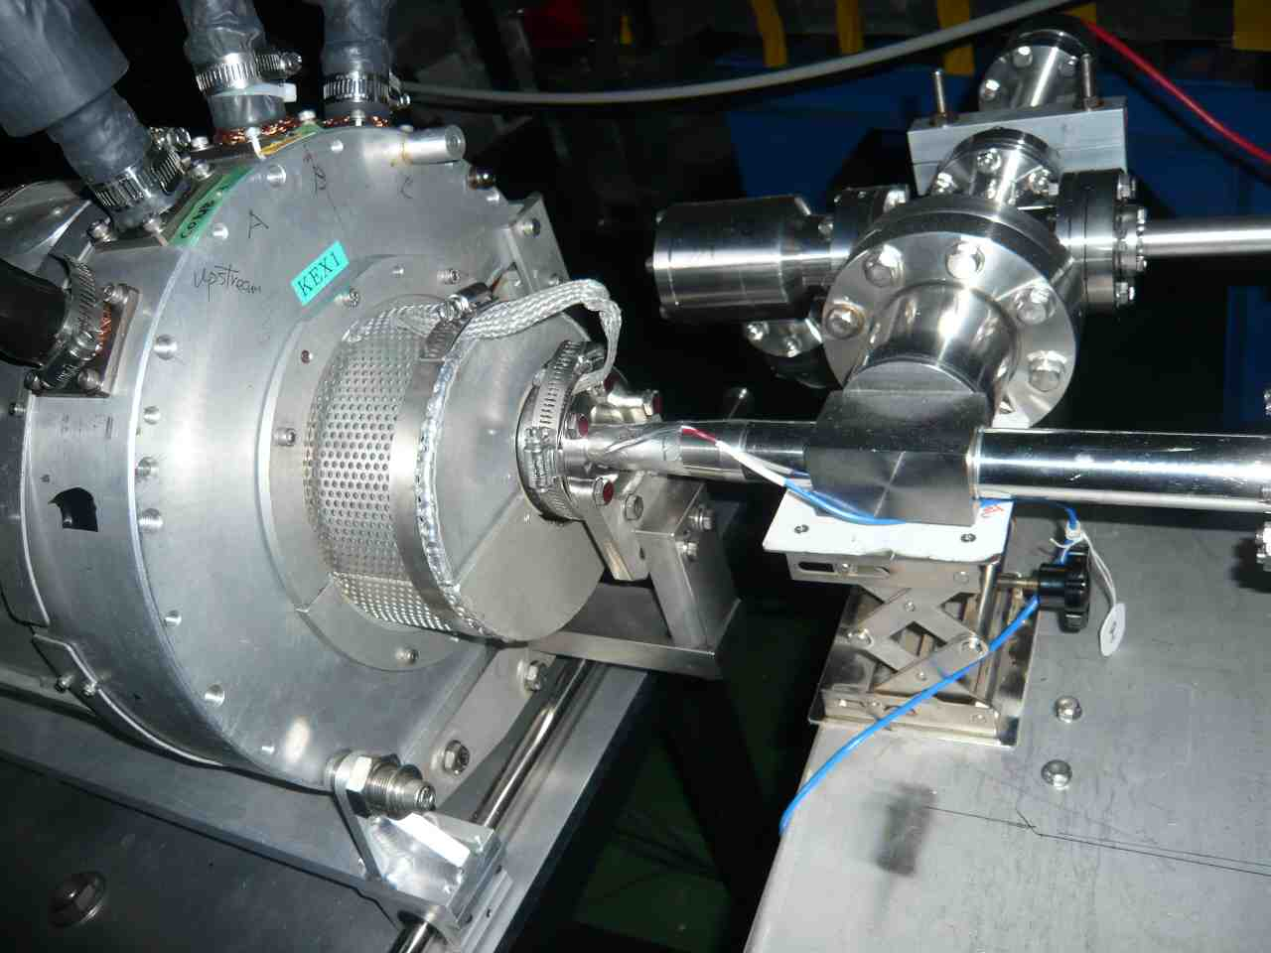
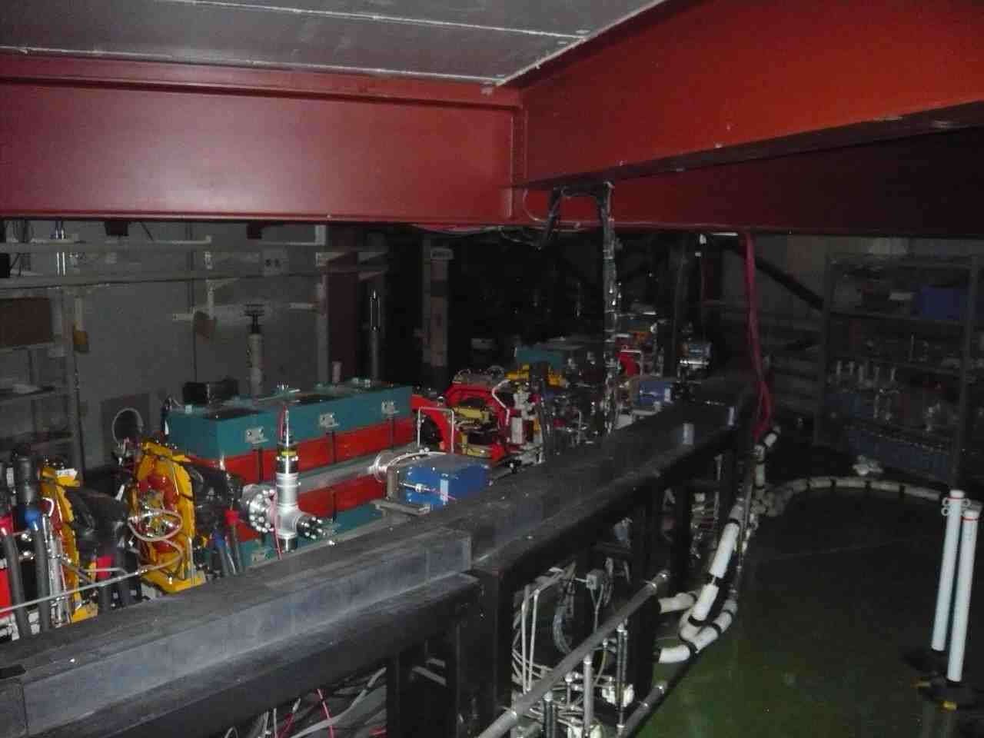
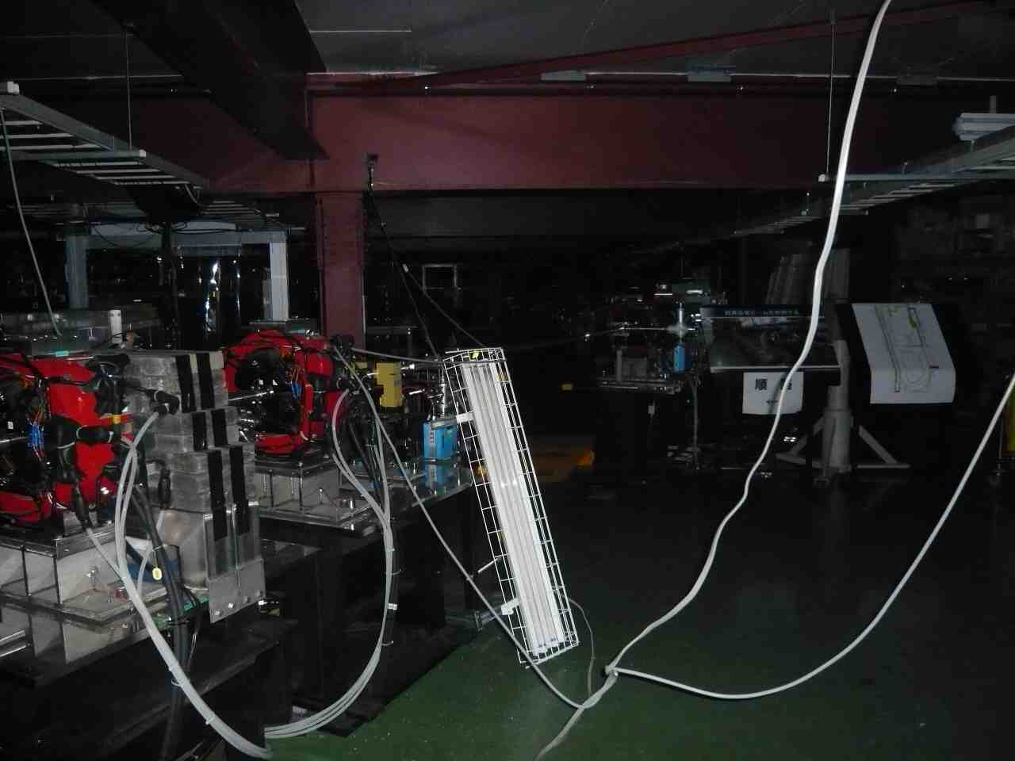
DR Vacuum
The vacuum level of the DR is OK.
Inside of all bellows was surveyed by eyes.
Inside of the DR Kicker/Septum chambers was surveyed by eyes. No damage was found.

Slide 13
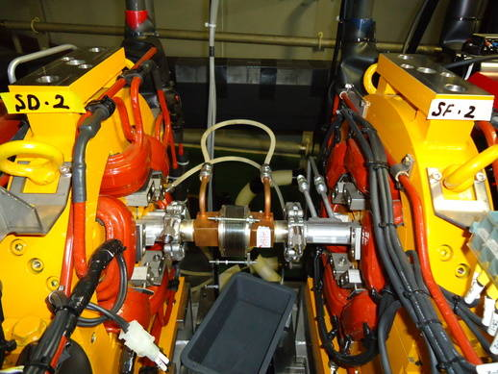
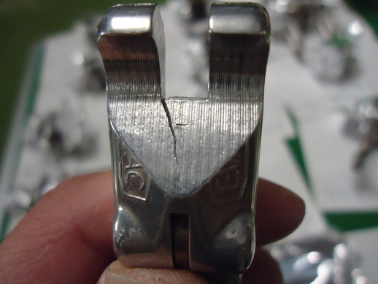
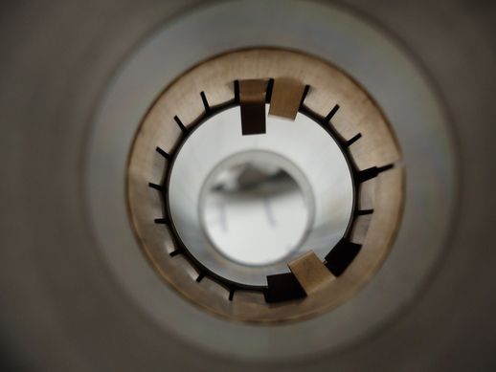
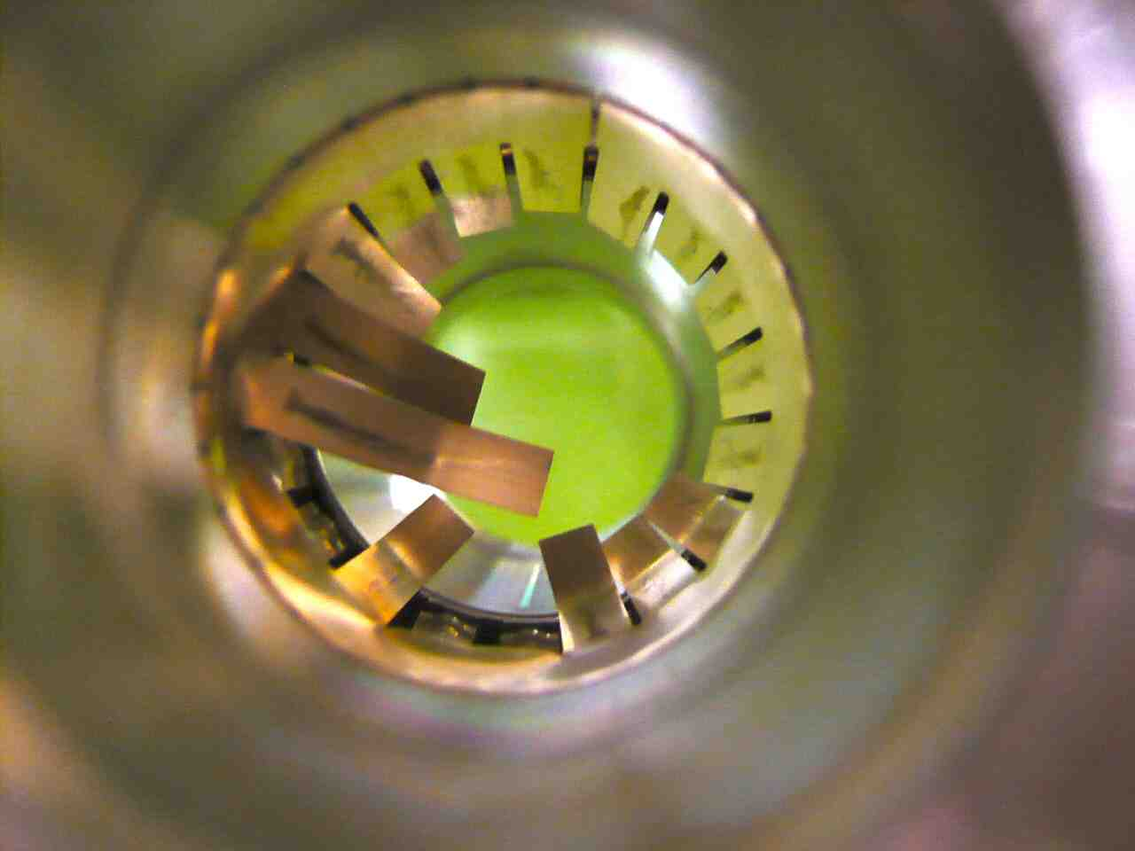
DR bellows
The bellows for DR has a RF shield fingers.
All bellows were checked.
Damaged bellows were repaired or exchanged.
Damaged Clamps for vacuum flanges were exchanged too.

Slide 14
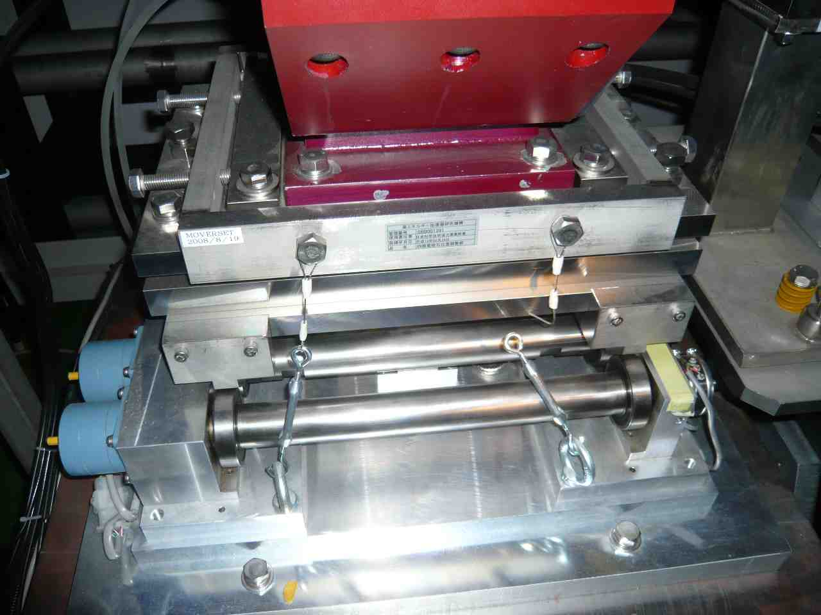
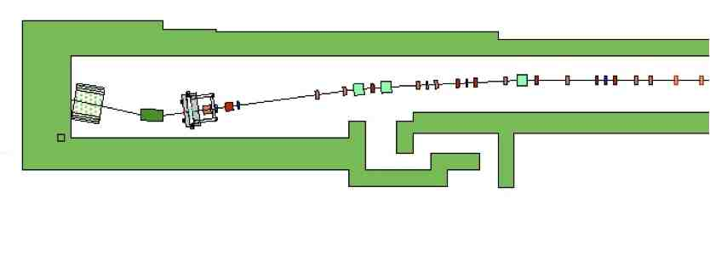
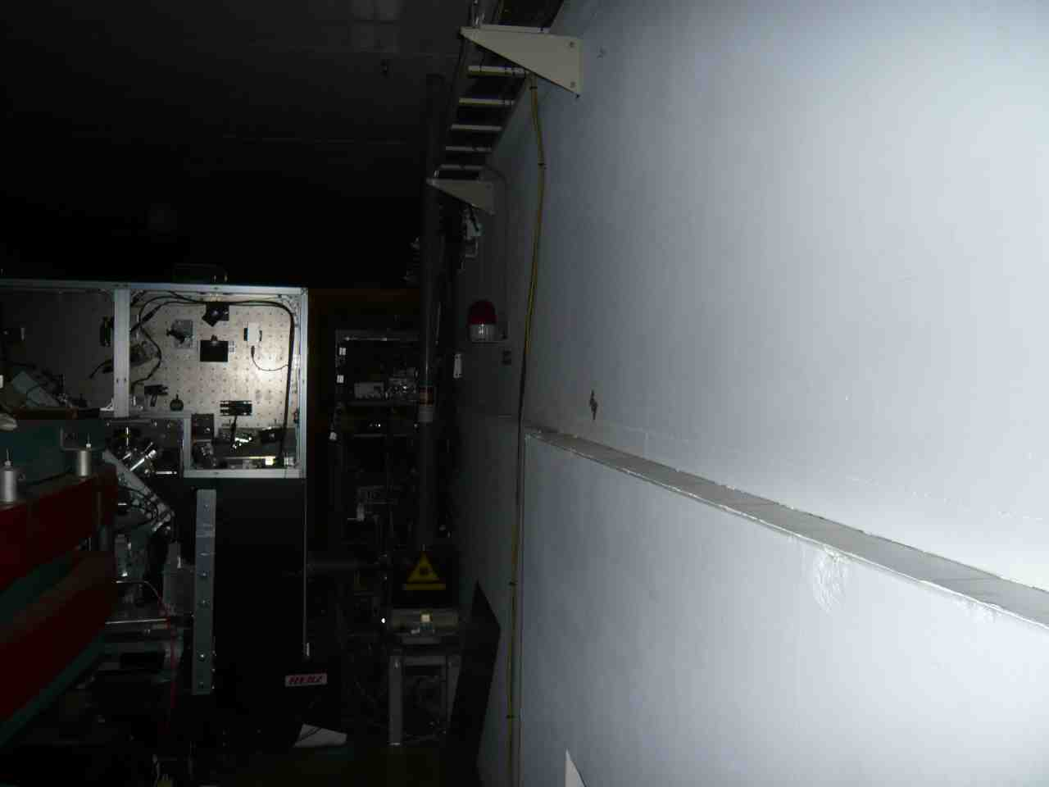
ATF2 beam line
Repositioning
Broken earthquake-proof wires were repaired.
Some of the radiation shields have to be re-positioned correctly. It leads us to move almost all ATF2 blocks.
Further the cables for S-band BPM and IP-BSM have to be pulled back for the shield works.
The optical components of IP-BSM should be cleaned.

Slide 15
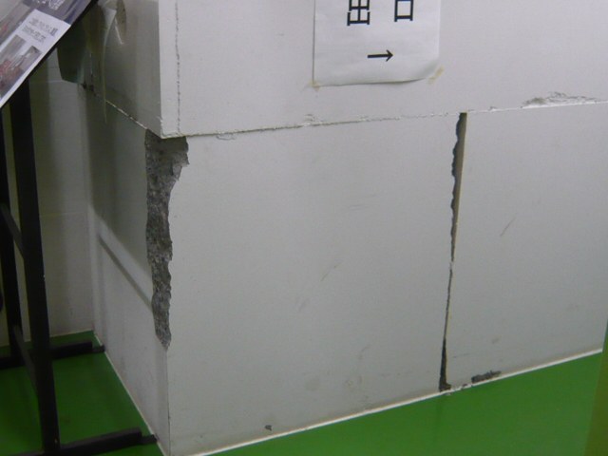
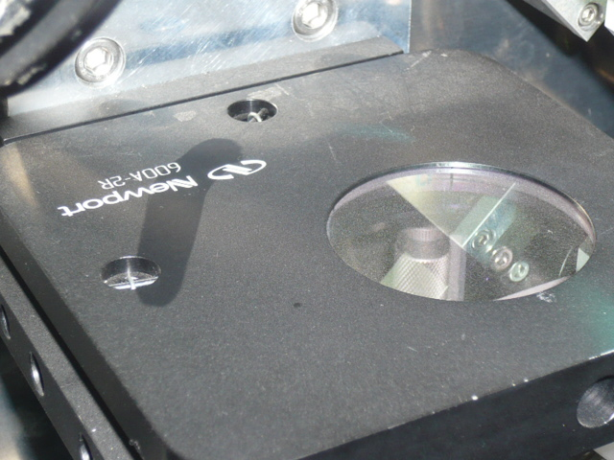
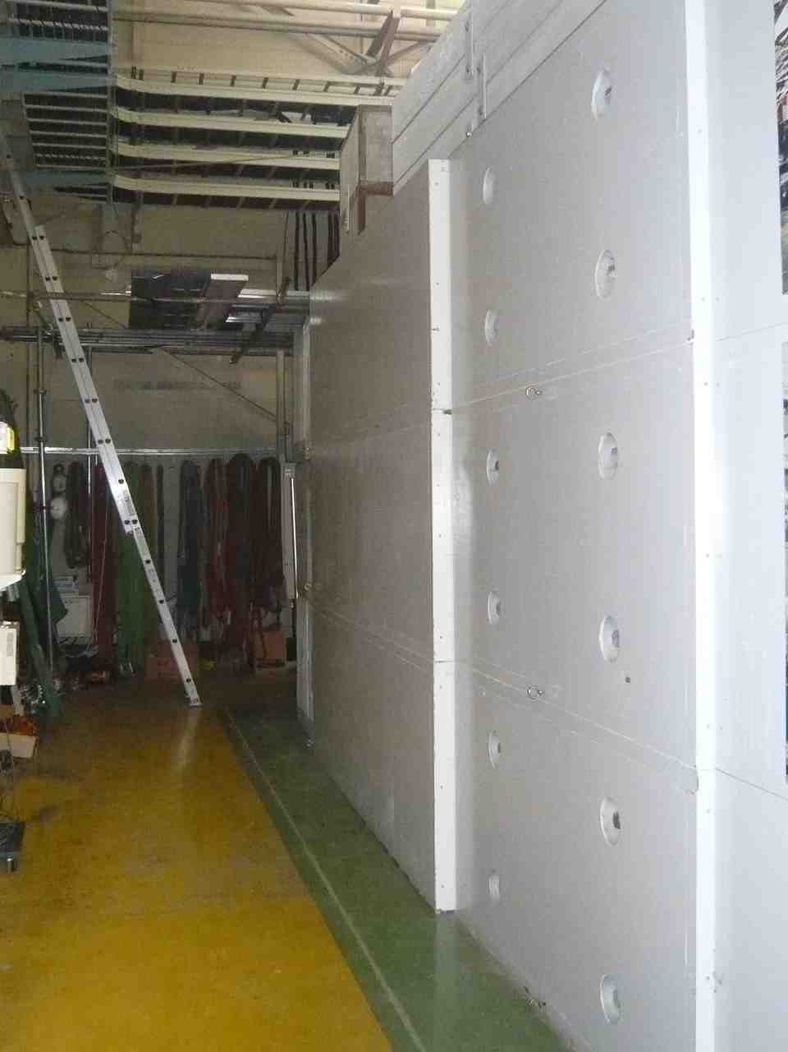
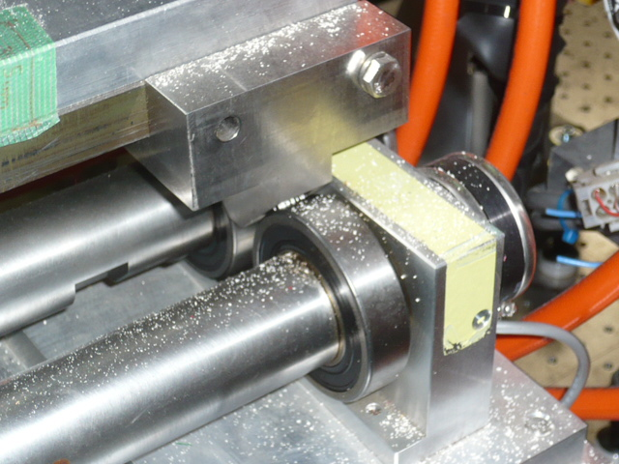
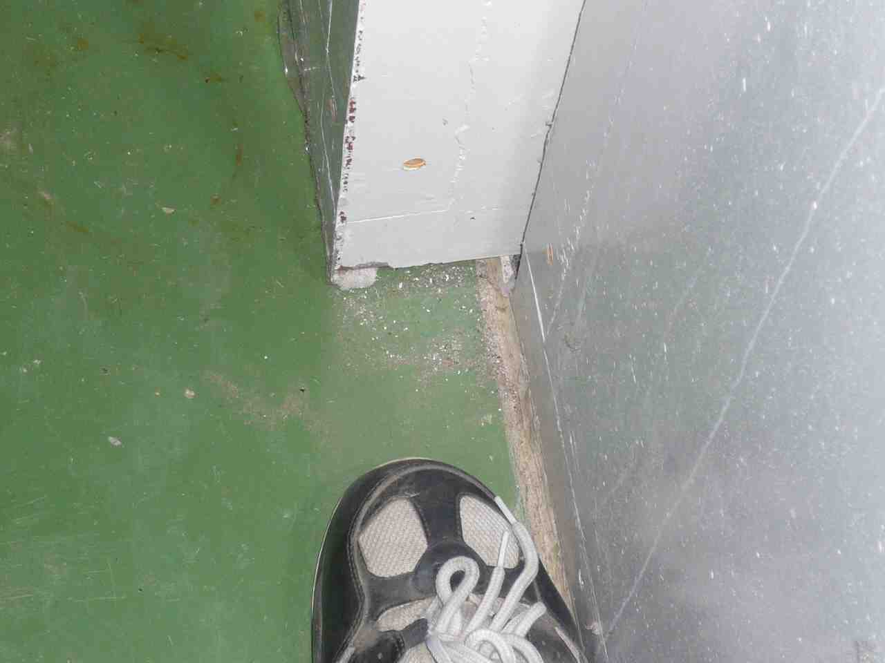
ATF2 beam line
Entrance of ATF2
Repositioning
Dust on the IP-BSM Optics
Outside of ATF2 end
Dust on the FD mover

