Slide 1
CLIC future R&D
towards a technical design (2012-2016)
Consider CDR completed
Organize future R&D towards technical design in work packages
Aim is to find collaborators which would like to contribute to
certain work packages or even take responsibility for full packages
Responsible are nominated for each work package
(link person for collaborations)
CERN organizes workshop in November (3-4.11) to discuss
and get a list of interested institutes

Slide 2
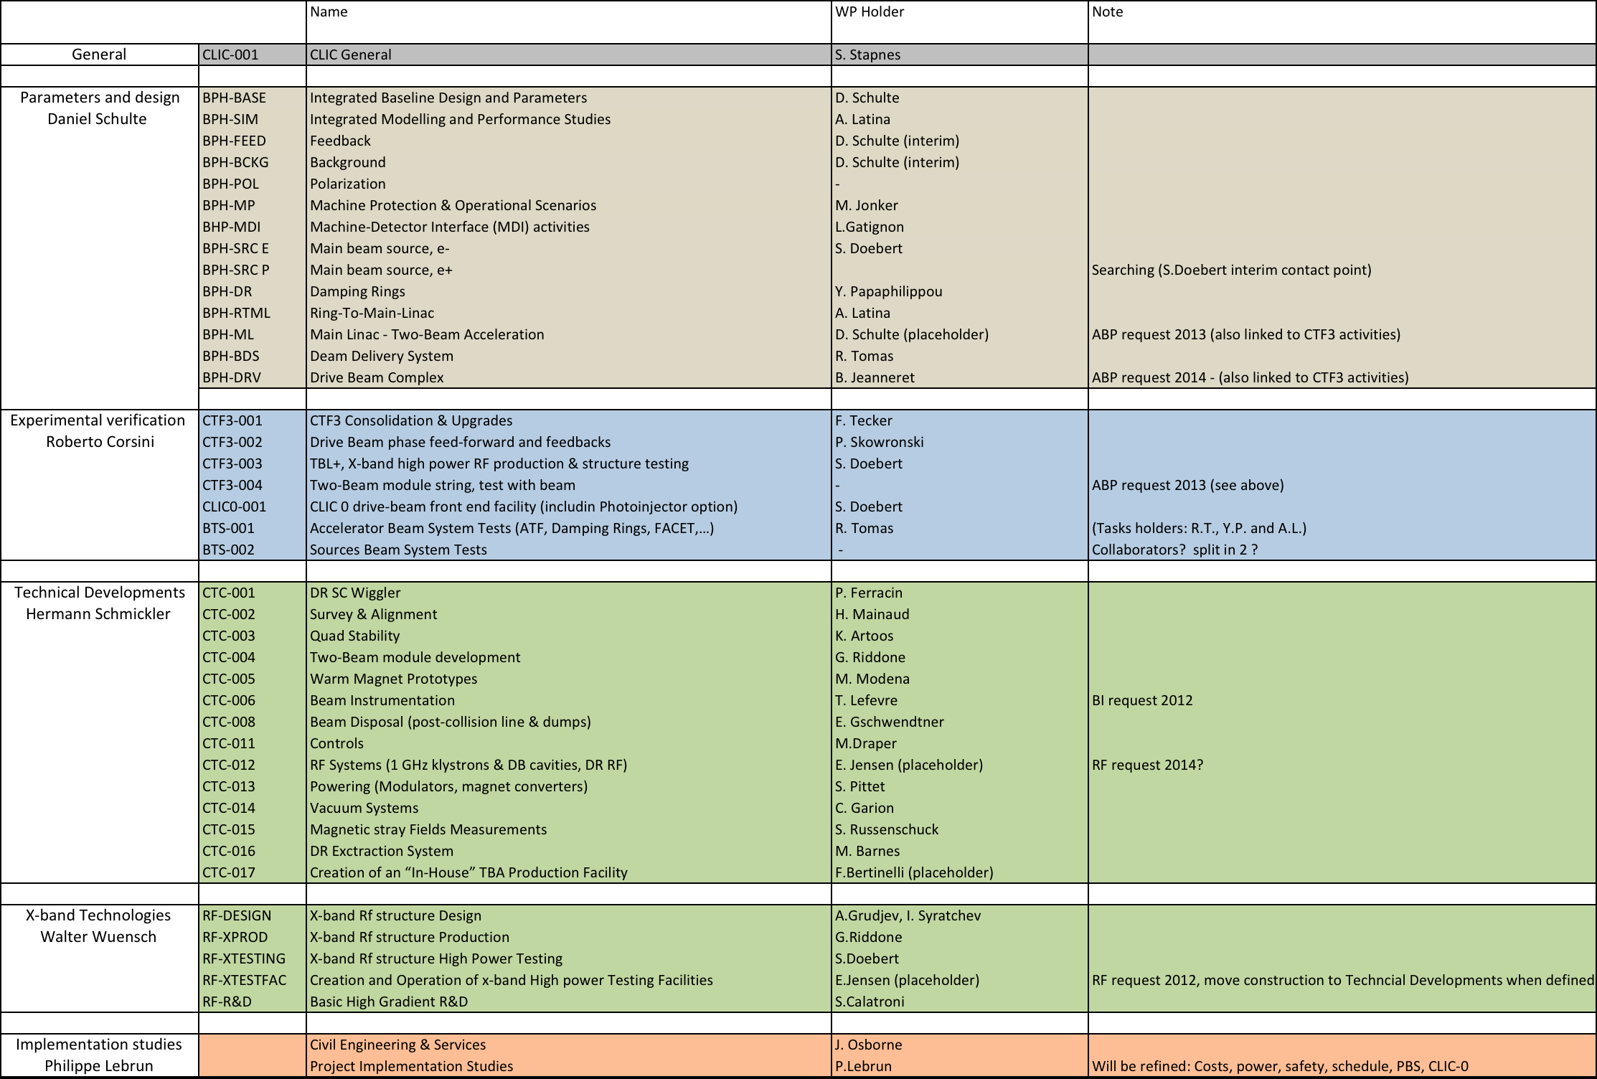
Work-package responsibilities

Slide 3
Working packages and plans
WP: Main Beam Sources (2012-2016)
Complete positron simulation from target to end of injector linac,
taking into account recent changes
Injector linac optics optimization
Electron pre-injector linac design, optics and rf
Positron pre-injector linac design, optics and rf
Develop detailed target region concept, target, AMD etc
Technical design of polarized electron gun
Design positron driver linac
Injector diagnostics, needs and specifications, diagnostic line design
Polarized positron production concept, converge to one?
Bunch charge stability feedback
More detailed conceptual laser design
Beam loading compensation studies
Study transfer lines
Hardware: AMD, target studies, 2 GHz rf, polarized electron gun ?

Slide 4
Working packages and plans
WP: CLIC Drive Beam Injector 2012-2016
Detailed technical design of the injector
Thermionic gun, design and construction
RF-structures (buncher + accelerating structure),
design and construction
1 GHz and 500 MHz high power system
(Klystron, Modulator, waveguide system)
LLRF system
Magnets, solenoids, quadrupoles, dipoles, correctors
Vacuum system including collimators
Diagnostics (high current, long pulse, very good resolution)
Controls
Commissioning and operation

Slide 5
Work package
Photo injector option 2012-2016
Continue working with PHIN set up,
study increased bunch charge and cathode lifetime issues
Laser Intensity feedback
Try to generate CLIC-like laser pulses to study
average power and train stability issues
Eventually design and realize 1 GHz rf-gun
Full system test (1 GHz rf system needed)
Some work on alternative (green) cathodes

Slide 6
List of critical issues for the CLIC main beam injectors
The CLIC main beam injectors as described in the CDR have been found to be feasible. The technical systems are rather conservative and rely on existing technology. Nevertheless there are issues critical for the beam quality and performance of the collider. In the following three critical performance issues have been identified.
1.Reliability of positron production
The positron production uses a hybrid target approach which has been tested at KEK but has not been used extensively during production runs yet. The life time of this system determined by the peak energy deposition might be shorter than expected. The problem can be mitigated by adding additional target stations in parallel.
2.Emittance preservation in the RTML
Unprecedented small emittance will be generated by the CLIC damping rings, this small emittance has to be transported without too much emittance growth through the 9 GeV booster linac and the almost 30 km long transfer line to the end of the main linac. Simulations showed that this should be possible but it remains to be a challenge. If the system does not perform as simulated emittance growth and therefore luminosity loss could be a consequence. The injector linacs could be installed at each end of the linac to avoid the long transport in order to mitigate such a problem.
3.Current stability, shot to shot and flat top
The CLIC main beam demands quite tight tolerances of 0.2 % for the current stability. This depends on the stability of the laser for the polarized electrons and on the positron production stability in addition a well controlled beam loading compensation in the linac’s has to be insured. If not sufficient a current feedback has to be used to achieve the required stability.

