Slide 1


Drive Beam Injector RF Structures
“Hayy Ibn Yaqzân”
by “Ibn Tufail” from Granada region
Translated by Simon Ockley
Hamed Shaker
School of Particles and Accelerators, Institute for Research in Fundamental Sciences, Iran ; CERN , Switzerland

Slide 2
CLIC Drive Beam Injector Layout
Energy = 140 KeV
Energy = 26 MeV
Energy = 53 MeV
Gun
Magnetic chicane
SHB 1-2-3
PB
Buncher
Acc. Structures
Quadrupoles
Slit
Bucking coil
Solenoids
The values was found by S. Bettoni et al. [1] during CLIC DB Injector design and optimization.
Initial design of RF structures was started with these numbers. But these values should be corrected afterward depend on the structure and the power source restrictions.
CLIC DB Injector (CDR) | Field (MV/m) | Length (cm) | Voltage (KV)
Gun |  |  | 140 (β=0.62)
SHB - I | 0.224 | 15.6 | 35
SHB - II | 0.234 | 15.6 | 36.5
SHB - III | 0.249 | 15.6 | 38.8
PB | 1.2 | 6 | 72
Buncher | 4.2 | 168.1
Acc Cavity - I | 4.6 (Average) | 99.98
The accelerating structures are designed and optimized for 4.2 A beam current after the magnetic chicane but the beam current is 6 A before the magnetic chicane. Then to keep the same structure and the same input power we should change the input phase.

Slide 3
Powering Layout
Scaling from the CTF3
15 MW
15 MW
15 MW
 | Field (MV/m) | Length (cm) | Voltage (KV) | Input Power (CTF3 rescaling)
Gun |  |  | 140
SHB - I | 0.224 | 15.6 | 35 | 1.1 MW
SHB - II | 0.234 | 15.6 | 36.5 | 1.2 MW
SHB - III | 0.249 | 15.6 | 38.8 | 1.4 MW
PB | 1.2 | 6 | 72 | 686 KW
Gun
SHB-I
SHB-II
SHB-III
PB
Buncher
Accelerating cavity
PB - II
To scale the prebuncher, I used the CTF3 data (27.5 KV voltage with 100 KW input power).
?
?
?
The SHBs structures should be changed to reduce the input power and this talk is more focused on this topic. to scale, using this fact that The CTF SHBs have the same length and their voltages are 20 KV with 40KW input power[2,3].
The power source for the accelerating structure was chosen by Erk Jensen (his presentation in the evening) and the accelerating structure is designed and optimized based on that by Rolf Wegner.
S. Bettoni et al. assumed a constant gradient structure for the buncher with 4.2 MV/m axial electric field with beam loading. By a raw calculation we can see about 27 MW input power is needed for 6 A beam current and 1 m structure length. This calculation comes from this fact that about 90% percent of the input power is consumed by beam. The electric field could not keep constant anymore at the end of buncher and the structure length should be shortened to 1 m instead of 1.68 m. And the rest power (about 3 MW) can be used for one or two prebunchers.

Slide 4
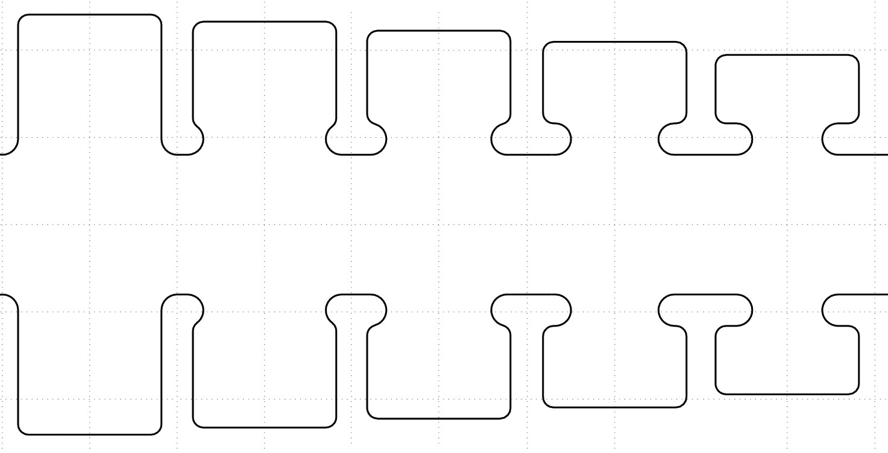
Accelerating Structure
Borrowed from Rolf Wegner [4]
SICA structure with constant aperture
R_{a,n}
Ncells
gap_{n}
P_{b}
P_{b}
R_{BP}
v_{gr,n}
tapering
E₀T(n)
V_{acc}
constant
free parameter
φ_{n}=120⁰
P_{in}
P_{out}
η= ΔP_{b}/P_{in}
t_{fill}
mode spectrum

Slide 5
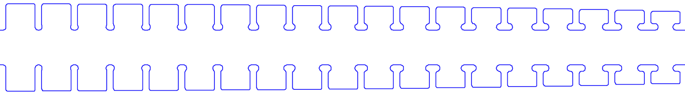
Baseline structure, 19 cells, RB=49 mm
Borrowed from Rolf Wegner [4]
P_{in} = 15 MW
RB = 49 mm,
N = 19 cells
Energy gain =3.4 MeV
Length = 1.8996m
Average electric field≈1.8 MV/m.
These numbers are different from S. Bettoni et al. model then the model should be corrected.

Slide 6
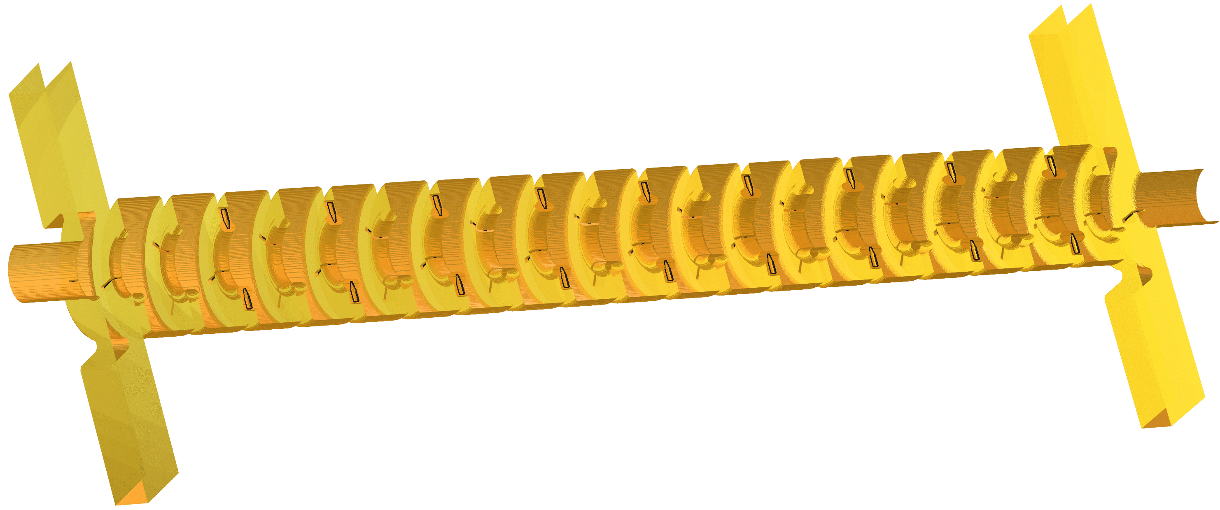
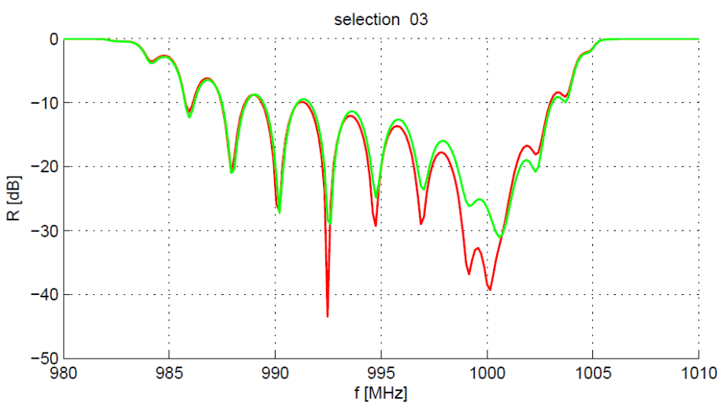

SICA – GdfidL simulations
Borrowed from Erk Jensen [5]
input
output
nose cones
SiC dampers
beam
Input and output coupler design finished
Correct match, input reflection < 30 dB.
(red and green: two different geometries; red is final)
Rolf Wegner

Slide 7
Sub Harmonic Bunchers
Gap creation and combination
Phase coding
Sub-harmonic bunching ν₀ / 2
even
buckets
180° phase switch
odd buckets
Acceleration ν₀
  RF deflector ν₀ / 2
Sub Harmonic Bunchers (SHBs) works at 499.75 MHz that is half of the frequency of the rest structures (999.5 MHz). The main challenge for SHBs is the fast phase switching capability of these structures (about 10ns).
Deflection ν₀ / 2

Slide 8
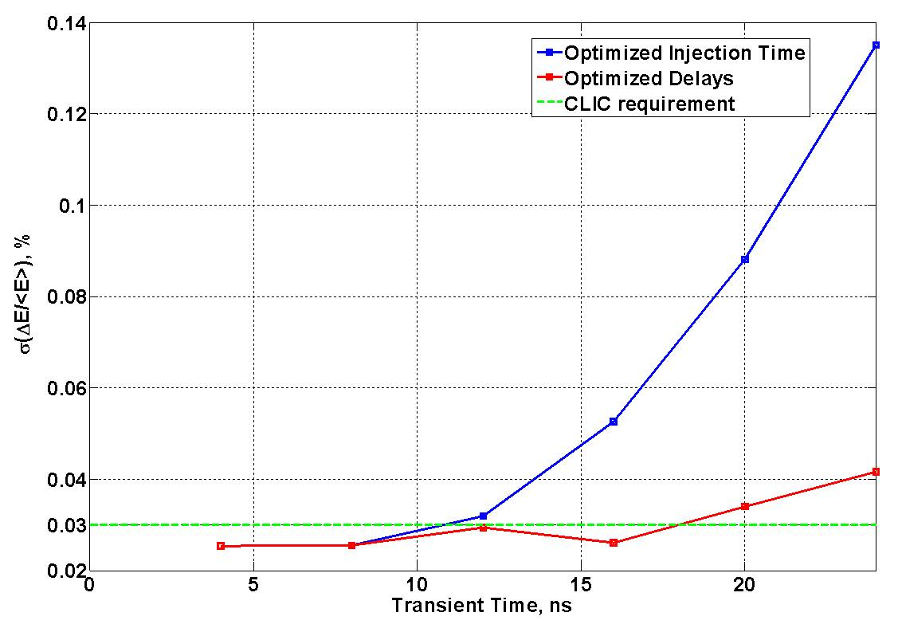
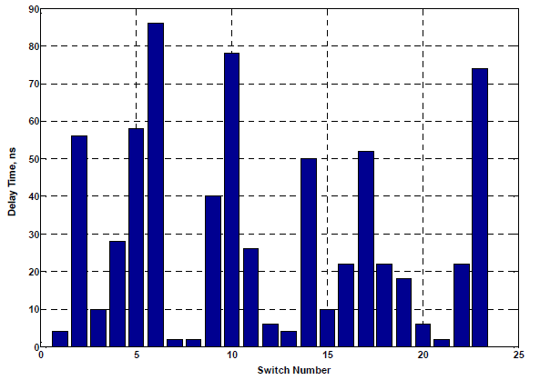
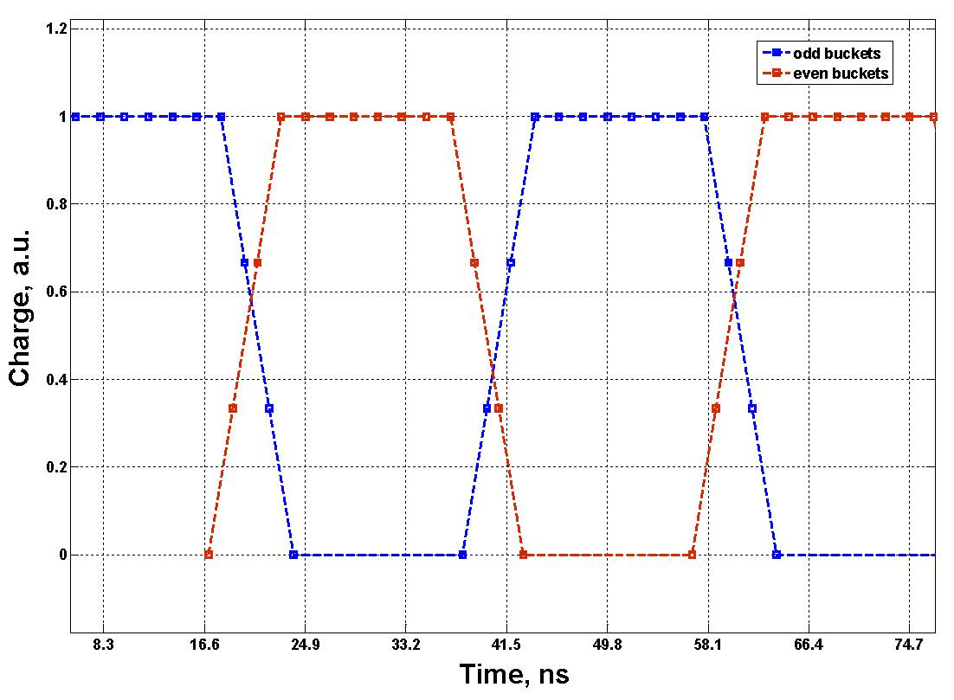
Filling time choosing
Borrowed from Oleksiy Kononenko [6]
In the normal case the time interval between phase switching is constant (243.7 ns). In the Oleksiy model these intervals are not constant to have better energy dispersion at the end of main beam linac. It also give us an idea that how much the filling time should be. The result shows us it should be less than 18ns. In this talk I use 10ns as the filling time similar to CTF3 SHBs.

Slide 9



Fundamental Equation
R : Effective shunt impedance
R’: Effective shunt impedance per length
Q : Unloaded quality factor
P: Source power
V : Gap voltage
W’ : Stored energy per length
L: Structure length
v_{g} : Group velocity
n : Cell numbers
P_{d} : Power disappears on surface.
β : Coupling coefficient
Q_{e} = ωτ : External quality factor
τ : Filling time
P
Standing Wave Structure
Load
…
P/n V/n , τ
P/n V/n , τ
P/n V/n , τ
Travelling Wave Structure
P
Load
Load
P
For the known gap voltage and filling time our goal is to increase R/Q to reduce the input power.
V , τ
V , τ
τ=10ns
V=36.5 KV
Forward Travelling Wave structure
Backward Travelling Wave structure

Slide 10
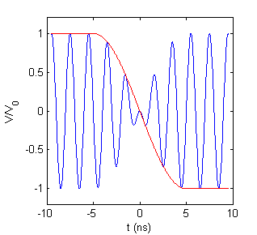

Phase Switching Model and the Power Source Bandwidth
A
B
C
At f₀±f_{s} (499.75 ± 50 MHz) frequencies the amplitude is half of f₀ frequency. By this fact that the bandwidth is measured from the frequencies that power consumption is half , the BW is about 57.7 MHz or 11.5%.
The BW of CTF3 SHBs sources - that are TWT structures -are about 160 MHz (10.7 %) then they have capability of phase switching at less than 4 ns.

Slide 11
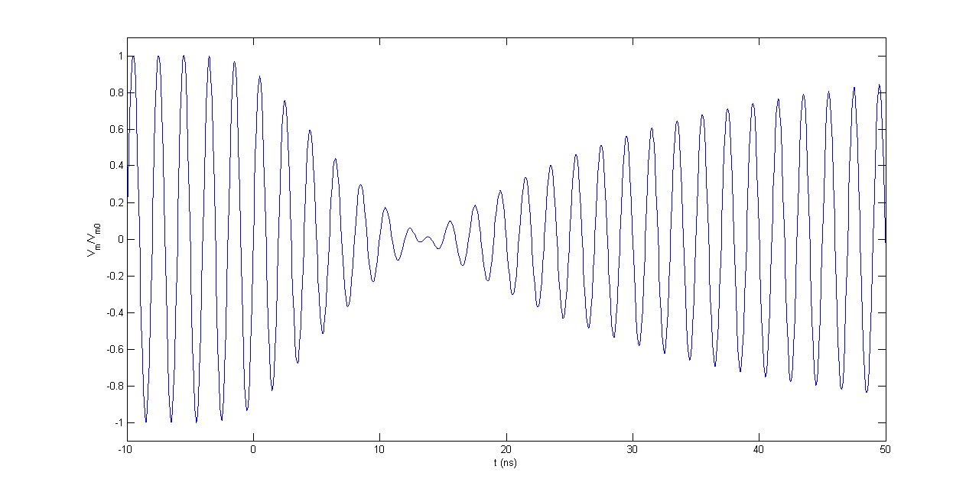
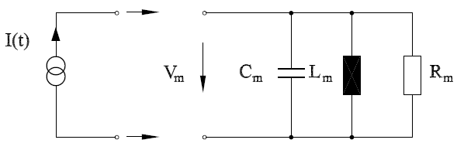

Effective filling time in a SW structure
To see what is the behaviour of a single cell SW structure I used a simple RF circuit [7] with the input from last slide. τ=10 ns and Q=ωτ=10π. It is about 39 ns between two 80% electric field level after phase switching.
It can be introduced by this fact that the BW/f₀ is equal to 1/Q then the BW is equal to 15.9 MHz. By the fact that 57.7 MHz bandwidth is needed for 10ns phase switching, the phase switch for this SW structure should be around 36 ns – close to 39 ns - .

Slide 12
Effective filling time in a TW structure-I
In a TW structure with n cells and the total filling time(τ) defined by length/group velocity, the filling time of each cell is equal to τ/n. Then the external Q for one cell is equal to ωτ/n. It means that the BW for this structure is n times more than a single cell SW structure. The pass band is about two times more than the BW for these structure. Now if we use 4 cells structure with 10ns filling time the BW is equal to 63.7 MHz and the pass band is equal to 127.3 MHz. It means this structure accept all the frequencies are needed for 10ns phase switching or less but still it takes 10ns to fill the whole structure. It is a description why for a TW structure, effective filling time is more or less equal to standard filling time.
I haven’t modeled a TW structure during phase switching but we have data from CTF3 SHBs at the moment. The filling time is about 11ns for CTF SHBs. In these structures, group velocity and phase velocity are 4.8% and ~62% of light speed, respectively and in the same direction. It means the beam sees 10ns for the phase switching.
For CTF3 SHBs with 6 cells the structure pass-band is equal to 173.6 MHz and the BW is equal to 86.8 MHz (75.5±(20,22.5)°). A raw calculation – but not exactly correct - gives us about 6.6 ns for the transient time for the phase switching that is close to streak camera measurement that you can see in the next slide.

Slide 13
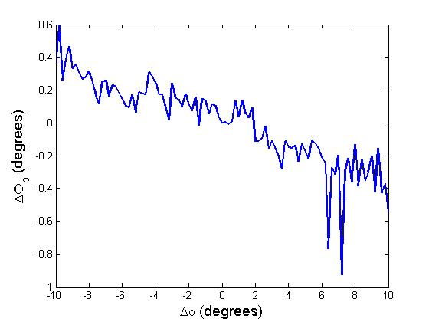
Effective filling time in a TW structure-II
There is one description by Roberto Corsini from the sensitivity studies done by A. Vivoli [8] . This graph shows the final phase variation (end of the linac) around 0° and 180° SHBs input phase. This graph shows it takes at least 40° less for the final phase switching then it is about 7.7 ns.
The streak camera measurement at the end of the CTF3 linac shows transient time less than 10 ns(~ 6 ns).
With similar filling time for a single cell SW structure and a TW structure, it seems the effective filling time for the SW case is about four times more. Then a TW structure should be our choose.

Slide 14





Pill Box Model – TM₀₁₀ mode
Maximum at 133.5°
Maximum at 77°
g
a

Slide 15
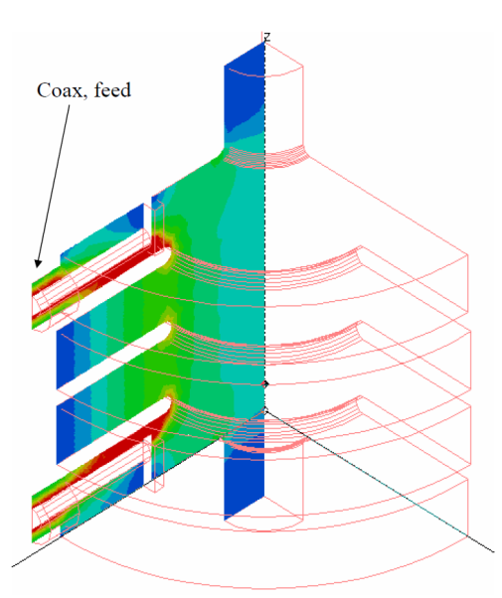
CTF3 case – Forward TW structure
Related to pill-box model and by attention to the disk thickness, the maximum R/Q is at 85° phase advance but 75.5° was chosen for CTF3 SHBs before detuning for beam loading compensation.
Maximum is around 4.8% that was chosen for CTF3 SHBs.
From L. Thorndahl presentation [2] for 4 cells model. Finally 6 cells structure was chosen.
The group velocity is increased by increasing the iris radius. The iris radius is about 10cm for 4.8% group velocity.
It means the minimum input power needs using the fundamental equation is around 1.11MW for CLIC DB injector.
The best thing was done for the CTF3 SHBs with Forward TW structure and it can not be reduced so much then we should look for another structure type.

Slide 16
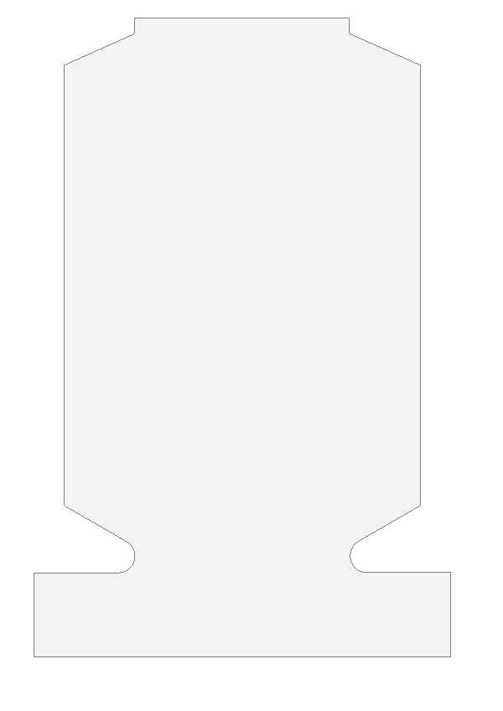
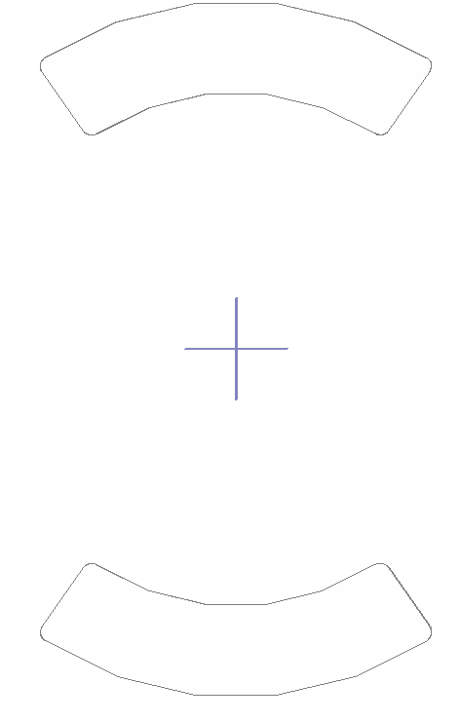

Backward TW structure
g
θ₂
l_{c}
g/l | ≈0.51
r_{b} | 25 mm
r_{n} | 5 mm
θ₁ | 30°
θ₂ | 24°
t (disk thickness) | 18 mm
r_{c}
θ_{c}
r₁
r₂
This design is based on the LEP cavity [9].
t/2
θ₁
g
r_{n}
r_{b}
l

Slide 17
R/Q and V_{g} vs. Coupling angle
Frequency | 499.75 MHz
l (for 75.5° phase advance per cell) | 78mm
r₁ | 176 mm
r_{c} | 171 mm
l_{c} | 45 mm
r₂ is changed to keep resonant frequency constant.
We can keep the beam hole radius as small as possible(r_{b}) to have higher R/Q per cell. Then we can increase the group velocity by using magnetic coupling holes and it means more cell numbers.
R/Q per cell is weakly depend on the magnetic coupling angle. It means that total R/Q is linear vs. group velocity because the cell numbers is linearly dependent on group velocity.

Slide 18
Optimization
number of cells | Phase advance per cell (deg) | V_{g}/c(%) | R/Q - cell (Ω) | R'/Q (Ω/m) | R/Q (Ω) | Input power (KW) | r₁ (mm) | r₂ (mm) | r_{c} (mm)
3 | 122 | 12.79 | 149.15 | 1183.3 | 453.71 | 93.46 | 159 | 174 | 154
4 | 110 | 15.17 | 131.82 | 1160.21 | 527.73 | 80.34 | 163 | 173 | 158
5 | 98 | 16.74 | 117.59 | 1161.44 | 582.93 | 72.74 | 166 | 177.7 | 161
6 | 86 | 17.79 | 99.91 | 1124.49 | 599.61 | 70.79 | 173 | 178.8 | 167.8
7 | 62 | 15.02 | 66.33 | 1035.47 | 466.31 | 90.98 | 187 | 191 | 182
The maximum R/Q was found with HFSS for each cell numbers for θ_{c}=90°
If we have allowed to increase filling time, then by using 4 and 5(6) cells for 122° and 110° structures, respectively, we can reach to 52.6 KW and 51.2(35.6) KW power.
I think the best option to have limited cell numbers is the 4 cells structure with 110° phase advance that needs 80 KW input power.
R’/Q seems to be constant then we can imagine that the maximum R/Q is close to 90° phase advance because the group velocity is maximum.

Slide 19
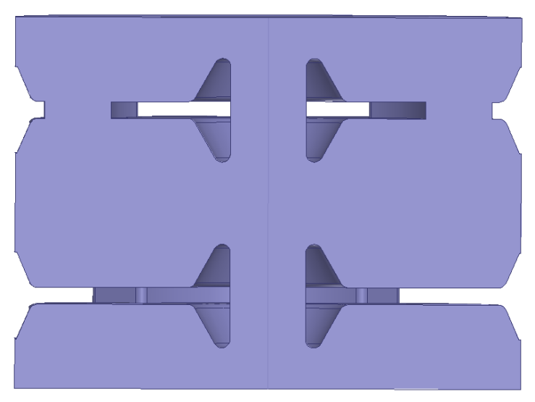
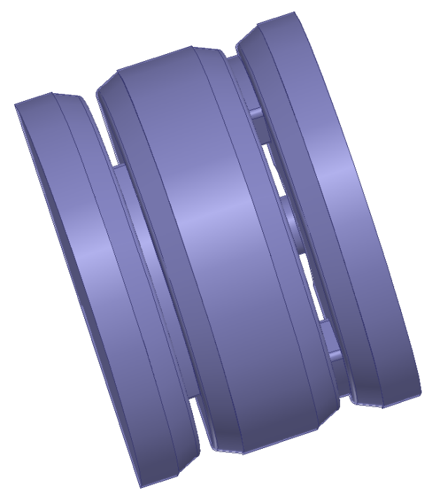

Optimization - II
another HFSS models with a little better R/Q
number of cells | phase(deg) | vg/c(%) | R/Q - cell (Ω) | R'/Q (Ω/m) | R/Q (Ω) | Input power (KW) | r₁(mm) | r₂(mm) | r_{c}(mm) | θ_{c}(deg) | l_{c}(mm) | r_{n}(mm) | t(mm) | g/l | phase velocity/c
3 | 105 | 10.86 | 142.76 | 1337.61 | 428.28 | 100.79 | 169.8 | 186.35 | 164.9 | 75 | 49.04 | 6.13 | 12.26 | 0.45 | 0.61
3 | 120 | 12.2 | 163 | 1336.35 | 489 | 86.81 | 152.9 | 167.8 | 148.49 | 89 | 44.16 | 5.52 | 11.04 | 0.44 | 0.61
4 | 105 | 14.34 | 142.16 | 1331.96 | 568.64 | 75.04 | 159.55 | 175.1 | 154.94 | 87 | 46.08 | 5.76 | 11.52 | 0.46 | 0.61
5 | 105 | 16.14 | 126.89 | 1314.05 | 634.45 | 67.07 | 162.88 | 178.75 | 158.17 | 95 | 47.04 | 5.88 | 11.76 | 0.54 | 0.61
It is possible to reduce the power a little. For example to 75 KW from 80 KW in last slide.
After choosing the structure we can work to optimize cells depend on all parameters affect the design like beam loading, HOMs, minimum wall thickness for cooling water pipe holes and ...
It is the definition of drain time as was introduce by L. Thorndahl et al.[2] . This time is used to find the number of bunches passages during phase switching. For FTW case it is about 8% less (τ’≈9ns) and for BTW case it is about 20 % more than filling time(τ’≈12ns).

Slide 20
Standing Wave structure
The main idea from Alexej
P
Load
As another options , we can use the SW structure with two single cells with two power coupling like a TW structure.
…
Maximum is around 230°
P/n V/n , τ
P/n V/n , τ
P/n V/n , τ
As mentioned briefly, most power is reflected because of low external Q (≈ 31.4 for τ=10ns) to have small filling time. In the case of beam loading the external Q can be increased to use a fraction part of reflected power to compensate beam loading then we have not need more input power except the beam loading consuming power exceeds the input power. Maximum 13.3 (16.5) KV beam voltage gain for 80(100) KW input power.
By using two single cells at 230° phase advance we just need 93.5 KW that it is 17% more than 80KW for the 110° four cells BTW structure. If we want to keep drain time at 10ns for BTW structure then it needs about 120KW input power that it is about 30% more than SW case.

Slide 21
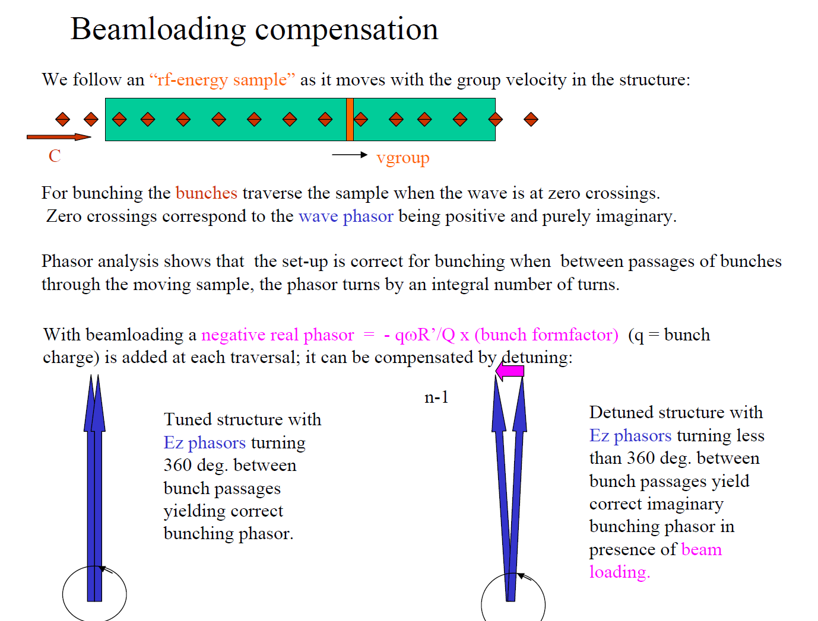
Borrowed from L. Thorndahl [2]
At CTF3, the SHBs are detuned to turn more than 360° between bunch passage to compensate negative real phasor but with the negative group velocity, this number should be smaller than 360° .
It is the fundamental theorem of beam loading. This equation is based on circuit convention then we need to divide it by two for our convention.

Slide 22



Beam Loading Compensation
For SW structures this concept is not useful. As mentioned previously, we just need to increase external Q for the beam loading compensation.
I= 6 A
V= 36.5 KV
τ = 10 ns
ω = 2π x 499.75 MHz
F= bunch form factor = 1 (maximum)
This is valid for a Gaussian charge distribution that σ is the time width and Δφ is the phase width of one bunch .
Historically, the problem was discovered after building the structure then they try to detune it to compensate the negative beam loading but we can just change the phase advance by changing the length then we doesn't need to detune the structures.
The detuning angle could be decreased by decreasing the gap voltage and filling time or by increasing the filling time if we keep the total length constant by decreasing the group velocity.
Maximum 15.7° for 80KW and 12.6° for 100KW input power. The bunch form factor in CTF3 for the third SHB is around 0.6 and if assume the same for CLIC the detuning angles are around 9.3° and 7.6° for 80KW and 100KW input power, respectively.

Slide 23
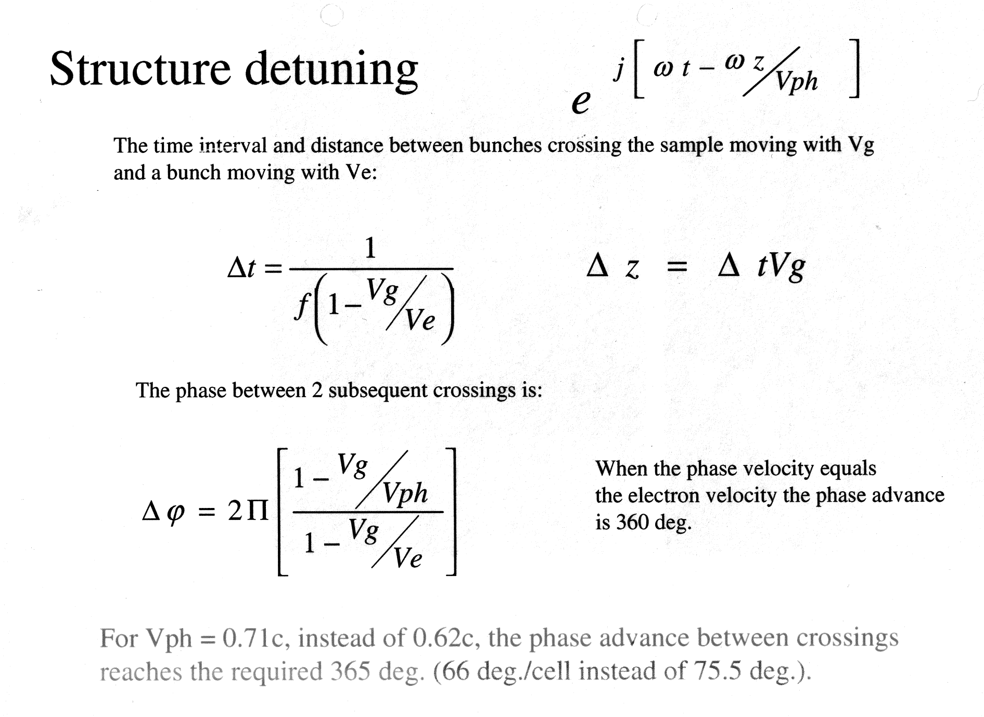
For our case (BTW) the sign should be positive.
Borrowed from L. Thorndahl presentation [10]
Using this equation, v_{ph} will be 0.72c (0.71c) for the 110° four cells (122° three cells ) BTW structures for F=0.6 in comparison with v_{e}=0.62c.

Slide 24
Alternatives to remove satellites
Gun
SHB-I
SHB-II
SHB-III
PB
Buncher
Accelerating cavity
New prebuncher (PB – II) is added to reduce the satellite – the idea from P. Urschütz- . In this case, the SHB – III should be operated at non-zero crossing.
PB - II
Borrowed from S. Bettoni et al. [1]
CDR version
Modified version
Gun
SHB-I
SHB-II
Passive
cavity
Buncher
Accelerating cavity
Another Option – The idea from Steffen and Roberto : Using a RF chopper but the energy location is still unknown and also we need phase switching.
PB - II
PB
Another raw idea – from Steffen and me – is to using a passive cavity instead of SHB-III. It means we doesn’t need any power source.

Slide 25
Power source requirement
80 KW (114 KW) output power for 10(8) ns filling time
499.75 MHz with 60(75) MHz bandwidth.
140 μs pulse length
50 Hz repetition rate
8 ns is chosen to have effective filling time close to 10 ns (group velocity and phase velocity in the opposite direction).
Looking for the power source.
Any suggestions?

Slide 26
Summary
BTW structure with 4 cells seems the best case for SHBs.
A power source with about 120 KW output power and 75 MHz bandwidth is needed.
Need to study more on the transient behavior for the BTW structure with and without beam.
Work on passive cavity and RF chopper to remove satellites.
Input/output couplers with strong coupling is needed. Using an electrical coupling waveguide is an option.

Slide 27
References
CLIC drive beam injector design, S. Bettoni, R. Corsini, A. Vivoli , 2010
Sub harmonic buncher at 1.5 GHz for CTF3, H. Braun, G. Carron, A. Millich, L. Thorndahl, A. Yeremian , CLIC Note 580 , 2003
Parameter list of the CTF3 Linac and the CT line , P. Urschütz , CTF3 Note 071 , 2006
Drive Beam Accelerating Structures , R. Wegner , 21 October 2010
Drive Beam linac structures and RF power sources , E. Jensen , 6th CLIC advisory committee, 3 Feb 2011
Advanced model to compensate transient beam-loading in CLIC main linac , O. Kononenko, not published yet
Physics and Technology of Linear Accelerators, Lecture 4 : RF Structures (Design) , H. Henke
Status of the Drive Beam Injector Study , A. Vivoli, 31 August 2011 , CLIC Beam Physics meeting
The LEP accelerating cavity, H. Henke, LEP note 143, 1979
From documents I got from L. Thorndahl.

Slide 28
Thanks for your attention

