Slide 1
DRFS Toward 1 TeV and R&D
S. Fukuda

Slide 2
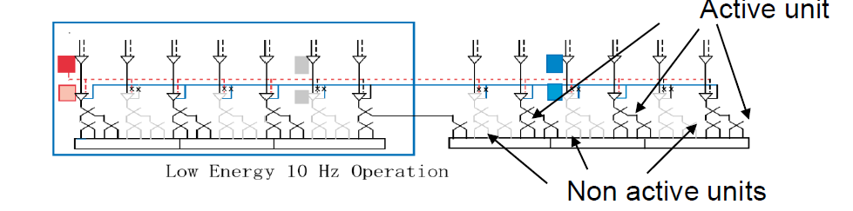
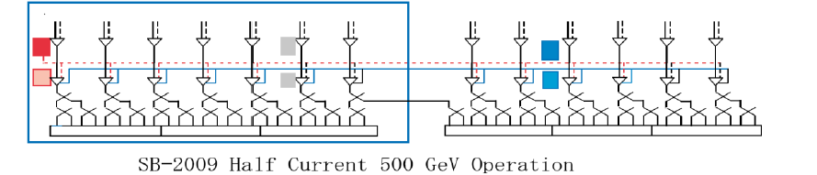
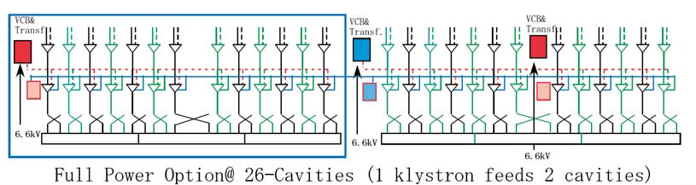
3 operation mode (Low Energy 10Hz, SB2009 and Full scheme) and DRFS Layout (and the pass to 1 TeV)
(1) Low energy 10Hz operation: 250GeV, 4.5mA, 10Hz
All units have a capability of 2.3ms pulse width, 10Hz.
Facility requires 144% power capability.
Numbers of active klystrons are 50% to 70% depending on the sorted kly. group.
(2) Reduced bunch operation: 500GeV, 4.5mA, 5Hz
All units have a
capability of 2.3ms
pulse width, 5Hz.
Facility requires 144%
power capability.
Numbers of active
klystrons are same in
sorted kly. group.
Same units
KEK Fukuda
(3) Full energy operation: 500GeV, 9mA, 5Hz
Increase units
Old units have same
capability, and new
units with 1.8ms pulse
width.
Facility for new units
requires 113%
power capability.
2011/9/28

Slide 3
DRFS is still applicable to 1 TeV?
Power Calculation
 | Current |  | 9 | mA
 | Electric Field |  | 45 | MV/m
 | Length |  | 1.0377 | m
 | Power Required |  |  |  | 420.3 | kW
 | 2 cavities tota |  |  |  | 840.5 | kW
 | Margin or overhead |  | 20 | % | 1050.7 | kW
 | RF eff |  | 99.990 | % | 1050.8 | kW
 | Required Pulse Width |  |  |  | 1.94 | ms
 | Required Kly Voltage |  |  |  | 73 | kV
Simple Power Consideration
For the case of 9mA, 45MV/m,
if 2 cavity feed scheme is used,
applied voltage for DRFS klystron
needs 73kV.
If using current scheme of DRFS,
73 kV is not desirable.
For the lower beam than 9mA,
peak power requirement pass the
current specification. But more
wider pulse width is required.
This affects to the specification of
constructed linac RF section.
Power Calculation
 | Current |  | 4.5 | mA
 | Electric Field |  | 45 | MV/m
 | Length |  | 1.0377 | m
 | Power Required |  |  |  | 210.1 | kW
 | 2 cavities total |  |  |  | 420.3 | kW
 | Margin or overhead |  | 20 | % | 525.3 | kW
 | RF eff |  | 99.990 | % | 525.4 | kW
 | Required Pulse Width |  |  |  | 2.55 | ms
Power Calculation
 | Current |  | 6 | mA
 | Electric Field |  | 45 | MV/m
 | Length |  | 1.0377 | m
 | Power Required |  |  |  | 280.2 | kW
 | 2 cavities total |  |  |  | 560.4 | kW
 | Margin or overhead |  | 20 | % | 700.4 | kW
 | RF eff |  | 99.990 | % | 700.5 | kW
 | Required Pulse Width |  |  |  | 2.27 | ms

Slide 4
DRFS is still applicable to 1 TeV?(II)
For 9mA, 45MV/m
  More 70 kV is not desirable for MA klystron due to the high-voltage supply cable. One possibly is to use Marx modulator.
  It is necessary to develop new klystron, but it is not difficult.
For lower current case
  Need the longer pulse, which is roughly the same as the case of low current option (SB2009), but in full scheme, longer pulse P/S is not used and cost-up factor. We should check the feasibility for pulse sag compensation among bouncer, another circuit and Marx modulator.

Slide 5
DRFS is still applicable to 1 TeV?(III)
More careful consideration:
Similar situation such as cavity gradient variation and degradation problem, which affect to more higher applied voltage and power. 9mA case faces to more higher request.
Cost is not considered in this presentation

Slide 6
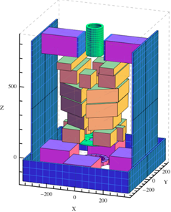
Technical Progress (Klystron R&D Issues)
Basic Klystron Design was OK
( output power, operation experiment).
  Main R&D Issues:
  Power up is straigh forward
  Permanent magnet focusing
  Collaboration with Kyoto University (Dr. Iwashita)
Permanent magnet using Ferrite material is progressed
and FY11 budget is approved. Full model and operation
will be done in 2011. This will be expected to be included
in TDR. Cost evaluation is also done.
  Complete new
  design ic necessary.
Saturated rf power
Efficiency
Cathode voltage

Slide 7
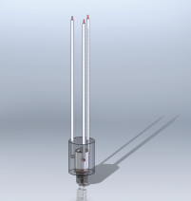
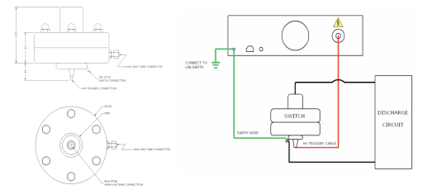
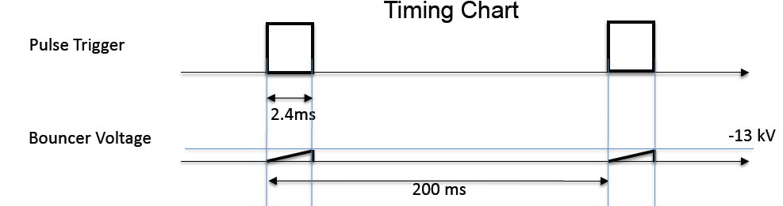
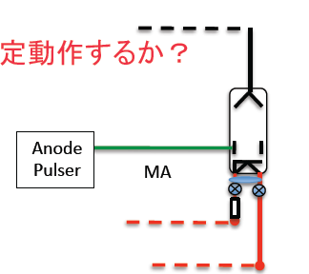
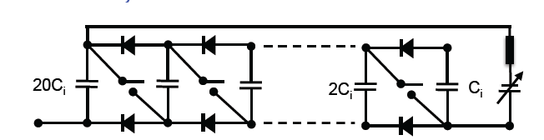
Technical Progress (Modulator/PS)
Main R&D Issues: Items which are not included in S1-global:
  Bouncer circuits with adjustable pulse shape (for seeking smaller bouncer)
    Switching PS Bouncer
    Marx-type Bouncer
    Modulation anode pulser
    with sag compensation
  Instead of MA Klystron,
  diode and marx modulator
  (need cost comparison )
High voltage relay
Spark-gap for crowbar
2011/9/29
7

