Slide 1
Status of the photon collimator studies for the ILC e⁺ source
O. S. Adeyemi¹, V. Kovalenko¹, G. Moortgat-Pick^{1;2}
S. Riemann², F. Staufenbiel², A. Ushakov¹
¹University of Hamburg
²DESY
- modelling a positron target and collimator system for the ILC accelerator
- temperature simulations in a photon collimator system
- time dependent simulations for the collimator system with ANSYS software
- conclusion

Slide 2
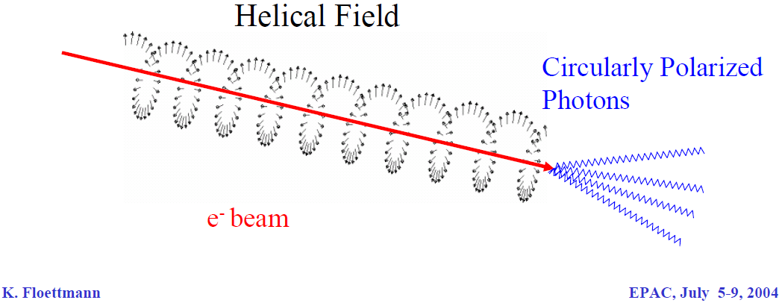
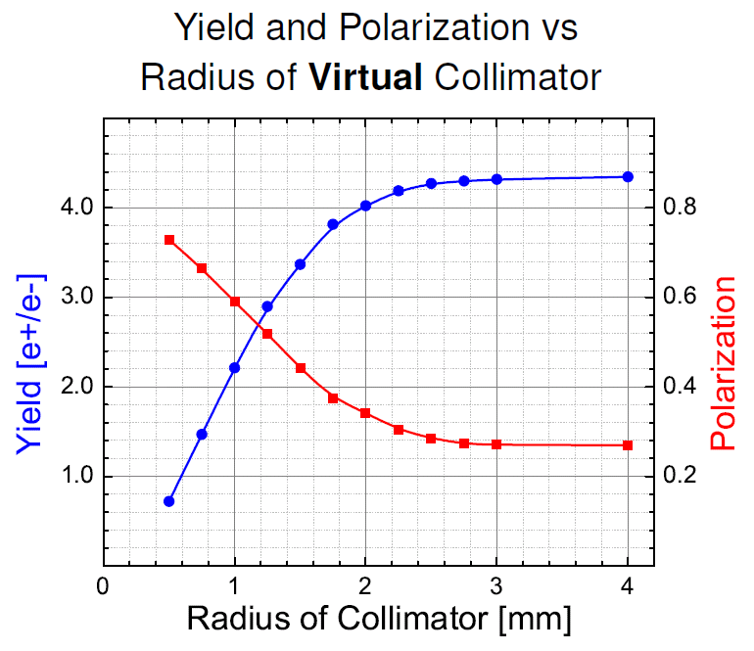
polarised positron production
collimator
 | Pe+ | Yield [e+/e-]
no collimator | 27 % | 4.4 (100%)
2 mm | 35 % | 4.0 (91%)
1.4 mm | 47 % | 3.2 (73%)
1.0 mm | 60 % | 2.2 (50%)

Slide 3
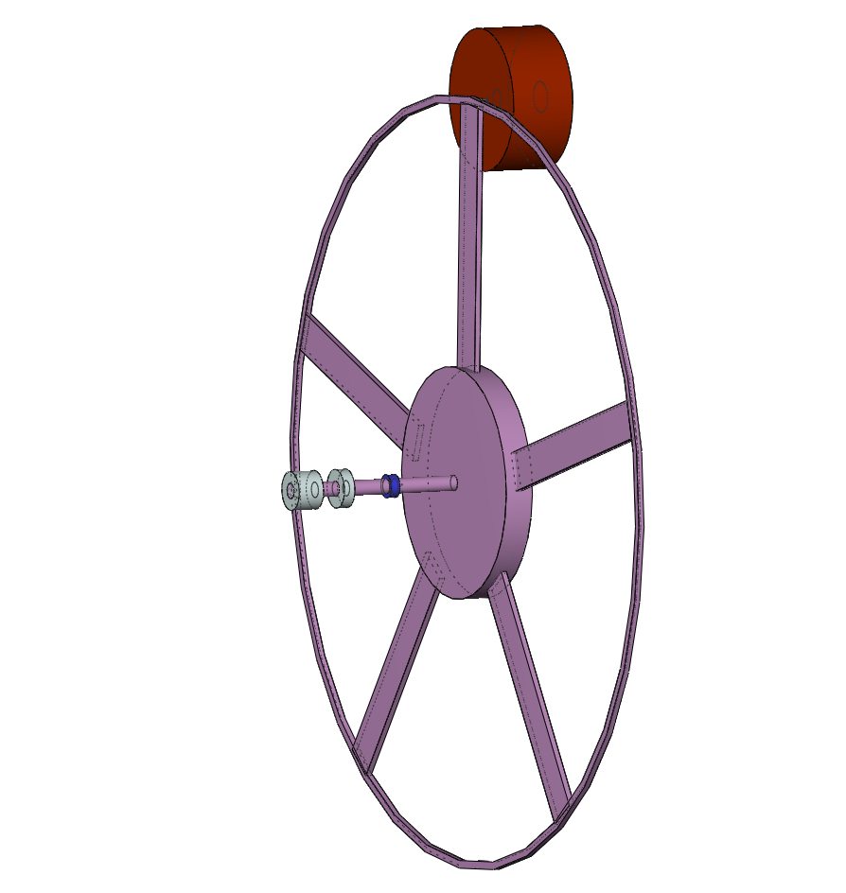
modelling the ILC-target unit
2*10¹⁰ e⁻ / bunch = 3.2 nC / bunch
2625 bunch / train (0.97ms) = 2.7052 MHz repetition rate
5 train / s
-> 4.6*10¹⁵ photon / train
Titan target for polarised positron production
~ 14.4 MeV e⁺
250 GeV e⁻
~ 28.8 MeV photon beam
helical undulator
distribution of
heat load !!
v_{rim} = 100 m/s
( 955 rpm = 15.9Hz )
r
r = 1 m

Slide 4
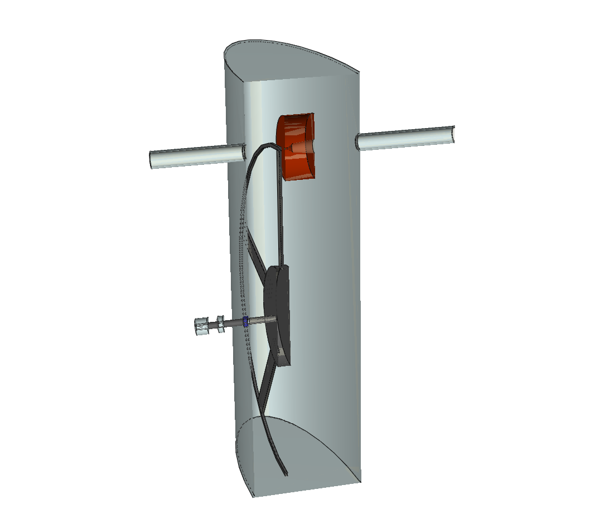
modelling the ILC-target unit
flux concentrator
beam pipe
~ 28.8 MeV photon beam
bearing
chamber
motor
d₁ = 1.0 cm , l₁ = 5.0 cm
d₂ = 5.0 cm , l₂ = 3.0 cm
d₃ = 8.0 cm , l₃ = 12.5 cm
vacuum seal

Slide 5
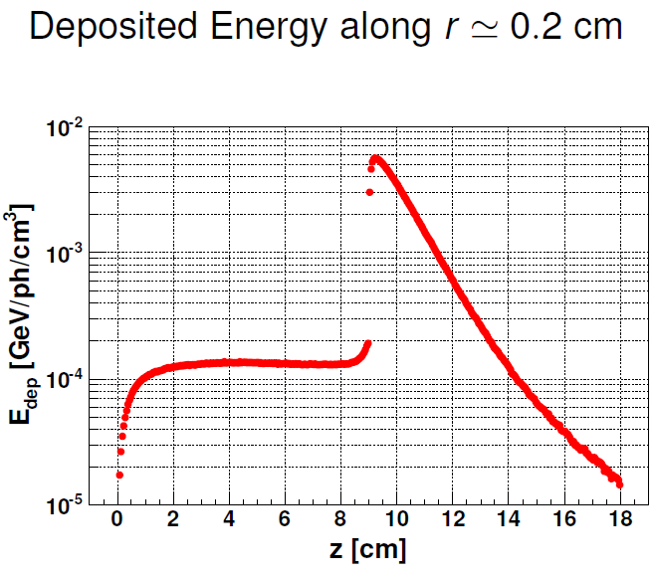
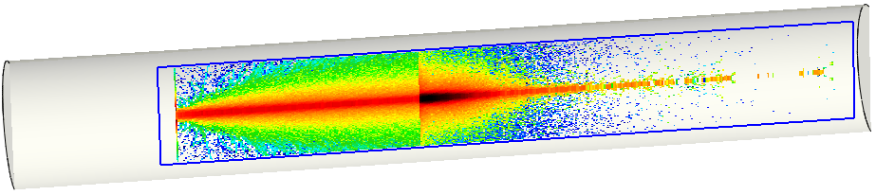
flux concentrator
Δ Q
~
beam pipe
T_{W} = 1800 K / train
m c_{v}
~
C W
collimator
~ 28.8 MeV photon beam
r = 0.1 cm -> _____ K / train
14 000
???
this is to much !!
bearing
chamber
motor
vacuum seal

Slide 6
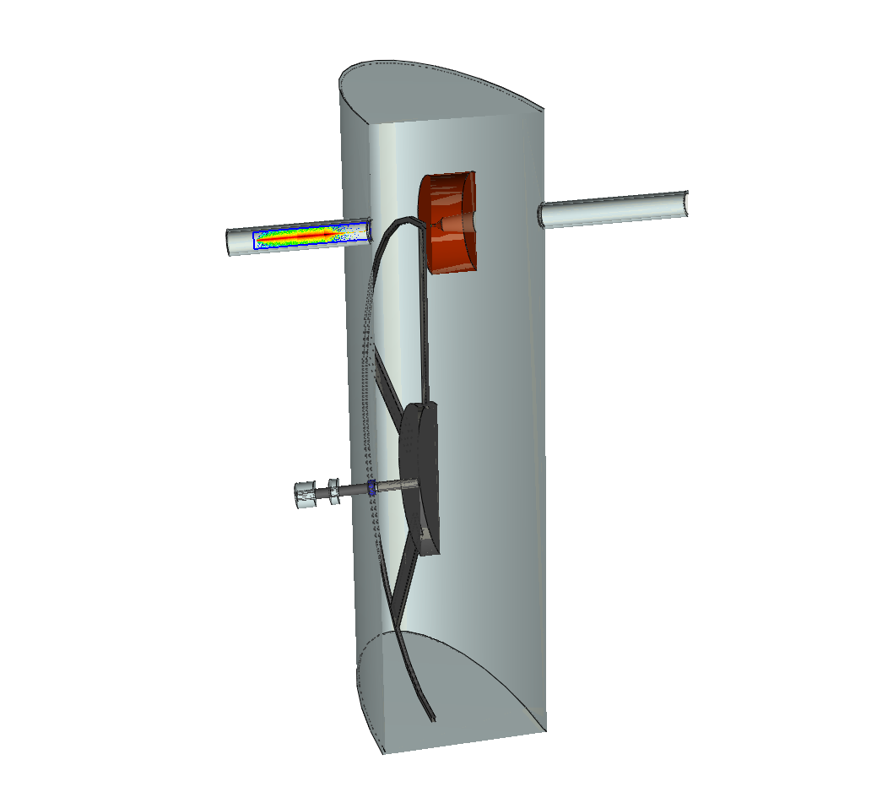
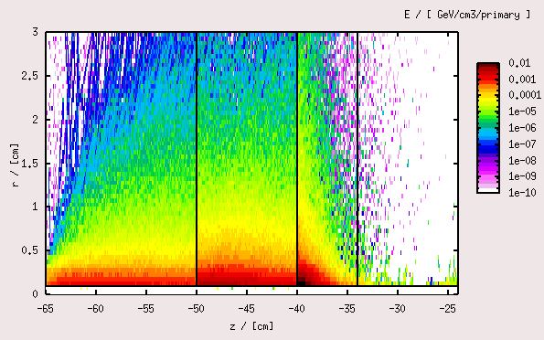
modelling the collimator
C Ti W
r = 0.1 cm
~
Δ T_{C} 500 K / train
~
~
Δ T_{Ti} 1300 K / train
~
~
Δ T_{W} 3600 K / train
~
but this is still to much !!

Slide 7

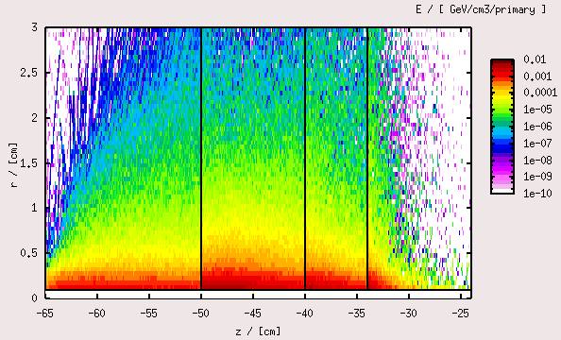
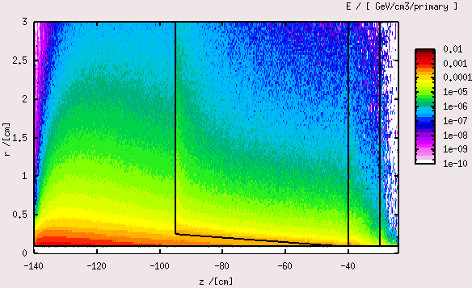
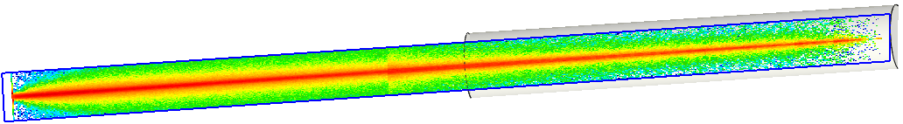
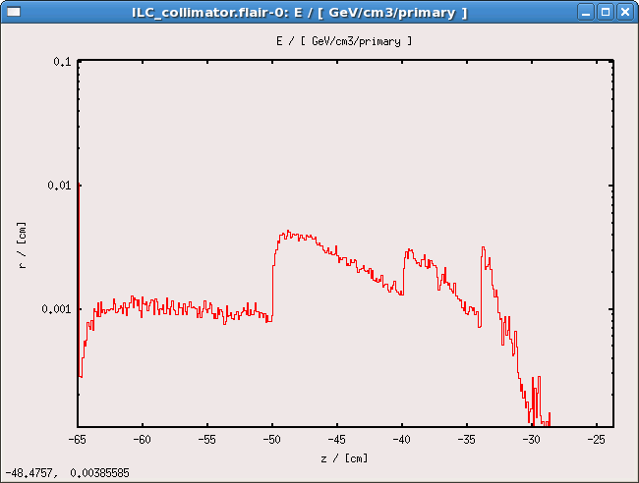
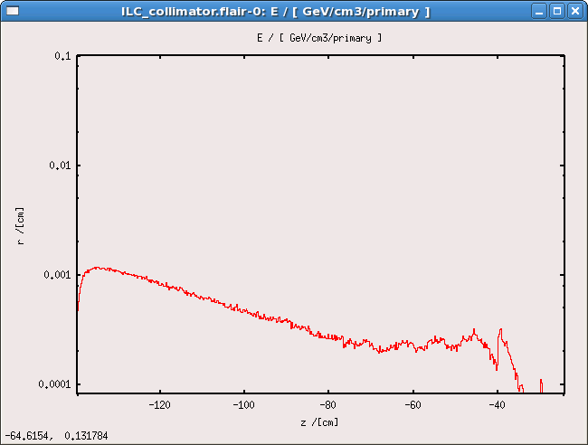
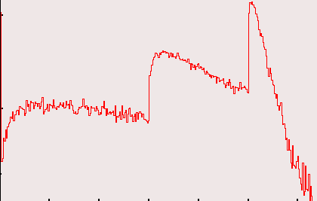
modelling the collimator
C Ti Fe W
C Ti Fe W
C Ti W
r = 0.1 cm
~
z = 1.2 m
Δ T_{C} 500 K / train
~
~
-> 40 K / train
Δ T_{Ti} 1300 K / train
~
~
-> 40 K / train
Δ T_{Fe} 600 K / train
~
~
-> 20 K / train
Δ T_{W} 900 K / train
~
~
Δ T_{W} 3600 K / train
~

Slide 8
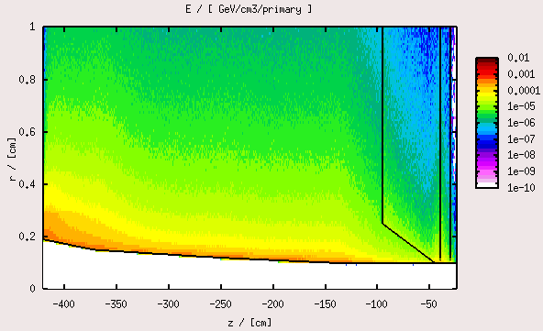
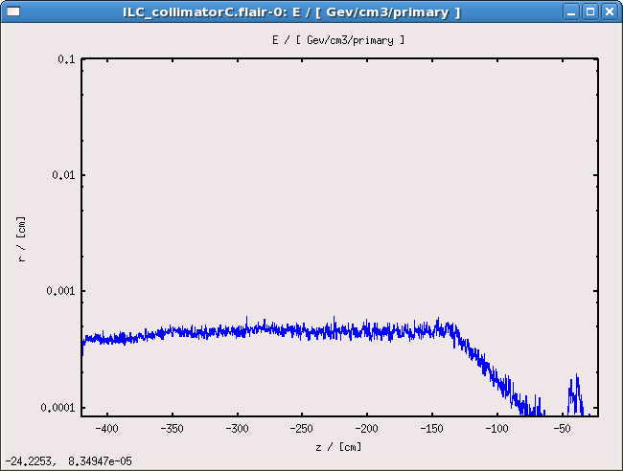
modelling the collimator
C Ti
r = 0.1 cm
~
-> 200 K / train
z = 1.2 m
Δ T_{C} 500 K / train
~
~
-> 40 K / train
z = 4.0 m
Δ T_{Ti} 1300 K / train
~
~
-> 40 K / train
Δ T_{Fe} 600 K / train
~
~
-> 20 K / train
Δ T_{W} 900 K / train
~

Slide 9
modelling the collimator
300K
l = r – r₀
C Ti Fe W
r = 0.1 cm
800K
z = 1.2 m
~
Δ T_{C} 500 K / train
~
~
-> 40 K / train
Δ T_{Ti} 1300 K / train
~
~
-> 40 K / train
Δ T_{Fe} 600 K / train
~
~
-> 20 K / train
Δ T_{W} 900 K / train
~
.
λ_{C} A ΔT
Q_{C} =
l
λ : heat conduction coefficient [W/m/K]
A_{zyl} : mean girthed area of the collimator [m²]
l : heat conduction path length [m]
ΔT : difference in temperature [K]
.
Q : heat current

Slide 10
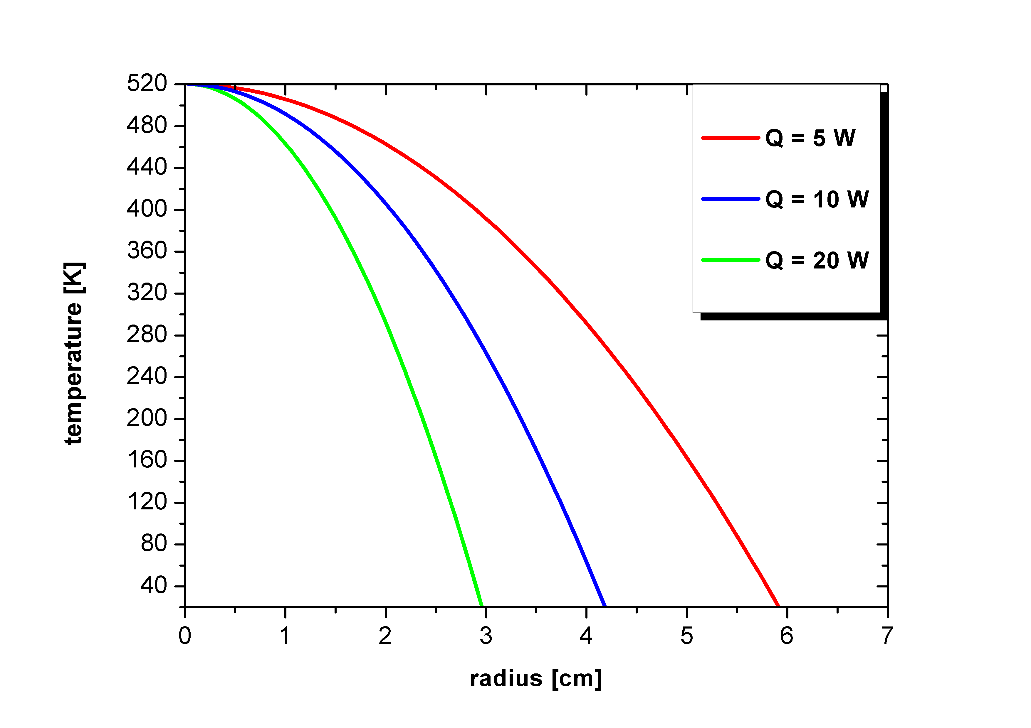
modelling the collimator
z = 1.0 cm
.
.
.
r = 0.1 cm
.
λ_{C} A ΔT
zyl.
λ_{C} 2π ( r-r₀ ) z ΔT
Q_{C} =
l
=
ln( r / r₀ )
λ : heat conduction coefficient [W/m/K]
A_{zyl} : mean girthed area of the collimator [m²]
l : heat conduction path length [m]
ΔT : difference in temperature [K]
.
Q : heat current

Slide 11
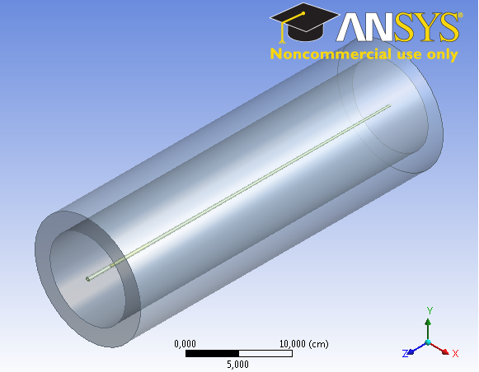
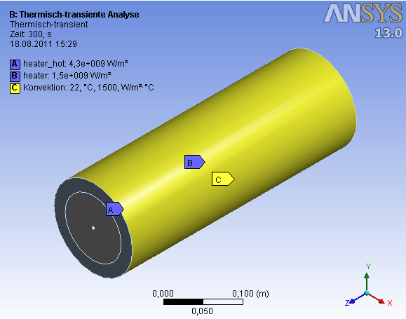
time dependent simulations with computer aided engineering software

Slide 12
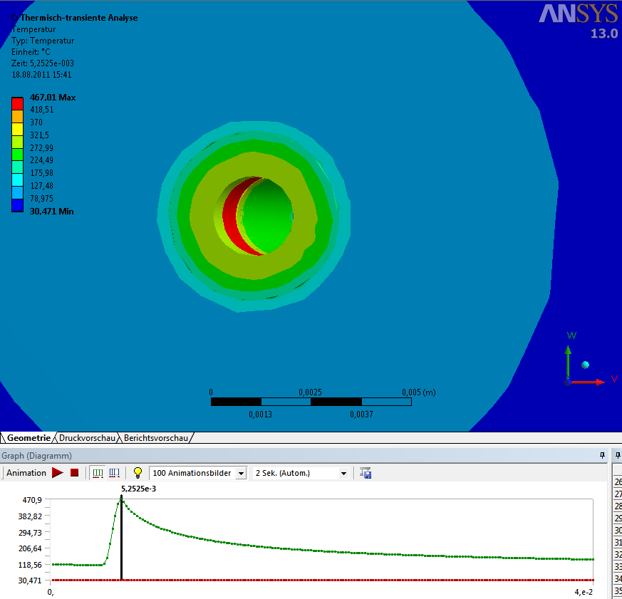
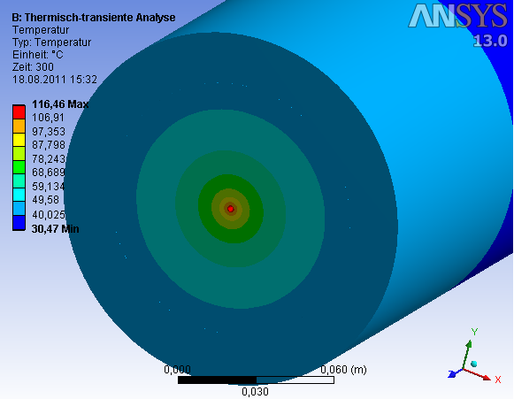
time dependent simulations with computer aided engineering software
C Ti

Slide 13
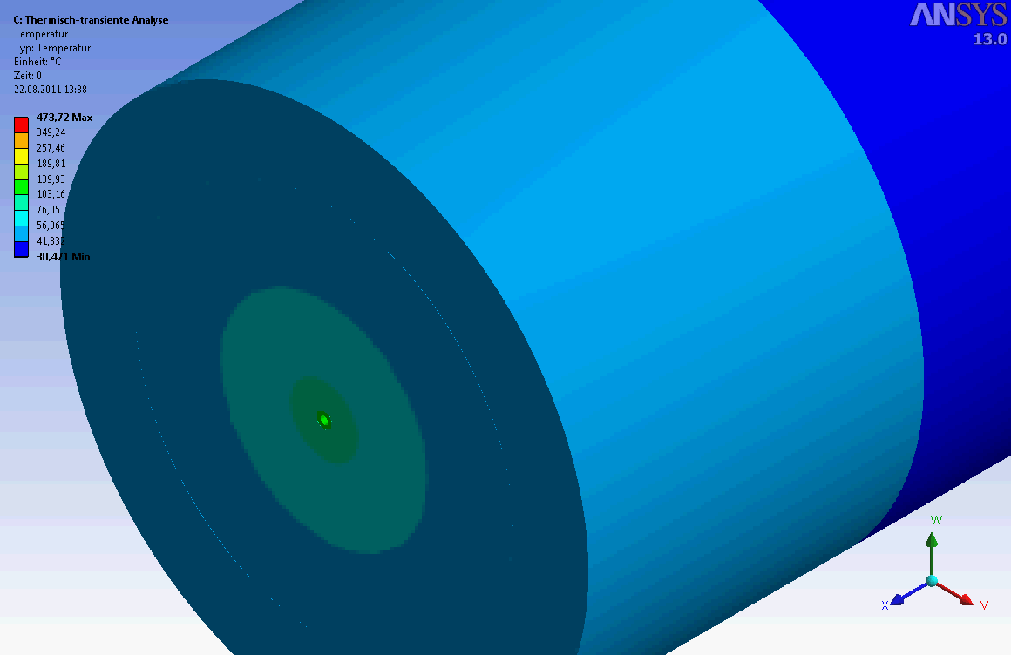
time dependent simulations with computer aided engineering software

Slide 14
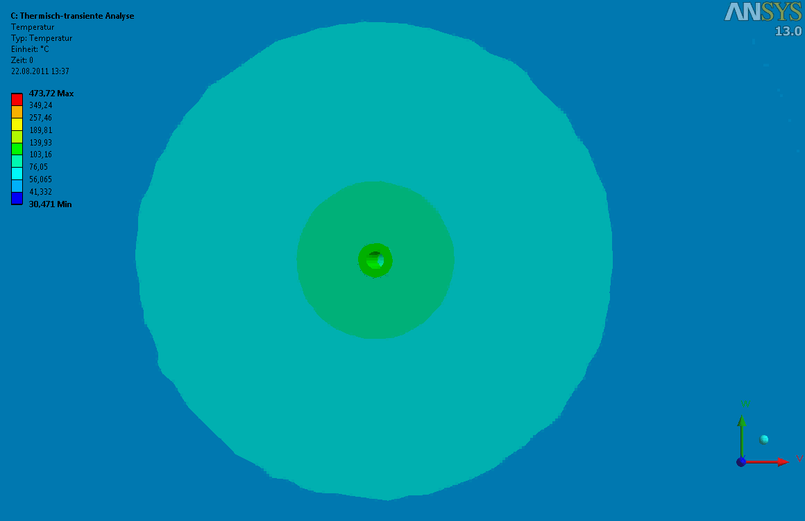
time dependent simulations with computer aided engineering software

Slide 15
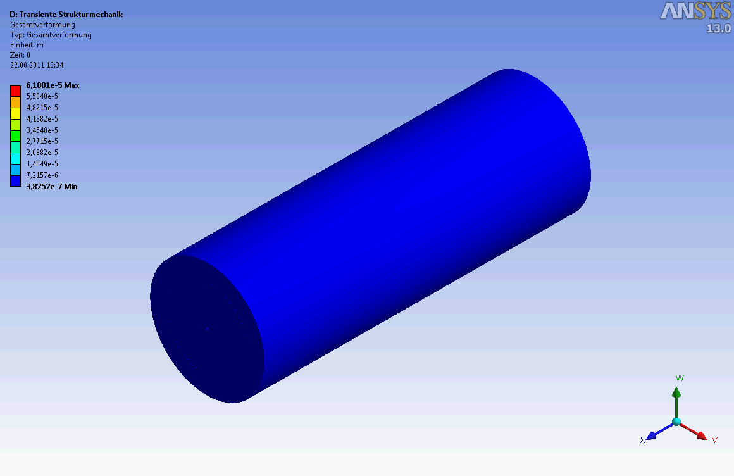
time dependent simulations with computer aided engineering software

Slide 16
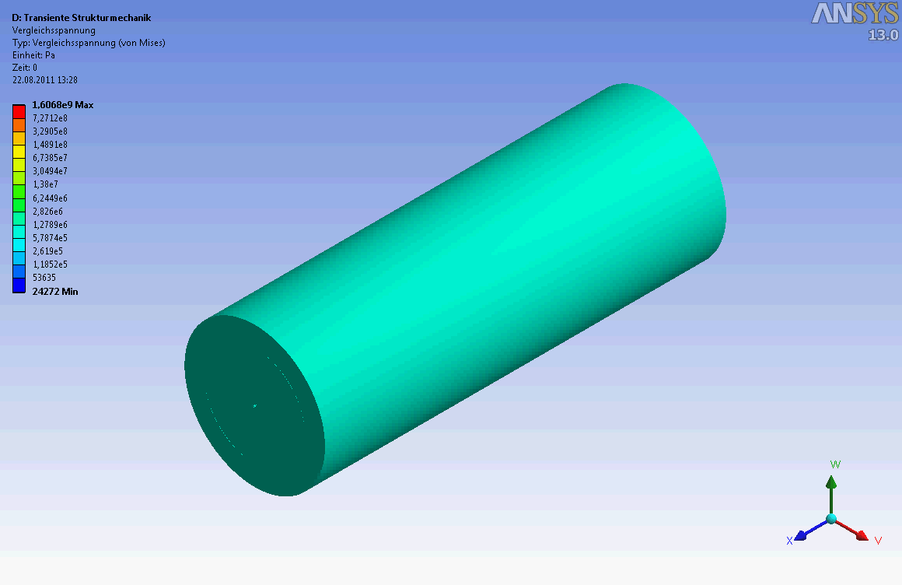
time dependent simulations with computer aided engineering software

Slide 17
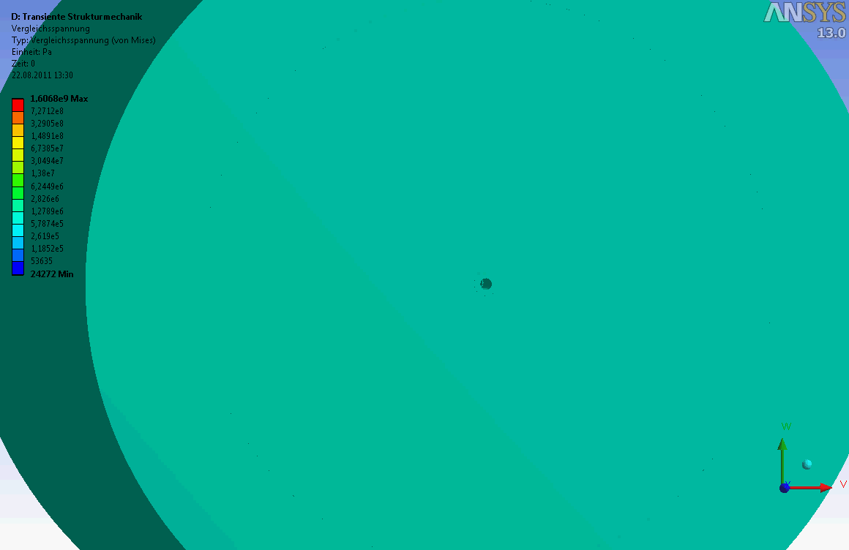
time dependent simulations with computer aided engineering software

Slide 18
jitter of e⁻ beam can overload the collimator
 | Pe+ | Yield [e+/e-]
no collimator | 27 % | 4.4 (100%)
2 mm | 35 % | 4.0 (91%)
1.4 mm | 47 % | 3.2 (73%)
1.0 mm | 60 % | 2.2 (50%)

Slide 19
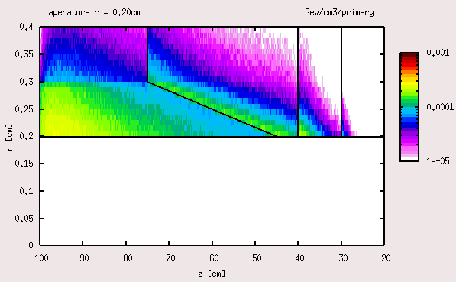
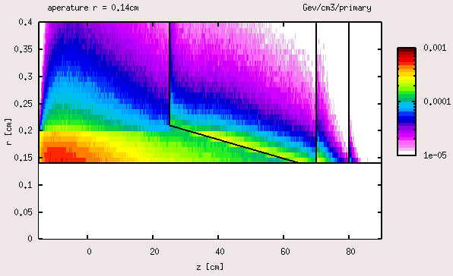
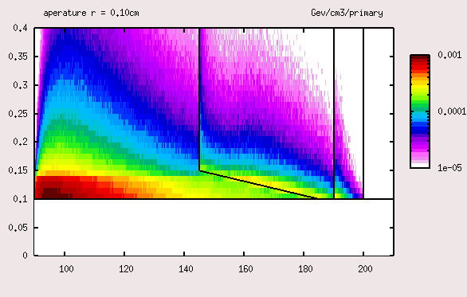
chained collimators
ΔT = 120K
ΔT = 240K
ΔT = 440K
 | Pe+ | Yield [e+/e-]
no collimator | 27 % | 4.4 (100%)
2 mm | 35 % | 4.0 (91%)
1.4 mm | 47 % | 3.2 (73%)
1.0 mm | 60 % | 2.2 (50%)
z_{coll} = 120cm + 145cm + 160cm = 425cm

Slide 20
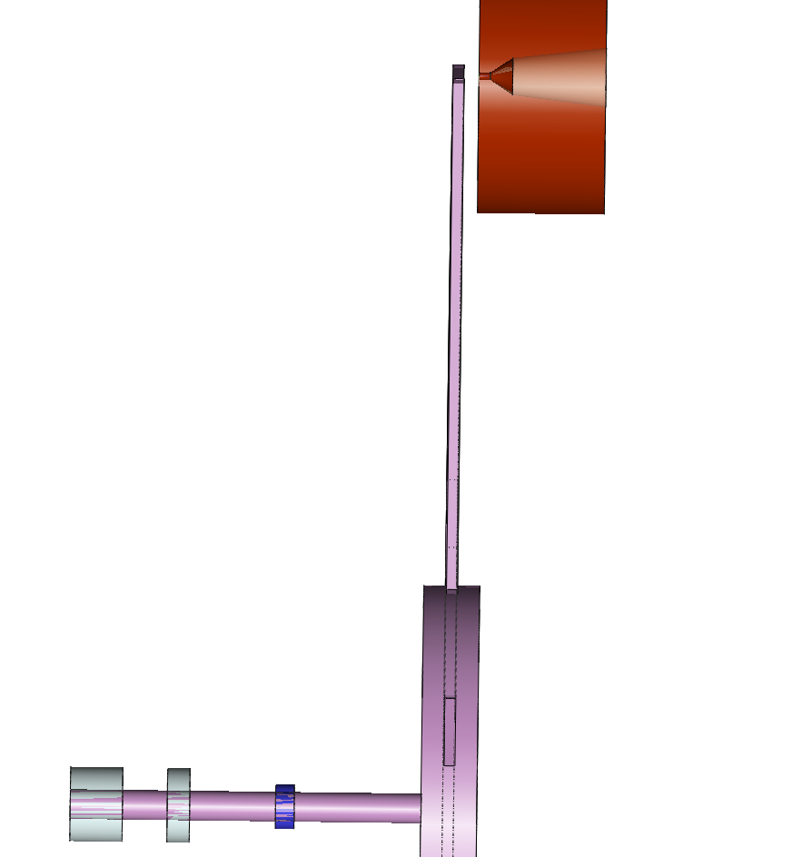
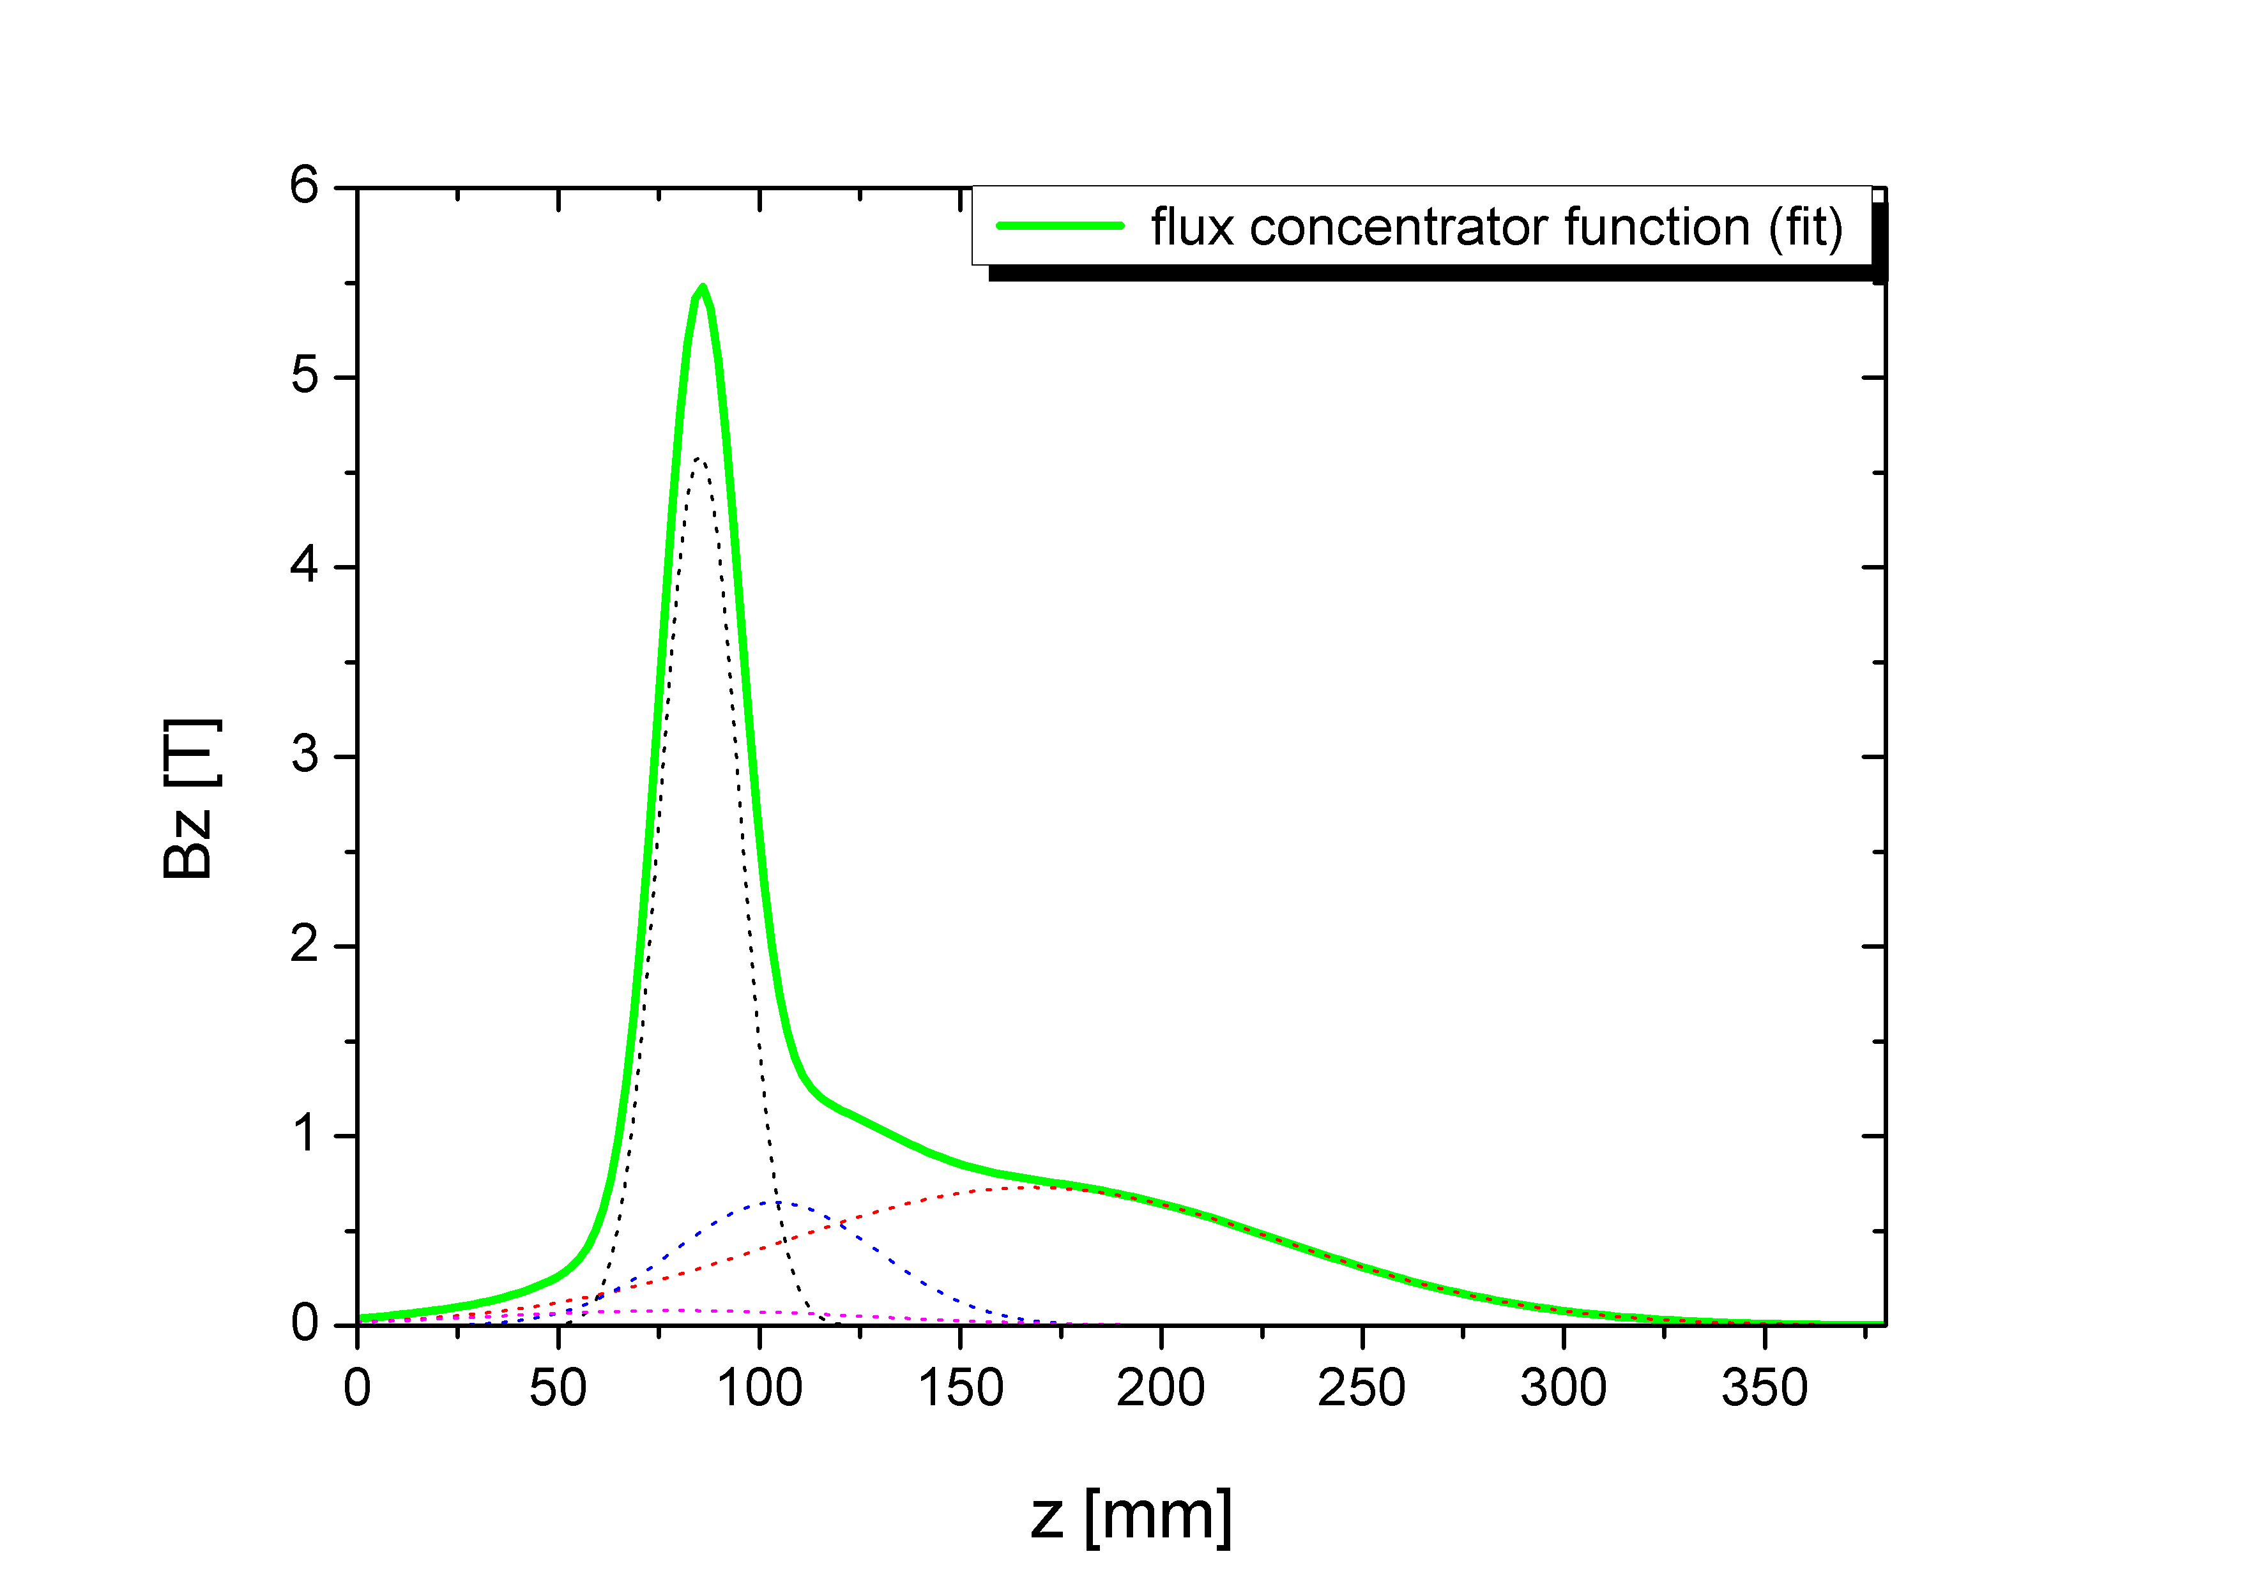
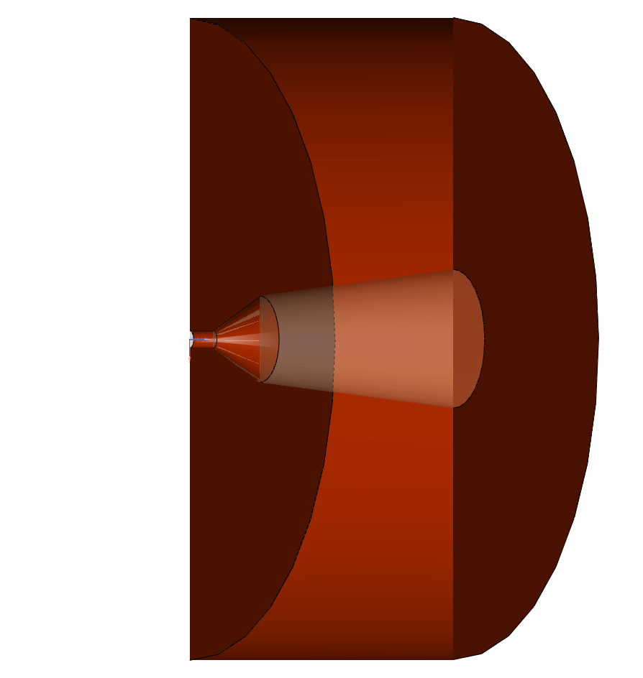
modelling the flux concentrator
2.0 cm
m
b
s
l₁
a b c d
d₁
d₂
d₃
l₂
l₃
d₁ = 1.0 cm , l₁ = 5.0 cm
d₂ = 5.0 cm , l₂ = 3.0 cm
d₃ = 8.0 cm , l₃ = 12.5 cm

Slide 21
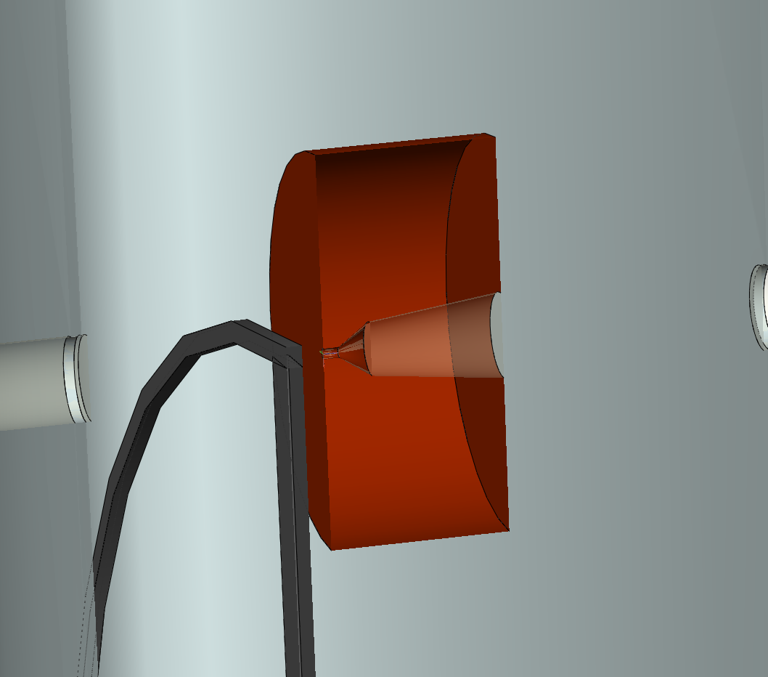
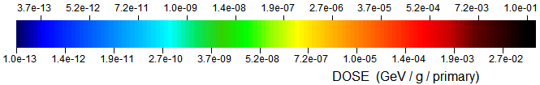
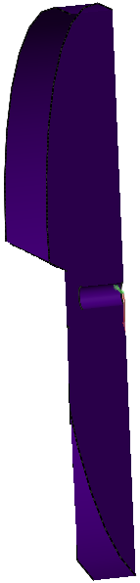
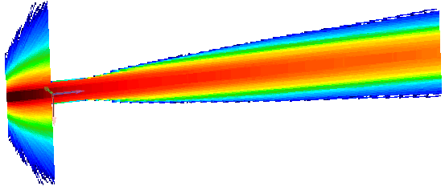

~ 130 K / train
|
2.0 cm
-
POSITRON beam
Q_{Ti target}
~
6 (x 52.5)kW / train
~
1.5 cm
v_{rim} = 100 m/s
-> 50 pulses hits in
the same position
tungsten collimator
for flux concentrator

Slide 22
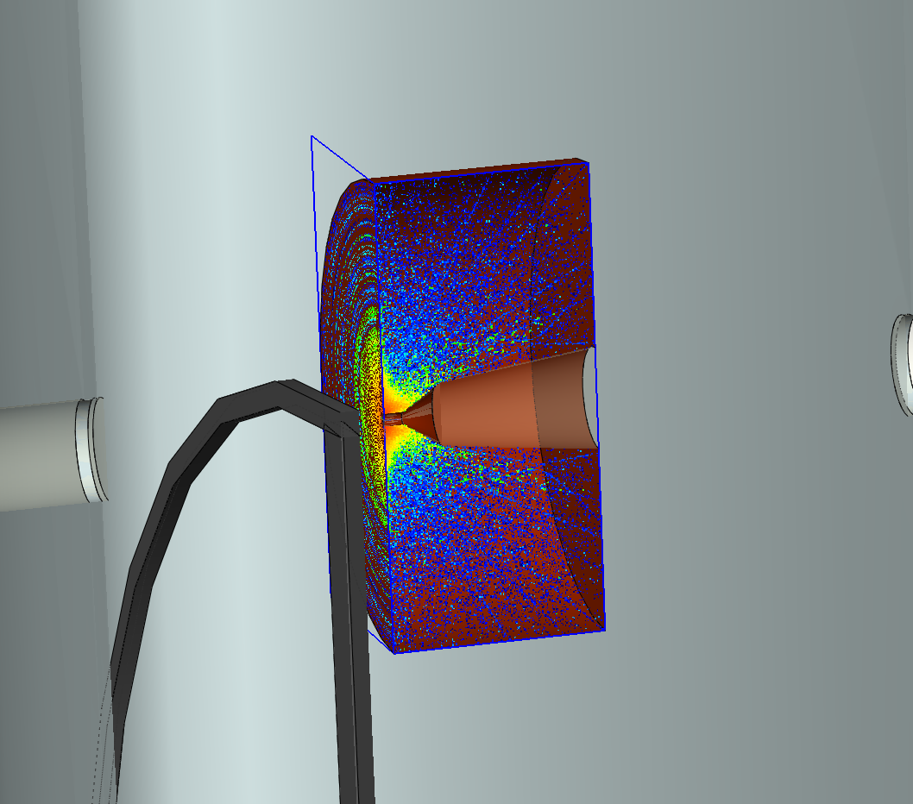
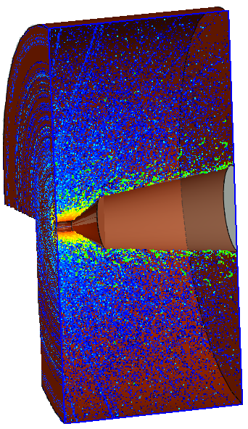
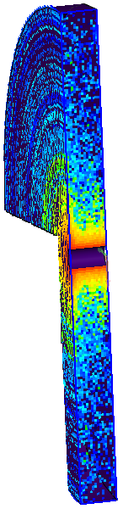
~ 50 K / train
|
~ 80 K / train
|
~ 320 K / train
|
flux concentrator
-
Q_{Ti target}
~
6 (x 52.5)kW / train
~
-
Q_{W colli}
~
115 kW / train
~
-
Q_{flux con+W}
~
20 kW / train
tungsten collimator
for flux concentrator
~
-
Q_{flux con-W}
~
100 kW / train
~

Slide 23
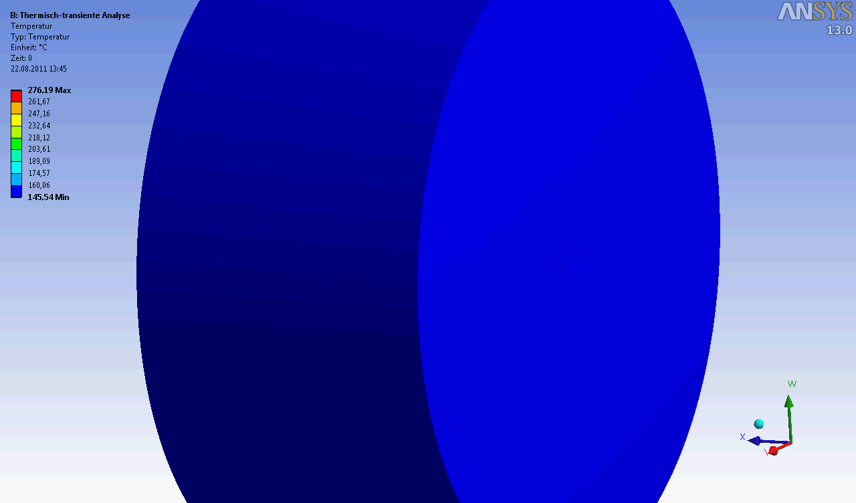
time dependent simulations with computer aided engineering software

Slide 24
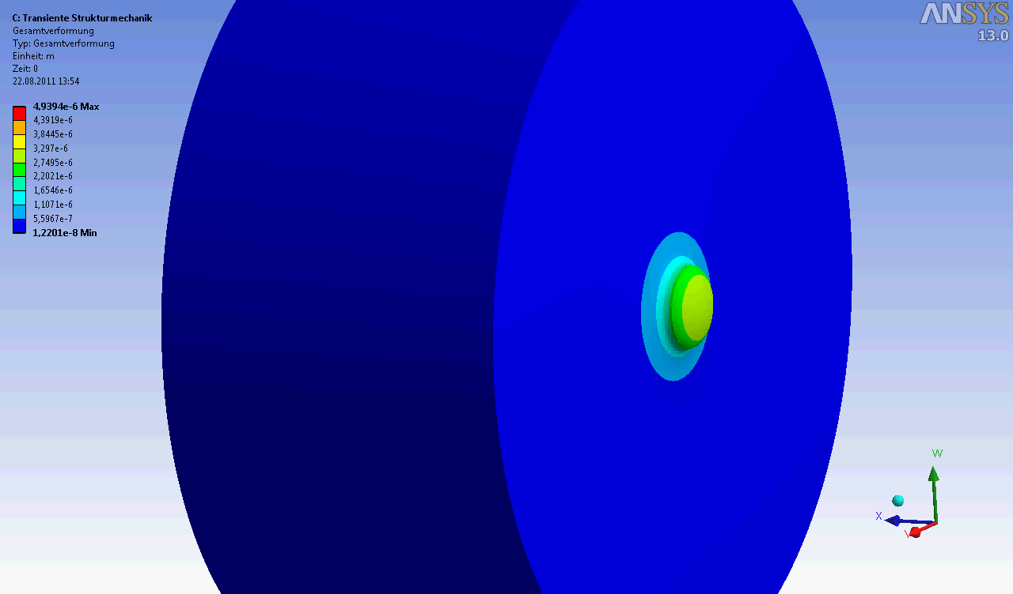
time dependent simulations with computer aided engineering software

Slide 25
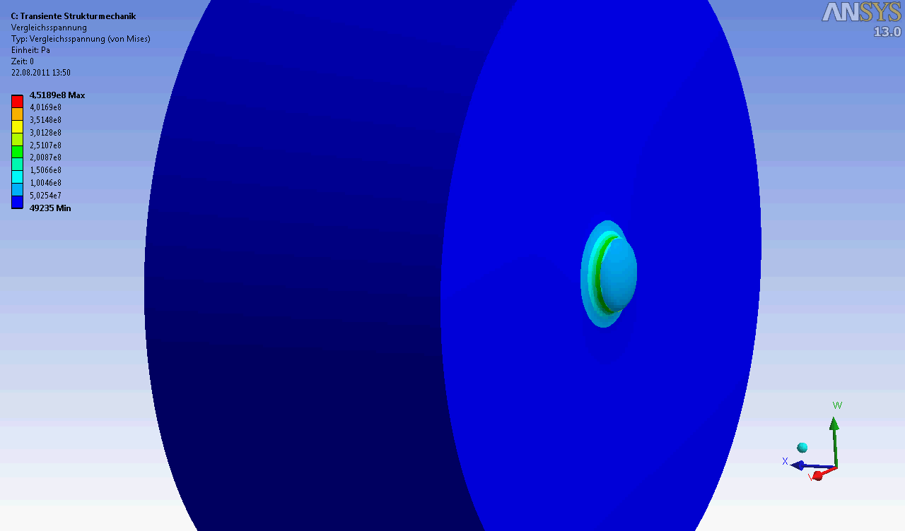
time dependent simulations with computer aided engineering software

Slide 26
conclusion
- heat loads (temperatures) for different collimator designs are simulated
-> collimator design is improved to withstand the heat load
->
C Ti W
C Ti Fe W
->
C Ti Fe W

Slide 27
conclusion
- heat loads (temperatures) for different collimator designs are simulated
-> collimator design is improved to withstand the heat load
- time dependent heat and structural loads are simulated with ANSYS software
graphite collimator | simulation | theoretical _{max}
temperature | 800 K | ~ 4000 K
deformation | 45 μm | -
stress | 10 MPa | 20-70 MPa

Slide 28
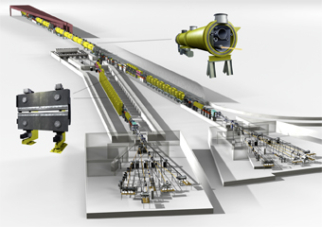
conclusion
- heat loads (temperatures) for different collimator designs are simulated
-> collimator design is improved to withstand the heat load
- time dependent heat and structural loads are simulated with ANSYS software
graphite collimator | simulation | theoretical _{max}
temperature | 800 K | ~ 4000 K
deformation | 45 μm | -
stress | 10 MPa | 20-70 MPa
- what is now to do ?
-> a experimental setup for shock wave studies have to developed @ DESY/FLASH

Slide 29
end of show
 | α [10⁻⁶m/K] | E [GPa] Young modulus | ν Poisson ratio | G [GPa] Shear modulus | R [MPa] Yield strength
Ti 6Al 4V | 9 | 114 | 0.34 | 41 | 924
graphite | 6 - 40 | 10 - 30 | 0.25 | - | 20 - 70
iron | 12 | 196 | 0.25 | 80 | 500
tungsten | 4.5 | 406 | - | - | 1200
copper | 17 | 124 | 0.34 | 47 | 200

