Slide 1
L-band power sources for drive beam
E. Jensen, CERN

Slide 2
CLIC scheme at 3 TeV
11 GW
11 GW
326 klystrons
33 MW, 139 μs
326 klystrons
33 MW, 139 μs
drive beam accelerator
2.38 GeV, 1.0 GHz
combiner rings
Circumferences
delay loop 72.4 m
CR1 144.8 m
CR2 434.3 m
drive beam accelerator
2.38 GeV, 1.0 GHz
1 km
1 km
delay
loop
delay
loop
CR2
CR2
CR1
CR1
decelerator, 24 sectors of 878 m
BC2
BDS
2.75 km
BDS
2.75 km
BC2
245m
IP
e⁺ main linac
245m
TA
R=120m
e⁻ main linac , 12 GHz, 100 MV/m, 21.1 km
TA
R=120m
48.4 km
booster linac,
9 GeV
e⁺ injector,
0.2 GeV
e⁺ DR
365m
e⁺ PDR
365m
BC1
e⁻ DR
365m
e⁻ PDR
365m
linac,
2.2 GeV
e⁻ injector,
0.2 GeV

Slide 3
CLIC 3 TeV
1/’cosφ_{i}’
650 MVA
+5% network losses
622 MW
‘wall plug’
594 MW
337 MW
266 MW
Modulator
η_{K} = 0.65
η_{MOD} = 0.9
η_{rise} = 0.875
MB+DB production & transport,
services, infrastructure
and detector
Power supplies
klystrons
173.0 MW
256 MW
Drive beam
acceleration
η_{Klys→ struct→beam} = .86
cosφ_{s} = .94
Wall plug | 100%
To DB-RF | 57%
To DECEL | 41%
To PETS_out | 73%
To Main Beam | 28%
Overall η | 4.7%
140 MW
23.8 MW
F(σ) = .97 × .96
η_{D} = .84
Drive beam
power extr.
Dumps
109 MW
η_{TRS} = .98
PETS
η_{T} = .96
102 MW
(2 x 101 kJ x 50 Hz)
From B. Jeanneret – PRELIMINARY!
Main
linac
η_{RF} = .277
28 MW
Main beam

Slide 4
CLIC power consumption
Anticipating from B. Jeanneret’s talk later today, the actual numbers are:
  CLIC 3 TeV: 582 MW
  CLIC 1.5 TeV: 361 MW
  CLIC 0.5 TeV: 271 MW
I think: This is too high!
What can we do about it?

Slide 5
CLIC power generation scheme
Drive Beam Accelerator
efficient acceleration in fully loaded linac
Delay loop × 2
gap creation, pulse compression & frequency multiplication
Transverse RF Deflectors
Combiner ring × 3
pulse compression &
frequency multiplication
Combiner ring × 4
pulse compression &
frequency multiplication
Drive Beam Decelerator Sector (24 in total)
Power Extraction
Drive beam time structure - initial
Drive beam time structure - final
240 ns
240 ns
5.8 μs
140 μs total length - 24 × 24 sub-pulses - 4.2 A
2.4 GeV - 60 cm between bunches
24 pulses – 100 A – 2.5 cm between bunches

Slide 6
Full beam-loading acceleration
RF in
No
RF to load
No beam
High current
beam
“short” structure - low Ohmic losses
most of RF power
(≥ 95%) to the beam

Slide 7
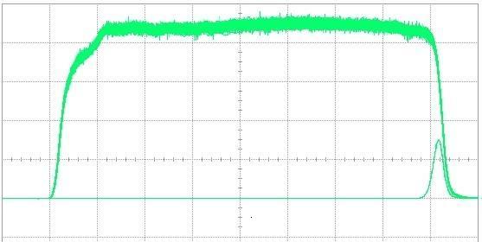
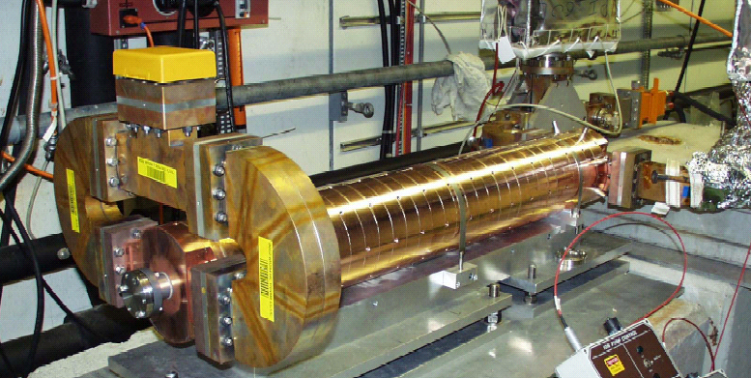
Full beam-loading acceleration
3 GHz 2π/3 TW constant aperture
Slotted-iris damping + detuning with nose cones
Up to 4 A – 1.4 μs beam pulse accelerated – no sign of BBU
RF pulse at structure input
1.5 µs beam pulse
RF pulse at structure output
analog signal
Measured RF-to-beam efficiency
95.3 %
Theory
96% (~ 4 % ohmic losses)
At 1 GHz, this will be even higher!

Slide 8

Optimum aperture found!
η_{RF} ≥ 97.5 %
|t_{fill} – 245 ns| ≤ 5 ns
P_{in} = 15 MW
Beam dynamic (Avni Aksoy):
R_{B} = 49 mm,
N = 19 cells
Rolf Wegner

Slide 9
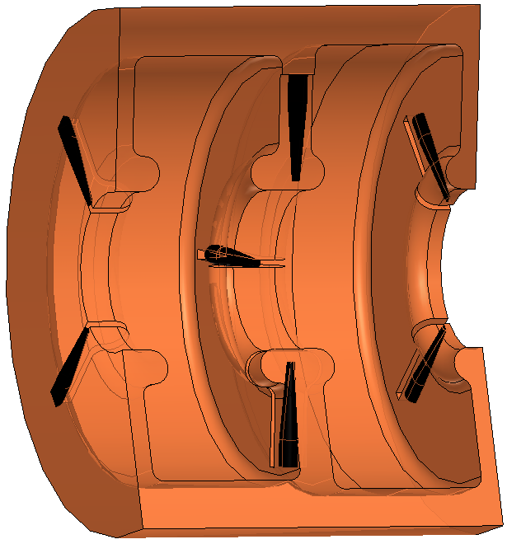
Damping and detuning
Reduction of transverse wakefields by damping and detuning
Alexej Grudiev’s idea:
dampers in web (~18 mm tick)
acc. mode
Q₀= 2.2 ∙10⁴, Q_{ext}= 3.7∙10⁷
distorted, 0.1° <=> 0.1 mm @ nose
Q_{ext}= 1.5 ∙10⁶
P_{ext,peak}= 110 W, P_{ext,avg}= 0.83 W
Ø≈ 250 mm
Rolf Wegner

Slide 10
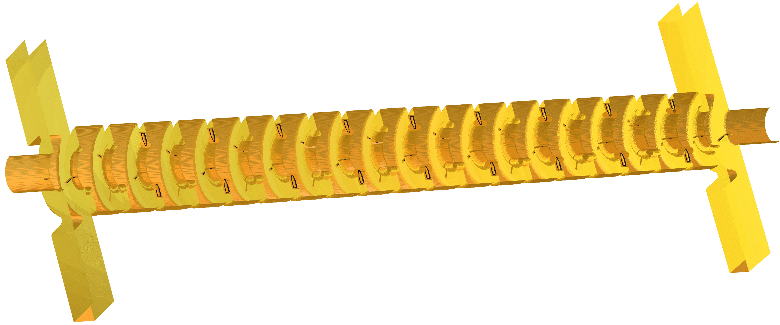
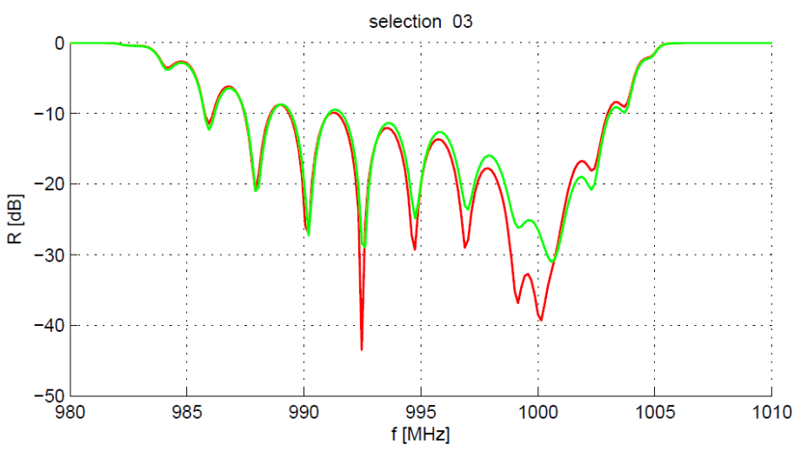
SICA: Slotted Iris – Constant Aperture
input
output
nose cones
SiC dampers
beam
Rolf Wegner

Slide 11
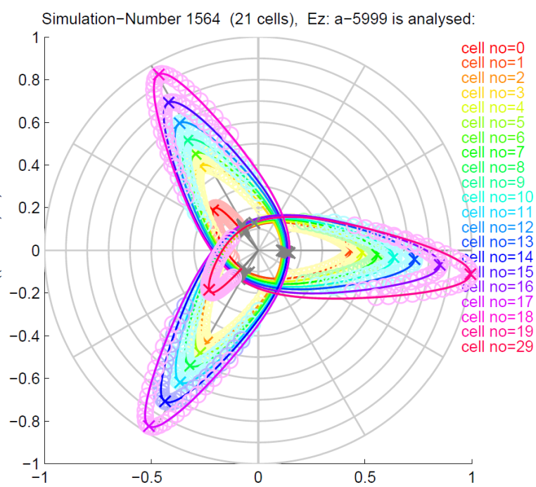
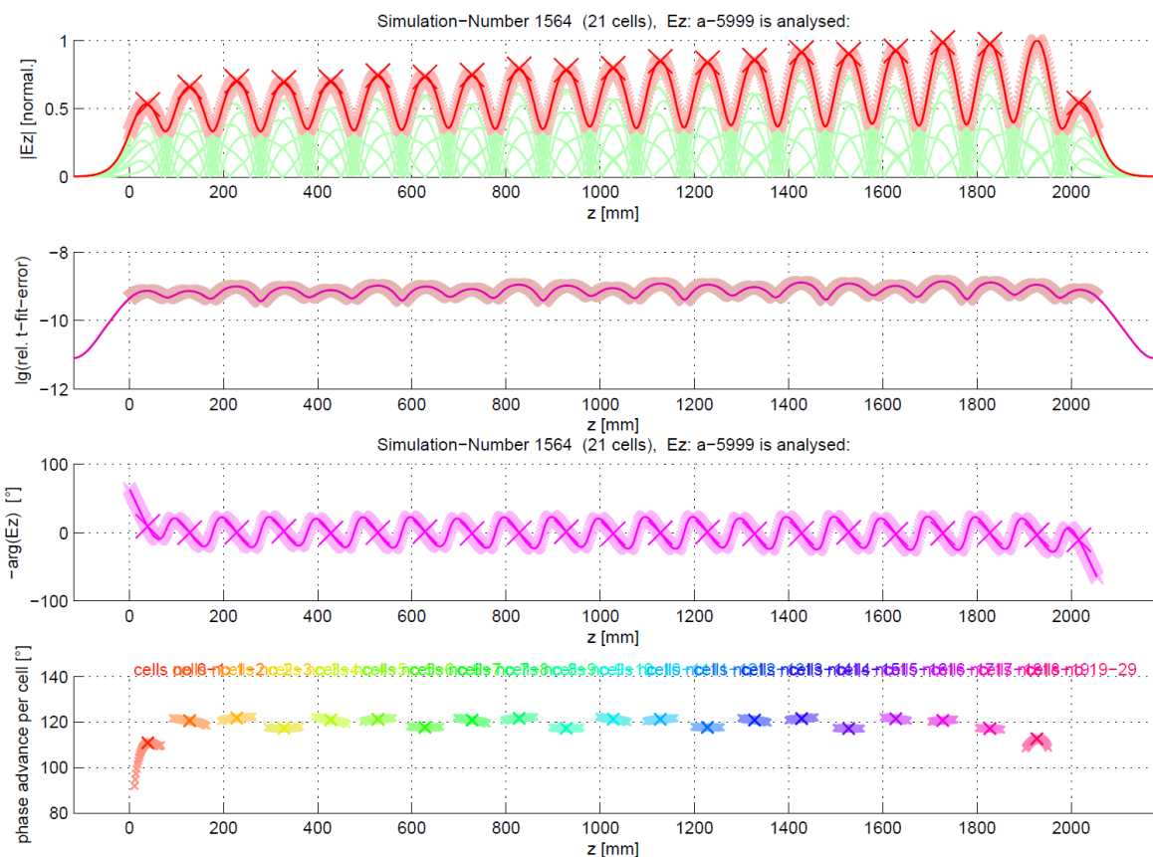
SICA design finished:
Results for field distribution,
phase advance per cell,
bead pull result simulation (E_{z}²)
numerical error < 10⁻⁹
GdfidL time domain simulations to verify dipole mode damping and detuning are ongoing.
Rolf Wegner

Slide 12
Typical average power ranges (commercially available)
ESS/SPL: 704 MHz
SNS: 805 MHz
CLIC: 1 GHz
ILC/P-X: 1.3 GHz
State of the art
UHF

Slide 13
Optimum peak power for an MBK?
The used model may be wrong, but there is an optimum which justifies the R&D.

Slide 14
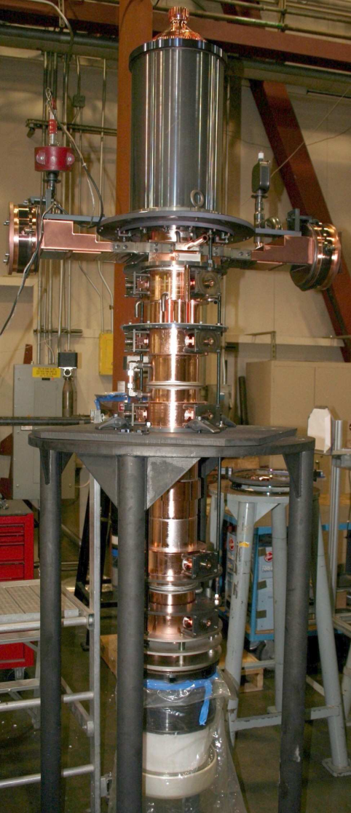
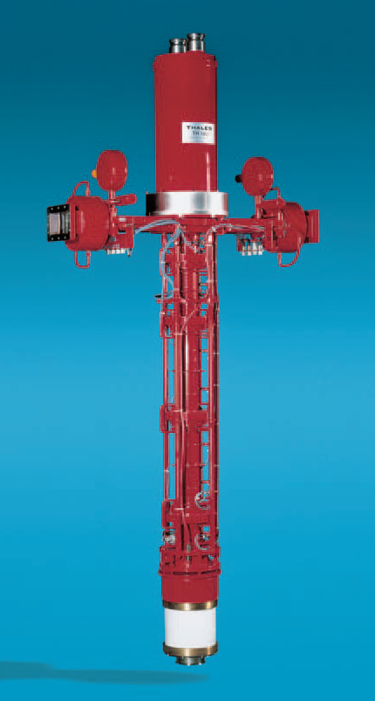
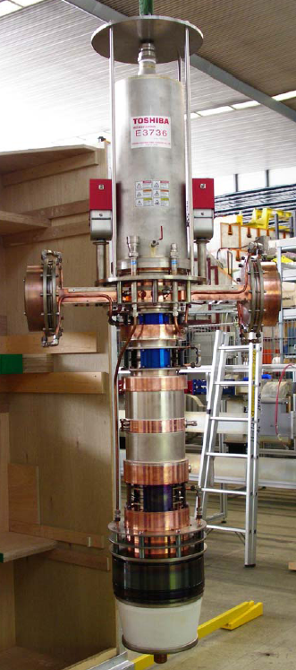
UHF: State of the art: X-FEL/ILC MBK’s
CPI: VKL-8301B (6 beam): 1.3 GHz, 10.2 MW, 10 Hz, 66.3 %, 49.3 dB gain
Thales: TH 1801 (7 beam): 1.3 GHz, 10.1 MW, 10 Hz, 63 %, 48 dB gain
Toshiba: E3736 (6 beam): 1.3 GHz, 10.4 MW, 10 Hz, 66 %, 49 dB gain
1.
2.
3.

Slide 15
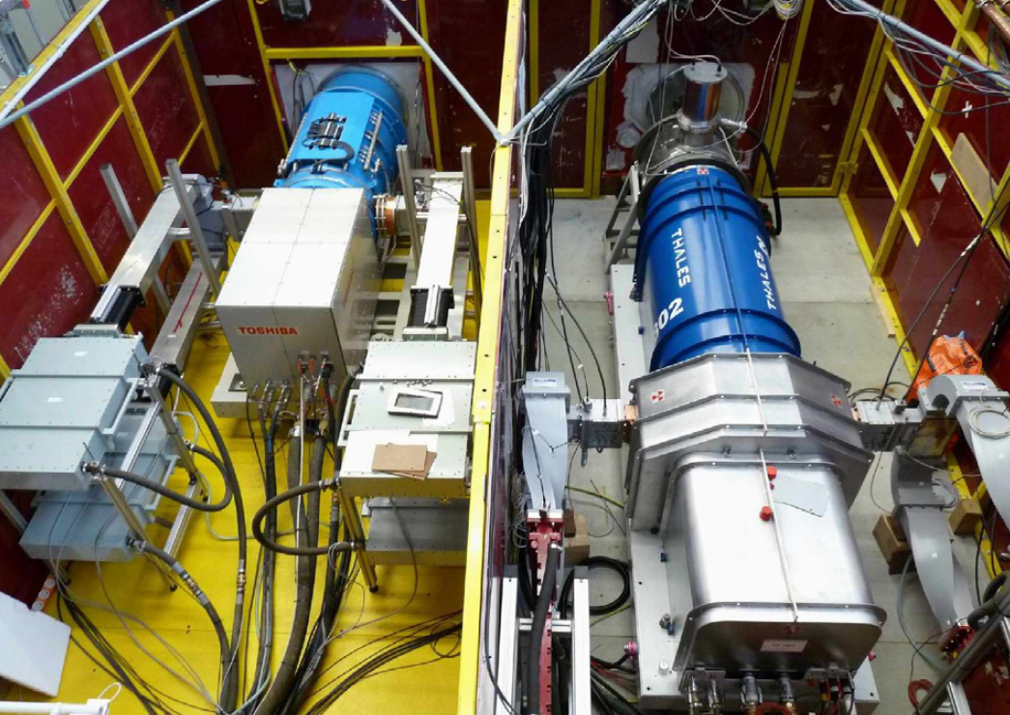
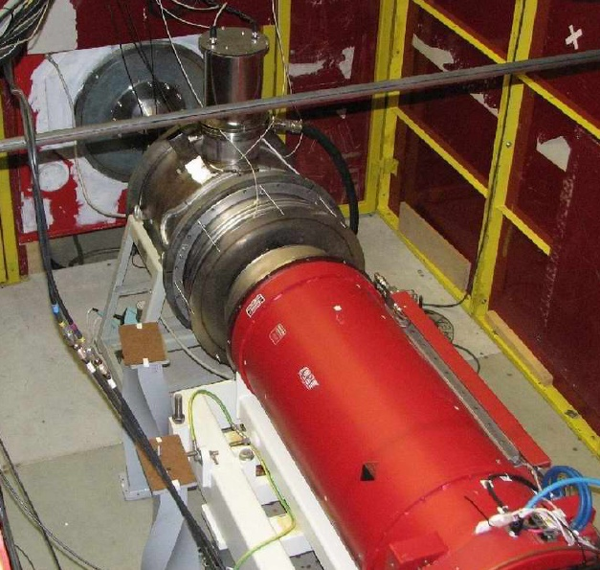
X-FEL MBK’s: horizontal test
Toshiba E3736 H
Thales TH 1802
CPI VKL 8301 B

Slide 16
Power needs for future Linacs:
 | ESS | SPL II | ILC .5 TeV | CLIC .5 TeV | CLIC 3 TeV
Frequency | 704 MHz | 704 MHz | 1300 MHz | 1000 MHz | 1000 MHz
Technology | klystrons | klystrons | MBK | MBK | MBK
Total AC power | 38 MW | 40 MW | 230 MW | 249 MW | 594 MW
Modulator output | 17.8 MW | 26.5 MW | 135 MW | 64 MW | 266 MW
Power source output | 8.9 MW | 10.7 MW | 88 MW | 41.6 MW | 173 MW
Drive beam power |  |  |  | 33.6 MW | 140 MW
Acc. structure input | 6.5 MW | 7.8 MW | 67 MW | 24.6 MW | 102 MW
Total beam(s) power | 5 MW | 4 MW | 21.6 MW | 9.75 MW | 28 MW
Efficiency | 13.5 % | 10 % | 9.4 % | 3.9 % | 4.7 %
Table from Linac10 talk “TH103”, CLIC numbers adjusted to present preliminary numbers.

Slide 17
Synergies
Energy efficient systems are in high demand to make these large projects sustainable and compatible with environmental and ecological requirements
The “EuCARD 2” proposal includes a “Network” activity “EnEfficient” – please take part!

Slide 18
Announcement EuCARD2
From the EuCARD 2 draft proposal:
Task 3. higher electronic efficiency RF power generation (Erk Jensen, CERN)
The power conversion efficiency of a typical accelerator facility is a product of many individual efficiencies (mains to DC, DC to RF, RF to beam). One of the important contributors to the relatively low overall efficiency is the RF power generation, which for present day high power klystrons reaches 65% (ILC 10 MW klystrons) – the main purpose of task 6.3 is to create a network of interested and competent partners to facilitate and foster work on possible technologies and strategies to increase the RF power generation efficiency.
topics for task 3 include:
Possibilities to increase the efficiency of conventional, sheet-beam and multi-beam klystrons, including the use of higher harmonic cavities, smaller perveance and/or techniques for multi-stage depressed collectors,
the investigation of alternative sources with potentially higher efficiency compatible with large scale accelerator facilities including SSPA, IOTs, magnetrons and CFAs, or even more exotic devices like the magnicon,
possible techniques to increase the efficiency of klystrons that have to work with a non-zero differential gain (normally the maximum efficiency is obtained in saturation),
optimizing the design of power distribution systems and of the accelerating structures for maximum efficiency.

Slide 19

Announcement ESS Workshop

Slide 20
Klystron efficiency
100 % η would mean that all electrons will be slowed down to zero by the self-induced field in the output cavity. This is impossible!
For a maximum η, one needs:
  Dirac-delta like bunches through output cavity
    needs harmonic cavities,
    space charge forces counteract (small current helps)
  small ratio energy spread/voltage
    large voltage helps
  correct output cavity impedance! (Tolerances!)

Slide 21
Increase klystron efficiency?
Good ideas are needed!
Some ingredients:
  small perveance
  higher harmonics
  travelling wave
  output structures?
  …
CERN and U Lancaster have started to jointly work on this, in the view of the needs of both ESS and CLIC! First results: 83% simulated!

Slide 22
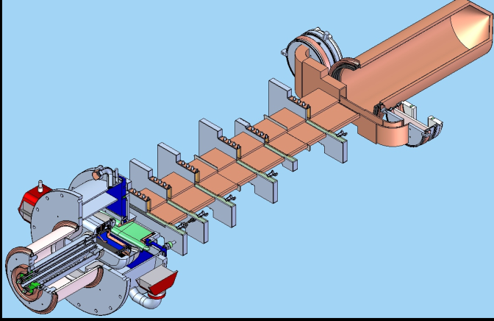
Sheet beam klystron
Instead of many beams, also flat beams would reduce the effect of space charge forces and thus potentially increase η.
Potential advantage:
Fabrication techniques
may be better suited
for cost-effective mass
production.
Courtesy CPI
Courtesy CPI
SLAC design of a 1.3 GHz, 10 MW SBK

Slide 23
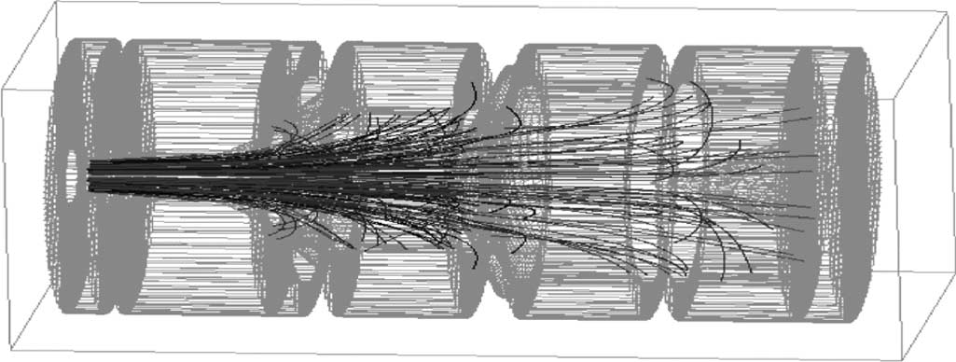
Multi-stage depressed collector?
Idea:
The collector consists of a number of electrodes with different potential.
the spent electron beam drifts against a potential and is intercepted at lower energy.
more energetic electrons drift further and their energy is recuperated.

Slide 24
Magnetrons
Magnetrons have potentially very high η.
They have a good ratio MW/$.
But they are oscillators, not amplifiers!
Pulsed operation requires settling time – this effectively reduces efficiency.
They make a lot of phase noise!
If you run an accelerator with more than one magnetron, you need to phase-lock them! This can be done to about 1° precision (dixit Amos Dexter) – this is not good enough for the CLIC drive beam

Slide 25
Thank you!

