Slide 1
New algorithms for tuning the
CLIC beam delivery system
Andrea Latina (CERN)

Slide 2
Outline of this talk
CLIC BDS
Tuning strategies
BBA, and its pitfalls
Luminosity tuning knobs
Simulation results
Conclusions and next step

Slide 3
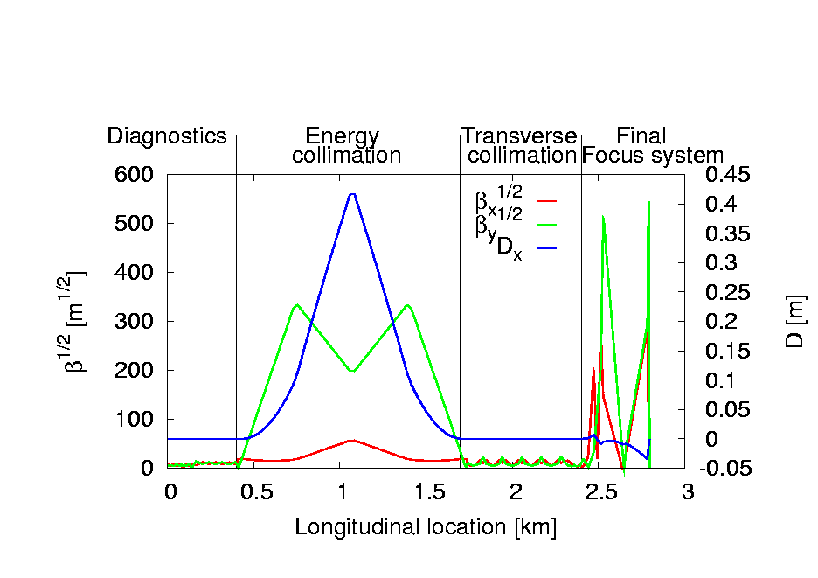
CLIC BDS

Slide 4
Emittance preservation in the CLIC BDS
Control beam blow-up due to static imperfections
  We consider magnet displacements only
Traditional Dispersion-free-steering algorithm works well in the Collimation section of the BDS but not in the FFS
FFS is a highly non-linear system
  Traditional algorithms fail to preserve the emittance growth
  Emittance is not a good figure of merit
  Beam sizes and luminosity are better “reference”

Slide 5
Tuning strategy
Setup
horizontal and vertical random magnets displacements: σ =10 μm rms
bending magnets not misaligned
100 random seeds
identical electron and positron machines
Tuning steps
Luminosity optimization (Simplex algorithm)
  All horizontal and vertical positions of the magnets are moved to reach maximum performance
Horizontal and Vertical sextupole knobs
Speed of convergence
Luminosity measurements required are O(10000)
Knobs : L points × M knobs × N iter O( 100 )

Slide 6
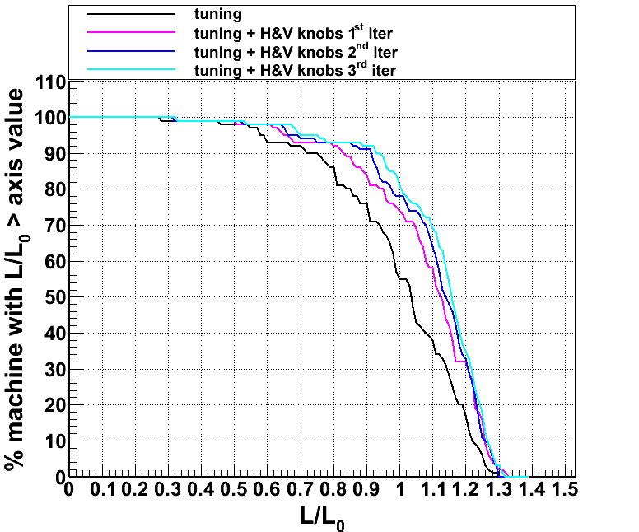
Luminosity results
linear knobs based on FFS sextupole H&V displacements (E. Marin)
after 2 iterations of H and V knobs: 90% of the seed reach 90% of nominal luminosity
luminosity optimization needs ~16000 luminosity measurements
tuning knobs
20 points × 8 knobs × 2 iter ~
320 luminosity measurements
J. Barranco + B.Dalena

Slide 7
New tuning strategy
Same setup
horizontal and vertical random magnets displacements: σ =10 μm rms
bending magnets not misaligned
10 nm bpm resolution
100 random seeds
identical electron and positron machines
Tuning steps
BBA: 1-to-1 correction + DFS (multipoles off),
BBA: DFS (multipoles on)
Horizontal and Vertical sextupole knobs
Speed of convergence
BBA does not require luminosity measurement
Knobs : L points × M knobs × N iter O( 100 )

Slide 8
Luminosity results
most of the luminosity is recovered by the sextupole knobs (10 H &V knobs )
50% of machine reach 100% of nominal CLIC luminosity
~ 1000 luminosity measurement required
Luminosity measurements reduced from ~17000 to ~500
It is much faster, but only 50% converges (long tail of seeds that do not converge)

Slide 9
Tuning procedure in detail
Step 1: 1-1 correction
Step 2: 1-1 correction + dispersion free steering
The free parameters beta, w1 (and, later, w2), and the gains, must be carefully chosen.
I scan beta and run a simplex optimization of w1 and w2 to find the best combination

Slide 10
Tuning procedure in detail
Step 3: DFS with multipoles ON
Step 4: Luminosity tuning knobs using sextupoles
Repeat steps 1 to 4 a few times.

Slide 11
Results for 110 machines

Slide 12
Response matrix calculation
BBA relies on orbit measurements and response matrix inversion.
The response matrix can be calculated in different ways
Exciting each corrector
From the optics T₁₂, T₃₄
Fitting the beam
We use (1) but probably it is not the optimal choice:
Must remember that the system is highly not linear
Response depends on the excitation of the kickers
Radiation must be kept into account
Must keep into account the energy profile along the BDS
Need to carefully choose the appropriate method.
Need to track a full bunch of particles (150-200k particles) to properly include the effect of radiation.

Slide 13
Orbit response matrix

Slide 14
Dispersion response matrix

Slide 15
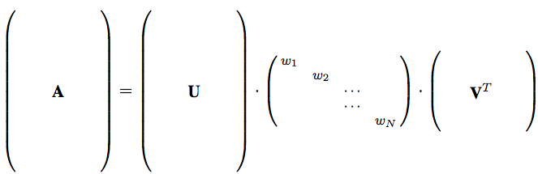
Tuning knobs
Knobs are used to tune beam quantities such as beam size at the IP, or correlations.
The knobs are calculated through a SVD decomposition of the beam covariance matrix in response to sextupoles displacements.
Singular Value Decomposition
A : response matrix
U : orthonormal base in the cov. space
W : singular values
V : orthonormal base in the sext. space

Slide 16
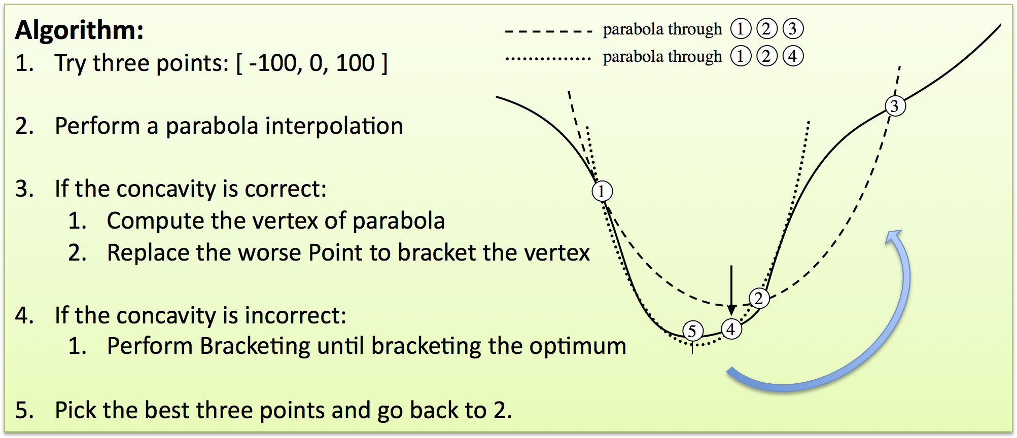
Luminosity tuning with the knobs
The knobs are optimized applying the Brent Minimization Algorithm on the Luminosity (parabola minimization) to each knobs.
For each knobs, three times:
Minimize “-Luminosity”.

Slide 17
Convergence of the tuning knobs

Slide 18
Convergence of the tuning knobs

Slide 19
Convergence of the tuning knobs

Slide 20
Convergence of the tuning knobs

Slide 21
Conclusions and new ideas
The advantage of BBA is its speed.
If carefully tuned, BBA can successfully be used also in the FFS.
Carefully means:
Appropriate choice of the response matrix
Keep into account the energy loss due to SR
Tune finely the free parameters
Future work:
Tuning knobs: evaluate the direct impact of each knobs on the Luminosity
  (FWHM)
2) Non-linear BBA
  Use not just 1st order response matrix, but also 2nd or 3rd order matrices
  PLACET can already generate 2nd order response matrices (first tests showed that 2nd is not sufficient)

