Slide 1
Towards a Compensatable Muon Collider Calorimeter with Manageable Backgrounds
Rajendran Raja
Fermilab,
Sep 28,2011

Slide 2
Muon Collider parameters
Beams of 750 GeV/c μ⁺ and μ⁻ bunches cross each other at a frequency of ~10μs
  Scaled from Tevatron for momentum and using 6 Tesla magnets.
Bunch length = 1 cm (1 sigma).
  This results in event time jitter of100 picoseconds (3x 33ps) at the 3 sigma level. This effect will be neglected in what follows.
Bunch Intensity 2x10¹² muons per bunch
Number of decays 4.28x10⁵ per meter
~1000 turns before half muons decay.

Slide 3
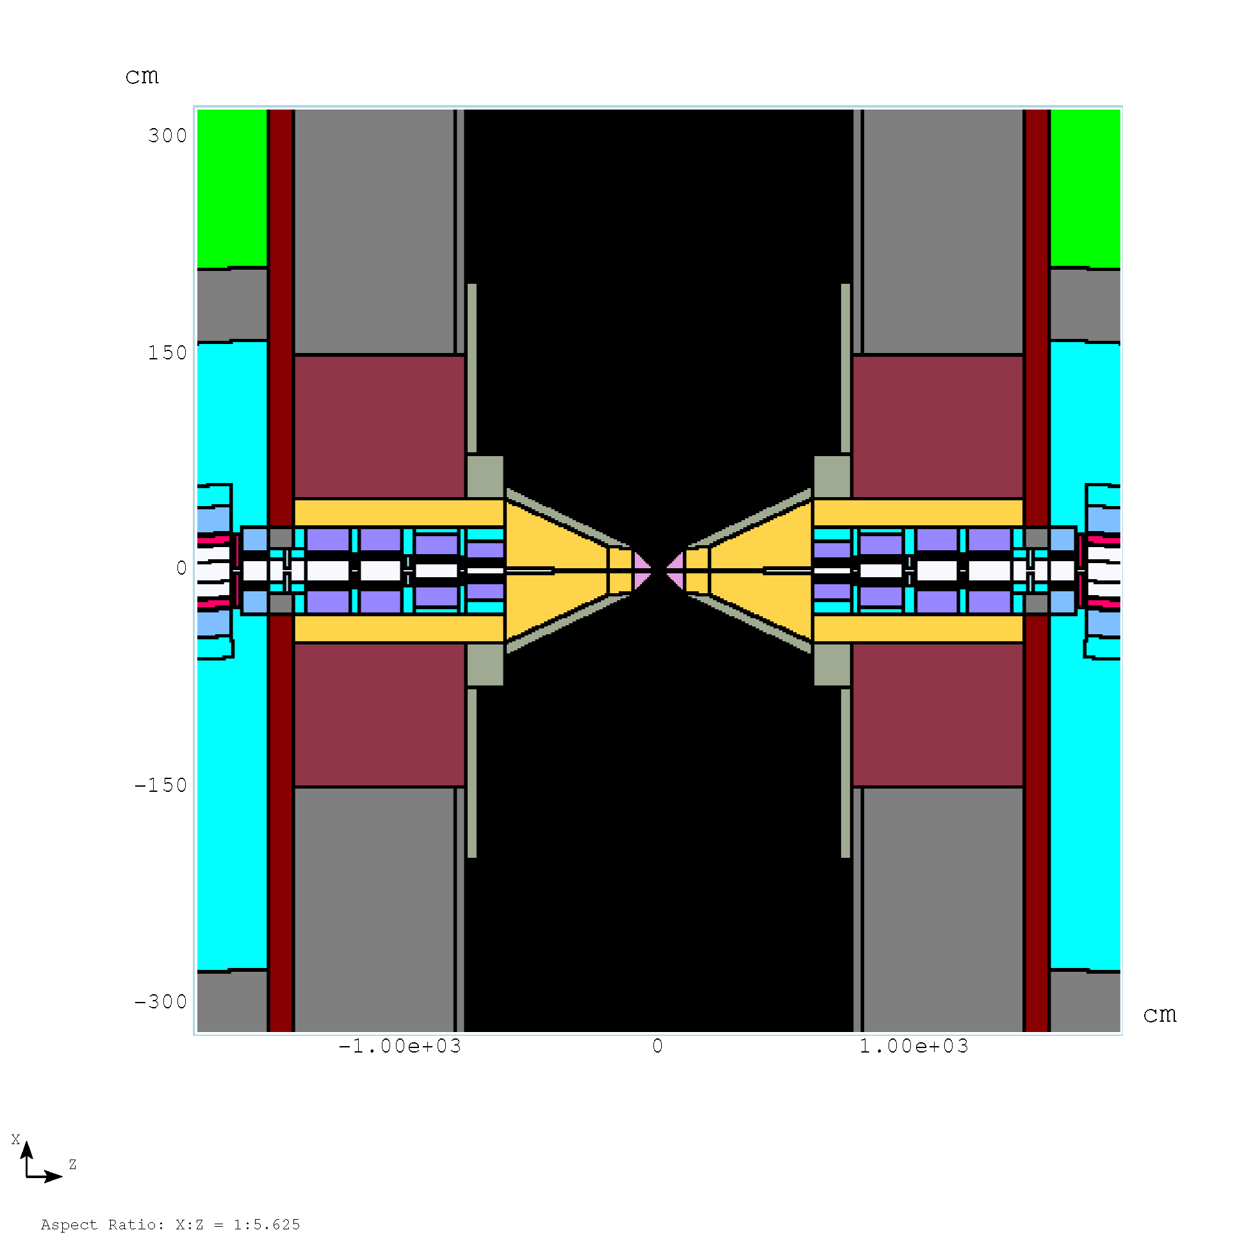
Mars Simulation
http://www-ap.fnal.gov/users/strigano/mumu/mixture/
excl1to25m-mumi
excl-25to1m-mupl
Files are weighted tracks which contain information on where they appear in the detector volume first, their 4 vector, time of appearance wrt crossing time etc.
We divide these particles into 4 categories
EM - g e+ e-
BARYONS n p other baryons
MESONS pions, kaons and others
MUONS m+ m-

Slide 4
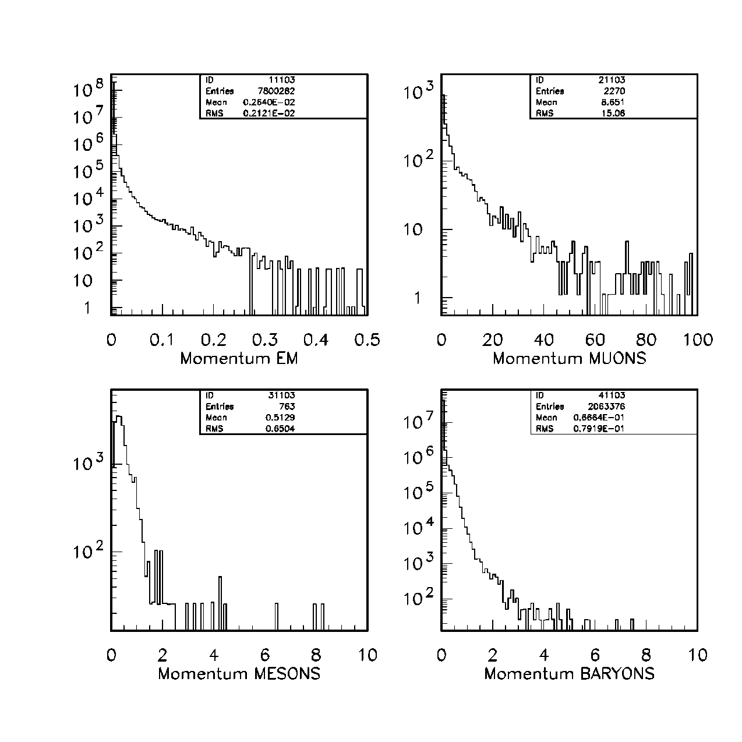
Analysis of MARS backgrounds. Momentum Distributions

Slide 5
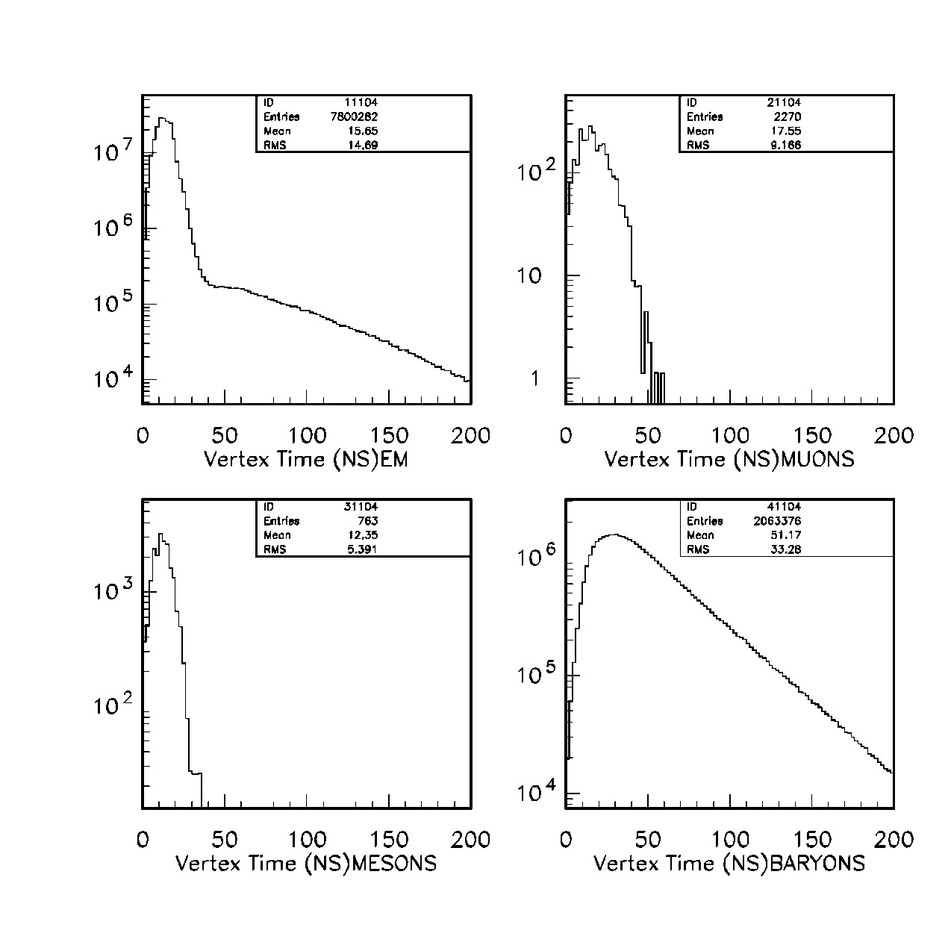
Time at MARS Vertex (after crossing time)

Slide 6
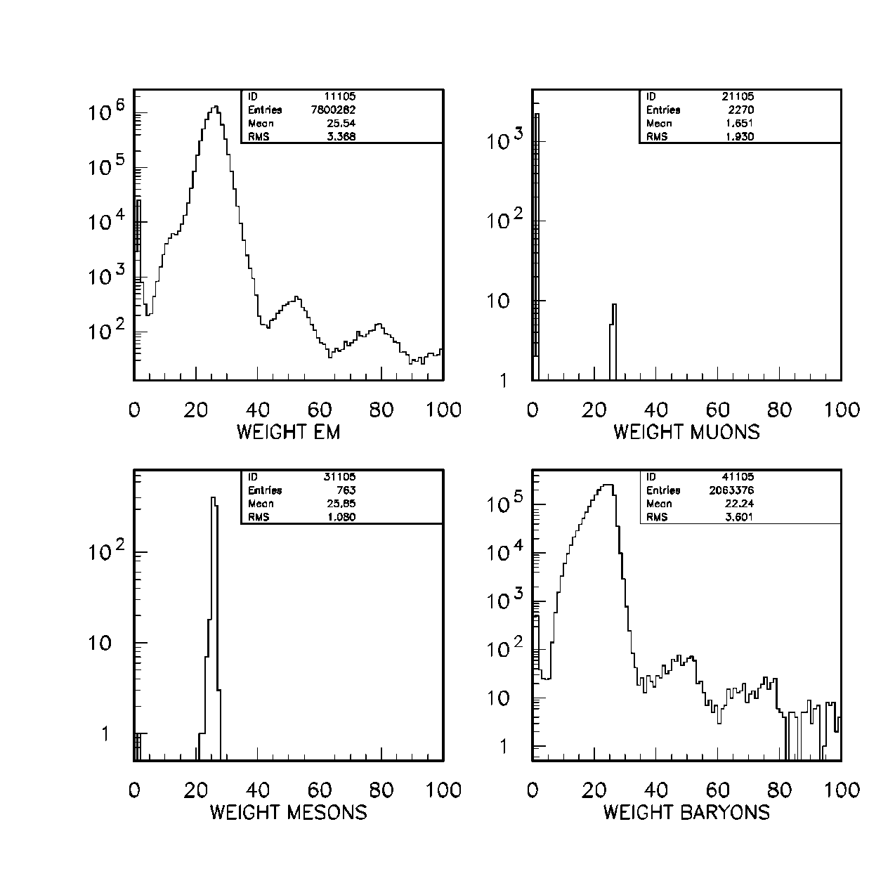
MARS Weight and raw fluxes
Particle Type | Number per crossing | Energy (TeV)
EM | 1.79x10⁸ | 169.9
MUONS | 8021 | 184.4
MESONS | 17589 | 6.8
BARYONS | 0.409x10⁸ | 177.4
Calorimeter with 50%/√(E) resolution will have fluctuations of 206 GeV in EM and 211 GeV in Baryons alone! Total energy of event is 1500 GeV!!
So some out of box thinking is needed.

Slide 7
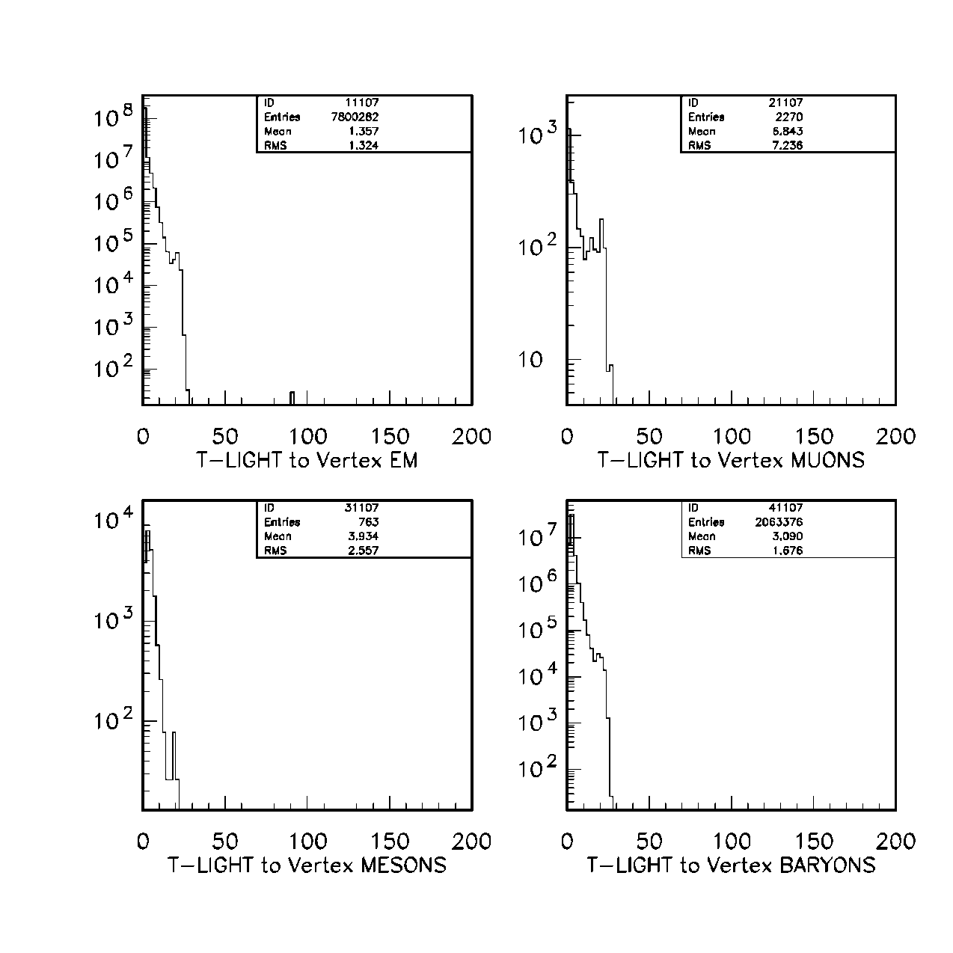
T light to MARS vertex (ns)

Slide 8
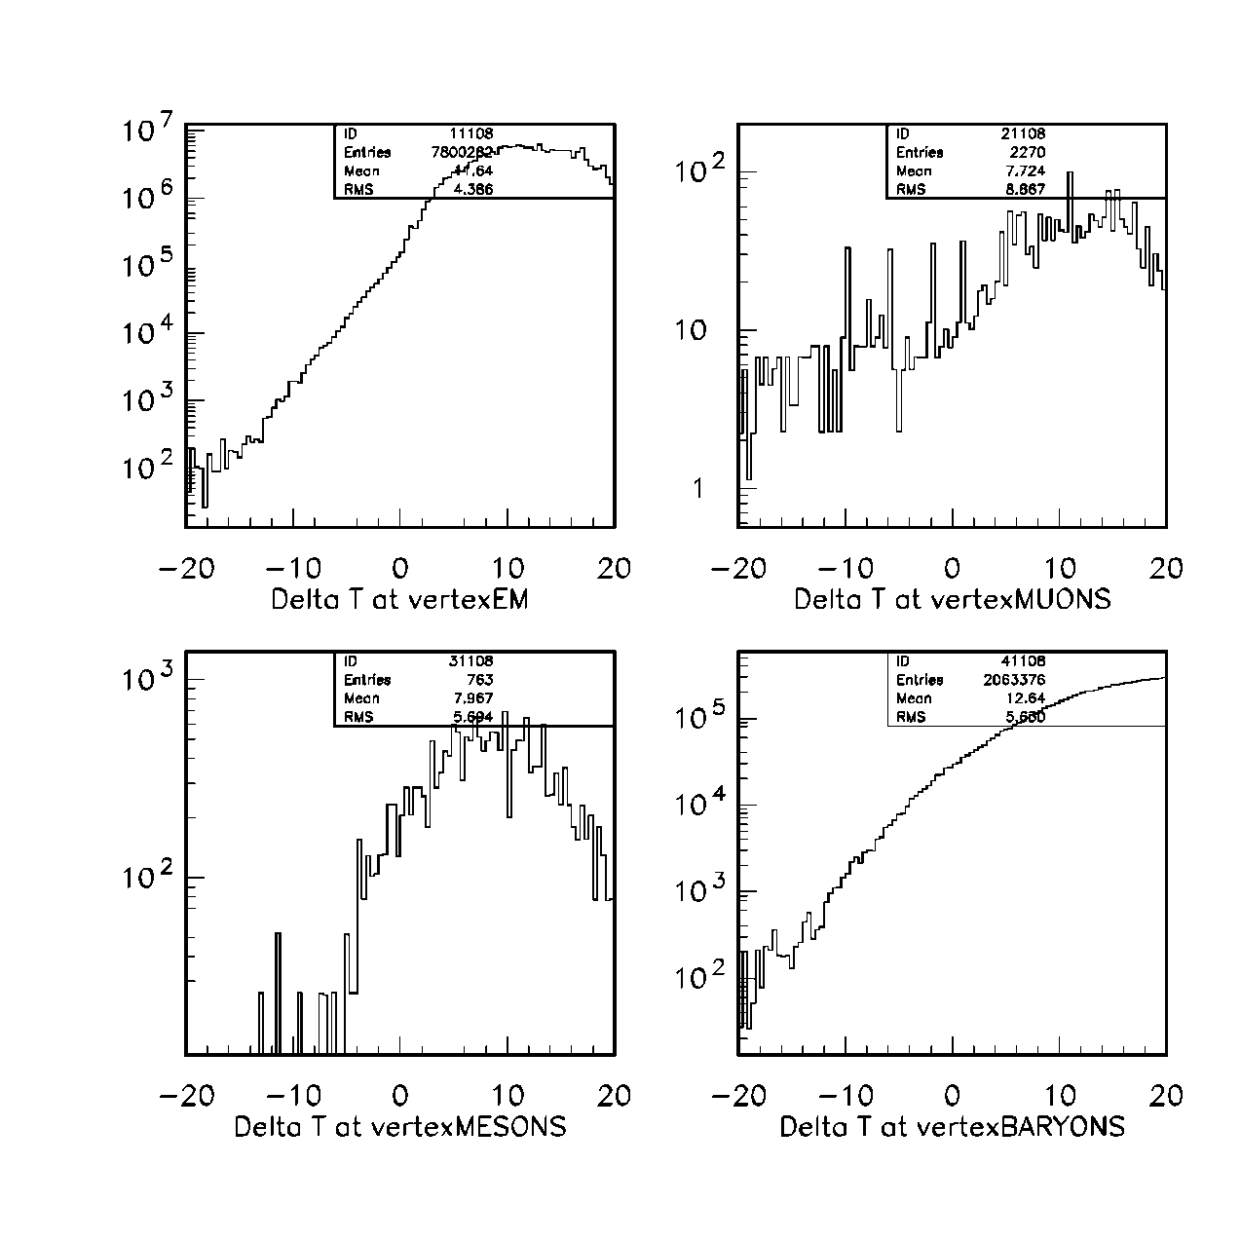
δ t =(t – tlight)(ns) at MARS vertex

Slide 9
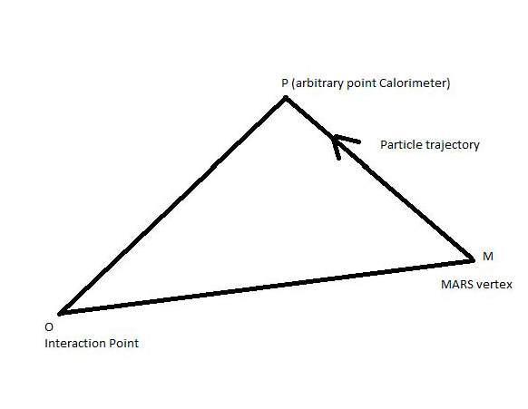
Theorem I (originaly due to Euclid)
If δ t > 2 ns at MARS vertex, that particle and all its showering daughters will always be out of trigger gate at all points in the calorimeter.
Assume all particles at β=1. c=1.
If theorem is proven for light, then it is true for all massive particles.
g = gate=2ns.
t_{M}= Mars arrival time at M
t_{P}= particle arrival time at P

Slide 10
This gets rid of a lot of background!

Slide 11
Theorem II
For particles with δt<2ns, the particle can come into time, be in gate and then go out of gate. We only need track these particles in Geant in this technique. Let M now denote the point when the particle just comes into the gate.
d thus gives the distance it will travel in calorimeter before going out of time.

Slide 12
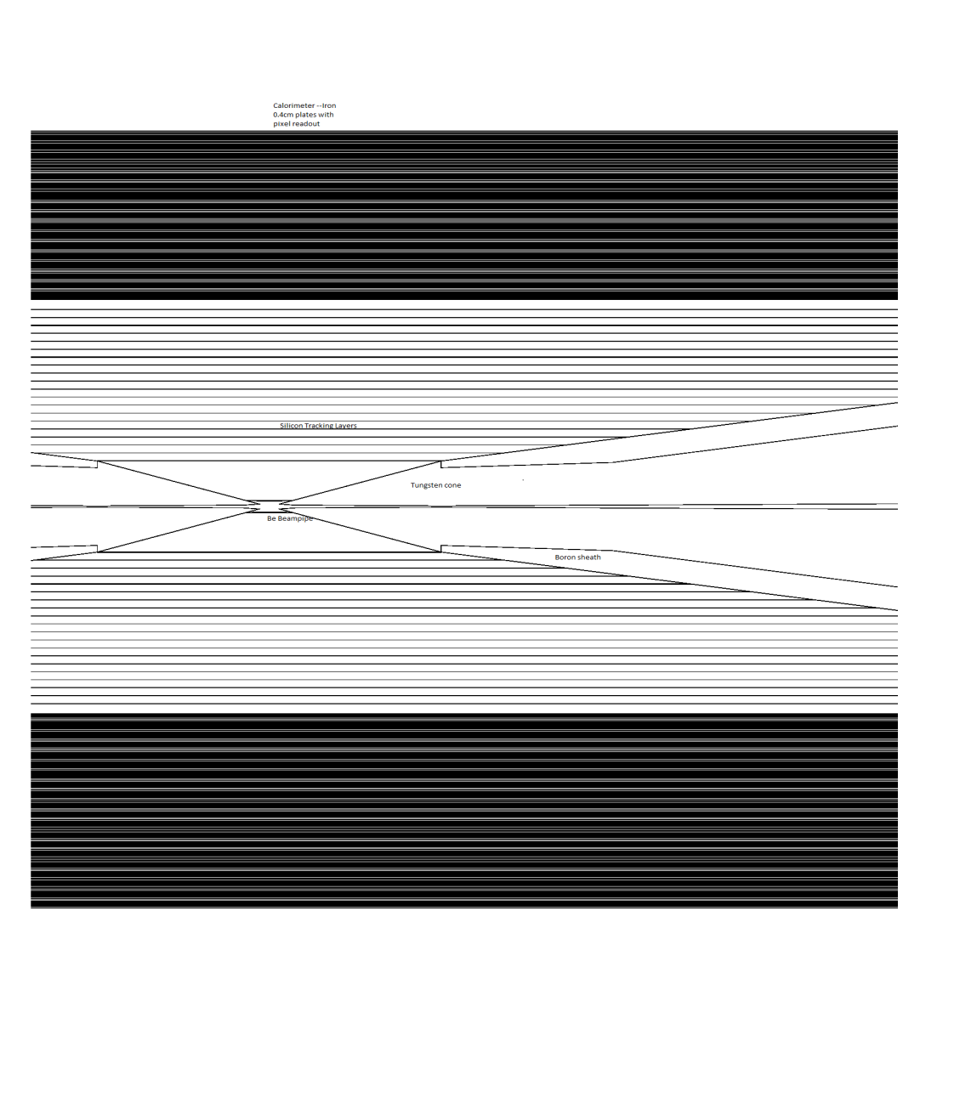
Geant3 Simulation
The detector solenoid field at abs(z) < 750 cm (same as in MARS)
  B_{z}=-3.5 T at r < 330 cm
  B_{z}= 1.5 T at 330 < r < 600 cm
  B_{z}=0 at r > 600 cm
  B_{z}=0 at 600 < abs(z) < 750 cm and r < 10 cm

Slide 13
Calorimeter—Entirely digital information.
0.4 cm thick iron plates. 340 of them.
  Inner radius 80 cm
  Outer radius 250 cm
  1st 100 layers 22 radiation lengths –EM section
  340 layers = 8.11 Interaction lengths
Interleaved with silicon pixel layers.
Each pixel has ability to say yes/no. No dE/dx information.
Pixel size 200micron x 200 micron. Thickness ~400micron.
  Pixel digitization is not currently implemented (i.e hits not smeared by 200 microns / √(12).
  Multiple hits/pixel will result in single hit. Both these can be implemented later offline and will make little difference to conclusions drawn here.
Number of pixels can be addressed by 41 bits.
Consideration of cost are not relevant at this stage. Our aim is to determine how to obtain physics results with these severe backgrounds.
I will indicate ways to reduce cost at the end.

Slide 14
Travelling trigger– This idea is crucial to all that follows.
Each crossing, a trigger is generated.
Each pixel is triggered by a 2 ns gate.
The beginning of the gate coincides with the time taken for light to travel from IP to the pixel.
End of trigger = t light + 2 ns. The 2ns gate is chosen to make sure that each pixel can respond to 1 MIP particle going through it and say yes or no.
We will use the term δt to denote (tlight – tcrossing) at each pixel.
Each pixel will have a different start and end gate. Further away from crossing, the more delayed the start of the gate. Each pixel will pass its gate to the next one delayed by a tiny amount. Readout electronics design.
Pixels at the same radius from crossing will have the same gate.
Trigger travels at the speed of light from interaction point.
Does NOT depend on an interaction. Only on the crossing time, which is known in advance.

Slide 15
Tracker
20 tracking layers- same as calorimeter layers-pixels same triggering scheme. No absorber.
Inner radius 17.6 cm
Outer radius 76.1 cm
Solenoid outside calorimeter.
B field same as used by Mokhov, Striganov

Slide 16
Software
Geant3 uses data driven geometry– This geometry is also usable by ROOT.
MIPP Software converts Geant3 output into ROOT
What follows will use ROOT Graphics (3D) heavily.
Not enough person-power yet to write pattern recognition code.
Will use the ansatz—if it can be recognized by eye, a PR program can be written to recognize the pattern.

Slide 17
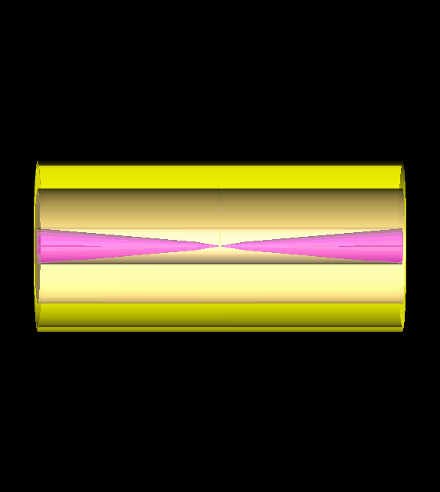
Geometry with visible 100 GeV pion shower

Slide 18
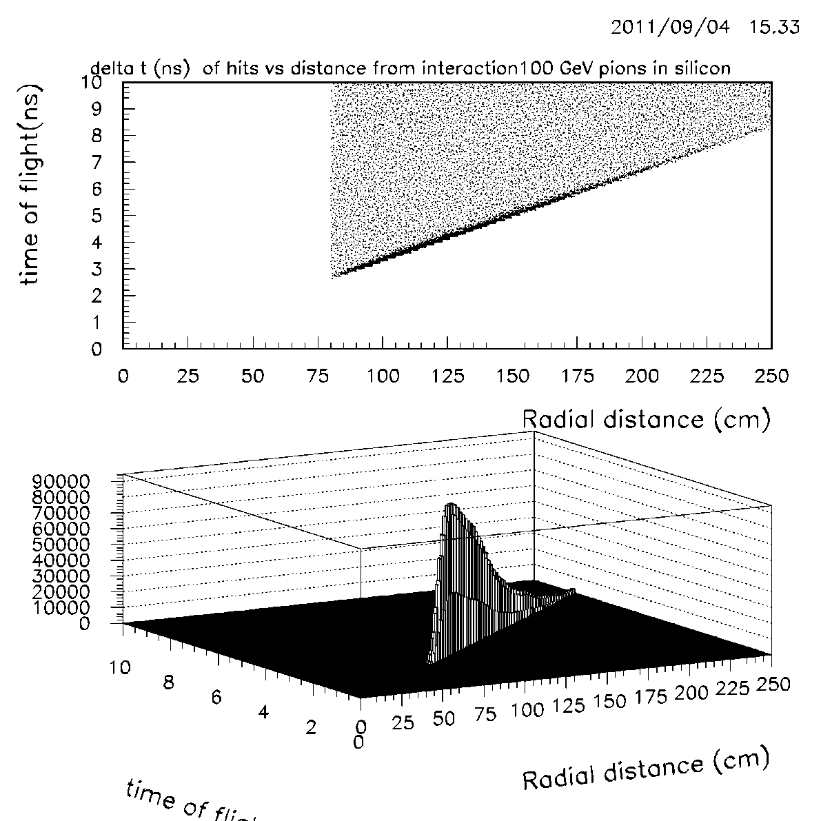
TIme of hit vs radial distance from interaction point.

Slide 19
Time distributions 100 GEV pion hits

Slide 20
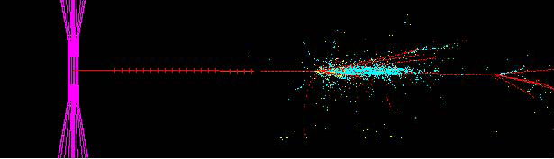
100 GeV pion in calorimeter
Color scheme—to guide the eye
  Hadrons—red
  Electrons-cyan
  Muons green
  Out of time hits—yellow
  Calorimeter hits-dots
  Tracking hits + sign
See detail available. Note EM hits more dense. Observe different hadronic vertices.
Observe a small number of out of time hits
Observe the Moliere radius of the EM shower due to pizero production—2.7 cm in Iron.

Slide 21
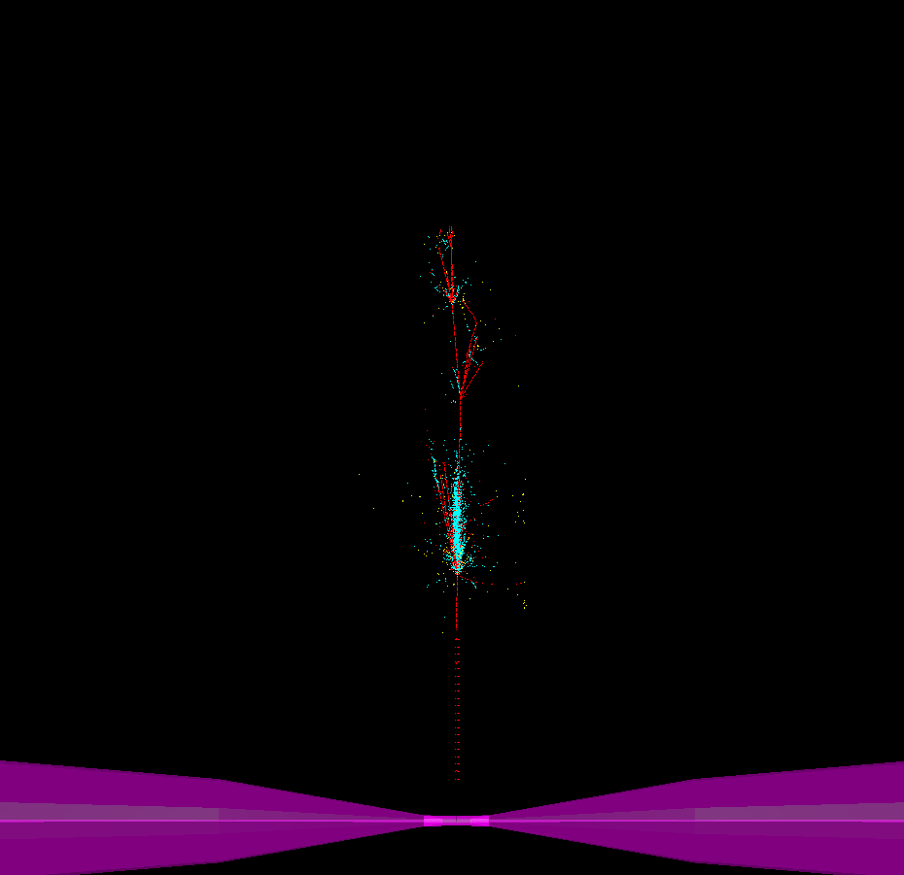
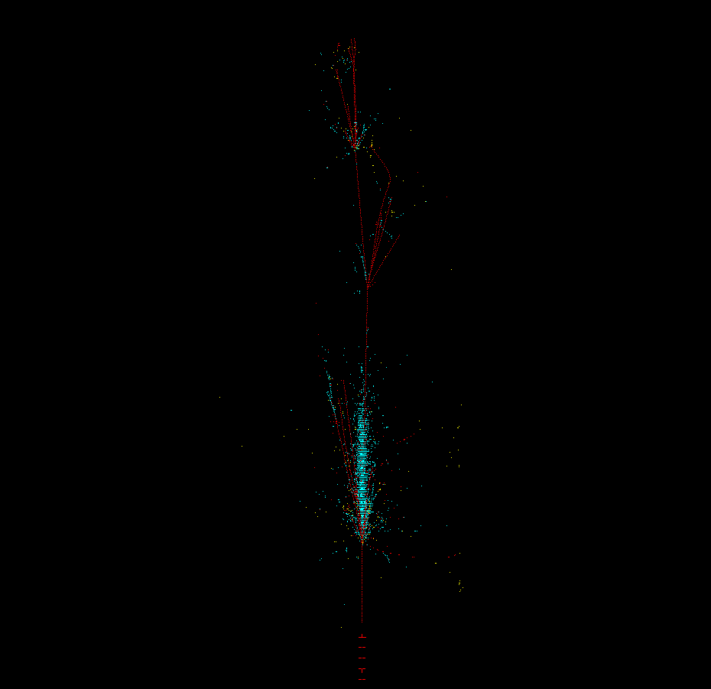
More 100 GeV Pion pictures.

Slide 22
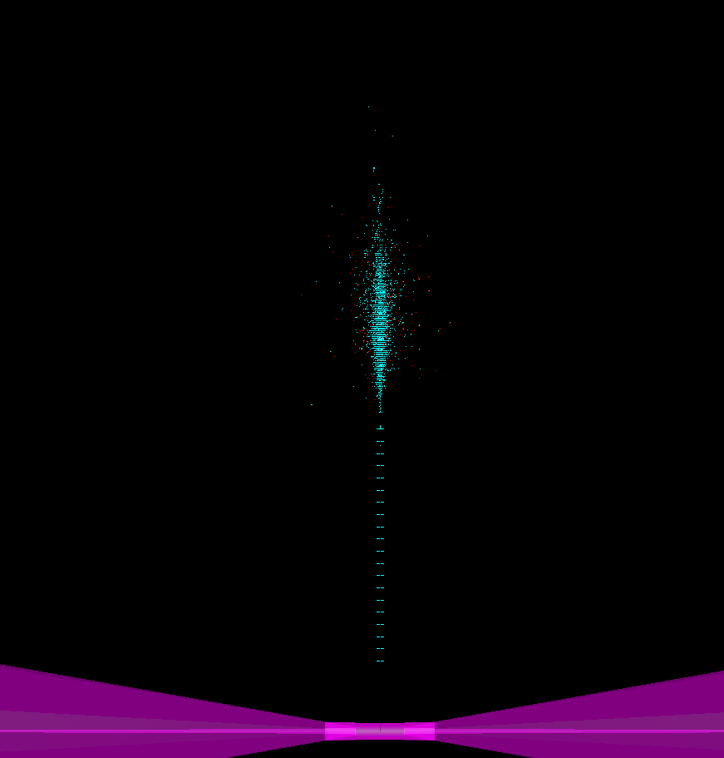
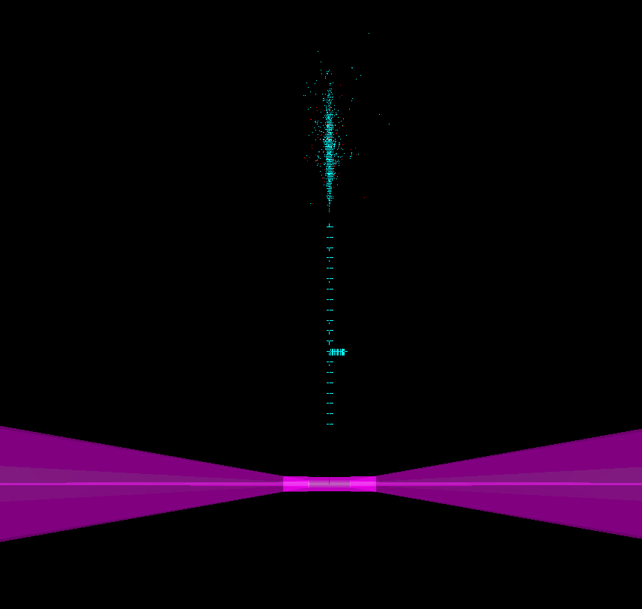
Electrons in Calorimeter
100 GeV Electron
30 GeV Electron

Slide 23
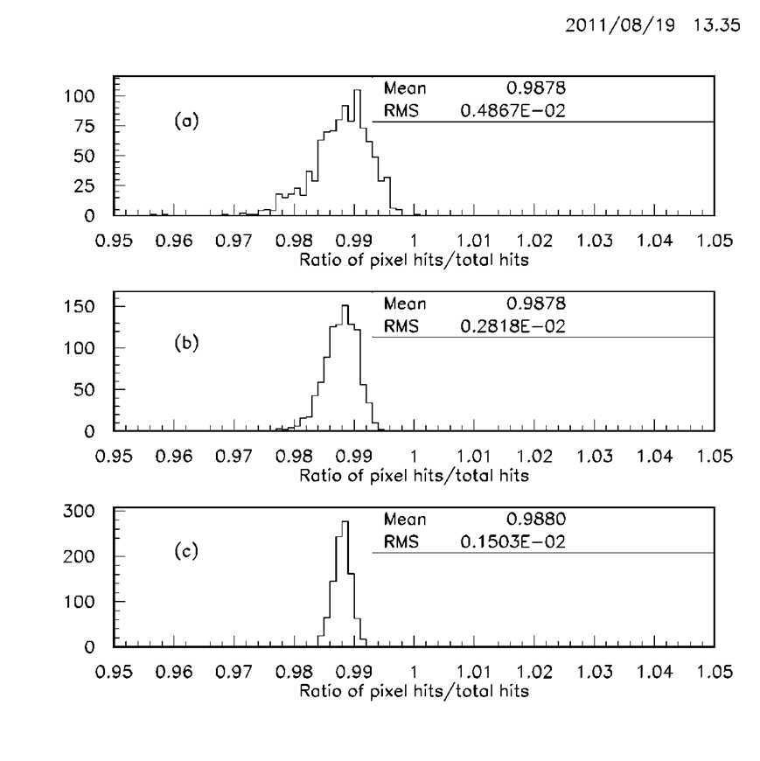
Overlap of hits in EM shower in 200μx200μ pixel as a function of energy
(a) 10 GeV electrons
(b) 30 GeV electrons
(c) 100 GeV electrons
Note mean ratio is energy independent and indicate overlaps due to shower dynamics (Photons in shower converting in iron close to the silicon will send both electrons to the same pixel no matter what the pixel size) rather than pixel size.

Slide 24
Why should such a calorimeter work?
Short Answer -dE/dx is a strong breaking force.
Shower particles are above Bragg Peak. As they slow down due to dE/dx, the dE/dx gets stronger and stronger bringing te particles to a rapid halt.
Bragg peak for pions occurs at ~ 10 keV.

Slide 25
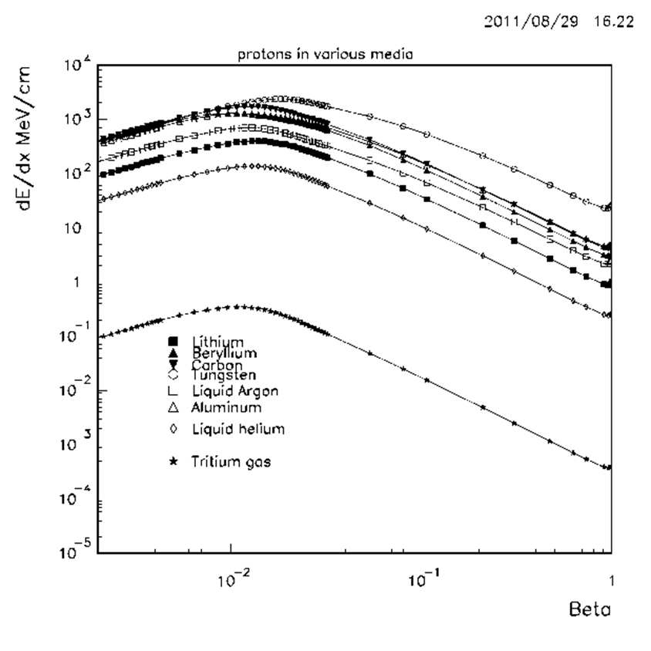
dE/dx vs β
Bethe Bloch formalism together with Andersen-Ziegler for low values of β.
Work done in 1998 towards an “Alternate Muon cooling scheme”.

Slide 26
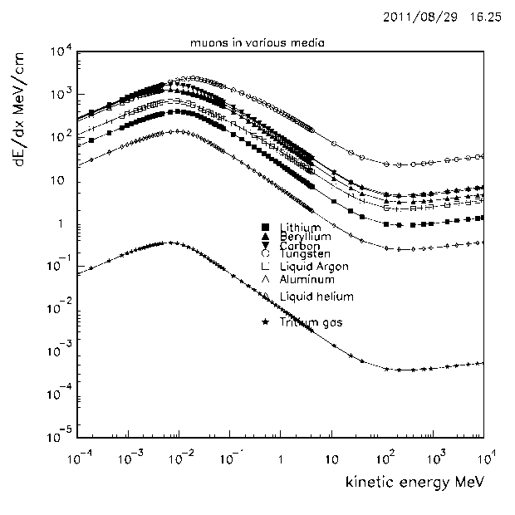
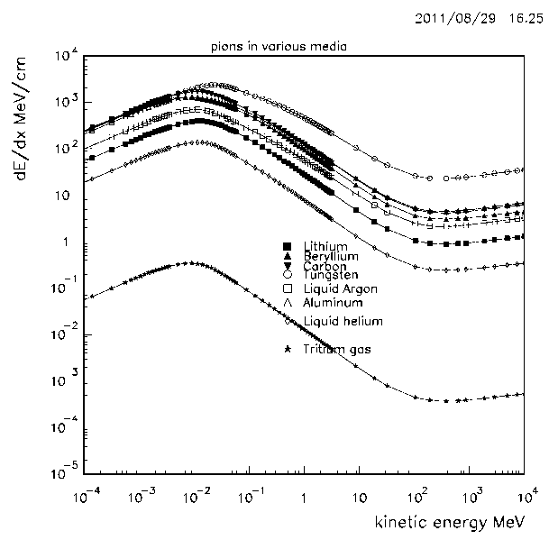
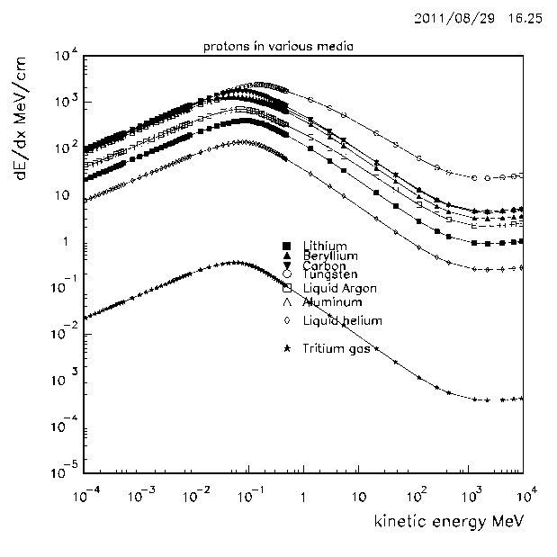
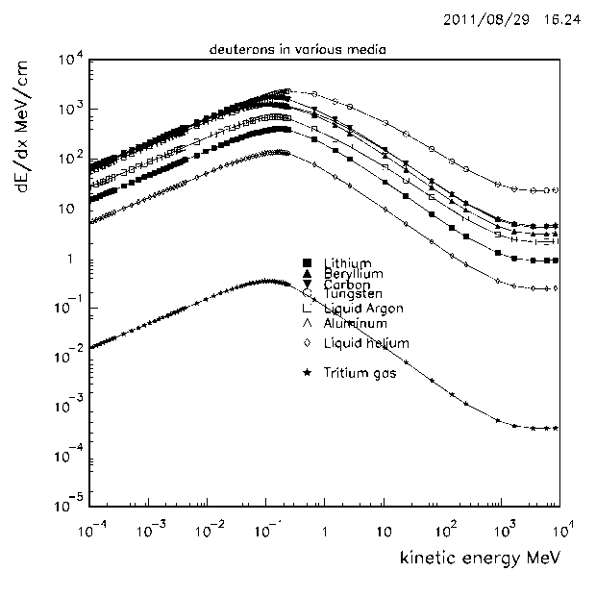
dE/dx vs Kinetic Energy

Slide 27
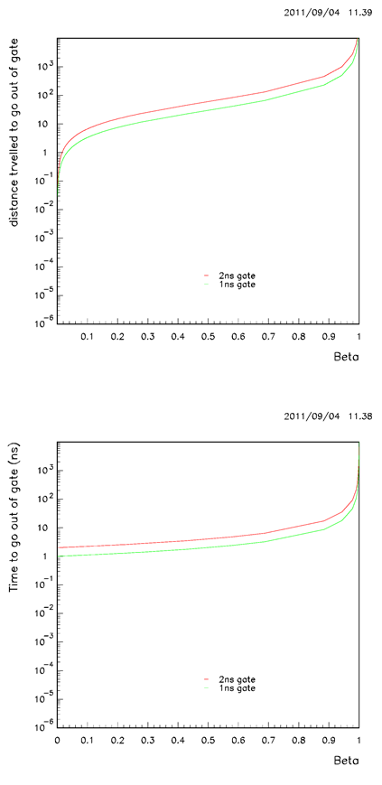

Time and distance travelled before going out of gate g
Assume only calorimeter. Deal with tracking later.
After travelling distance d and time t, the particle will be just out of time gate g
$t_{light}=\frac{d}{c}; t=\frac{d}{βc};g=t−t_{light}$
$≫d=\frac{βgc }{1−β}$;$t=\frac{g}{1−β}$

Slide 28
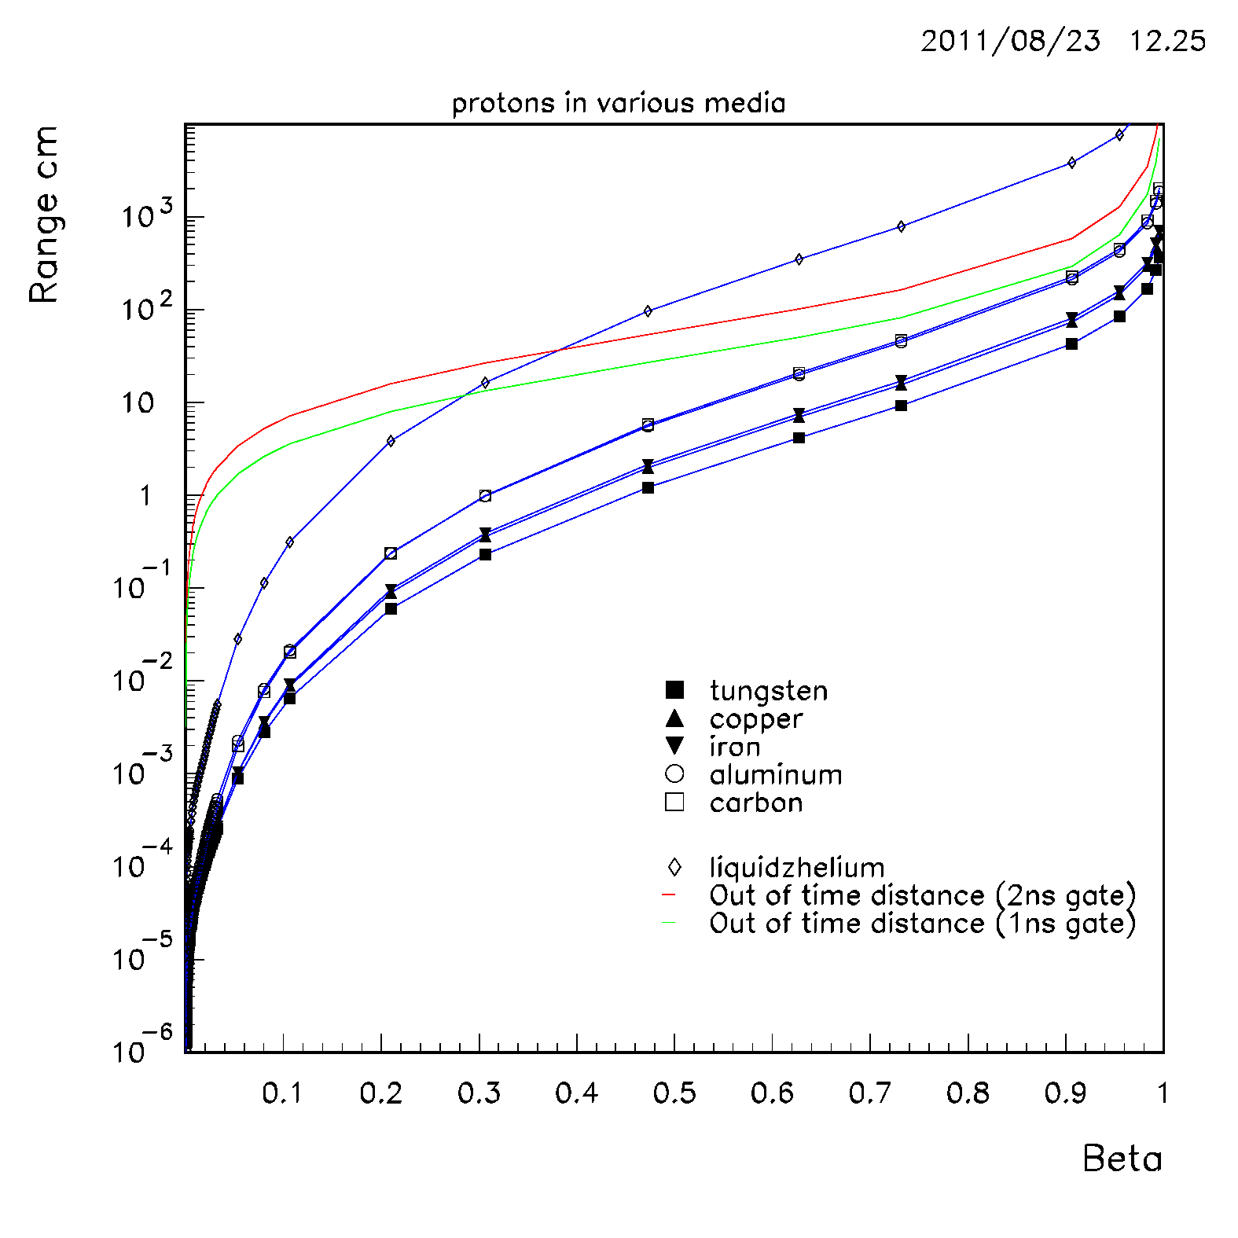
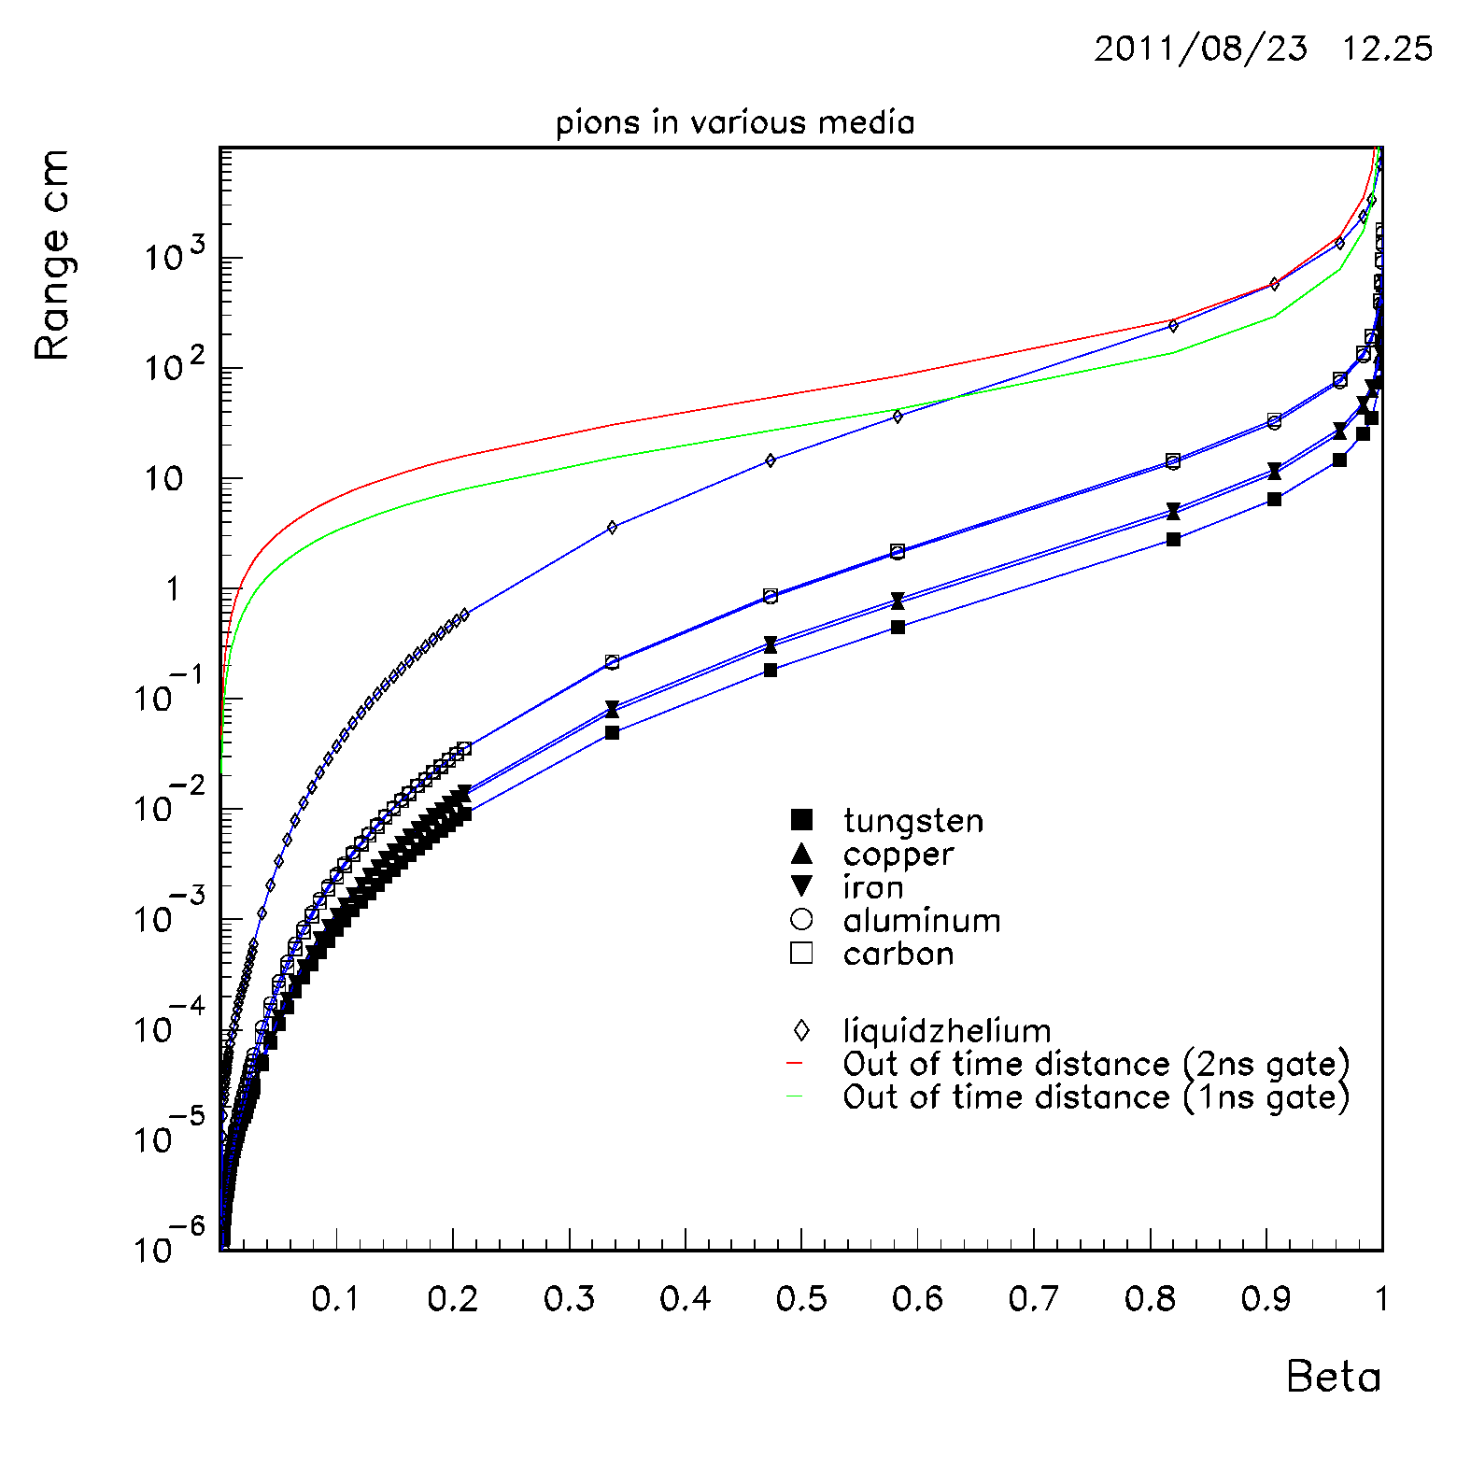
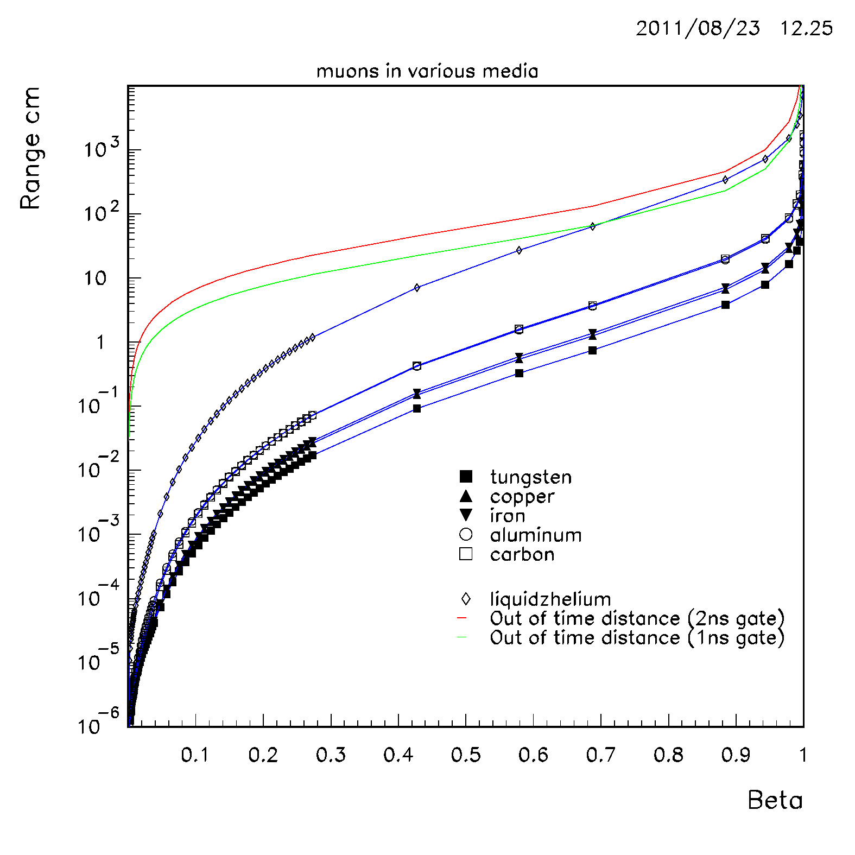
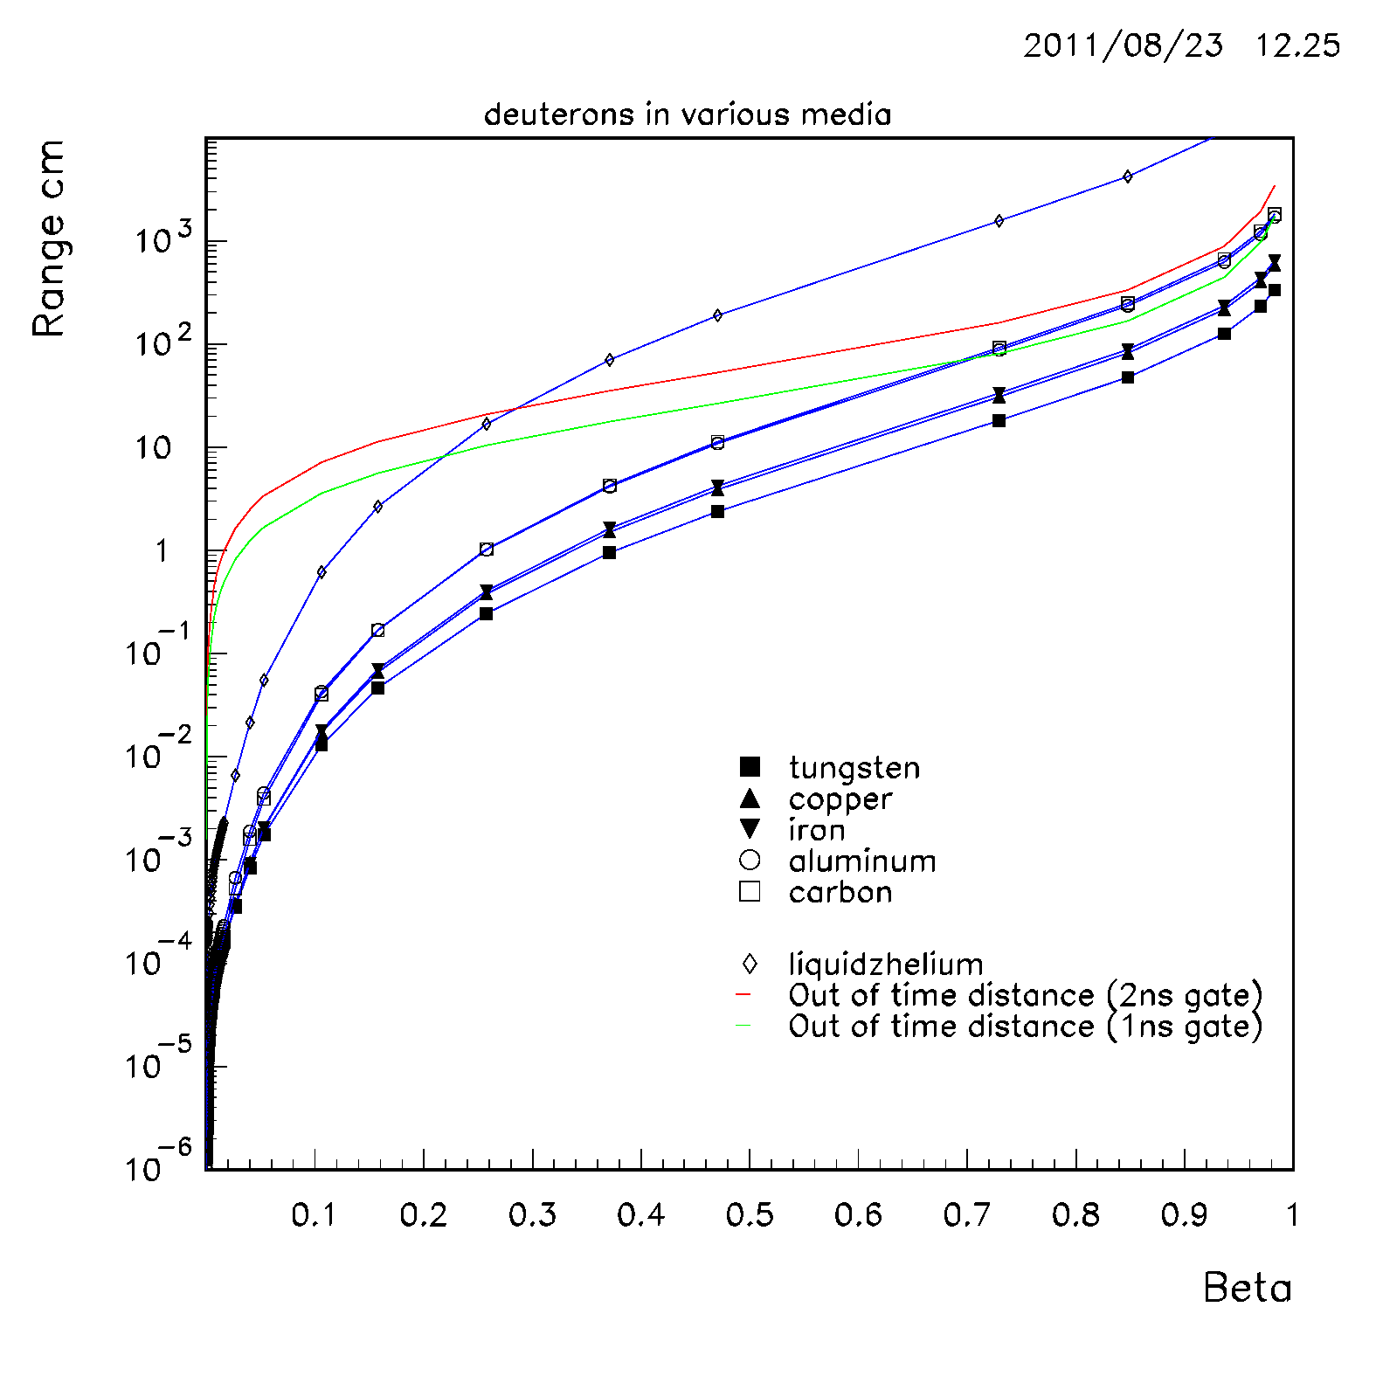
Range vs β

Slide 29
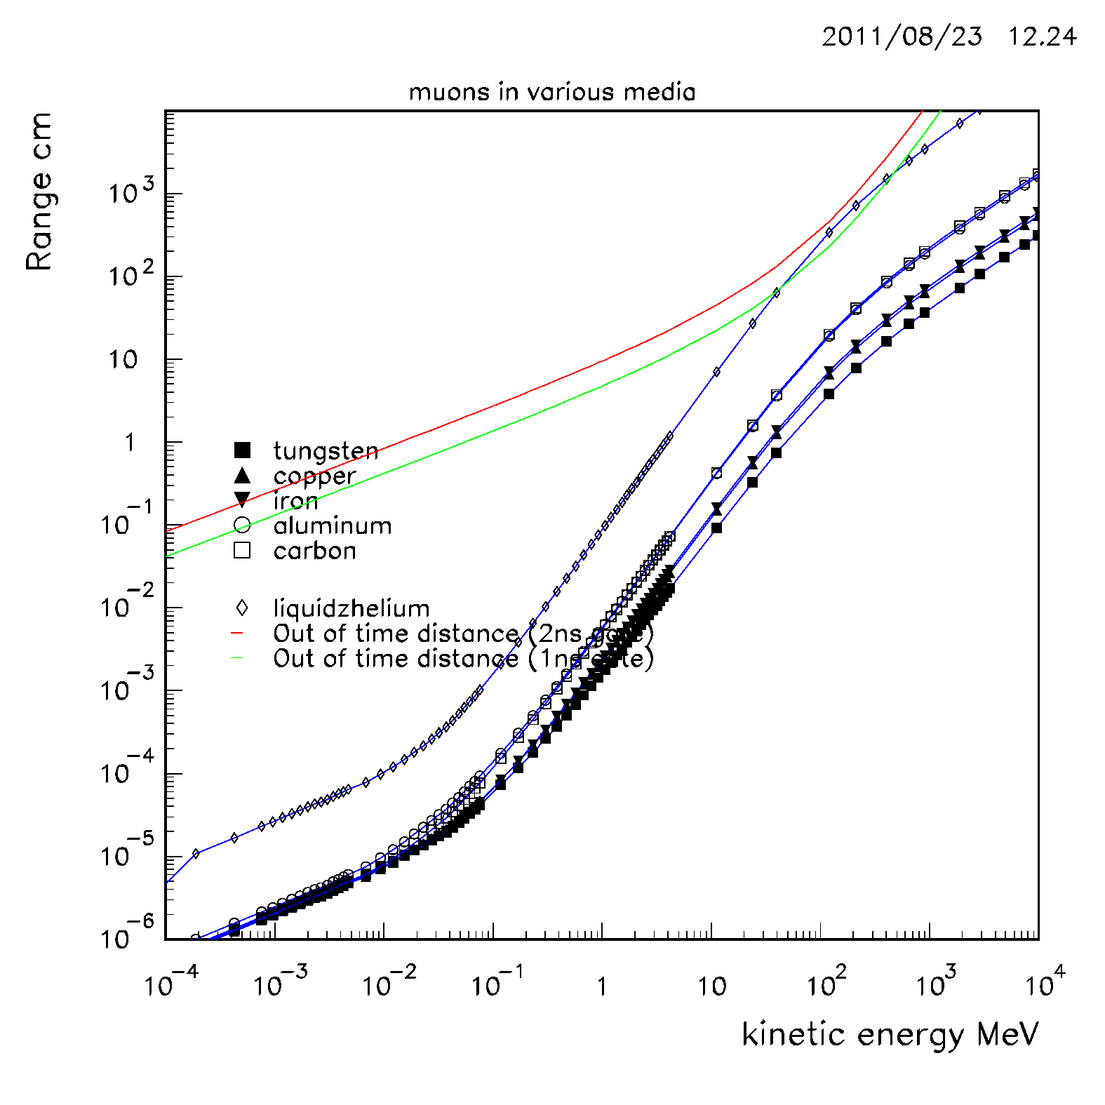
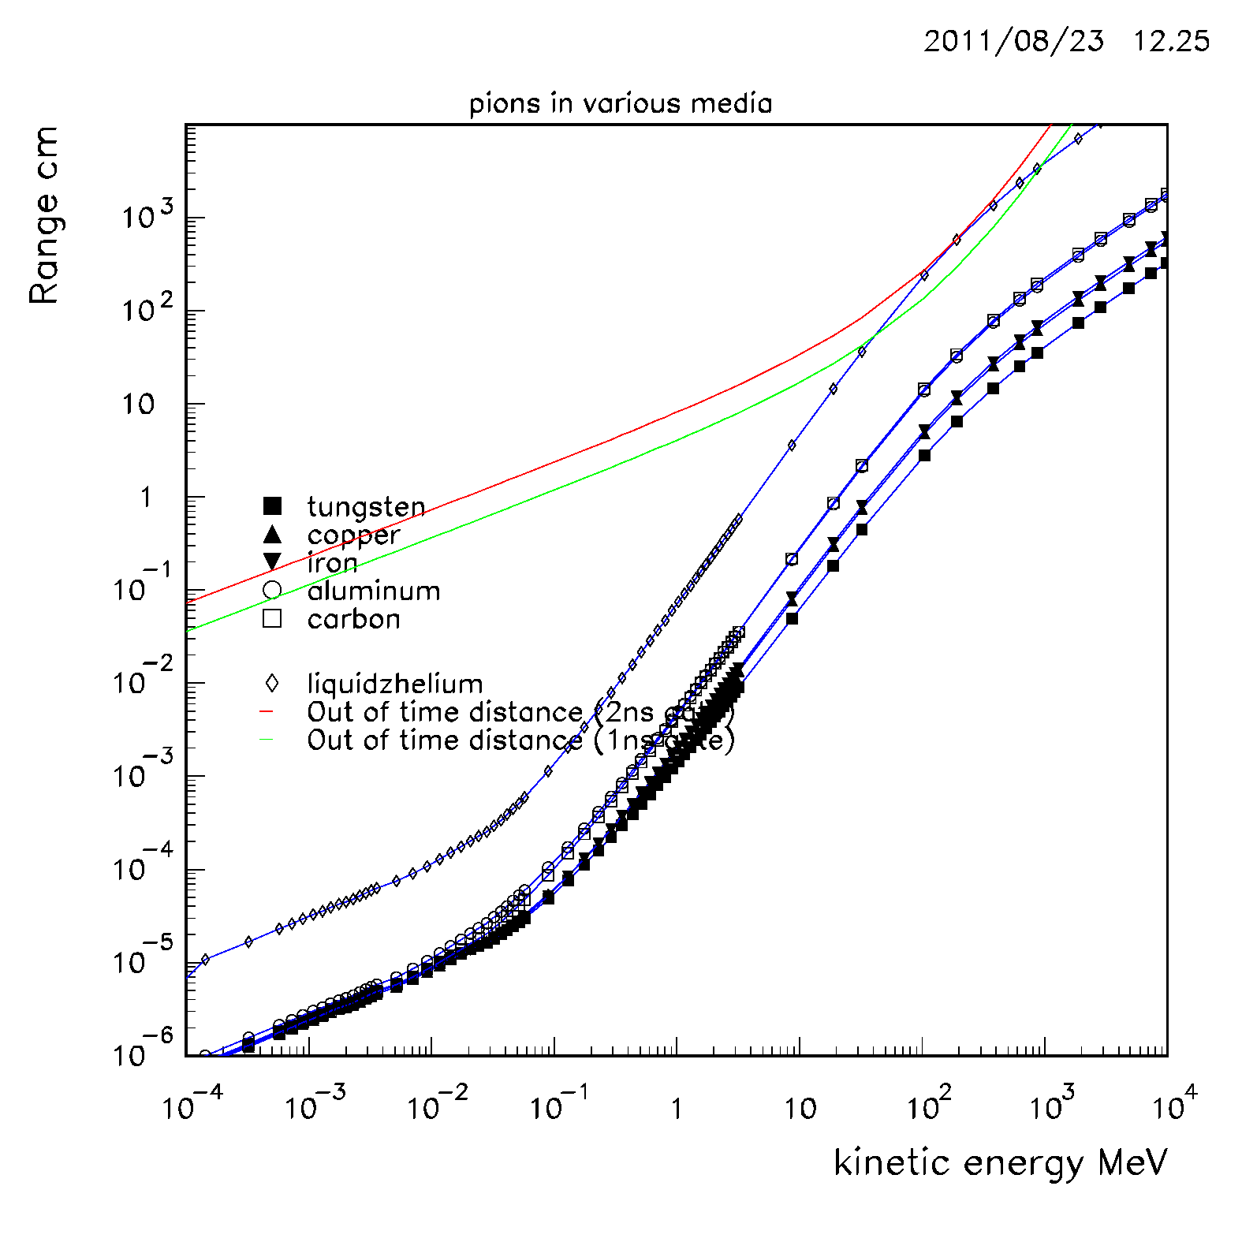
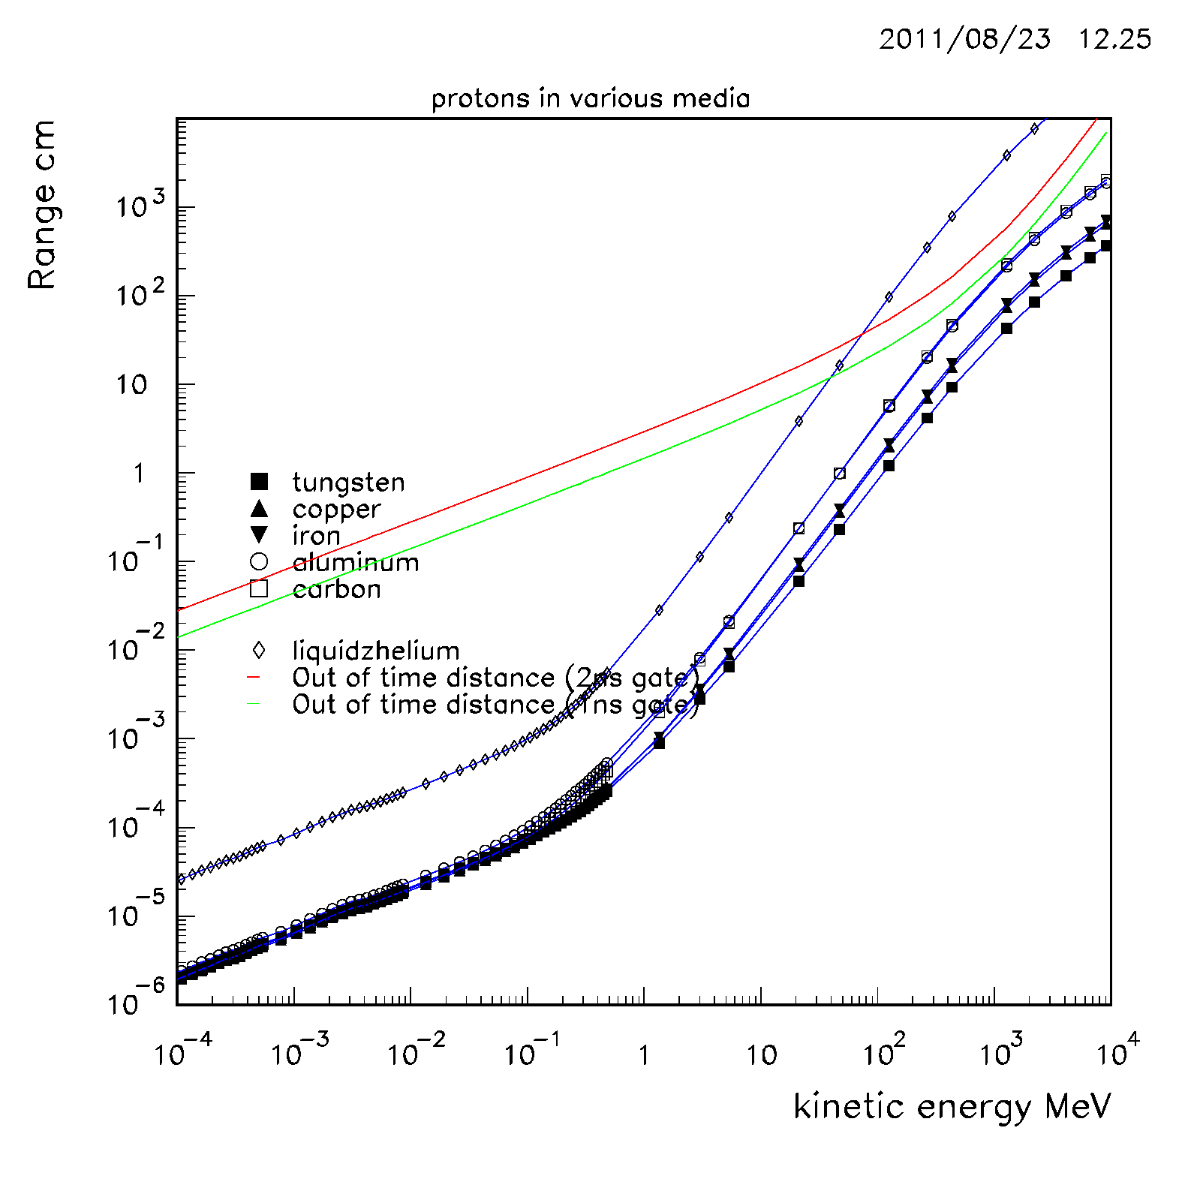
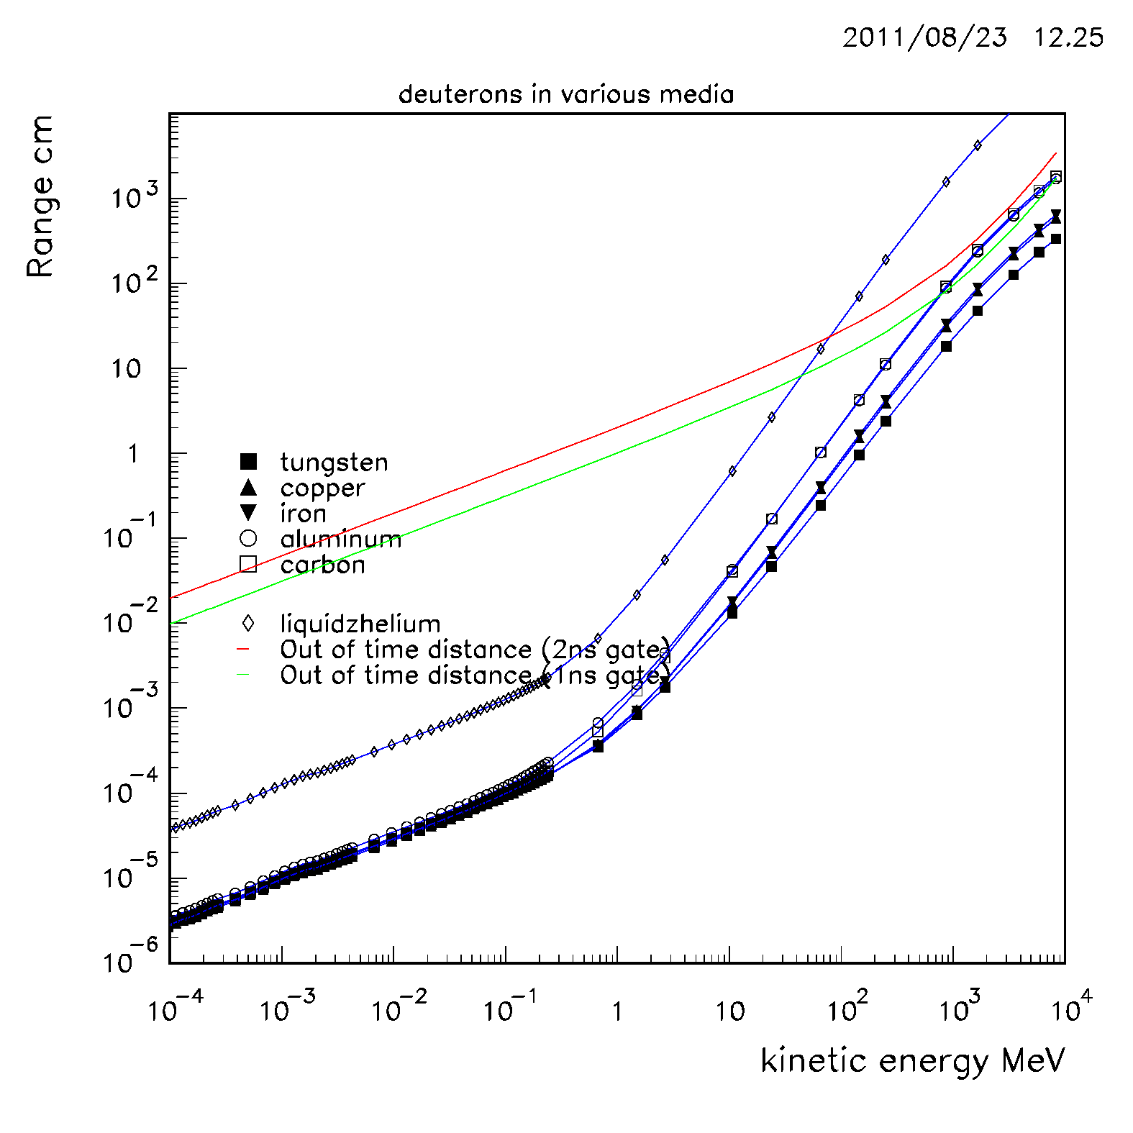
Range vs kinetic Energy

Slide 30
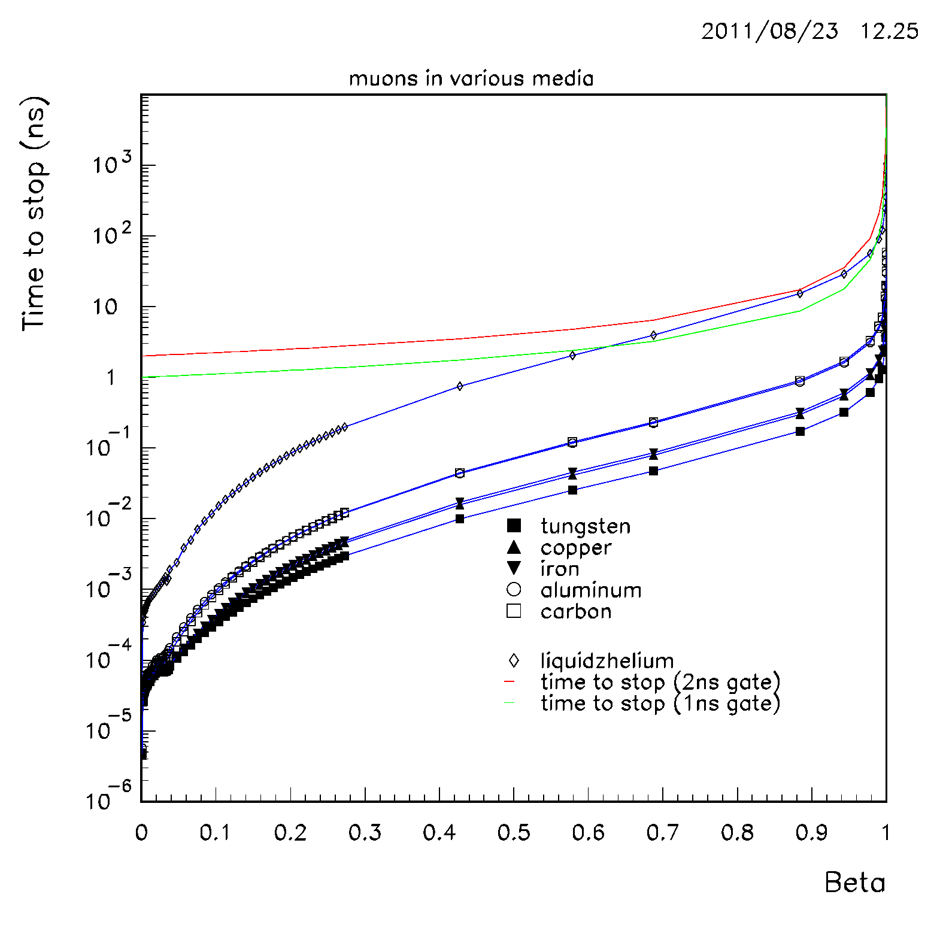
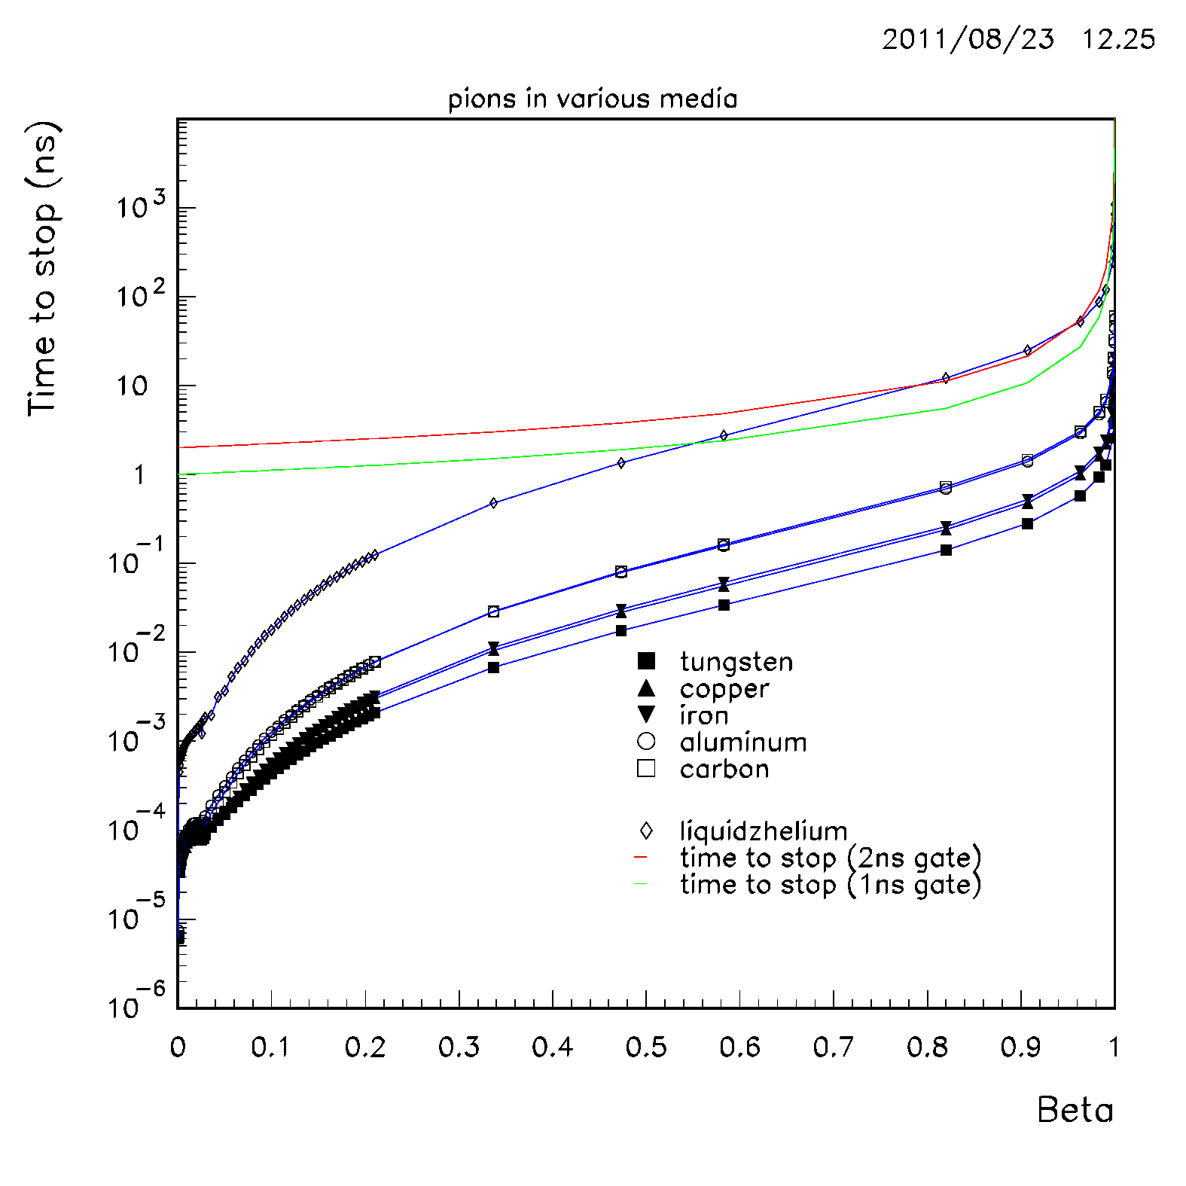
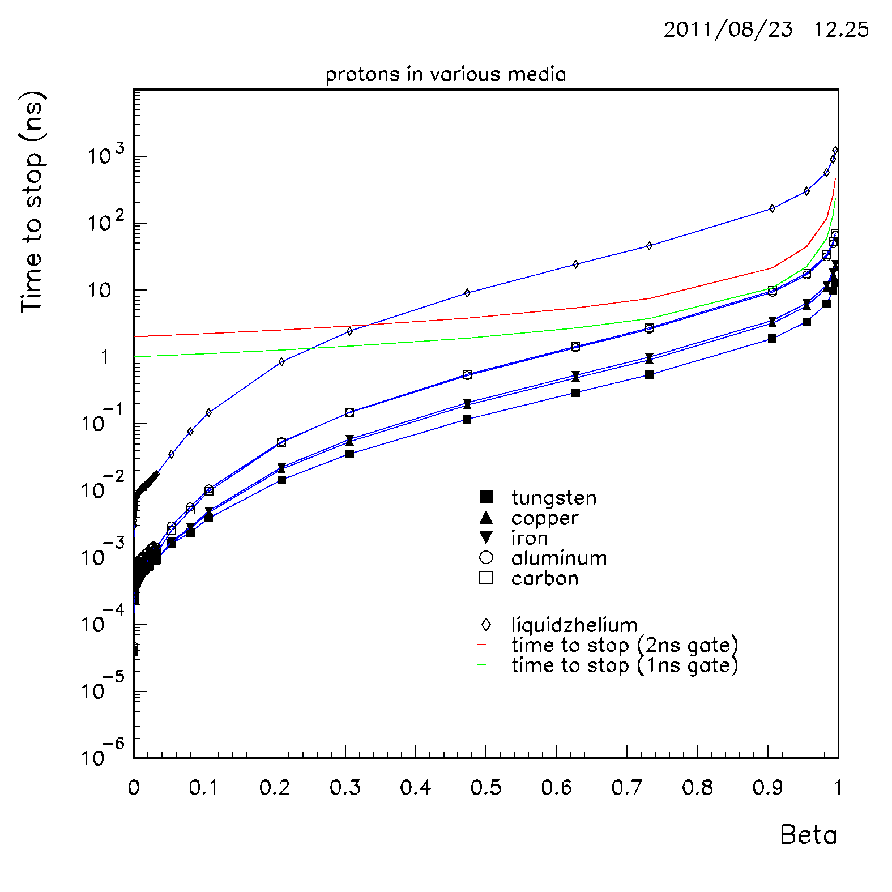
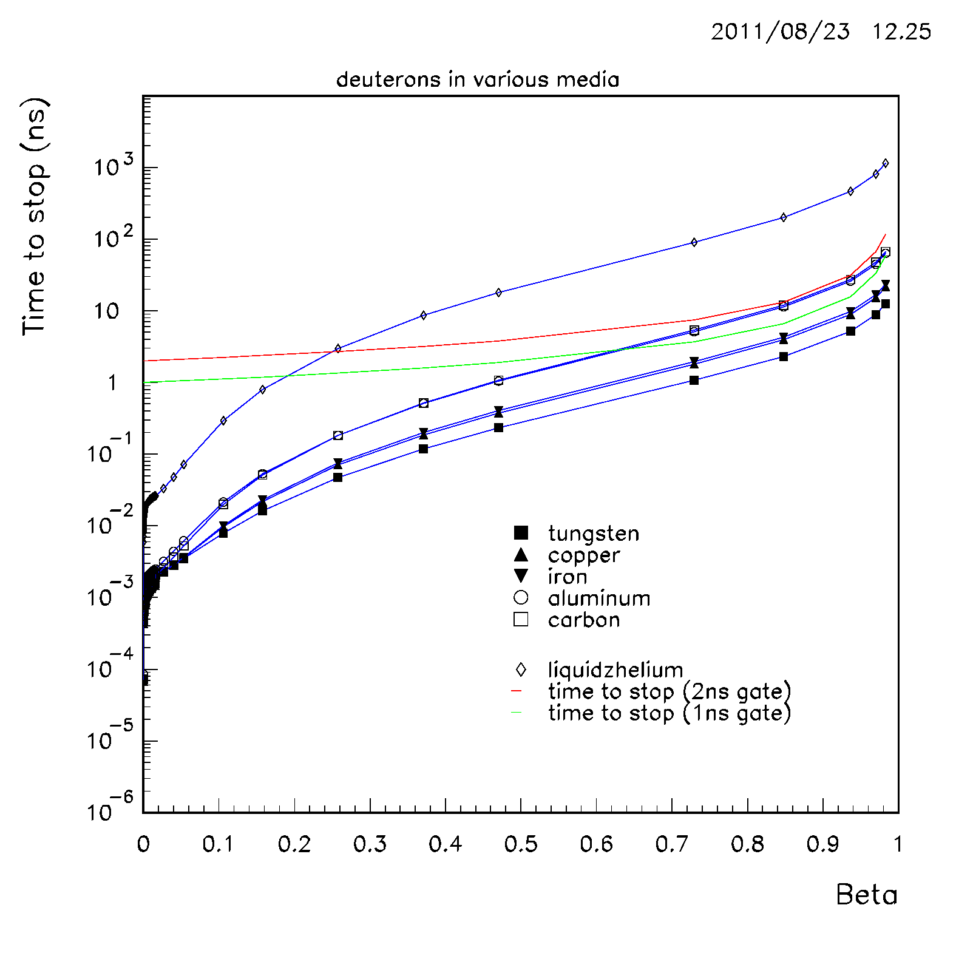
Time to stop vs β

Slide 31
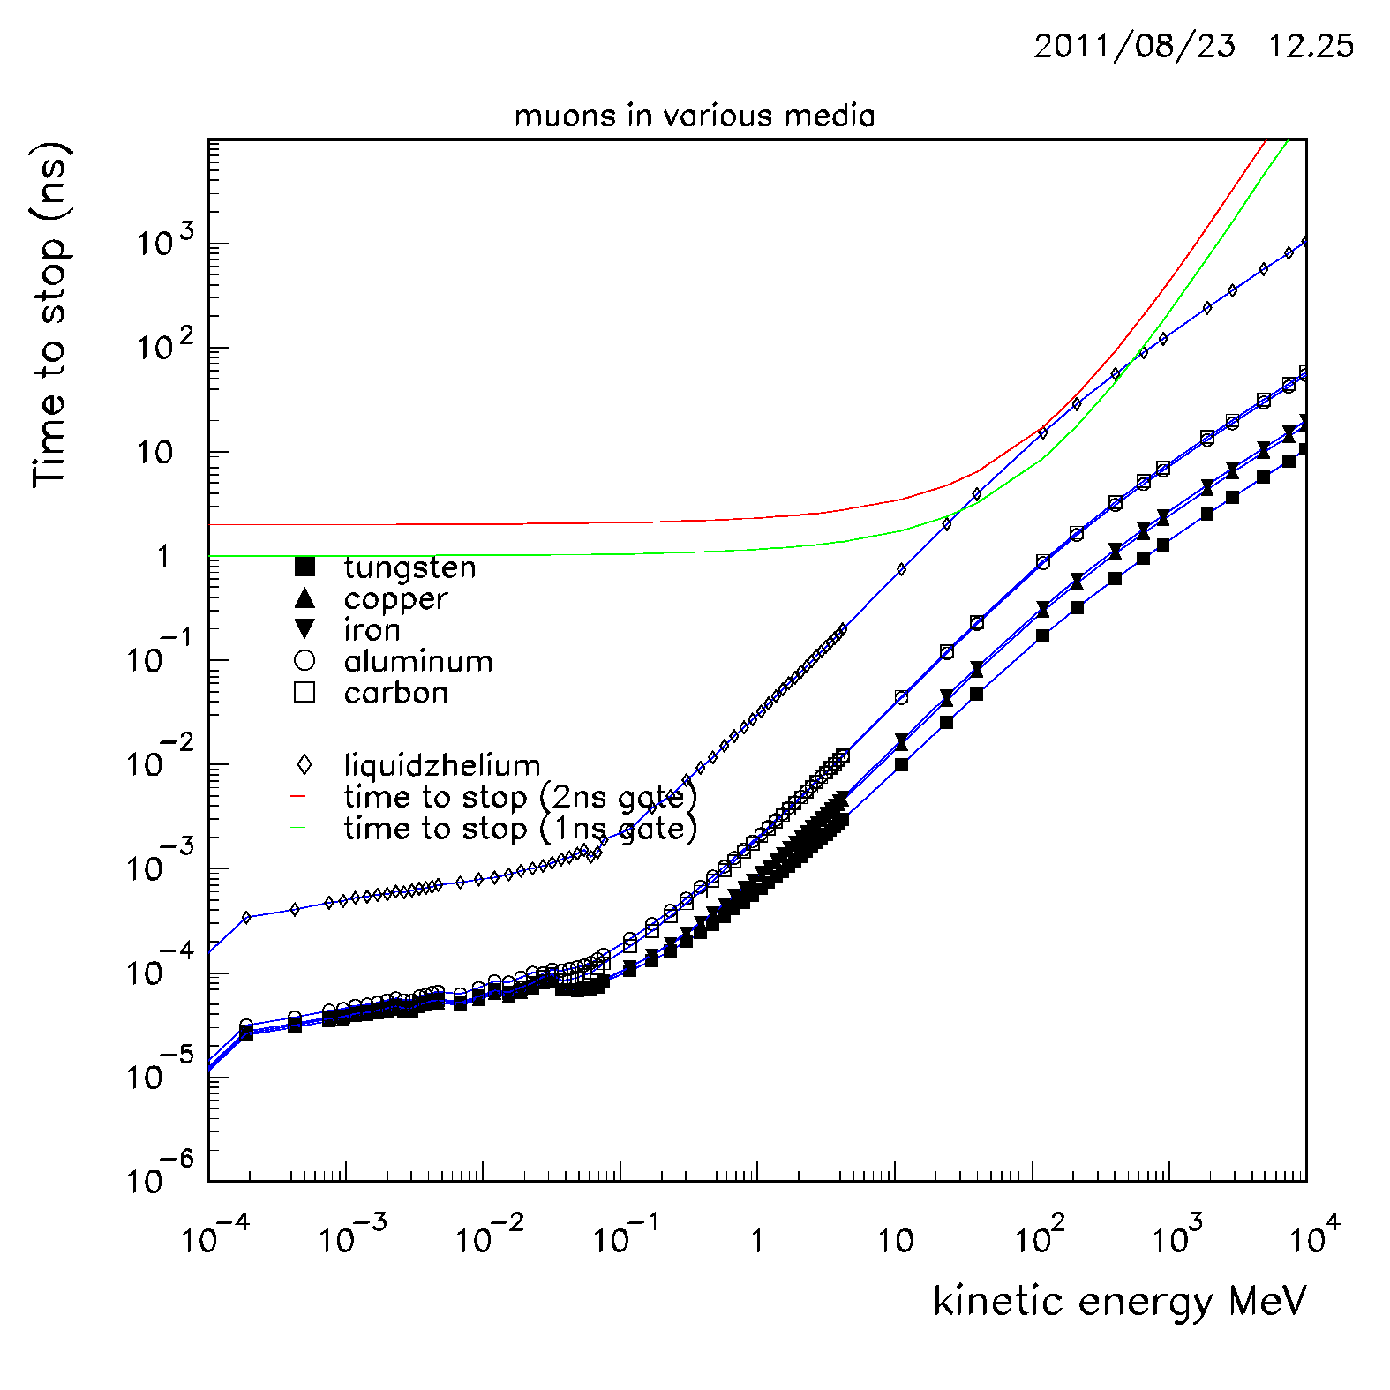
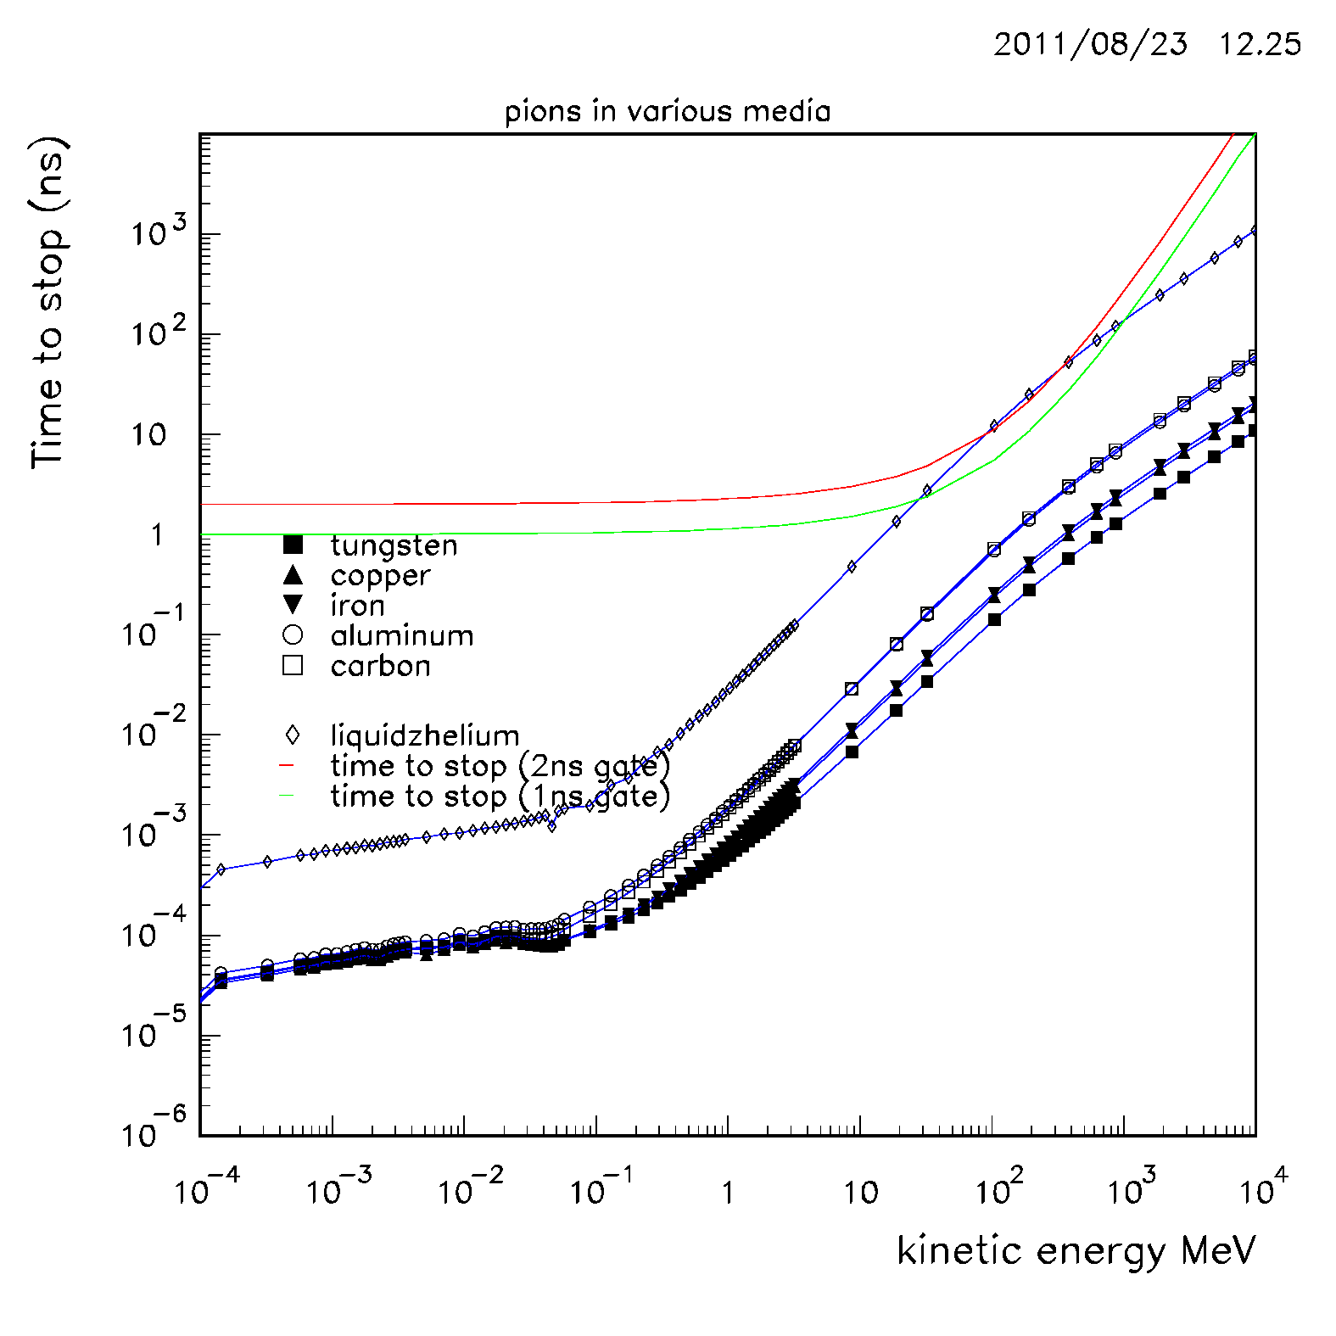
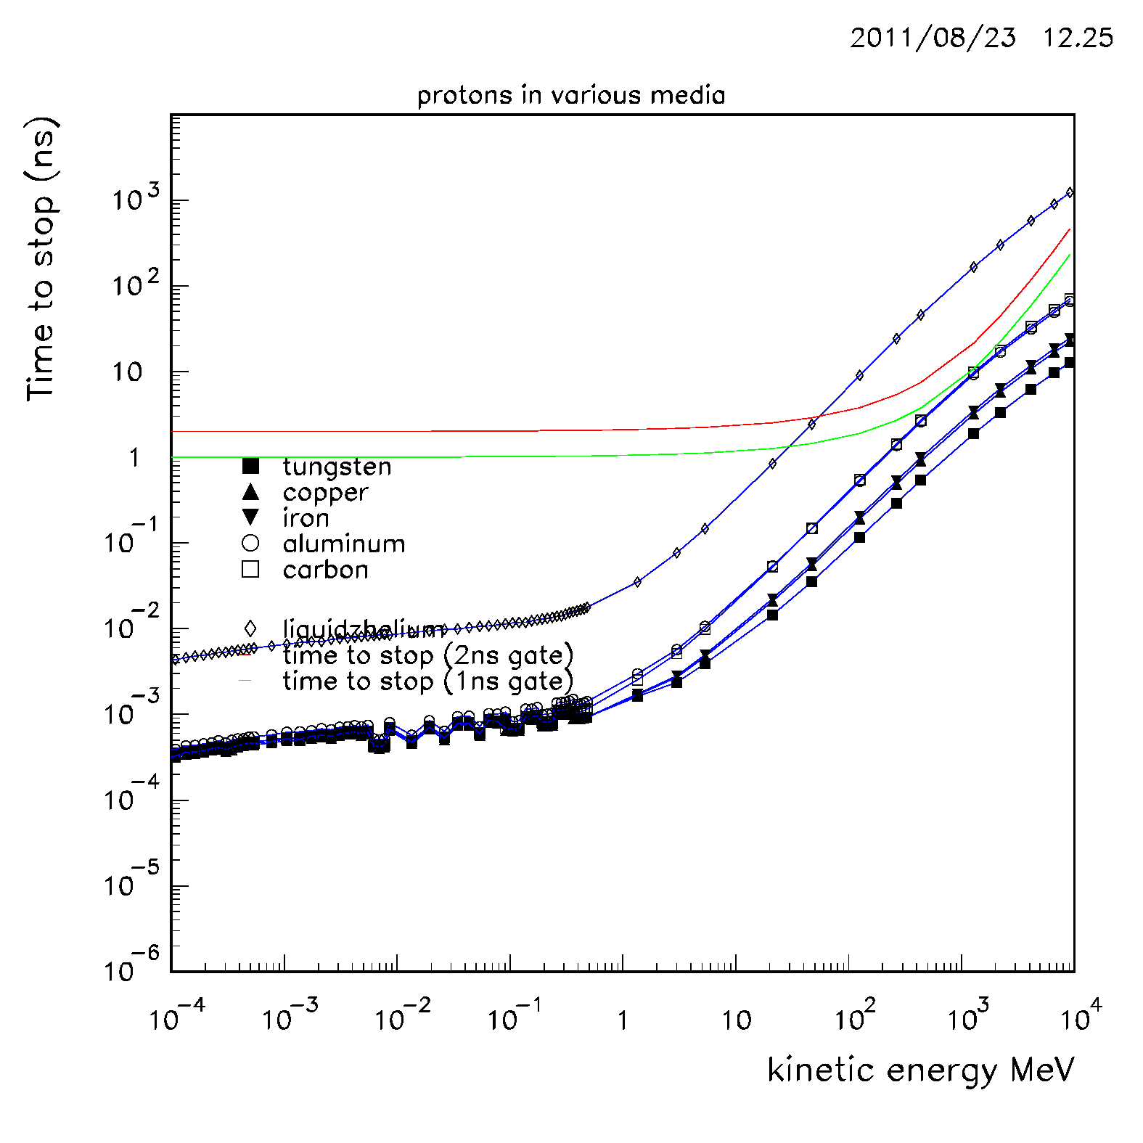
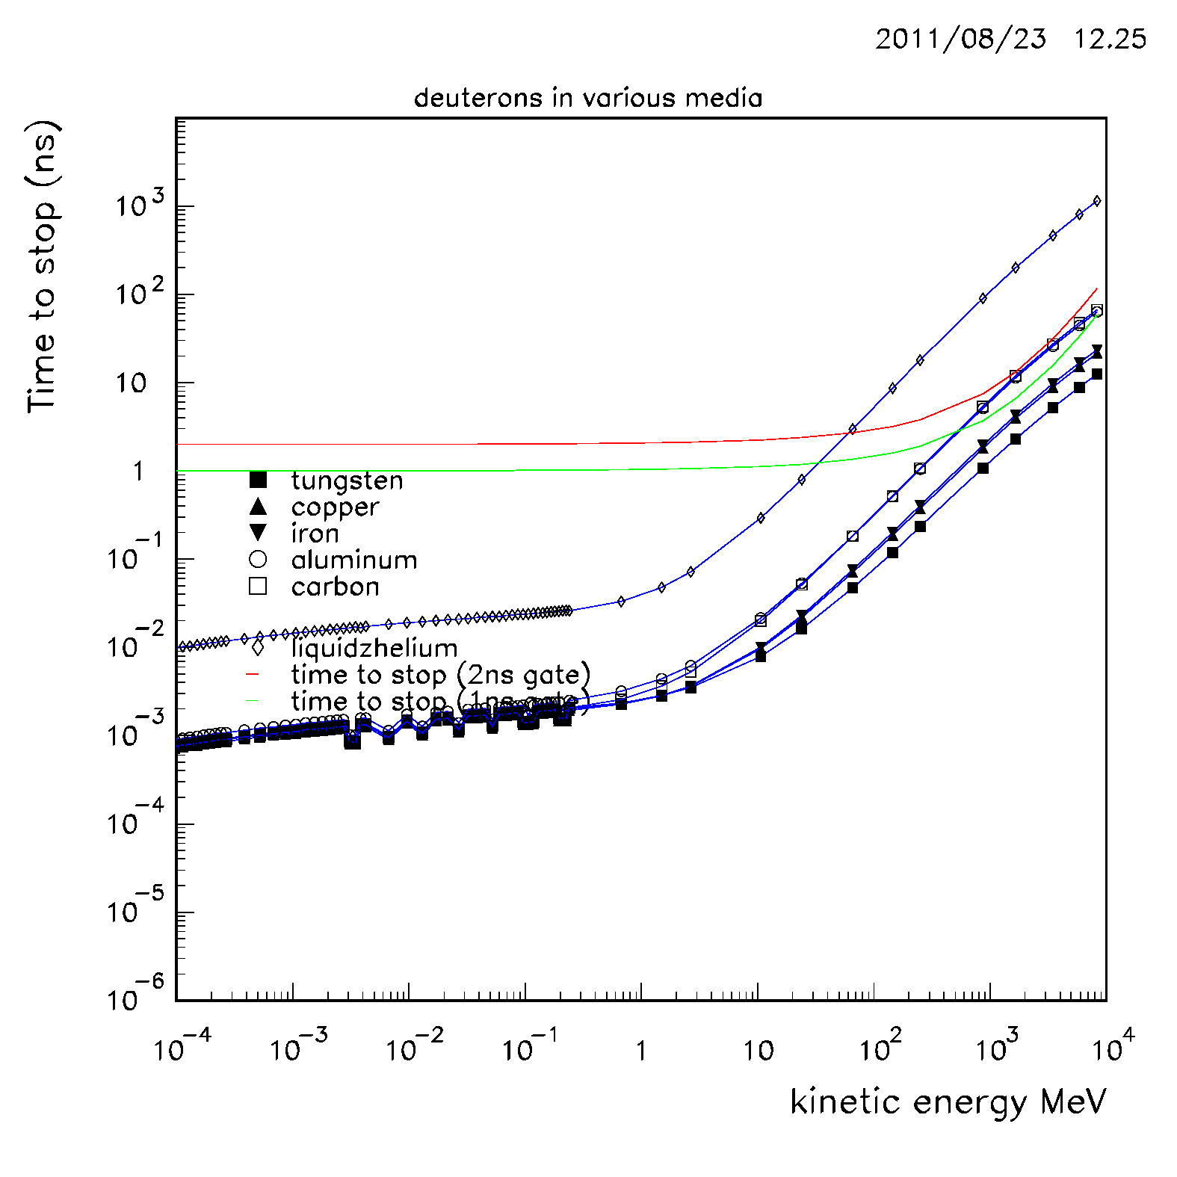
Time to stop vs Kinetic Energy

Slide 32
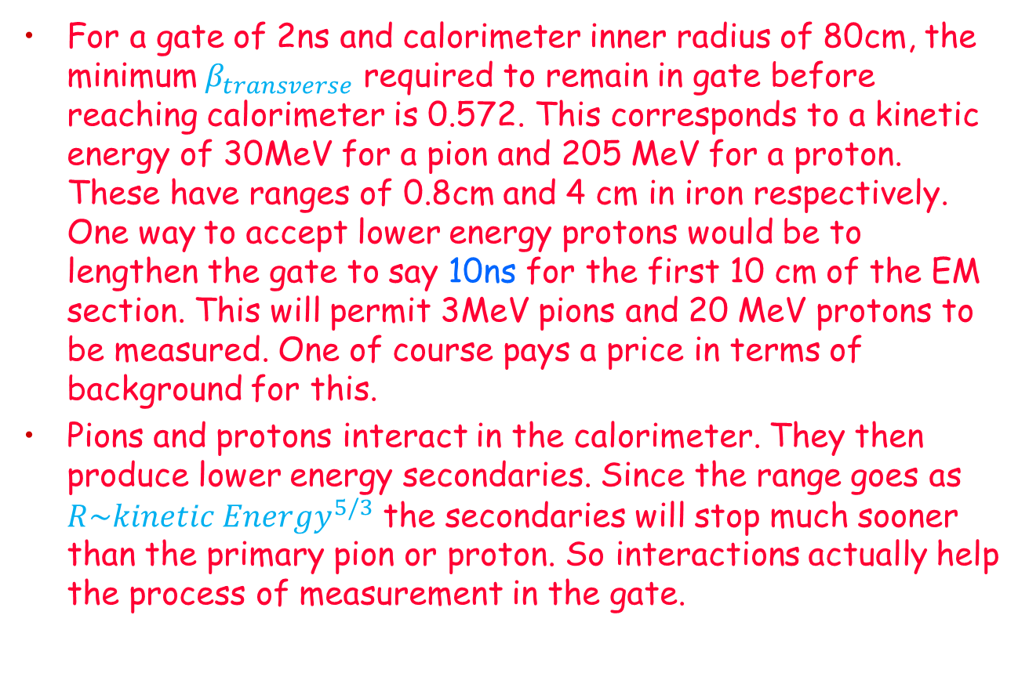
Tracking Dimensions and Interactions
For a gate of 2ns and calorimeter inner radius of 80cm, the minimum $β_{transverse}$ required to remain in gate before reaching calorimeter is 0.572. This corresponds to a kinetic energy of 30MeV for a pion and 205 MeV for a proton. These have ranges of 0.8cm and 4 cm in iron respectively. One way to accept lower energy protons would be to lengthen the gate to say 10ns for the first 10 cm of the EM section. This will permit 3MeV pions and 20 MeV protons to be measured. One of course pays a price in terms of background for this.
Pions and protons interact in the calorimeter. They then produce lower energy secondaries. Since the range goes as $R\sim {kinetic Energy}^{5/3}$ the secondaries will stop much sooner than the primary pion or proton. So interactions actually help the process of measurement in the gate.

Slide 33
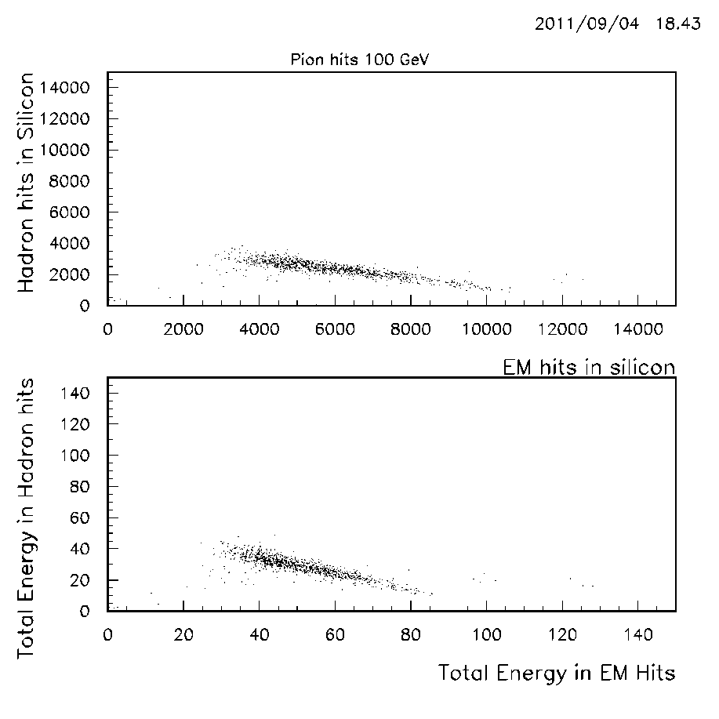
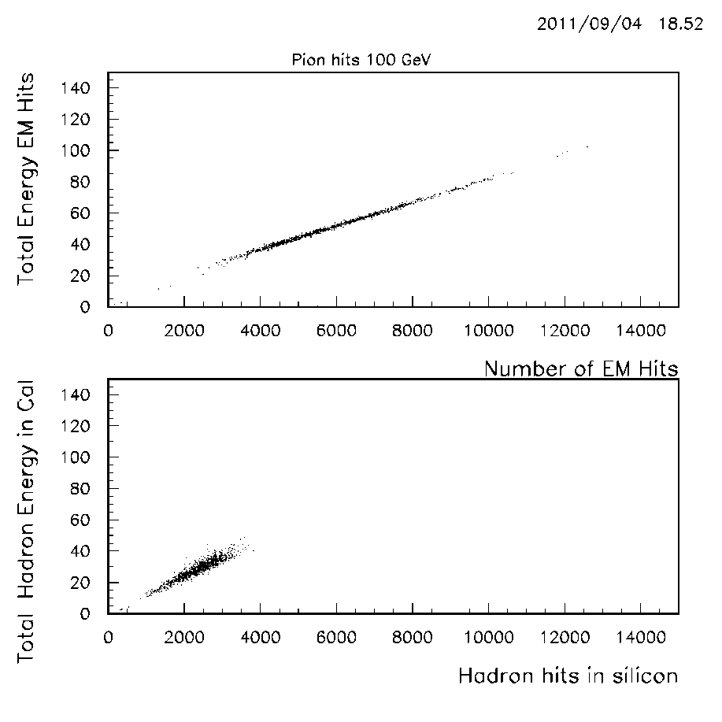
100 GeV pion distributions

Slide 34
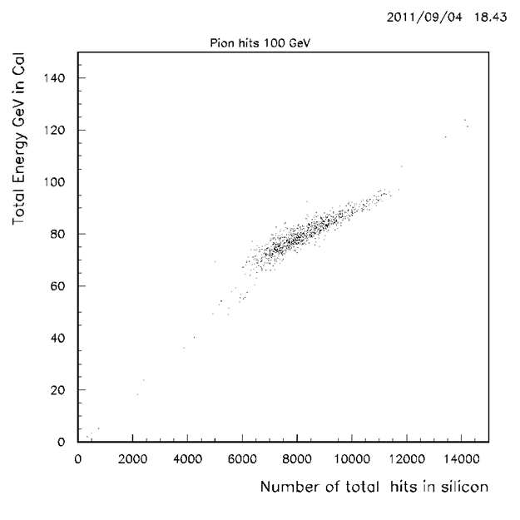
100 GeV pion distributions
All distributions canonical.
EM and hadronic hits and energy both anti-correlate
Hadronic energy does not reach 100 GeV when EM energy is small-due to lack of compensation in iron.
Digital calorimeter works and is software compensatable

Slide 35
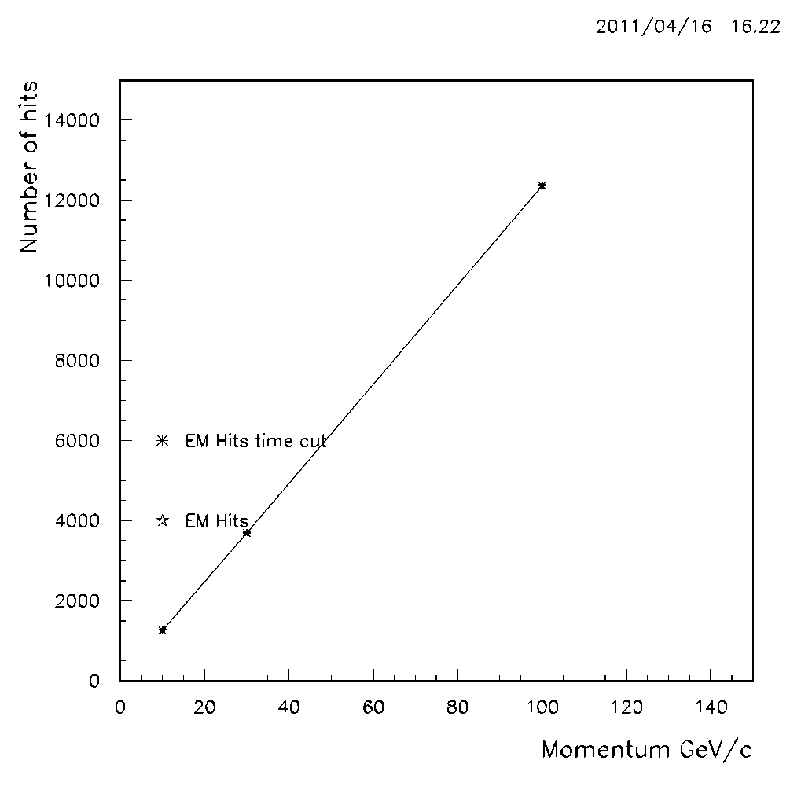
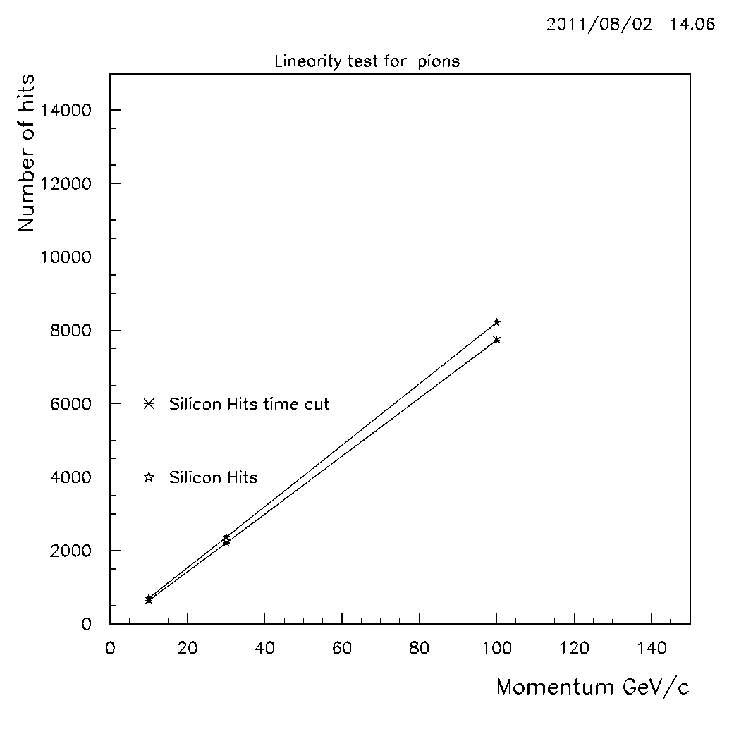
Linearity—Average number of its vs momentum

Slide 36
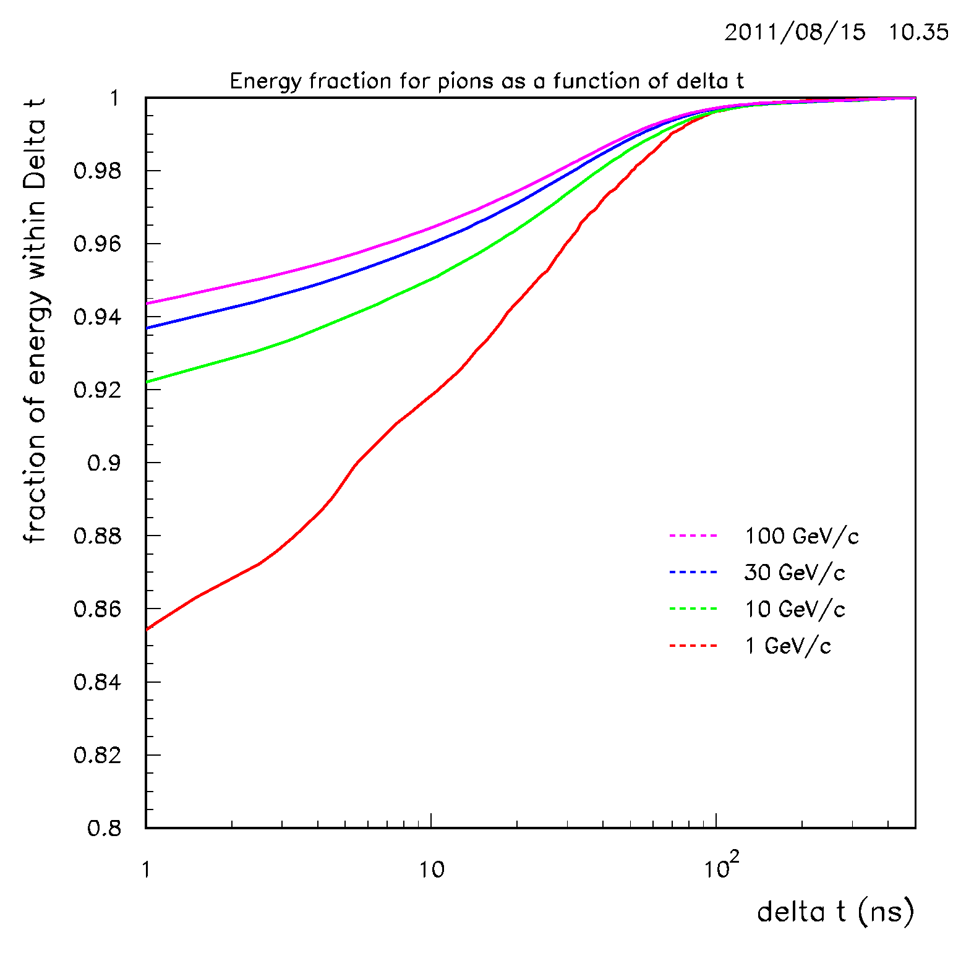
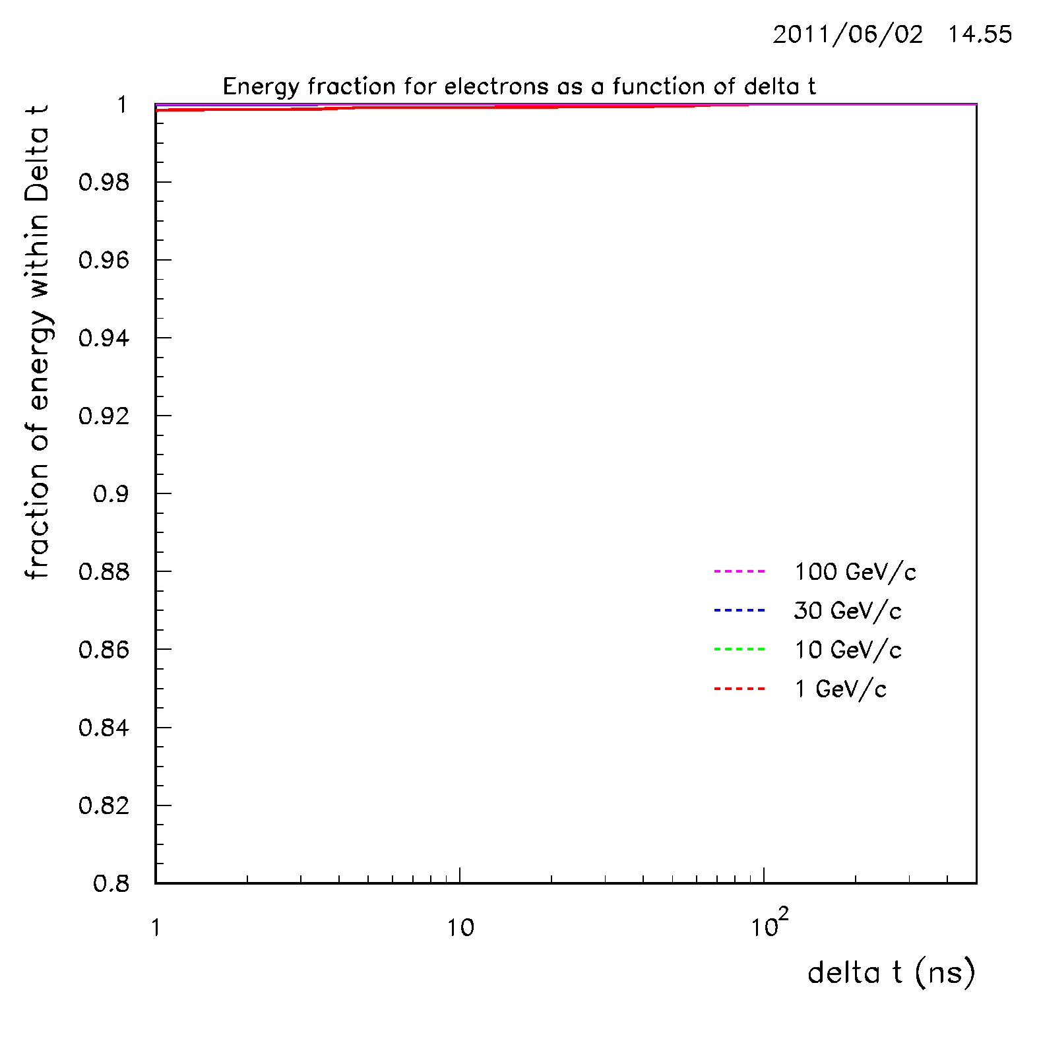
Fraction of energy captured vs time cut δt (ns)
Can correct individual particle energy non-linearity offline

Slide 37
e/π ratios and compensation
Pions leave less hits since they lose energy due to binding energy losses and undetected spallation neutrons. This results in e/π ratios greater than unity in uncompensated calorimeters—non–linearities as well as constant terms in resolutions.
EM hits vs hadronic hits can be separated by patter recognition via 2 methods
  Density of hits. EM hits denser
  Following hadron tracks and counting hadronic vertices. This is a new and powerful tool—new since Telluride
Assuming EM/Hadron hit separation, compensation results in 2 calibration constants one for a hadron hit and one for an EM hit
  EM=0.8578E-2 GeV/hit
  HAD=0.21018E-1 GeV/hit
The above assumes all hadron tracks same. Some have more vertices than others. Number of vertices is a better way to go.

Slide 38
Compensation 101
Hardware compensation– Wigmans—Neutrons from spallations can be made to knock on protons in hydrogenous material with large dE/dx and the amount of hydrogen can be tuned to make e/π ratios close to unity. Also improves linearity of calorimetry since the EM fraction in showers increases with energy and would produce non-linearities if e/π not unity.
Lack of compensation also introduces a constant term in the resolution function σ/E which will come to dominate at high E.
Software Compensation-We show that we can compensate the pixelated calorimeter in two different ways both done in software afterwards.
  Density of hits. EM hits are much more dense than hadronic hits. Software algorithm using pattern recognition of hit density needs to be written-Several man years. We assume that if it is obvious to human eye, the pattern recognition software can be made to exist. We use our MC knowledge of EM and hadronic hits.
  Least squares algorithm. We shine 1000 electrons at energies of 10, 30 and 100 GeV each and use the MC as a test beam. We then assume one calibration constant for EM hits and another for hadron hits and minimize the resolution function between the calorimeter energy and the beam energy using a 2x2 matrix inversion least squares algorithm
  Vertex counting technique– This is being introduced here. The difference in energy deposits is not in the hadronic tracks (mostly β=1) vs EM tracks (β=1). The loss of hadronic energy occurs at the hadronic vertices which are clearly pattern recognizable.
  Least squares algorithm– We treat EM and hadronic hits with the same calibration constant. Count the number of hadronic vertices in event as a second variable and associate a loss of energy depending on the number of vertices and again minimize least squares.
.

Slide 39
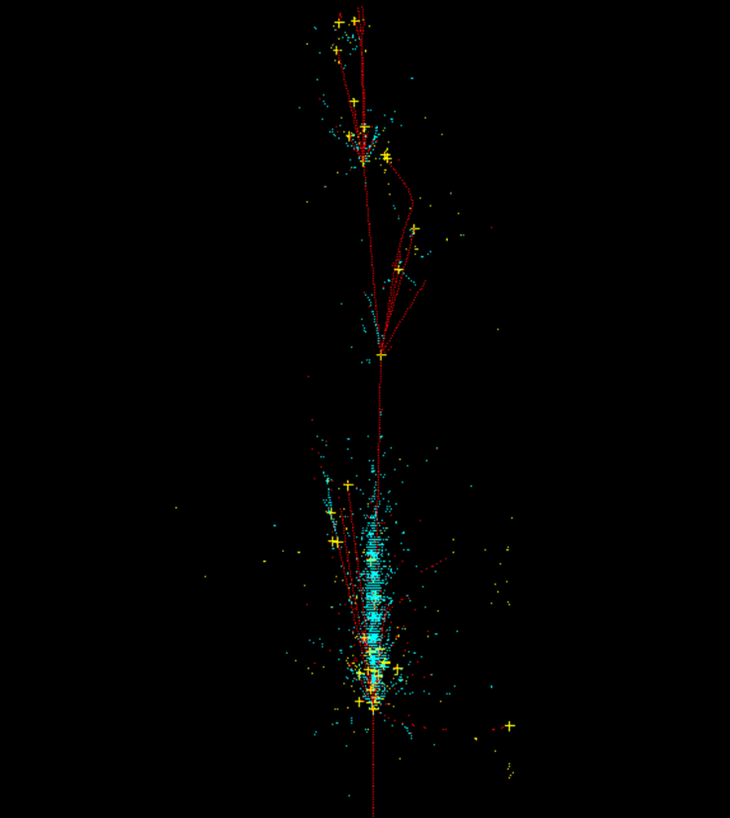
Vertex Counting
Again we use our knowledge of MC since pattern recognition algorithms need several man years of effort.
Three different cuts used to define vertices
Cut-1 = hadronic vertices with charged beam track
Cut-2 = Cut-1 AND difference in KE between incoming and outgoing tracks > 0.1 GeV
Cut-3 = Cut-2 AND more than 1 outgoing charged track.
Yellow crosses mark Cut-2 vertices on 100 GeV pion shower.

Slide 40
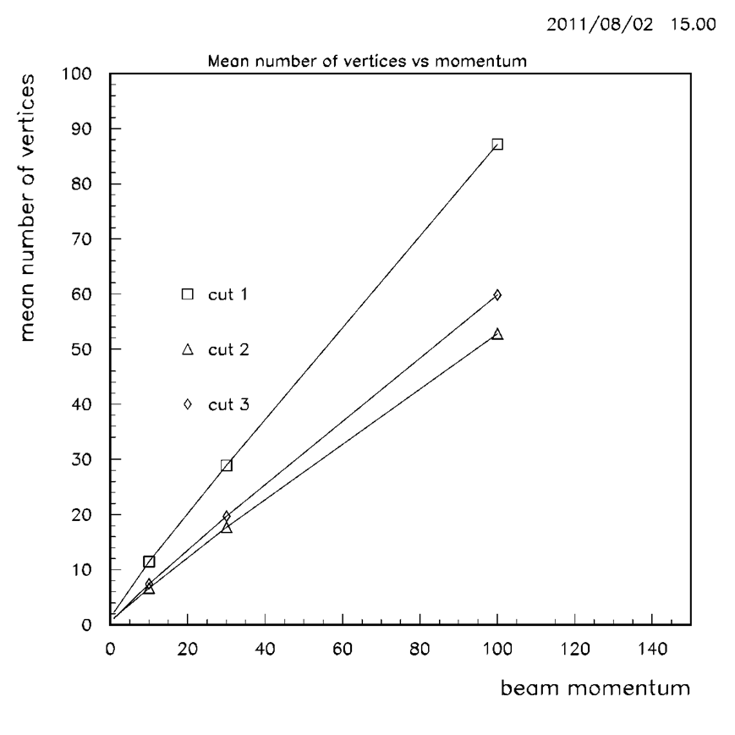
Vertex Counting
Mean number of vertices vs beam momentum for cut1, cut2 and cut3
Linearity of mean number of vertices established (in Geant3 model).
Essential for this to be true for this method to produce energy independent calibration terms.

Slide 41
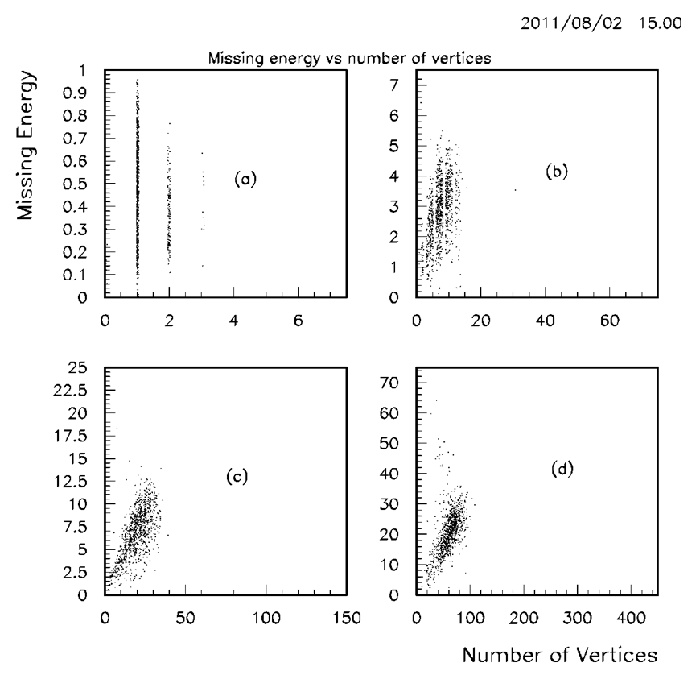
Vertex counting—Cut 2
1 GeV pion beam
10 GeV pion beam
30 GeV pion beam
100 GeV pion beam
Number of vertices is proportional to missing energy. So method should work to compensate for missing energy by counting hadronic vertices. It works for all three cuts.
When pattern recognition is developed, there will be a new vertex selection. It does not have to perfect for this method to work.

Slide 42

e/π ratios with and without compensation

Slide 43


Calorimeter resolutions--Hadrons

Slide 44


Calorimeter Resolutions--Electrons
EM resolutions can be further improved using EM correlations and finding weights rather than simple hit to energy conversion factors—work to be done.

Slide 45


Calibration constants for electrons and pions using density compensation method
Vertex counting technique treats EM and hadron hits identically. Missing hadronic energy proportional to the number of vertices

Slide 46
Remaining Backgrounds
We have eliminated significant backgrounds using Theorem 1. This is possible because each pixel is individually triggerable.
Remaining particles have to be tracked in Geant and will come into time as per theorem 2 depending on where and when the particle enters the calorimeter.
Because of the excellent granularity of the calorimeter, we are able to employ maximum pattern recognition to eliminate remaining backgrounds. But only barely….!!!

Slide 47

Remaining backgrounds-Calorimeter
Both beams | Total | Theorem1 < 2ns | fraction | Energy | Energy in time | Overall reduction
 |  |  |  | GeV | GeV
EM | 1.98E+08 | 2.43E+06 | 1.23E-02 | 1075.3 | 453.9 | 5.18E-03
MUONS | 2.89E+03 | 5.77E+02 | 2.00E-01 | 585.3 | 12.5 | 4.27E-03
MESONS | 1.97E+04 | 2.99E+03 | 1.51E-01 | 302.9 | 56.9 | 2.84E-02
BARYONS | 4.59E+07 | 4.41E+05 | 9.62E-03 | 9444 | 432.8 | 4.41E-04

Slide 48
Remaining backgrounds-Tracking
 | Theorem1 <2ns hits | In time Hits | In time hits/layer
EM | 100282.6 | 48175.2 | 2.41E+03
MUONS | 7653.7 | 674.1 | 3.37E+01
MESONS | 53206.2 | 10654.6 | 5.33E+02
BARYONS | 218937.1 | 22962.7 | 1.15E+03

Slide 49

Baryons all times-Theorem 1-Yellow out of gate.

Slide 50

Baryons 0 <δt< 2ns

Slide 51

Mesons all times- Theorem1- yellow out of gate

Slide 52

Mesons 0 <δt< 2ns

Slide 53

EM All times-Theorem 1- Yellow out of gate

Slide 54

EM 0 <δt< 2ns

Slide 55

Muons All times-Theorem1- Yellow out of gate in calorimeter. Green muon tracks in tracker.

Slide 56

Muons 0 <δt< 2ns

Slide 57

Pseudo Rapidity of background

Slide 58

Azimuthal distribution of background

Slide 59

Layer in calorimeter of background

Slide 60

Momentum Distribution of background

Slide 61

Particle composition (Geant3 Id) of background

Slide 62

Signal event WW fusion to Higgs

Slide 63

Total background In-time hits in Calorimeter layers
9000 hits total in layer 1.
Number of pixels in layer1= 1.99E9
This is an occupancy of4.5E-6
Total In-time Hits in calorimeter =117931 (mostly in EM layers)

Slide 64
Can we pattern recognize the event embedded in the remaining background?
Muons can be pattern-recognized away.
So can Mesons.
Baryons and EM pose a problem.
Need to superimpose them on the signal.
  My graphics card runs out of memory!!
However, the following observations hold
  Hadronic tracks in calorimeter can be followed even if here are neighboring cloud of uncorrelated hits.
  EM showers will have background superimposed.
  Question—How much?

Slide 65
Moliere Radius analysis
Moliere radius of electron in iron =2.7cm.
Look at the part in Z where there is most deposition.
EM showers confined to 100 layers (22 radiation lengths).
Ask how much energy is deposited in an EM shower size volume due to background.

Slide 66

100 GeV pion in Calorimeter

Slide 67
Moliere Radius Analysis
both beams | In Moliere Volume | In Time
 | MeV | MeV
EM | 136.42 | 57.58
MUONS | 27.28 | 0.58
MESONS | 17.05 | 3.20
BARYONS | 852.62 | 39.07
 | Total (MeV) | 100.44 ±29

Slide 68
Conclusions
We have proposed a highly granular digital pixel calorimeter with a “travelling trigger” that can trigger the individual pixels with a 2 ns gate.
Without travelling trigger, one will need ~30ns gate for all of calorimeter to be alive. So it produces at least a factor of 15 in background reduction.
Resulting Calorimeter is compensatable and works.
We have introduced a new compensation scheme—vertex counting. Applicable to LAr TPC’s
We have proposed 2 schemes to compensate the calorimeter.
The muon collider backgrounds are effectively managed by such a device.
Tracking using similar scheme is possible
There is no separate muon system needed for such a detector, since the calorimeter is the muon system.
The concepts of particle flow and compensation merge in this approach. If the momentum for a particular charged track is better measured using the magnetic field, then that information is used in conjunction with the calorimeter energy, that is available track by track to get an energy value that is better than both measurements.
The Tungsten cone should be instrumentable using the same technology and timing can be used similarly. Needs MARS backgrounds in the cones to estimate signal/noise.

Slide 69
Conclusions
Suggestions for implementation
  Silicon Pixels
  Inkjet printing of circuits using materials such as carbon nanotubes, OLED. Being done now.
  Silicon Photomultipliers?
If this technology can be made cheap, one can envisage highly granular magnetized neutrino detectors that can be used for neutrino factory purposes as well as conventional neutrino beams.

Slide 70

100 GeV pion all times. Out of time hits in yellow

Slide 71
100 GeV pion enlarged

Slide 72
100 GeV pion very enlarged

Slide 73
30 GeV electron

Slide 74
100 GeV electron

