Slide 1
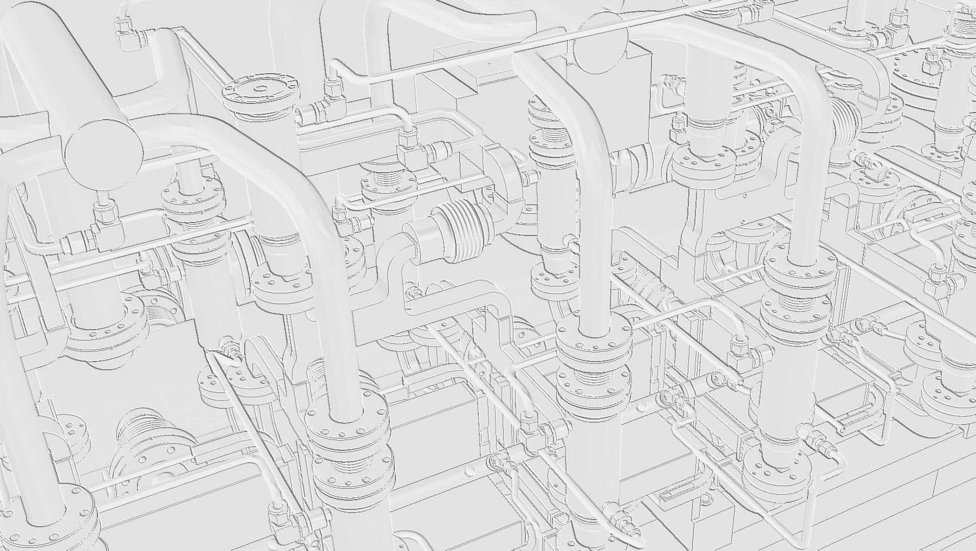
LCWS11 WG4
Fully featured accelerating structure
engineering design
G. Riddone on behalf of the eng. design team
(great contribution from A. Solodko)
28.09.2011

Slide 2
Contents
Introduction
Mechanical Design of Copper Discs and Compact Couplers
Mechanical Design of Vacuum Manifolds
Wake Field Monitor Design
Interconnection Design
Alignment Features
Super Structure Main Assembly Steps
Dedicated Tests
Conclusions

Slide 3
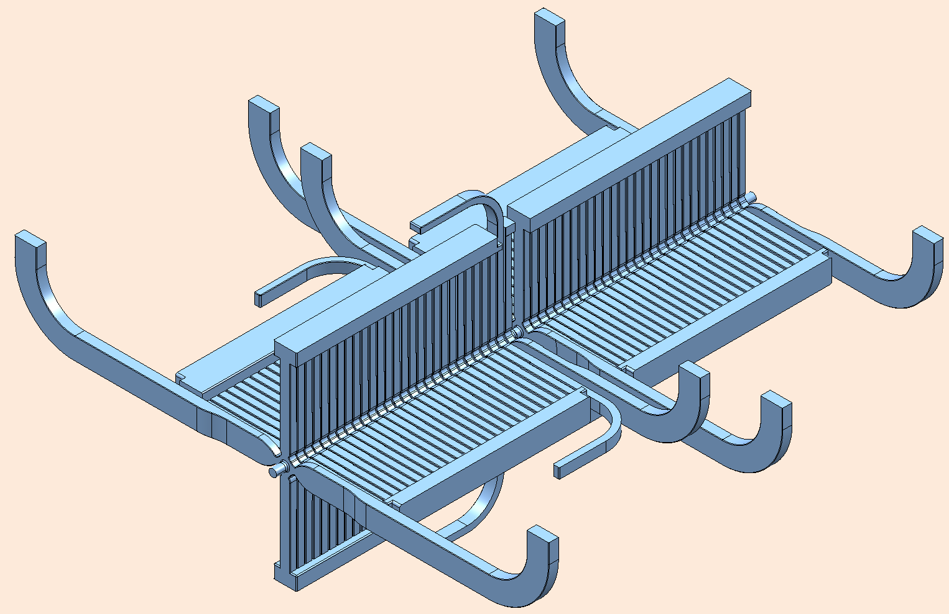
Introduction
1. Each Accelerating Structure consists of:
26 regular cells with four damping waveguides
2 compact coupler cells with two damping waveguides and other two opposite waveguides for WR90 connections
2. 4 WFMs are integrated in the first cell of the second AS
WFM
1st AS
BEAM
DIRECTION
WR90
2nd AS
L_{SAS}=502.5mm (1/4L_{MODULE})
COMPACT COUPLER

Slide 4
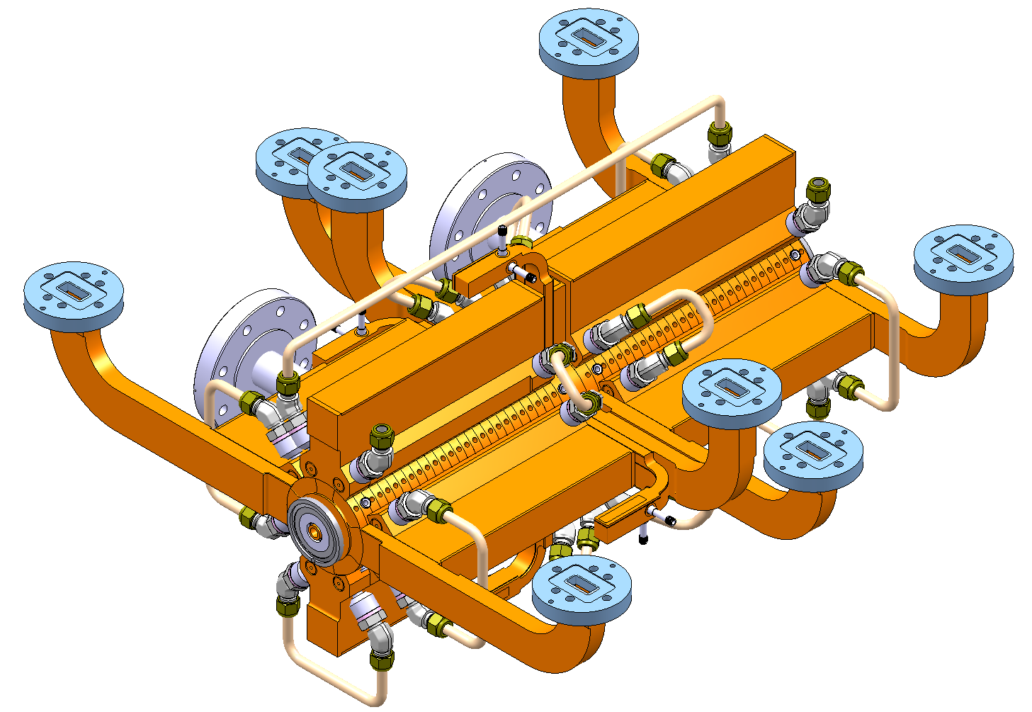
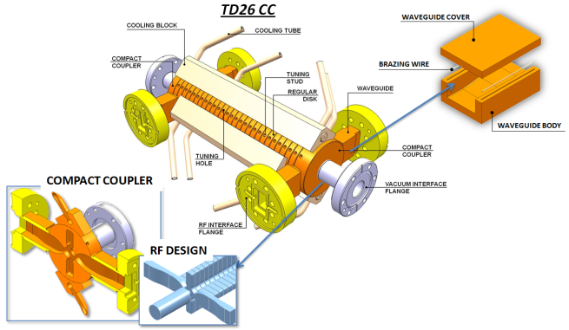
Engineering Design Overview
VACUUM FLANGE
VACUUM MANIFOLD
& COOLING SYSTEM
RF FLANGE
VACUUM PORT
BEAM
DIRECTION
ALIGNMENT
1st AS
VACUUM PORT
2nd AS
502.5 mm
WAVEGUIDE
INTERCONNECTION
COOLING FITTING
WFM WAVEGUIDE
BEAM
DIRECTION
243.701 mm
COOLING TUBE
BONDED DISC STACK
Compact coupler design (already in TD26 CC);
The body of an AS formed by high-precision copper discs joint by diffusion bonding at 1040 °C;
Two AS are brazed together to form a superstructure (SAS);
The SAS has 8 vacuum manifolds and 4 Wakefield Monitor (WFM) waveguides;
The cooling system is integrated into the vacuum manifolds in order to provide a more compact technical solution.

Slide 5
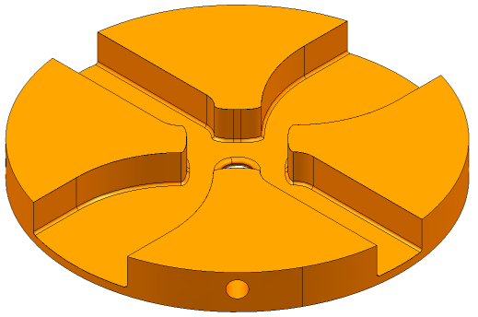
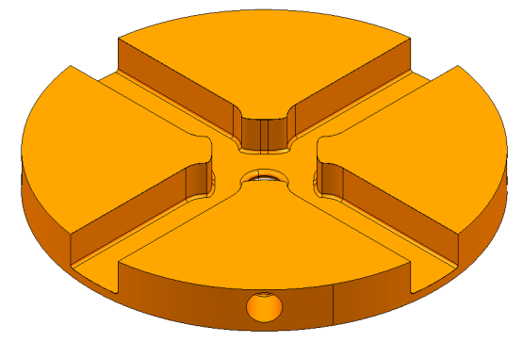
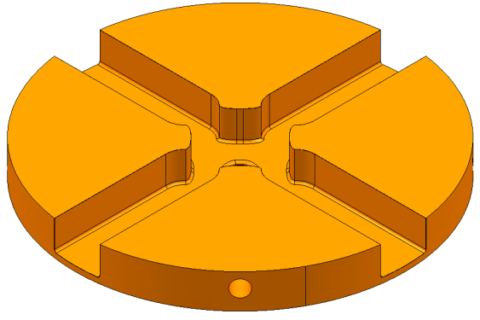
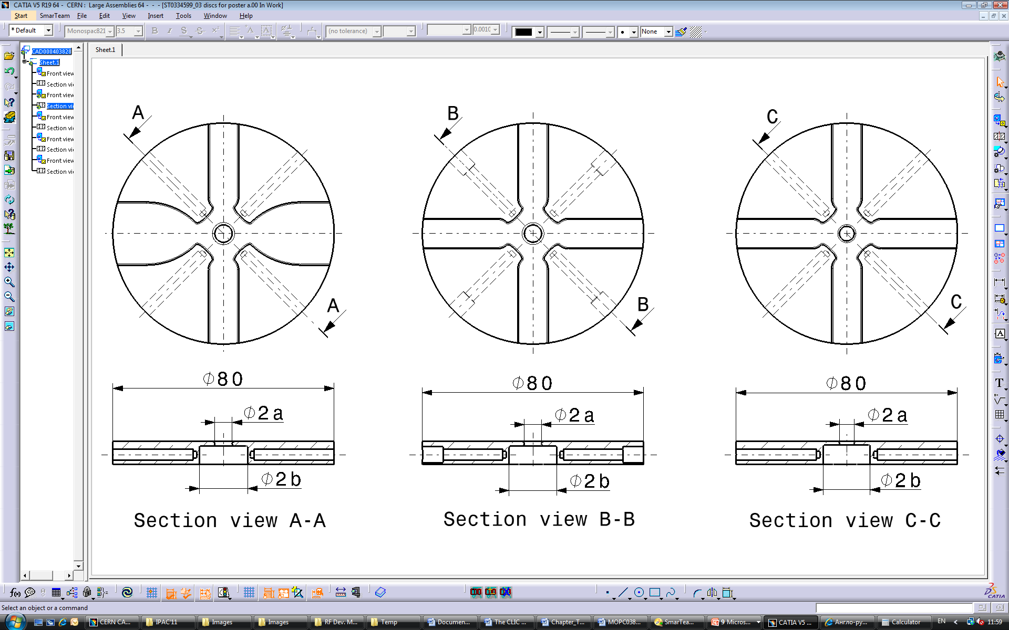
Mechanical Design of Copper Discs and Compact Couplers
Compact Coupler Cell
Cell with Alignment Features
Regular Cell

Slide 6
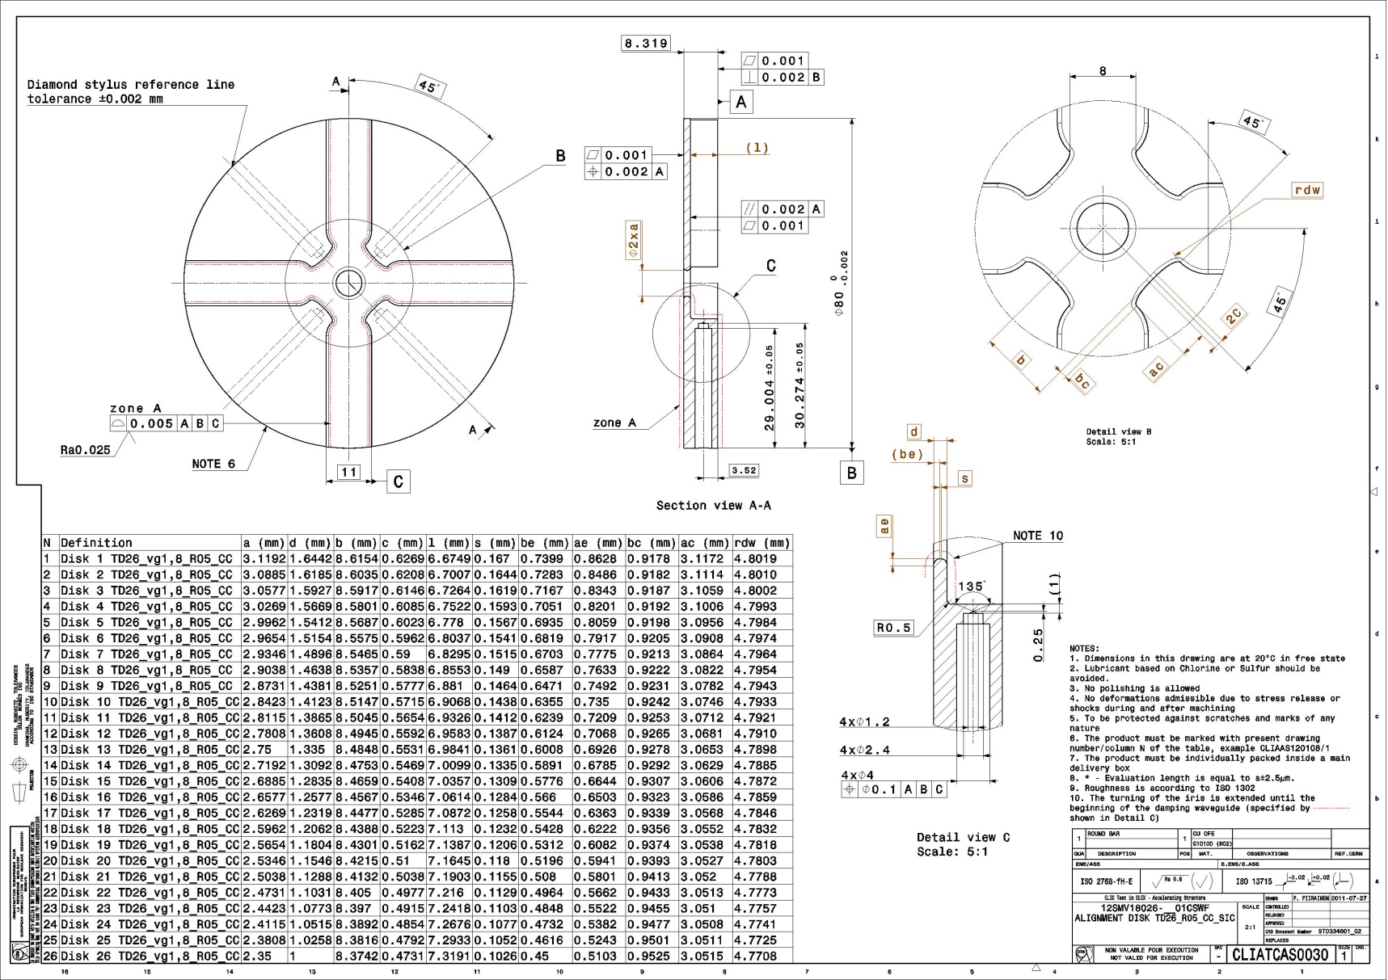
Mechanical Design of Copper Discs and Compact Couplers
• Cell shape accuracy 0.005 mm • Flatness accuracy 0.001 mm • Cell shape roughness Ra 0.025 μm

Slide 7
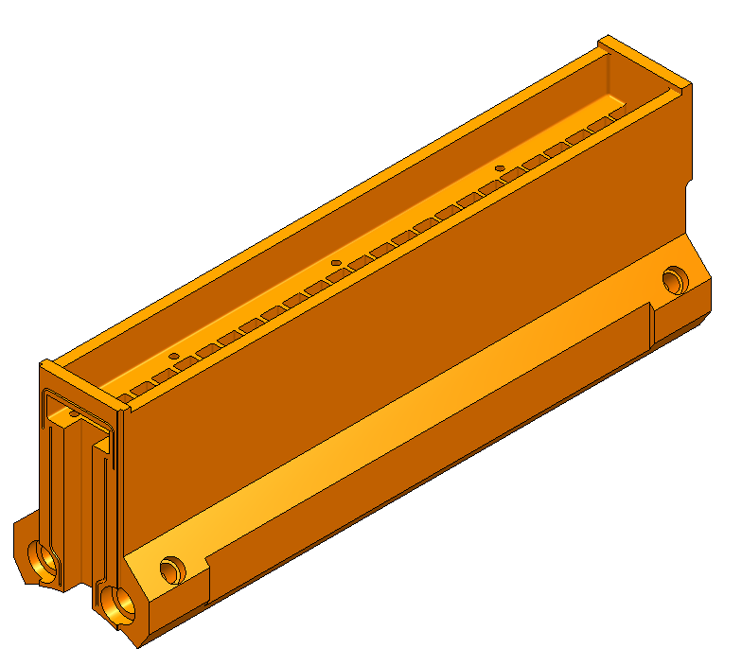
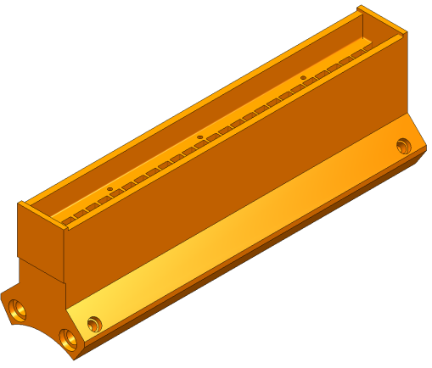
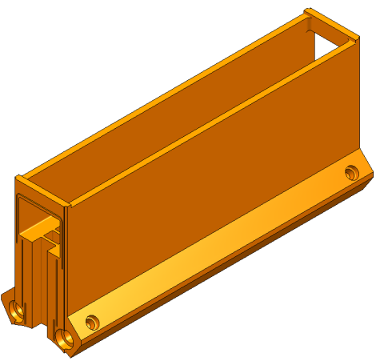
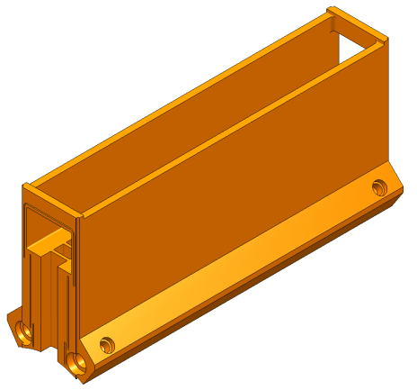
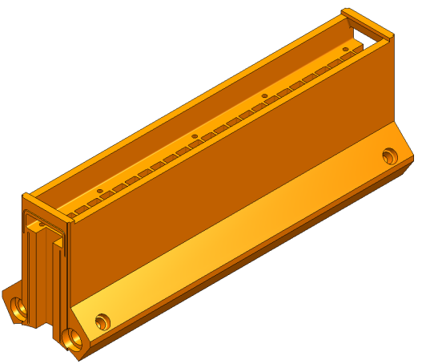
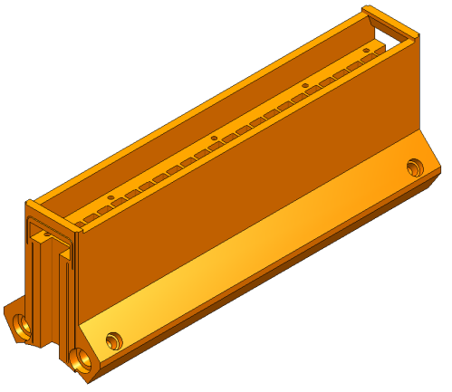
Mechanical Design of Vacuum Manifolds
Type 6
Type 2
Type 1
Type 2
Type 5
Type 1
Type 4
Type 3
Interface for WFM WG
Interface for supporting system
Type 3
Type 4
Type 5
Type 6
Interface for WFM WG
Interface for WG
Interface for WG (x2)
Interface for WFM WG
Interface for WG
Pumping the SAS
Interface for WG (x2)
Pumping the SAS

Slide 8
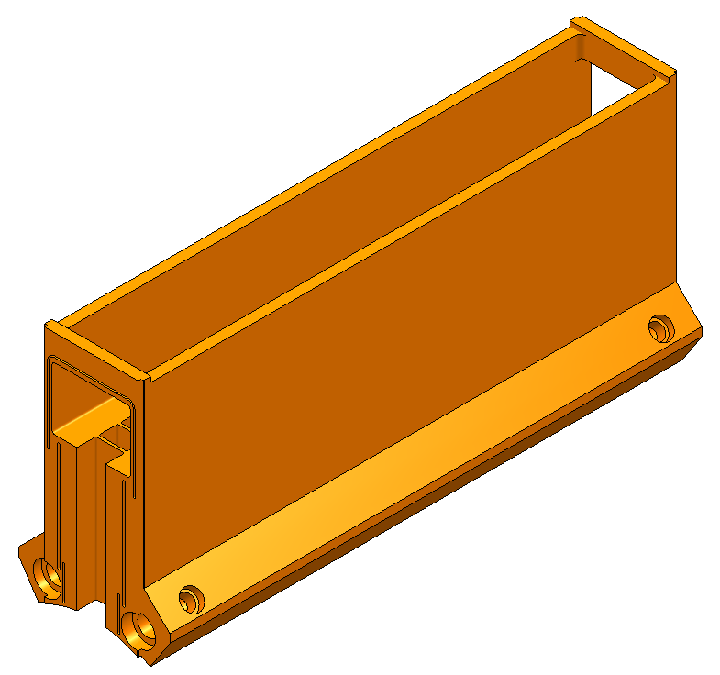
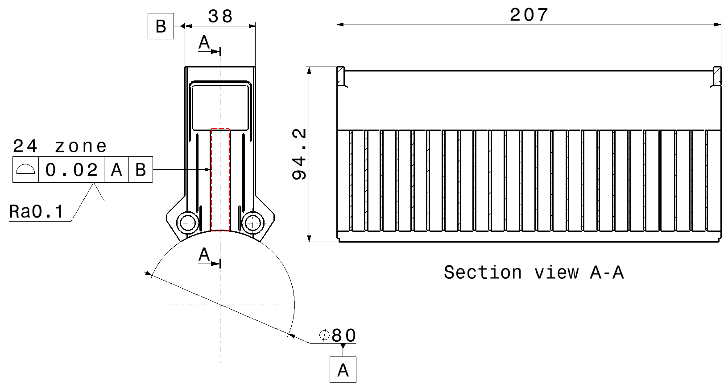
Mechanical Design of Vacuum Manifolds
• Waveguide shape accuracy 0.02 mm
• Waveguide surface roughness Ra 0.1 μm

Slide 9
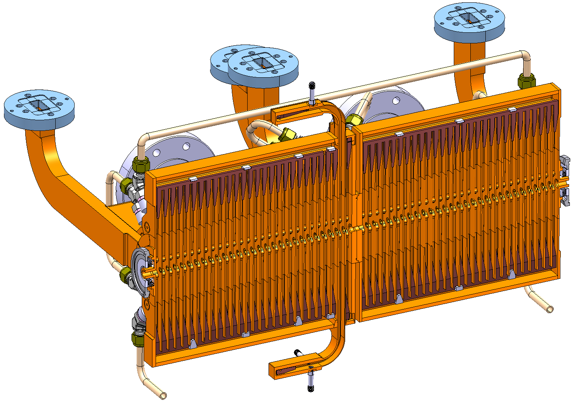
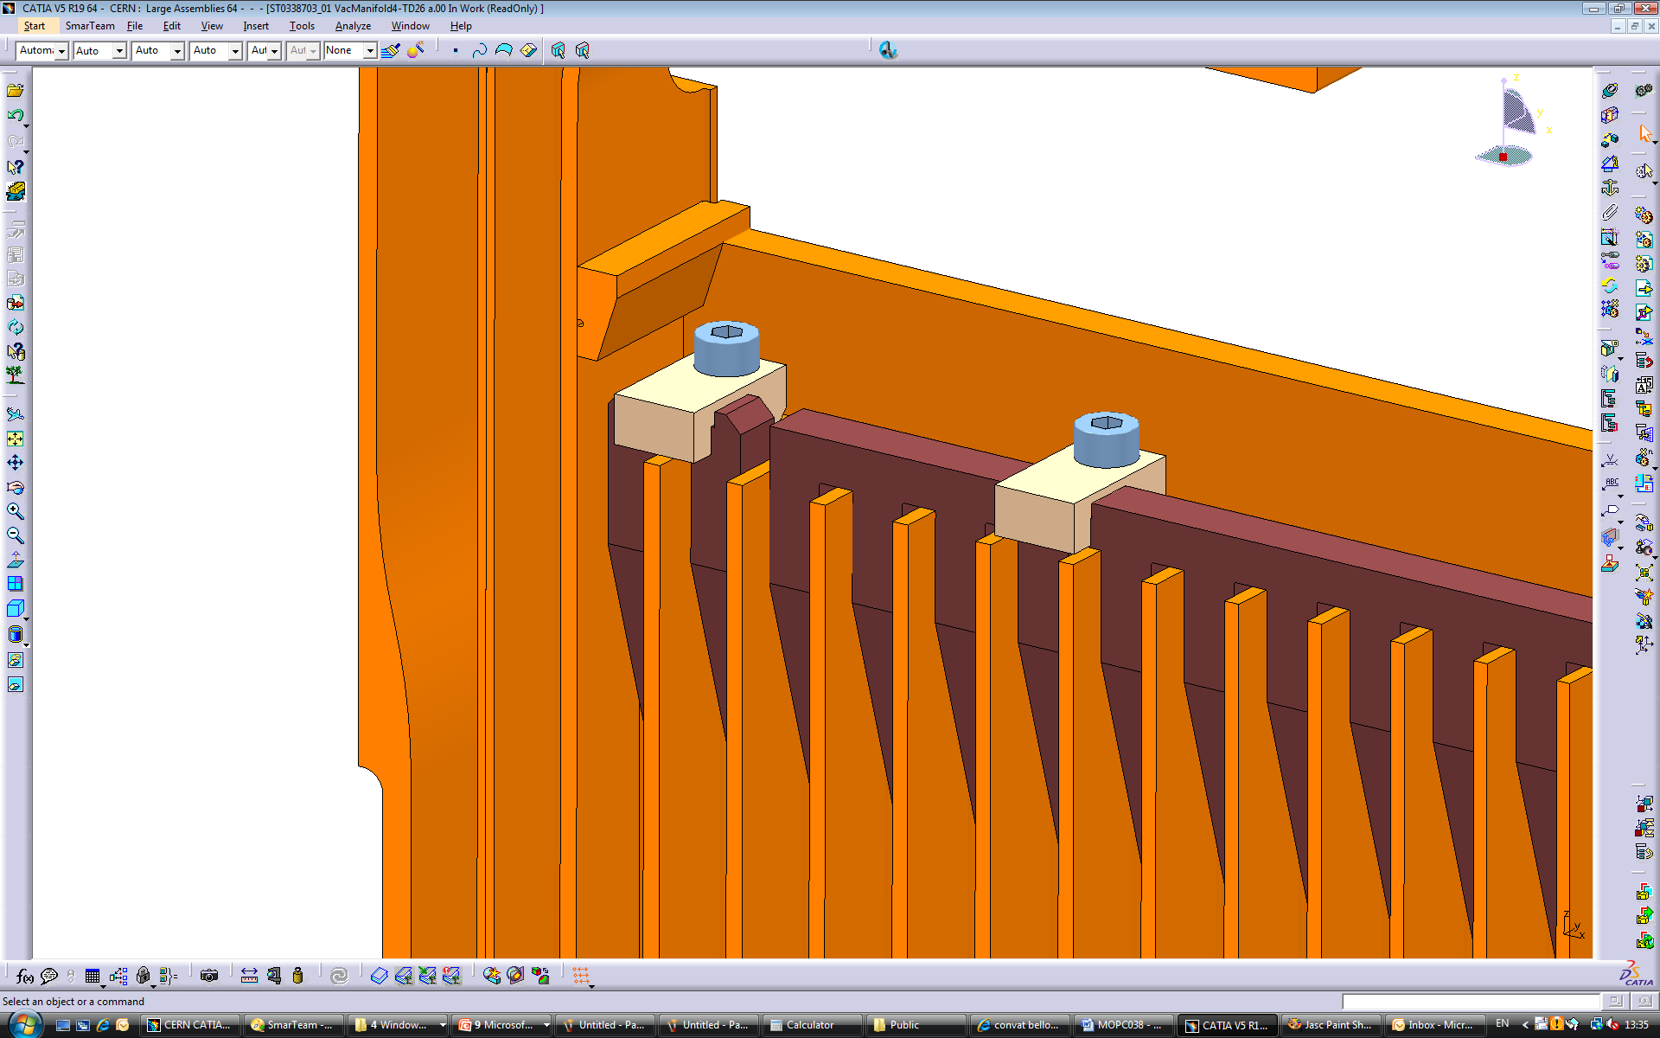
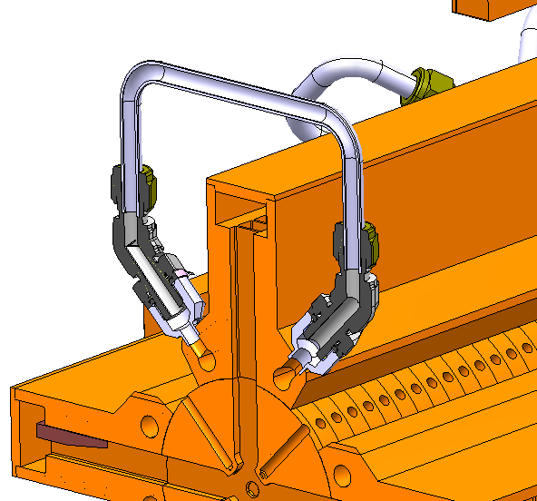
Mechanical Design of Vacuum Manifolds
The vacuum manifolds combine a number of functions:
Damping. Silicon carbide absorbers are fixed inside each manifold for effective damping of HOMs.
Vacuum pumping. Two of the eight vacuum manifolds are equipped with vacuum flanges.
Cooling. Two internal cooling channels for the water flow are presented in each manifold.
VACUUM PORT
VENTED SCREW
CORNER SUPPORT
VACUUM PORT
COOLING
FITTING
COOLING
CHANNEL
DAMPING MATERIAL
COOLING TUBE

Slide 10
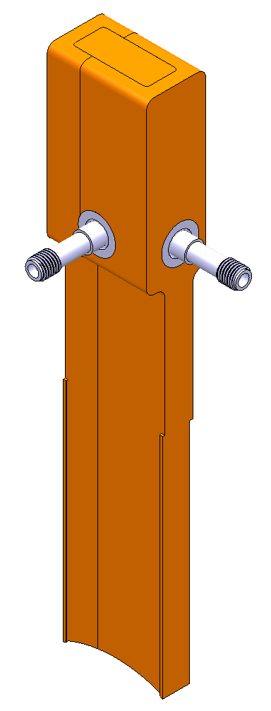
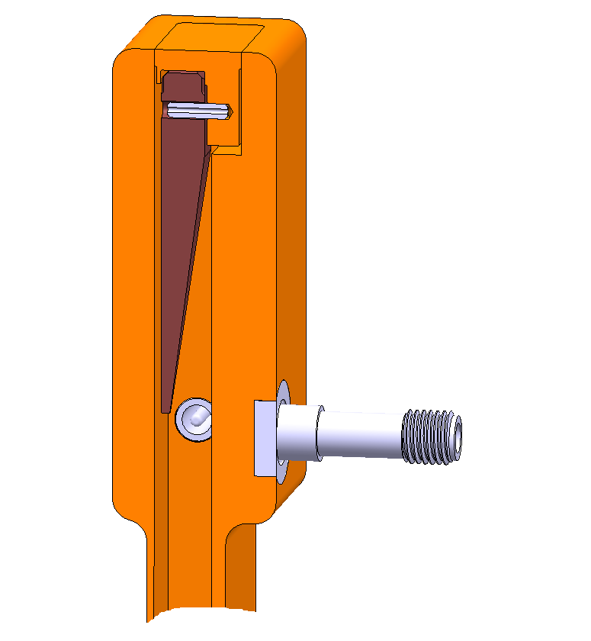
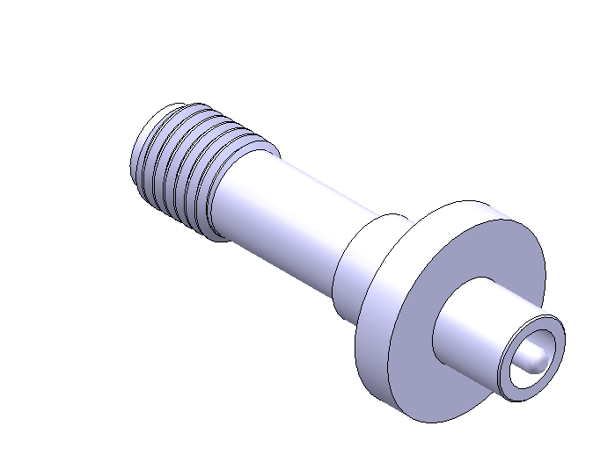
Wakefield Monitor Design
WFM: accuracy of 5 μm;
Four WFM are integrated in the first cell of the second AS.
DAMPING MATERIAL
WFM WAVEGUIDE
TE-LIKE
MODE PICK-UP
TM-LIKE
MODE PICK-UP
Custom design of feedthrough
Required tolerances
Waveguide shape tolerance ±10 μm
Waveguide surface roughness Ra 0.1 μm
ST.STEEL ADAPTER
FLANGE

Slide 11
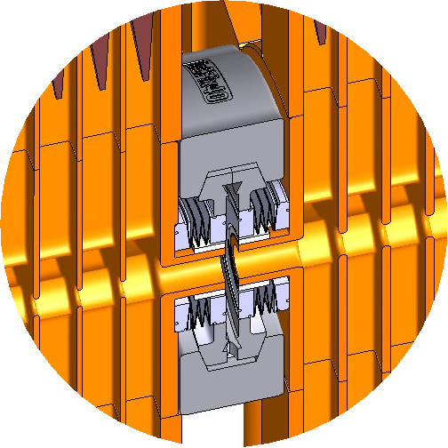
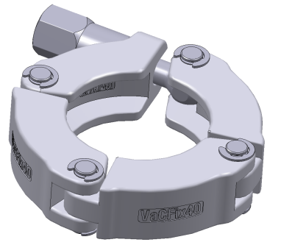
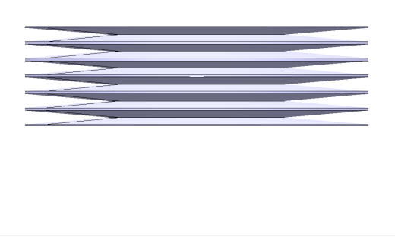
Interconnection Design
QUICK CF CLAMP CHAIN
XS40 VACOM
EDGE WELDED
BELLOWS
Stretched length ~+30%
Press formed length ~-70%
DAMPING
MATERIAL
SAS (N+1)
SAS (N)
QUICK CF FLANGE
Requirements
Keeping low pressure 10⁻⁹mbar;
Electrical continuity with low impedance;
Damping material must be used to avoid wakefields;
Be flexible;
Be compact.
* Agreed with Vacuum Group

Slide 12
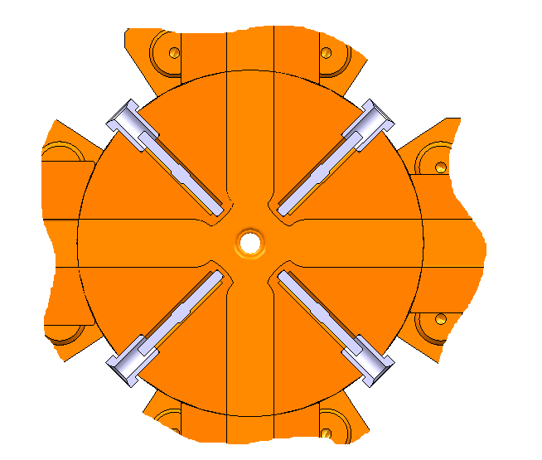
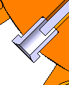
Alignment Features
TUNING STUD
ST.STEEL INSERT
REFERENCE CONICAL BORE
Placed on the external reference surface of AS;
Stainless steel inserts are brazed to the tuning holes;
8 stainless steel inserts per one AS;
Conical bore on the insert top to provide a reference for the measuring arm;
The recorded coordinates of all points help to determine the AS beam axis and to align the AS properly.

Slide 13
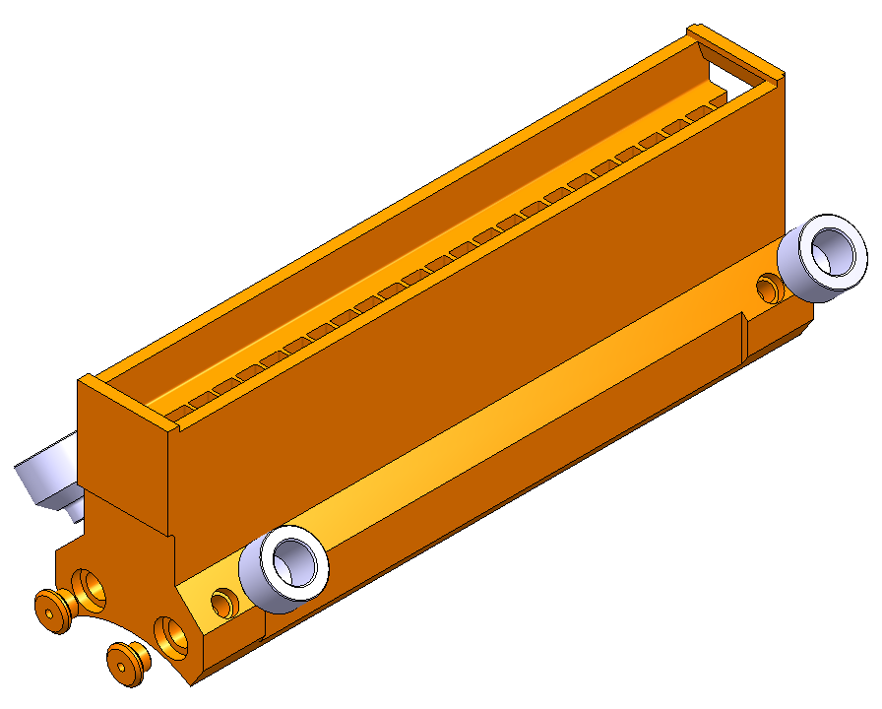
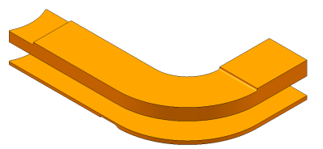
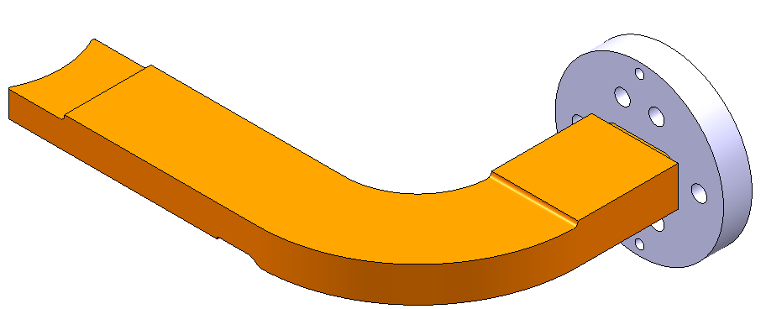
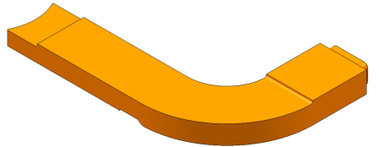
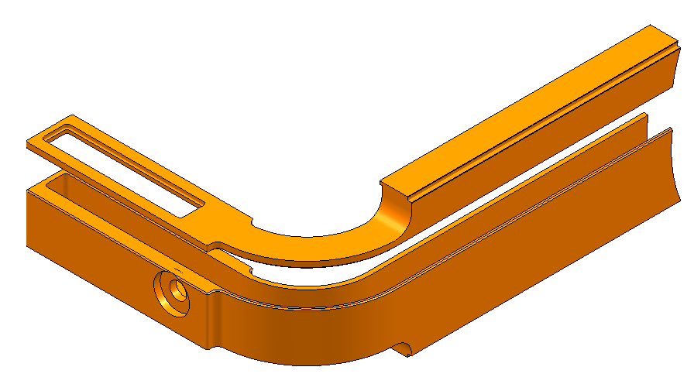
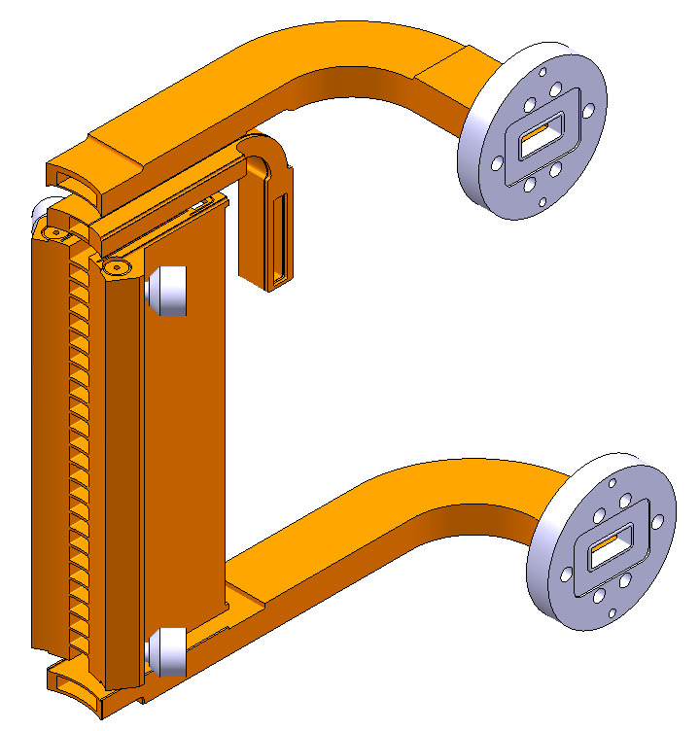
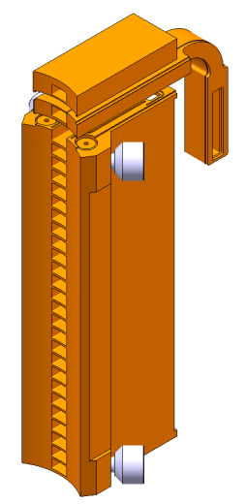
Super Structure Main Assembly Steps
1a. Brazing of the vacuum manifold bodies, cooling adapters and cooling caps
1c. Brazing of the waveguides
1e. Brazing of the waveguides and RF flanges
1d. Machining of the waveguides
x 8
x 8
1b. Brazing of the WFM waveguides
2. Brazing of the pre-assemblies to the vacuum manifolds
x 4
x 8

Slide 14
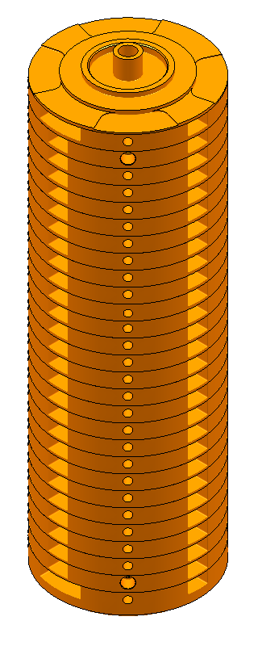
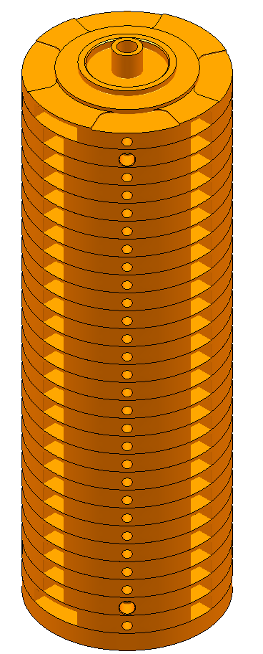
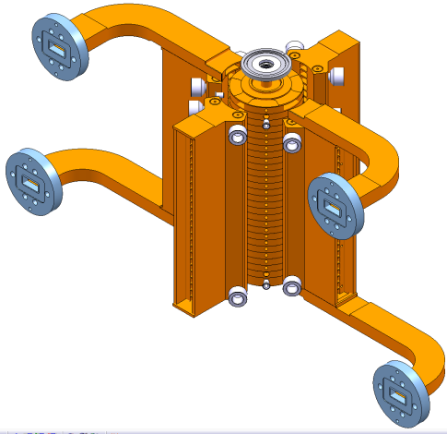
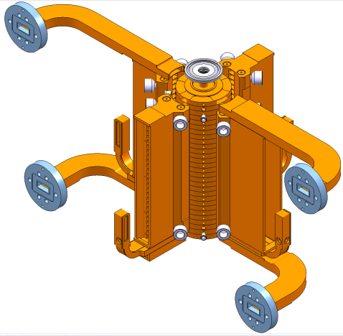
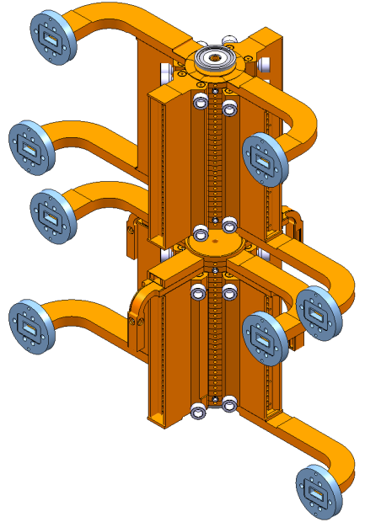
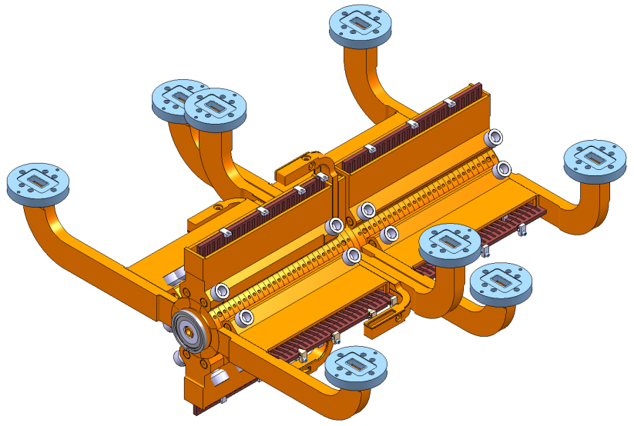
Super Structure Main Assembly Steps
3. Diffusion bonding of 2 disc’s stacks
4. Brazing of the vacuum manifolds and interconnection bellows to the bonded disc’s stack
5. Brazing of the two equipped stacks to form a superstructure
6. Installation of the silicon carbide damping loads

Slide 15
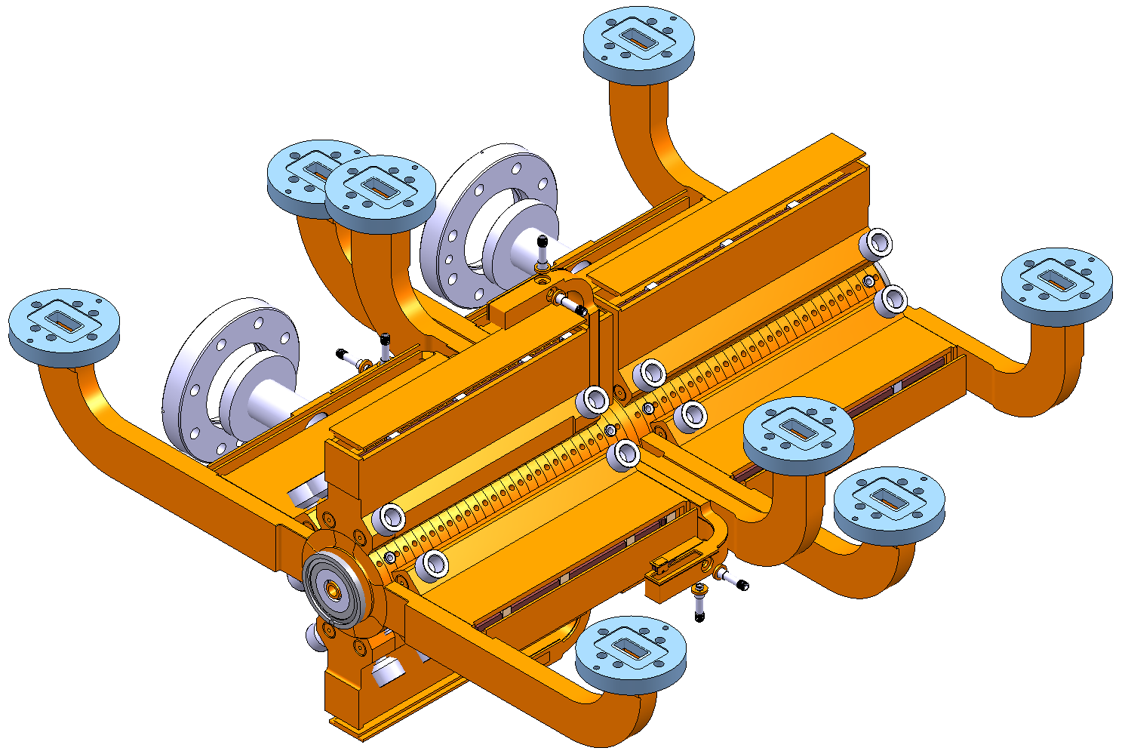
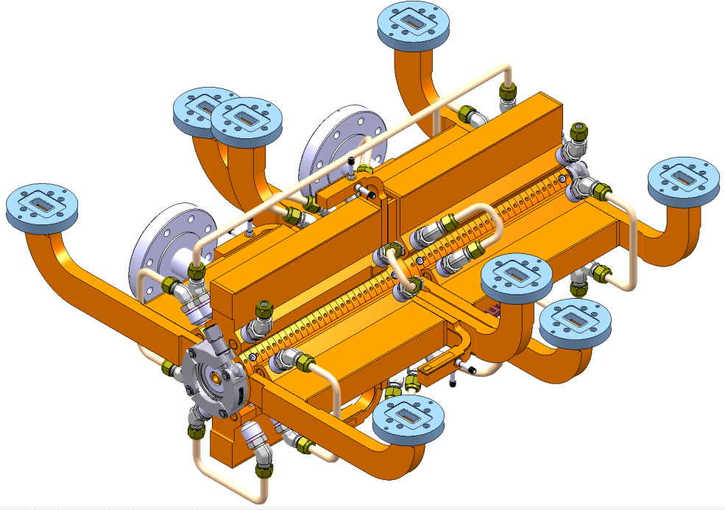
Super Structure Main Assembly Steps
7. EBW of the vacuum manifold covers, vacuum flanges, feedthroughs
8. Installation of cooling fittings and tubes
Intermediate leak tests and alignment verifications

Slide 16
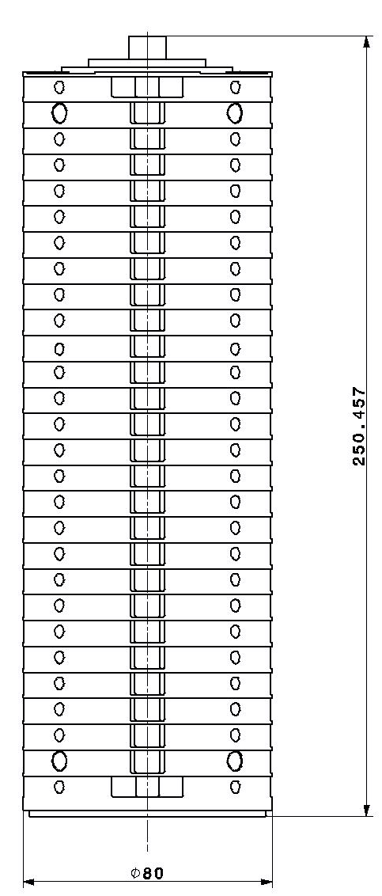
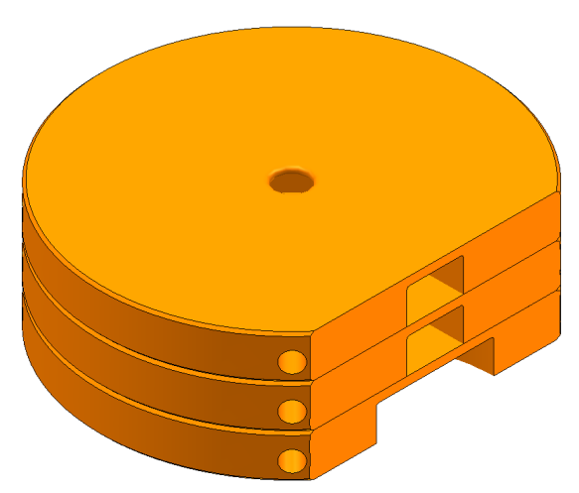
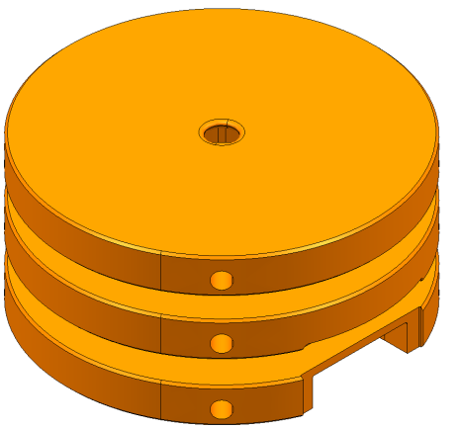
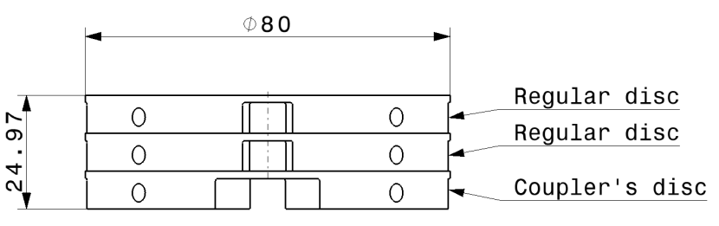
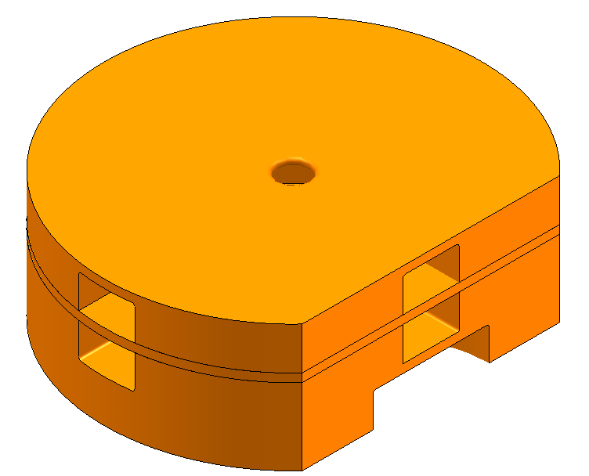
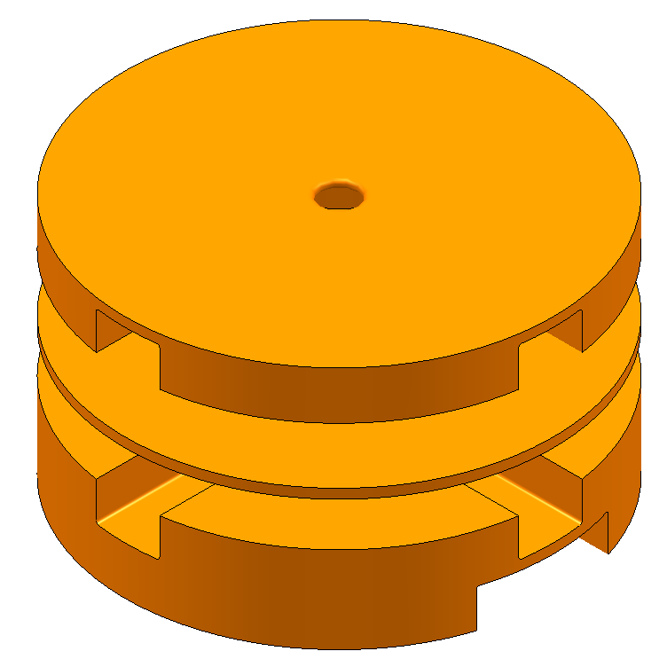
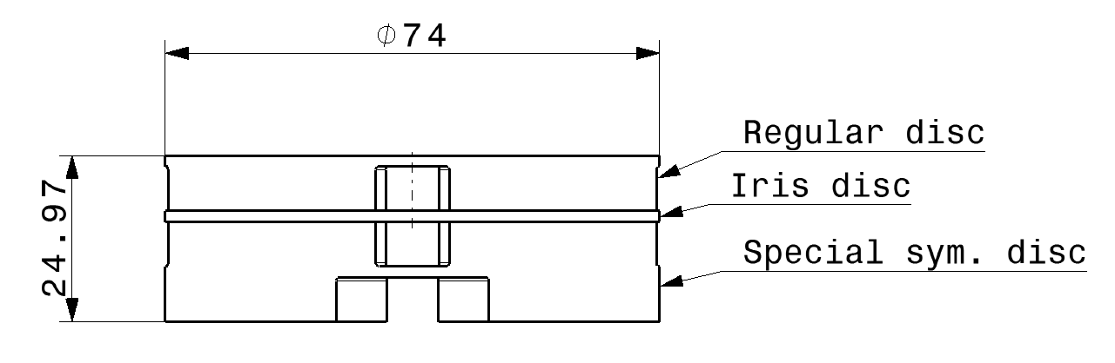



Test Program. Bonding
This will be done before for TD26 CC
Option 1:
- 2 sets of regular discs
Option 2:
2 sets of special discs
Could be the problem regions for bonding
Option 3:
2 sets of special discs

Slide 17




Test Program. Brazing
Option 1: (hard to realize in a real structure)
Ni, Cu, Au
Disk Copper
Nickel 4 um
Copper 15 um
Gold 15 um
Could be a critical
region for brazing
Disk Copper
Option 2: (hard to realize in a real structure)
Ag 10 microns
Disk copper
Silver 10 um on one disk
Disk copper
Option 3: (hard to realize in a real structure)
Ag 15 microns
Disk copper
Silver 15 um on one disk
Disk copper
Option 4: (already validated for couplers and cooling circuits)
Au/Cu 50/50 foil, h=0.05mm
Disk copper
Could be a critical
region for brazing
Au/Cu foil
Disk copper
* Courtesy of Serge Lebet

Slide 18
Conclusions
Engineering design under completion
It is foreseen to order fully equipped SASs to be tested in CLEX modules (June 2012)
A “version” for the stand-alone test stand will also be needed
First time we develop a fully equipped accelerating structure: main assembly steps under validation with mock-ups to be installed in dedicated modules

Slide 19
Workpackage

Slide 20


