Slide 1


Development and qualification of cam movers for the micrometric re-adjustment of CLIC Main Beam quadrupoles

Slide 2
SUMMARY
Why cam movers?
Validation of cam movers on a 1 DOF setup
Validation of cam movers on a 5 DOF mock-up

Slide 3
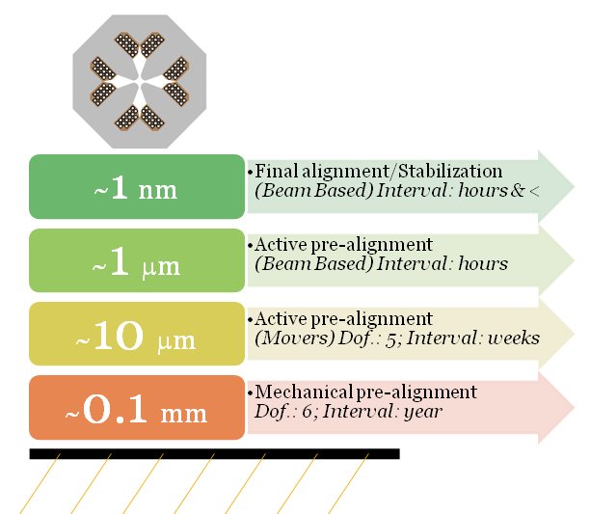
Why cam movers?
Context
~ 4000 quadrupoles in Main Linac (and ~ 100 in BDS) to steer the beam
MB quad:
  Length : 420 mm to 1915 mm.
  Weight : 300 kg to 800 kg
In order to reach CLIC target luminosity:
  BPM based alignment requires an active pre-alignment of the MB quad along 5 DOF with a precision and accuracy of 17 μm
  Each MB quad must be stabilized to 1 nm in vertical and 40 nm in horizontal ➔ requires high stiffness (>100 Hz) from the re-adjustment system
Beam off
(F. Lackner)

Slide 4
Why cam movers?
Technical requirements
Providing rigid support, low vertical dimension
High first eigen frequency of supporting structure : > 100 Hz
Simple kinematics
Low friction in contact points
Stroke: ± 3 mm
Repeatability < 1 μm
Solutions considered
Hexapod structures, based on linear actuation Low rigidity, low eigen frequency
Wedge system Larger contact surface ➔ higher contact friction
Cam based repositioning systems Chosen for further studies
Cam based solutions in work or in study in other labs (Diamond, SLAC [LCLS], PSI [SLS],…), but not with these requirements.

Slide 5
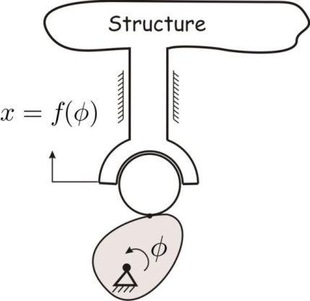
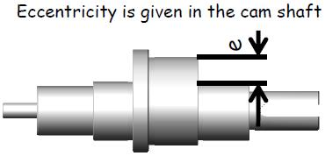
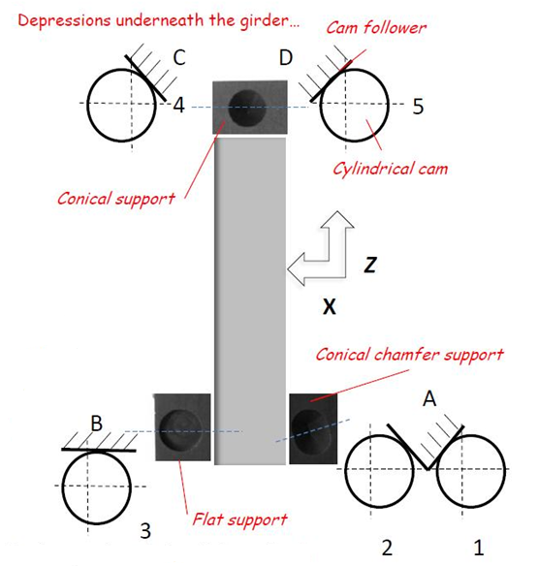
Why cam movers?
Cam movers
Configuration:
5 cam movers in order to provide 5 DOF
A kinematic mount interface below the common support of MB quad support providing a unique solution of interface: spheres in contact with cone, conical chamfer and flat plane
4 interfaces with ground for higher stiffness

Slide 6
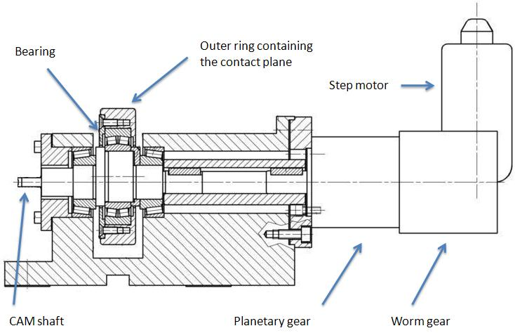
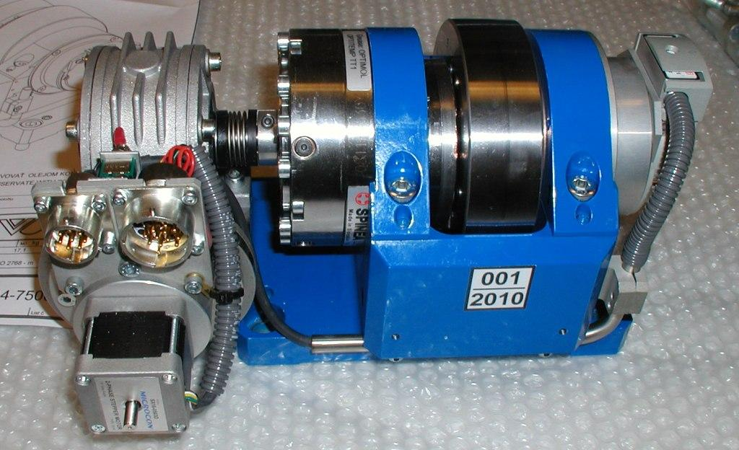
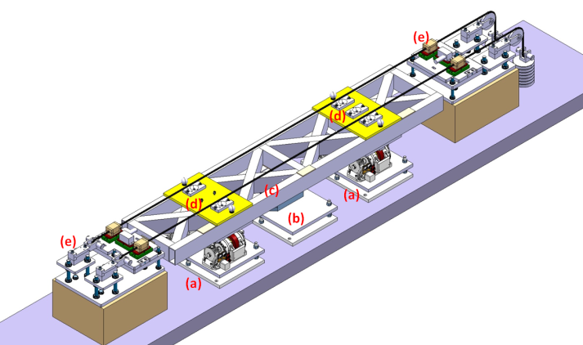
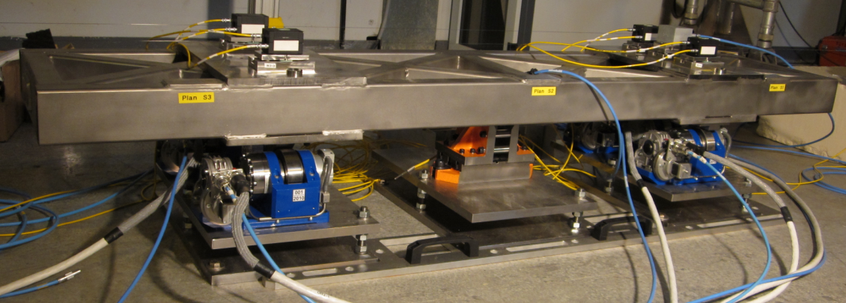
Why cam movers?
Cam movers
[1 DOF mock-up]
[5 DOF mock-up]
Cam movers
from SLS
Upgraded SLS cam movers:
(optimization of clearances
and links between parts)
Cam movers from ZTS vvu Kosice:
A more rigid structure
Higher gear ratio (Worm gearbox ratio = 60, bearing reducer ratio = 85)
Different worm gear and stepper motor
The stepper motor and the worm gear unit are coupled to the cam shaft via a zero backlash bearing reducer instead of a planetary gear
A high resolution absolute rotary angle encoder from Renishaw is directly mounted on the cam shaft
Cam movers from SLS

Slide 7
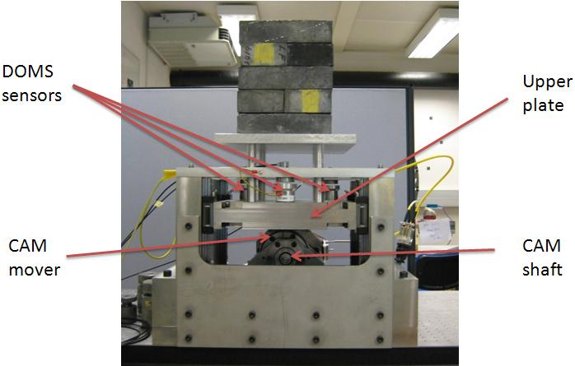
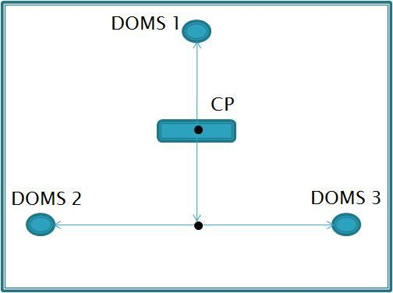
Validation on 1 DOF mock-up
1 DOF mock-up
Cam mover repeatability on full stroke
Effect of bearing and outer ring shape on cam mover repeatability

Slide 8
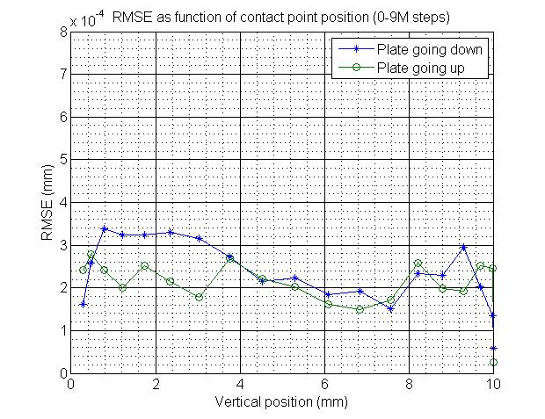
Validation on 1 DOF mock-up
Tests & results on 1 DOF mock-up
Repeatability test:
➔ Cycling the plate 10 times between upper and lower position. Within each cycle, the plate was stopped 20 times to measure the vertical position with capacitive sensors (DOMS).
Hysteresis ~50μm
Repeatability is better when the cam is driven upwards than downwards
Measurement of the 1st eigen frequency did not succeed.

Slide 9
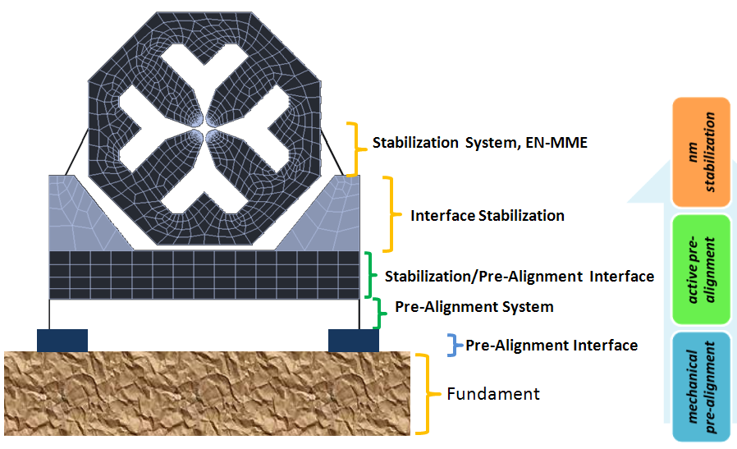
Validation on a 5 DOF
From the concept to the reality

Slide 10
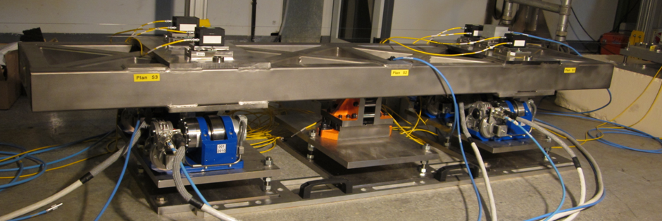
Validation of 5 DOF
Description of the 5 DOF mock-up

Slide 11
Validation on a 5 DOF setup
Latest results
Blank assembly of the setup
Resolution of displacements:
According to the manufacturer, the cam mover’s movement resolution is 3.8’’. Based on this, the 5 DOF setup theoretical resolution in translations is below 1µm and in rotations below 1µrad.
The cam movers were not calibrated before the blank assembly of the 5 DOF setup so the control algorithm could not be fully exploited. Therefore it was not possible to test the resolution of re-adjustment of all translations and rotations separately.
First tests do however indicate that the re-adjustment resolution of translations are below 2 µm.
But area very noisy: standard deviation of WPS measurements ~ 1.3 μm.
Eigen frequencies measurements:
The measurements took place before concrete is added around the plates
Several natural frequencies were measured below 50 Hz, coming from the mechanical plates and their anchoring screws
A RMS integrated level close to 9 nm at 1 Hz was computed; this confirmed that the area is too noisy for our measurements.

Slide 12
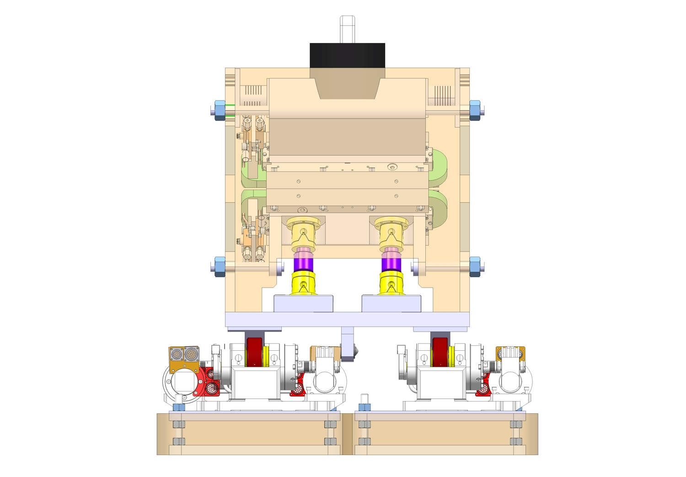
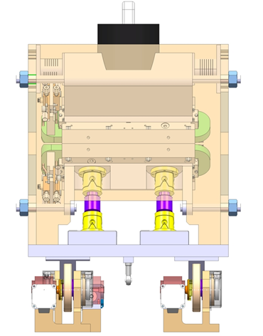
Validation on a 5 DOF mock-up
Next steps:
Find a new area
Calibration of cam movers
Remounting of 5 DOF setup, with higher rigidity of mechanical plates
Determination of the first resonant frequencies of the support
Validation of re-adjustment algorithm based on PSI/SLS algorithms (A. Streun)
Develop more compact cam movers for shorter MB quadrupoles
Extrapolation at MDI case, where 6 motorized DOF are needed

Slide 13
Summary
Eccentric cam movers proposed for the adjustment of the MB quadrupoles of CLIC.
Cam movers from SLS were considered as a starting point and upgraded
Tests of repeatability performed on 1 DOF setup were successfull (repeatability < 0.5 μm over the full stroke)
A blank assembly of a 5 DOF mock-up was performed
After calibration of the cam movers, 5 DOF mock-up will be re-assembled in a more quiet area

