Slide 1
RF kicks in the CLIC accelerating structures
A. Grudiev
29.09.2011
LCWS11, Granada, September 2011

Slide 2
Outline
RF kicks in the CLIC baseline accelerating structure: TD26_CC
RF kicks in an alternative with single feed compact couplers

Slide 3
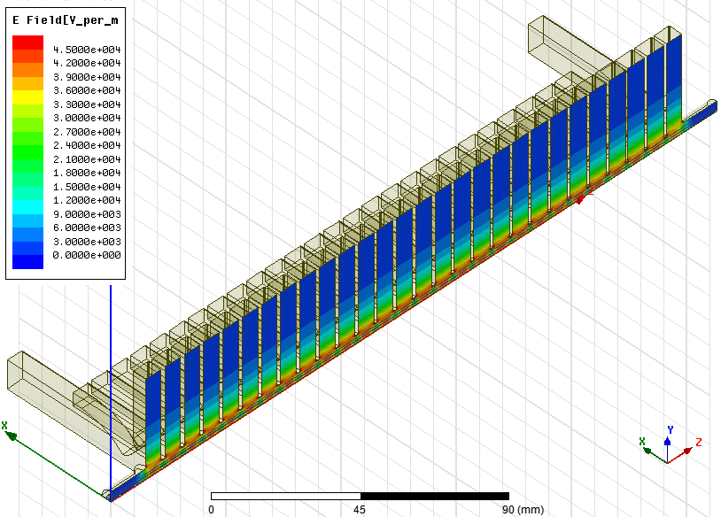
TD26_vg1p8_CC geometry

Slide 4
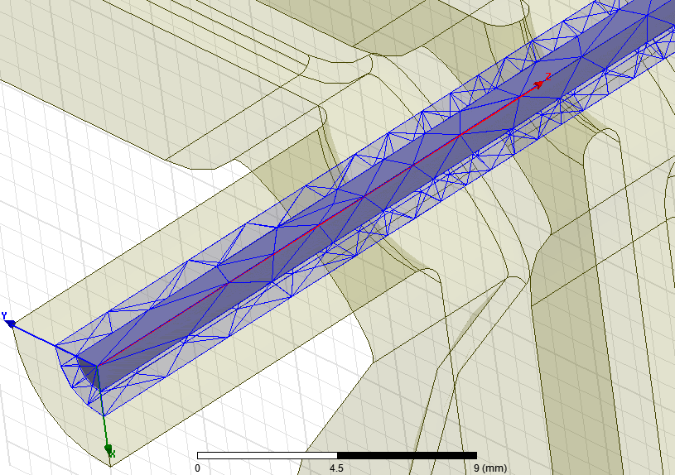
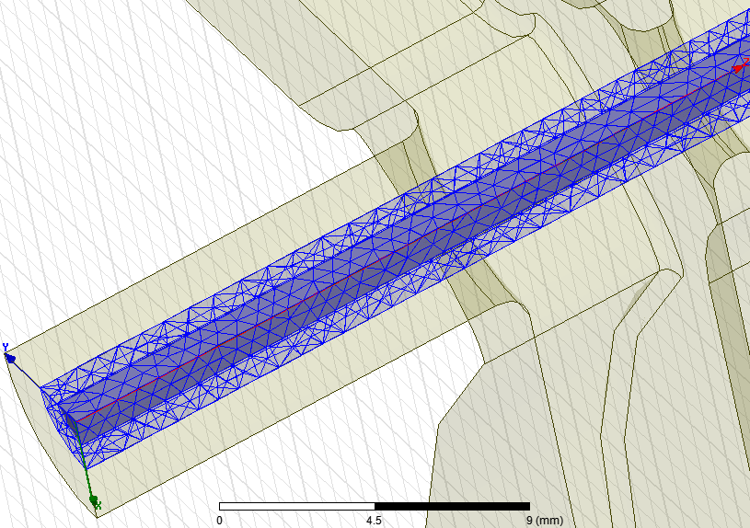
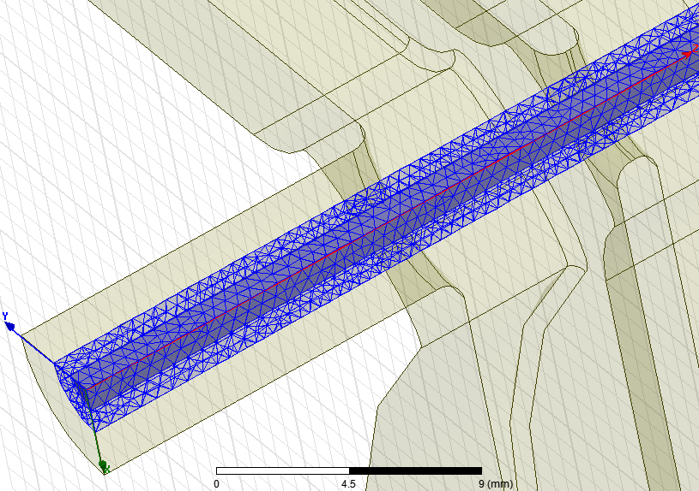
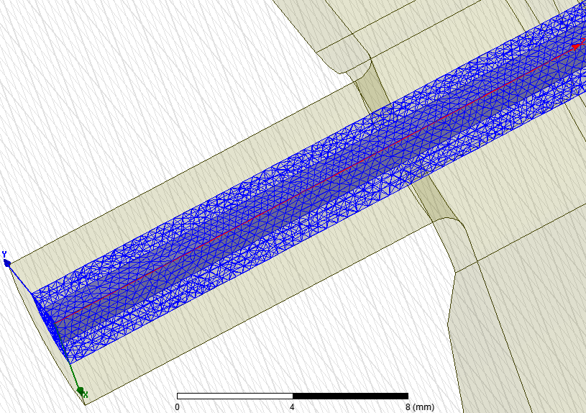
Mesh convergence study
No mesh refinement
Ntetr = 271962
1mm mesh refinement
Ntetr = 341774
0.7mm mesh refinement
Ntetr = 425854
0.5mm mesh refinement
Ntetr = 828290
Final mesh

Slide 5
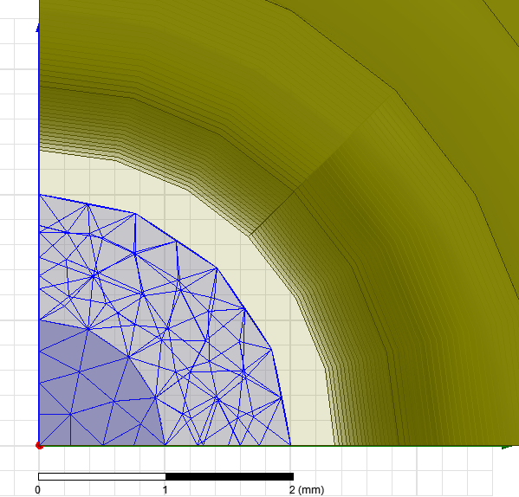
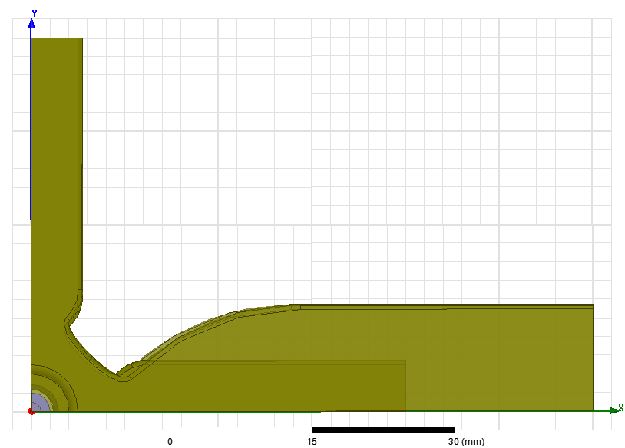
Where it is calculated ?
r=2mm
r=1mm
r=0

Slide 6
Multipole expansion
Due to the symmetry
Accelerating gradient:
Multipole expansion:
Monopole:
Dipole:
Quadrupole:
Sextupole:
Octupole:
Due to the symmetry
Due to the symmetry

Slide 7
Different multipoles for P_{in} = 4 W
For loaded conditions, this distributions must be multiplied with 1-z/0.25*75/120

Slide 8
Multipolar focusing in AS
Panofsky-Wenzel theorem:
Gives an expression for multipolar focusing
From the RF accelerating field:
Quadrupolar focusing :
Octipolar focusing:
Lorenz force:
Gives an expression for kick directly from the RF fields:
Which can be decomposed into multipoles:
Quadrupolar:
Octupolar:

Slide 9
Quadrupolar kick comparison Panofsky-Wenzel and Lorenz

Slide 10
Quadrupolar kick comparison to CLIC magnetic quads
Quadrupolar focusing from the quads:
Equating the quadrupolar kicks Effective gradient of the RF quads is introduced:
For comparison, in main beam quads, peak magnetic gradient is 150 T/m, which is about factor 150=150/[2.5e-4*sqrt(61.3MW/4W)] higher than in RF quad of the Input coupler cell of the AS at the nominal gradient
Integrated RF quad strength in 2 coupler cell for the input power of 61.3 MW:
Input:
(PW): -0.0065 - 0.0033i [T]
(Lorenz): -0.0066 - 0.0033i [T]
Output:
(PW): 0.0032 - 0.0105i [T]
(Lorenz): 0.0030 - 0.0106i [T]
Compare to MB quad of 25cm: 150/4=37.5 [T]
5500

Slide 11
Octupolar kick comparison Panofsky-Wenzel and Lorenz

Slide 12
Octupolar kick comparison to CLIC magnetic octupoles
Octupolar focusing from magnetic octupoles:
Equating the octupolar kicks Effective octupolar gradient of the RF octupoles is introduced:
For comparison, typical value of magnetic octupolar gradient of 10⁶ T/m³(pole field: 1T, bore radius: 10mm) is about factor 2.5 = 10⁶ /[100*sqrt(61.3MW/4W)] higher than in RF octupole of AS at the nominal acc. gradient
Integrated RF octupolar strength in AS for the input power of 61.3 MW:
(PW): -316 +79404i [T/m²]
(Lorenz):-145 +79333i [T/m²]
Compare to typical octupole of 25mm length: 10⁶ /4=2.5e5 [T/m²]
3
Strong RF octupole

Slide 13
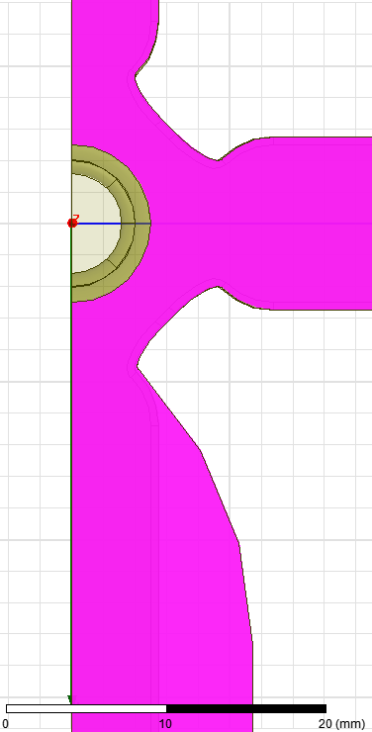
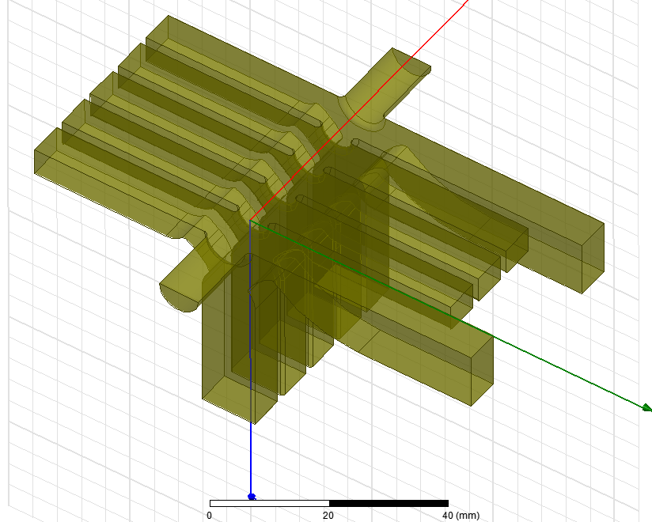
Compact Coupler with Single Feed, geometry
idw/2
b
idw
ipw/2
idw = ipw
b=8.6528mm and ipw=idw=7.81mm are matching parameters

Slide 14
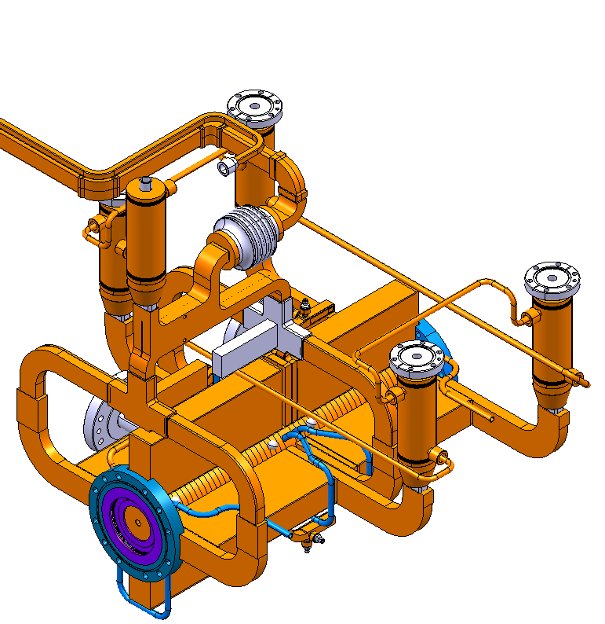
Alternative layout of CLIC SAS based on compact coupler with single feed (CCSF)
Image courtesy of A. Samoshkin
Alternative layout:
Input and Output kicks are compensated independently within one SAS = AS1 – AS2
Baseline layout
Load
Hybrid
Load
AS1
AS2
Load
Advantages:
No splitters (HOMagic-T)
3 loads per SAS instead of 5
less waveguides
group delay difference between two AS can be adjusted to 0
more space for input/output waveguide connection to the AS

Slide 15
Multipole expansion
Due to the symmetry
Accelerating gradient:
Multipole expansion:
Monopole:
Dipole:
Quadrupole:
Sextupole:
Octupole:
The main disadvantage is the presence of the RF dipolar kick

Slide 16
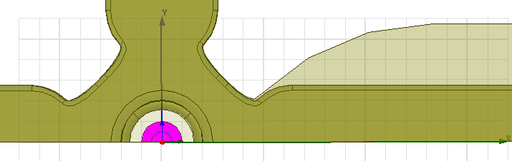
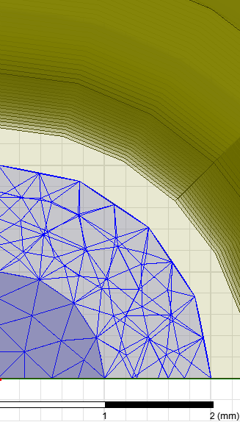
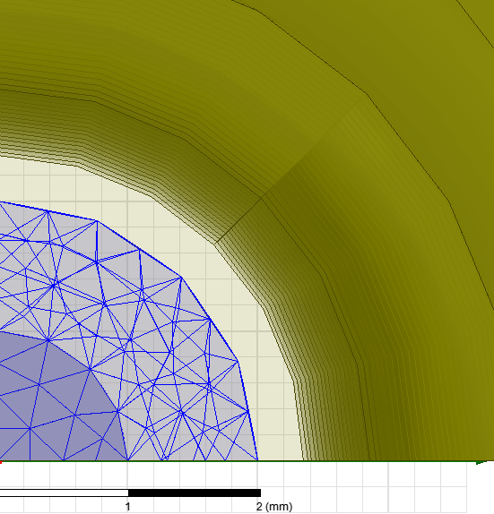
Multipole coordinate system
Y
r=2mm
r=1mm
r=0
X

Slide 17
Multipoles in Input CCSF at 2 W

Slide 18
Multipoles in Output CCSF at 2 W

Slide 19
RF kicks from Panofsky-Wenzel theorem and from Lorenz force
Panofsky-Wenzel theorem:
Gives an expression for
Dipolar kick from accelerating rf field:
Lorenz force:
Transverse kick directly from Lorenz:
Dipolar kick directly from Lorenz:

Slide 20
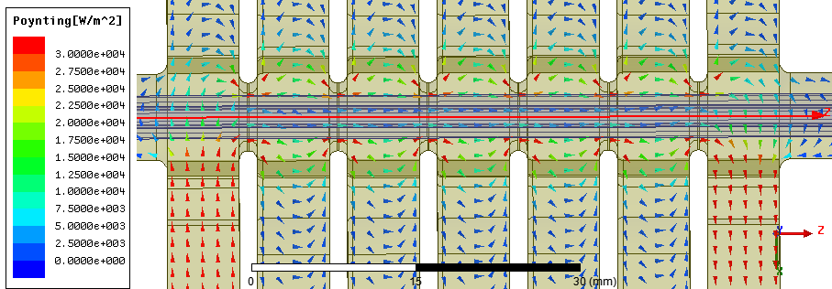
Dipolar kick on crest in the Input CCSF
Dipolar kick for particle on crest is mostly magnetic (-Z₀H_{y})
H_{y} is needed to let power flow cross the middle plane: H_{y} x E_{z}, that is why it is in phase with accelerating field Ez
The kick is proportional to the input power (fixed) divided by Ez (fixed) and by the cell radius (more or less fixed by the cell frequency)
The sign is given by the direction of the power flow. It is asymmetric in the input/output couplers
There is not a lot we can do here!
-2.56 V
For nominal input power : 61.3 MW
Dipolar kick on crest
P-W: -14171 V
Lorenz: -14173 V
Kt/Kz ~ 14kV/23MV
~ 6e-4
Real Poynting vector

Slide 21
Dipolar kick 90º off crest in the input CCSF
Dipolar kick for particle 90º off crest is again mostly magnetic (-Z₀H_{y})
H_{y} comes from the offset of the EM field centre with respect to the beam axis, that is why it is in phase with H_{φ} and 90º out of phase with the accelerating field E_{z}
The kick is proportional to the accelerating field (fixed) and the offset between the beam and EM field axis (can be optimized),
The sign depends on the sign of the accelerating field and of the offset. It is symmetric in input/output couplers
This kick can be optimized down to zero if necessary!
-0.26 V
For nominal input power : 61.3 MW
Dipolar kick 90º off crest
P-W: -1425 V
Lorenz: -1424 V
For Input CCSF at 2W, on crest kick of 2.56 V is already much larger (x10) than 90º off crest kick 0.26 V due to very high degree of symmetry of the EM field. Still can be fine tuned if necessary.

Slide 22
Dipolar kicks in the Output CCSF
1.77 V
0.3 V
For nominal input power : 61.3 MW
Unloaded output power is 26.6 MW
Dipolar kick:
P-W: -6470 +1095i V
Lorenz: -6481 +1089i V
Loaded output power is 10.0 MW
Dipolar kick:
P-W: -3967 +671i V
Lorenz: -3974 +668i V

Slide 23
Quadrupolar and sextupolar kicks in the Input CCSF
For nominal input power : 61.3 MW
Integrated quadrupolar kick from P-W:
-0.0064 - 0.0009i [T] (1st)
0.0063 - 0.0009i [T] (2nd)
Real part is very close to the CCDF
Imaginary part is 3-4 times smaller
For nominal input power : 61.3 MW
Integrated sextupolar kick from P-W:
-0.82 - 0.11i [T/m] (1st)
0.92 - 0.14i [T/m] (2nd)

Slide 24
Quadrupolar and sextupolar kicks in the Output CCSF
For nominal input power : 61.3 MW
Unloaded output power is 26.6 MW
Quadrupolar kick: 0.0030 + 0.0004i [T]
Sextupolar kick: 0.38 + 0.01i [T/m]
Loaded output power is 10 MW
Quadrupolar kick: 0.0018 + 0.0002i [T]
Sextupolar kick: 0.23 + 0.006i [T/m]
Typical magnetic sextupolar gradient: (1T pole filed, 10 mm bore radius) => 10000 T/m²
RF sextupolar gradient for 61.3 MW reaches ~0.03*4000 = 120 T/m².
~100

